Slide 1
Statistical learning
Shrikrishna Anand Narvekar
Assistant Professor
Agnel Institute of Technology and Design

Slide 2
Content
Introduction
How we learn rules
Descriptive vs Inferential statistics

Slide 3
Introduction
Statistical analysis saw the development of two branches in the 18th century-
Bayesian Statistics(Believer):Uses Prior Belief + New Data to reach a conclusion.
Classical Statistics(Observer):Uses Only the Current Data.
Both deal with probability, but in different ways.
Notes:
Bayesian (The "Believer"): Uses Prior Belief + New Data to reach a conclusion.
The "Doctor" Example: You think a young patient is healthy (Prior). They have chest pain (New Data). You still conclude it’s likely not heart disease because the Prior is so strong.
Classical (The "Observer"): Uses Only the Current Data.
The "Coin Flip" Example: It doesn’t matter if the coin "felt" lucky yesterday. If you flip it 100 times now and get 50 heads, that is your only truth.

Slide 4
How we learn rules
Deductive (Top-Down): Start with a Rule, apply it to Data.
Logic: “All humans need water” →"John is human" → “John needs water”
Inductive (Botttom-up): Start with a Rule, apply it to Data.
The "Baby" Example: Touching a hot stove + hot soup + hot iron = "Don't touch hot things!"
Notes:
Deductive (Conventional Statistics): Example: "All humans need water. John is a human. Therefore, John needs water."
Inductive (Machine Learning): A baby touches a hot stove, a hot iron, and a hot soup bowl. After three painful experiences, the baby induces a rule: "Glowing/steaming things shouldn't be touched." The baby discovered the rule from the data.

Slide 5
Descriptive vs. Inferential Statistics
Type | Purpose | Example
Descriptive | Summarizes the Past. | A fitness app showing you walked 10,000 steps yesterday.
Inferential | Predicts the Future/Whole. | Asking 1,000 voters their opinion to predict how 30 million will vote.

Slide 6
Finding signals in the Mess
What is "Noise"? Random errors or irrelevant data that distract from the pattern.
Signal: Your friend’s voice (the data you want).
Noise: The loud music and crowd shouting (the distraction).
Goal: Machine Learning acts like "Noise-Cancelling Headphones"—it filters out the music to hear the message.

Slide 7
Explaining noise in terms of data
House Size (sq.ft) | Actual Price (₹ Lakhs)
1000 | 50
1200 | 60
1500 | 75
1800 | 90
2000 | 500
First four rows show a clear pattern: Bigger house → Higher price 📈
But last row: 2000 sq.ft → ₹500 Lakhs
This value is unusually high and may be:
Data entry error
Luxury villa in different location
Typing mistake
This abnormal value is called Noise (Outlier).

Slide 8
Hard vs. Soft Modelling
Hard Computing (Analytical): Following a strict, 100% exact recipe
Rule: If A + B = C then C is always same
Example : When you type 567×432, the computer uses a "hard" mathematical rule. There is no guesswork; the answer is either right or wrong.
Soft modelling: Learning patterns to make a "best guess.“
Rule: Based on thousands of examples, this is probably the answer.
Example: : Netflix Recommendations. There is no "hard" rule that says if you liked Stranger Things, you will definitely like Wednesday.
Notes:
Hard Computing (Analytical Models): This is like following a strict recipe. You use specific mathematical equations to get an exact answer. If you have the right formula and the right input, you get the 100% correct output every time.
Day-to-Day Example: A Calculator. When you type 567×432, the computer uses a "hard" mathematical rule. There is no guesswork; the answer is either right or wrong.
Soft Modeling (Machine Learning): This is more like a human learning to recognize a face. There isn't one single equation for "what a face looks like." Instead, the computer looks at thousands of photos and builds a "soft" model that says, "This is probably a face."
Day-to-Day Example: Netflix Recommendations. There is no "hard" rule that says if you liked Stranger Things, you will definitely like Wednesday. The computer uses a "soft model" to guess your preferences based on patterns

Slide 9
Dealing with messy data
Data is rarely perfect. We have to manage three main problems:
Noise: Irrelevant "jitter" or extra info that hides the truth.
Missing Values: Gaps where data wasn't recorded.
Inconsistencies: Data that contradicts itself.
Notes:
Noise: Sometimes the GPS "jitters," making it look like you suddenly jumped 20 feet to the left and back. That "jump" is noise.
Missing Values: You run through a tunnel, and the GPS loses signal for 30 seconds. That is a missing value.
The Solution: The app uses probability to "smooth out" the jitter and "guess" your path through the tunnel. It handles the uncertainty so the final map looks correct.

Slide 10
Employee ID | Age | Experience (Years) | Department | Salary (₹ Lakhs)
E101 | 25 | 2 | Sales | 4.5
E102 | 30 | 5 | Marketing | 6.8
E103 | 29 | 4 | Sales | 150.0
E104 | – | 3 | HR | 5.2
E105 | 32 | 12 | Intern | 3.0
E106 | 28 | 4 | Sales | 6.0
Notes:
1. Noise (Irrelevant or Extreme Values)
👉 Row: E103 – Salary ₹150 Lakhs
Others earn between 4–7 Lakhs.
₹150 Lakhs looks unrealistic.
Could be:
Typing mistake (15 instead of 150)
Extra zero added
Data entry error
✔ This extreme value is Noise (Outlier) It can distort average salary calculations.
🟡 2. Missing Values (Data Gaps)
👉 Row: E104 – Age is missing (–)
Age not recorded.
We don’t know whether employee is 22 or 45.
✔ This is a Missing Value
Machine Learning must:
Remove the row
Or replace with average age
Or predict age using other features
🟠 3. Inconsistencies (Contradicting Data)
👉 Row: E105 – 12 Years Experience but Department = Intern
Interns usually have 0–1 years experience.
12 years experience contradicts job role.
✔ This is Inconsistent Data
Possible causes:
Wrong department entry
Wrong experience value
Data merged from two sources incorrectly

Slide 11
Sample Space & Sample Points
The Sample Space (D): This is the "world" of all possible outcomes. In Machine Learning, your entire dataset (the Data Matrix) is your Sample Space.
Example: If you are analysing a deck of cards, the Sample Space is all 52 cards.
Sample Points (x):This is a single "event" or a single row in your data. It is one specific instance from the Sample Space.
Example: Drawing the 7 of Hearts is a "sample point." In a medical study, one single patient’s records would be a sample point

Slide 12
Random Variables
We call the characteristics of our data "Random Variables" because we don't know the value until we actually look at a specific example.
These are the Columns in your table (Attributes).
The "House Hunting" Example: If you are looking for a house, the Random Variables are:
Number of Bedrooms
Square Footage
Price

Slide 13
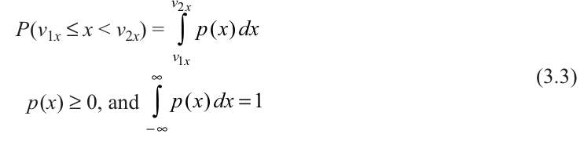
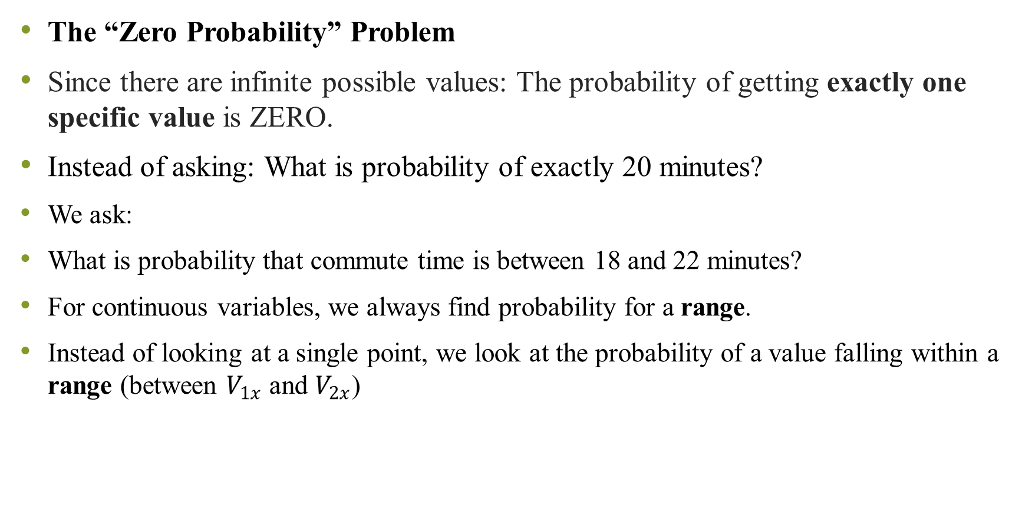
The “Zero Probability” Problem
Since there are infinite possible values: The probability of getting exactly one specific value is ZERO.
Instead of asking: What is probability of exactly 20 minutes?
We ask:
What is probability that commute time is between 18 and 22 minutes?
For continuous variables, we always find probability for a range.
Instead of looking at a single point, we look at the probability of a value falling within a range (between $V_{1x}$ and $V_{2x}$)
Notes:
Example: Probability that your commute time is exactly 20.000000 minutes = 0
Why?
Because time can be: 20.000001 20.000002 20.000003
There are infinite options!

Slide 14
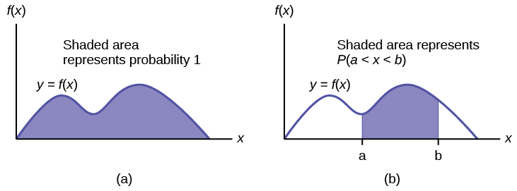
What is PDF
A Probability Density Function (PDF) is:
A smooth curve
That shows how values are distributed
Probability is the area under the curve It looks like a smooth wave (not spikes like PMF).

Slide 15
How do we calculate Probability
To find probability between two values:
We calculate the area under the curve between those two points.
Mathematically, we use integration.
Simple meaning:
Probability = Area under curve between V₁ and V₂

Slide 16
Rules of PDF
Rule 1: Density must be zero or positive
p(x) ≥ 0
You cannot have negative density.
Rule 2: Total area under curve must equal 1
The entire area under the curve = 1 (which means 100%)
If total area ≠ 1 → it is not a valid PDF.

Slide 17

Very Small Interval Idea (Δx Concept)
If we take a very small range:
x₀ to x₀ + Δx
Then,
Probability ≈ Density at that point × Width of range
In simple words:
Small Probability ≈ Height × Width
Just like area of a rectangle.

Slide 18

Data Scientist perspective:
From a data point of view:
Density means:
How frequently values occur in a very tiny interval.
If:
N = total observations ΔN = number of values in small interval
Then:
Density = (Relative frequency) ÷ (Width of interval)
As interval becomes extremely small → it becomes PDF.
Notes:
Self-Driving Car Example (Very Practical)
A self-driving car uses both PMF and PDF:
🟥 PMF (Discrete Decision)
Traffic light color:
Red
Green
Yellow
These are countable categories → PMF
📏 PDF (Continuous Measurement)
Distance from car in front:
10.25 meters
10.256 meters
10.25678 meters
Infinite possible values → PDF

Slide 19
Descriptive Measures of Probability Distributions
One of the most important descriptive values of a random variable is the point around which distribution is centered, known as measure of central tendency.
The expected (mean or average) value is the best measure for central tendency.
Expected value is just the average of a random situation.

Slide 20
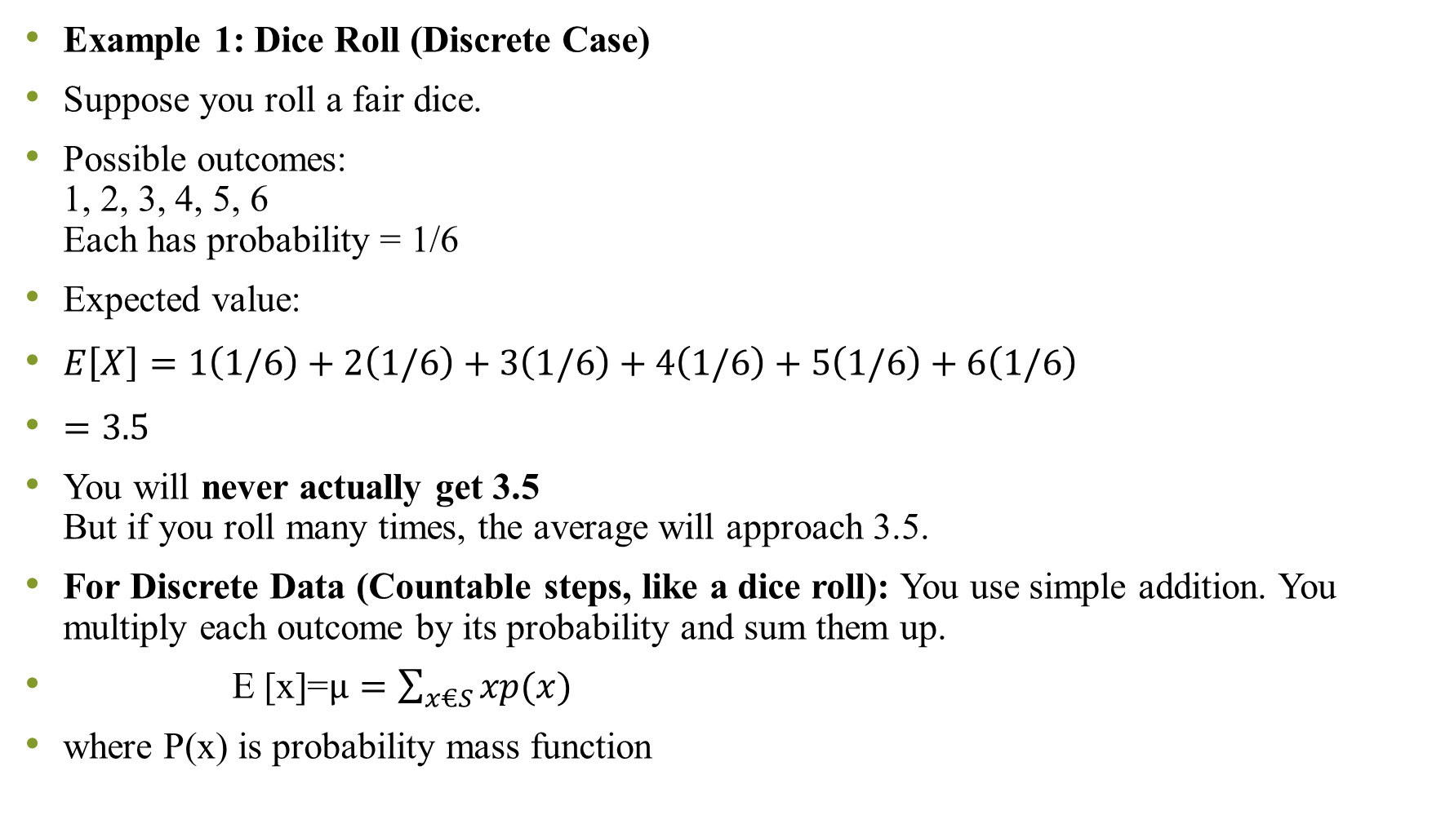
Example 1: Dice Roll (Discrete Case)
Suppose you roll a fair dice.
Possible outcomes: 1, 2, 3, 4, 5, 6 Each has probability = 1/6
Expected value:
$E\left[X\right]=1\left(1/6\right)+2\left(1/6\right)+3\left(1/6\right)+4\left(1/6\right)+5\left(1/6\right)+6\left(1/6\right)$
$=3.5$
You will never actually get 3.5 But if you roll many times, the average will approach 3.5.
For Discrete Data (Countable steps, like a dice roll): You use simple addition. You multiply each outcome by its probability and sum them up.
E [x]=$µ=\sum_{x€S}{xp(x)}$
where P(x) is probability mass function

Slide 21
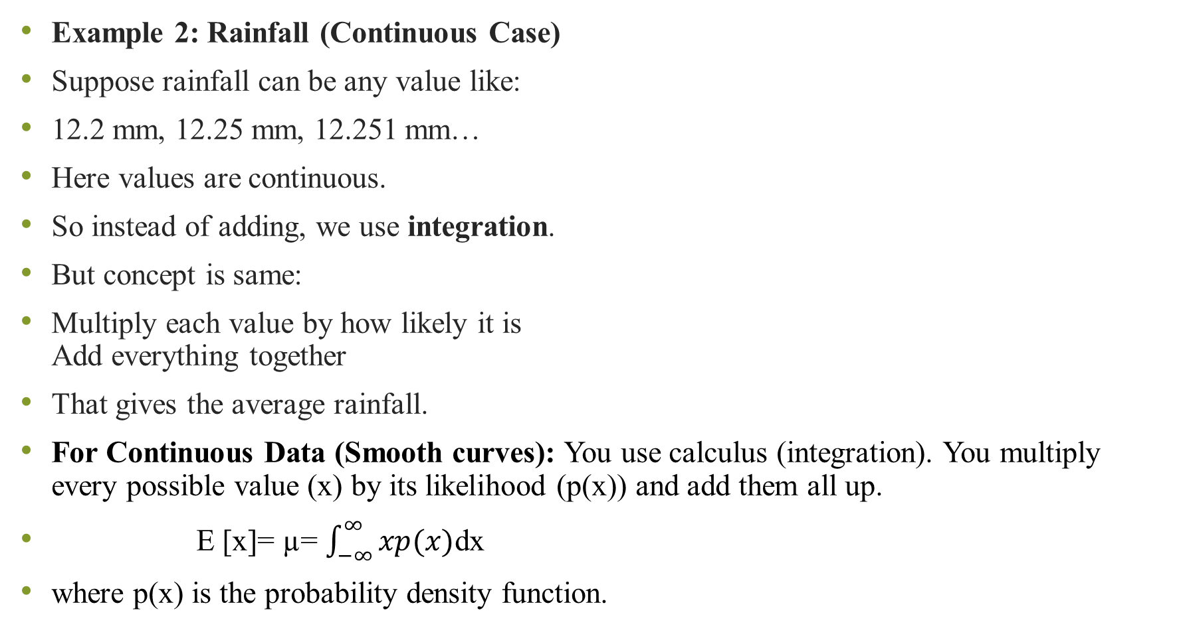
Example 2: Rainfall (Continuous Case)
Suppose rainfall can be any value like:
12.2 mm, 12.25 mm, 12.251 mm…
Here values are continuous.
So instead of adding, we use integration.
But concept is same:
Multiply each value by how likely it is Add everything together
That gives the average rainfall.
For Continuous Data (Smooth curves): You use calculus (integration). You multiply every possible value (x) by its likelihood (p(x)) and add them all up.
E [x]= µ= $\int_{−∞}^{∞}{xp(x)}$dx
where p(x) is the probability density function.

Slide 22
Numerical
A data scientist is evaluating a simple "Recommender System" for a streaming app. The random variable x represents the number of stars (1 to 4) a user is likely to give a specific genre based on historical data.
Questions: Verify that this is valid PMF
Calculate Expected Value E[x]
(Average Rating)
Find Variance and Standard deviations
x | P(x)
1 | 0.1
2 | 0.3
3 | 0.4
4 | 0.2

Slide 23
A food delivery company tracks number of orders received per hour. The following data was collected:
Questions:
Construct the probability mass function P(x).
Verify that it is a valid PMF.
Find the expected number of orders per hour.
Find variance and standard deviation.
Orders per hour (x) | Frequency
0 | 5
1 | 10
2 | 20
3 | 10
4 | 5

Slide 24
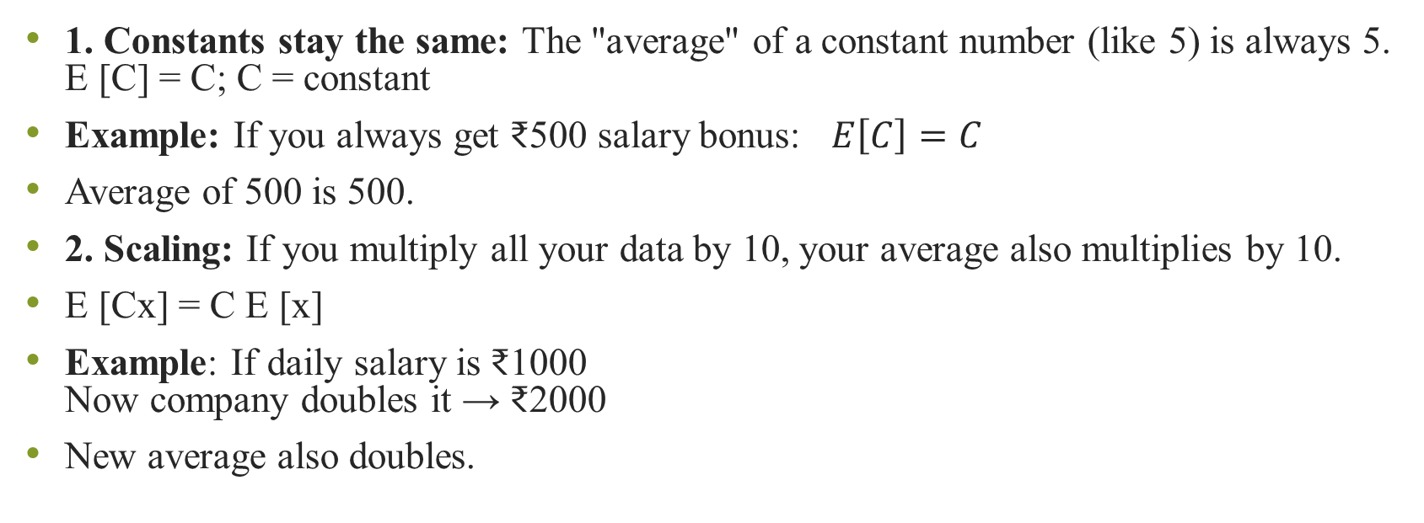
Important properties
1. Constants stay the same: The "average" of a constant number (like 5) is always 5. E [C] = C; C = constant
Example: If you always get ₹500 salary bonus: $E\left[C\right]=C$
Average of 500 is 500.
2. Scaling: If you multiply all your data by 10, your average also multiplies by 10.
E [Cx] = C E [x]
Example: If daily salary is ₹1000 Now company doubles it → ₹2000
New average also doubles.

Slide 25
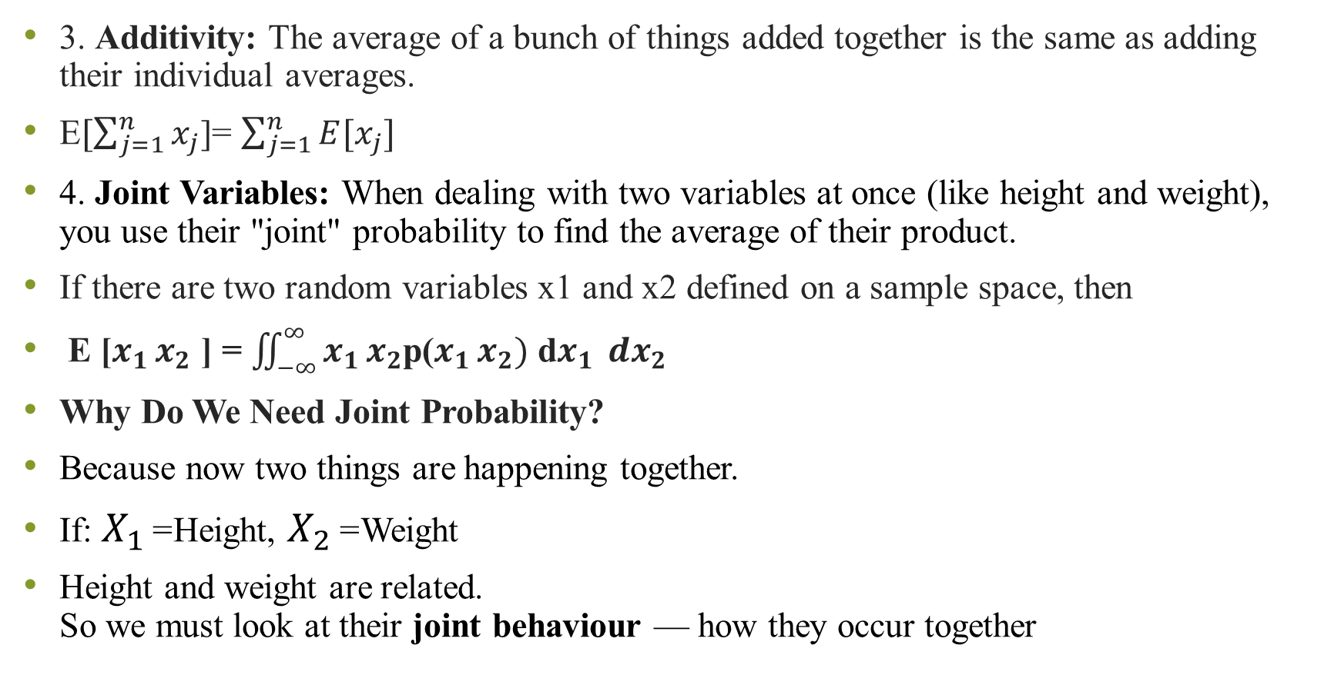
3. Additivity: The average of a bunch of things added together is the same as adding their individual averages.
E$[\sum_{j=1}^{n}{x_{j}}$]= $\sum_{j=1}^{n}{E[x_{j}]}$
4. Joint Variables: When dealing with two variables at once (like height and weight), you use their "joint" probability to find the average of their product.
If there are two random variables x1 and x2 defined on a sample space, then
E [$x_{1 }x_{2}$ ] = $\iint_{−∞}^{∞}{x_{1 }x_{2}}$p($x_{1 }x_{2})$ d$x_{1 }{ dx}_{2}$
Why Do We Need Joint Probability?
Because now two things are happening together.
If: $X_{1}$= Height, $X_{2}$= Weight
Height and weight are related. So we must look at their joint behaviour — how they occur together
Notes:
3. Additivity Rule
Suppose:
Daily food expense = average ₹200 Daily travel expense = average ₹100
Total expense = ₹300
$$E\left[X+Y\right]=E\left[X\right]+E\left[Y\right]$$
👉 Average total expense = sum of averages.
What Does the Double Integral Mean?
$$E\left[X_{1}X_{2}\right]=\int{∫}x_{1}x_{2} p\left(x_{1} , x_{2}\right) dx_{1}dx_{2}$$
In simple words:
Take all possible values of X₁ and X₂
Multiply them
Multiply by how likely they occur together
Add everything up
That’s it.
The double integral is just a continuous version of adding all combinations

Slide 26
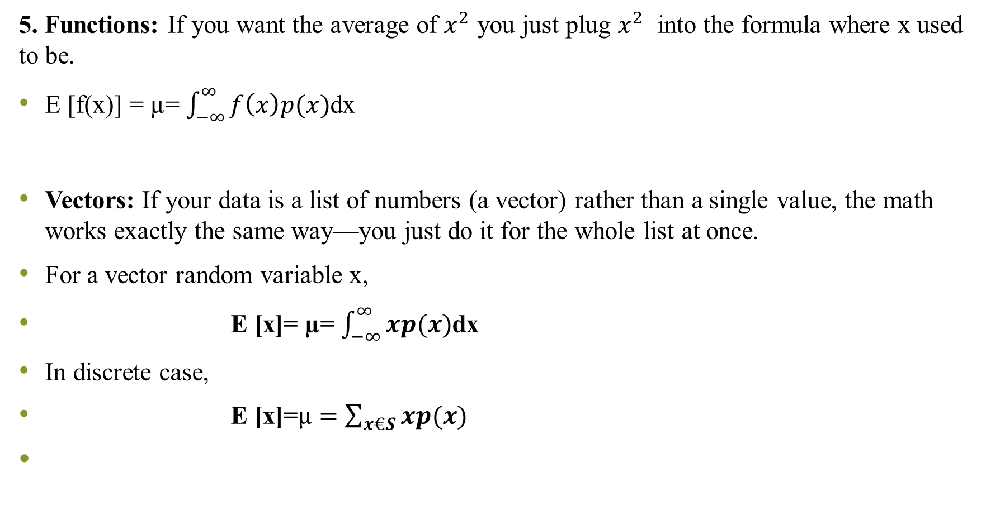
5. Functions: If you want the average of $x^{2}$ you just plug $x^{2}$ into the formula where x used to be.
E [f(x)] = µ= $\int_{−∞}^{∞}{f\left(x\right)p(x)}$dx
Vectors: If your data is a list of numbers (a vector) rather than a single value, the math works exactly the same way—you just do it for the whole list at once.
For a vector random variable x,
E [x]= µ= $\int_{−∞}^{∞}{xp(x)}$dx
In discrete case,
E [x]=$µ=\sum_{x€S}{xp(x)}$
Notes:
In Machine Learning:
Data point = vector
$$X=\left(x_{1} , x_{2} , x_{3} , . , ..x_{n}\right)$$
Expected value gives:
Mean vector
Which is used in:
Clustering
Gaussian distribution
Covariance matrix
PCA

Slide 27
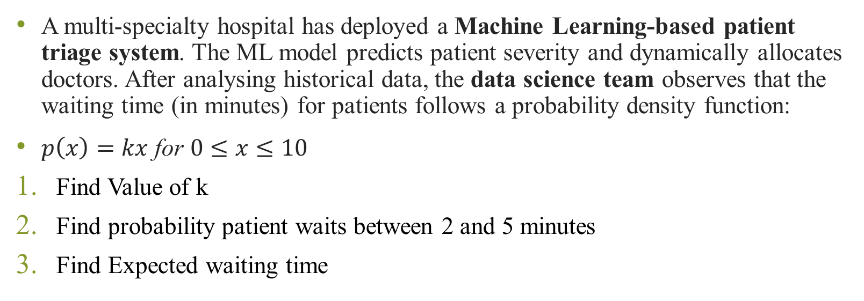
Numerical
A multi-specialty hospital has deployed a Machine Learning-based patient triage system. The ML model predicts patient severity and dynamically allocates doctors. After analysing historical data, the data science team observes that the waiting time (in minutes) for patients follows a probability density function:
$p\left(x\right)=kx \text{for} 0≤x≤10$
Find Value of k
Find probability patient waits between 2 and 5 minutes
Find Expected waiting time

Slide 28
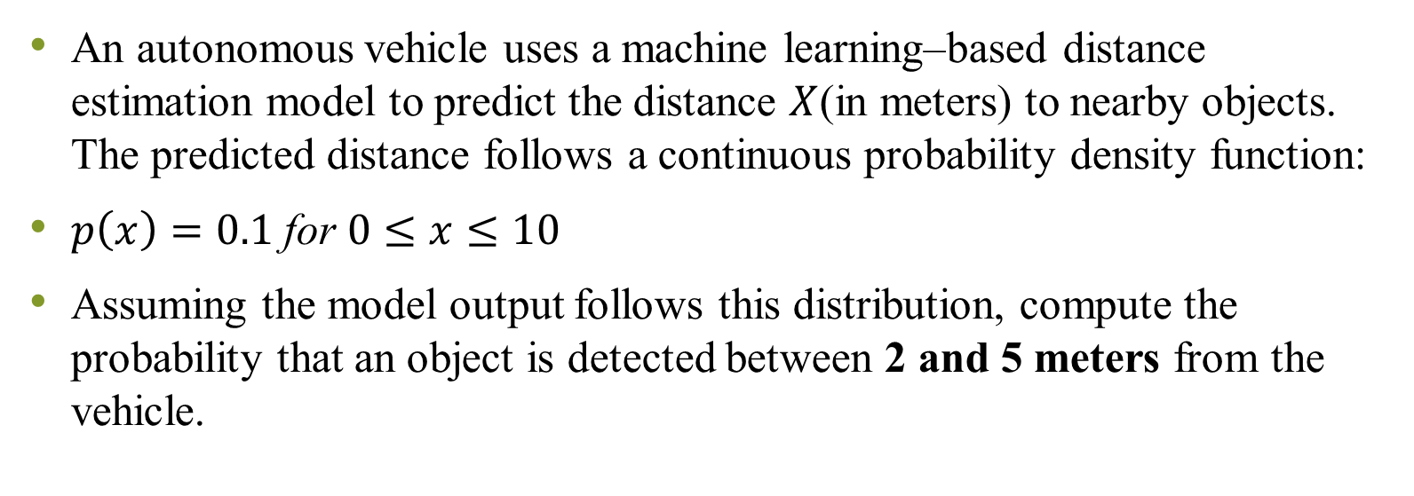
Numerical
An autonomous vehicle uses a machine learning–based distance estimation model to predict the distance $X$(in meters) to nearby objects. The predicted distance follows a continuous probability density function:
$p\left(x\right)=0.1 \text{for} 0≤x≤10$
Assuming the model output follows this distribution, compute the probability that an object is detected between 2 and 5 meters from the vehicle.

Slide 29
Variance
The expected value (mean) describes the central tendency of a random variable.
We also need to measure the spread of values around the mean.
Variance is desired to know the ‘spread’ of the random variable about the mean.
It is denoted as Var[X] or σ²

Slide 30
Variance (Discrete Case)
Var[X] = σ² = E[(X - μ)²]
Summation Form: Var[X] = Σ (x - μ)² P(x), x ∈ S
It represents weighted squared deviations
from the mean

Slide 31
Derivation of Variance Formula
Var[X] = E[(X - E[X])²]
= E[X² - 2X E[X] + (E[X])²]
Using linearity of expectation:
= E[X²] - (E[X])²
Final Formula: Var[X] = E[X²] - (E[X])²
This form is often easier to compute in practical problems

Slide 32
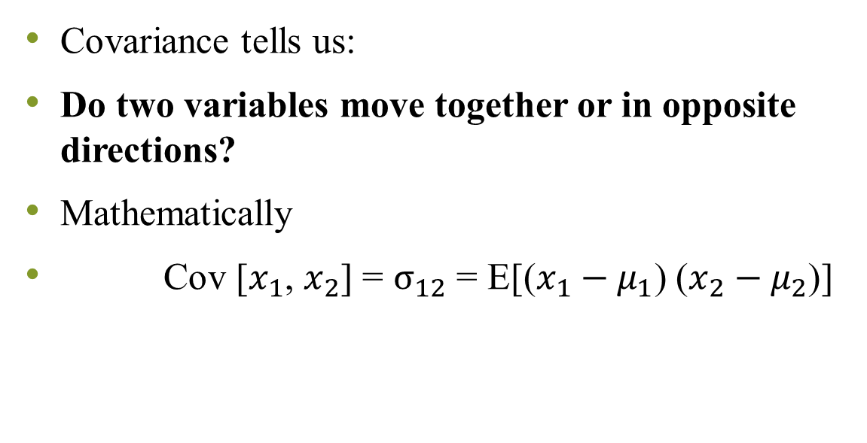
Covariance
Covariance tells us:
Do two variables move together or in opposite directions?
Mathematically
Cov [$x_{1}$, $x_{2}$] = $σ_{12}$ = E[($x_{1}−μ_{1}$) ($x_{2}−μ_{2}$)]
Covariance Value | Meaning
Positive (+) | Both increase together
Negative (−) | One increases, other decreases
Zero (0) | Non linear relationship

Slide 33
Positive covariance
Example 1: CPU Usage vs Temperature
When CPU usage increases, temperature increases.
So, Covariance > 0 (Positive)
CPU Usage (%) | Temperature (°C)
20 | 40
40 | 55
60 | 70
80 | 85

Slide 34
Negative covariance
Example 2: Internet Speed vs Download Time
When speed increases, download time decreases.
Covariance < 0 (Negative)
Covariance alone is not enough
Covariance depends on the scale (units) of the variables.
That means if we change the units, the covariance value changes — even though the relationship between variables is exactly the same.
Speed (Mbps) | Download Time (min)
10 | 20
20 | 10
40 | 5

Slide 35

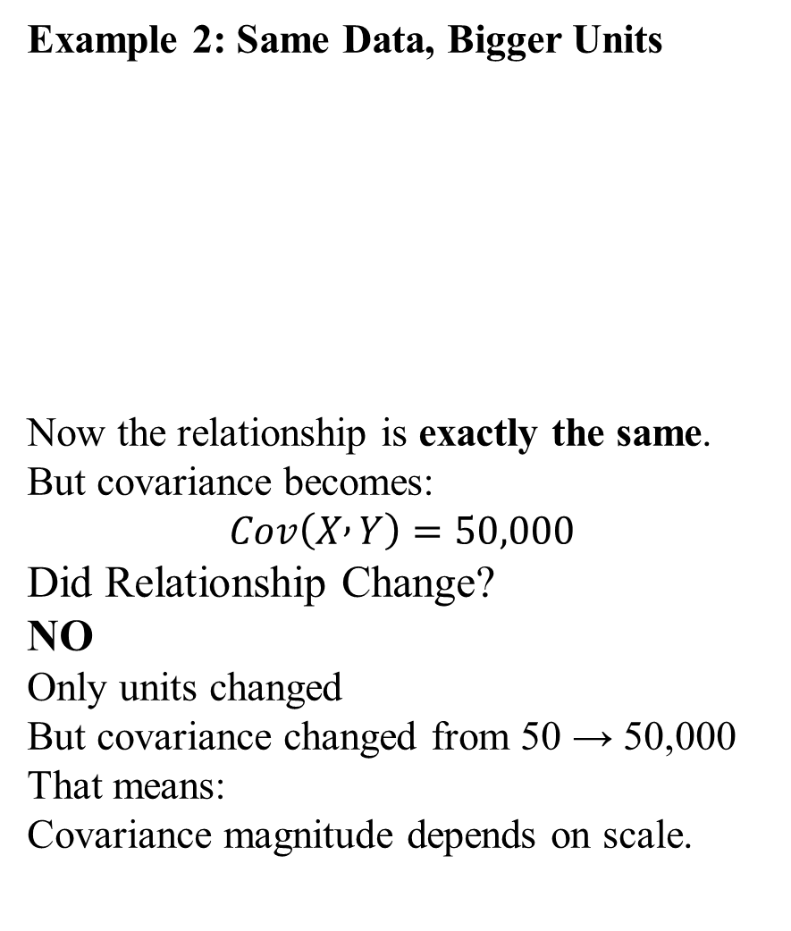
Example 1: Small Scale Variables
These are perfectly positively related.
Covariance might be something like:
$Cov\left(X , Y\right)=50$
Example 2: Same Data, Bigger Units
Now the relationship is exactly the same.
But covariance becomes:
$$Cov\left(X , Y\right)=50,000$$
Did Relationship Change?
NO
Only units changed
But covariance changed from 50 → 50,000
That means:
Covariance magnitude depends on scale.
Student | Marks (X) | Salary (₹) (Y)
A | 50 | 5000
B | 60 | 6000
C | 70 | 7000
Student | Marks (X) | Stipend (₹ thousands) (Y)
A | 50 | 5
B | 60 | 6
C | 70 | 7
Notes:
So we cannot say:
50 is weak
50,000 is strong
Because units are different.

Slide 36
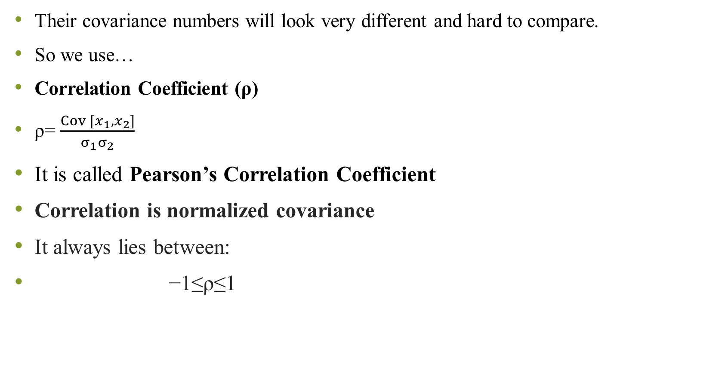
Their covariance numbers will look very different and hard to compare.
So we use…
Correlation Coefficient (ρ)
ρ= $\frac{Cov [x_{1}, x_{2}]}{σ_{1}σ_{2}}$
It is called Pearson’s Correlation Coefficient
Correlation is normalized covariance
It always lies between:
−1≤ρ≤1
ρ Value | Meaning
+1 | Perfect positive relationship
−1 | Perfect negative relationship
0 | No linear relation

Slide 37
Covariance Matrix – When We Have Multiple Features
In Machine Learning, we don’t have just 2 variables.
We may have:
Age
Salary
Experience
Working hours
Productivity
Now we want to know:
How every feature relates to every other feature?
That is where Covariance Matrix comes.

Slide 38
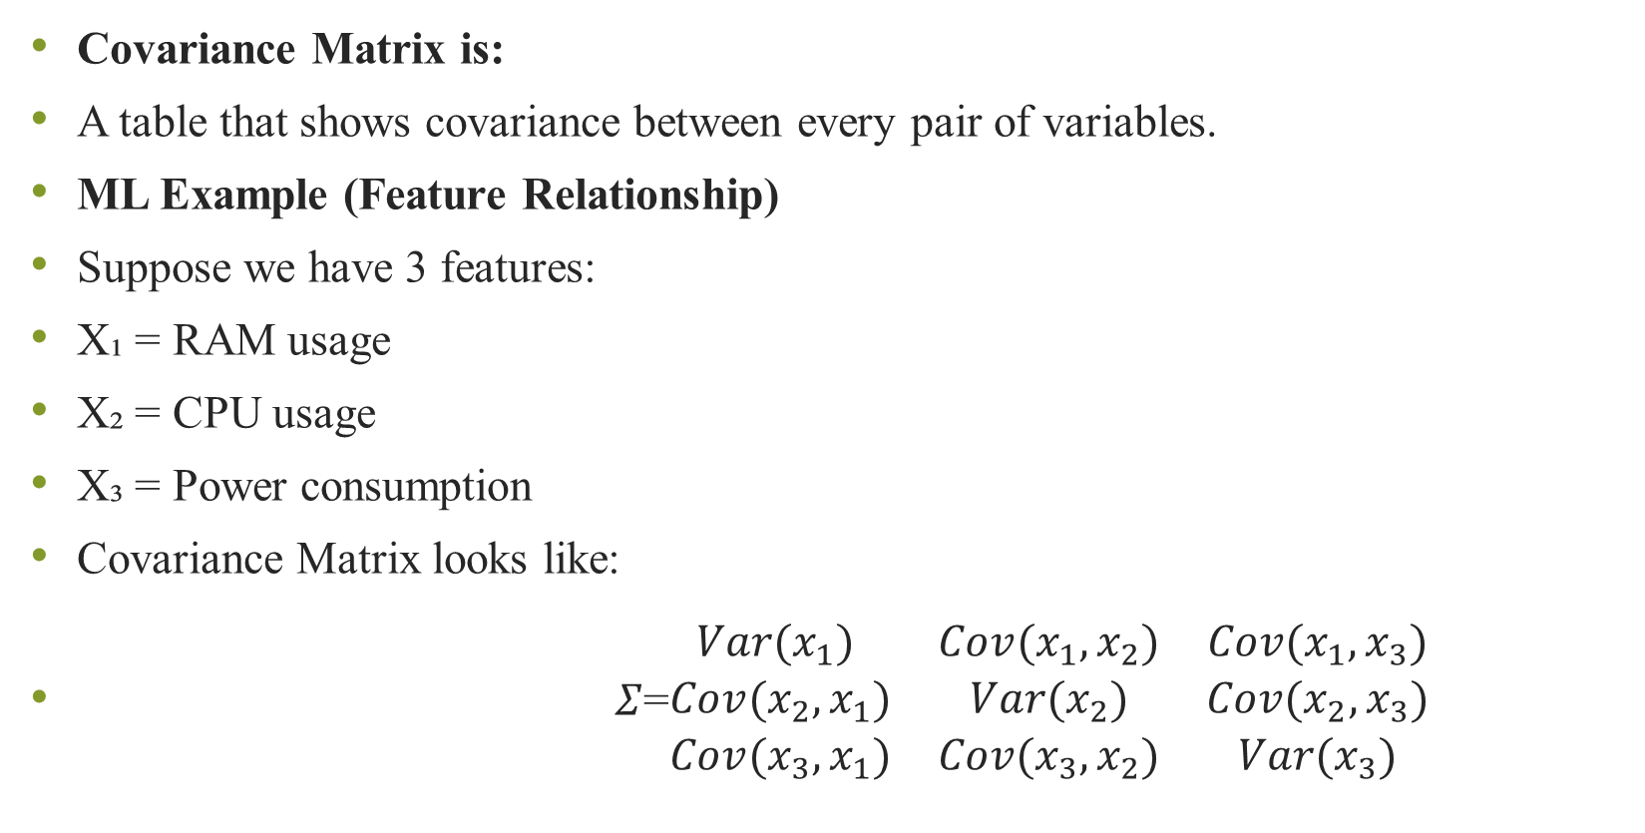
Covariance Matrix is:
A table that shows covariance between every pair of variables.
ML Example (Feature Relationship)
Suppose we have 3 features:
X₁ = RAM usage
X₂ = CPU usage
X₃ = Power consumption
Covariance Matrix looks like:
$Σ$=$\begin{matrix}Var(x_{1}) & Cov(x_{1},x_{2}) & Cov(x_{1},x_{3}) \\ Cov(x_{2},x_{1}) & Var(x_{2}) & Cov(x_{2},x_{3}) \\ Cov(x_{3},x_{1}) & Cov(x_{3},x_{2}) & Var(x_{3})\end{matrix}$
Notes:
Diagonal elements = Variance (How much each variable spreads)
Off-diagonal elements = Covariance (How two variables move together)
Matrix is symmetric Cov(X₁,X₂) = Cov(X₂,X₁)

Slide 40
Descriptive Measures from Data Sample

