Slide 1
Statistical learning
Shrikrishna Anand Narvekar
Assistant Professor
Agnel Institute of Technology and Design

Slide 2
Content
Introduction
How we learn rules
Descriptive vs Inferential statistics

Slide 3
Introduction
Statistical analysis saw the development of two branches in the 18th century-
Bayesian Statistics(Believer):Uses Prior Belief + New Data to reach a conclusion.
Classical Statistics(Observer):Uses Only the Current Data.
Both deal with probability, but in different ways.
Notes:
Bayesian (The "Believer"): Uses Prior Belief + New Data to reach a conclusion.
The "Doctor" Example: You think a young patient is healthy (Prior). They have chest pain (New Data). You still conclude it’s likely not heart disease because the Prior is so strong.
Classical (The "Observer"): Uses Only the Current Data.
The "Coin Flip" Example: It doesn’t matter if the coin "felt" lucky yesterday. If you flip it 100 times now and get 50 heads, that is your only truth.

Slide 4
How we learn rules
Deductive (Top-Down): Start with a Rule, apply it to Data.
Logic: “All humans need water” →"John is human" → “John needs water”
Inductive (Botttom-up): Start with a Rule, apply it to Data.
The "Baby" Example: Touching a hot stove + hot soup + hot iron = "Don't touch hot things!"
Notes:
Deductive (Conventional Statistics): Example: "All humans need water. John is a human. Therefore, John needs water."
Inductive (Machine Learning): A baby touches a hot stove, a hot iron, and a hot soup bowl. After three painful experiences, the baby induces a rule: "Glowing/steaming things shouldn't be touched." The baby discovered the rule from the data.

Slide 5
Descriptive vs. Inferential Statistics
Type | Purpose | Example
Descriptive | Summarizes the Past. | A fitness app showing you walked 10,000 steps yesterday.
Inferential | Predicts the Future/Whole. | Asking 1,000 voters their opinion to predict how 30 million will vote.

Slide 6
Finding signals in the Mess
What is "Noise"? Random errors or irrelevant data that distract from the pattern.
Signal: Your friend’s voice (the data you want).
Noise: The loud music and crowd shouting (the distraction).
Goal: Machine Learning acts like "Noise-Cancelling Headphones"—it filters out the music to hear the message.

Slide 7
Explaining noise in terms of data
House Size (sq.ft) | Actual Price (₹ Lakhs)
1000 | 50
1200 | 60
1500 | 75
1800 | 90
2000 | 500
First four rows show a clear pattern: Bigger house → Higher price 📈
But last row: 2000 sq.ft → ₹500 Lakhs
This value is unusually high and may be:
Data entry error
Luxury villa in different location
Typing mistake
This abnormal value is called Noise (Outlier).

Slide 8
Hard vs. Soft Modelling
Hard Computing (Analytical): Following a strict, 100% exact recipe
Rule: If A + B = C then C is always same
Example : When you type 567×432, the computer uses a "hard" mathematical rule. There is no guesswork; the answer is either right or wrong.
Soft modelling: Learning patterns to make a "best guess.“
Rule: Based on thousands of examples, this is probably the answer.
Example: : Netflix Recommendations. There is no "hard" rule that says if you liked Stranger Things, you will definitely like Wednesday.
Notes:
Hard Computing (Analytical Models): This is like following a strict recipe. You use specific mathematical equations to get an exact answer. If you have the right formula and the right input, you get the 100% correct output every time.
Day-to-Day Example: A Calculator. When you type 567×432, the computer uses a "hard" mathematical rule. There is no guesswork; the answer is either right or wrong.
Soft Modeling (Machine Learning): This is more like a human learning to recognize a face. There isn't one single equation for "what a face looks like." Instead, the computer looks at thousands of photos and builds a "soft" model that says, "This is probably a face."
Day-to-Day Example: Netflix Recommendations. There is no "hard" rule that says if you liked Stranger Things, you will definitely like Wednesday. The computer uses a "soft model" to guess your preferences based on patterns

Slide 9
Dealing with messy data
Data is rarely perfect. We have to manage three main problems:
Noise: Irrelevant "jitter" or extra info that hides the truth.
Missing Values: Gaps where data wasn't recorded.
Inconsistencies: Data that contradicts itself.
Notes:
Noise: Sometimes the GPS "jitters," making it look like you suddenly jumped 20 feet to the left and back. That "jump" is noise.
Missing Values: You run through a tunnel, and the GPS loses signal for 30 seconds. That is a missing value.
The Solution: The app uses probability to "smooth out" the jitter and "guess" your path through the tunnel. It handles the uncertainty so the final map looks correct.

Slide 10
Employee ID | Age | Experience (Years) | Department | Salary (₹ Lakhs)
E101 | 25 | 2 | Sales | 4.5
E102 | 30 | 5 | Marketing | 6.8
E103 | 29 | 4 | Sales | 150.0
E104 | – | 3 | HR | 5.2
E105 | 32 | 12 | Intern | 3.0
E106 | 28 | 4 | Sales | 6.0
Notes:
1. Noise (Irrelevant or Extreme Values)
👉 Row: E103 – Salary ₹150 Lakhs
Others earn between 4–7 Lakhs.
₹150 Lakhs looks unrealistic.
Could be:
Typing mistake (15 instead of 150)
Extra zero added
Data entry error
✔ This extreme value is Noise (Outlier) It can distort average salary calculations.
🟡 2. Missing Values (Data Gaps)
👉 Row: E104 – Age is missing (–)
Age not recorded.
We don’t know whether employee is 22 or 45.
✔ This is a Missing Value
Machine Learning must:
Remove the row
Or replace with average age
Or predict age using other features
🟠 3. Inconsistencies (Contradicting Data)
👉 Row: E105 – 12 Years Experience but Department = Intern
Interns usually have 0–1 years experience.
12 years experience contradicts job role.
✔ This is Inconsistent Data
Possible causes:
Wrong department entry
Wrong experience value
Data merged from two sources incorrectly

Slide 11
Sample Space & Sample Points
The Sample Space (D): This is the "world" of all possible outcomes. In Machine Learning, your entire dataset (the Data Matrix) is your Sample Space.
Example: If you are analysing a deck of cards, the Sample Space is all 52 cards.
Sample Points (x):This is a single "event" or a single row in your data. It is one specific instance from the Sample Space.
Example: Drawing the 7 of Hearts is a "sample point." In a medical study, one single patient’s records would be a sample point

Slide 12
Random Variables
We call the characteristics of our data "Random Variables" because we don't know the value until we actually look at a specific example.
These are the Columns in your table (Attributes).
The "House Hunting" Example: If you are looking for a house, the Random Variables are:
Number of Bedrooms
Square Footage
Price

Slide 13
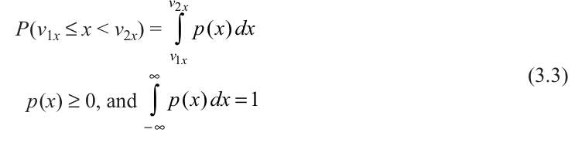
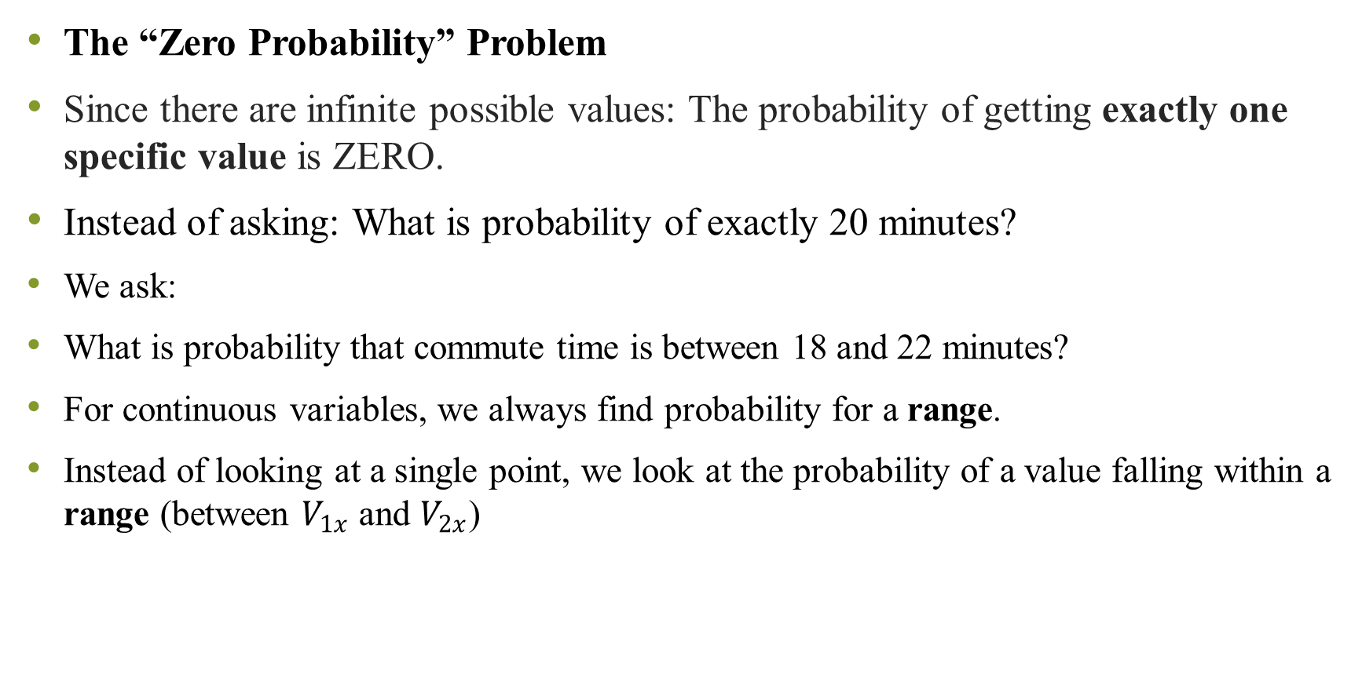
The “Zero Probability” Problem
Since there are infinite possible values: The probability of getting exactly one specific value is ZERO.
Instead of asking: What is probability of exactly 20 minutes?
We ask:
What is probability that commute time is between 18 and 22 minutes?
For continuous variables, we always find probability for a range.
Instead of looking at a single point, we look at the probability of a value falling within a range (between $V_{1x}$ and $V_{2x}$)
Notes:
Example: Probability that your commute time is exactly 20.000000 minutes = 0
Why?
Because time can be: 20.000001 20.000002 20.000003
There are infinite options!

Slide 14
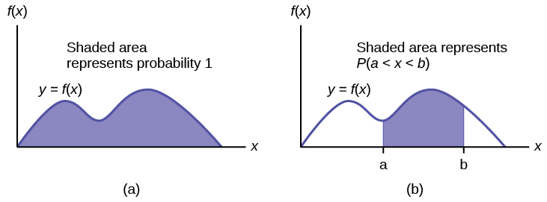
What is PDF
A Probability Density Function (PDF) is:
A smooth curve
That shows how values are distributed
Probability is the area under the curve It looks like a smooth wave (not spikes like PMF).

Slide 15
How do we calculate Probability
To find probability between two values:
We calculate the area under the curve between those two points.
Mathematically, we use integration.
Simple meaning:
Probability = Area under curve between V₁ and V₂

Slide 16
Rules of PDF
Rule 1: Density must be zero or positive
p(x) ≥ 0
You cannot have negative density.
Rule 2: Total area under curve must equal 1
The entire area under the curve = 1 (which means 100%)
If total area ≠ 1 → it is not a valid PDF.

Slide 17

Very Small Interval Idea (Δx Concept)
If we take a very small range:
x₀ to x₀ + Δx
Then,
Probability ≈ Density at that point × Width of range
In simple words:
Small Probability ≈ Height × Width
Just like area of a rectangle.

Slide 18

Data Scientist perspective:
From a data point of view:
Density means:
How frequently values occur in a very tiny interval.
If:
N = total observations ΔN = number of values in small interval
Then:
Density = (Relative frequency) ÷ (Width of interval)
As interval becomes extremely small → it becomes PDF.
Notes:
Self-Driving Car Example (Very Practical)
A self-driving car uses both PMF and PDF:
🟥 PMF (Discrete Decision)
Traffic light color:
Red
Green
Yellow
These are countable categories → PMF
📏 PDF (Continuous Measurement)
Distance from car in front:
10.25 meters
10.256 meters
10.25678 meters
Infinite possible values → PDF

Slide 19
Descriptive Measures of Probability Distributions
One of the most important descriptive values of a random variable is the point around which distribution is centered, known as measure of central tendency.
The expected (mean or average) value is the best measure for central tendency.
Expected value is just the average of a random situation.

Slide 20
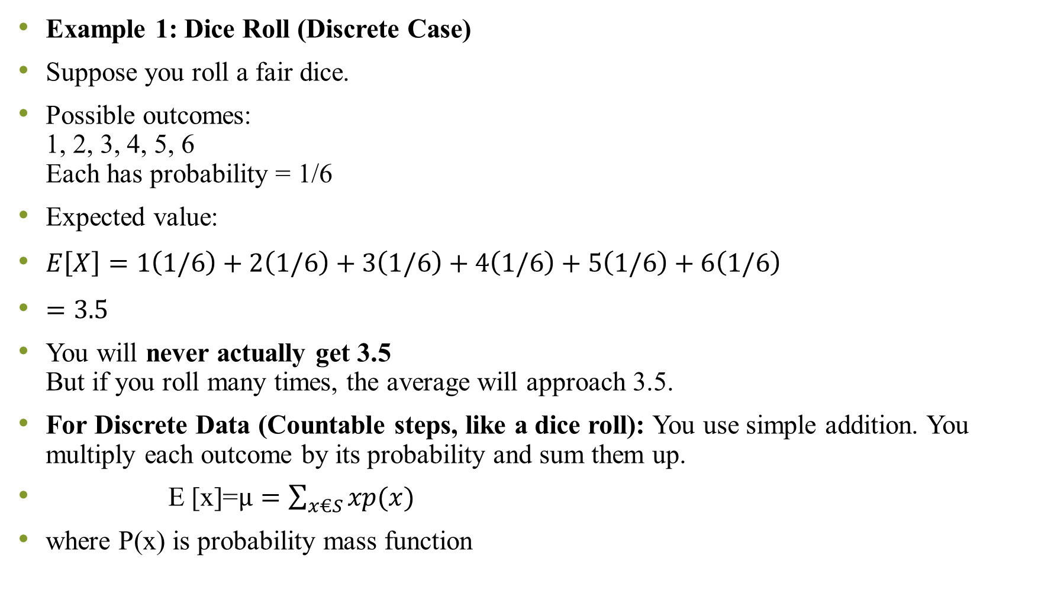
Example 1: Dice Roll (Discrete Case)
Suppose you roll a fair dice.
Possible outcomes: 1, 2, 3, 4, 5, 6 Each has probability = 1/6
Expected value:
$E\left[X\right]=1\left(1/6\right)+2\left(1/6\right)+3\left(1/6\right)+4\left(1/6\right)+5\left(1/6\right)+6\left(1/6\right)$
$=3.5$
You will never actually get 3.5 But if you roll many times, the average will approach 3.5.
For Discrete Data (Countable steps, like a dice roll): You use simple addition. You multiply each outcome by its probability and sum them up.
E [x]=$µ=\sum_{x€S}{xp(x)}$
where P(x) is probability mass function

Slide 21
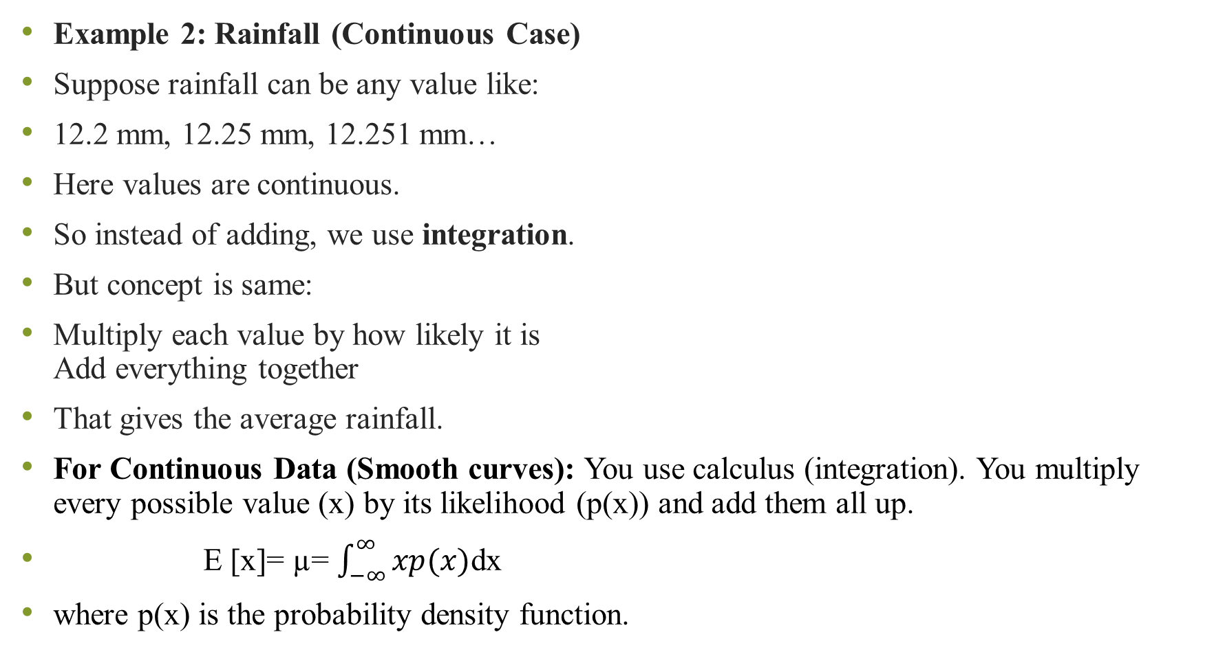
Example 2: Rainfall (Continuous Case)
Suppose rainfall can be any value like:
12.2 mm, 12.25 mm, 12.251 mm…
Here values are continuous.
So instead of adding, we use integration.
But concept is same:
Multiply each value by how likely it is Add everything together
That gives the average rainfall.
For Continuous Data (Smooth curves): You use calculus (integration). You multiply every possible value (x) by its likelihood (p(x)) and add them all up.
E [x]= µ= $\int_{−∞}^{∞}{xp(x)}$dx
where p(x) is the probability density function.

Slide 22
Numerical
A data scientist is evaluating a simple "Recommender System" for a streaming app. The random variable x represents the number of stars (1 to 4) a user is likely to give a specific genre based on historical data.
Questions: Verify that this is valid PMF
Calculate Expected Value E[x]
(Average Rating)
Find Variance and Standard deviations
x | P(x)
1 | 0.1
2 | 0.3
3 | 0.4
4 | 0.2

Slide 23
A food delivery company tracks number of orders received per hour. The following data was collected:
Questions:
Construct the probability mass function P(x).
Verify that it is a valid PMF.
Find the expected number of orders per hour.
Find variance and standard deviation.
Orders per hour (x) | Frequency
0 | 5
1 | 10
2 | 20
3 | 10
4 | 5

Slide 24
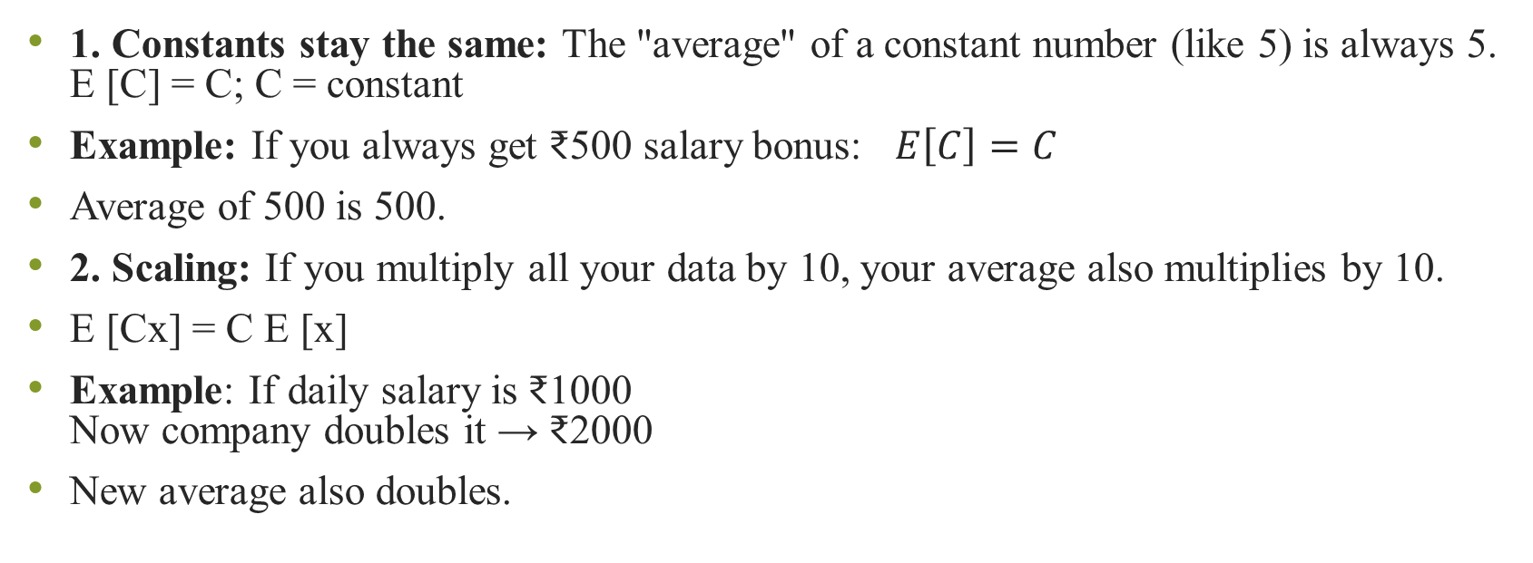
Important properties
1. Constants stay the same: The "average" of a constant number (like 5) is always 5. E [C] = C; C = constant
Example: If you always get ₹500 salary bonus: $E\left[C\right]=C$
Average of 500 is 500.
2. Scaling: If you multiply all your data by 10, your average also multiplies by 10.
E [Cx] = C E [x]
Example: If daily salary is ₹1000 Now company doubles it → ₹2000
New average also doubles.

Slide 25
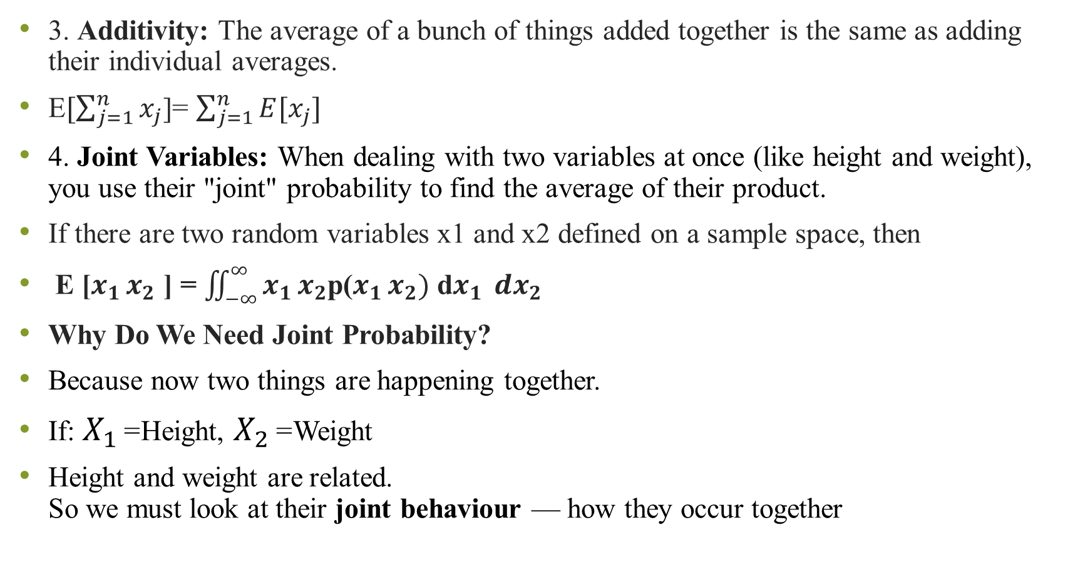
3. Additivity: The average of a bunch of things added together is the same as adding their individual averages.
E$[\sum_{j=1}^{n}{x_{j}}$]= $\sum_{j=1}^{n}{E[x_{j}]}$
4. Joint Variables: When dealing with two variables at once (like height and weight), you use their "joint" probability to find the average of their product.
If there are two random variables x1 and x2 defined on a sample space, then
E [$x_{1 }x_{2}$ ] = $\iint_{−∞}^{∞}{x_{1 }x_{2}}$p($x_{1 }x_{2})$ d$x_{1 }{ dx}_{2}$
Why Do We Need Joint Probability?
Because now two things are happening together.
If: $X_{1}$= Height, $X_{2}$= Weight
Height and weight are related. So we must look at their joint behaviour — how they occur together
Notes:
3. Additivity Rule
Suppose:
Daily food expense = average ₹200 Daily travel expense = average ₹100
Total expense = ₹300
$$E\left[X+Y\right]=E\left[X\right]+E\left[Y\right]$$
👉 Average total expense = sum of averages.
What Does the Double Integral Mean?
$$E\left[X_{1}X_{2}\right]=\int{∫}x_{1}x_{2} p\left(x_{1} , x_{2}\right) dx_{1}dx_{2}$$
In simple words:
Take all possible values of X₁ and X₂
Multiply them
Multiply by how likely they occur together
Add everything up
That’s it.
The double integral is just a continuous version of adding all combinations

Slide 26
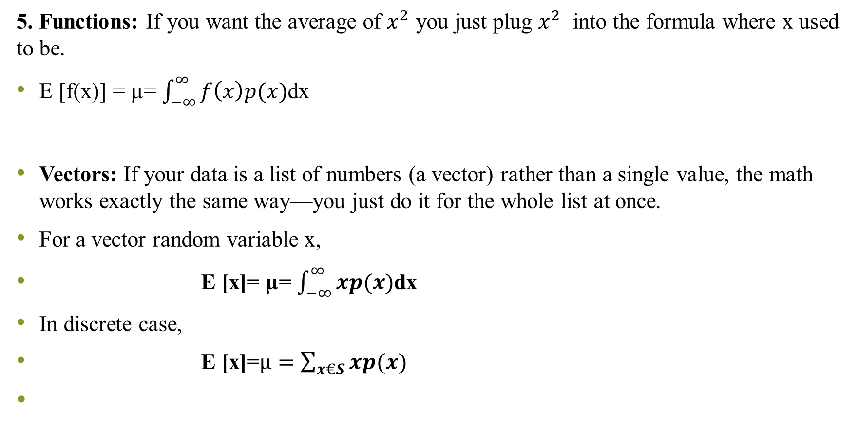
5. Functions: If you want the average of $x^{2}$ you just plug $x^{2}$ into the formula where x used to be.
E [f(x)] = µ= $\int_{−∞}^{∞}{f\left(x\right)p(x)}$dx
Vectors: If your data is a list of numbers (a vector) rather than a single value, the math works exactly the same way—you just do it for the whole list at once.
For a vector random variable x,
E [x]= µ= $\int_{−∞}^{∞}{xp(x)}$dx
In discrete case,
E [x]=$µ=\sum_{x€S}{xp(x)}$
Notes:
In Machine Learning:
Data point = vector
$$X=\left(x_{1} , x_{2} , x_{3} , . , ..x_{n}\right)$$
Expected value gives:
Mean vector
Which is used in:
Clustering
Gaussian distribution
Covariance matrix
PCA

Slide 27
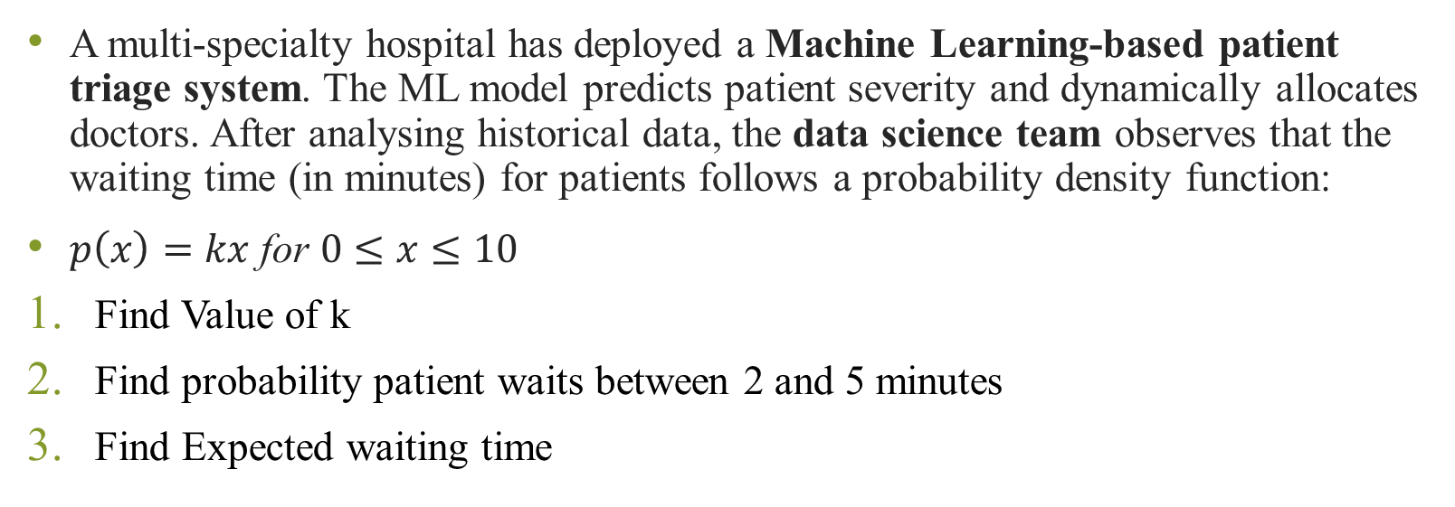
Numerical
A multi-specialty hospital has deployed a Machine Learning-based patient triage system. The ML model predicts patient severity and dynamically allocates doctors. After analysing historical data, the data science team observes that the waiting time (in minutes) for patients follows a probability density function:
$p\left(x\right)=kx \text{for} 0≤x≤10$
Find Value of k
Find probability patient waits between 2 and 5 minutes
Find Expected waiting time

Slide 28
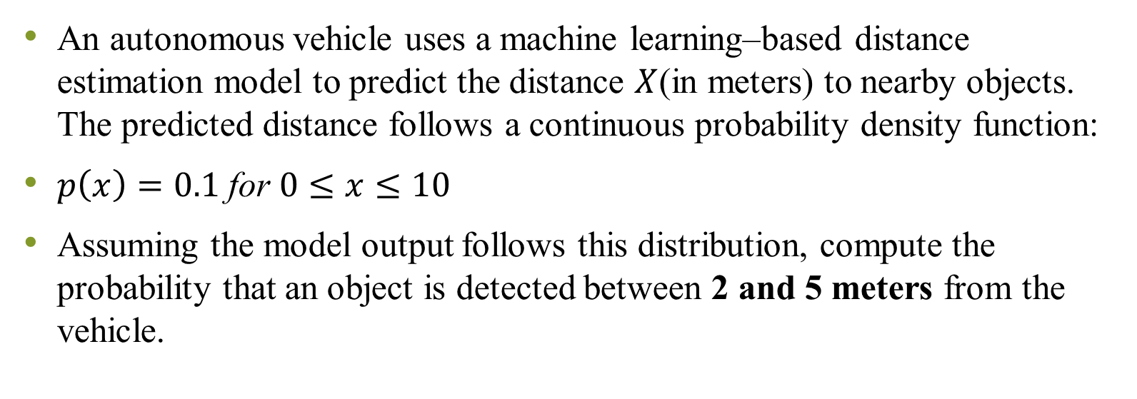
Numerical
An autonomous vehicle uses a machine learning–based distance estimation model to predict the distance $X$(in meters) to nearby objects. The predicted distance follows a continuous probability density function:
$p\left(x\right)=0.1 \text{for} 0≤x≤10$
Assuming the model output follows this distribution, compute the probability that an object is detected between 2 and 5 meters from the vehicle.

Slide 29
Variance
The expected value (mean) describes the central tendency of a random variable.
We also need to measure the spread of values around the mean.
Variance is desired to know the ‘spread’ of the random variable about the mean.
It is denoted as Var[X] or σ²

Slide 30
Variance (Discrete Case)
Var[X] = σ² = E[(X - μ)²]
Summation Form: Var[X] = Σ (x - μ)² P(x), x ∈ S
It represents weighted squared deviations
from the mean

Slide 31
Derivation of Variance Formula
Var[X] = E[(X - E[X])²]
= E[X² - 2X E[X] + (E[X])²]
Using linearity of expectation:
= E[X²] - (E[X])²
Final Formula: Var[X] = E[X²] - (E[X])²
This form is often easier to compute in practical problems

Slide 32
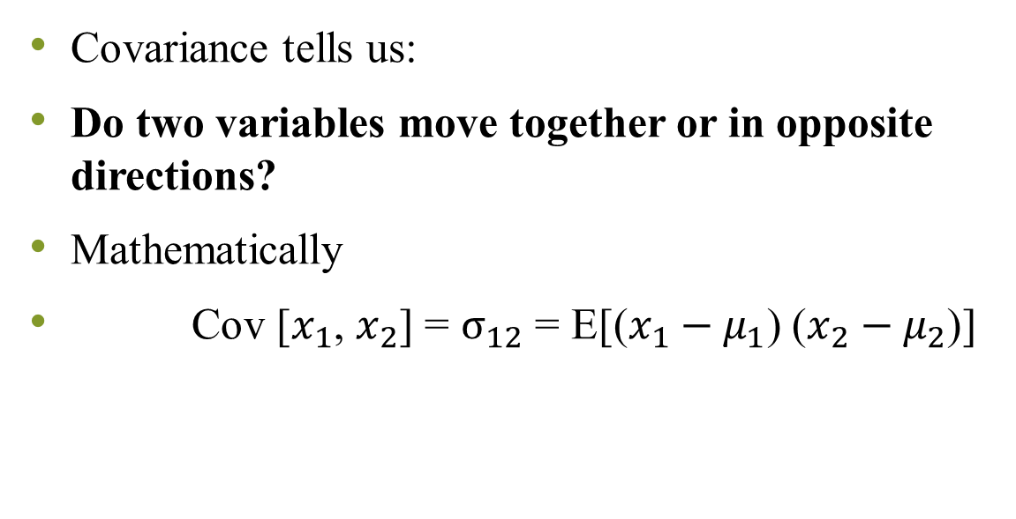
Covariance
Covariance tells us:
Do two variables move together or in opposite directions?
Mathematically
Cov [$x_{1}$, $x_{2}$] = $σ_{12}$ = E[($x_{1}−μ_{1}$) ($x_{2}−μ_{2}$)]
Covariance Value | Meaning
Positive (+) | Both increase together
Negative (−) | One increases, other decreases
Zero (0) | Non linear relationship

Slide 33
Positive covariance
Example 1: CPU Usage vs Temperature
When CPU usage increases, temperature increases.
So, Covariance > 0 (Positive)
CPU Usage (%) | Temperature (°C)
20 | 40
40 | 55
60 | 70
80 | 85

Slide 34
Negative covariance
Example 2: Internet Speed vs Download Time
When speed increases, download time decreases.
Covariance < 0 (Negative)
Covariance alone is not enough
Covariance depends on the scale (units) of the variables.
That means if we change the units, the covariance value changes — even though the relationship between variables is exactly the same.
Speed (Mbps) | Download Time (min)
10 | 20
20 | 10
40 | 5

Slide 35

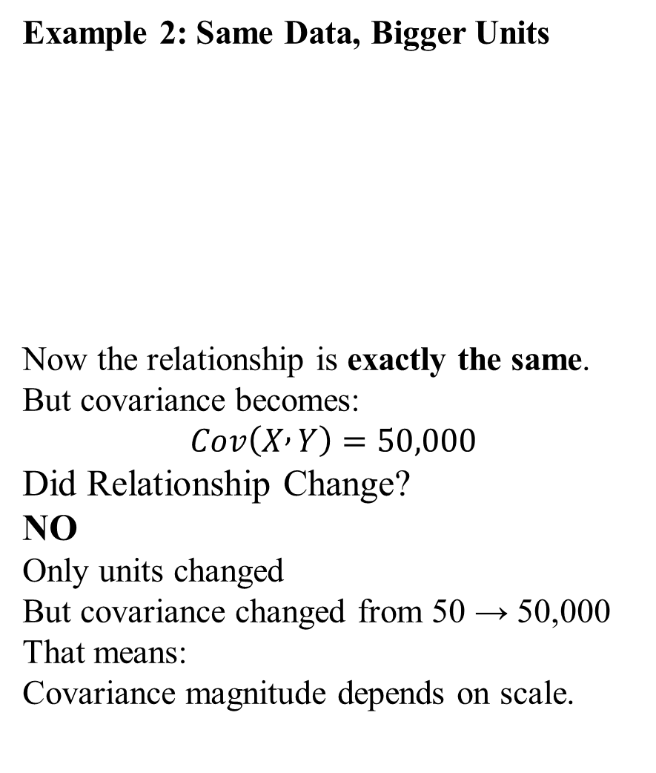
Example 1: Small Scale Variables
These are perfectly positively related.
Covariance might be something like:
$Cov\left(X , Y\right)=50$
Example 2: Same Data, Bigger Units
Now the relationship is exactly the same.
But covariance becomes:
$$Cov\left(X , Y\right)=50,000$$
Did Relationship Change?
NO
Only units changed
But covariance changed from 50 → 50,000
That means:
Covariance magnitude depends on scale.
Student | Marks (X) | Salary (₹) (Y)
A | 50 | 5000
B | 60 | 6000
C | 70 | 7000
Student | Marks (X) | Stipend (₹ thousands) (Y)
A | 50 | 5
B | 60 | 6
C | 70 | 7
Notes:
So we cannot say:
50 is weak
50,000 is strong
Because units are different.

Slide 36
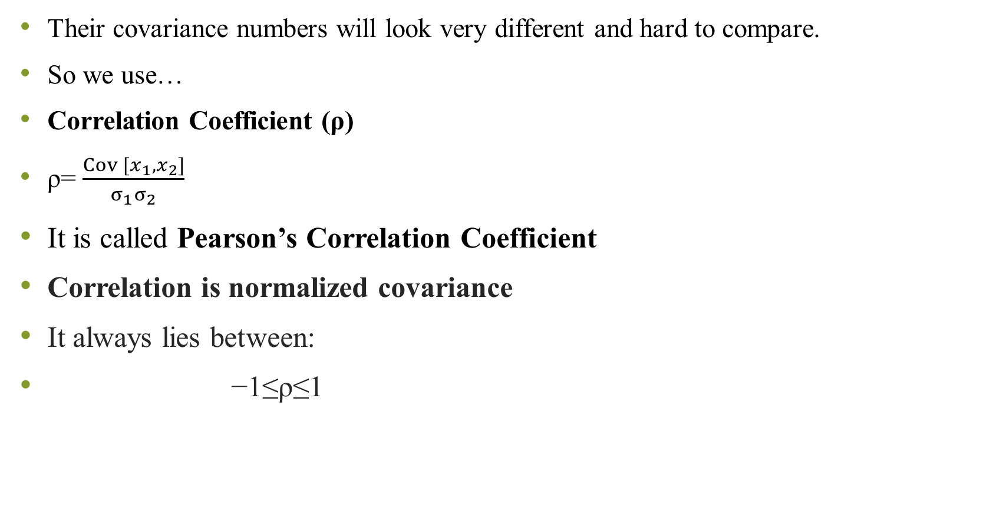
Their covariance numbers will look very different and hard to compare.
So we use…
Correlation Coefficient (ρ)
ρ= $\frac{Cov [x_{1}, x_{2}]}{σ_{1}σ_{2}}$
It is called Pearson’s Correlation Coefficient
Correlation is normalized covariance
It always lies between:
−1≤ρ≤1
ρ Value | Meaning
+1 | Perfect positive relationship
−1 | Perfect negative relationship
0 | No linear relation

Slide 37
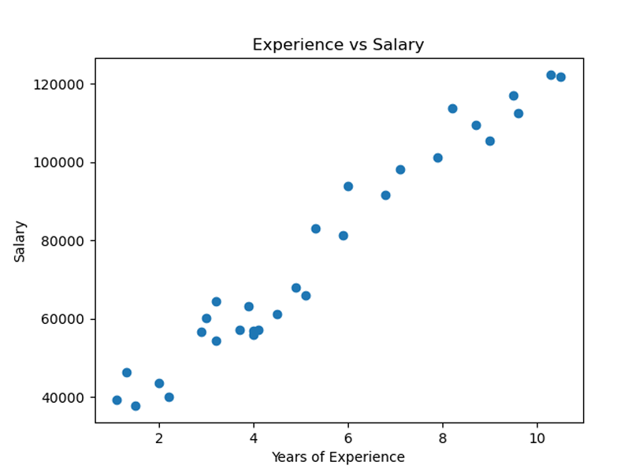
Strong positive correlation

Slide 38
Covariance
Now here comes the important conceptual point.
If this is SAMPLE data: Then We Divide by N-1
If We have population data then we divide by N

Slide 39
Covariance Matrix – When We Have Multiple Features
In Machine Learning, we don’t have just 2 variables.
We may have:
Age
Salary
Experience
Working hours
Productivity
Now we want to know:
How every feature relates to every other feature?
That is where Covariance Matrix comes.

Slide 40
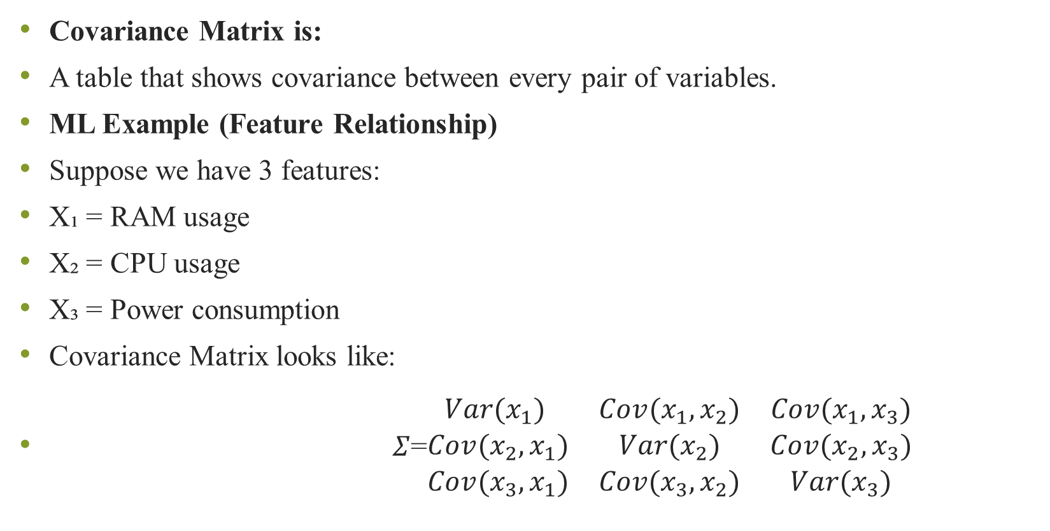
Covariance Matrix is:
A table that shows covariance between every pair of variables.
ML Example (Feature Relationship)
Suppose we have 3 features:
X₁ = RAM usage
X₂ = CPU usage
X₃ = Power consumption
Covariance Matrix looks like:
$Σ$=$\begin{matrix}Var(x_{1}) & Cov(x_{1},x_{2}) & Cov(x_{1},x_{3}) \\ Cov(x_{2},x_{1}) & Var(x_{2}) & Cov(x_{2},x_{3}) \\ Cov(x_{3},x_{1}) & Cov(x_{3},x_{2}) & Var(x_{3})\end{matrix}$
Notes:
Diagonal elements = Variance (How much each variable spreads)
Off-diagonal elements = Covariance (How two variables move together)
Matrix is symmetric Cov(X₁,X₂) = Cov(X₂,X₁)

Slide 41
Numerical
A server monitoring system recorded CPU usage (%) and CPU temperature (°C) over 5 hours. The dataset represents the entire population for that period.
Questions
Compute Cov(X,Y)
Compute Pearson correlation coefficient
Interpret the result
Hour | CPU Usage (X) | Temperature (Y)
1 | 20 | 40
2 | 40 | 50
3 | 60 | 65
4 | 80 | 80
5 | 100 | 95

Slide 42
A network engineer recorded internet speed (Mbps) and download time (minutes). Out of many possible connections available in the city he randomly selected 5 connections as a sample and recorded their speed and corresponding download time.
Questions
Find Covariance
Find Pearson correlation
Interpret the result
Speed (X) | Time (Y)
10 | 20
20 | 12
30 | 8
40 | 5
50 | 4

Slide 43
Descriptive Measures from Data Sample
Range: It is the difference between the smallest and the largest observation in the sample.
Mean: It is the arithmetic average value, that is, the sum of all the values divided by the number of values.
Median: The median value divides the observations into two groups of equal size—one possessing values smaller than the median and another one possessing values bigger than the median.
Mode: The value that occurs most often, is called the mode of data sample
Notes:
Range – Spread of Data
$$\text{Range}=\text{Maximum}−\text{Minimum}$$
👉 What it tells:
How wide the data is spread
The overall variation between smallest and largest value
💻 Example:
If CPU temperature varies from 40°C to 90°C,
Range = 50°C
✔ Large range → Data varies a lot ✔ Small range → Data values are close
Mean – Central Location
$$\text{Mean}=\frac{\text{Sum} \text{of} \text{all} \text{values}}{N}$$
👉 What it tells:
The average value
The “center” of the data
💻 Example:
If average network latency is 20 ms,
✔ That is the typical system performance.
But ❗ Mean is affected by extreme values.
Median – Middle Value
👉 What it tells:
The true center when data is skewed
Divides dataset into two equal parts
Mode – Most Frequent Value
👉 What it tells:
Most common value
Most common category (important in categorical data)
Variance & Standard Deviation – Data Dispersion
Variance measures:
How far values are from the mean (on average)
Standard deviation is:
Square root of variance (easier to interpret)
ML Applications
📌 1. Feature Scaling Decision
If one feature has a very large range (e.g., salary: 10,000–1,000,000) and another has a small range (e.g., rating: 1–5), algorithms like:
Linear Regression
KNN
SVM
will be biased toward large-range features.
👉 So we apply Min-Max Normalization.
📌 2. Outlier Detection
If range is extremely large → possible outliers exist.
Example:
Fraud detection dataset
Sensor temperature readings
2️⃣ Mean (μ)
🔹 What it Measures
Central tendency (average).
✅ ML Applications
📌 1. Data Centering (Very Important in ML)
Algorithms like:
PCA
Logistic Regression
Neural Networks
require mean-centered data.
Formula used:
$$x_{centered}=x−μ$$
📌 2. Missing Value Imputation
If salary is missing:
$$Replace missing value=Mean salary$$
📌 3. Gradient Descent Optimization
Loss functions are based on mean error:

Slide 44
Variance and Standard Deviation: The difference between a given observation and the arithmetic average of the sample is called its deviation.
The variance is defined as the arithmetic average of the squares of the deviations.
Standard deviation is the square root of the variance and is commonly employed in measuring dispersion.
Notes:
Variance and Standard Deviation:It is a measure of dispersion of data values; measures how closely the values cluster around their arithmetic average value. A low variance means that the values stay near the arithmatic average; a high variance means the opposite.
Median
🔹 What it Measures
Middle value (robust to outliers)
✅ ML Applications
📌 1. Robust Feature Engineering
In skewed data like:
House prices
Income data
E-commerce transaction amounts
Median is preferred over mean.
Example: In house price prediction:
Mean price may be affected by luxury villas
Median gives realistic central value
📌 2. Median Imputation
Used when dataset contains extreme values.
4️⃣ Mode
🔹 What it Measures
Most frequent value.
✅ ML Applications
📌 1. Categorical Missing Value Imputation
Example:
Most common city
Most common product category
Replace missing category with mode.
📌 2. Class Prediction in Classification
In:
K-Nearest Neighbors
Prediction is:
$$Predicted class=Mode of nearest neighbors$$
5️⃣ Variance
🔹 What it Measures
Spread of data.
✅ ML Applications
📌 1. Feature Selection (Variance Threshold)
If variance ≈ 0 → feature has almost same value → useless feature.
Example: If "Country = India" for all rows → variance = 0 → remove feature.
Used in:
Dimensionality reduction
Preprocessing pipelines
📌 2. Bias-Variance Tradeoff
In ML model evaluation:
High variance → overfitting
High bias → underfitting
Very important theoretical concept.
6️⃣ Standard Deviation (σ)
🔹 What it Measures
Spread in original unit.
$$σ=\sqrt{Variance}$$
✅ ML Applications
📌 1. Standardization (Z-score Scaling)
Used in:
Logistic Regression
SVM
PCA
Neural Networks
Formula:
$$Z=\frac{x−μ}{σ}$$
📌 2. Anomaly Detection
If value lies beyond:
$$μ±3σ$$
→ Potential anomaly
Used in:
Fraud detection
Network intrusion detection
Sensor monitoring
7️⃣ Covariance Matrix (Very Important in ML)
🔹 What it Measures
Relationship between multiple features.

Slide 45
Day | Response Time (ms) | CPU Usage (%) | Failures
1 | 120 | 45 | 1
2 | 130 | 50 | 1
3 | 125 | 48 | 2
4 | 140 | 55 | 1
5 | 150 | 60 | 2
6 | 135 | 52 | 1
7 | 160 | 65 | 3
8 | 170 | 70 | 4
9 | 300 | 92 | 8
10 | 145 | 58 | 2
A cloud-based software company is facing customer complaints about:
Slow application response time
Occasional server overheating
Inconsistent system performance
The IT team collects data from 10 days.
They record:
Daily Server Response Time (ms)
CPU Usage (%)
Number of System Failures
PART A – Descriptive Measures
Calculate mean response time, Median response time, mode of failures, range and standard deviation
Perform skewness analysis

Slide 46
PART B – Relationship Analysis
Compute covariance between:
a) CPU Usage and Response Time
Compute Pearson’s correlation coefficient between:
CPU Usage and Response Time
Interpret the result.

Slide 47
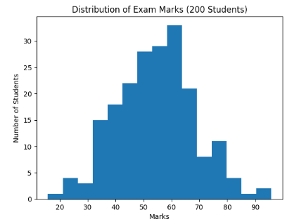
Normal Distribution
Suppose you conduct a test for 200 students.
Most students score around 50–60 marks
Few students score very low (10–20)
Few students score very high (90–100)
If you draw a graph, it forms a bell-shaped curve.
That is called a Normal Distribution.
Notes:
μ (Mean) → Average marks
σ (Standard Deviation) → Spread of marks
Most students lie near μ
Very few students lie far from μ
The histogram forms a bell-shaped curve.
Most students are clustered around 50–60 marks.
Very few students scored:
Below 20 marks
Above 90 marks
This confirms the data approximately follows a Normal Distribution.

Slide 48
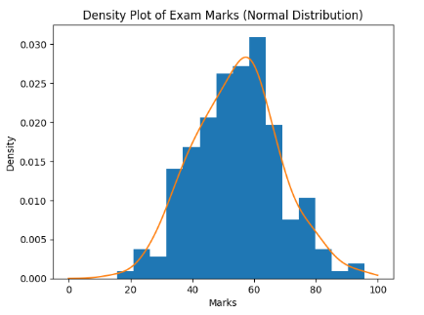
Smooth curve
Histogram (bars) → Actual student marks
Smooth curve → Density curve (KDE – Kernel Density Estimation)
The curve clearly forms a bell shape

Slide 49
Measures of shapes
Measure of shape are tools that can be used to describe the shape of the distribution of data
Skewness is when distribution is asymmetrical or lacks symmetry.
When we work with statistical problem, we must decide whether to use the mean, the median or the mode as a measure of central tendency. Symmetrical distributions that contain only one mode always have the same value for the mean, median and the mode. In that context, the choice is easy.

Slide 50
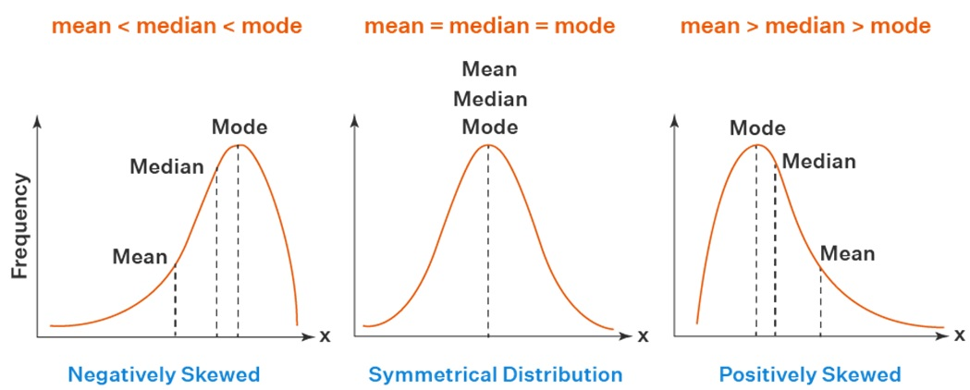
When the distributions are positively skewed or negatively skewed, the median is often the best measure of location because it is always between the mean and the mode
The median is not as highly influenced by the frequency of occurrence of a single value as is the mode nor it is affected by extreme values as is the mean.

Slide 51
Importance of normal distribution in ML
Why Normal distribution is important in ML?
If we take:
Many small random effects
Add them together
The result becomes approximately normal distribution.
Notes:
Example: Final exam marks depend on:
Study time
Sleep
Health
IQ
Question difficulty
Stress
All combined → Final score ≈ Normal distribution
This is why ML models assume normality.

Slide 52
Formal Definition
The Normal Distribution, also known as the Gaussian distribution, is a continuous probability distribution that is symmetrical about its mean and characterized by a bell-shaped curve.
It describes a distribution in which most observations cluster around the central value (mean, μ), and the probabilities for values further away from the mean decrease equally in both directions.
In a normal distribution, the majority of data points lie close to the mean, and fewer observations occur as we move farther away from it, creating a symmetric, bell-shaped curve.
Notes:
The shape and spread of the distribution are completely determined by two parameters: the mean (μ), which locates the center of the distribution, and the standard deviation (σ), which measures the dispersion or spread of the data around the mean.

Slide 53
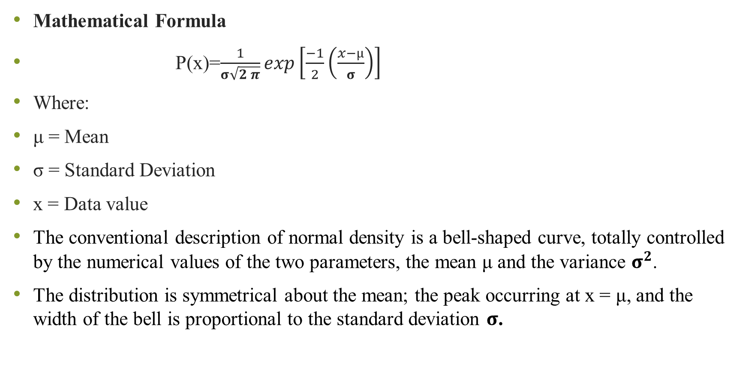
Mathematical Formula
P(x)=$\frac{1}{σ\sqrt{2 π}}exp\left[\frac{−1}{2}\left(\frac{x−µ}{σ}\right)\right]$
Where:
μ = Mean
σ = Standard Deviation
x = Data value
The conventional description of normal density is a bell-shaped curve, totally controlled by the numerical values of the two parameters, the mean μ and the variance $σ^{2}$.
The distribution is symmetrical about the mean; the peak occurring at x = μ, and the width of the bell is proportional to the standard deviation $σ$.

Slide 54
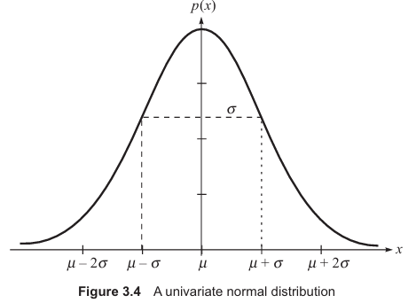
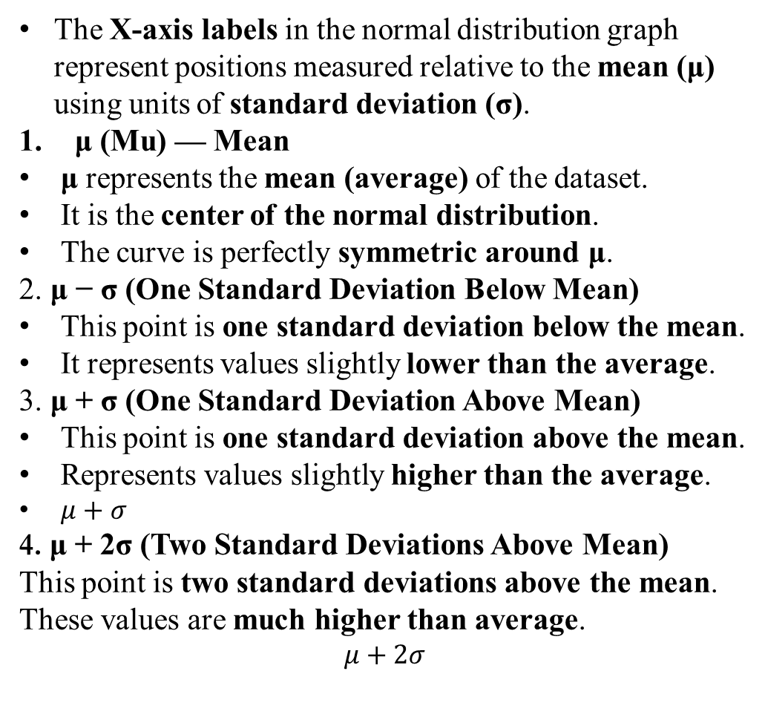
The X-axis labels in the normal distribution graph represent positions measured relative to the mean (μ) using units of standard deviation (σ).
μ (Mu) — Mean
μ represents the mean (average) of the dataset.
It is the center of the normal distribution.
The curve is perfectly symmetric around μ.
2. μ − σ (One Standard Deviation Below Mean)
This point is one standard deviation below the mean.
It represents values slightly lower than the average.
3. μ + σ (One Standard Deviation Above Mean)
This point is one standard deviation above the mean.
Represents values slightly higher than the average.
$μ+σ$
4. μ + 2σ (Two Standard Deviations Above Mean)
This point is two standard deviations above the mean.
These values are much higher than average.
$$μ+2σ$$
In Machine Learning: These labels help us standardize data (Z-score normalization) and detect outliers.
Notes:
Important Interpretation (Empirical Rule)
In a normal distribution:
68% of data lies between
$$μ−σ \text{and} μ+σ$$
95% of data lies between
$$μ−2σ \text{and} μ+2σ$$
99.7% of data lies between
$$μ−3σ \text{and} μ+3σ$$

Slide 55

Multivariate normal distribution
When we have multiple variables:
Example:
Exam Marks
Study Hours
Attendance %
Then we use:
Where:
μ = Mean vector
Σ = Covariance matrix

Slide 56
Data Similarity
Machine Learning works by answering one basic question:
"How similar are two data points?"
If two items are similar → group them together If very different → keep them separate
Why We Need Distance Measures?
Computers do not understand:
“Close”
“Similar”
“Almost same”
They only understand numbers.
So we convert similarity into a mathematical distance.
Smaller distance → More similar Larger distance → Less similar
Notes:
Real Life Example 1: Choosing Friends
Suppose you compare two students based on:
Age
Marks
Attendance
If values are close → they are similar If values are far → they are different
This “closeness” is measured using Distance Measures

Slide 57
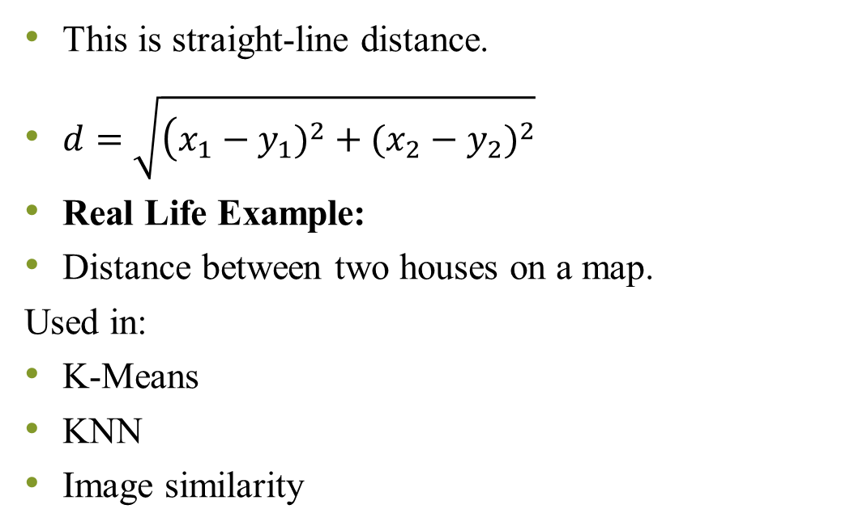
Euclidean distance
This is straight-line distance.
$d=\sqrt{\left(x_{1}−y_{1})^{2}+(x_{2}−y_{2})^{2}\right.}$
Real Life Example:
Distance between two houses on a map.
Used in:
K-Means
KNN
Image similarity
Limitations:
Sensitive to outliers
Scale problem (marks in 100 vs income in lakhs)

Slide 58
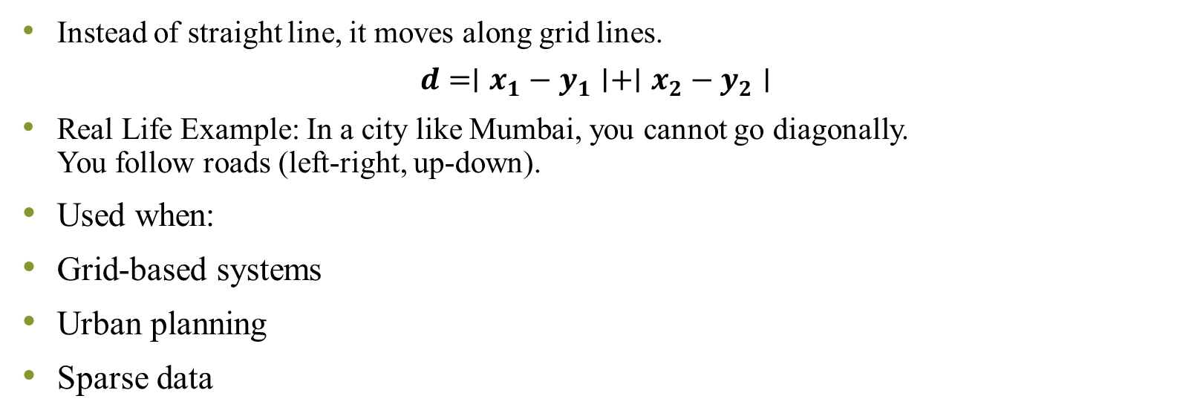
Manhattan distance
Instead of straight line, it moves along grid lines.
$$d=∣x_{1}−y_{1}∣+∣x_{2}−y_{2}∣$$
Real Life Example: In a city like Mumbai, you cannot go diagonally. You follow roads (left-right, up-down).
Used when:
Grid-based systems
Urban planning
Sparse data

Slide 59
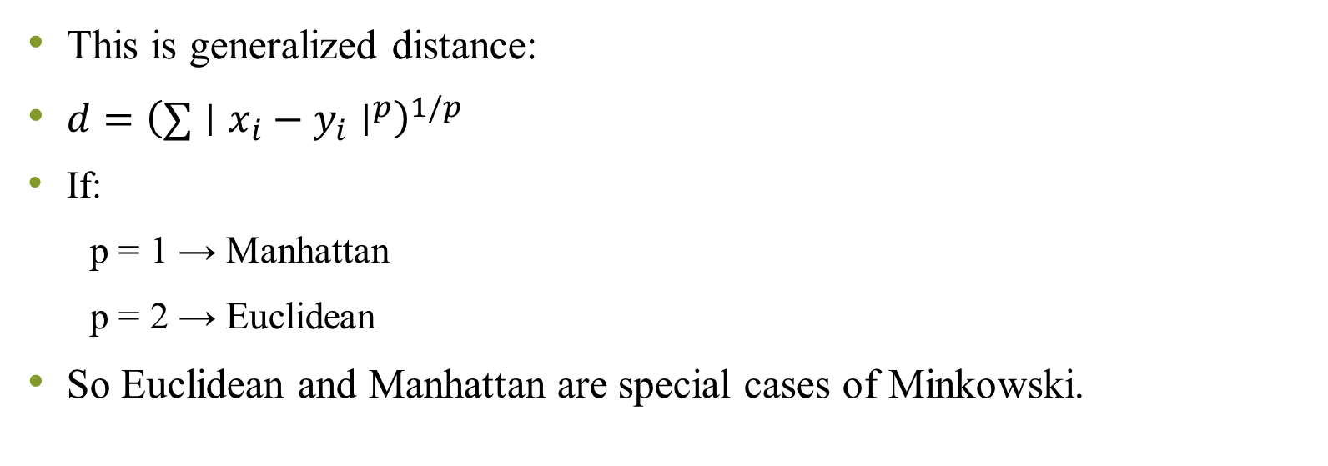
Minkowski Distance (General Form)
This is generalized distance:
$d={\left(∑∣x_{i}−y_{i}∣^{p}\right)}^{1/p}$
If:
p = 1 → Manhattan
p = 2 → Euclidean
So Euclidean and Manhattan are special cases of Minkowski.

