Slide 1
Agnel Institute Of Design And Technology Faculty Of Mechanical And Automation Engineering
COURSE NAME: CREATIVE THINKING AND INNOVATION
COURSE CODE : AEC102
ASST.PROF. S.JESSINTHA

Slide 2
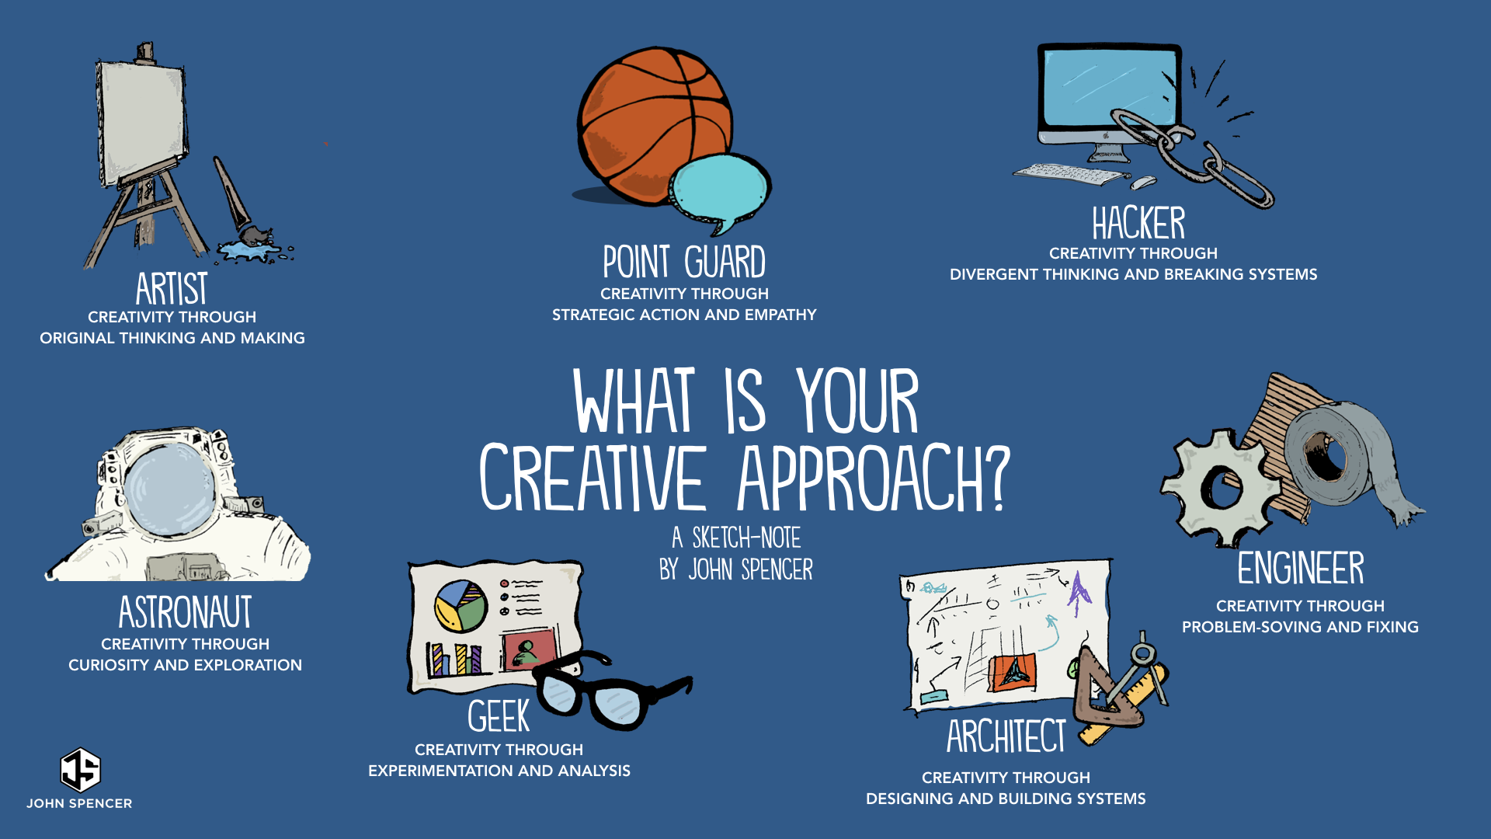

Slide 3
Unit – 3
THEORY OF INVENTIVE PROBLEM SOLVING (TRIZ)
Common features of good solutions – resolve contradiction, use available resource, increase the ideality, trade-off, inherent contradiction, 30 key TRIZ principles – multifunction, preliminary action, compensation, nested doll, blessing in disguise, segmentation, separation, regional influences, symmetry change, opaque & porous, inflate and deflate, color, recycle & recover, phase transformation, energy, imaging, environment, composition, economical, surface response, equipotential, static & dynamic, continuous & intermittent, servo systems, smart systems, dimensions

Slide 4
Introduction
The term TRIZ comes from the Russian phrase teorija rezhenija izobretatelskih zadach, which means Theory Of Inventing Problem.
Why do we need a new theory ?
Without a theory , people generate ideas by guesswork and then select the one they like or those they think other people will like.
With TRIZ you will able to generate ideas faster, and you will have a basis for selecting the best ideas, the idea that will solve your problem effectively and form a basis for further improvements.
People cannot select ideas properly, cannot produce better idea effectively if they are unaware of the common features of good solutions, resolving contradictions making use of idle resources and increasing value.

Slide 5
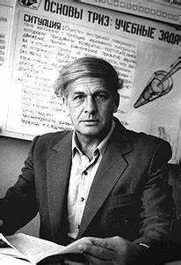
TRIZ
TRIZ (Theory of Inventive Problem Solving) is a problem-solving and innovation methodology developed in Russia by the engineer and scientist, Genrich Altshuller, in the mid 20th century. TRIZ is a systematic approach that helps identify and solve complex problems by analyzing patterns and trends in past solutions. It focuses on identifying contradictions in systems or processes and finding ways to eliminate those contradictions to achieve a better solution. TRIZ has a set of principles, tools, and techniques to help users generate and evaluate innovative and effective solutions to complex problems. It is widely used by businesses, engineers, designers, and scientists around the world.
GENRICH ALTSHULLER

Slide 6
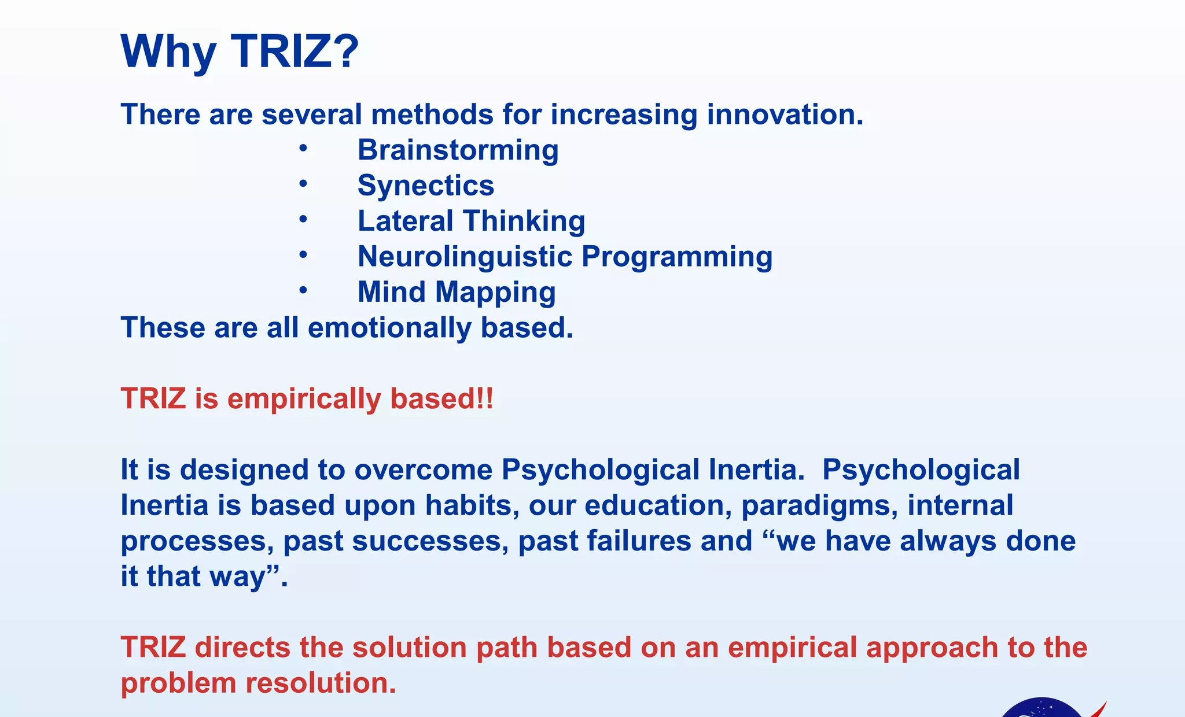
TRIZ

Slide 7
Why we need triz?
We need TRIZ , the theory based on the features of great inventions and the patterns of the evolution of systems, rather than approaches with no theory, based primarily on the emotions of the people involved.

Slide 8
TRIZ
TRIZ:-
- applies trivial solutions to non-trivial problems
eliminates unfocused solutions
TRIZ and the analytical tools developed to function within the TRIZ framework do not guarantee a problem will be solved but they do guarantee an improvement in the engineering system being addressed.
Paradigm: TRIZ eliminates categories of unworkable solutions so the professional does not have to work to find them
Advantages:
High efficiency
High predictability
Independent of psychological inertia

Slide 9
EXAMPLES OF GOOD SOLUTION
IDEA | YEAR CREATED | YEAR IMPLEMENTED
Concept Of Global Network Of Computers | 1962 | 1969
Hypertext System For Sharing Information | 1989 | 1991
Combining A Mobile Phone With Computing Capabilities | 1973 | 1994
Machines simulating human intelligence | 1956 | 1997
Battery powered vehicle | 1828 | 2008
A tool for precise genetic editing | 1987 | 2012
Using quantum mechanics for computation | 1980 | 2020

Slide 10
TRIZ
WHY DOES IT TAKE YEARS FOR EXCELLENT IDEAS TO COMMERCIALIZED
Inventor is ahead of his time
Inventor is not a good sales man
No financial support
Overbearing of popular and accepted ideas in the society
Evolution of products such as bi-cycles, watches reflects the growth of mankind

Slide 11
?
How can the inventors know what is really new and better than the old technology?
What about prejudices? Would the result be better if experts and managers were less prejudiced and more creative?
But how inventors know when to accept ideas and criticism and when to reject them?
One must select good solution from many ideas, some good and some bad.
How can we select the good solution?

Slide 12
People reject good solutions and invest in bad ones because they don’t know the difference between them.
Looking at cases of lost opportunities and great losses for business and society, people can take one two positions:
With hindsight, it is easy to see that often very good ideas are rejected and resources lost to bad ones. But obviously it is not possible to know whether the idea is good or bad when it is proposed.
Because the same patterns are repeated over and over again, we can learn from the past. The patterns of evolution can be discovered and used to get better solutions today

Slide 13
Common features of good solutions
Good features have several common features. The good idea does the following:
Resolves contradictions
Increases the “ideality” of the system
Use idle, easily available resources
Three Basic Concepts For Reaching The Best Solution
A good solution resolves the contradiction that is the cause of the problem.
There are two kinds of contradictions
Trade off contradiction
If something good happens, something bad happens too.
Inherent contradiction
I want that one thing but that has two opposite properties

Slide 14
Trade off contradiction
When something gets better, something else automatically gets worse.
For example:
The product gets stronger (good), but the weight increases (bad).
Service is customized to each customer (good), but the service delivery system gets complicated (bad).
Training is comprehensive (good), but it keeps employees away from their assignments (bad).

Slide 15
Physical (or "inherent") contradictions
Physical (or "inherent") contradictions:-
These are situations in which an object or system suffers contradictory, opposite requirements.
Everyday examples include:
Software should be complex (to have many features), but simple (to be easy to learn).
Coffee should be hot (to be enjoyed), but cool (to avoid burning the drinker).
An umbrella should be large (to keep the rain off), but small (to be maneuverable in a crowd).

Slide 16
Common features of good solutions
2. The “ ideality” of a system is the measure of how close it is to the perfect system. The perfect system ( called the “ideal final result” in TRIZ) has all the benefits the customer wants, at no cost, with no harmful effects. So a system increases ideality when it gives you more of what you want or less of what you don’t want, does it at lower cost and usually with less complexity.
3. Unseen idle resources of the system are used to reach these seemingly incompatible goals. These EXISTING resources include energy, materials, objects, information or things that can be made easily from the resources that are in the system or nearby.

Slide 17
FEATURES OF GOOD SOLUTION
SOLUTION
IDEAL FINAL RESULT
RESOURCES
CONTRADICTION
PROBLEM

Slide 18
REORGANIZATION OF CREATIVE ACTIVITY
Old way of working
Trial and error
Contradictions are hidden
Adding resources
Compromise
Evolution is considered accident
New way of working
Systematic work
Contradictions are clarified
Using available resources
Ideal final result
Knowledge of the patterns of evolution

Slide 19
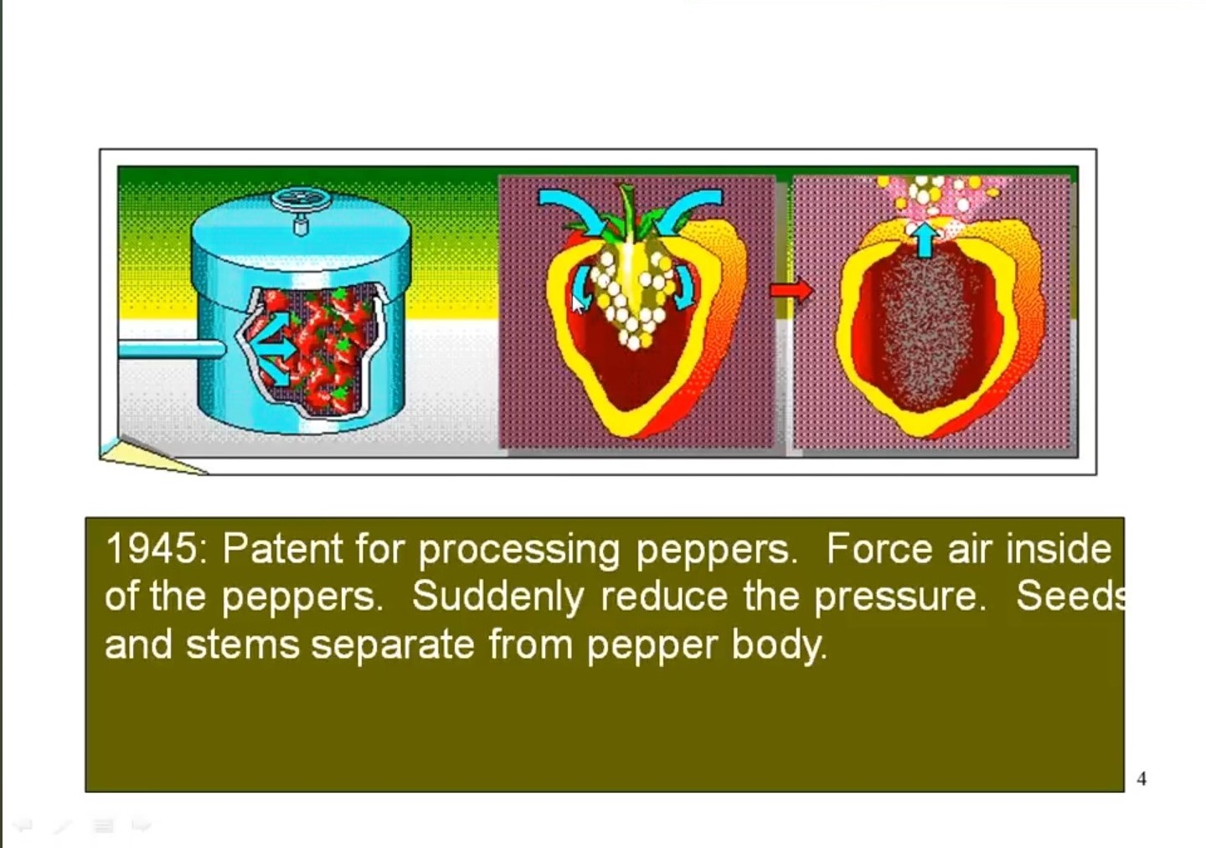

Slide 20
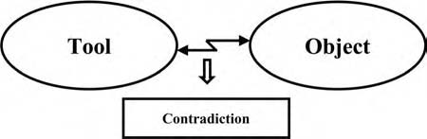
RESOLVING CONTRADICTIONS
One of the early insights of the TRIZ researchers was that solving a problem meant removing a contradiction.
Resolving contradictions in a system causes the development of the system
A contradiction is a conflict in the system.
A system consists of two components: tool (T) and object (O).

Slide 21
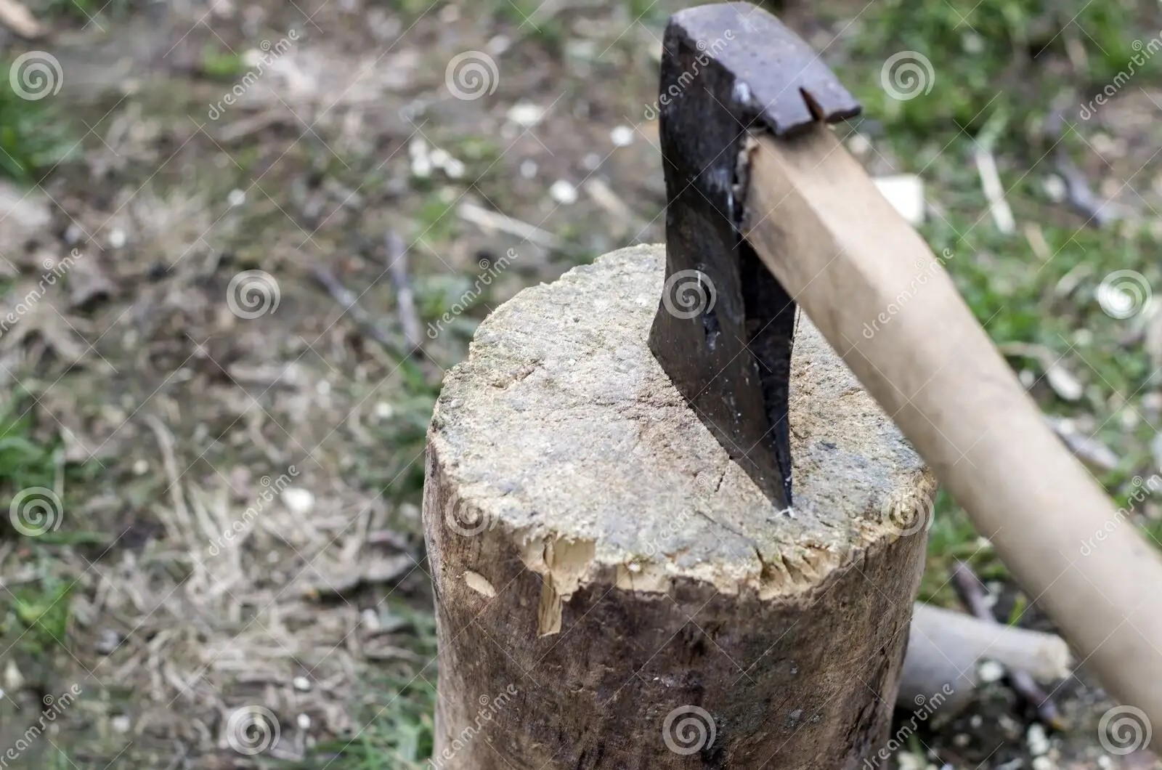
RESOLVING CONTRADICTIONS
The edge of the ax blade, is a tool that splits the object, a chunk of wood.
Splitting power is a good feature that is connected with harmful properties, such as the clumsiness of the tool.
If you make the blade heavier, the ax can strike a more effective blow, but it becomes more awkward to handle
We meet contradictions .

Slide 22

RESOLVING CONTRADICTIONS
For example, a company wants to improve business by improving customer service and decides to get better service by increasing staff training.
Training is the T that is used to improve a certain O: the professional quality of employees. If employees get extensive and thorough training, service surely can be improved, but the time loss might be intolerable. We get a contradiction: the better the service, the more training time is needed

Slide 23

RESOLVING CONTRADICTIONS
Think of a seesaw, When one end of the plank goes up, the other goes down. You cannot get both ends to go up at the same time.
In this case, the connection of features (up-down) is not a problem having one end go up when the other goes down is a natural property of a seesaw.
If you do not want the experience of going up and down, you will need to choose a different toy or make some major changes to the seesaw system.
Sometimes the clear formulation of the contradiction suggests a possible answer to the problem.

Slide 24
RESOURCES
Usually, however, additional information is needed.
Resource analysis helps you find ways to resolve the contradiction.
Resources are things, information, energy, or properties of the materials that are already in or near the environment of the problem.
If they can be used directly or modified to make them useful, the problem will appear to have solved itself.
Think of the resources as the reserves—they are invisible at first, because we are accustomed to not seeing them when we look at the problem situation, but we can mobilize these reserves to solve the problem.
Mapping the resources.

Slide 25
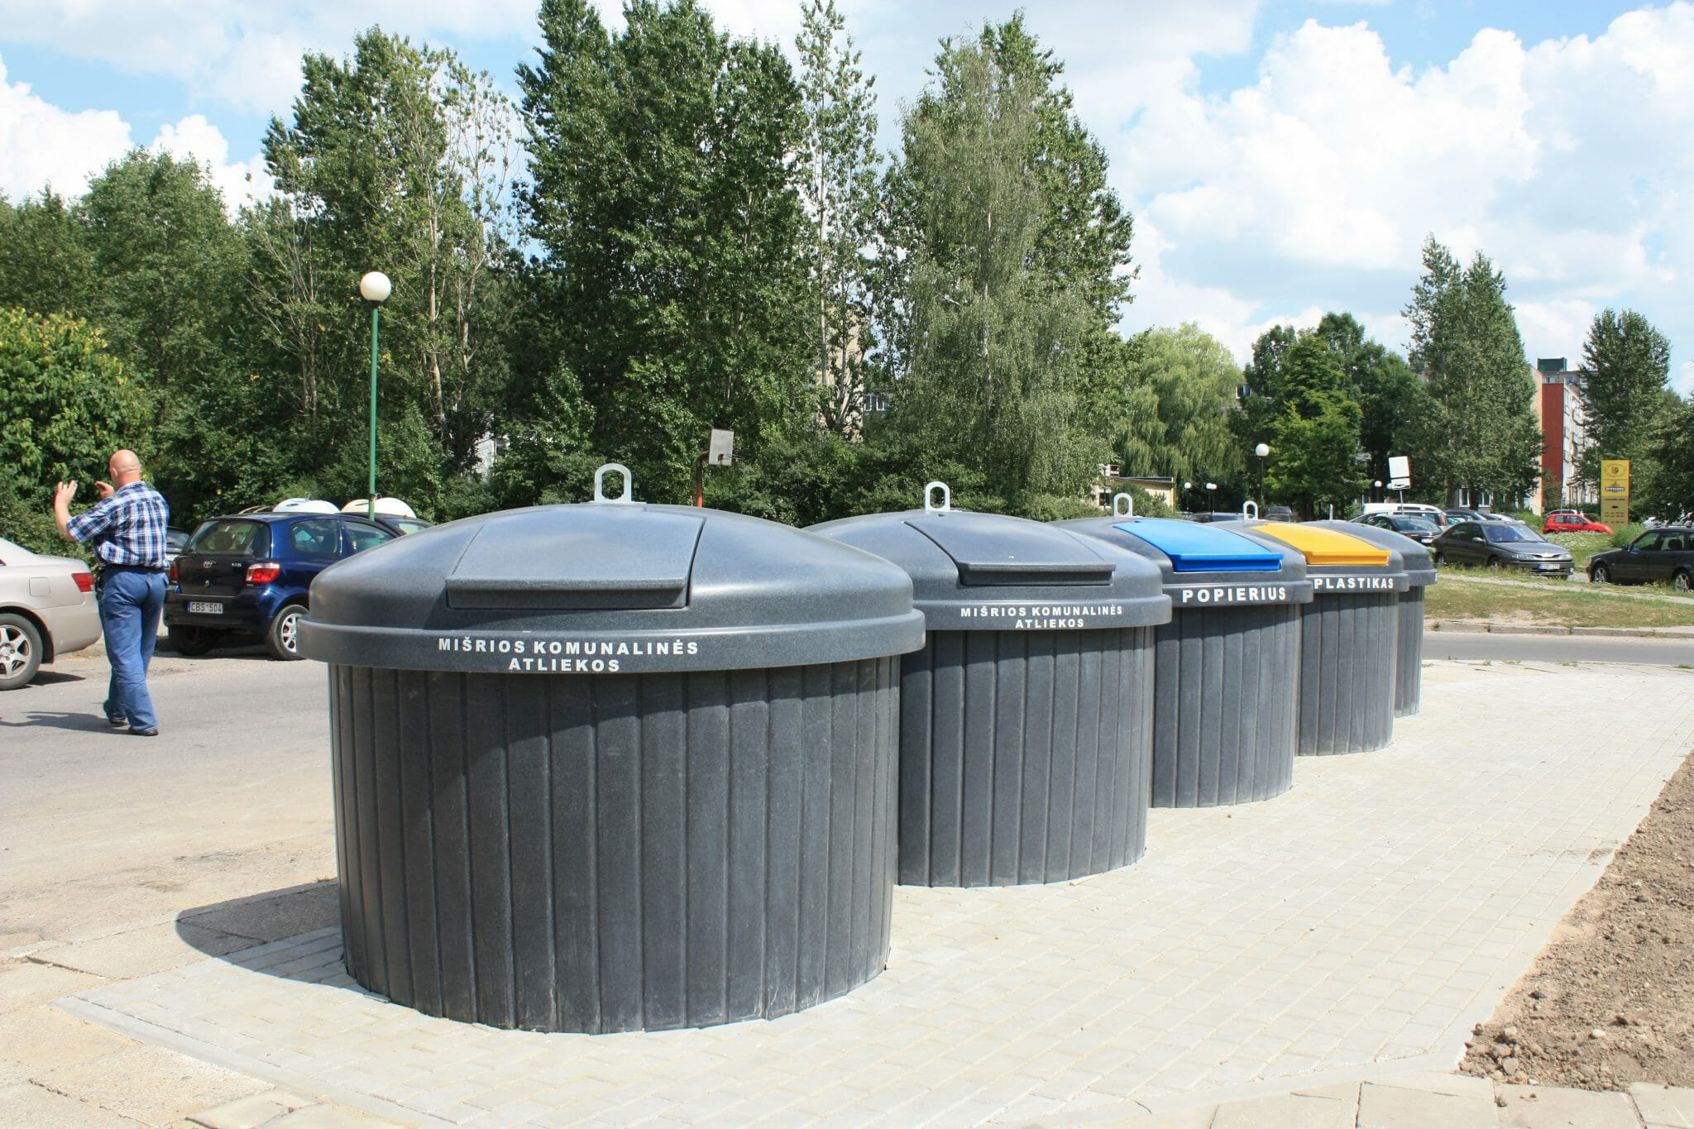
RESOURCES
For example, a garbage bin that was partly hidden underground. The needed change was achieved using the space beneath the bin.
In the ax example mentioned earlier, we need to change the system so that splitting power is improved, but the ax does not get more difficult to use.
The resources in the ax and chunk of wood system are the blade, its edge, form, material, and other properties, the handle and its properties, the chunk of wood and its properties, the surrounding air, and so forth.
Depending on how the system is defined, we can also include the person whose arm provides the energy and whose hands provide the transmission of energy to the ax.

Slide 26
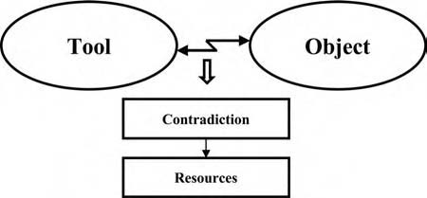
RESOURCES
In the training example, the curriculum, its structure and properties, skills of teachers, textbooks, the motivation, and existing knowledge and skills of the students are all resources, as well as the culture of the company and the physical environment of the training.

Slide 27
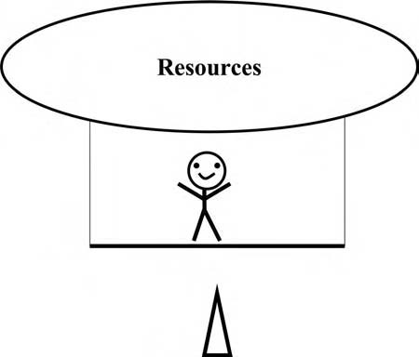
IDEALITY
Imagine that both ends of the plank forming the seesaw go up by virtue of resources. If the child’s resources included some rope, a tree, and a strong parent, both ends of the plank could go up at the same time.
The seesaw analogy of the ideal final result. Both ends of the plank go up.

Slide 28
IDEALITY
The blow struck by the ax should be made stronger, but, at the same time, the tool should remain easy to use. To split the chunk of wood, the ax should be heavy, but, at the same time, for ease of handling, the ax should be light.
The ideal final result can now be described as follows: something changes the ax in some way so that it is both heavy and light, for the double purpose of making the blow stronger without decreasing the ease of use.
The ax marketed by Fiskars solves this problem by using a hollow handle. Air is used as the resource that solves the problem.
The hollow handle gives an unexpected new quality. The center of gravity moves nearer to the blade. The blow is more powerful, which could be thought of as heavy, although the tool is lighter.

Slide 29
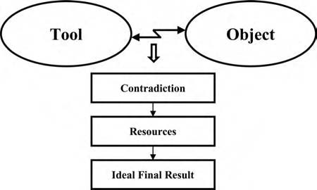
IDEALITY
“Ideality” is the measure of how close the system is to the ideal final result. If the useful feature improves, the ideality improves. If the harmful feature lessens, the ideality also improves.
To solve the problem, look for resources already in the system that can help the useful feature get better or the harmful feature be reduced—or vanish entirely.
The ideal final result is the solution that resolves the contradiction without compromise. Resources are used to go from the contradiction to as perfect a solution as possible.

Slide 30
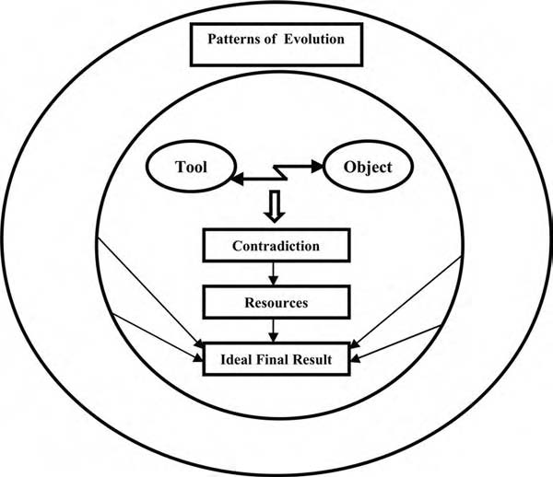
PATTERNS OF EVOLUTION
The patterns of evolution have multiple uses: they support the tools for problem solving, help to get solutions directly, and can be used for the prediction of the future features of technology.

Slide 31
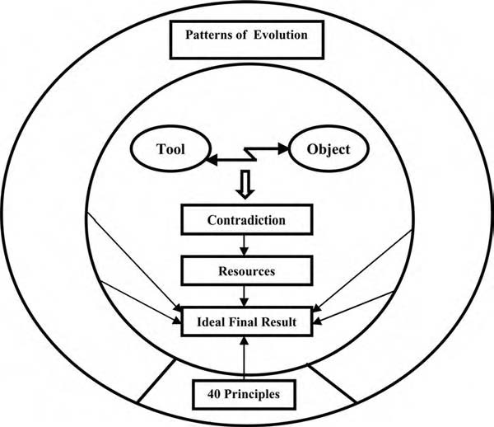
INNOVATIVE PRINCIPLES
Forty innovative principles give clues for finding ideas. They can be used both as independent tools and to support other methods.

Slide 32
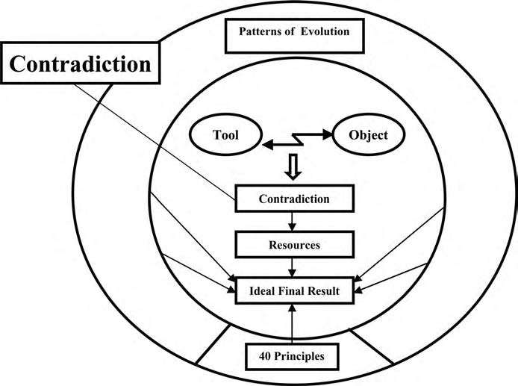
CONTRADICTION

Slide 33
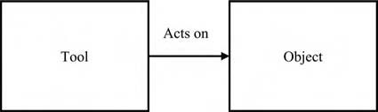

TRADE OFF CONTRADICTION
Contradictions are at the core of the most challenging problems
TRIZ is a new approach that sees contradictions (tradeoffs and inherent contradictions) as sources of development.
We analyze the conflict between two features.
Resolving conflicts is the rationale behind successful inventions and innovations.
These are frequently called “tradeoffs” because the problem solver trades improvement of one feature against decline in another feature in the hope of finding a solution to the problem.
The tradeoff arises in a system consisting of a tool and an object. All engineering systems (and many others that would not be considered engineering systems) are built from tools and objects.
It is useful to formulate problems and tradeoffs on more than one level. The selection of the tradeoff depends on the constraints and conditions of the problem
Tool, action, and object diagram that defines a system.

Slide 34
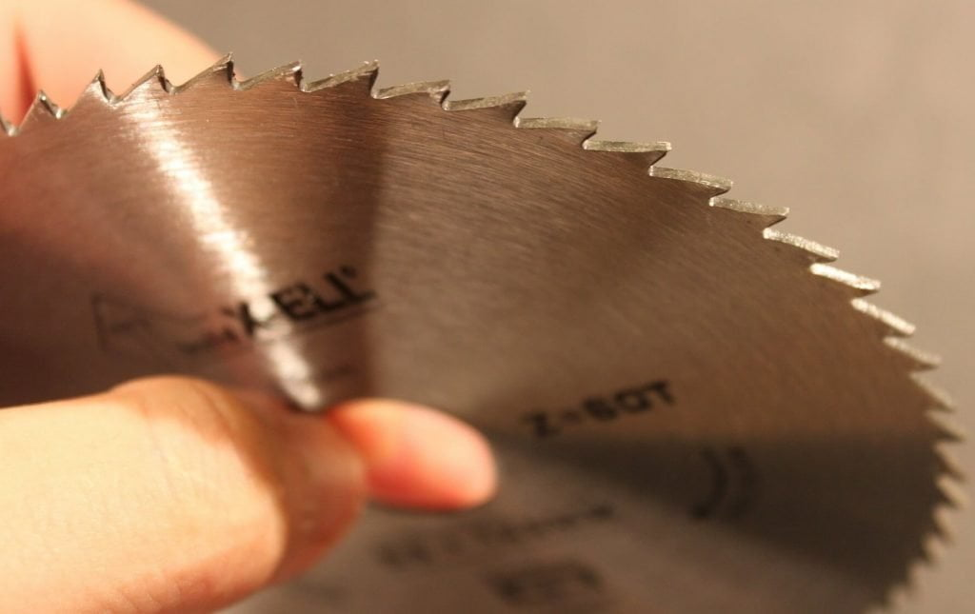
DEFINING THE TOOL AND OBJECT
A car is a tool for carrying passengers and cargo.
A transistor is a tool for switching electrical current on and off.
A bee is a tool for collecting pollen.
Knowledge, models, and information are also tools.
An advertisement is a tool to inform potential buyers.
The tool is the component that is easiest to change when the problem is resolved
Action means that the tool does something that causes the object to change
If the problem is how to decrease the wear of a saw that cuts metal, there are many possibilities change the sharpness or the shape of the teeth, put coatings of tougher metal on the teeth, change the thickness of the blade, add a lubricant during cutting, and so on. The metal being cut (the object) most often cannot be changed or can be changed very little.
The object, on the other hand, gives constraints for the change of the tool. The material being cut limits the choice of cutting tool. Sometimes the object, too, can be changed in some way, for example, many objects can be combined—it may be easier to cut a stack of glass plates than a single thin sheet of glass.

Slide 35
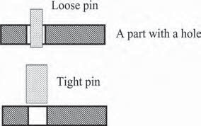
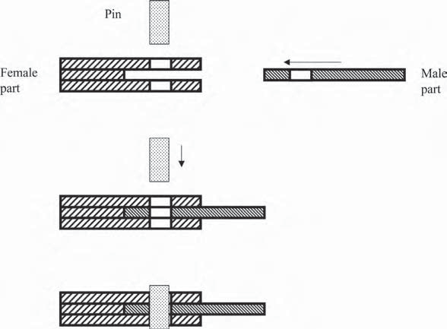
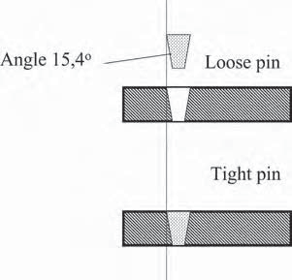
The statements of problem and solving the problem become much easier
when the tool and the object that are at the heart of the problem are isolated from the numerous other components of the system.
For example, many gates are locked by a latch mechanism.
A part with a hole
Pin
Limiting the view in the latching mechanism problem
Angle 15.4°
Tools and objects in the latching mechanism
The principle of solution of the locking mechanism problem

Slide 36
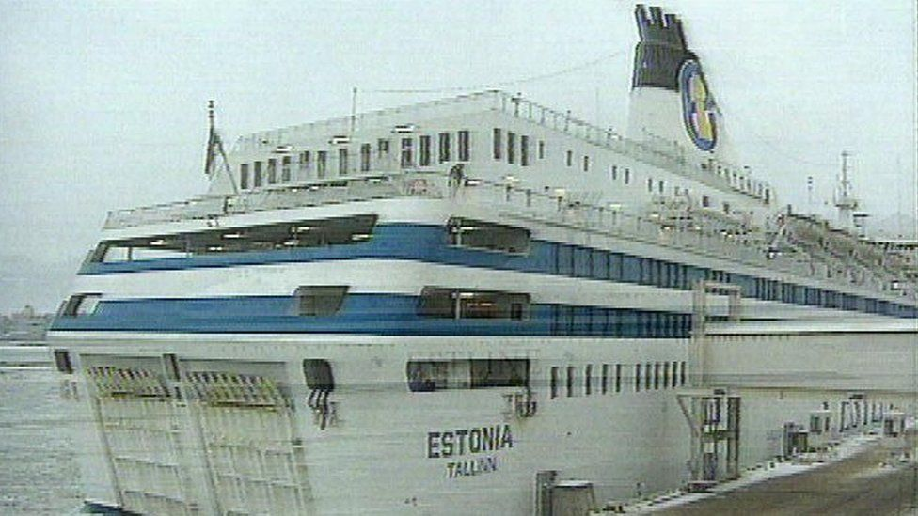
In 1994, the ferry Estonia sank in the Baltic Sea and 852 persons lost their lives. The investigating commission found that the reason for the disaster was failure of a locking mechanism.
The locking mechanism reduces the amount of force needed to initially open a gate or hatch.

Slide 37
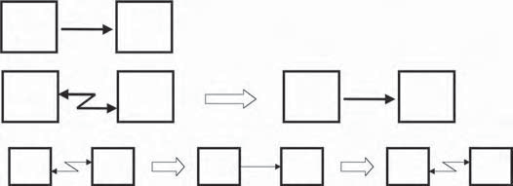
Tradeoffs Everywhere
The tradeoff may appear clearly as a harmful action that accompanies a useful action. In the cutting tool, the edge works the material, but at the same time heats it.
The car transports people and cargo, but the noise of the car disturbs people and exhaust gases pollute the atmosphere. The transistor produces harmful heat while it does beneficial switching.
There are tradeoffs in the system even when there are no visible harmful effects. To generalize, the system is bad simply because it exists.
Tool
Object
Tool
Object
Tool
Object
T
O
T
O
T
O

Slide 38
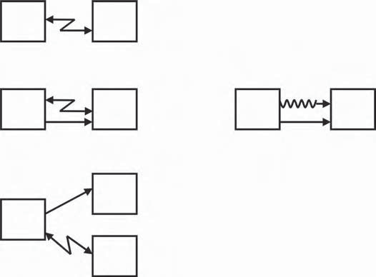
To have the capability of acting on the object (useful feature), the tool has dimensions and weight, consumes energy, and has other features that engender cost and harm.
When the tradeoff is removed, you might think that the perfect system or the ideal final result has been achieved. This achievement, however, is relative and temporary.
New tradeoffs appear soon, either in the system itself or in other systems that are affected by it. Every new generation of transistors has occupied less space and consumed less energy than the previous one, but the higher density of transistors on the new chips requires more and more complex systems for connection and for heat dissipation.
The electric car eliminates petrochemical pollution, but increases the problem of battery production and disposal.
Tool
Object
Edge
Material
Edge
Material
Cargo
Car
Road

Slide 39
FEATURES
Features and actions can describe tradeoffs. It is simplest to describe features. Most often, the development of a product means the improvement of the features. Usually, the user does not need the product itself, but needs the features.
How can we improve a muffler in the conventional lawnmower powered by an internal combustion engine? List the features of the muffler:
Dimensions
Weight
Noise absorption capacity
Ease of manufacture
Form, outer appearance
How can we thin out carrot seedlings in a small home garden? List the features of the thinning technology:
Speed
Precision
Ergonomic level
We have spoken of the latch mechanism. How can we improve the pin? List the features of the pin:
Dimensions
Form
Surface quality, manufacturing precision
Ease of manufacture
Ease of locking and opening
Reliability

Slide 40
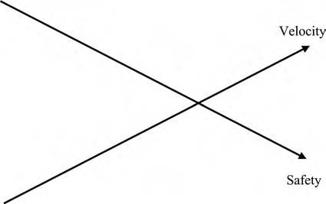
The Tradeoff between Features
The tradeoff between tool and object shows where the problem lies. It is useful to express the tradeoff as a conflict between two features. When the velocity of the car increases, safety worsens.
When the velocity of the car increases, the consumption of fuel also increases.
We can use the features to describe the current state of the system and we can use them to describe the system that we want. If there is a conflict between the features or a tradeoff, we can use TRIZ to remove the tradeoff and create the new, improved system.
What is the function of a water tap? Is it to control water flow? “Control” is an extremely general verb that does not tell how to detect the function of delivery of water. “To stop water” or “to regulate water” both define only one-half of a function. In contrast, one can easily list essential features of a water tap: water flow, reliability, ease of use, decorative appearance, and others. Therefore, we will use features rather than functions for most of our examples.

Slide 41
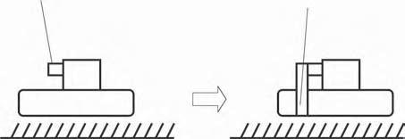
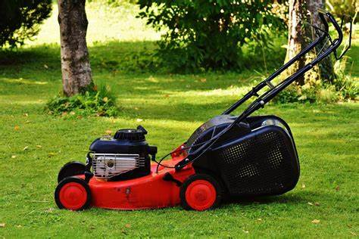
WHERE DOES THE TRADEOFF APPEAR?
Old design New design
The problem statement is like the answers to a journalist’s questions: who, what, where, when, why, and how. Answering the questions may reveal the tradeoffs. The level of the system is important, too. The system contains some parts of lower level and is itself a part of the higher-level system or macrosystem
The muffler of the lawnmower is a system containing at least two subsystems: a casing and porous absorbing material. The muffler itself is a part of the lawnmower
The level of the muffler: The lower the level of noise, the thicker the layer of porous material. One possible way to decrease noise without thickening the muffler is using noise cancellation
The level of a garden (or yard or park): The system contains at least the lawnmower and grass.
The level of the lawnmower: This system contains casing, engine, exhaust tube, muffler, and other parts of the lawnmower. If noise is decreased using the muffler, the lawnmower becomes more complex.

Slide 42
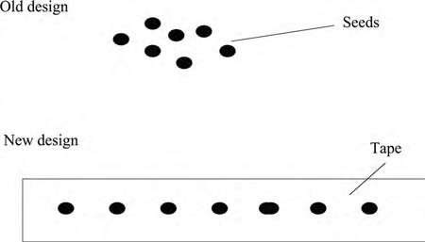
When Does the Tradeoff Appear?
Carrots are cultivated in a small home garden. The initial problem is how to make the thinning of carrot plants easier. Thinning is necessary so that there will be enough space between the plants as they mature to allow each plant to get enough nutrients and water.
Seeding: If every seed is planted precisely in the right place, no thinning is needed. If one plants seeds very simply by hand, much time is needed. Time can be saved using seeding equipment, but then the drawback is the existence of the equipment, its cost, storage, maintenance, and such.
Thinning: The same tradeoff as in seeding — thinning can be mechanized in some way and time saved, but the system becomes complex.
There is one beautiful solution that makes seeding simple and thinning unnecessary. Seeds are fixed on a biodegradable tape.
Sometimes a good solution is found in another stage of the process. That is why it is useful to formulate tradeoffs in different process stages.

Slide 43
How to Decide Whether to Develop the System or Remove It
How to Identify the Right Problems to Solve
Finding the best problem to work on means selecting a relevant conflict from many tradeoffs. First, consider the available time and resources. In principle, there are many alternatives
The elimination of a part or operation means, in most cases, that some useful features and functions will disappear. By suggesting the removal of a part of a system or a process, we have created a tradeoff. If we can formulate the tradeoff explicitly, and then resolve the tradeoff so that the system will have fewer parts and operations and more useful features, we will have significantly improved the system. Conventional thinking often stops before considering this kind of tradeoff.
Sometimes one can solve the problem by going to the past (see the example of carrot cultivation) or to the future and sometimes not.
Second, the problem appears between certain components. That simplifies the choice of the problem. You simply select the components touched by problems
Removing the component or operation is not always possible. Often, some other solution for the tradeoff is needed, but this method, thinking about what would happen if we removed the component or operation, helps to find the real problem.
State the problem that seems to be most reasonable based on existing knowledge and try to solve it. During the attempt to get the solution, new obstacles, as well as new opportunities, will appear. This new knowledge allows us to modify the problem statement.

Slide 44
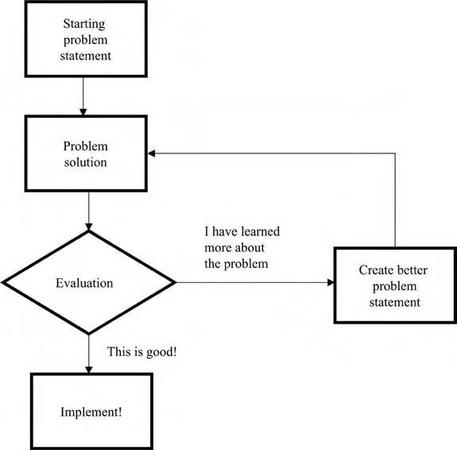
From the Problem to the Tradeoff
There are five steps for the clarification of a problem:
Describe pairs of tools and objects and the action that links them. Select one pair. Explain why you picked this tool and object.
Describe features and conflicts between them.
Select one tradeoff.
Explain why you identified this tradeoff.
Describe the tradeoff graphically and in words.

Slide 45
Inherent Contradiction
The crazier the conflict you imagine, the better solution you get the formulation of the inherent contradiction helps to get the best solutions because it helps find the key problem.
There are always many problems and tradeoffs, but not all problems are equally important. One problem is key. The solution of this problem leads to the solution of other
How to formulate the inherent contradiction?
Instead of the two conflicting features that we worked with when we used the tradeoffs, we will have only one feature with incompatible values (big–small, many–few, long–short, much–little)
Second, we describe how to intensify the contradiction further. Often the contradiction can be made sharper, even more bizarre, which will help point the way to good solutions. The third section presents examples of how to go from the visible drawback to the intensified inherent contradiction
Real problems frequently are not simple, and there are conflicts within each object, as well as between them.
The solution of the inherent contradiction removes many problems and gets many benefits at one stroke.

Slide 46
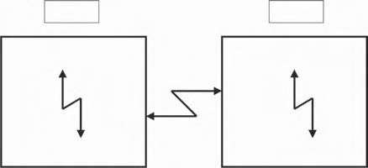
HOW TO FORMULATE THE INHERENT CONTRADICTION
Real problems frequently are not simple, and there are conflicts within each object, as well as between them
Tool
Object
Conflicts within and between components.
Tradeoffs (between components) may be difficult to solve directly because the components should have two opposite properties
Generally, to improve feature A, an element should have a certain property, but to improve feature B, the same element should have the opposite property.
Just the formulation of the inherent contradiction, incompatible values of the same parameter, can guide us to ideas for solutions, as we can see in our examples. In the lawnmower noise problem, we had a tradeoff: if noise absorption improves, the size of the muffler increases. We can easily formulate the inherent contradiction “big muffler–small muffler.”

Slide 47
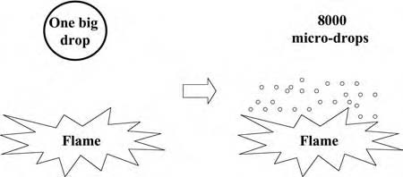
Using water to fight fires is a technical example the more water used, the more equipment needed. If the fire is put out, large amounts of water can damage the parts of the building that were not damaged by the fire. In some cases, the water does more damage than the fire. The inherent contradiction is “much water–little water.”
Water is atomized and sprayed in very small micro drops, or mist. Much less water is needed to extinguish the fire and there is much less damage caused by the water itself. Of course, there is the new contradiction in the complexity of the atomizing equipment. That contradiction is partially eliminated by virtue of decreased water flow and high pressure the size of tubes and other equipment can be decreased
The same volume of water gives 8000 times more drops than a conventional sprinkler and 200 times more than low-pressure mist equipment. Because the extinguishing efficiency depends mainly on the number of drops, pipe sizes can be radically decreased.
The conflict “much water–little water” resolved.

Slide 48
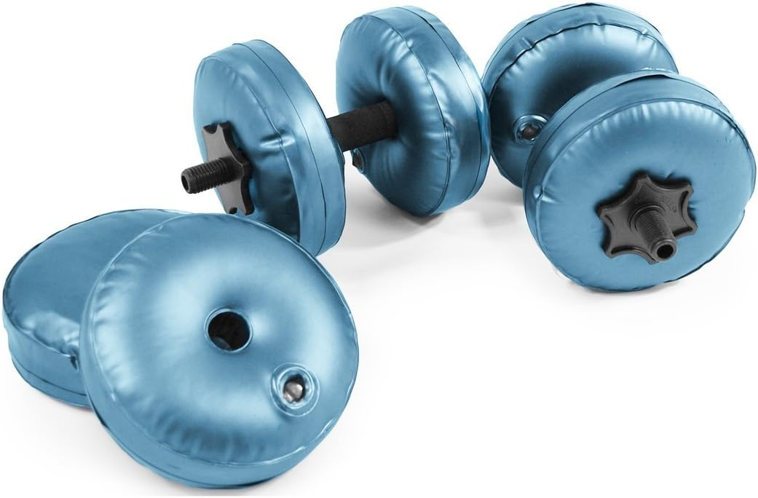
Present and Absent
How to Intensify the Inherent Contradiction
One important group of inherent contradictions is made up of situations in which the object should be present to get some useful feature and absent to keep the system simple.
We can sometimes make the internal conflict we just formulated much stronger. This will make the problem seem unsolvable you might think this is a bizarre technique, but it can lead to great solutions.
Tradeoff: A spare tire in the car increases reliability (+) but occupies space (–).
Inherent contradiction: A spare tire should be present and absent. One beautiful solution is to use the normal tire as the spare by making it able to survive a blowout (inherent contradiction solved), rather than making the separate spare tire smaller, as in some cars (compromise).
The airplane is heavier than air (more dense) yet, in some sense, lighter (thanks to the lifting force).
The transistor can be a conductor and an insulator at different times.
Biodegradable materials are present and exist (at certain times) and become absent and nonexistent (at other times).
These examples show how the TRIZ technique of forcing the contradiction to the extreme can be a technique for breakthrough. Analyzing the extreme contradiction helps one break out of conventional thinking into the realm of ideas that get rid of the contradiction and solve the problem.
If you have an existing solution to the problem that needs minor improvement, go ahead and improve it

Slide 49
Reducing Lawnmower Noise: Intensifying Contradiction
Cultivating Carrots: Intensifying Contradiction
Modeling Steps | Example: Reduce Lawnmower Noise
Visible drawback | The lawnmower is too noisy
Tradeoff: the conflict between two features | When noise absorption improves, the size of muffler and number of parts increase
Inherent contradiction | Big muffler–small muffler
Intensified inherent contradiction (if it can be intensified) | Big muffler–no muffler
Modeling Steps | Example: Make It Easy to Grow Carrots
Visible drawback | Thinning of carrots is an arduous job
Tradeoff: the conflict between two features | The more precisely carrot seeds are planted, the slower the speed
Inherent contradiction | Many seeds–few seeds
Intensified inherent contradiction (if it can be intensified) | Very many seeds–one seed

Slide 50
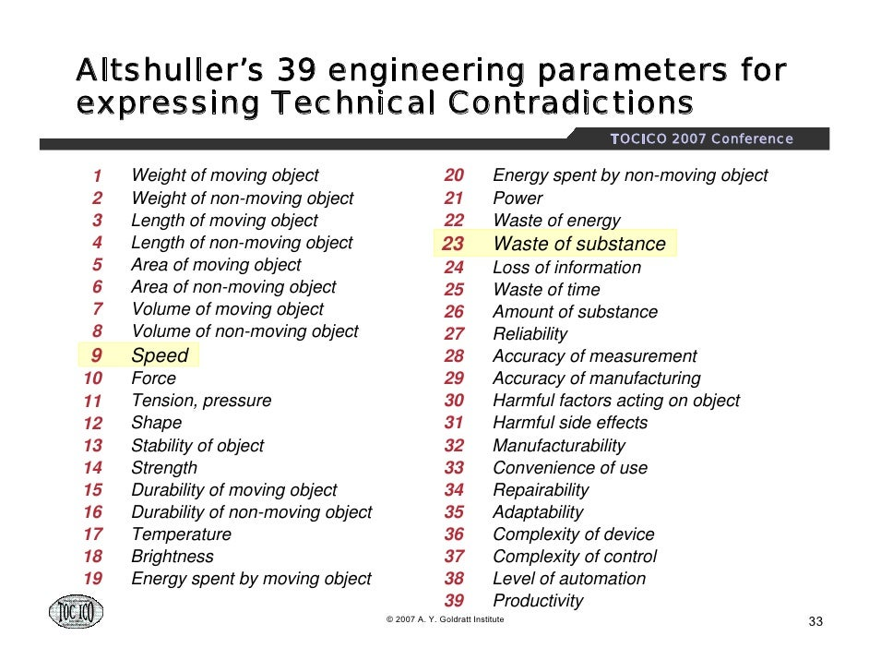

Slide 51
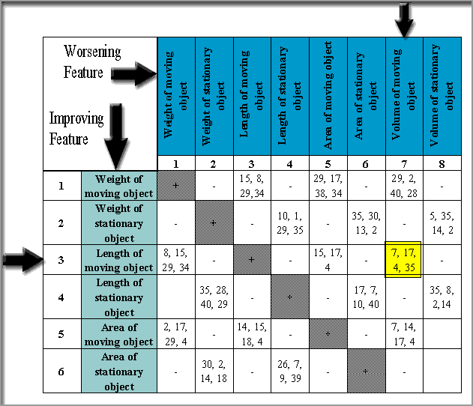

Slide 52
Principles for Innovation: 40 Ways to Create Good Solutions
Understanding the common features of good solutions is crucial to the enhancement of creativity. One obvious conclusion is to simply make a list of the most important features and then use the list for generating bright ideas and successful products.
Good generic solutions across industries have been studied as part of the development of TRIZ. Altshuller and his researchers collected examples of repeated use of the same solutions from patent information. After painstaking work, the information on tens of thousands of good solutions was boiled down to 40 principles in the early 1970s.
The efficiency of the 40 principles increases when they are used together with other tools. Patterns of evolution, ideality, and contradiction analysis may give the same solutions or may give different solutions from the 40 principles considerable overlap is quite common. The tools strengthen and enrich each other.

Slide 53
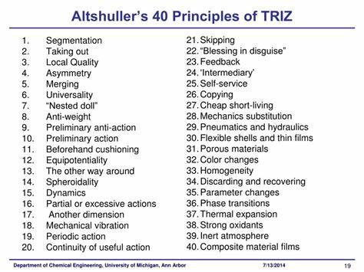

Slide 54
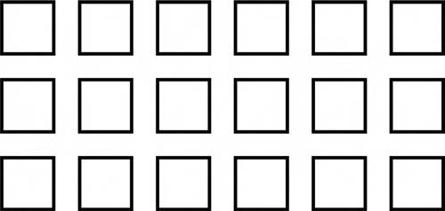
Segmentation
Segmentation. Fragmentation. Transition to microlevel.
Divide an object or system into independent parts. Make an object easy to disassemble. Increase the degree of fragmentation or segmentation
It helps to “combine the incompatible” and meet contradictory requirements in many different problems
Principle 1: Segmentation. Divide a system into parts.
Segmentation is a good and often accessible way to use resources. The system can be divided into smaller parts. New components and substances are not needed.
More effective firefighting (good) requires more water and causes water damage (bad). Water is necessary and, at the same time, there should be no water. Let us segment water to small droplets and then increase the degree of fragmentation to mist. Mist can suppress fire effectively, using a very small amount of water.

Slide 55
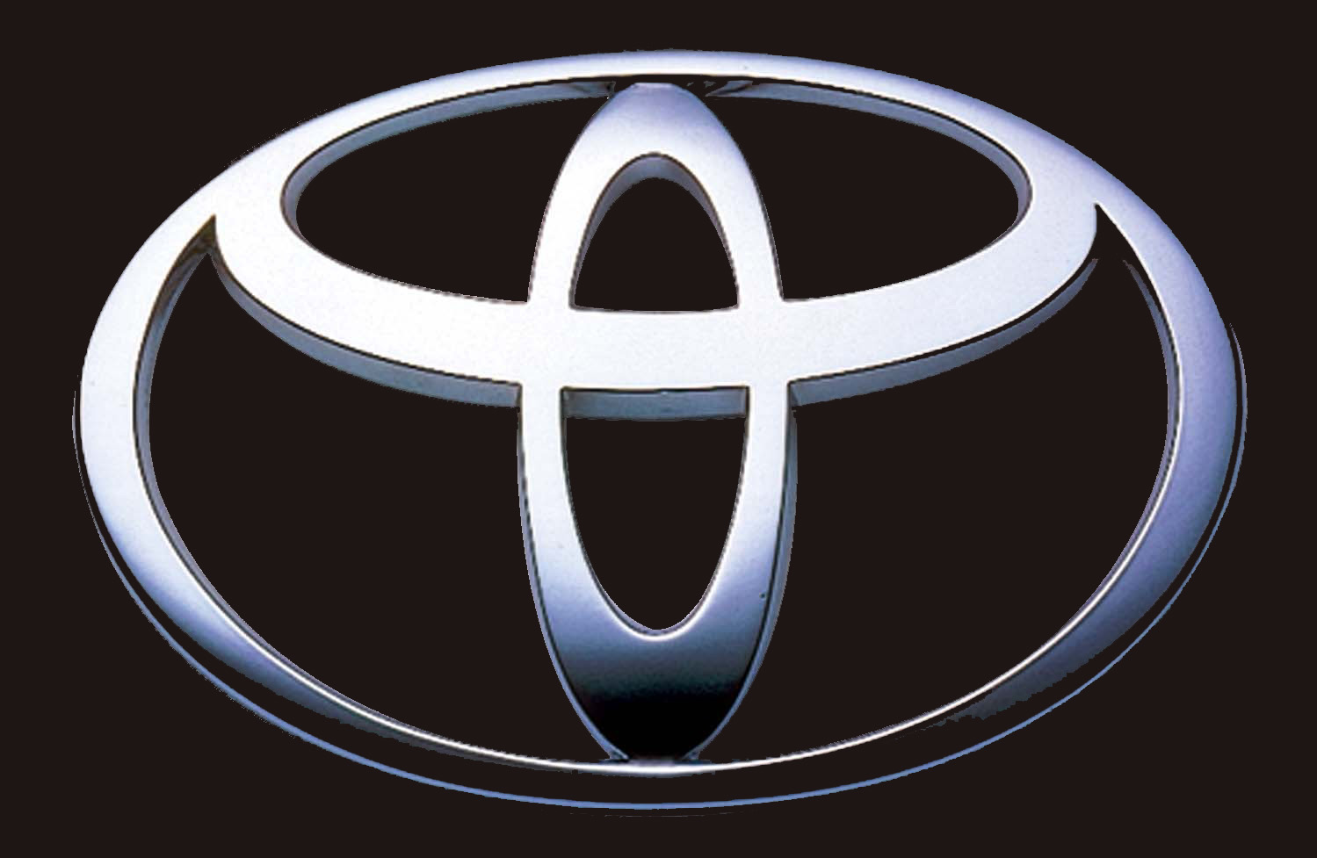
The segmentation principle has many applications in business. The segmentation of the market is a common practice and a commonly used term. Most big corporations have segmented themselves into business units or profit.
A corporation should be small to be flexible and big to have enough resources for production and marketing. To be small and big at the same time, a huge company is divided into subsidiaries, profit centers, or other units working relatively independently.
ABB and the Gore Corporation are exemplary they create a new organization whenever an existing part of the company exceeds 150 people
A large job can be broken into many smaller jobs (called “a work breakdown structure in project management”).
The JIT (just-in-time or Kanban) system uses the concept of segmentation to an extreme it replaces the idea of mass production with the idea that the most efficient production system can produce a single unit just as easily as multiple units

Slide 56
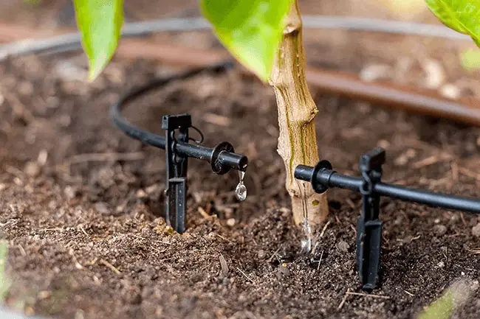
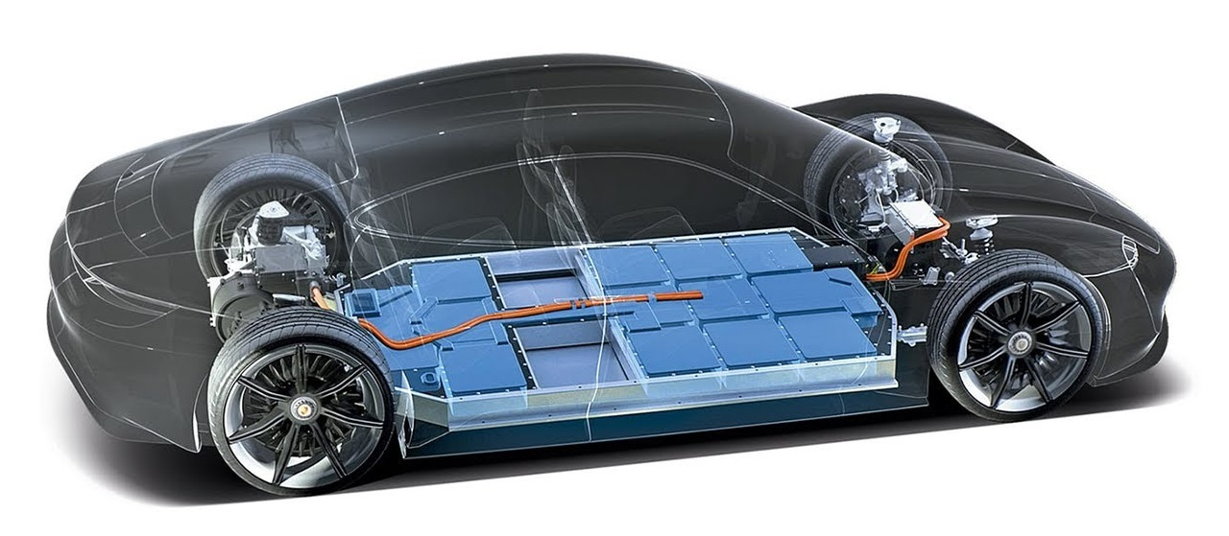


Slide 57

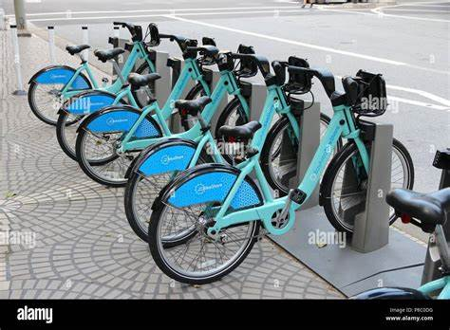
2. SEPARATION:
Separate the only necessary part (or property) or remove an interfering part or property from an object or system. We usually need only a part of the system or some property or feature
Separate a part or property from a system
New shared-use schemes are emerging, at least on an experimental level. The user buys the right to use a car or a bicycle for a certain time. . These experiments give us transportation capacity, individual routes and schedules, comfort, prestige, certain lifestyle and many other features, but separate the use of the automobile from the ownership, care, and cost of a ton of metal and plastic. The proponents of these new schemes claim that a customer can actually have many cars by not owning any.
The ASP (application system provider) is a new business concept many companies do not own their own software, but rent it as needed from a provider.

Slide 58


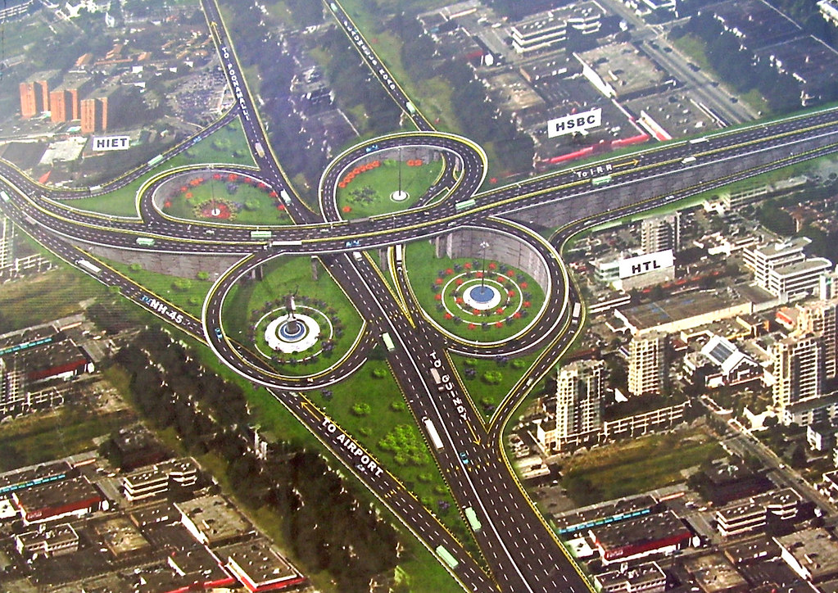
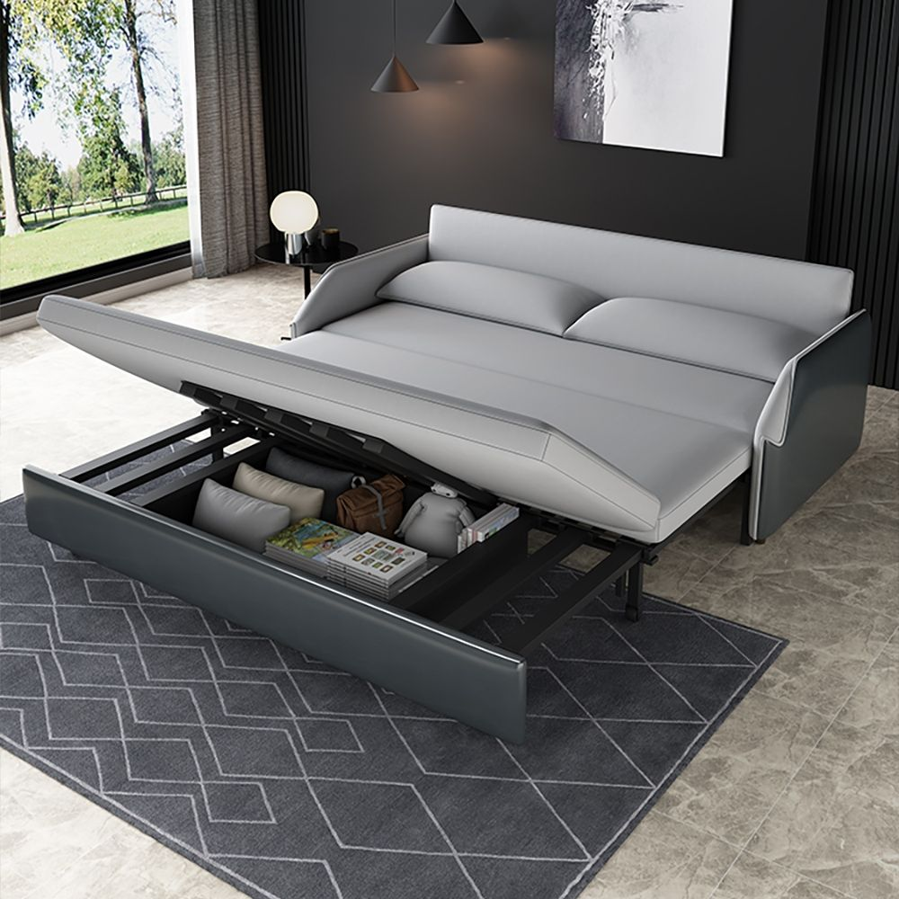

Slide 59
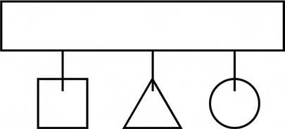
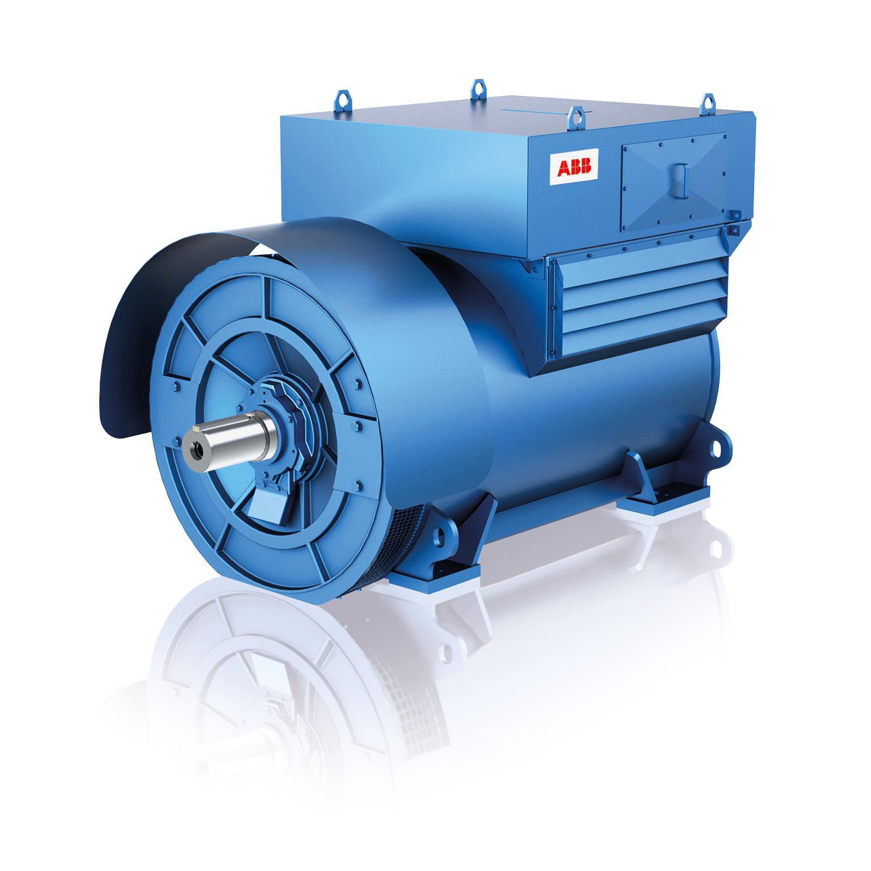
3.Multifunctionality or universality:
Make a part of an object or system perform multiple functions, and eliminate the need for other parts. The number of parts and operations decreases and useful features and functions are retained.
ABB has developed an electric generator with high voltage. A conventional transformer is not needed because the generator can directly feed the electric network.
In some new car designs, the flywheel, alternator, starter, and some other parts are combined into a single component. A single adjustable wrench for all nuts is another example.
People use the universality principle also. Cross-functional training makes people much less susceptible to layoffs because they have multiple skills instead of one skill. Compare this with the local quality principle.
Make a system perform multiple functions.

Slide 60

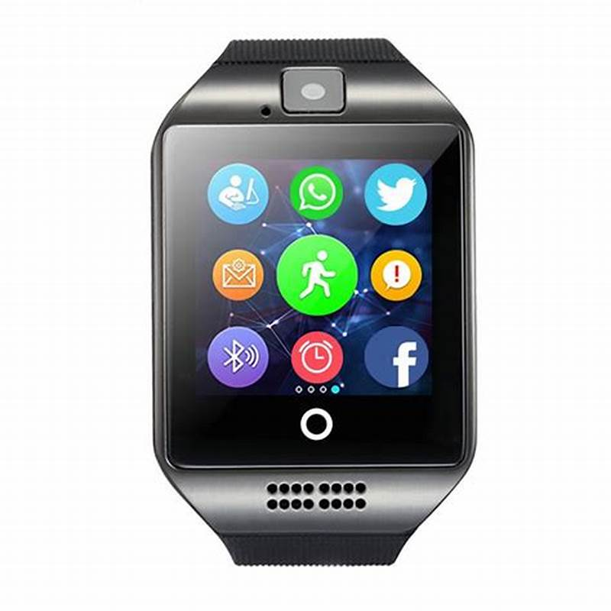
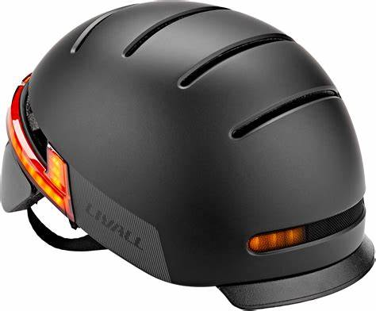

Slide 61
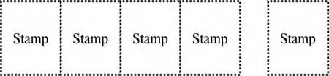

4.Preliminary action: Perform, before it is needed, the required change of an object or system (either fully or partially). Prearrange objects so that they can come into action from the most convenient place and without losing time for their delivery.
Preliminary perforated packaging is easy to open.
Precut parts for the building of wooden houses save work at the construction site.
Workers arrange their workspace so that the most frequently used tools (physical, paper, or electronic) are the easiest to reach.
Do market research, study possible futures, build reserves for changes.
Prepare solutions to problems that customers are not complaining about today, but may notice tomorrow environment, moral code.
sheets of stamps are perforated before sale, to make separation easy

Slide 62
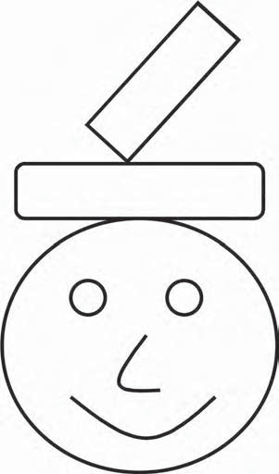
5. BEFOREHAND COMPENSATION:
Prepare emergency means beforehand to compensate for the relatively low reliability of an object or system over time.
Well-known technological examples are airbags in cars and pressure relief valves in boilers and chemical reactors.
Nontechnical examples are posting instructions for possible emergency situations: fires, the use of narcotics among personnel, environment problems, and preparation of equipment (first aid and rescue kits, fire extinguishers) where they may be needed.
Prepare emergency means beforehand to compensate for the low reliability of a system.
The frequently asked questions (FAQs) sections of many Web sites commonly, users are told how to help themselves solve problems that are known to exist in the system.

Slide 63
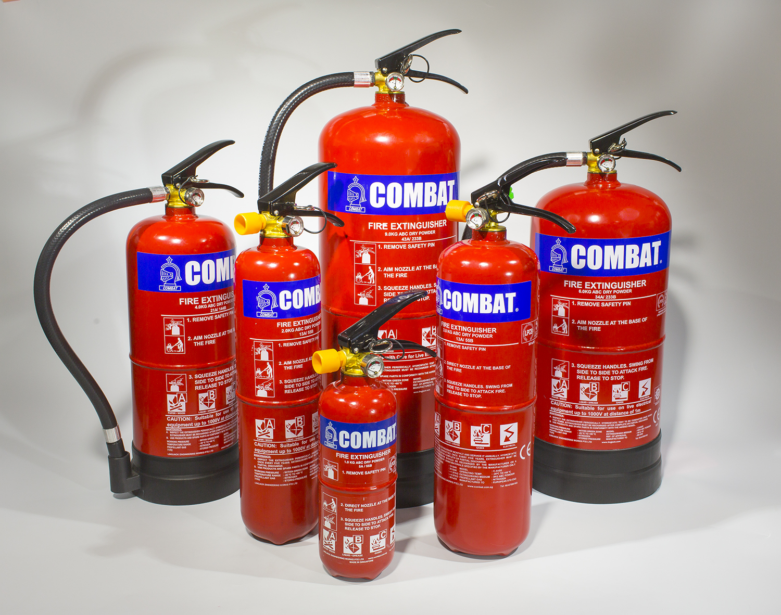

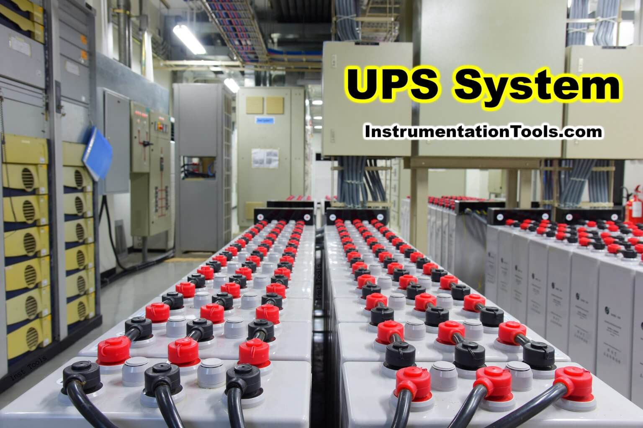

Slide 64
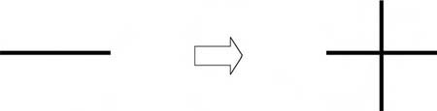
6. BLESSING IN DISGUISE or “turn lemons into lemonade.”
Use harmful factors (particularly harmful effects of the environment or surroundings) to achieve a positive effect.
Eliminate the primary harmful action by adding it to another harmful action to resolve the problem.
Amplify a harmful factor to such a degree that it is no longer harmful
“Blessing in disguise.” Use harmful factors to achieve a positive effect.
Electric charges that are usually harmful can be used for the control of process. Charges can cause fires and explosions, destroy electronic components, make materials stick, and do other harm, but, the same charges, present in most industrial processes, can give valuable information for the optimization of process.
In coal firing, the measurement of electrical charges on coal dust is used to control burning, decrease harmful nitrogen oxide emissions, and improve efficiency. In cement and lime grinding, the product quality can be improved
Virus attacks in computer networks are never good, but each time the system survives an attack, information is generated that makes the system better protected from the next attack. This is similar to the way the body works— surviving an illness generates antibodies that protect the victim from the next incipient infection.
Flash-melting of copper, sulfur is used both as fuel and raw material for the production of sulfuric acid.

Slide 65

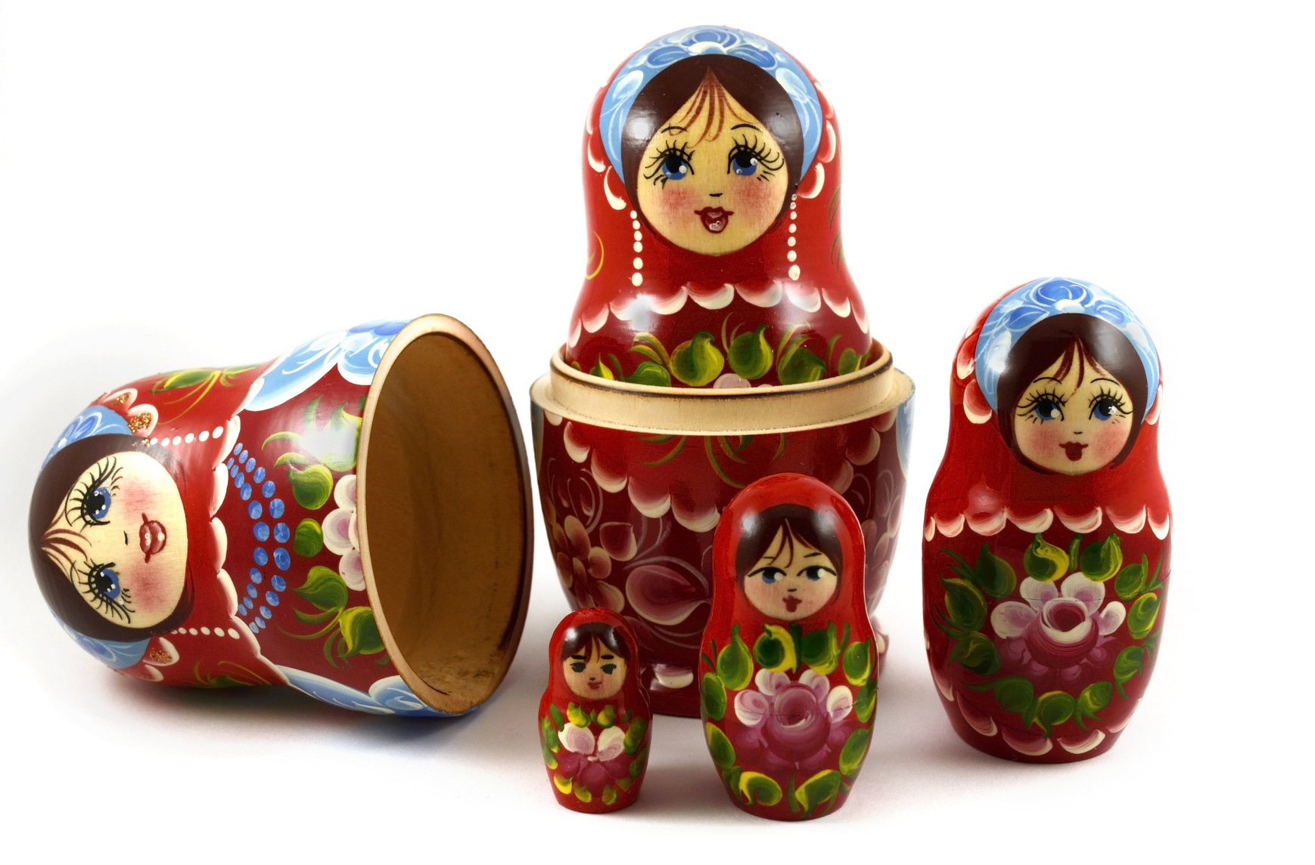
7. NESTED DOLL: Place one object inside another; place each object, in turn, inside the other. Make one part pass through a cavity in the other.
The name of this principle comes from the Russian folk art dolls or matrushkas, in which a series of wooden dolls are nested one inside the other.
The double hull in oil tankers
Telescoping structures (umbrella handles, radio antennas, pointers)
Business analogies: a special exhibit for one designer inside a boutique store, inside a big market
File structures in the Windows computer operating system
Measuring cups or spoons
Stuffing a turkey with sausage, stuffing the sausage with chestnuts, and so on
“Nested doll.” Place one object inside another

Slide 66
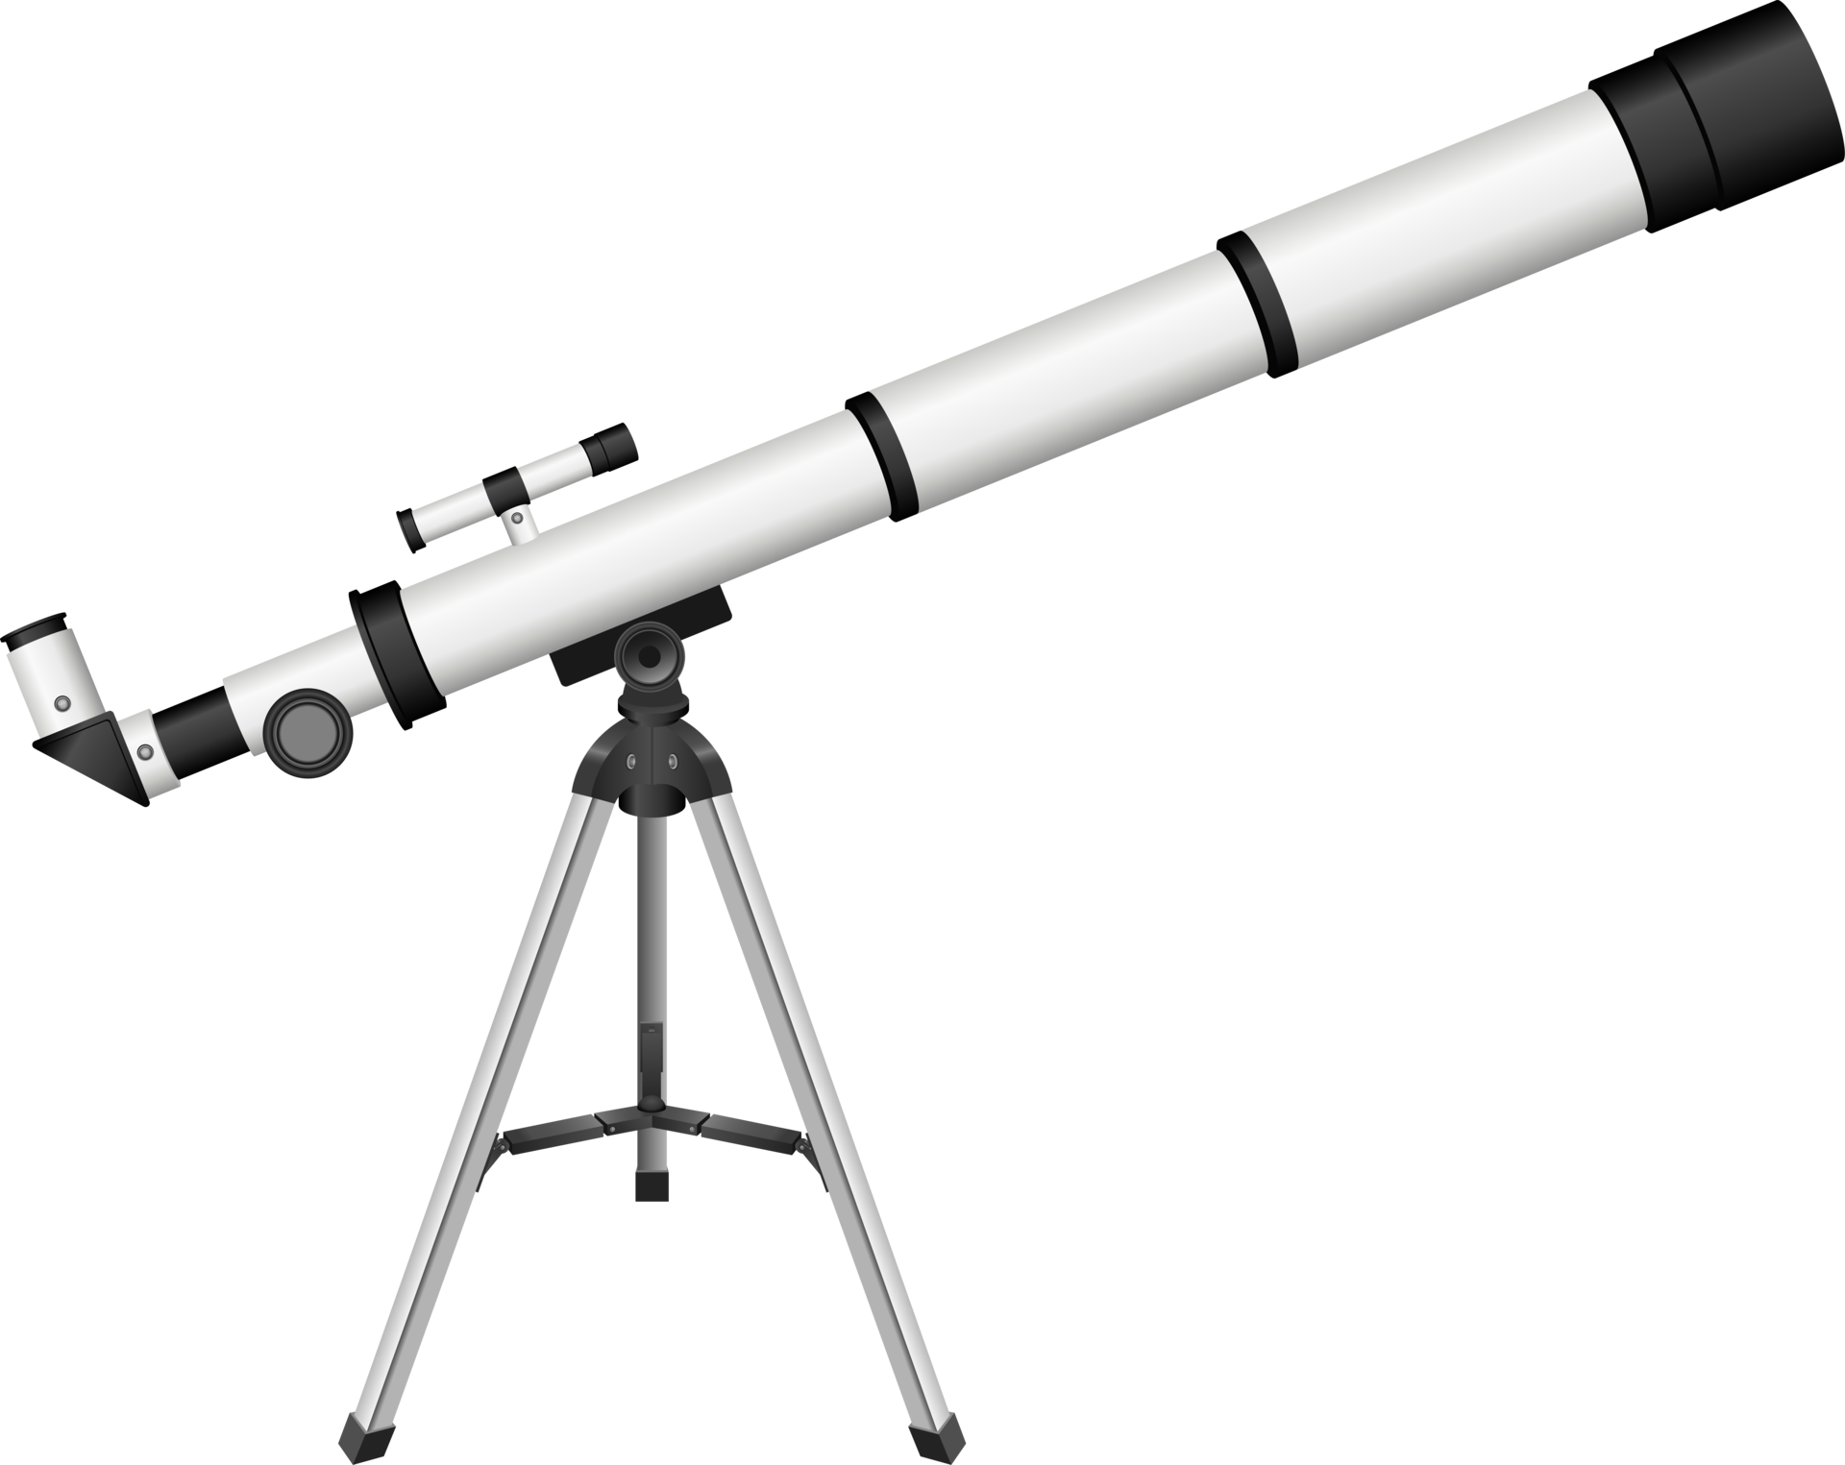



Slide 67


8. SYMMETRY CHANGE
Change the shape of an object or system from symmetrical to asymmetrical. If an object is asymmetrical, increase its degree of asymmetry.
Asymmetric paddles mix more effectively than symmetrical ones (both for concrete and for cake batter). Asymmetric scissors are handier than symmetric ones.
Increasing asymmetry is a way to use geometric resources. It is often easier to change the geometry than to introduce new substances or components.
Mass customization is a business strategy that corresponds to asymmetry the product, service, or policies of a business are specifically designed for each customer and do not need to be the same as those provided to other customers.
More examples include:
Using astigmatic optics to merge colors.
Budgeting for different departments individually rather than using a constant percentage increase or reduction for all departments.
Principle 4: Symmetry change.
Change the system from symmetrical to asymmetrical

Slide 68





Slide 69


9. POROUS MATERIALS.
Make an object porous or add porous elements (inserts, coatings, etc.). If an object is already porous, use the pores to introduce a useful substance or function. Some examples are
A ceramic filter made from hydrophilic porous sintered material simplifies and improves vacuum systems. Water that passes through the filter seals the filter at the same time. The air leak of the conventional vacuum filter is eliminated, and the consumption of energy decreased.
Similarly, porous ceramics are used in many hazardous-waste-cleanup systems the pores can be filled with materials that bind the hazardous substances, and the ceramic particles make it much easier to distribute and remove these materials.
High-tech microfibers are now well known. Small pores prevent water from passing through, but allow moisture to evaporate.
New plasters, or wound dressings, are less known but not less exciting. They are covered by semipermeable film. Water, dirt, and bacteria are kept out, but excess moisture can evaporate through.
Business analogy:
Make the organization “porous” make it easy for information to flow through the system. Make it easy for customers to penetrate the organization to find what they need
Principle 31: Porous materials. Make an object porous

Slide 70


10. PNEUMATICS AND HYDRAULICS (INFLATE AND DEFLATE)
Use gas or liquid as parts of an object or system instead of solid parts (e.g., inflatable, filled with liquids, air cushion, hydrostatic, hydro reactive). Some examples are
One way to transition to the microlevel is through the use of pneumatics and hydraulics. Examples of pneumatics are inflatable houses or air houses (stores, exhibition pavilions, sports halls, and the like), inflatable boats and the moving of heavy components with an air cushion.
Inflatable components allow the designer to decrease weight without losing strength. Air cushions enable movement of heavy objects using very little energy for instance, they are used instead of mechanical jacks to raise aircraft that are on soft surfaces such as grass or mud.
Similarly, hydraulic equipment can exert more force than simple mechanical systems of the same size. Replacing a physical cutting blade with a water jet illustrates the hydraulics principle of replacing solid objects with liquids.
Business analogies use the idea of fluidity replacing rigid structures. Insurance companies now have “fluid” systems in which customers modify policies to suit their own needs.
In 1997, NASA used air bags, instead of expensive rockets, for the landing of Mars Pathfinder.
Pneumatics and hydraulics. Use gas and liquid instead of solid parts.

Slide 71




Slide 72


11. OPTICAL PROPERTY CHANGES. (Change the color)
Change the color or transparency of an object or its external environment. Some examples are
Enzymes producing light can be used for detecting impurities in food.
Toys for preschool children are packed in transparent packages.
Sunglasses that change the amount of light blocked, depending on the brightness of the environment.
Transparency is both a physical and a business term. Changing the transparency increasing or decreasing it is one important and often cheap way to improve business.
Children want to see the toy; adults want to see that products and the whole production process are safe and ecological.
Here transparency can make the difference between success and failure.
Optical property changes.
Change the color or transparency of an object.

Slide 73


Business school case studies often cite Johnson & Johnson for its exemplary “transparent” behavior as a form of crisis management. When there was a tampering problem with its Tylenol product, the company immediately recalled the product and gave the public full information on its actions. Both the speed and the full disclosure of the situation are credited with the product’s recovery and the company’s retention of its excellent reputation.
Porous materials and optical property changes compose a pair of principles that are frequently used together. Porous materials are often semitransparent. A business analogy is the firewall in a computer system. The wall should be transparent for legitimate users and should, at the same time, be impermeable to those who might try to steal essential information.
Use of lighting effects to change mood in a room or office.
Highlighter pens.
Creation of corporate colors creating a strong brand image through use of bespoke colors BP green, British Telecom red phone boxes, Ford blue, and so on.
“Tell the truth” tape turning a darker gray when food is spoiled.

Slide 74


12. LOCAL QUALITY (REGIONAL INFLUENCES)
Change an object’s structure or an external environment (or external influence) so that the object will have different features or influences in different places or situations.
Make each part of an object or system function in conditions most suitable for its operation. Make each part of an object fulfill a different and useful function.
Local quality. Change an object’s structure.
Non-uniformity: Instead of applying the same properties or characteristics throughout a system, modify individual parts based on their specific needs.
Functionality at Local Levels: Design different areas or elements of an object to perform different, specialized functions, rather than relying on a uniform design that applies the same across all areas.
Optimization of Components: The principle encourages adjusting the shape, material, or design of each part of a system for improved performance based on local conditions.

Slide 75


Often the object should have an additional feature, but the introduction of this feature causes new problems or makes the system more complex and expensive. We should change the system, and we should not change it.
It is easier to change the system locally. There are many examples in technology. Quenching and other treatments of the surface layer of metal components make the surface properties different from the bulk properties of the material.
We use a different wrench for every nut because fixed-size wrenches are much stronger than adjustable wrenches. Specialized compartments in a lunchbox for each type of food keep hot things hot, cold things cold, and make it safe and economical for workers and schoolchildren to carry their lunches with them.

Slide 76



13. DISCARDING AND RECOVERING (RECYCLE AND RECOVER)
Make portions of an object that have fulfilled their functions go away (discard by dissolving, evaporating, etc.) or modify them directly during operation. Conversely, restore consumable parts of an object directly in operation.
Discarding and recovering. Make portions of an object that have fulfilled their functions go away. Restore consumable parts
Biodegradable materials in medicine: Polylactides are used to make dissolvable screws and pins. They can replace titanium screws used by surgeons to mend broken bones. The second operation for the removal of screws is not needed.
The tread of a tire that restores the edges of tread blocks when the tire wears.

Slide 77

Many recovery processes have been used in technology for a long time.
Chemicals used for pulping wood are recovered in a recovery boiler. Environmental requirements will make recovery more popular.
Water polluted in some process is more and more often purified and recycled back to the process.
In business, the project organization is a good example of discarding and recovering. A good project should have an end. The organization will then be dissolved. The members can use their skills again in new projects.
In all work, knowledge and skills are updated and improved directly during work and by retraining.
Heat recovery system
Compressed gas for inflation
Inkjet printers (waste ink recovery)

Slide 78


15.PHASE TRANSITIONS.
Use phenomena occurring during phase transitions (e.g., volume changes, loss or absorption of heat, etc.). The most common of the many kinds of phase transitions include solid–liquid–gas–plasma, paramagnetic–ferromagnetic and normal conductor–superconductor, but many useful phenomena are associated with more exotic transitions as well, such as solid–solid crystallographic changes, superfluidity, antiferromagnetism.
Blasting with solid carbon dioxide can clean surfaces. Impurities will freeze immediately, contract, and loosen easily. The example also illustrates parameter changes (35), thermal expansion (37), and hurrying (21). Impurities are frozen so quickly that the cleaned material does not suffer from thermal expansion. The carbon dioxide then sublimes (harmlessly turns into gas), so there is no cleanup needed.
Heat pipes are well-known examples of using the phenomena associated with phase transitions. The heat given up and absorbed as the fluid in the pipe transitions from liquid to gas can be used either as a heater or air conditioner, depending on how the system is arranged.

Slide 79


“Muscle wire” is a form of nickel-titanium alloy that is used in robot systems and in orthodontics. Small electric currents heat the wire, which goes through a crystallographic phase change that changes its length.
When businesses make structural changes (mergers, acquisitions, or internal changes) the accompanying phenomena are analogous to heat in a phase change there is lots of confusion. Constructive ways to use this period of disruption include finding new means of aligning business systems with new strategies, forming new alliances with customers or suppliers and getting rid of obsolete practices.
Thermal inkjet uses vaporization to force ink out of the nozzle.
Be aware of the requirements of different stages conception, birth, development, maturity, retirement of a project.

Slide 80

16. COPYING (IMAGING)
Instead of an unavailable, expensive, or fragile object, use simpler, inexpensive copies. Replace an object, system, or process with optical copies.
If visible optical copies are already used, change the wavelength to infrared or ultraviolet. Some examples are
Make measurements from an image instead of directly. This includes a wide spectrum of technologies, from satellite photographs of farm and timber resources to ultrasonic images of a fetus in the womb.
Use a simulation instead of the object. This applies to many business processes as well as to products and services.
Use prototypes for testing new systems so that any harm is detected early.
Use virtual prototypes instead of physical ones.
Use video-conferencing instead of travel.

Slide 81

Use virtual reality to test new processes or to train people to do work in difficult situations. Surgeons now test new operating procedures on virtual patients , and automobile assembly workers practice new procedures in virtual factories.
Scan rare historic books, documents, and such so they can be made accessible to all, while the original remains protected.
Use telepresence instead of fully independent robots.
Fake furs and leathers are also examples of the copying principle. Artificial grass might be an acceptable alternative in some places. No need to mow. Compare with plastic flowers and plants.
Ultraviolet light shows certain kinds of skin lesions better than visible light; dyes that are sensitive to ultraviolet are used to find cracks in metal parts. Infrared images show the heat this is the basis of most night-vision systems.

Slide 82

17. ENVIRONMENT (Inert atmosphere)
Creating a non-reactive or neutral environment in order to prevent unwanted reactions or to protect a process or material from external influences such as oxidation corrosion or combustion.
Replace a normal environment with an inert one. Add neutral parts or inert additives to an object or system. Some examples are
Inert gases (such as carbon dioxide or argon) are used in welding to prevent oxidation of the material at the weld.
Inert materials are added to detergents to make them easier for consumers to measure. (Did you ever wonder why the box says “97 percent inert materials”?)
Oxygen is used to generate needed energy and inert gases are used to prevent undesired oxidation.
An inventor proposed using a welding device as a fire extinguisher. A device is provided with a simple system that can blast inert gas with high pressure.

Slide 83



A social analogy of inert atmosphere may be indifference and neutrality.
In business, negative situations mostly need cooling. Ignore or neutralize negative and destructive actions.
Use neutral arbitrators. Here, too, the point is to use the correct approach at the right time.
Another example is metal inert gas (MIG) welding.

Slide 84


18. COMPOSITE MATERIALS (SYSTEM)
Change from uniform to composite (multiple) materials and systems . Some examples are
Rubber reinforced with woven cords, reinforced concrete, and glass-fiber reinforced plastics are typical technology examples.
The use of nothing (air or vacuum) as one of the elements of a composite is very typical of TRIZ no resource is available in all situations.
Examples include honeycomb materials (egg crates, aircraft structures), hollow systems (golf clubs, bones), and sponge materials (packaging materials, scuba diving suits.)
In business, we can speak of composite structures as well.
Multidisciplinary project teams are often more effective than groups representing experts from one field.
Composite materials
Change from uniform to composite systems

Slide 85


Multimedia presentations often do better in marketing, teaching, learning, and entertainment than single-medium performances.
Fanatic commitment to cleanliness is one famous feature of McDonald’s.
Consistent preparation of food is another major commitment. These are two principles or values or fibers that tie together a loose organization.
The principle of composite materials or, more generally, composite systems, is a good conclusion for this section on using inventive principles. If you have a system, you can improve the result by combining it with another system. Innovative principles are also systems. Composite principles often do better than single ones.
More examples are
Combined high risk/low risk investment strategy
Flammable polyurethane coated with fire-resistant Kevlar (e.g., in airplane seat cushions)

Slide 86

19. ENERGY (Self-service)
Make an object or system serve itself by performing auxiliary helpful functions. Use resources, including energy and materials especially those that were originally wasted to enhance the system. Some examples are
In a tire that repairs itself, liquids are sprayed inside the tire. When the tire is punctured, the liquid fills the hole. When it contacts the outside air, it solidifies, forming a permanent repair.
A classical example of self-service in business is a self-service fast food restaurant.
Many electronic business ideas are based on including the customer and the customer’s resources in the system as resources of the system this includes everything from communities of interest and chat rooms to data exchanges such as Napster and Gnutella.
Make a system serve itself

Slide 87

Some search engines use the frequency of use of a Web site as the indicator of quality, so the more often a site is used, the higher it rates on their recommendation list. This is a combination of feedback (24) and self-service.
Self-treatment and self-test. Patients themselves can perform some medical tests, like the measurement of blood pressure or blood sugar or testing for fertility (then later testing for pregnancy) previously done only by medical personnel.
In some cases, patients also adjust their treatment or behavior based on the test results.
Self-service is a way to use the object’s resources. This principle illustrates the pattern of increasing ideality. What is more ideal than a system serving itself?
Modern technology of melting steel scrap uses the energy of scrap itself; carbon and silicon are burned.

Slide 88


19. DIMENSIONALITY CHANGE
Move an object or system in two or three dimensional space. Use a multistory arrangement of objects instead of a single-story arrangement. Tilt or reorient the object, lay it on its side, use its other side.
In our earlier example of the cultivation of carrots, plants are placed in rows that is, one dimensionally. Square-foot gardening is a method developed for small gardens. Plants are placed in square blocks (a 4-foot block subdivided into 16 1-foot squares), that is, two dimensionally. They are placed much closer than in large-scale agriculture. The yield is higher and weeds almost nonexistent because of the close spacing.
Move an object or system in two- or three-dimensional space.
Use of underground tunnels and buildings is increasing. At the same time, more and more high buildings, multilevel highways, and overpasses are built.
In winter, Toronto becomes a multistory city people can travel more than five miles indoors by going from the basement of one building to enclosed walkways at the third floor of another, to the main lobby of the next.

Slide 89


See also an earlier example of a garbage bin: vertical dimension is used to get space. Sometimes the additional dimension is invisible to the customer.
Disney World in Florida pioneered the multidimensional concept now used in many amusement parks. A network of tunnels, workshops, dressing rooms, storerooms, and staff centers runs under the park. Characters are never seen in part of the park that does not match their role instead, the worker vanishes from one area and uses the underground system to travel to the new area or to rest or remove or replace parts of a costume. This preserves the “magic” for visitors.
Less glamorously, garbage is dumped into another system of tunnels, so visitors never see garbage being transported through the park.
Holograms as three-dimensional photographs
IMAX movies with three-dimensional effects
Inflatable Products (Shape or Volume Change)

Slide 90


20. DYNAMIC PARTS
Allow (or design) the characteristics of an object, external environment, process, or system to change to be optimal or to find an optimal operating condition. Divide an object or system into parts capable of movement relative to each other. If an object (or process or system) is rigid or inflexible, make it movable or adaptive.
Make a system or process movable or adaptive.
Repeated use of this principle and combination with the principle of segmentation results in the pattern of increasing interactions and the pattern of transition to a microlevel. Some steps in increasing dynamics are
Rigid, immobile system
One hinge
Many hinges
Elastic system
A field instead of a physical object or system

Slide 91


Stiff and immovable structures are often replaced by more dynamic ones: flexible printed circuits and accumulator batteries in electronics, flexible and self-breaking light poles on the roadsides, wings that change form in airplanes (through the use of flaps and slats on fixed-wing aircraft and through motion of the wings on fighter aircraft), and other dynamic structures.
A first step to making a building safe for earthquakes was to make it more rigid: thicker walls, for example. Later, to avoid impractical heavy structures, certain dynamics were added: the building now has bearings and shock absorbers that allow it to move a little. Strength is increased without extra weight.
The automobile has gone through a similar evolution: first safety belts (passenger fixed more stiffly), then a dynamic part, the airbag, was added.

Slide 92

Ways to increase flexibility are segmentation, flatter organizations (see Principle 12), preparing changes before encountering a problem (Principles 9–11), discarding and recovering (Principle 34), and others.
NASA has successfully tested an aircraft that can inflate its wings in flight.
Software applications have user-configurable toolbars and interfaces.
“Cafeteria” benefits allow employees to pick which types of insurance, health coverage, and such, they want.
Traditional printed traffic signs are often replaced by signs that vary in response to changes in weather and traffic conditions.
In self-righting vessels, the ballast shifts, making the vessel right itself.
Smart traffic lights help drivers to arrive when the lights are green and discourage frequent starts and stops.
Flexible manufacturing systems (FMSs) are increasingly used in industry.

Slide 93



21. INTERMEDIARY.
Use an intermediary carrier article or intermediary process. Merge one object temporarily with another that can be easily removed
Fixtures or jigs are used to position parts to make assembly easy. The assembled parts are removed and the jigs are used repeatedly. This concept is applied in the home as well as in the factory a baking pan or a gelatin mold is an “intermediary” for shaping a dessert, and a potholder is an intermediary for carrying a hot dish to the table without burning the server’s hands.
Ice can be used to hold small components in place temporarily if they will not be harmed by water when the ice melts. See also the earlier example of fixing carrot seeds on tape.
A neutral third party can be used as an intermediary during difficult negotiations. For sales promotion, an intermediary who is seen by the customer as an impartial expert can make recommendations.

Slide 94



22.CONTINUITY OF USEFUL ACTION
Carry on work continuously; make all parts of an object or system work at full load all the time. Eliminate all idle or intermittent actions.
if you eliminate all intermittent actions, you will not have any pauses to use. This just emphasizes that the various suggestions in each principle must be applied with common sense to a particular situation.
The changing character of manufacturing shows considerable influence of this principle. Lean and JIT manufacturing methods both emphasize small, customized production runs instead of long series.
Continuous casting of steel and other metals
Continuously variable automatic transmission (CVT)

Slide 95


23. EQUIPOTENTIALITY
Change operating conditions to eliminate the need to work against a potential field (e.g., eliminate the need to raise or lower objects in a gravity field).
This principle suggests eliminating differences in potential, such as differences in energy, pressure, height, and so on, that cause problems or inefficiencies in a system. The goal is to bring elements of the system to the same potential level to prevent unnecessary energy consumption or mechanical stress.
In the flat factory, there is no high shelving; one does not practically raise or lower components.
Use spring systems to lift sheets of wood to the right height so that workers can slide them into the machine for the next step in the process.
Eliminate the need to raise or lower objects or “walk uphill” some way.
The Bishamon Company makes these devices. When sold as productivity tools, they were a moderate success. When advertised as tools to prevent workers’ back injuries, sales increased dramatically.

Slide 96

Use grounding straps to bring people and objects to equal electrical potential to prevent harm from static electricity.
A business analogy might be a transition to a flatter organization with fewer hierarchical layers. One step in team formation is to bring all team members to the same level eliminate hierarchical behaviors.
Hydraulic systems:
Maintaining equal pressure across all parts of the system to ensure smooth operation and prevent damage from pressure differences.
Electrical systems:
Grounding circuits properly so that electrical potential is balanced, avoiding current surges.

Slide 97

24. FEEDBACK / SERVO SYSTEM (CONTROL SYSTEM)
Introduce feedback to improve a process or action. If feedback is already used, change its magnitude or influence.
A technical example:
In a typical car, a driver makes observations and uses the steering mechanism, brakes, and other “actuators” to make necessary corrections.
In new designs under development, the car has active driver-assistance systems with feedback.
If the driver, for example, takes a curve too fast, the system turns the steering wheel automatically.
The evolution of measurements and control is another example.
Online measurements and online control are increased.
Quality control in production is improved by introducing the immediate measurement and control during the production process, rather than inspection after production.
In business, systems for getting feedback from customers are being continuously improved.

Slide 98


25.MECHANICAL INTERACTION SUBSTITUTION (SMART SYSTEM)
Replace a mechanical method with a sensory (optical, acoustic, taste, or smell) method.
Use electric, magnetic, and electromagnetic fields to interact with the object.
Change from static to movable fields to those having structure.
Use fields in conjunction with field-activated (e.g., ferromagnetic) particles.
The best-known example of the use of a smell as a warning is the incorporation of bad odors into natural gas to warn users when the system has a leak.
The JIT manufacturing systems use Kanban cards or objects such as portable bins to indicate visibly when supplies are needed.

Slide 99

The pattern of evolution called “the increase of interactions.”
The history of technology is full of examples in which the mechanical means of doing something is first supplemented by an electrical system and then replaced by an electrical or electronic system.
Automobile steering systems are mainly mechanical, but control by wire (already used extensively in aviation) is intensively studied in the automotive industry.
In telecommunications, infrared and radio waves and other wireless technologies are increasingly used.

Slide 100


