Slide 1
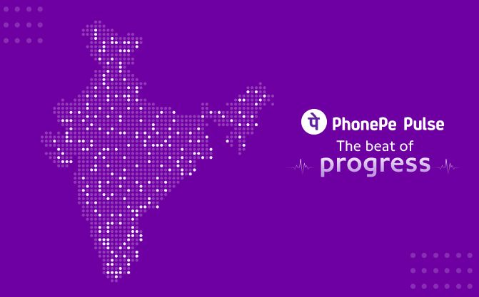
PhonePe Pulse Analysis Key Findings & Recommendations

Slide 2
OVERVIEW
Comprehensive analysis of PhonePe Pulse transaction and user engagement data.
Goals: Derive insights on transaction trends, device usage, insurance, and geography.
Tools: Python, SQL, Streamlit, MySQL, Plotly.

Slide 3
DATA FLOW
STAGE | TOOL / ACTION
Data Source | PhonePe Pulse GitHub (JSON)
Preprocessing | Python (cleaning & insertion)
Storage | MySQL (relational DB)
Analysis | Python + SQL (query + transform)
Visualization | Streamlit + Plotly/Seaborn

Slide 4
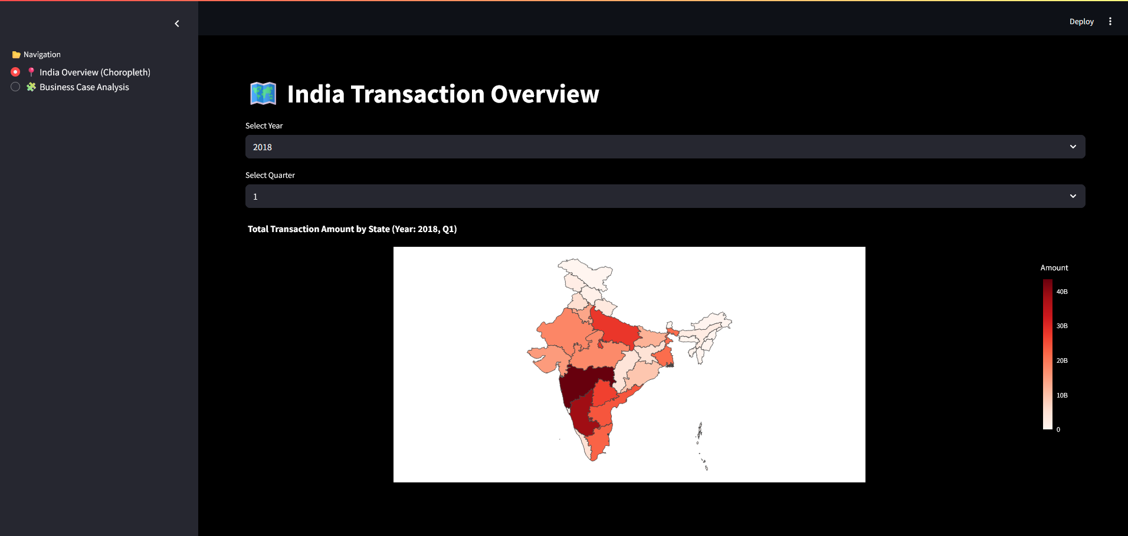
STREAMLIT DASHBOARD
Choropleth: State-wise transaction heatmap.
Business Case Analysis: 5 detailed use-cases with SQL + visualizations.

Slide 5
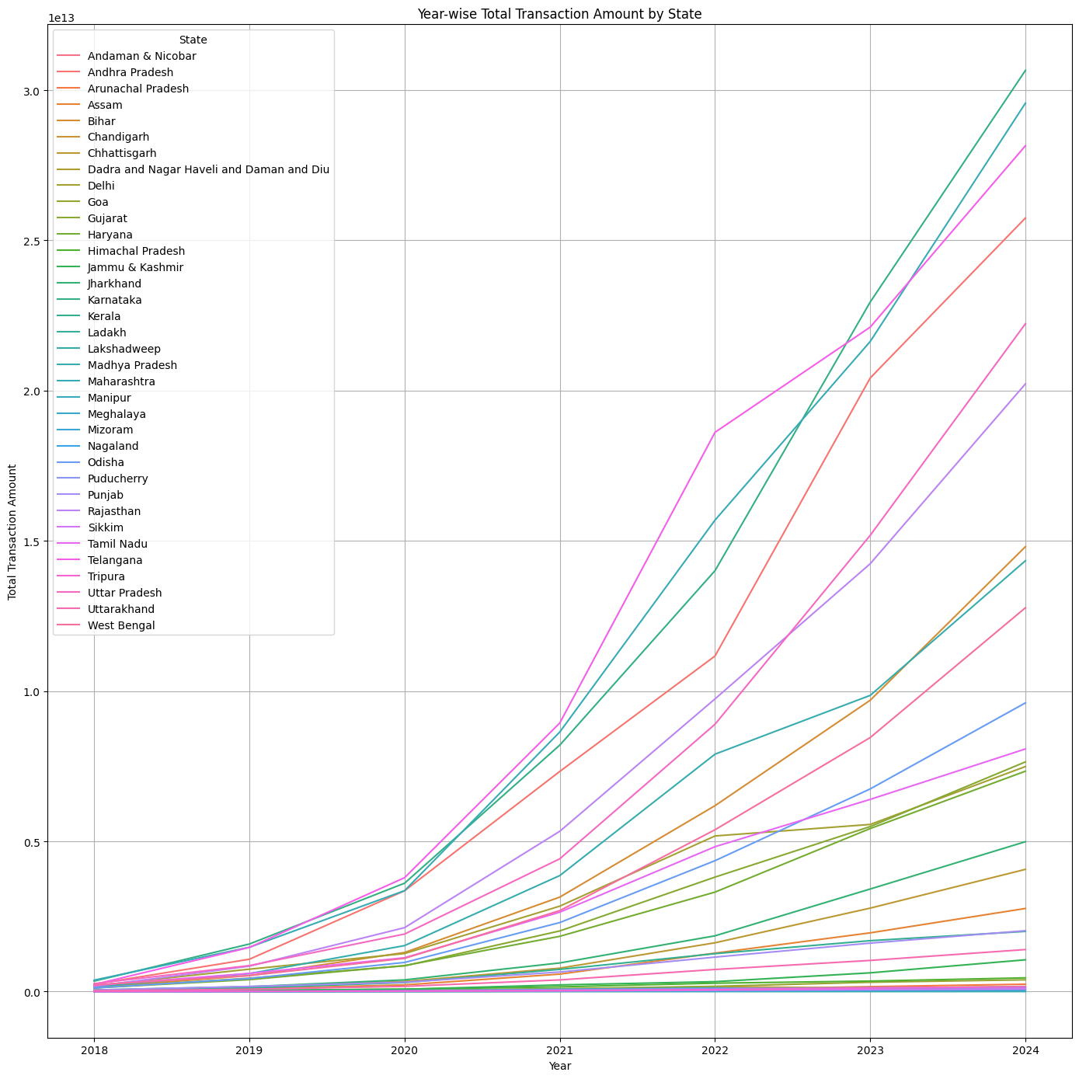
KEY FINDINGS
• UP, Maharashtra, Karnataka lead in total transactions.

Slide 6
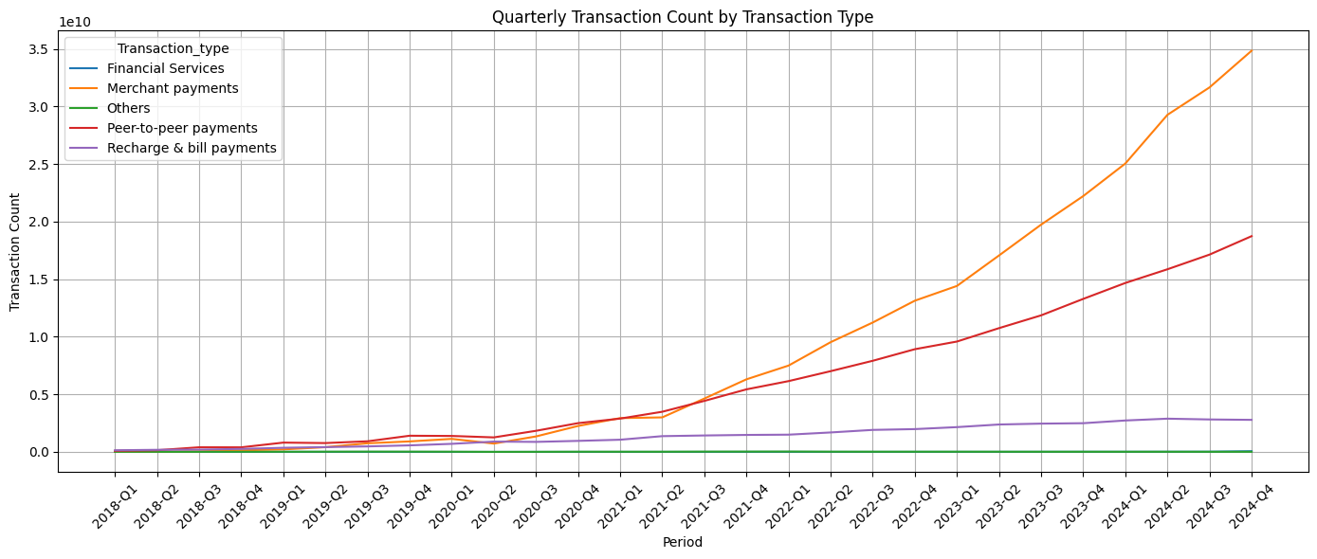
• Merchant Payments and P2P transfers dominate usage followed by Recharge and bill payments.

Slide 7
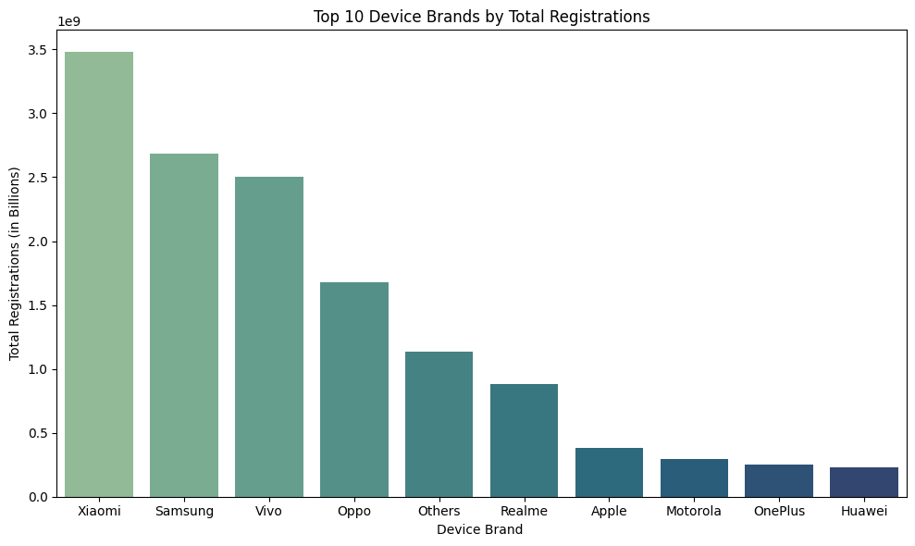
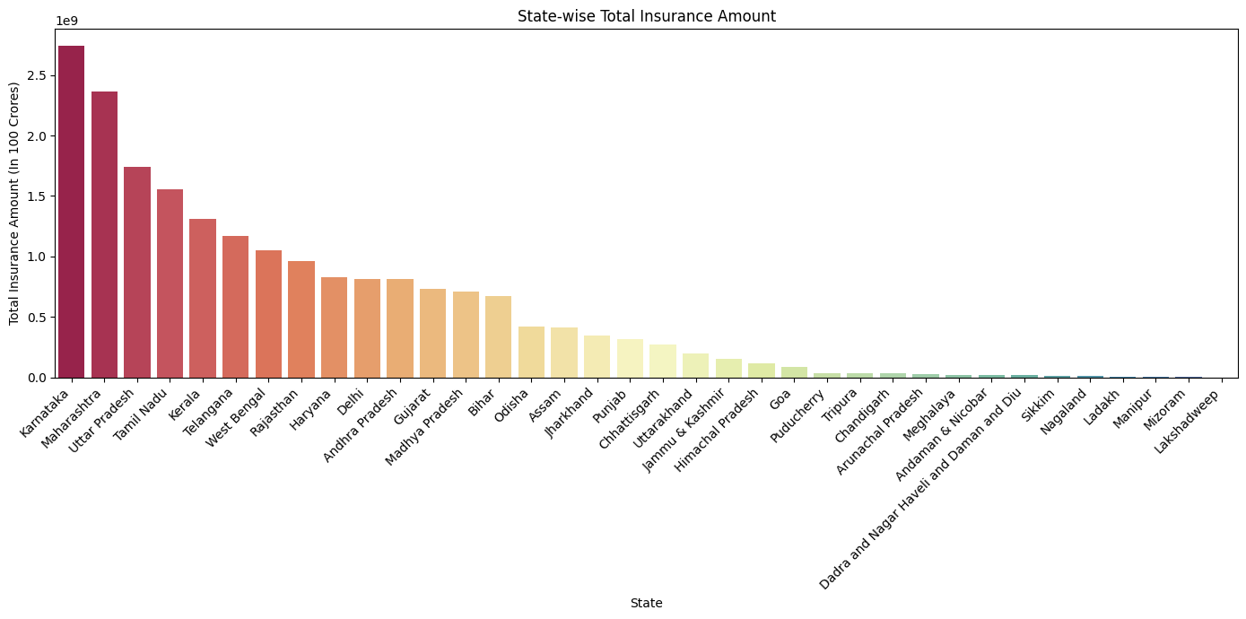
Xiaomi and Samsung together account for the largest share of PhonePe user registrations, significantly ahead of other device brands.
Karnataka and Maharashtra lead in total insurance transaction volumes, far ahead of other states

Slide 8
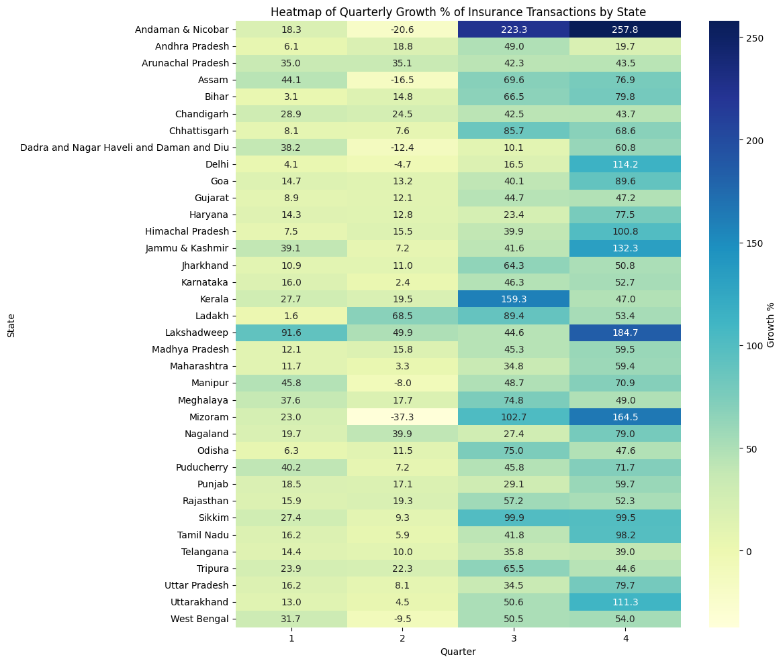
East and Northeast states like Mizoram, Assam, and Meghalaya show strong quarterly growth, indicating emerging adoption hubs.

Slide 9
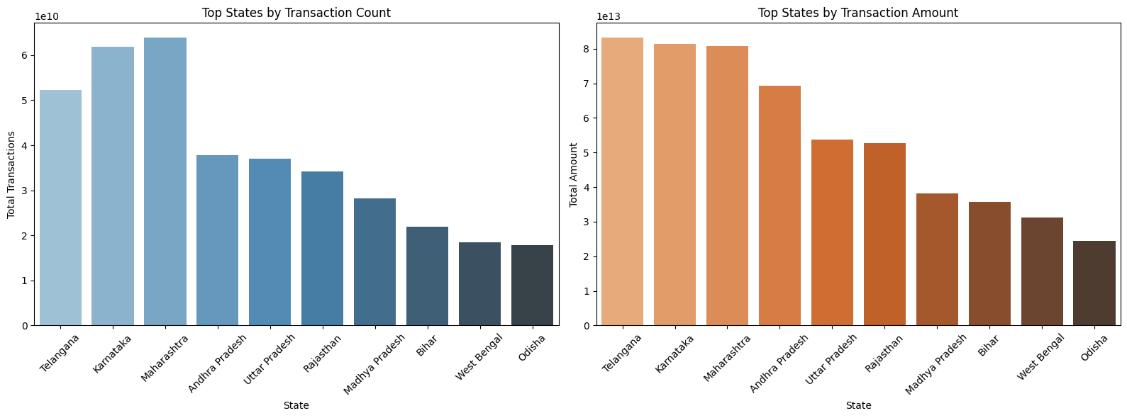
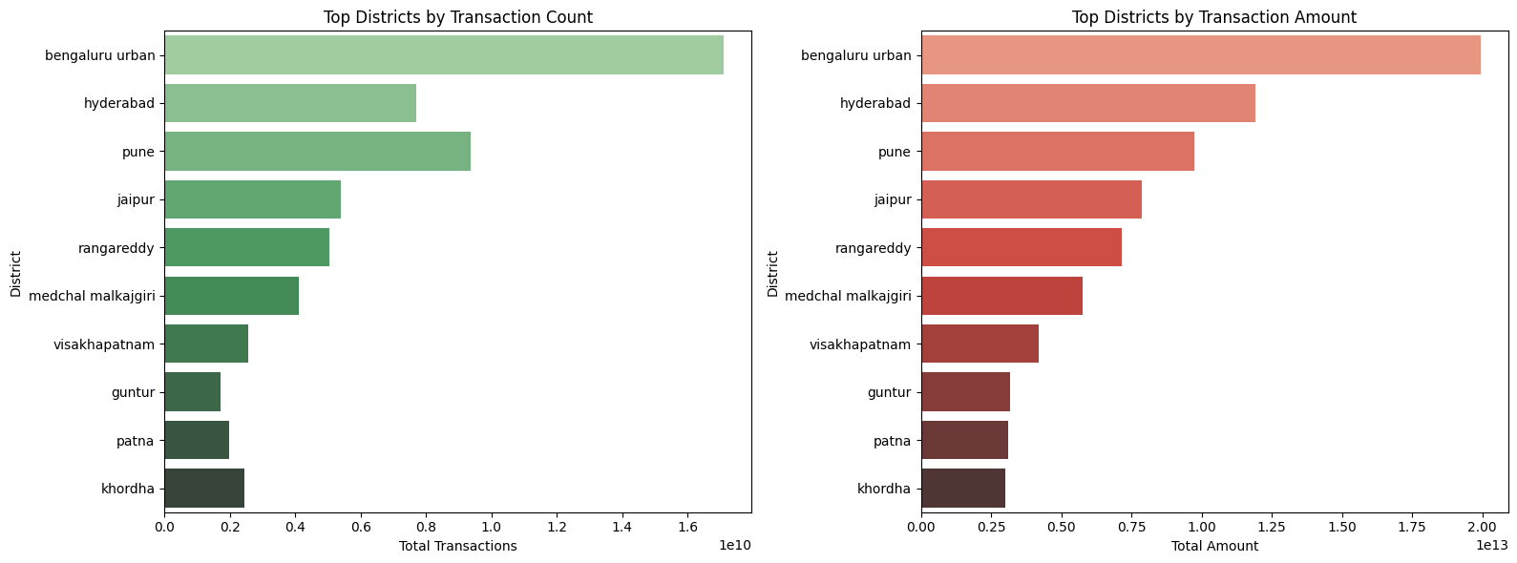
At the state level, Telangana, Maharashtra, and Karnataka lead in both transaction count and amount.
At the district level, Bengaluru Urban leads in both transaction count and value, with Pune consistently ranking among the top performers.

Slide 10
RECOMMENDATIONS
Providing the app in regional languages (e.g., Bengali, Odia, Rajasthani/Hindi) enhances accessibility in Tier-2 and Tier-3 markets. Coupled with localized promotional offers, this approach improves onboarding, builds trust, and significantly increases user engagement.
Xiaomi and Samsung account for the majority of PhonePe registrations. Strategic tie-ups—like pre-installed apps or promotional campaigns—on these devices can significantly boost reach and accelerate new user acquisition across all market tiers.
Target states like Odisha, Jharkhand, and Assam where insurance adoption is still low but quarterly growth rates are rising. Offering affordable, customized micro-insurance plans can drive adoption, financial inclusion, and long-term user retention.

Slide 11
RECOMMENDATIONS
Introduce EMI-based premium payments in mid-income Tier-2 states (e.g., Odisha, West Bengal, Rajasthan) to reduce entry barriers and improve insurance penetration.
Launch customized insurance products such as crop insurance in agrarian regions like Bihar, Chhattisgarh, and Jharkhand to address local needs and increase adoption.
Use transaction and user data to identify districts with low current activity but rising digital adoption. Focus efforts on digital literacy, agent deployment, and awareness drives to unlock new user bases.
Integrate insurance offerings with frequently used services like travel bookings and bill payments in states such as Odisha and Assam, where digital adoption is growing. This approach encourages adoption through contextual relevance and convenience.

Slide 12
THANK YOU

