Slide 1
Team & Solution Overview
• Team name : Dataforge
• Members: 3 (Kruthika S L,Manasa BP, Ashwini L)
• Challenge area: The main challenge is to build a fast, stable, and interpretable analytics dashboard that can compare assessment outcomes across years and geographies, while also delivering predictive and diagnostic evidence that is useful for institutional reporting and decision-making.
• One-line solution: Build a fast, stable, and interpretable multi-year assessment dashboard that turns workbook data into actionable district/block/GP-level insights with predictive and diagnostic evidence for reporting
• Contact: 7899249481/ kruthilokesh49@gmail.com
Evaluation: Depth of analysis | Policy relevance | Cross-dataset analysis | Innovation | Clarity of insights | Visualisation & presentation

Slide 2
Problem Statement
• Educational challenge : Create a data-driven assessment dashboard that helps educators compare student performance across years, grades, districts, blocks, and gram panchayats, while identifying weak learning areas and generating predictive insights to support targeted academic improvement.
• Objectives:
1:Analyze student assessment performance year-wise and compare trends across years.
2:Enable multi-level filtering by district, block, GP ID, grade, and gender.
3:Identify weak competency areas and question-level performance gaps.
4:Generate predictive and diagnostic insights using machine learning models.
5:Present the results through a Streamlit dashboard for interactive exploration.
6:Convert findings into a report-ready and presentation-ready narrative.
Evaluation: Depth of analysis | Policy relevance | Cross-dataset analysis | Innovation | Clarity of insights | Visualisation & presentation

Slide 3
Key questions:
How does student performance change across the three academic years?
Which grades are improving or declining over time?
How do district, block, and GP-level regions compare in performance?
Which gender groups are more represented and how does performance vary by gender?
Which competency areas or question types are the weakest?
Which geographies can be used as strong benchmark models for improvement?
Can predictive machine learning models identify likely high-performing or low-performing groups?
What actionable recommendations can be made from the dataset for intervention and planning?

Slide 4
Why it matters?:
These key questions matter because they convert raw assessment data into actionable educational insight.
They show whether the program is improving over time.
They help compare performance across administrative units like districts, blocks, and GP IDs.
They reveal where interventions are most needed by identifying weak competency areas.
They support targeted support for different gender groups and grade segments.
They make predictive analysis useful for planning future outcomes.
They turn the dashboard from a raw data view into a decision-support tool for educators and administrators.

Slide 5
Dataset Understanding
• Dataset summary : The dataset is a multi-year student assessment workbook collection containing student-level response records across academic years, with fields such as district, block, GP name, GP ID, gender, and question-wise score columns from Q1 to Q20. Each record represents a learner’s assessment response pattern, and the overall score is derived by summing the question responses, enabling year-wise, geography-wise, grade-wise, gender-wise, and competency-wise analysis. This makes the dataset suitable for identifying performance trends, benchmarking regions, diagnosing weak learning areas, and supporting predictive and intervention-focused decision-making.
Evaluation: Depth of analysis | Policy relevance | Cross-dataset analysis | Innovation | Clarity of insights | Visualisation & presentation

Slide 6
Variables:
The main variables used for analysis are:
District
Block
Cluster
GP Name
GP ID
Gender
Unique Identifier
Q1 to Q20 for question-wise responses
year for academic year
grade for the grade level
Derived variables
total_score = sum of all question responses from Q1 to Q20
gender_code = encoded gender label
year_code = encoded academic year
grade_code = encoded grade
district_code, block_code, gp_code = encoded geography identifiers used for modeling

Slide 7
Derived variables
total_score = sum of all question responses from Q1 to Q20
gender_code = encoded gender label
year_code = encoded academic year
grade_code = encoded grade
district_code, block_code, gp_code = encoded geography identifiers used for modeling
These variables are what make the dashboard capable of:
year-wise comparisons,
region-wise benchmarking,
gender comparison,
question-level diagnostics,
and model-based prediction.
If you want, I can also give you:
a short variable list for the report,
a definitions list for all variables,
or a modeling-feature list.

Slide 8
Cleaning: Without cleaning, the dashboard would show inconsistent results, incorrect averages, and unstable predictive models. Cleaning is what makes the analysis reliable and comparable across years and regions.
Assumptions:
The workbook files follow a consistent structure across all three academic years.
The Q1 to Q20 columns represent the main assessment response variables.
Missing or blank values in question fields can be safely treated as zero for scoring purposes.
Gender values are standardized enough to support demographic comparison.
The GP ID and geography fields are reliable identifiers for benchmarking and filtering.
The dashboard is intended for educational decision support, not as a formal academic evaluation model.

Slide 9
Analytical Approach
• Workflow :
The workflow for this project follows a simple evidence-based pipeline:
Load the workbook files year-wise and remove non-useful temporary files.
Clean and standardize the dataset fields such as geography, gender, and question responses.
Derive key indicators like total score, average score, participation counts, and question-wise averages.
Slice the data using filters such as year, grade, district, block, GP ID, and gender.
Generate trend and comparison views for performance across years and geographies.
Identify weak competency areas and low-performing question segments.
Build predictive models such as Random Forest and Logistic Regression for evidence-backed forecasting.
Translate the findings into clear insights and recommendations for report and presentation use.
Evaluation: Depth of analysis | Policy relevance | Cross-dataset analysis | Innovation | Clarity of insights | Visualisation & presentation

Slide 10
Methods
The project uses a practical analytical workflow built around data preprocessing, exploration, and predictive modeling:
Data ingestion
Read the workbook files from the year folders using openpyxl.
Data cleaning and standardization
Normalize text labels, remove temporary lock files, convert question columns to numeric values, and create derived fields such as total score and encoded demographic/geography variables.
Descriptive analysis
Compute year-wise student counts, average scores, gender distribution, and question-wise averages.
Comparative analytics
Compare performance across district, block, GP ID, grade, and gender using filtered summaries.

Slide 11
Diagnostic analysis
Identify the weakest question areas and competency groups to highlight intervention opportunities.
Predictive modeling
Use Random Forest Regressor for score prediction and Random Forest / Logistic Regression for classification-style performance checks.
Dashboard delivery
Present the findings through a Streamlit interface for interactive exploration.
Validation
Data validation
Confirm that all required fields such as District, Block, GP ID, Gender, and Q1 to Q20 are present in the workbook schema before analysis.

Slide 12
Quality validation
Check for missing values, invalid entries, and inconsistent naming in geography and gender variables, then clean them before modeling.
Model validation
Use train-test splitting and measure model reliability through metrics such as MAE and classification accuracy to ensure the predictive output is meaningful.
Business/insight validation
Verify that the final insights align with the actual dataset facts, such as year trends, question weakness, and strong/weak geography performance, rather than just model output.

Slide 13
Key Insight 1: Year-wise Performance and Participation Analysis.
Evidence
Student participation increased consistently from 312,702 (2022–23) to 470,857 (2023–24) and 595,528 (2024–25).
The average score was 11.18 in 2022–23, decreased to 10.24 in 2023–24, and improved slightly to 10.62 in 2024–25, while female participation remained higher than male participation in all three years.
Findings
Student enrollment and participation increased every academic year, indicating broader coverage of the assessment.
Despite higher participation, average performance did not improve proportionally, and question-wise averages varied across years, showing differences in competency across assessed skills.
Interpretation
The education system successfully reached more students over time, but maintaining learning outcomes as participation grew appears to be a continuing challenge. This interpretation follows from the increase in participation alongside relatively stable average scores.
The variation in question-wise performance suggests that some competencies were consistently stronger than others, indicating areas where targeted instructional support may be beneficial
Evaluation: Depth of analysis | Policy relevance | Cross-dataset analysis | Innovation | Clarity of insights | Visualisation & presentation

Slide 14
Key Insight 2: Gender-wise Participation
Evidence
Female participation was consistently higher than male participation in all three academic years.
The number of both female and male participants increased from 2022–23 to 2024–25, reflecting broader participation across years.
Findings
Female students formed the larger share of participants throughout the study period.
Participation growth occurred for both genders, indicating that the assessment expanded its reach over time.
Interpretation
The consistently higher female participation indicates sustained engagement of girls in the assessment process during the three academic years. This interpretation is based on the participation counts reported by your analysis.
The increase in participation for both genders suggests that the program reached a larger student population over time, although participation counts alone do not indicate differences in learning outcomes
Evaluation: Depth of analysis | Policy relevance | Cross-dataset analysis | Innovation | Clarity of insights | Visualisation & presentation

Slide 15
Predictive / Diagnostic Analysis
• Model
• Metrics
• Important predictors
• Early warning
Evaluation: Depth of analysis | Policy relevance | Cross-dataset analysis | Innovation | Clarity of insights | Visualisation & presentation

Slide 16
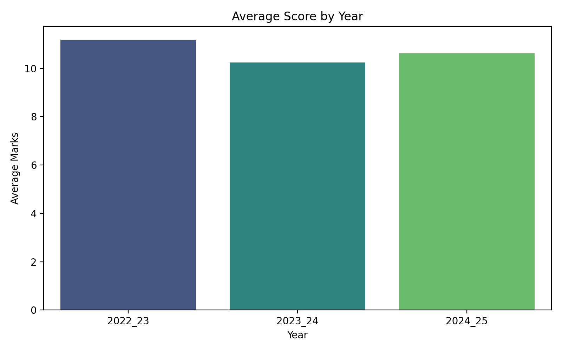
Visualization / Dashboard
• Dashboard screenshots
• KPIs
• Maps/Charts
Evaluation: Depth of analysis | Policy relevance | Cross-dataset analysis | Innovation | Clarity of insights | Visualisation & presentation

Slide 17
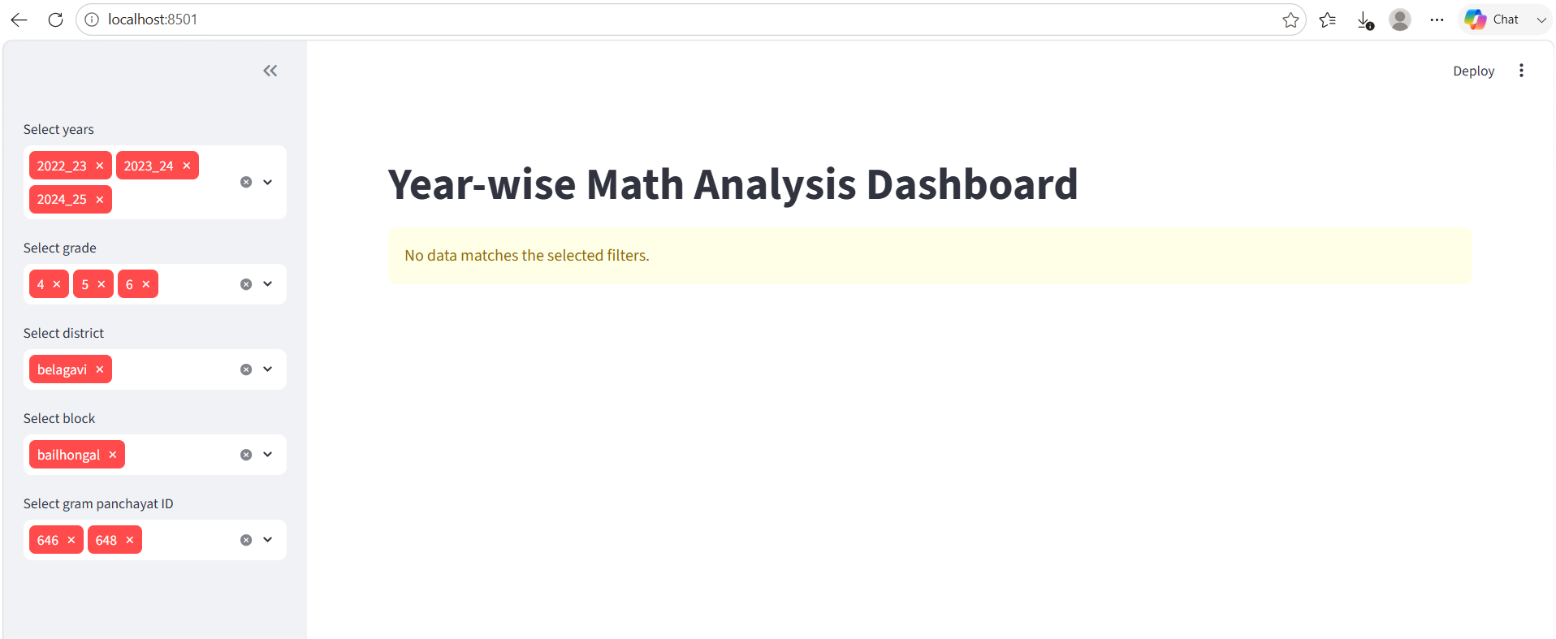

Slide 18
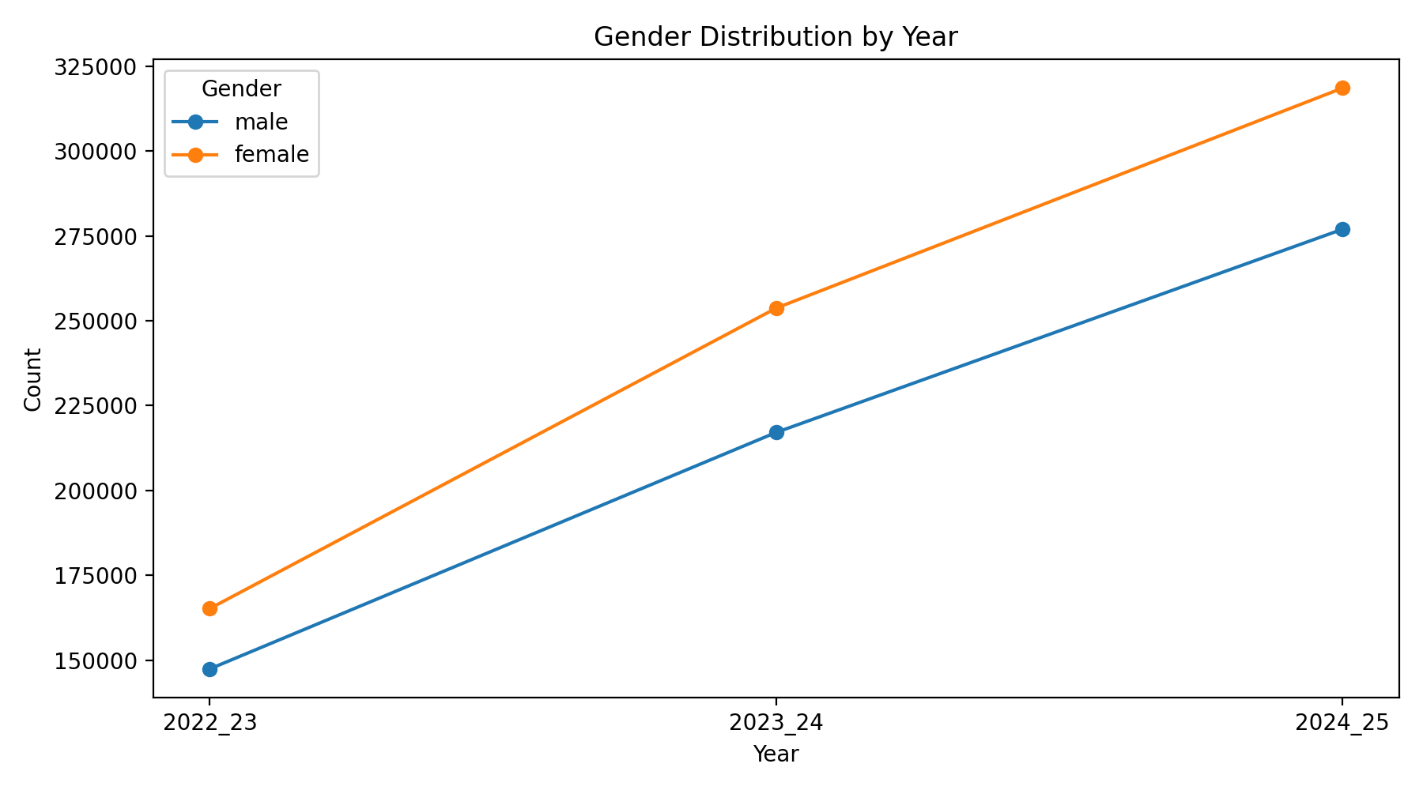

Slide 19
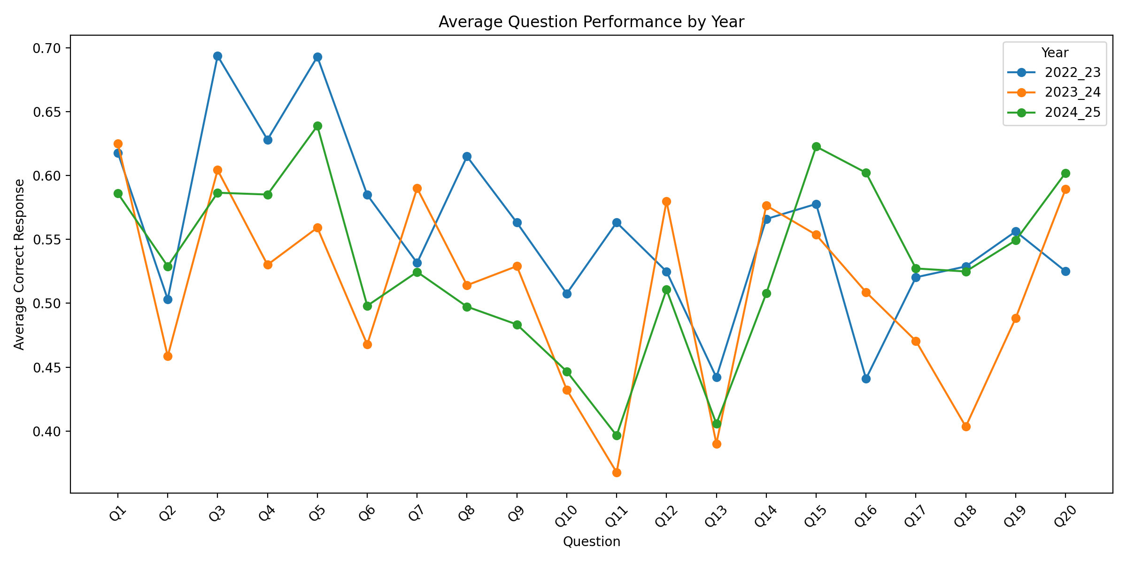

Slide 20
Recommendations and Road Map
Priority Actions
Focus remedial learning programs in low-performing districts and blocks.
Strengthen weak math competencies through targeted classroom activities.
Impact
Improve overall student math competency and learning outcomes.
Reduce performance gaps between high- and low-performing regions.
Feasibility
Can be implemented using existing school teachers and district education officers.
Progress can be monitored annually using the same competency assessment framework.
Evaluation: Depth of analysis | Policy relevance | Cross-dataset analysis | Innovation | Clarity of insights | Visualisation & presentation

Slide 21
Innovation & Impact
Novelty
Combines multi-year (2022–23 to 2024–25) competency analysis for trend identification.
Provides district-wise and block-wise insights for targeted interventions.
Scalability
The framework can be extended to all districts and future academic years.
Can be adapted for other subjects like Science and Language.
Limitations
Results depend on the completeness and accuracy of the assessment data.
External factors (attendance, socioeconomic conditions) are not included in the analysis.
Expected Impact
Supports evidence-based educational planning and resource allocation.
Helps policymakers prioritize interventions in low-performing regions.
Evaluation: Depth of analysis | Policy relevance | Cross-dataset analysis | Innovation | Clarity of insights | Visualisation & presentation

Slide 22
Conclusion & Key Takeaways
Top Takeaways
Significant variation exists in math competency across districts and blocks.
Multi-year analysis highlights both improving regions and areas requiring immediate attention.
Next Steps
Implement focused interventions for low-performing competencies and monitor progress yearly.
Develop an interactive dashboard for continuous district and block-level performance tracking.
Thank You
Thank you for your time and valuable attention.
We welcome your questions and feedback.
Evaluation: Depth of analysis | Policy relevance | Cross-dataset analysis | Innovation | Clarity of insights | Visualisation & presentation

