Slide 1
BTP PRESENTATION Multimodal Biometric Template Protection
By: Divakar Kushwaha [2022CS11615] , Dharavath Ashvitha [2022CS11132]
Supervised By: Prof. Ashok Kumar Bhateja,
Department of Computer Science and Engineering, IIT Delhi
Indian Institute of Technology (IIT) Delhi
New Delhi, India

Slide 2
Contents
Problem Statement / Motivation
Literature Survey/Review
Proposed Methodology
Experimental Set-up
Results and Discussion
Conclusion & Future Scope
References

Slide 3
Problem Statement / Motivation
Face and iris are widely used for authentication, but traditional systems store fixed biometric templates.
If an attacker steals these templates, they can reuse them and the user cannot change their face or iris like a password.
One leak can cause permanent identity theft and cross‑system tracking.
Why this project?
We need a way to use biometrics without storing them in a permanent, reusable form.
Our project solves this by using cancelable templates for face and iris, so templates are:
Non‑invertible (original cannot be recovered),
Revocable (can be re‑issued with a new key),
Unlinkable across different applications.

Slide 4
Proposed Methodology
Extract deep embeddings for face and iris using pretrained CNN/Transformer models.
Apply six cancelable protection schemes (MLP‑Hash, BioHash, IoM‑GRP, IoM‑URP, RP‑PCA, Bloom Filter) on these embeddings.
Perform enrollment: generate and store only protected templates (no raw biometrics).
Perform verification: protect probe features in the same way and compare with stored templates.
Evaluate and compare methods on LFW, AgeDB, IITD, CASIA, UtIris datasets.

Slide 5
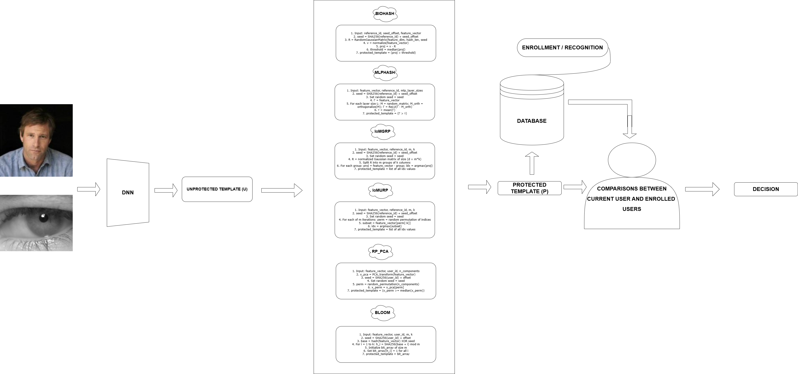
Proposed Method’s Complete Pipeline :

Slide 6
Experimental Set-up
Face datasets used:
LFW (Labeled Faces in the Wild)
AgeDB (age‑annotated face images)
Iris datasets used:
IITD Iris
CASIA‑IrisV3
UtIris
For each dataset, we take images of each user, generate embeddings, and then apply our six cancelable schemes for template protection.

Slide 7
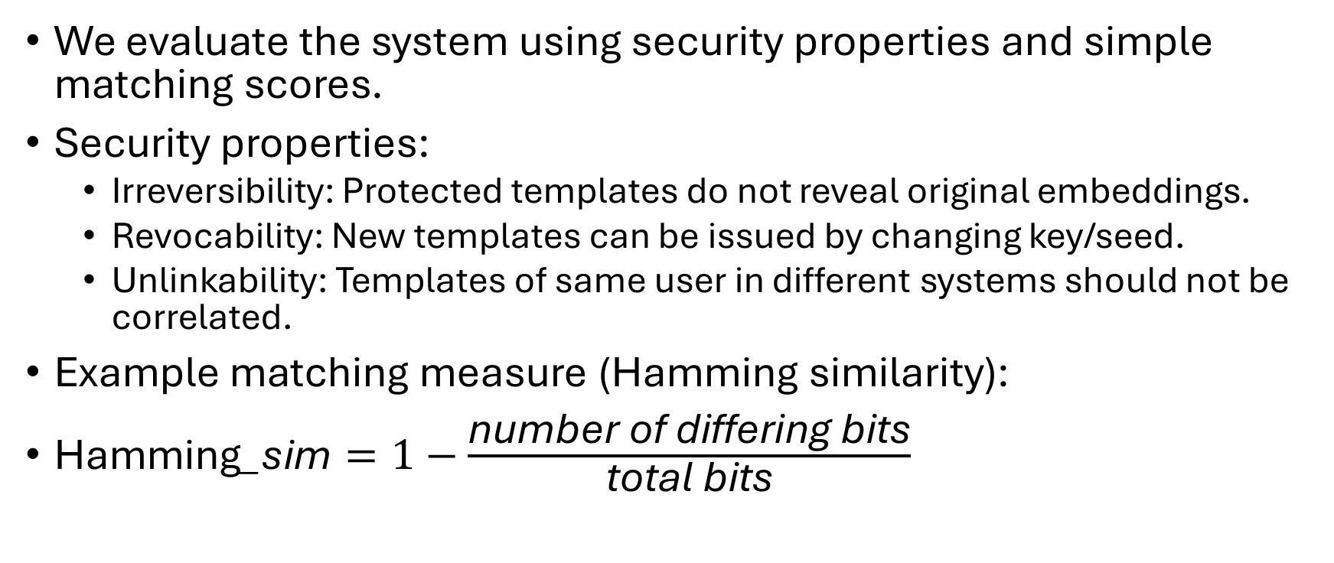
Results and Discussion
We evaluate the system using security properties and simple matching scores.
Security properties:
Irreversibility: Protected templates do not reveal original embeddings.
Revocability: New templates can be issued by changing key/seed.
Unlinkability: Templates of same user in different systems should not be correlated.
Example matching measure (Hamming similarity):
$\text{Hamming}\text{_}\text{sim}=1−\frac{\text{number} \text{of} \text{differing} \text{bits}}{\text{total} \text{bits}}$

Slide 8
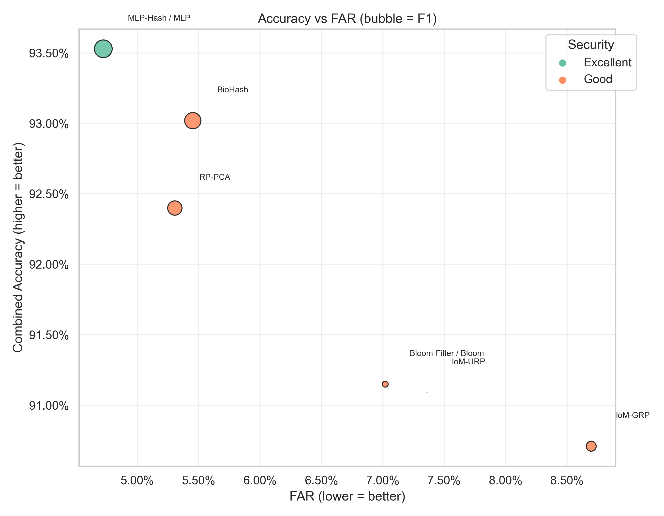
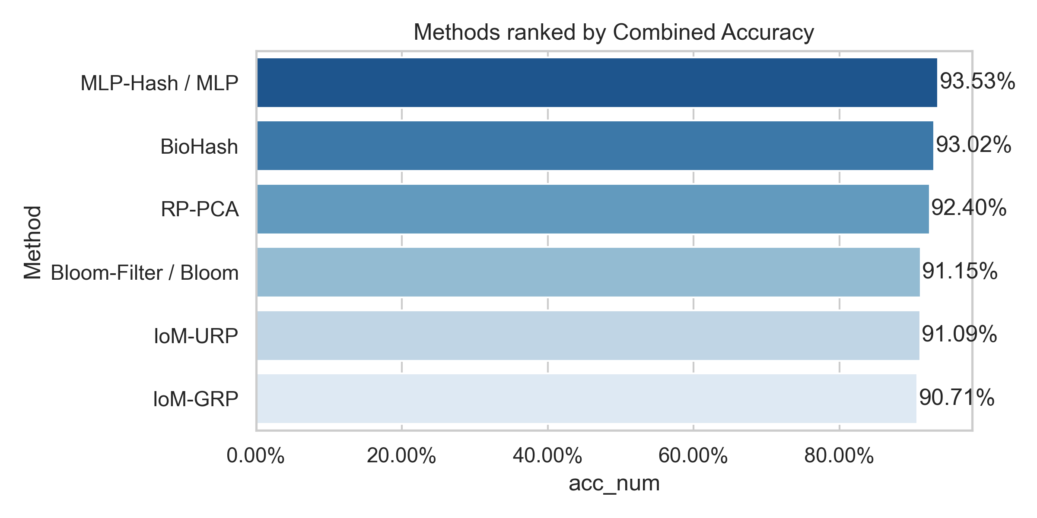
Rank | Method | Acc | F1 | FAR | FRR
1. | MLP-HASH | 93.53% | 0.9072 | 4.72% | 6.57%
2. | BIO-HASH | 93.02% | 0.9029 | 5.45% | 7.12%
3. | RP-PCA | 92.42% | 0.8977 | 5.31% | 7.99%
4. | BLOOM | 91.15% | 0.8828 | 7.02% | 8.51%
5. | IOM_URP | 91.09% | 0.8798 | 7.36% | 9.03%
6. | IOM_GRP | 90.71% | 0.8884 | 8.70% | 8.50%

Slide 9
Conclusion
We designed and implemented a multimodal cancelable biometric system for face and iris.
Raw biometric features are never stored; only protected templates are saved.
Using six different schemes, we showed that templates can be made non‑invertible, revocable and unlinkable while still allowing practical authentication.
The framework is modular and extensible: new models, datasets or protection methods can be plugged in easily.
Future work: multimodal fusion experiments, larger datasets, and integration with real deployment scenarios.

Slide 10
References
MLP‑Hash paper (face templates): Otroshi Shahreza, H., Krivokuca Hahn, V., & Marcel, S. “MLP‑Hash: Protecting Face Templates via Hashing of Randomized Multi‑Layer Perceptron.” Proceedings of EUSIPCO 2023, IEEE, 2023.
Iris RHoG paper (alignment‑robust iris): Lee, M. J., Jin, Z., Liang, S.‑N., & Tistarelli, M. “Alignment‑Robust Cancelable Biometric Scheme for Iris Verification.” IEEE Transactions on Information Forensics and Security, 17, 3449–3463, 2022.

Slide 11

Thank You

