Slide 1


Sentiment Analysis classification
Combining Supervised and Unsupervised Approaches

Slide 2
details
Submitters:
Ron Ashwal, 208573139
Zohar Simhon, 211871868
Link for github: https://github.com/Ashwal200/sentiment-analysis
Introduction
Dataset
Data Processing
Results
Conclusion
Classifier Tools
Unsupervised Model

Slide 3

Agenda
Introduction
Dataset
Data Processing
Classifier Tools
Results
Conclusion
Unsupervised Model

Slide 4
Introduction
This project focuses on sentiment analysis using both supervised and unsupervised methods.
We use the Hugging Face dataset.
Various natural language processing tools and machine learning classifiers or clustering techniques were employed to achieve accurate results.
Introduction
Dataset
Data Processing
Results
Conclusion
Classifier Tools
Unsupervised Model

Slide 5
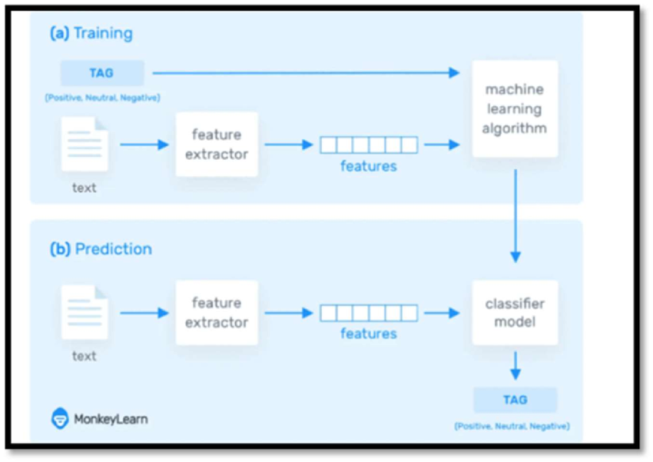
Introduction
Introduction
Dataset
Data Processing
Classifier Tools
Unsupervised Model
Results
Conclusion

Slide 6
Dataset explanation
The Hugging Face dataset used in this project contains data labeled with six distinct emotional categories: anger, fear, joy, love, sadness, and surprise.
This variety allows for comprehensive emotional classification in text, aiding in more accurate sentiment analysis.
Introduction
Dataset
Data Processing
Classifier Tools
Unsupervised Model
Results
Conclusion

Slide 7
Pre-process
The dataset was initially imbalanced, with some emotion labels significantly underrepresented.
To address this, we removed sentences from the overrepresented categories to achieve a more balanced distribution across all six emotions.
This adjustment helps ensure fair and accurate training for the sentiment analysis models.
Introduction
Dataset
Data Processing
Classifier Tools
Unsupervised Model
Results
Conclusion

Slide 8
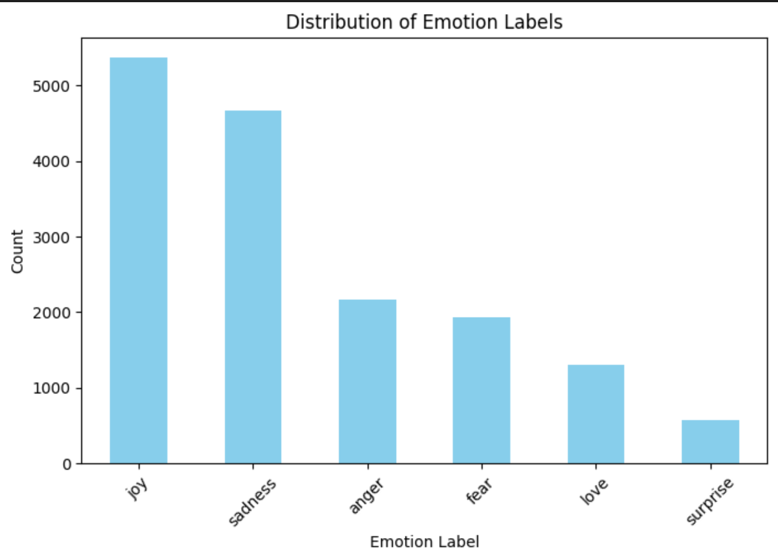
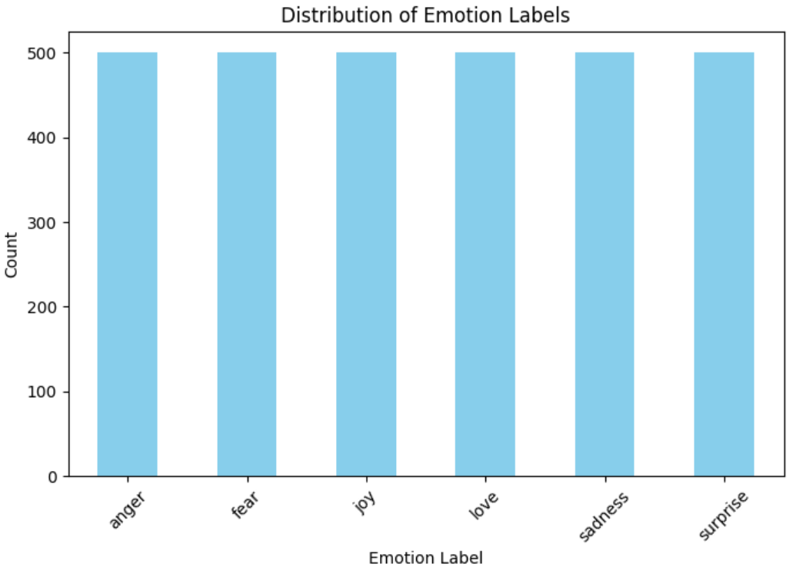
Pre-process
The imbalanced data: The balanced data:
Introduction
Dataset
Data Processing
Classifier Tools
Unsupervised Model
Results
Conclusion

Slide 9
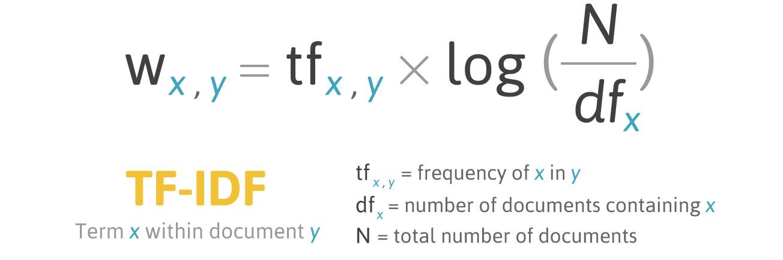
TF-idf
One of the processing tools we choose to work with is: TF-IDF
Short explanation: TF-IDF stands for Term Frequency-Inverse Document Frequency. It is a numerical statistic that reflects the importance of a term (word) in a document relative to a collection of documents (corpus). TF-IDF is commonly used in information retrieval and text mining tasks, such as document classification and search engine ranking.
Introduction
Dataset
Data Processing
Classifier Tools
Unsupervised Model
Results
Conclusion

Slide 10
TF-idf
To optimize the TF-IDF parameters, we employed GridSearchCV, a technique that systematically evaluates a range of parameter values and selects the best combination based on model performance.
The parameters we insert to the Tf-idf model are:
min_df : This parameter sets the minimum document frequency for a term (word or n-gram) to be included in the vocabulary.
max_df : This parameter sets the maximum document frequency for a term to be included in the vocabulary.
ngram_range This parameter defines the range of n-grams to consider. An n-gram is a contiguous sequence of n items from a given sample of text or speech.
max_features This parameter limits the number of features (unique terms or n-grams) to be extracted from the text data.
Introduction
Dataset
Data Processing
Classifier Tools
Conclusion
Unsupervised Model
Results

Slide 11
Count Vectorizer
CountVectorizer is a technique used to convert a collection of text documents into a matrix of token counts.
CountVectorizer converts text into fixed-length vectors by counting how many times each word appears. The tokens are now stored as a bag-of-words.
Key Points:
Simplicity: It is simple and easy to implement. It directly counts the occurrences of each word, which makes it intuitive for understanding word frequencies.
Feature Representation: It transforms text data into a numerical format that can be used as input for machine learning models.
Limitations: It doesn’t capture the context or semantics of words beyond their frequencies. For example, it doesn’t differentiate between different meanings of the same word based on context.
Introduction
Dataset
Data Processing
Classifier Tools
Results
Conclusion
Unsupervised Model

Slide 12
Count-Vectorizer
The process of the countVectorizer:
Tokenization: The CountVectorizer first splits each document into individual tokens (words or terms). This process involves breaking down the text into words or phrases based on spaces and punctuation.
Vocabulary Building: It then constructs a vocabulary of all unique tokens across the entire dataset. Each unique token is assigned a unique index.
Vectorization: Each document is represented as a vector where each element corresponds to a token in the vocabulary. The value at each index of the vector represents the count of that token in the document.
Output Matrix: The final output is a sparse matrix where rows represent documents and columns represent tokens. Each entry in the matrix is the count of the corresponding token in the corresponding document.
Introduction
Dataset
Data Processing
Classifier Tools
Results
Conclusion
Unsupervised Model

Slide 13
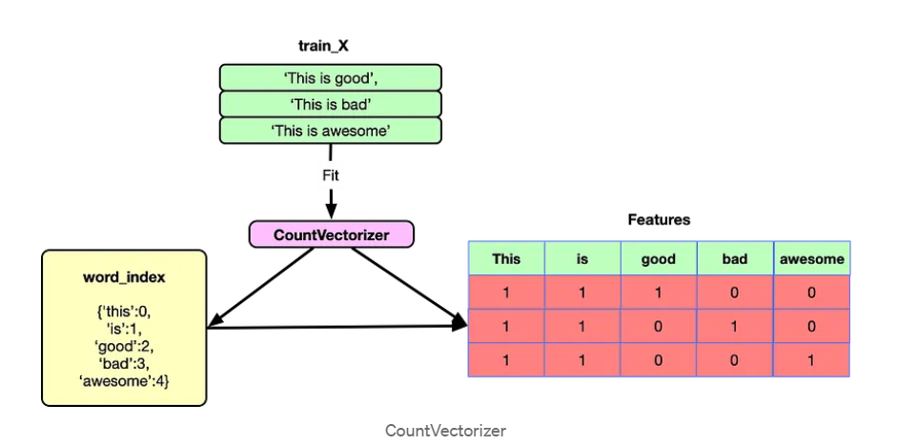
Count-Vectorizer Example
Introduction
Dataset
Data Processing
Classifier Tools
Results
Conclusion
Unsupervised Model

Slide 14
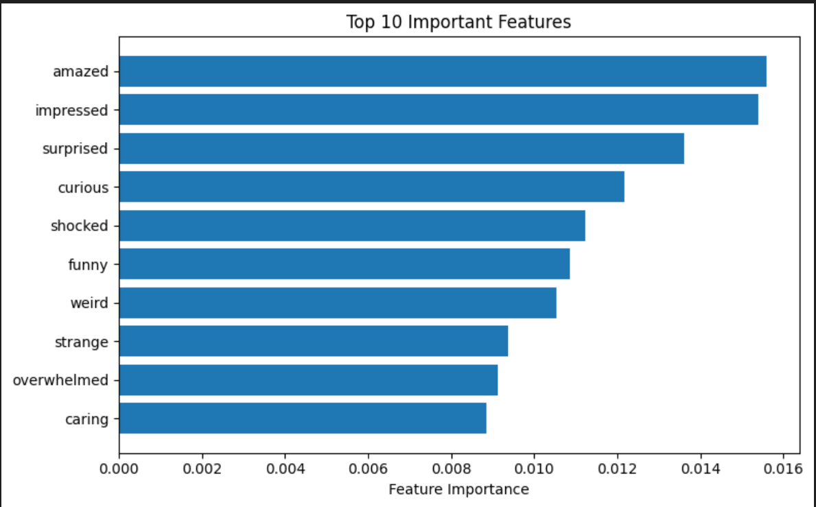
Count-Vectorizer important features
Introduction
Dataset
Data Processing
Classifier Tools
Results
Conclusion
Unsupervised Model

Slide 15
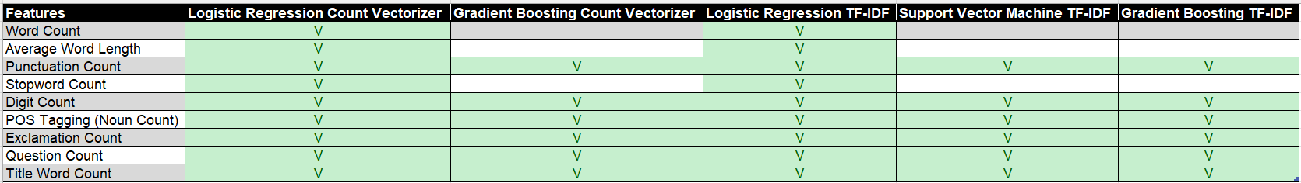
Feature Engineering
Additional features were added to the vectors to enhance model performance.
The features we added are:
Introduction
Dataset
Data Processing
Classifier Tools
Results
Conclusion
Unsupervised Model

Slide 16
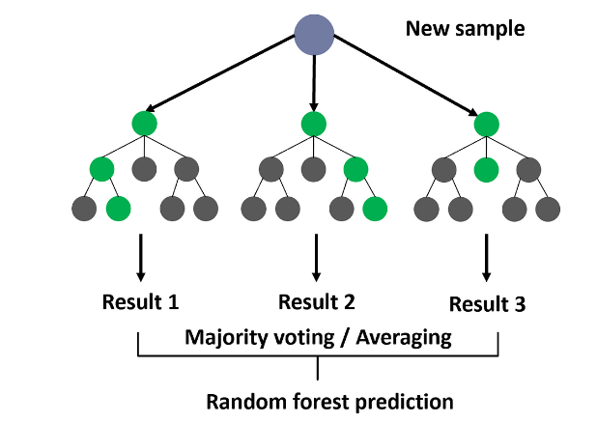
Random forest
Short explanation: Random Forest is a versatile machine learning algorithm that constructs multiple decision trees during training. Each tree is trained on a random subset of the data and a random subset of features. This randomness reduces overfitting and improves generalization. During prediction, it combines the outputs of these trees.
Advantages:
It handles large datasets well
is robust to overfitting
provides insights into feature importance.
Introduction
Dataset
Data Processing
Classifier Tools
Results
Conclusion
Unsupervised Model

Slide 17
Random forest
To optimize the Random forest parameters, we employed GridSearchCV, a technique that systematically evaluates a range of parameter values and selects the best combination based on model performance.
The parameters we insert to the Random Forest model are:
n_estimators: This parameter specifies the number of trees in the random forest. We applied n_estimators = [100, 200]
Random_state: This parameter is used to set the random seed for reproducibility. We applied random_state = 42
n_jobs The number of jobs to run in parallel. We applied n_jobs = [10, 20, None]
Introduction
Dataset
Data Processing
Classifier Tools
Results
Conclusion
Unsupervised Model

Slide 18
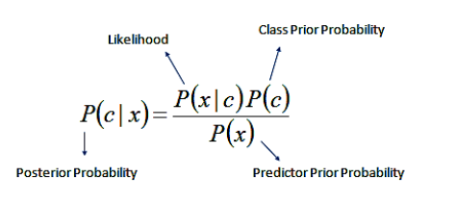
Naive Bayes
Short explanation: The Naive Bayes classifier is a probabilistic model that uses Bayes' theorem to predict data classes based on feature probabilities, assuming features are independent given the class. The model calculates prior probabilities of classes and the likelihood of features given each class, then predicts the class with the highest posterior probability for new data.
Advantages:
Simple and Fast
Handles Large Datasets Well
Robust to Irrelevant Features
Introduction
Dataset
Data Processing
Classifier Tools
Results
Conclusion
Unsupervised Model

Slide 19
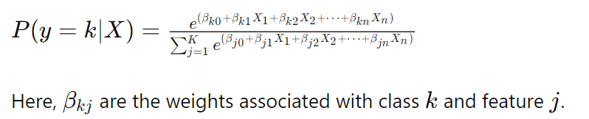
Logistic regression
Short explanation:
Logistic regression, extended to multiclass classification via multinomial logistic regression (or softmax regression), models class probabilities using the softmax function.
The model calculates probabilities for each class and assigns the class with the highest probability to new data points.
Introduction
Dataset
Data Processing
Classifier Tools
Results
Conclusion
Unsupervised Model

Slide 20
Logistic regression
To optimize the model parameters, we employed GridSearchCV
The parameters we insert to the model are:
C This is the inverse of regularization strength. Smaller values specify stronger regularization, which helps prevent overfitting by penalizing larger coefficients in the model. We applied C = [0.01, 0.1, 1, 10, 100]
Solver This parameter specifies the algorithm used to optimize the model's parameters. We applied solver = ['newton-cg', 'lbfgs', 'liblinear’]
max_iter This parameter sets the maximum number of iterations that the solver will use to converge to a solution We applied max_iter = 1000
Introduction
Dataset
Data Processing
Classifier Tools
Results
Conclusion
Unsupervised Model

Slide 21
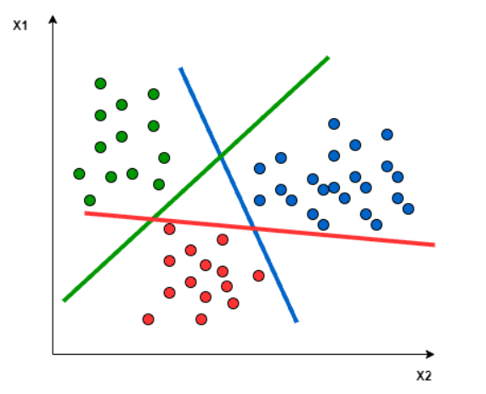
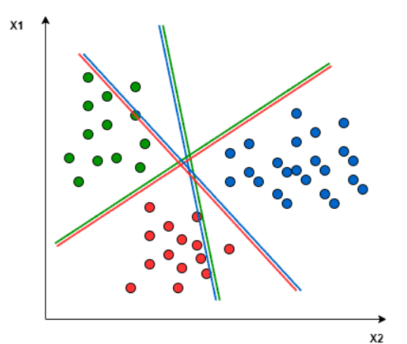
Support Vector Machine (SVM)
Short explanation: SVM is a powerful supervised learning algorithm used for classification and regression tasks. It works by finding the optimal hyperplane that separates different classes in the feature space with the maximum margin. This hyperplane is determined by the support vectors, which are the data points closest to the hyperplane and crucial for defining its position.
One-to-Rest
Approach:
One-to-One
Approach:
Introduction
Dataset
Data Processing
Classifier Tools
Results
Conclusion
Unsupervised Model

Slide 22
Support Vector Machine (SVM)
To optimize the model parameters, we employed GridSearchCV
The parameters we insert to model are:
Kernel This specifies the type of kernel function to be. The kernel function transforms the data into a higher-dimensional space to make it easier to find a separating hyperplane. We applied kernel = ‘linear’
C This specifies the regularization parameter. It controls the trade-off between achieving a low training error and a low testing error. A smaller `C` value encourages a larger margin and simpler decision boundary, which can help prevent overfitting. We applied C = [0.1, 1, 10]
Introduction
Dataset
Data Processing
Classifier Tools
Results
Conclusion
Unsupervised Model

Slide 23
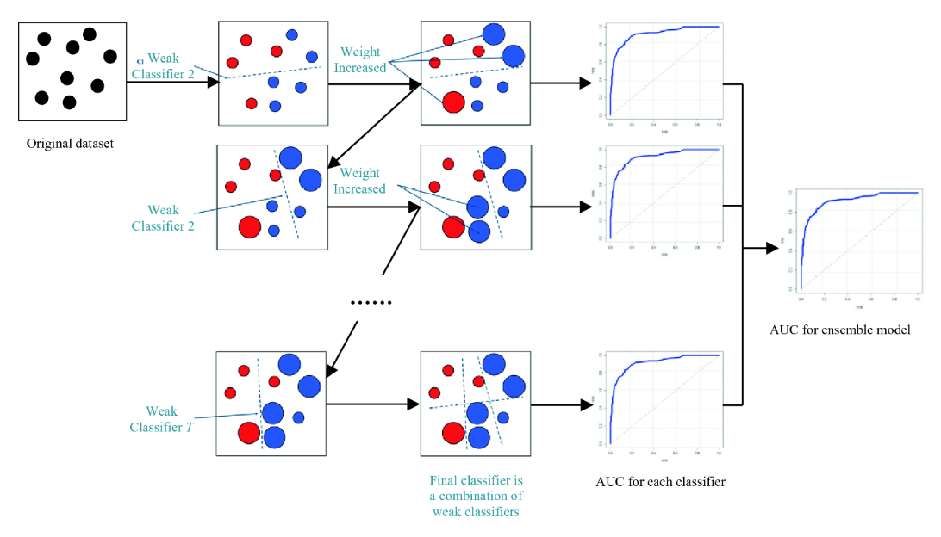
Gradient Boosting
Gradient Boosting is an ensemble machine learning technique used for classification and regression tasks. It builds a model by combining the predictions of multiple weak learners, typically decision trees, in a sequential manner to improve accuracy. The key idea is to correct the errors of previous models iteratively, focusing on the residuals (errors) that remain.
Introduction
Dataset
Data Processing
Feature Engineering
Classifier Tools
Results
Conclusion
Notes:
https://datascience.eu/machine-learning/gradient-boosting-what-you-need-to-know/

Slide 24
Gradient Boosting
How it works?
Initialization: Start with a simple model, like the mean of target values.
Iterative Improvement: Train a new decision tree on the residuals of the current model, correcting errors from previous iterations.
Update Predictions: Add the new tree's predictions to the existing model's predictions, adjusted by a learning rate.
Repeat: Continue this process for a set number of iterations or until improvement stops.
Introduction
Dataset
Data Processing
Classifier Tools
Results
Conclusion
Unsupervised Model

Slide 25
Gradient Boosting
The parameters we insert to the Random Forest model are:
n_estimators: This parameter specifies the number of trees in the ensemble. It is affecting model performance and computation time. We applied n_estimators = [100, 200]
Learning rate: Step size for each tree's contribution, balancing between model accuracy and overfitting. We applied learning_rate = [0.01, 0.1]
Maximum depth Maximum depth of each tree, controlling complexity and risk of overfitting. We applied max_depth = [3, 5]
Introduction
Dataset
Data Processing
Classifier Tools
Results
Conclusion
Unsupervised Model

Slide 26
Training Techniques
Pipeline: Integrated preprocessing and model training steps to streamline the workflow.
GridSearchCV: Used for hyperparameter tuning to find the best model settings.
Feature Integration: Added custom features to improve model accuracy and performance.
SelectKBest Focuses on the most significant features, reducing dimensionality and improving model results.
Introduction
Dataset
Data Processing
Classifier Tools
Results
Conclusion
Unsupervised Model

Slide 27
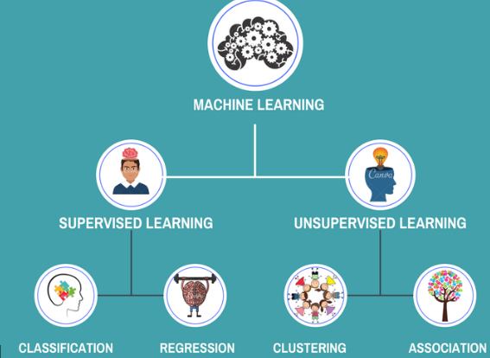
machine learning
Supervised Learning: In supervised learning the model is trained on a labeled dataset and learns to map inputs to corresponding outputs.
Unsupervised Learning: Unsupervised learning involves training a model on unlabeled data without explicit output labels.
Introduction
Dataset
Data Processing
Classifier Tools
Results
Conclusion
Unsupervised Model

Slide 28
Short explanation
Objective: Analyze movie reviews from the IMDB dataset to classify sentiments into positive or negative using K-Means clustering.
Approach:
Preprocess the text data by removing digits, punctuation, and converting to lowercase.
Convert text to numerical features using TF-IDF.
Apply K-Means clustering to group similar sentiments.
Evaluate cluster quality and classify sentiments.
Introduction
Dataset
Data Processing
Classifier Tools
Results
Conclusion
Unsupervised Model

Slide 29
IMDB Dataset Overview
Source: IMDB movie reviews dataset.
Components:
Text: Movie reviews (e.g., "This movie was fantastic!").
Labels: Sentiment labels (0 for negative, 1 for positive).
Objective: To perform sentiment analysis and assess the performance of clustering-based classification.
Introduction
Dataset
Data Processing
Classifier Tools
Results
Conclusion
Unsupervised Model

Slide 30
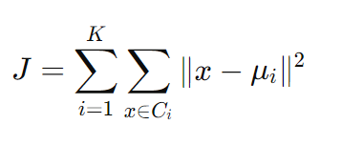
K-Means Clustering Approach
K-Means clustering is an unsupervised machine learning algorithm used to partition data into K distinct clusters based on feature similarity.
Algorithm:
Choose K (number of clusters)
Randomly initialize K centroids
Assign each data point to nearest centroid
Recalculate centroids as mean of assigned points
Repeat steps 3-4 until convergence
Introduction
Dataset
Data Processing
Classifier Tools
Results
Conclusion
Unsupervised Model

Slide 31
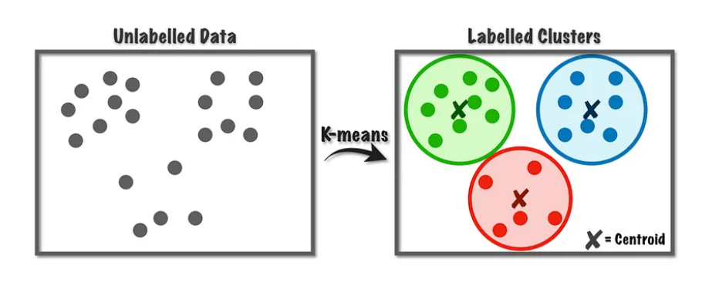
K-Means Clustering Approach
K-Means clustering is an unsupervised machine learning algorithm used to partition data into K distinct clusters based on feature similarity.
Advantages:
Simple and easy to implement.
Efficient with large datasets.
Limitations:
Requires specifying the number of clusters in advance.
Assumes clusters are of similar size and density.
Introduction
Dataset
Data Processing
Classifier Tools
Results
Conclusion
Unsupervised Model

Slide 32
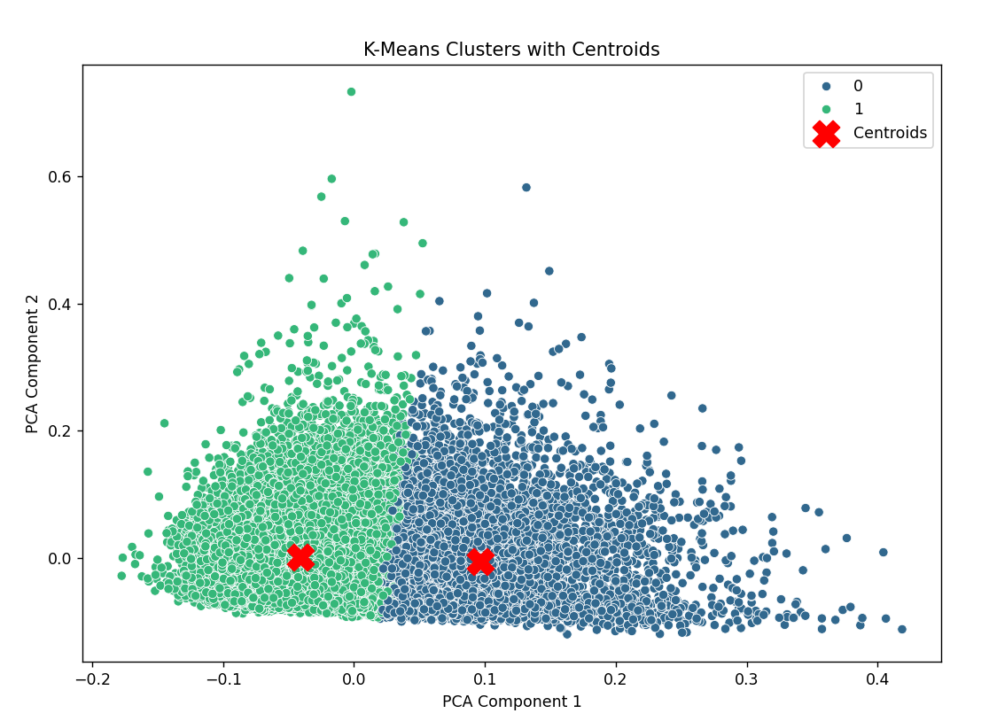
Unsupervised results
Unfortunately, the accuracy percentages are not good enough
Accuracy: 58% correct classification rate.
PCA Visualization: Reduced feature dimensions to visualize clusters in 2D space.
Introduction
Dataset
Data Processing
Classifier Tools
Results
Conclusion
Unsupervised Model

Slide 33
supervised results
Evaluation results of proposed approach:
Accuracy | processor | Classifier
89.50% | Count Vectorizer | Gradient Boosting (GB)
88.80% | TF-IDF | Gradient Boosting (GB)
81.70% | TF-IDF | Random Forest (RF)
84.20% | Count Vectorizer | Random Forest (RF)
77.60% | TF-IDF | Naive Bayes (BNB)
69.70% | Count Vectorizer | Naive Bayes (BNB)
78.30% | TF-IDF | Logistic Regression (LR)
78.60% | Count Vectorizer | Logistic Regression (LR)
75.90% | TF-IDF | Support Vector Machine (SVM)
81.70% | Count Vectorizer | Support Vector Machine (SVM)
Introduction
Dataset
Data Processing
Classifier Tools
Results
Conclusion
Unsupervised Model

Slide 34
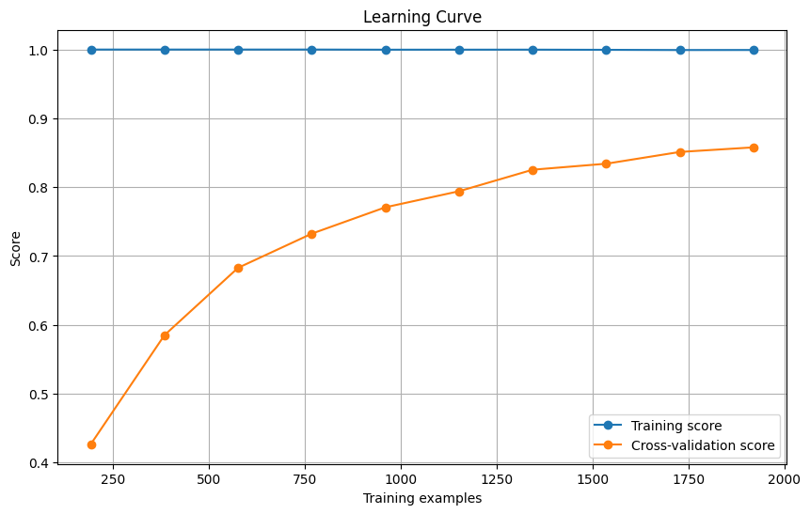
Learning Curve
Evaluation results of the Gradient Boosting classifier with the Count Vectorizer:
Introduction
Dataset
Data Processing
Classifier Tools
Results
Conclusion
Unsupervised Model

Slide 35
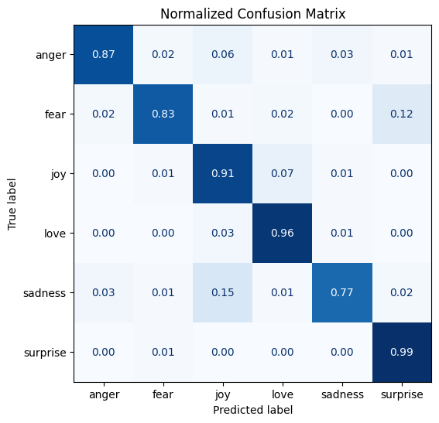
Confusion Matrix
Evaluation results of the Gradient Boosting classifier with the Count Vectorizer:
Introduction
Dataset
Data Processing
Classifier Tools
Results
Conclusion
Unsupervised Model

Slide 36
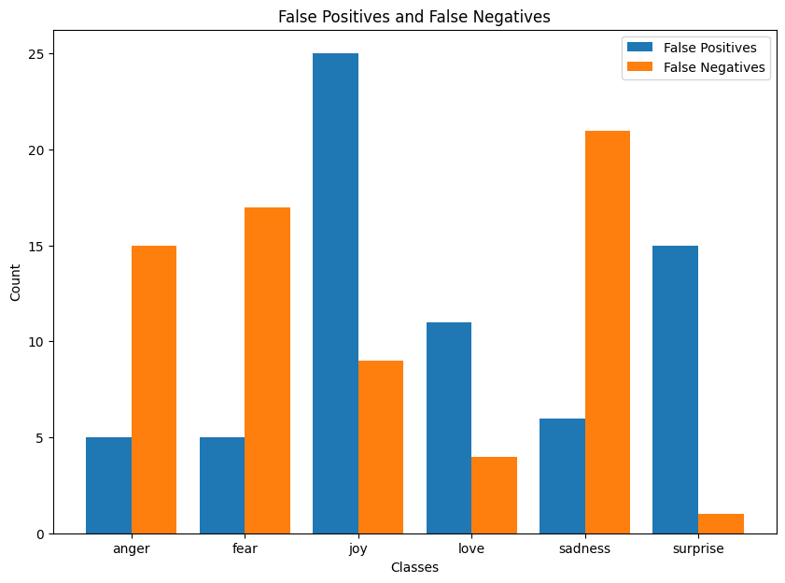
False positive and negative
Evaluation results of the Gradient Boosting classifier with the Count Vectorizer:
Introduction
Dataset
Data Processing
Classifier Tools
Results
Conclusion
Unsupervised Model

Slide 37
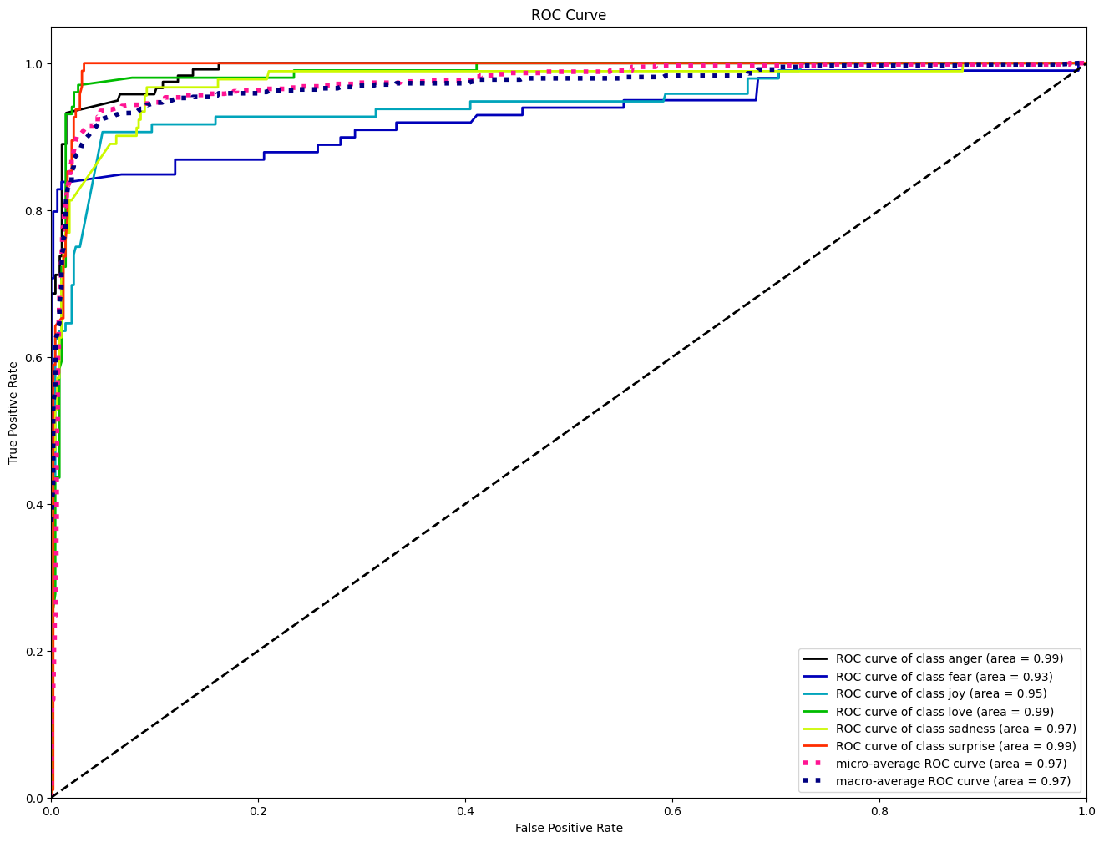
Roc crave
Evaluation results of the Gradient Boosting classifier with the Count Vectorizer:
Introduction
Dataset
Data Processing
Classifier Tools
Results
Conclusion
Unsupervised Model

Slide 38
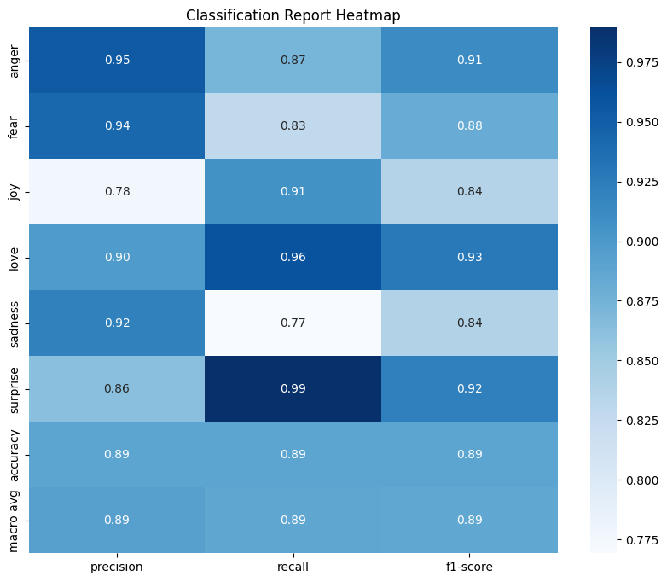
Classification report
Evaluation results of the Gradient Boosting classifier with the Count Vectorizer:
Introduction
Dataset
Data Processing
Classifier Tools
Results
Conclusion
Unsupervised Model

Slide 39

Difficulties Encountered
Lack of Reference Articles: We struggled to find articles that suggest appropriate features for sentiment analysis, necessitating independent feature engineering.
AdaBoost Classifier Performance: Despite planning to use AdaBoost, it yielded very poor results, necessitating a reconsideration of our approach.
Introduction
Dataset
Data Processing
Classifier Tools
Results
Conclusion
Unsupervised Model

Slide 40
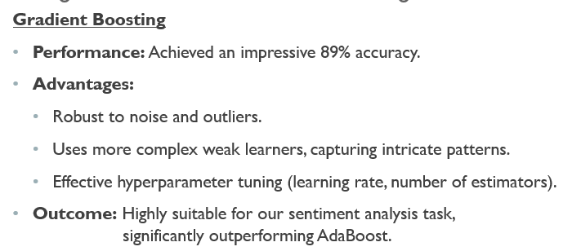
Adaboost vs Gradient Boosting
AdaBoost
Performance: Achieved only 42% accuracy.
Challenges:
- Highly sensitive to noisy data and outliers.
- Uses simple weak learners (e.g., decision stumps).
- Required extensive tuning, but still underperformed.
Outcome: Not suitable for our sentiment analysis task.
Introduction
Dataset
Data Processing
Classifier Tools
Results
Conclusion
Unsupervised Model

Slide 41
summery
Effective Methodology: Our approach combined various feature extraction techniques and classification models to identify the most effective method for sentiment analysis on our dataset.
Challenges Overcome: Despite difficulties in feature engineering and the underperformance of some models, we successfully adapted our approach to find the optimal solution.
Robust Results: Gradient Boosting, coupled with Count Vectorizer, provided the best performance, demonstrating the importance of selecting appropriate models and feature extraction methods for sentiment analysis.
Introduction
Dataset
Data Processing
Classifier Tools
Results
Conclusion
Unsupervised Model

Slide 42
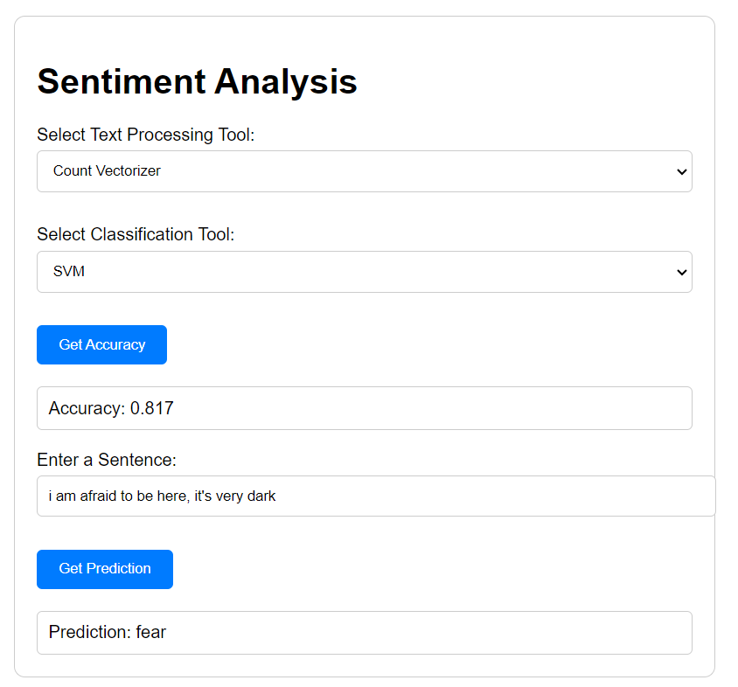
demo
Try it Yourself
Introduction
Dataset
Data Processing
Classifier Tools
Results
Conclusion
Unsupervised Model

Slide 43
The end
Thank you for listening
☺ ☺ ☺

