Slide 1

Final Year Project Mid Sem Presentation
On
Supervised learning for big social data analysis
Submitted by :
Chandan Partap Singh(151456)
Ashwani Tandon(151465)
Group No: 193
Faculty Guide:
Dr. Hari Singh

Slide 2
Contents
Introduction
Importance of Machine Learning
Types of Learning
Algorithms for Supervised Learning
Related Work
Software Process Model
System Design
Gantt Chart
Implementation
Results
Conclusion
References

Slide 3
Introduction
In an era of social media and connectivity, web users are becoming increasingly enthusiastic about working together through online media.
With a growing impact on everyday life, such as in education, health, commerce and tourism, leading to an exponential growth in the size of the social web.
However, the structuring of knowledge from such unstructured big data is an extremely challenging task.
We will hence focus on extracting useful information from big social data.

Slide 4
Machine Learning
Machine learning is a field of artificial intelligence that uses statistical techniques to give computer systems the ability to "learn" from data, without being explicitly programmed.

Slide 5
Importance of Machine Learning
Machine learning proposes clever alternatives to analysing huge volumes of data. Machine learning is able to produce accurate results and analysis by developing efficient, fast algorithms and data-driven models for real-time processing of this data.
Machine learning has been used in a number of places like the self-driving cars, the online recommendation engines – friend recommendations on social media, offer recommendations from e-commerce sites, and in cyber fraud detection.

Slide 6
Types of Learning
Supervised Learning
Unsupervised Learning
Semi-Supervised Learning

Slide 7
Algorithms for Supervised Learning
C4.5
Support Vector Machines (SVM)
Naïve Bayes
Adaboost
K-nearest neighbour

Slide 8
Comparison Table for Supervised Learning Algorithms
Algorithms | Description | Example | Tools
C4.5 | Builds a classifier in form of a decision tree. | Patient-> Cancer-> Tumour Size | Weka
SVM | Hyperplane is used to classify the data. Regression is used to predict the future outcomes. | Bunch of red and blue balls. Use Hyperplane if required. | MATLAB
Naïve Bayes | Family of class algorithms. Used to predict the classes. | 1000 Fruits Classes: Banana, Apple Features: Long, Sweet, Yellow | Weka
Adaboost | Boosting Algorithm Uses Classification Strong Learner | Face Detection | Scikit-learn
K nearest neighbour | Uses Classification Lazy Learner Determines how close data is related. | Credit Rating Video/Image Recognition | MATLAB Scikit Learn

Slide 9
Related Work
People have used Deep Learning and graph algorithms to relate the data of the users from one to another and used link analysis to find the relations between data and users for prediction. Link analysis is a data-analysis technique used to evaluate relationships between nodes. Relationships may be identified among various types of nodes, including organizations, people and transactions
People have used Sentiment analysis to identify and categorize opinions expressed in a piece of text, especially in order to determine whether the writer's attitude towards a particular topic, product, etc. is positive, negative, or neutral. Sentiment analysis is widely applied to voice of the customer materials such as reviews and survey responses, online and social media, and healthcare materials for applications that range from marketing to customer service to clinical medicine.

Slide 10
Contd..
People have analysed data from Facebook walls of 153 public organisations using unsupervised machine learning techniques to understand the characteristics of user engagement and post-performance. Their analysis indicates an increasing trend of user engagement on public health posts during recent years. Based on the clustering results, their analysis shows that Photo and Link type posts are most favourable for high and medium user engagement respectively.
Research has also been done using semi-supervised learning model based on the combined use of random projection scaling as part of a vector space model, and support vector machines to perform reasoning on a knowledge base. It is developed by merging a graph representation of common sense with a linguistic resource for the lexical representation of affect.

Slide 11
Software Process Model
Incremental Model Development
Why Incremental Model Development ?
More flexible – less costly to change scope and requirements
Easier to test and debug during a smaller iteration
Each iteration is an easily managed milestone.

Slide 12
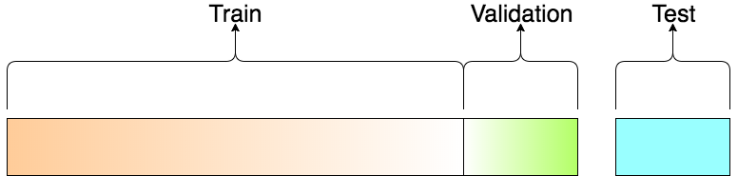
System Design
There are three phases in designing a model:
Training Data
Validation Dataset
Test Data.
3 phases of training data

Slide 13
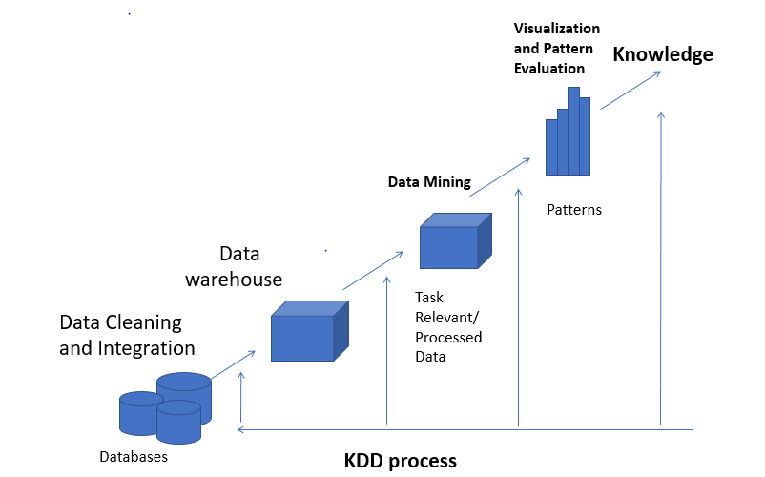
Knowledge Discovery in Databases
Knowledge discovery in databases (KDD) is the process of discovering useful knowledge from a collection of data.
Steps followed in KDD Process are as follows:
Data Cleaning
Data Integration
Data Selection
Data Transformation
Data Mining
Pattern Evaluation
Knowledge Presentation

Slide 14
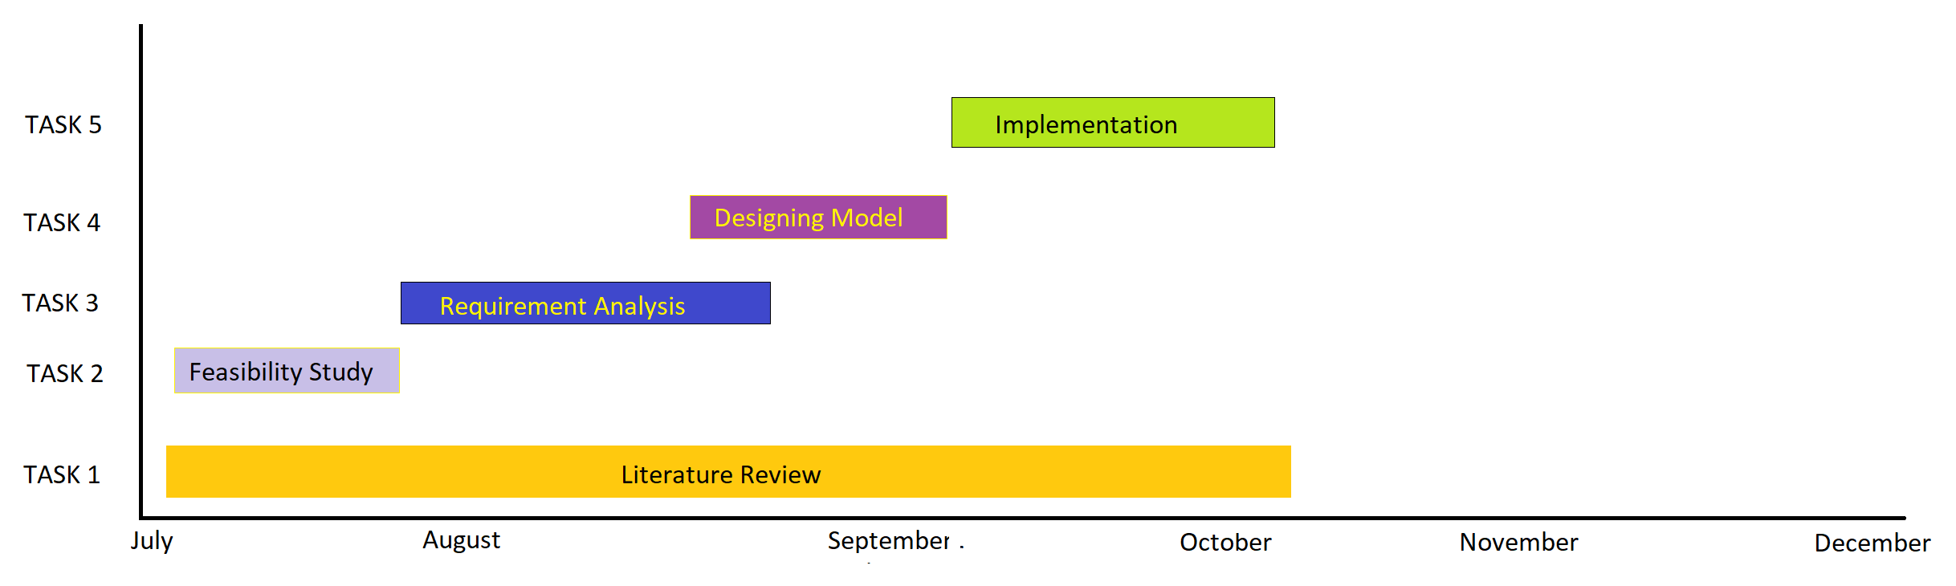
Gantt Chart

Slide 15
What we have done till now
We have gone through literature and information from research papers. We have reviewed most popular algorithms which could have assisted us in this project and selected only one of them based on the flexibility or resources available.
We have used Python for basic implementation of this project and using built in libraries we have come up with some useful results.
We have made one classifier based on the gender of the user and mined knowledge about the friend requests sent or received by his/her.

Slide 16
What we are planning further
We plan to make more classifiers using the one which we have made, that would help us to predict user trends or behaviour and could help us to target types of users.
Through complex analysis, it is possible to predict specific behaviour in users of the applications.
We will further predict which age group on social media is least/most active and how much time users spend on social media on different devices like mobiles/tablets/laptops through their activity on respective devices.

Slide 17
Implementation
Language used: Python
Why Python?
Python does contain special libraries for machine learning namely Pandas, matplotlib.pyplot and seaborn which are great for linear algebra and getting to know kernel methods of machine learning. The language is great to use when working with machine learning algorithms and has easy syntax relatively.
Dataset: Facebook Structured data with records of around 100000 users with columns like userid, age, dob_day, dob_year, dob_month, gender, tenure, friend_count, friendships_initiated and likes.

Slide 18
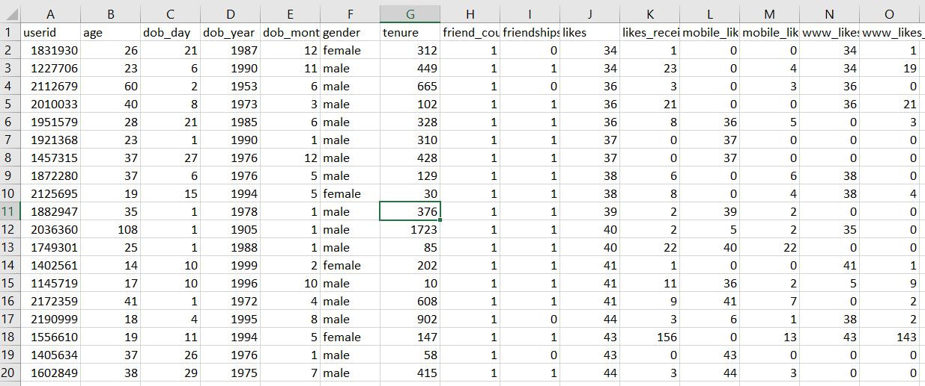
Snapshot of Dataset
Table 2: Facebook Dataset Snapshot from www.kaggle.com(pseudo_facebook.csv)

Slide 19
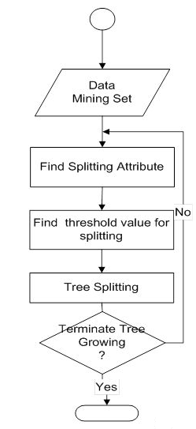
Implemented Algorithm
It constructs a classifier in the form of a decision tree. Classifier is a tool that attempts to predict which class the new data belongs to.
C4.5 can work with both continuous and discrete data. It does this by specifying ranges or thresholds for continuous data thus turning continuous data into discrete data.

Slide 20
Libraries Used:
Pandas: It offers operations for manipulating data.
matplotlib.pyplot : Provides pie-charts for plotting data.
seaborn: Provides bar-graphs for plotting data.

Slide 21
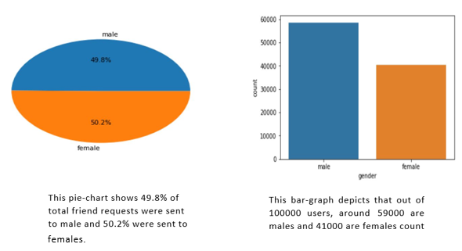
Results

Slide 22
System Requirements
Software used: Jupyter NoteBook
Why Jupyter NoteBook?
It turns into latex reports really easy. It also turn into slideshows really easy. It also lets you run blocks of code really easily.
Some other alternatives: PyCharm, RStudio
Minimum Hardware Requirements:
Pentium processor ---1 GHz or above
RAM Capacity ---1GB
Hard Disk ---- 80GB

Slide 23
Conclusion
We have learnt how machine learning algorithm help us to fabricate big-social data.
Though there are many algorithms such as C4.5, Adaboost, KNN, yet we have specifically used C4.5 in this project as it provides a flexible environment, improved performance than others with greater efficiency and less complexity.
As our project revolves around classification, hence C4.5 is the best choice to implement it as C4.5 creates a decision tree which performs seamless classification.

Slide 24
References
Elder, J., and Pregibon, D. A statistical perspective on KDD. In Advances in Knowledge Discovery and Data Mining, U. Fayyad, G. Piatetsky-Shapiro, P. Smyth, and R. Uthurusamy, Eds. AAAI/MIT Press, Cambridge, Mass., 1996.
S. Aral and D. Walker, “Identifying Influential and Susceptible Members of Social Networks,” Science, vol. 337, pp. 337-341, 2012.

Slide 25
References
V.Shaw and R. Khurana, “Using Deep Learning Neural Networks To Find Best Performing Audience Segments" Feb 2013
R. Ahmed and G. Karypis, “Algorithms for Mining the Evolution of Conserved Relational States in Dynamic Networks,” Knowledge and Information Systems, vol. 33, no. 3, pp. 603-630, Dec. 2012.

Slide 26

References
Huang, Po-Sen; He, Xiaodong; Gao, Jianfeng; Deng, Li; Acero, Alex; Heck, Larry (2013-10-01). "Learning Deep Structured Semantic Models for Web Search using Social Data". Microsoft Research.
Ribeiro, Filipe Nunes; Araujo, Matheus (2010). "A Benchmark Comparison of State-of-the-Practice Sentiment Analysis Methods". Transactions on Embedded Computing Systems.

