Slide 1
Wage and Social Determinants Data Hunters, Inc. Sep 29, 2021

Slide 2
Why This Topic?
To Survive
To Plan
To Build a Future for next generations
Let’s Solve people’s concerns:
What are the main factors affecting our wage?
How can we improve it?

Slide 3

Data
2016 Canadian Census

Slide 4
Technology and Tools Used
Dataset:
Raw Data (Website)
Filtered & Cleaned Data (Scada & Python)
Scaled Data (Python)
Model:
Multiple Linear Regression (Python)
Visualization (Scada)

Slide 5
Technology and Tools Used
SCADA is the acronym for Supervisory Control and Data Acquisition.
SCADA is a computer-based system for gathering and analyzing real-time data to monitor and control equipment that deals with critical and time-sensitive materials or events.

Slide 6
Variables
Age
Years of Education (YrEd, YrEd2)
STEM
Minimum Wage of residence: (PrMinWage_V)
Sex
Marital Status
Visible minority (VinMin)
Type of Job (Part-Time)

Slide 7
Age
We included Age variable because an individual's age is known to affect one's wage. If someone is young, they might be perceived to be without experience by employers.

Slide 8
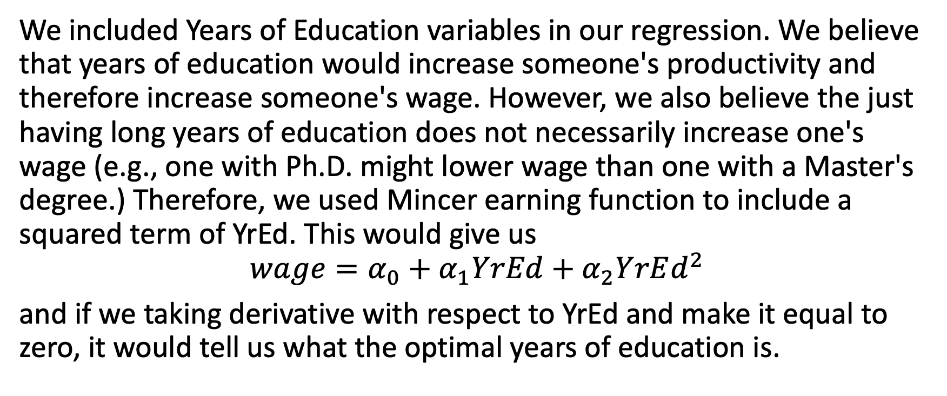
Years of Education (YrEd, YrEd2)
We included Years of Education variables in our regression. We believe that years of education would increase someone's productivity and therefore increase someone's wage. However, we also believe the just having long years of education does not necessarily increase one's wage (e.g., one with Ph.D. might lower wage than one with a Master's degree.) Therefore, we used Mincer earning function to include a squared term of YrEd. This would give us
$$wage=α_{0}+α_{1}YrEd+α_{2}YrEd^{2}$$
and if we taking derivative with respect to YrEd and make it equal to zero, it would tell us what the optimal years of education is.

Slide 9
STEM
We included a binary variable that indicated whether one's higher education is considered to be in the field of STEM (Science, technology, engineering, and mathematics). It is widely believed that people with STEM degrees receive a higher wage compared to their counterparts without a STEM degree. If someone without higher education, we would consider them without STEM (i.e., STEM = 0)

Slide 10
Minimum Wage of residence: (PrMinWage_V)
We believe that the provincial minimum wage would affect one's wage because a higher minimum wage might push up wage for the overall population by serval economic mechanism; thus, we included a variable indicating the min wage of the province of one's residence.

Slide 11
Sex
We included a Sex variable indicating the reported gender/sex of the observation. It is observed that there is a wage discrepancy between males and females.

Slide 12
Married
We included a current marital status (including common law unions) in our independent variables because it has been observed that marital status can affect someone's wage.

Slide 13
Visible minority (VinMin)
We included a variable that is a binary asking respondents whether they self-identified as a visible minority (i.e., VinMin = 1 if yes). It has been widely documented that being a visible minority would decrease one's wage

Slide 14
Part-Time
We included a binary variable that indicates whether one has a part-time job or not. It is believed that a part-time worker earns less than that of full-time workers.

Slide 15

Methods
Multivariate Regression:
$$wage=β_{0}+β_{i}V_{i}+ε$$

Slide 16
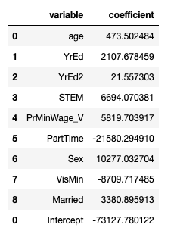
Result
Results

Slide 17
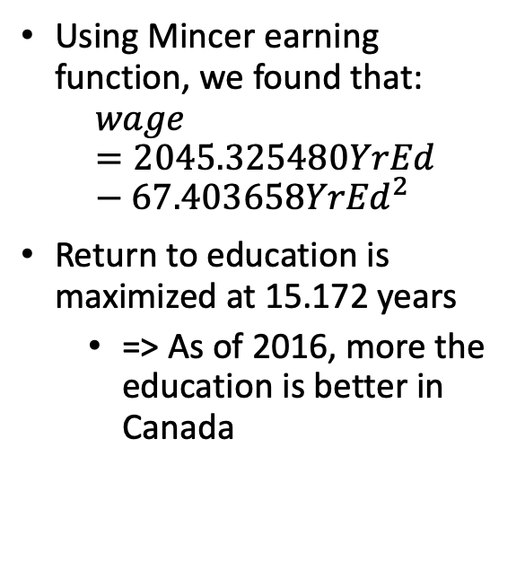
Results: Years of Education
Using Mincer earning function, we found that:
$$wage=2045.325480YrEd−67.403658{YrEd}^{2}$$
Return to education is maximized at 15.172 years
=> As of 2016, more the education is better in Canada

