Slide 1
DSA SELF PACED
16 WEEKS SUMMER TRAINING
BY
GEEKS FOR GEEKS

Slide 2
COURSE CODE: CAP-368
SUBMITTED BY:-
Ashwani Pandey
Reg No:12211155
​

Slide 3
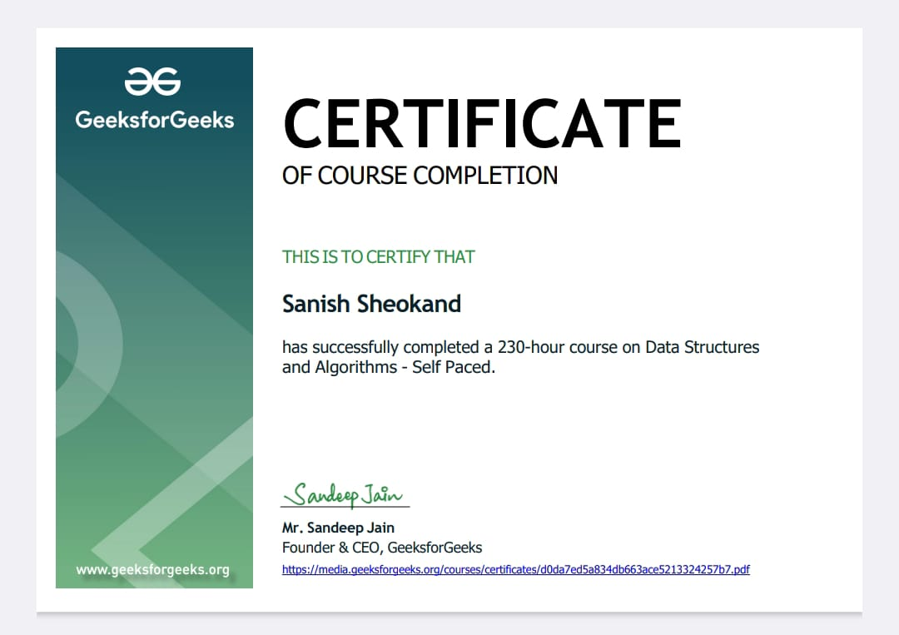

Slide 4
ABOUT SUMMER TRAINING:
It is an online Summer Training Program by Geeks For Geeks on Data Structures And Algorithms(Self-Paced).
The training started with basic data structures like Arrays, Strings and recursion, to the implementation of complex algorithms like dynamic programming, Segment trees and backtracking.
And in the end, I prepared well planned mini project about a small game called Sudoku solver using Backtracking algorithm.

Slide 5
Why this course?
This course is complete package that helped me learn Data Structures and Algorithms from basic to advanced level.
The course curriculum is divided into 8 weeks where one can practice questions and attempt the assessments according to their own pace.
This course offered a wealth of programming challenges that helped me to prepare for interviews with any company requirements.
Data Structures and Algorithms goes through solutions to standard problems in detail and gives us an insight into how efficient it is in use each one of them. It also teaches you the science of evaluating the efficiency of an algorithm. This enables you to choose the best of various choices.

Slide 6
Primary Goals:
1. Being able to solve problem on Data Structures and Algorithms.
2. Efficiency in writing code.
3. Understanding complex algorithms like dynamic programming, segment trees and backtracking.

Slide 7
Why DSA is important:
Data structures and Algorithms are an essential part of computer science because they help us to store, process and analyse large amount of data.
Without these tools it is practically impossible to collect, store and analyse all the data that is generated by computers around the world. In data structures, we learn how to organise data using various techniques , such as arrays and linked lists.
In algorithms we study various ways that computers can be programmed to solve problems

Slide 8
Summary:
With the idea of imparting programming knowledge, Geeks For Geeks helped me a lot to ace Data Structures and Algorithms. It is a one stop solution for all programming requirements.
With every tick of time, I have learnt about new technologies and various tools that are very helpful for my interviews and other competitive tests.
Following slide consists of the mini game project called Sudoku solver by using Backtracking algorithm.

Slide 9
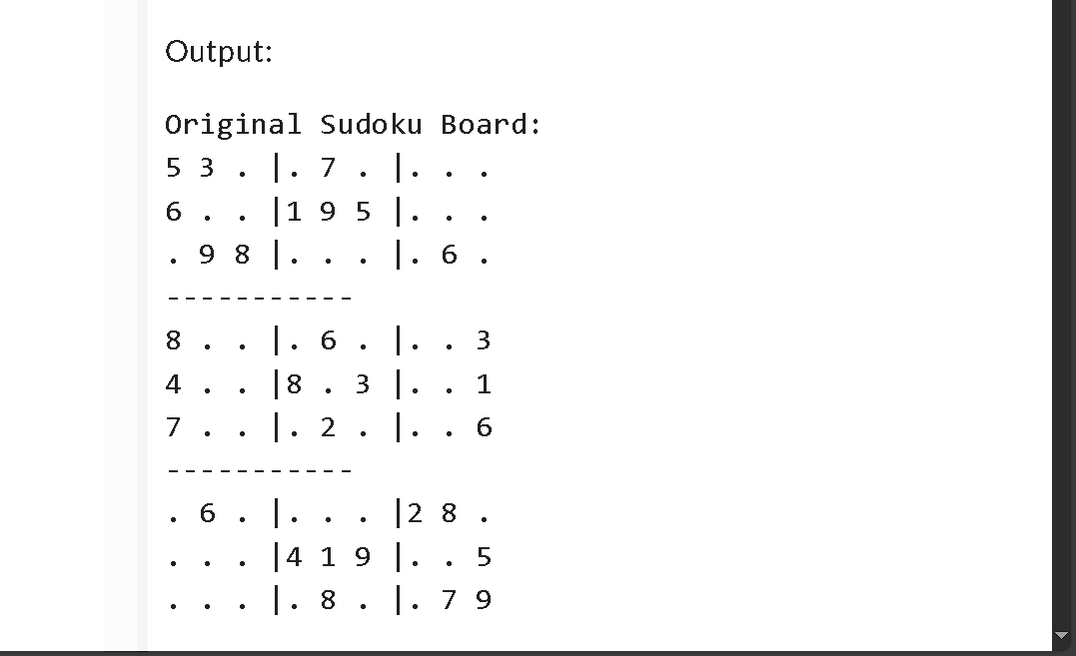
Sudoku solver (Project Illustration):

Slide 10
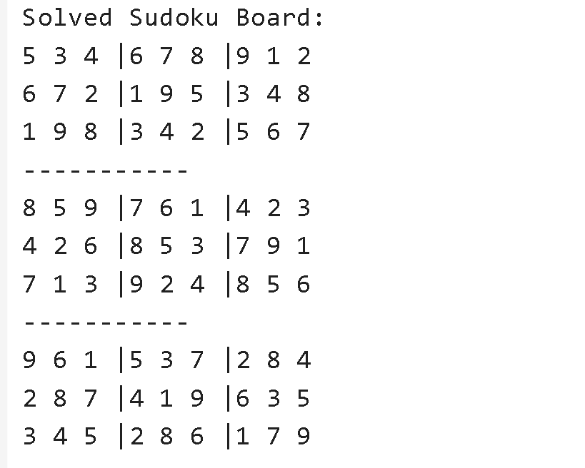
Sudoku solver (Project Illustration):

Slide 11
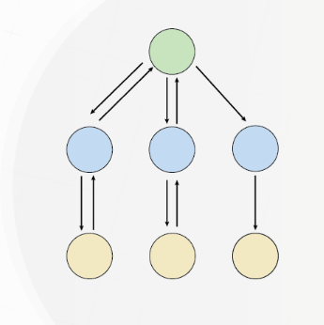
Backtracking algorithm
Backtracking is a method of solving problems recursively by trying out every possible solutions and undoing choices that lead to the dead end.
In this method, if it finds that the current step does not lead to a valid or optimal solution, it "backtracks" by undoing the last step and tries a different path.
The backtracking algorithm follows brute force approach which says that for any given problem we should try all possible solutions and pick the desired solution.

Slide 12
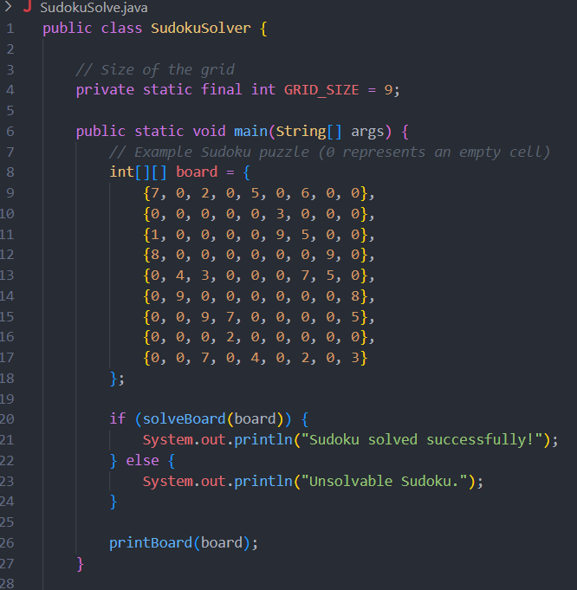
Sudoku solver (Project Illustration):
SudokuSolver class contain the main logic
GRID_SIZE can not be changed after initialized
This 2D-array represent the sudoku-grid
All the 0’s represents the empty cells needed to be filled
This method is called to attempt to solve sudoku.
If sudoku is solved the it will print successful other wise unsolvable sudoku.

Slide 13
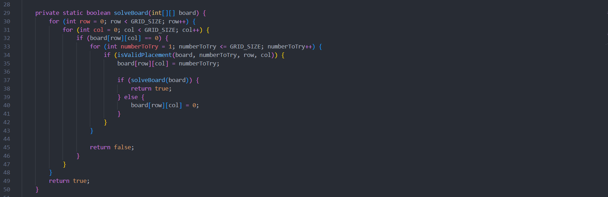
Code Explanation
This loop iterates over each row in the Sudoku board.
This loop iterates over each column in the Sudoku board.
Checks if cell is empty
Iterate from 1 to 9
isValidPlacement function checks the sudoku rules, if true it assines that value to empty cell
Recursive call
Else values remains 0 Empty

Slide 14
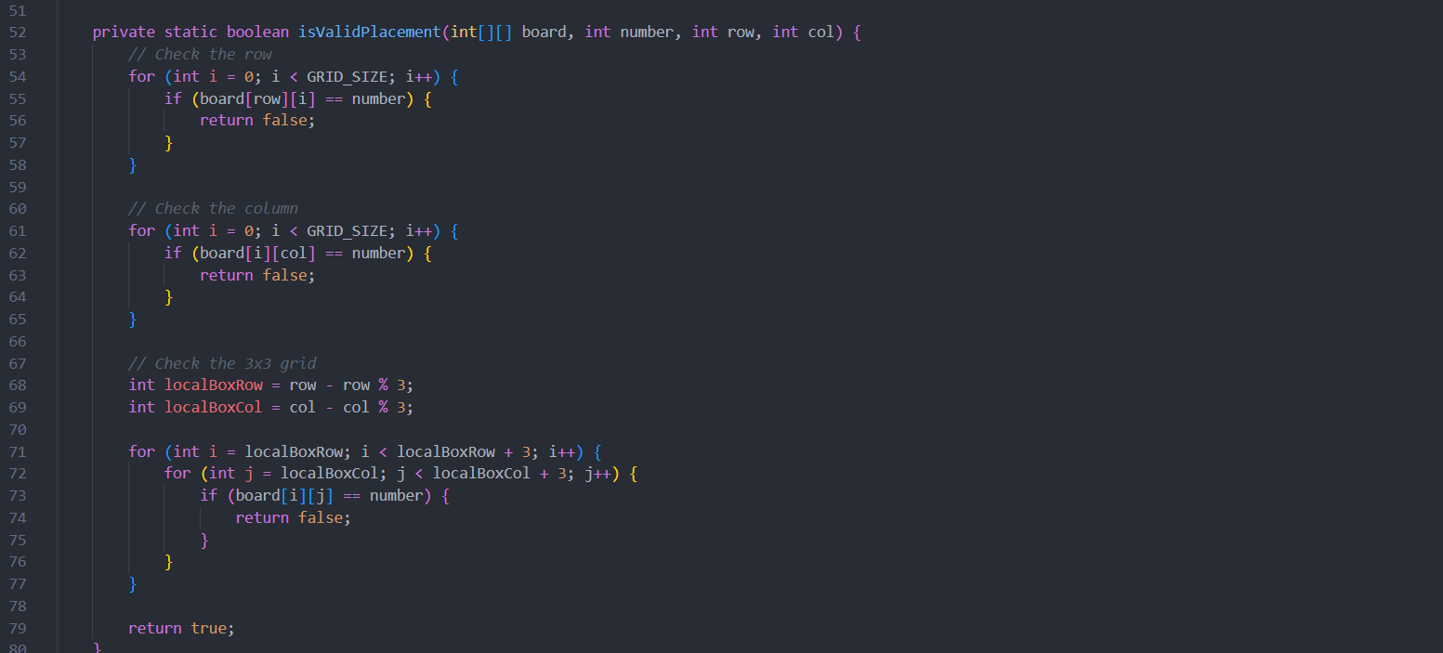
This loop iterates over all columns in the specified row.
This loop iterates over all rows in the specified column.
This calculates the starting row and column index of the 3x3 subgrid containing the cell at (row, col
Loop to ckeck across the subgrids

Slide 15
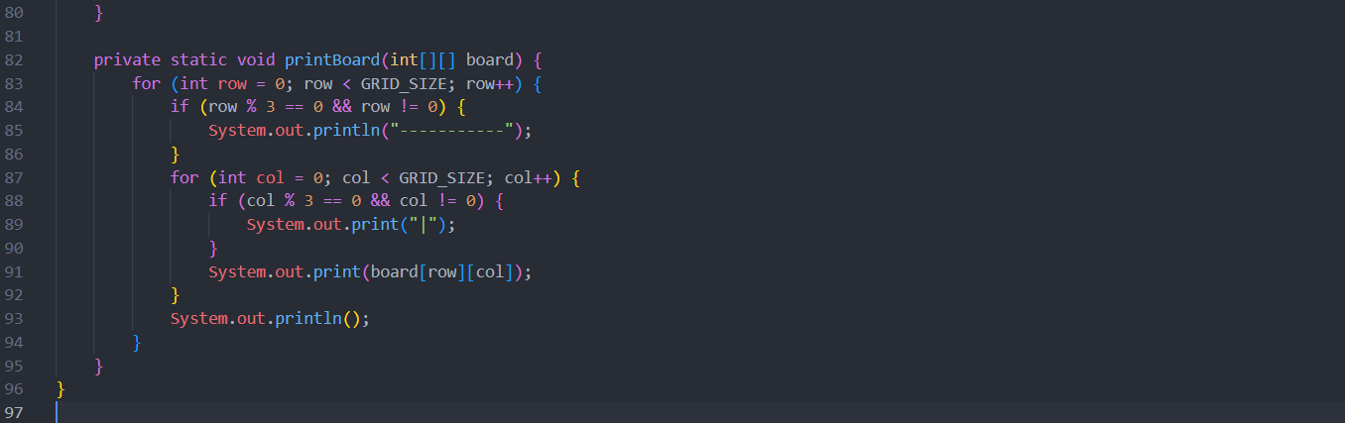
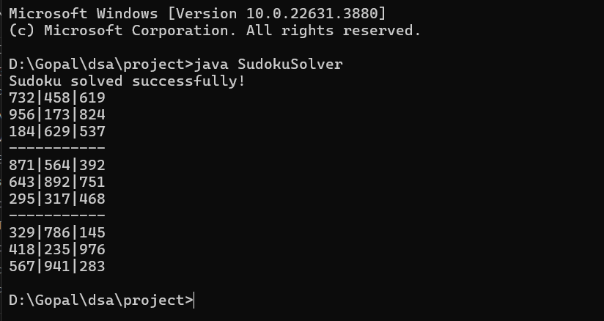
This checks if the row is a multiple of 3 (except the first row) to print a separator line.
This checks if the column is a multiple of 3 (except the first column) to print a vertical separator
Final Result of solved sudoku on terminal

Slide 16
THANK YOU

