Slide 1
KCA 101 : FUNDAMENTAL OF COMPUTERS & EMERGING TECHNOLOGIES for Master of Computer Application (MCA)
By
Ramjee Dixit,
Asstt. Professor,
GLBITM, Greater Noida

Slide 2
---Continue
Unit-V
Emerging Technologies: Introduction, overview, features, limitations and application areas of Augmented Reality , Virtual Reality, Grid computing, Green computing, Big data analytics, Quantum Computing and Brain Computer Interface.

Slide 3
Emerging Technologies
Emerging technology is a term generally used to describe a new technology, but it may also refer to the continuing development of an existing technology; it can have slightly different meaning when used in different areas, such as media, business, science, or education.
The term commonly refers to technologies that are currently developing, or that are expected to be available within the next five to ten years, and is usually reserved for technologies that are creating, or are expected to create, significant social or economic effects.’.

Slide 4
Artificial Intelligence
“The science and engineering of making intelligent machines, especially intelligent computer programs”
-John McCarthy

Slide 5
Definition
Artificial (man-made) & Intelligence(power of thinking)
It means man-made thinking power
“It is a branch of computer science by which we can create intelligent machines which can behave like humans, think like humans and able to make decision”

Slide 6
Advantages
Reduction in human errors
Useful in risky areas
High reliability
Fast
Digital assistant
Faster decision
Available 24*7

Slide 7
Disadvantages
High cost
can’t replace human
Lack of creativity
Risk of unemployment
No feeling and emotions

Slide 8
Lecture 2:Types of AI
Type-1:Based on Capability
Artificial Narrow Intelligence (ANI)
Artificial General Intelligence (AGI)
Artificial Super Intelligence (ASI)
Type-2 : Based on Functionality
Reactive Machines
Limited Memory
Theory of Minds
Self- Awareness

Slide 9
Type -1 : Based on Capability
Artificial Narrow Intelligence
Artificial Narrow Intelligence (ANI) also known as “Weak” AI.
AI that exists in our world today.
Narrow AI is AI that is programmed to perform a single task.
whether it’s checking the weather, being able to play chess, or analyzing raw data to write journalistic reports.

Slide 10
Type -1 : Based on Capability
Artificial General Intelligence
Artificial General Intelligence (AGI) also known as “Strong” AI.
It can perform variety of functions
It is concept of machine with general intelligence that mimic human intelligence or behaviours with ability to learn and apply it to solve any problem.

Slide 11
Type -1 : Based on Capability
Artificial Super Intelligence(ASI)
It is more capable than a human.
ASI is hypothetical, means AI that doesn't mimic or understand human intelligence and behaviours; ASI where machines become self-aware and surpass capability of human intelligence and ability.
ASI is purely speculative at this moment.

Slide 12
Type -2 : Based on Functionality
Reactive Machines
These machines are most common form of AI applications.
Such AI systems do not store or experiences for future actions.
These machines focus only on current scenario and react on it as per best possible action.
Example : Deep Blue and IBM's chess playing super computer.

Slide 13
Type -2 : Based on Functionality
Limited Memory
Limited memory machines can retain data for short period of time.
While they can use this data for specific period of time. They cannot add it to its library of their experiences.
Many self-driving cars use limited memory model they store data such as
Speed of nearby cars
Distance of such cars
The speed limits and other information that can help them navigate
on roads

Slide 14
Type -2 : Based on Functionality
Theory of Mind
AI should understand human emotions, beliefs and should able to interact socially.
There are lot of efforts are going on to develop such machines.

Slide 15
Type -2 : Based on Functionality
Self-Awareness
Self-awareness AI is future of artificial intelligence.
These machines will be super intelligent and they will have their own consciousness, sentiments and self-awareness.
These machines will be more smarter than human mind.
Hypothetical at this point.

Slide 16
Applications of AI
Face Detection and recognition
Text Editors and Autocorrect
Chatbots
E-Payments
Search and Recommendation algorithms
Digital Assistant
Social media
Healthcare
Gaming
Banking and Finance
Smart Home devices
Security and Surveillance
E-Commerce
Music and Media Streaming Service

Slide 17
Machine Learning (ML)
Machine learning is a growing technology which enables computers to learn automatically from past data.
Machine Learning is said as a subset of artificial intelligence
The term machine learning was first introduced by Arthur Samuel in 1959. We can define it in a summarized way as:
Machine learning enables a machine to automatically learn from data, improve performance from experiences, and predict things without being explicitly programmed.
With the help of sample historical data, which is known as training data, machine learning algorithms build a mathematical model that helps in making predictions or decisions without being explicitly programmed.
Currently, it is being used for various tasks such as image recognition, speech recognition, email filtering, Facebook auto-tagging, recommender system, and many more.

Slide 18
Working of ML
Suppose we have a complex problem, where we need to perform some predictions, so instead of writing a code for it, we just need to feed the data to generic algorithms, and with the help of these algorithms, machine builds the logic as per the data and predict the output.
Machine learning has changed our way of thinking about the problem.
The below block diagram explains the working of Machine Learning algorithm:

Slide 19
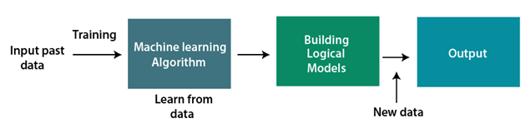
---Continue

Slide 20
Features of ML
Machine learning uses data to detect various patterns in a given dataset.
It can learn from past data and improve automatically.
It is a data-driven technology.
Machine learning is much similar to data mining as it also deals with the huge amount of the data.

Slide 21
Classification of ML
At a broad level, machine learning can be classified into three types:
Supervised learning
Unsupervised learning
Reinforcement learning

Slide 22
Supervised Learning
Supervised learning is a type of machine learning method in which we provide sample labeled data to the machine learning system in order to train it, and on that basis, it predicts the output.
The system creates a model using labeled data to understand the datasets and learn about each data, once the training and processing are done then we test the model by providing a sample data to check whether it is predicting the exact output or not.
The goal of supervised learning is to map input data with the output data.
The supervised learning is based on supervision, and it is the same as when a student learns things in the supervision of the teacher.
The example of supervised learning is spam filtering.
Supervised learning can be grouped further in two categories of algorithms:
Classification
Regression

Slide 23
Unsupervised Learning
Unsupervised learning is a learning method in which a machine learns without any supervision.
The training is provided to the machine with the set of data that has not been labeled, classified, or categorized, and the algorithm needs to act on that data without any supervision. The goal of unsupervised learning is to restructure the input data into new features or a group of objects with similar patterns.
In unsupervised learning, we don't have a predetermined result. The machine tries to find useful insights from the huge amount of data. It can be further classifieds into two categories of algorithms:
Clustering
Association

Slide 24
Reinforcement Learning
Reinforcement learning is a feedback-based learning method, in which a learning agent gets a reward for each right action and gets a penalty for each wrong action.
The agent learns automatically with these feedbacks and improves its performance.
In reinforcement learning, the agent interacts with the environment and explores it.
The goal of an agent is to get the most reward points, and hence, it improves its performance.
The robotic dog, which automatically learns the movement of his arms, is an example of Reinforcement learning

Slide 25
Grid Computing
Grid computing is a distributed architecture of multiple computers connected by networks to accomplish a joint task.
These tasks are compute-intensive and difficult for a single machine to handle.
Several machines on a network collaborate under a common protocol and work as a single virtual supercomputer to get complex tasks done.
This offers powerful virtualization by creating a single system image that grants users and applications seamless access to IT capabilities.

Slide 26
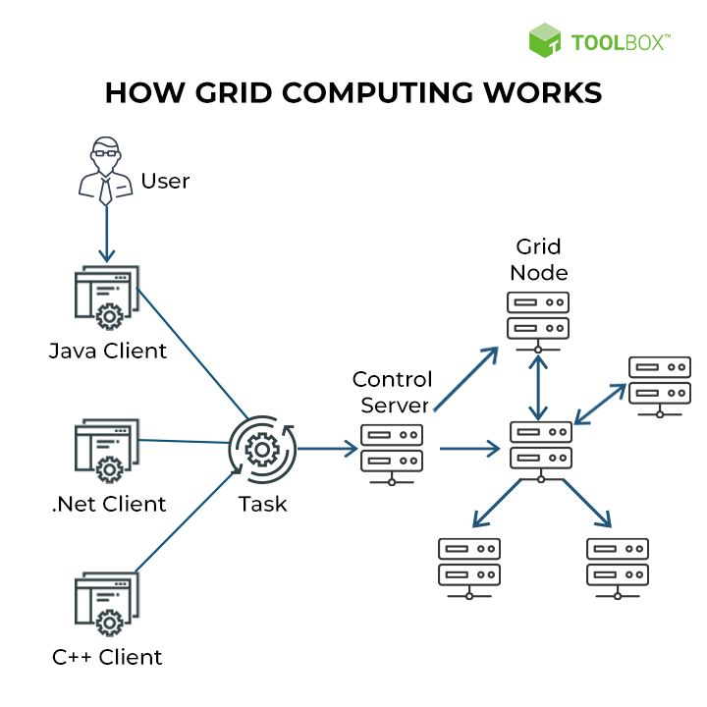

Slide 27
----Continue
A typical grid computing network consists of three machine types:
Control node/server: A control node is a server or a group of servers that administers the entire network and maintains the record for resources in a network pool.
Provider/grid node: A provider or grid node is a computer that contributes its resources to the network resource pool.
User: A user refers to the computer that uses the resources on the network to complete the task.

Slide 28
Grid Computing Working
Grid computing operates by running specialized software on every computer involved in the grid network.
The software coordinates and manages all the tasks of the grid. Fundamentally, the software segregates the main task into subtasks and assigns the subtasks to each computer.
This allows all the computers to work simultaneously on their respective subtasks. Upon completion of the subtasks, the outputs of all computers are aggregated to complete the larger main task. .
The software allows computers to communicate and share information on the portion of the subtasks being carried out. As a result, the computers can consolidate and deliver a combined output for the assigned main task.

Slide 29
Grid Computing Working
Grid computing can be viewed as a subset of distributed computing, where a virtual supercomputer integrates the resources of several independent computers that are distributed across geographies. Computers participating in a grid contribute resources such as processing power, network bandwidth, and storage capacity to perform operations requiring high computational power. The overall grid architecture looks like a single computing entity.

Slide 30
Advantage of Grid Computing
Easier to collaborate with other organizations.
Make better use of existing hardware.
No need to but huge servers for applications that can be split up and farmed out to smaller commodity type servers.
Grid environments are much more modular and don’t have single points of failure. If one of the servers/desktops within the grid fail there are plenty of other resources able to pick the load.
Jobs can be executed in parallel speeding performance
Can solve larger, more complex problems in a shorter time.

Slide 31
Disadvantage of Grid Computing
Grid software and standards are still evolving.
Learning curve to get started.
Non-interactive job submission.
You may need to have a fast interconnect between compute resources.
Licensing across many servers may make it prohibitive for some applications.
Many groups are reluctant with sharing resources even if it benefits everyone involved.

Slide 32
Virtual Reality
Virtual Reality refers to generating a virtual environment or projection which creates a realistic experience but does not exist in reality.
It is a virtual experience that you can observe, listen to, and interact with, but cannot touch.
For example, in a remote virtual tour, you will feel like you are actually taking a tour in that place. However, in reality, you are sitting at your home and taking a virtual through your computer, while still getting to look around the place as if you are physically there.
Over the years, people have developed many forms of virtual reality which they are using for innovative purposes such as virtual medical training, virtual skills practice, games, virtual tour of homes or hotels, and many more.
Industries such as real state, hotels, amusement parks, research facilities, army officials, motor companies, machine development companies, and many more industries have started using some forms of virtual reality to attain greater results in their business and purposes.

Slide 33
Types of Virtual Reality
Non-immersive Virtual Reality.
Fully Immersive Virtual Reality.
Semi-Immersive Virtual Reality.
Augmented Reality.
Collaborative VR.

Slide 34
Non-immersive Virtual Reality
Non-immersive virtual reality refers to a virtual experience through a computer where you can control some characters or activities within the software, but the environment is not directly interacting with you.
In addition to desktop computers, you can also find a robust laptop for virtual machines and work on the go.
Since more and more people appreciate mobility, manufacturers create powerful systems in compact bodies.
For example, when you play video games such as World of WarCraft, you can control characters within the game that have their own animations and attributes.
Technically, you are dealing with a virtual world but, you are not the center of attention in the game.
All actions or features are rather interacting with the characters within.
So basically, all basic forms of gaming devices such as PlayStation, Xbox, Computer, etc are providing you with a non-immersive virtual reality experience.

Slide 35
Fully Immersive Virtual Reality.
On contrary to non-immersive virtual reality, a fully immersive virtual technology ensures that you have a realistic experience within the virtual world.
It’ll give you a sense of being present in that virtual world and everything is happening to you for real.
This is an expensive form of virtual reality that involves helmets, gloves, and body connectors with sense detectors.
These are connected to a powerful computer. Your movements, reactions, and even a blink of an eye are detected and projected within the virtual world.
You will feel like you are within the virtual world physically.
One example could be a Virtual Shooter gaming zone where you will be equipped with the gears in a small room and you will be viewing a virtual world through the helmet where you are facing other shooters trying to kill you.
You will move your arms and body to run, jump, crouch, shoot, throw, and many more within the game.
A new concept of virtual medical training is being looked at to train neurosurgeons to avoid disasters during risky brain operations.

Slide 36
Semi-Immersive Virtual Reality
A semi-immersive virtual reality is a mixture of non-immersive and fully immersive virtual reality.
This can be in the form of a 3D space or virtual environment where you can move about on your own either through a computer screen or a VR box/headset. So all activities within the virtual world are concentrated toward you. However, you have no real physical movements other than your visual experience. On a computer, you can use the mouse to move about the virtual space and on mobile devices, you can touch and swipe to move about the place.
Most semi-immersive virtual environments support Gyroscope, which means the virtual space will be fixed on your phone based on the vertical axis, and you have to literally move your phone about in different directions to view the virtual environment in those directions.
A virtual tour is the most popular semi-immersive virtual reality that most businesses are embracing today.
They can be both device-based and web-based. Overall, they provide an interactive virtual experience.
It is mostly used in businesses such as real estate websites, hotels, local bars or pubs, universities, schools, and many more businesses that rely on highlighting and promoting their locations.

Slide 37
Augmented Reality
Augmented Reality is when a certain entity or device seems to be present in reality but is actually not.
Rather than putting you into a virtual world, a virtual entity is placed in the real world through any device.
For example, through your mobile screen, you can view your room, and probably place a cartoon character in the corner. You will be able to see the character through your mobile screen and not in reality.
It is mostly used by businesses such as furniture suppliers or decorators.
For example, a person willing to buy a table will be able to place the table in his room through his phone display.
This will let him understand if this table is suitable and looks good in his room, or if he has to choose another design.
Augmented reality often is argued to be a unique form of technology rather than VR.
But its ability to place entities virtually often puts it within the VR category.

Slide 38
Collaborative VR
This is a form of a virtual world where different people from various locations can come into contact within a virtual environment, usually in the form of 3D or projected characters.
For example, there is a video game called PUBG (Players Unknown Battle-Ground), where tons of players come into existence as individual virtual characters which they can control.
Here they can interact with each other through microphones, headsets, and chatting.
Recently people are getting used to virtual meeting rooms to conduct business meetings remotely, or for conducting virtual debate competitions.
The main goal of this form of VR is to create collaboration between people.

Slide 39
QUANTUM COMPUTING
It refers to computation that uses the principles of quantum physics.
Quantum physics deals with the smallest physical units that exist within the human realm.
The common principles applied in the computing system are the superposition, entanglement, and quantum interference.
The computing system is done by quantum computer. A conventional computer works with bits which can be 0 or 1 (a definite number). However, this computing method works with qubits instead. Instead of dealing with one definite problem at a time, it computes numerous probabilities at once

Slide 40
How Quantum Computing Can Change the World
Quantum computing is capable of simulating real life situations. Therefore, scientists can create a virtual laboratory that offers a great accuracy to what will happen in the real laboratory. There are so many different implications to the development of human civilization:
People can produce goods at much lower costs because the R&D process occurs in a virtual lab.
The amount of time to create urgent innovations is cut short.
Before manufacturing items, the developers can detect their possible failures and work on solutions.
The manufacturing process becomes more sustainable and environmentally friendly.

Slide 41
QUANTUM COMPUTING
A quantum computer is expected to be able to deal with more problems. Instead of counting the definite problem, it calculates the possible solution for that problem, regardless of the type. That possibility has a certain amplitude for it to be the right solution. For this to work, the computing system should be in the superposition state.
Here are the three important divisions in the computer system:
A specific area to house the qubits
The approach to transfer signals to the qubits
A classical computing machine to send instructions towards the system
The system can help human civilization to solve complex modern problems that conventional computers cannot solve right now. Thus, it is understandable that many people are willing to invest in its development.

Slide 42
Types of Quantum Computing
Analog Quantum : Analog quantum is the medium tier computing system that applies quantum principles. It can work on several sets of problems at once. The processing time is slightly quicker than conventional computers. It works with 50 to 100 qubits, which means that it is physically doable to build.
Quantum Annealer :This computing system is the most restrictive and works comparably to conventional computing machines. Although it uses quantum principles in its application, it can only work on one task at a time. It is an easy build but the advantages over conventional computers are unknown.
Universal Quantum :Out of the three quantum computers universal might be the most powerful and versatile. It speeds up the data computing process. However, it takes a lot of resources to build this computer as it is expected to host around 100,000 qubits. That will make the computer unworkable in conventional settings.

Slide 43
Application Areas of Quantum Computing
Simulation :The quantum computer is able to crunch enormous data, which includes molecular activity in one being. This ability enables the computer to create very accurate simulations of real life events, such as photosynthesis.
Optimization :Instead of calculating a problem at a time, this computing approach solves various probabilities. Through such a system, you can see how each option can provide the most advantages. Thus, you can optimize that option.
Cryptography :Cryptography involves difficult mathematical problems such as discrete algorithms and integer factorization. These problems take a long time to solve. However, a computer with quantum principles can do it quickly.
Machine Learning :This concept is difficult to apply as it takes so much time and financial resources to do it. The computing system can help speed up the process significantly.
Data search: Although the conventional computer has evolved so much over the past decades, data search still takes too long sometimes. Quantum principles are capable of speeding up this data search process, especially if the search is unstructured.

Slide 44
Application Areas of Quantum Computing
Simulation :The quantum computer is able to crunch enormous data, which includes molecular activity in one being. This ability enables the computer to create very accurate simulations of real life events, such as photosynthesis.
Optimization :Instead of calculating a problem at a time, this computing approach solves various probabilities. Through such a system, you can see how each option can provide the most advantages. Thus, you can optimize that option.
Cryptography :Cryptography involves difficult mathematical problems such as discrete algorithms and integer factorization. These problems take a long time to solve. However, a computer with quantum principles can do it quickly.
Machine Learning :This concept is difficult to apply as it takes so much time and financial resources to do it. The computing system can help speed up the process significantly.
Data search: Although the conventional computer has evolved so much over the past decades, data search still takes too long sometimes. Quantum principles are capable of speeding up this data search process, especially if the search is unstructured.

Slide 45
Green Computing
Green Computing also called as Green IT (Information Technology) or Green Technology refers to the durable computing of the environment which means eco-friendly use of computers, and it’s related resources.
In a broader term it refers to the study of designing, manufacturing, using and disposing of computing components in a way that reduces the bad environmental impacts.
Such practices include designing energy-efficient computing devices, implementation of energy-efficient processing units and servers, reducing the use of dangerous materials and encouraging the recyclability of digital devices, proper disposal of electronic waste (e-waste).
Green computing always aims to make the computing process more Green friendly. In 1992, it was originated and initially known as Energy Star, later it is known as Green Computing.

Slide 46
Objective of green Computing
To minimize the use of hazardous IT/computing products.
To make the computing process more eco-friendly.
To make the computing process energy efficiency.
Reducing travel requirements.
Recycling of computing wastage product.
Purchasing and using green energy.
Save money due to reduced utility cost.
Reducing the use of papers.
Designing good algorithms for better computer’s efficiency.

Slide 47
Approaches to Green Computing
For the promotion of green computing, the below four approaches are utilized
Green Use – Reducing the power usage of computers and its periphery subsystems and using them in an eco-friendly manner. Also adopting virtualization reducing the need of energy.
Green Disposal – Recycling and reusing existing equipment, properly disposing the wasted IT/computing materials, electronic equipment etc.
Green Design – Designing energy efficient as well as effective systems which have a minimal impact on the green environment.
Green manufacturing – Manufacturing Biodegradable materials, also manufacturing long usable, recyclable products and reducing wastage during manufacturing process.

Slide 48
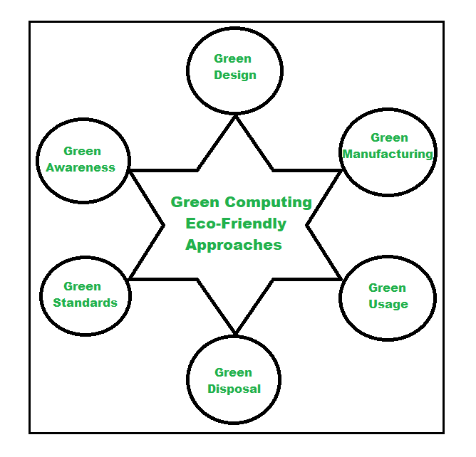

Slide 49
Applications of Green Computing
Green Wireless Network.
Energy Management in Data Centre’s.
Green Cloud Computing.
Green Parallel Computing.

Slide 50
Advantages of Green Computing
Reduced energy usage from green computing techniques translates into lower carbon dioxide emissions, stemming from a reduction in the fossil fuel used in power plants and transportation.
Conserving resources means less energy is required to produce, use, and dispose of products.
Saving energy and resources saves money
Green computing even includes changing government policy to encourage recycling and lowering energy use by individuals and businesses.
Reduce the risk existing in the laptops such as chemical known to cause cancer, nerve damage and immune reactions in humans.

Slide 51
Disadvantages of Green Computing
The initial implementation is costly.
There is frequent change in technology.
Green IT cause more burden to individual.
The disparity in level of understanding among companies, professionals and individuals.
There are fewer courses and publications related to green computing.

Slide 52
Big Data Analytics
Big data is a collection of data from many different sources and is often describe by five characteristics: volume, value, variety, velocity, and veracity.
Volume: the size and amounts of big data that companies manage and analyze
Value: the most important “V” from the perspective of the business, the value of big data usually comes from insight discovery and pattern recognition that lead to more effective operations, stronger customer relationships and other clear and quantifiable business benefits
Variety: the diversity and range of different data types, including unstructured data, semi-structured data and raw data
Velocity: the speed at which companies receive, store and manage data – e.g., the specific number of social media posts or search queries received within a day, hour or other unit of time
Veracity: the “truth” or accuracy of data and information assets, which often determines executive-level confidence
Additional variability

Slide 53
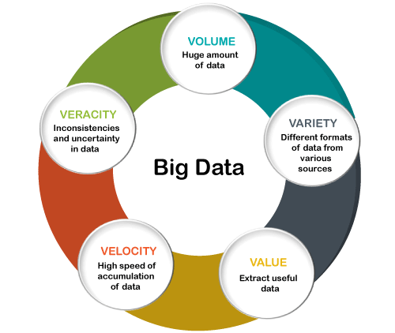

Slide 54
Big Data Analytics
Big data analytics describes the process of uncovering trends, patterns, and correlations in large amounts of raw data to help make data-informed decisions. These processes use familiar statistical analysis techniques—like clustering and regression—and apply them to more extensive datasets with the help of newer tools.

Slide 55
How Big Data Analytics Work
1. Collect Data
Data collection looks different for every organization. With today’s technology, organizations can gather both structured and unstructured data from a variety of sources — from cloud storage to mobile applications to in-store IoT sensors and beyond. Some data will be stored in data warehouses where business intelligence tools and solutions can access it easily. Raw or unstructured data that is too diverse or complex for a warehouse may be assigned metadata and stored in a data lake.
2. Process Data
Once data is collected and stored, it must be organized properly to get accurate results on analytical queries, especially when it’s large and unstructured. Available data is growing exponentially, making data processing a challenge for organizations. One processing option is batch processing, which looks at large data blocks over time. Batch processing is useful when there is a longer turnaround time between collecting and analyzing data. Stream processing looks at small batches of data at once, shortening the delay time between collection and analysis for quicker decision-making. Stream processing is more complex and often more expensive.

Slide 56
How Big Data Analytics Work
3. Clean Data
Data big or small requires scrubbing to improve data quality and get stronger results; all data must be formatted correctly, and any duplicative or irrelevant data must be eliminated or accounted for. Dirty data can obscure and mislead, creating flawed insights.
4. Analyze Data
Getting big data into a usable state takes time. Once it’s ready, advanced analytics processes can turn big data into big insights. Some of these big data analysis methods include:
Data mining sorts through large datasets to identify patterns and relationships by identifying anomalies and creating data clusters.
Predictive analytics uses an organization’s historical data to make predictions about the future, identifying upcoming risks and opportunities.
Deep learning imitates human learning patterns by using artificial intelligence and machine learning to layer algorithms and find patterns in the most complex and abstract data.

Slide 57
Big Data Analytics Tools
Big data analytics cannot be narrowed down to a single tool or technology. Instead, several types of tools work together to help you collect, process, cleanse, and analyze big data. Some of the major players in big data ecosystems are listed below.
Hadoop is an open-source framework that efficiently stores and processes big datasets on clusters of commodity hardware. This framework is free and can handle large amounts of structured and unstructured data, making it a valuable mainstay for any big data operation.
NoSQL databases are non-relational data management systems that do not require a fixed scheme, making them a great option for big, raw, unstructured data. NoSQL stands for “not only SQL,” and these databases can handle a variety of data models.

Slide 58
Big Data Analytics Tools
MapReduce is an essential component to the Hadoop framework serving two functions. The first is mapping, which filters data to various nodes within the cluster. The second is reducing, which organizes and reduces the results from each node to answer a query.
YARN stands for “Yet Another Resource Negotiator.” It is another component of second-generation Hadoop. The cluster management technology helps with job scheduling and resource management in the cluster.
Spark is an open source cluster computing framework that uses implicit data parallelism and fault tolerance to provide an interface for programming entire clusters. Spark can handle both batch and stream processing for fast computation.
Tableau is an end-to-end data analytics platform that allows you to prep, analyze, collaborate, and share your big data insights. Tableau excels in self-service visual analysis, allowing people to ask new questions of governed big data and easily share those insights across the organization.

Slide 59
Big Data Analytics Benefits
The ability to analyze more data at a faster rate can provide big benefits to an organization, allowing it to more efficiently use data to answer important questions. Big data analytics is important because it lets organizations use colossal amounts of data in multiple formats from multiple sources to identify opportunities and risks, helping organizations move quickly and improve their bottom lines. Some benefits of big data analytics include:
Cost savings. Helping organizations identify ways to do business more efficiently
Product development. Providing a better understanding of customer needs
Market insights. Tracking purchase behavior and market trends
Read more about how real organizations reap the benefits of big data.

Slide 60
The challenges of big data
Big data brings big benefits, but it also brings big challenges such new privacy and security concerns, accessibility for business users, and choosing the right solutions for your business needs. To capitalize on incoming data, organizations will have to address the following:
Making big data accessible. Collecting and processing data becomes more difficult as the amount of data grows. Organizations must make data easy and convenient for data owners of all skill levels to use.
Maintaining quality data. With so much data to maintain, organizations are spending more time than ever before scrubbing for duplicates, errors, absences, conflicts, and inconsistencies.

Slide 61
The big challenges of big data
Keeping data secure. As the amount of data grows, so do privacy and security concerns. Organizations will need to strive for compliance and put tight data processes in place before they take advantage of big data.
Finding the right tools and platforms. New technologies for processing and analyzing big data are developed all the time. Organizations must find the right technology to work within their established ecosystems and address their particular needs. Often, the right solution is also a flexible solution that can accommodate future infrastructure changes.

Slide 62
Brain Computer Interface
A Brain Computer Interface (BCI) is a device that translates brain signals into commands that can be executed by a computer or other machine. BCIs are still in development.
The primary goal of a BCI is to restore useful function for people who have developed neuromuscular disorders, such as amyotrophic lateral sclerosis, cerebral palsy, stroke, or spinal cord injury

Slide 63
Types of BCI
Non-Invasive Brain-Computer Interface
Invasive Brain-Computer Interface.

Slide 64
Non-Invasive Brain-Computer Interface
As the name suggests, a non-invasive brain-computer interface is one that can work without intrusive procedures into the brain. A non-Intrusive Brain-Computer Interface mostly works on the principles of EEG (Electroencephalography).
Electroencephalography is mostly used in the medical field to see and analyze the brain wave activity of patients. The way an EEG is performed in a medical setup is by attaching multiple electrodes to the scalp of the patient. EEG measures the voltage fluctuations in the brain caused by the ionic current within the neurons of the brain. An EEG records the spontaneous electrical activity of the brain over a certain period.

Slide 65
Non-Invasive Brain-Computer Interface
Most Non-Invasive BCI uses the concept of EEG in their models. The most famous among them is Neurosky, a consumer-friendly product that uses the concept of EEG. It has various modes where one can test one’s level of attention, mental effort, and meditation level. It consists of one EEG sensor that touches the front left upper part of the skull, just above the left eyebrow. The applications are only limited by the user’s own ability to use the product.
The advantages of a non-invasive brain-computer interface stem from the fact that it is much cheaper to work with and heavy research focus is always given to non-invasive BCI. Also, multiple people from diverse backgrounds can work on non-invasive BCI, whereas in the case of an invasive BCI, a medical professional is always needed.

Slide 66
Invasive Brain-Computer Interface
An invasive brain-computer interface involves the surgical implantation of a device into the skull of the user. There are two kinds of Invasive BCI that have been tried and tested thus far.
The first example is ECOG (Electrocorticography), which is when an electrode plate is kept in direct contact with the brain’s surface to measure the electrical activity of the cerebral cortex. To access the cerebral cortex, a surgeon must perform a craniotomy or open a part of the skull to expose the brain’s surface. This procedure is usually done under general or local anesthesia if patient interaction is required.
ECoG electrode arrays typically consist of sixteen sterile, disposable stainless steel, carbon tip, platinum, Platinum-iridium alloy or gold ball electrodes, each mounted on a ball and socket joint for ease in positioning. These electrodes are attached to an overlying frame in a “halo” configuration. The grids are transparent, flexible, and numbered at each electrode contact. The electrodes sit lightly on the cortical surface and are designed with enough flexibility to ensure that regular movements of the brain do not cause injury.

Slide 67
Invasive Brain-Computer Interface
Finally, we have the Intracortical Microelectrodes, also known as chronic electrode implants. A chronic electrode implant is an electronic device that is usually implanted into the brain or issue for an extended period.
It has two significant applications, one for stimulating and the other for recording. Applications for stimulating involve sensory prosthetics, such as cochlear implants. A cochlear implant is a device that provides the sensation of sound to a person with severe or profound sensorineural hearing loss.
Brain-Computer Interface is a cutting edge and relatively new topic. Ongoing research by prestigious universities and major corporations will undoubtedly take this technology to a whole new level in the near future!

