Slide 1

Capstone Project
Project Title
Telecom Churn Analysis
Team Members
BY:- ASHWANI BIST

Slide 2
Introduction
Churn : It is a problem for Telecom companies as it is more
expensive to acquire new customers than to keep the existing
ones from leaving.
Company : Orange S.A., formerly France Telecom S.A., is a
French Multinational telecommunications corporation. It has 266
million customers worldwide and is the 11th largest mobile
network operator in the world.
Data set : The data set given is for the country USA, consisting of all
51 states.

Slide 3
CONTENT
Business Problem Understanding
Objective
Data Summary
Exploratory Data Analysis
Challenges
Recommendation
Conclusion
Q & A

Slide 4
BUSINESS PROBLEM UNDERSTANDING
* In the telecom industry, customers are able to choose from multiple service providers and actively switch from one operator to another. In this highly competitive market, the telecommunications industry experiences an average of 15-25% annual churn rate. Given the fact that it costs 5-10 times more to acquire a new customer than to retain an existing one, customer retention has now become even more important than customer acquisition
*To reduce customer churn, telecom companies need to predict which customers are at high risk of churn retaining high profitable customers is the number one business goal.

Slide 5
OBJECTIVE * Identifying customers who are probably to cancel a subscription to a service. Telecommunication companies now focus on to have a more extensive customer base; therefore, retaining existing customers becomes a considerable challenge. * Highlighting the main variable/factors influencing customer churn. * Minimize customer churn by identifying key cause of problem. * Maximize the company’s profit by retaining customer.
CSSSSAASDDDDDDA

Slide 6
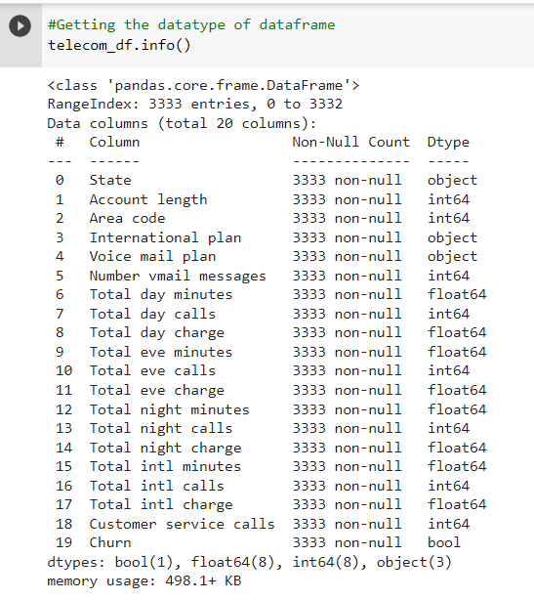
DATA SET DESCRIPTION *There are a total of 3333 number of rows present in the data set. *The total number of columns present is 20. *There are no missing values.

Slide 7
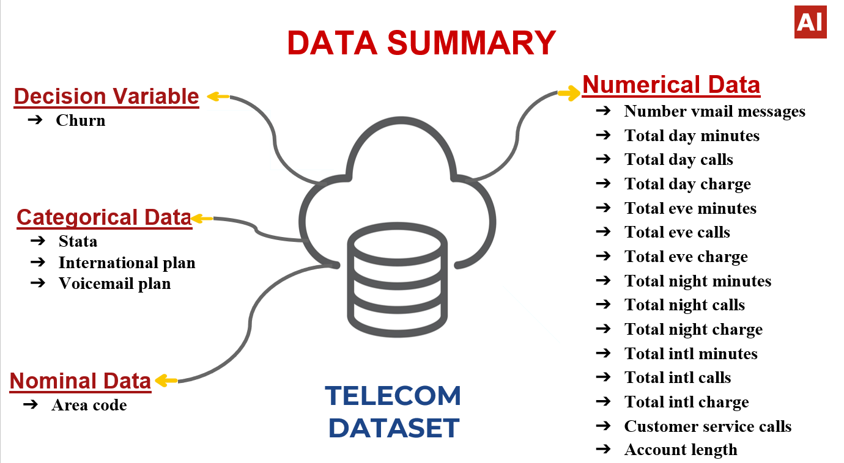

Slide 8
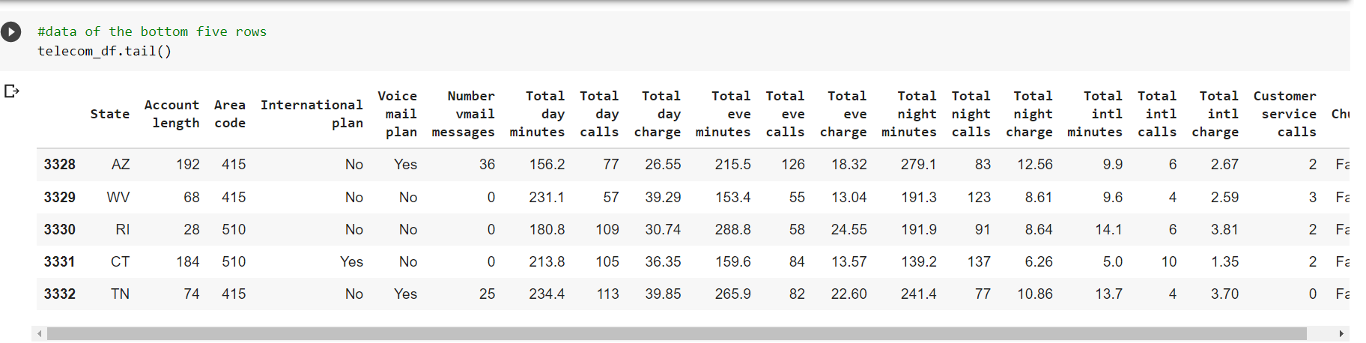
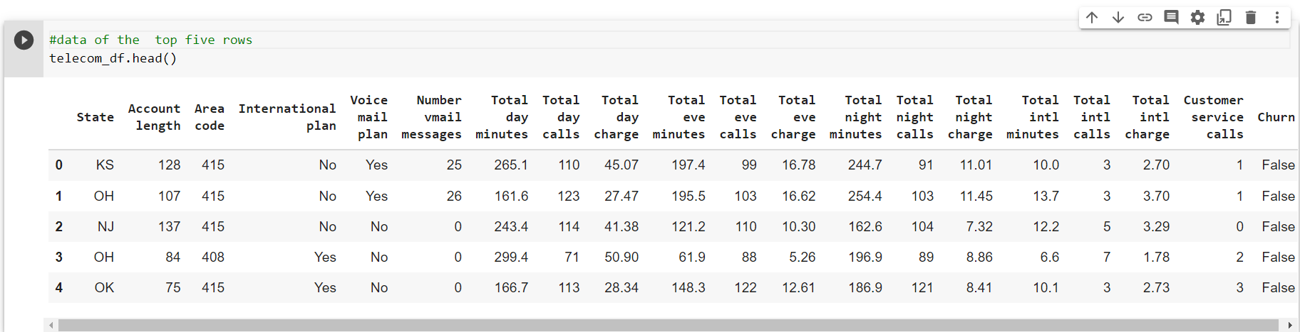
Overview of the data set of first five and last five rows.

Slide 9
Breakdown of Our Features
STATE: 51 Unique States name.
Account Length: Length of The Account.
Area Code: Code Number of Area having some States.
International Plan: Yes Indicate International Plan is Present and No Indicates no subscription for International Plan.
Voice Mail Plan: Yes Indicates Voice Mail Plan is Present and No Indicates no subscription for Voice Mail Plan.
Number vmail messages: Number of Voice Mail Messages ranging from 0 to 50.
Total day minutes: Total Number of Minutes Spent in Morning.
Total day calls: Total Number of Calls made in Morning.
Total day charge: Total Charge to the Customers in Morning.
Total eve minutes: Total Number of Minutes Spent in Evening
Total eve calls: Total Number of Calls made r in Evening.
Total eve charge: Total Charge to the Customers in Morning.
Total night minutes: Total Number of Minutes Spent in the Night.
Total night calls: Total Number of Calls made in Night.
Total night charge: Total Charge to the Customers in Night.
Customer service calls Number of customer service calls made by customer.
Churn Customer Churn, True means churned customer, False means retained customer.

Slide 10
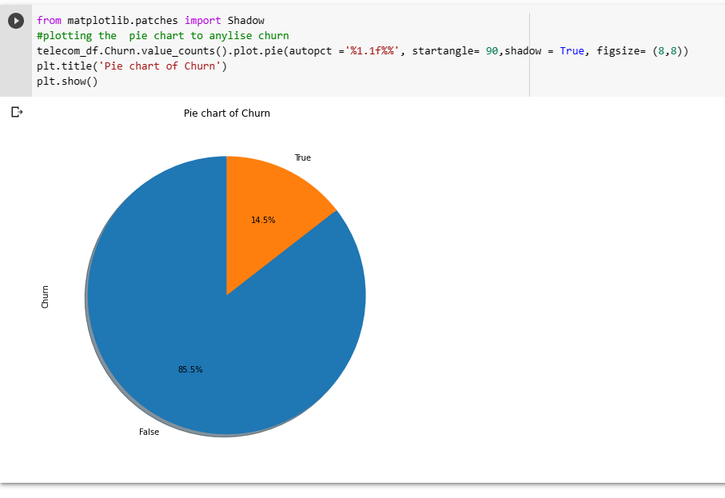
ANALYSING CHURN VARIABLE

Slide 11
ANALYSING ‘CHURN’ VARIABLE Total Users number - 3333. 2850 - Non churn (85.5%) 483 - Churn (14.5%) From the above pie chart and count plot, It was found that almost 14.5% of customers had churned .

Slide 12
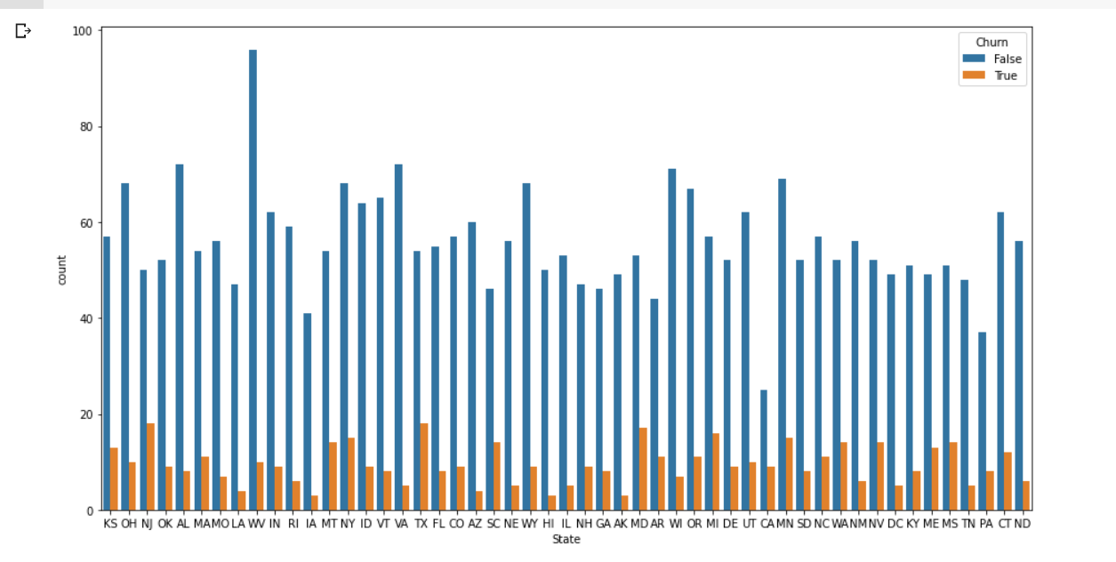
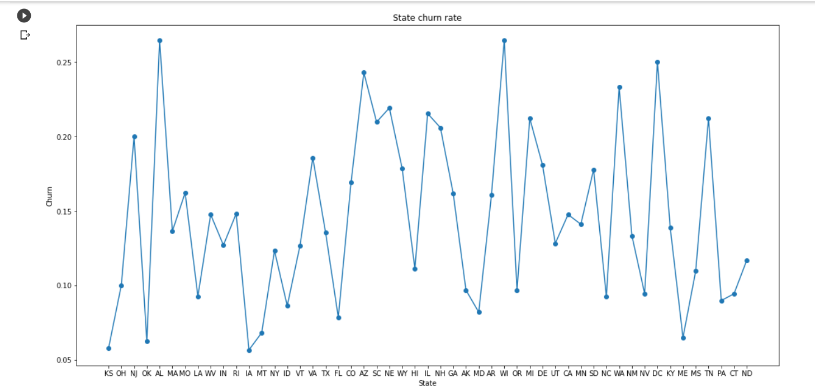
ANALYSING STATE COLUMN

Slide 13
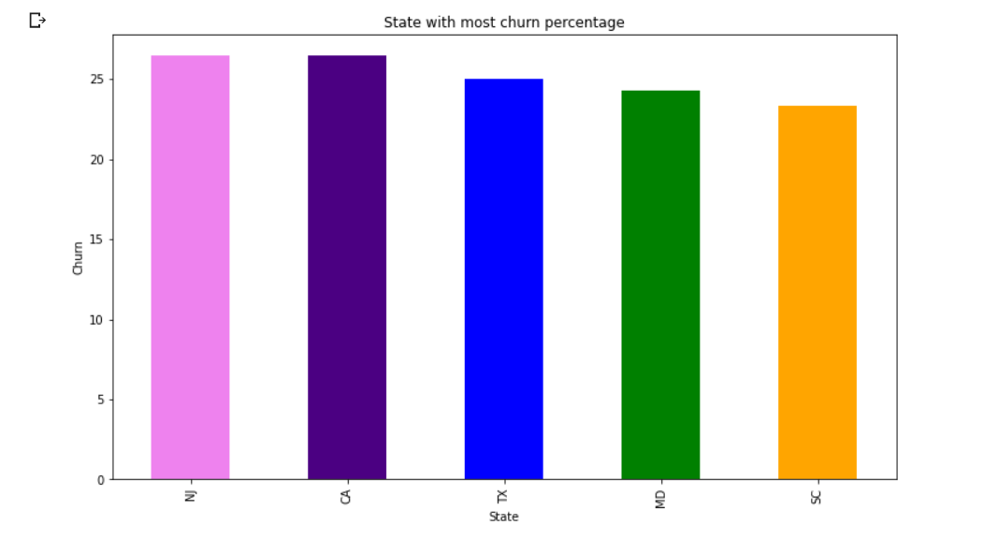
STATE WITH MOST CHURN PERCENTAGE NJ ,CA,TX , MD ,SC are the ones who have higher churn rate more than 21%.

Slide 14
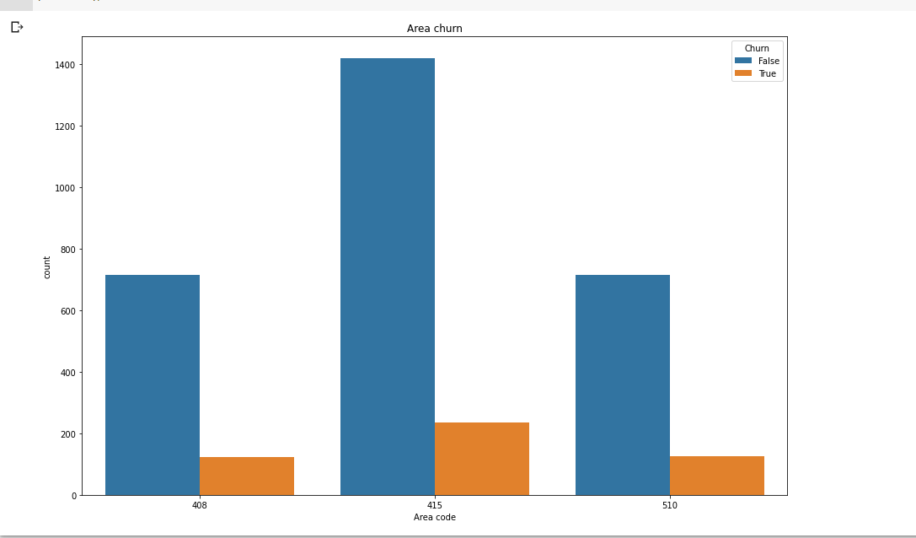
ANALYSING AREA CODE COLUMN Area code has only 3 unique values, and consider as a nominal data type and has equal number of churn percentage.

Slide 15
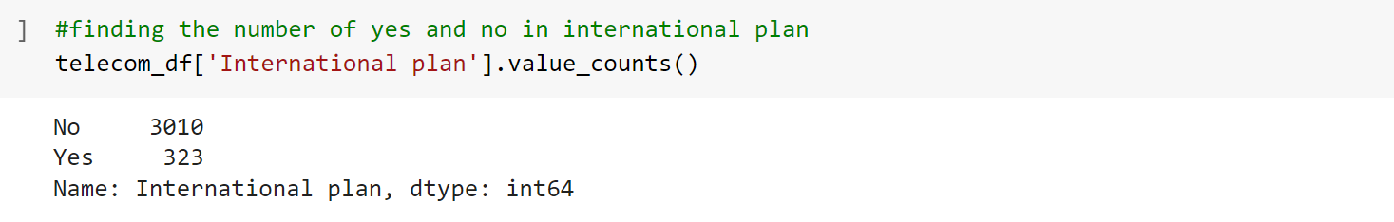
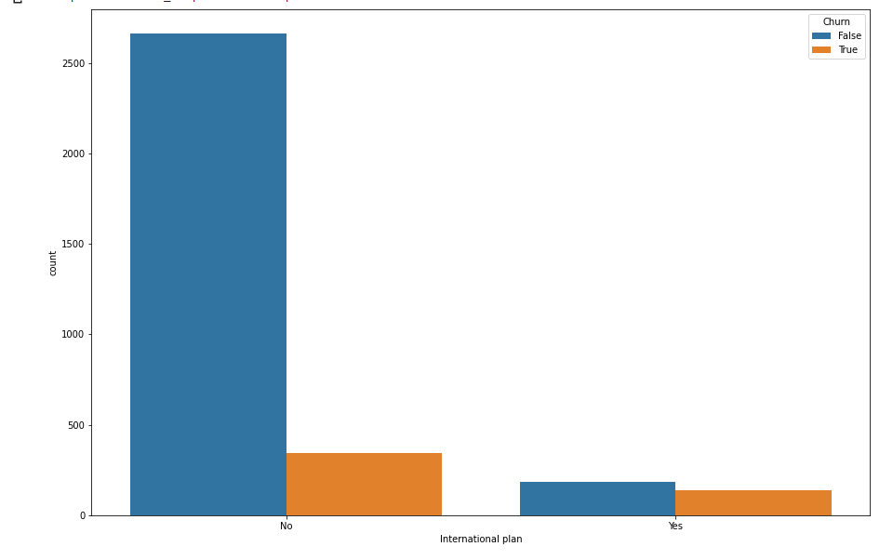
ANALYSING INTERNATIONAL PLAN

Slide 16
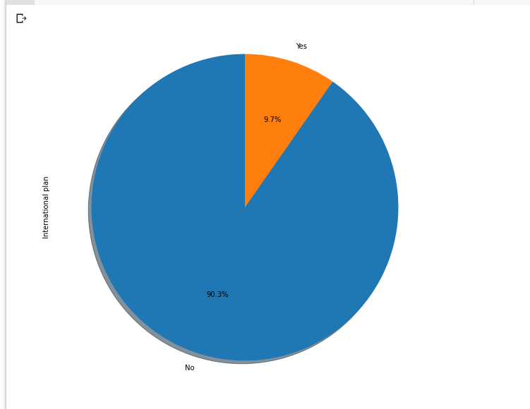
Pie Chart of international plan
There are 3333 people
323 have a International Plan
3010 do not have International Plan
So basically the people who bought
International plans are churning
in big numbers.

Slide 17
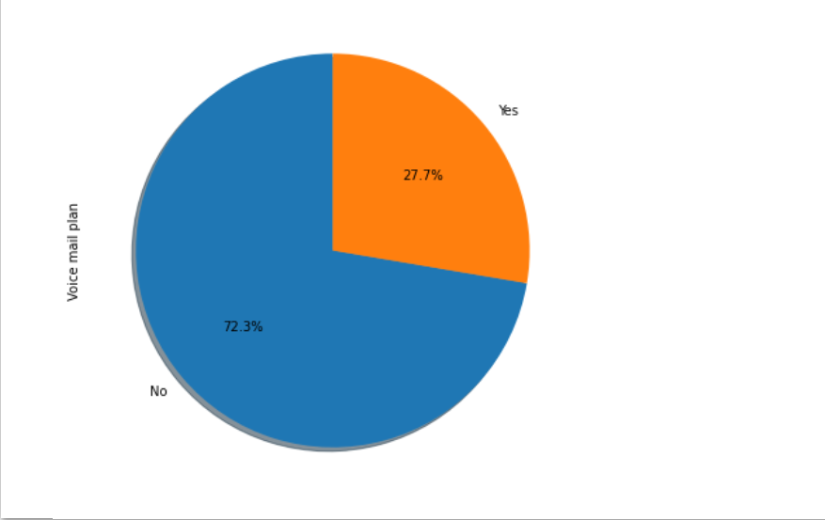
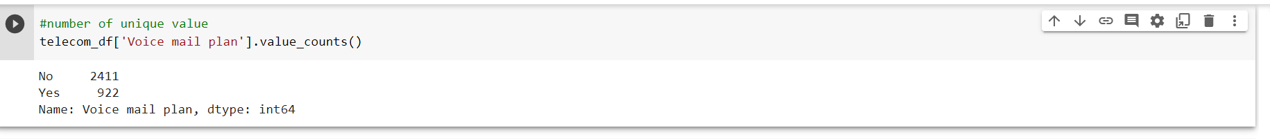
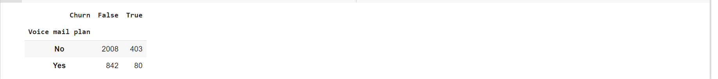
ANALYSING VOICEMAIL COLUMN Pie chart analysis

Slide 18
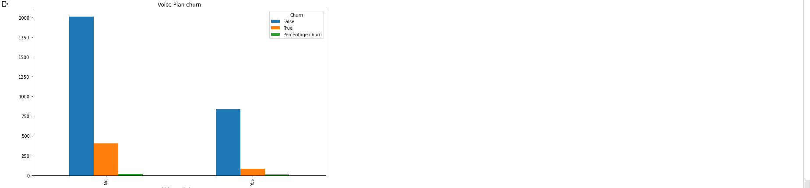
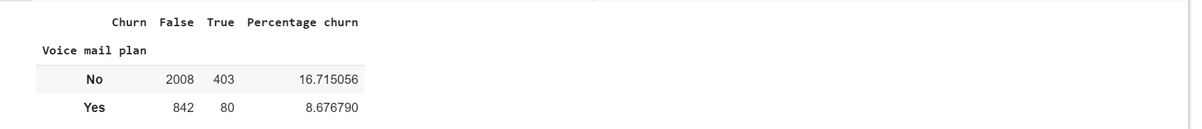
This plot shows churn
corresponding with the
subscription of voicemail
plan.
Out of 922 people
having Voicemail plan,
8.7% are Churn.

Slide 19
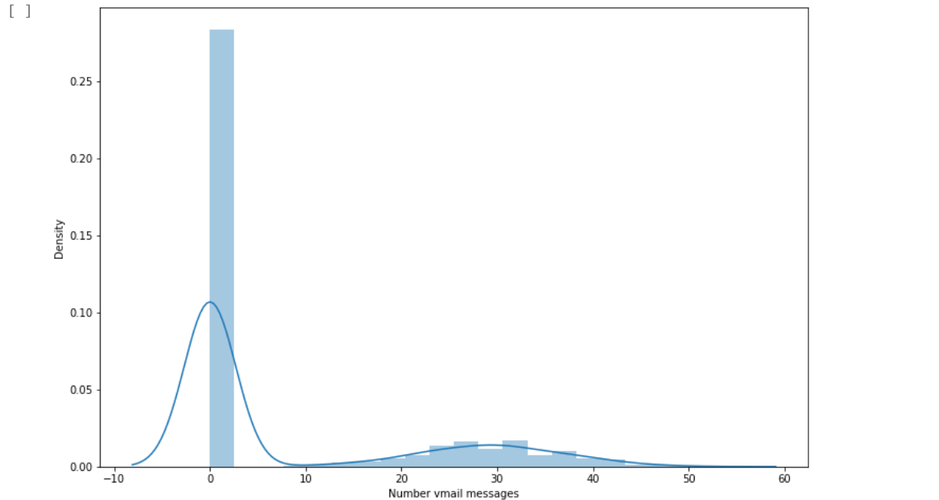
ANALYSING NUMBER VMAIL MESSAGES DISPLOT OF NUMBER VMAIL MESSAGES

Slide 20
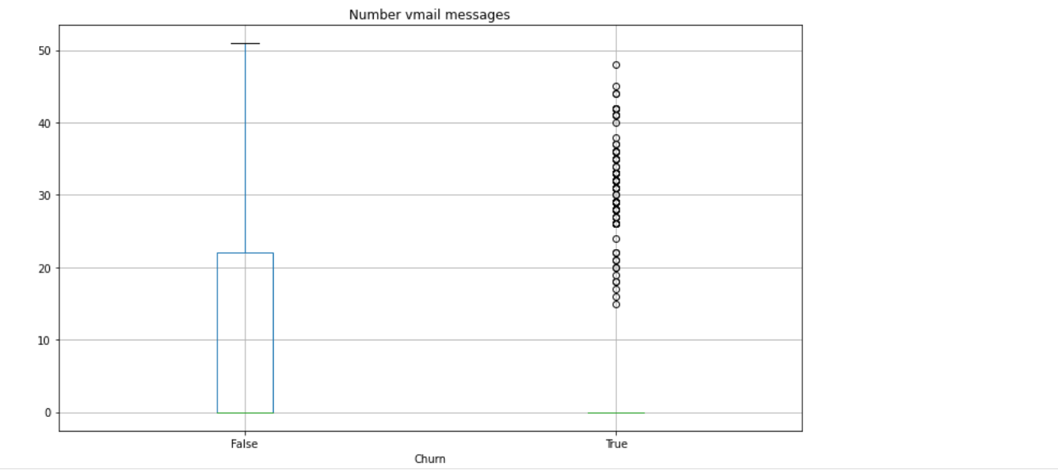
NO OF VOICEMAIL VS CHURN BOX PLOT
This box plot shows the relation between churn and no. of vmail
when there are more than 20 voice-mail messages then there is a churn

Slide 21
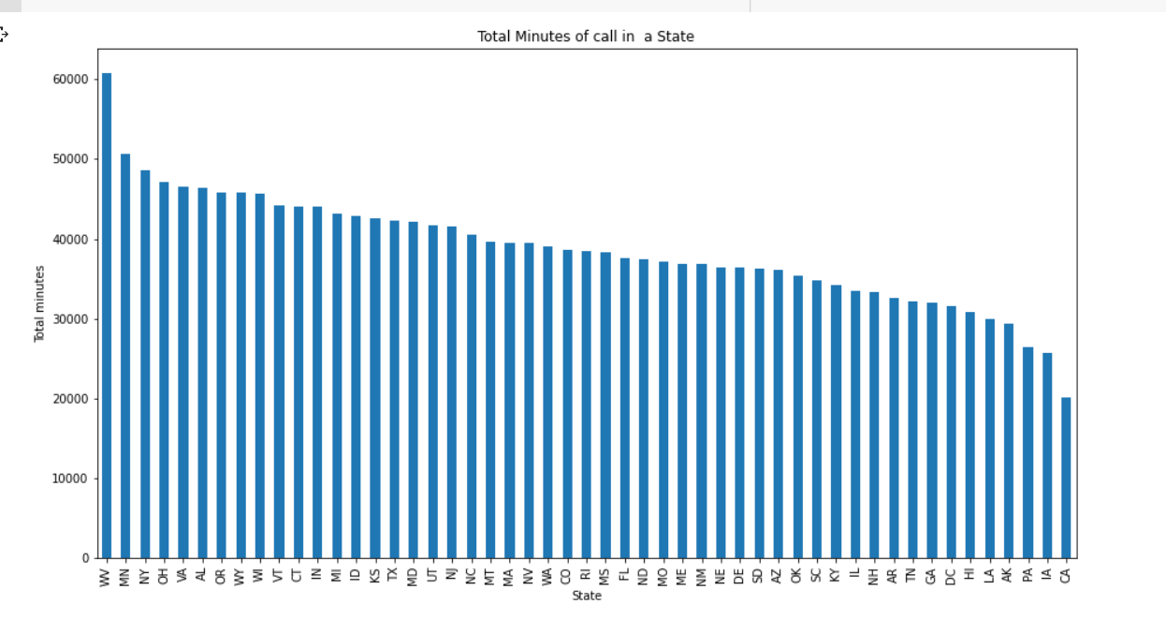
ANALYSING TOTAL MINUTES OF EACH STATE

Slide 22
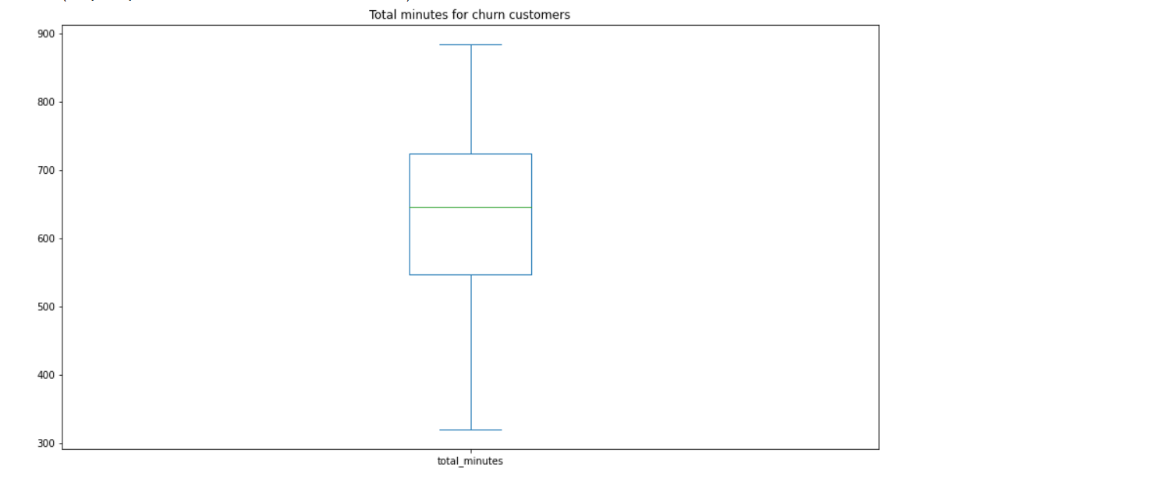
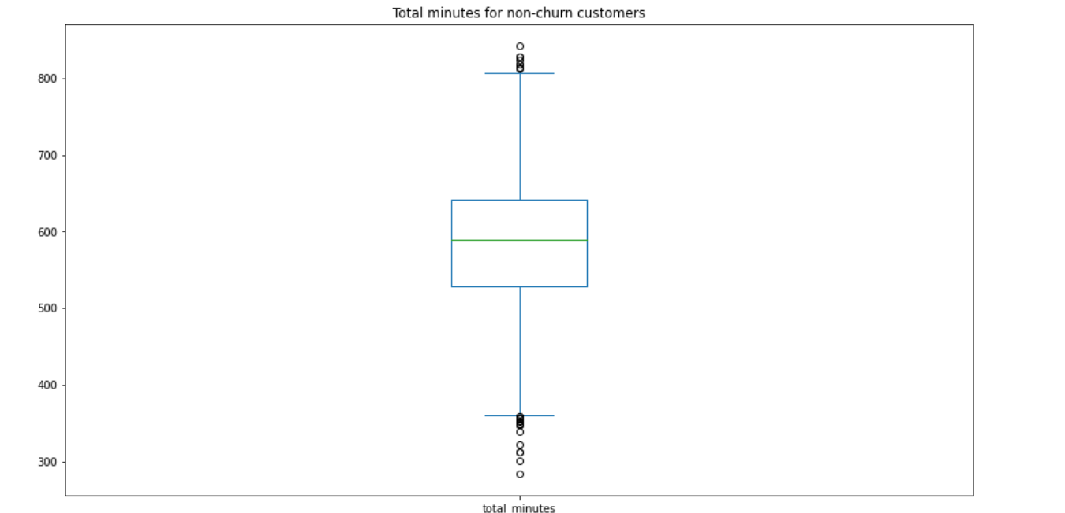
TOTAL MINUTES OF CHURN AND NON-CHURN This plot shows that for non-churn customers there are outliers for total minutes and for churn customers, there are no outliers.

Slide 23
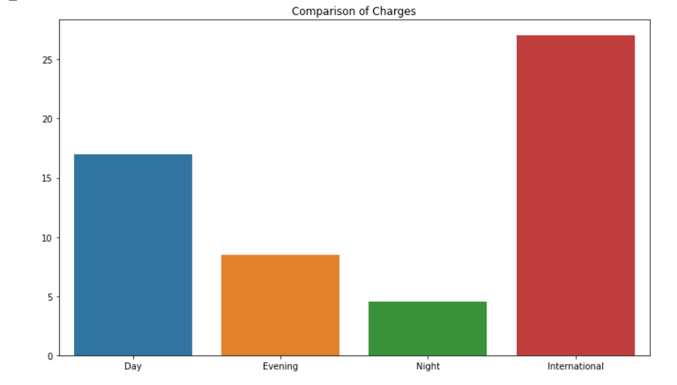
ANALYSING OVERALL CALL CHARGE
International call
charges are
high as compare to
others it's an obvious
thing but that may be
a cause for
international plan
customers to churn out.

Slide 24
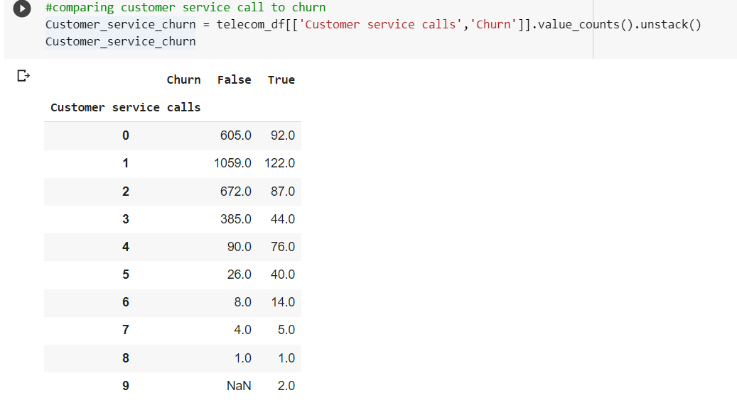
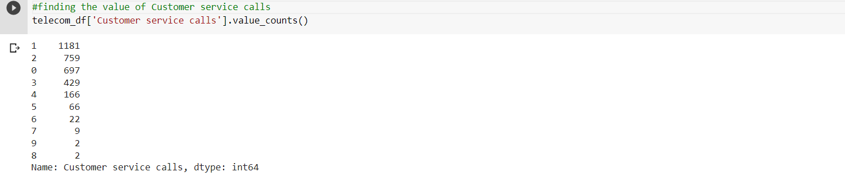
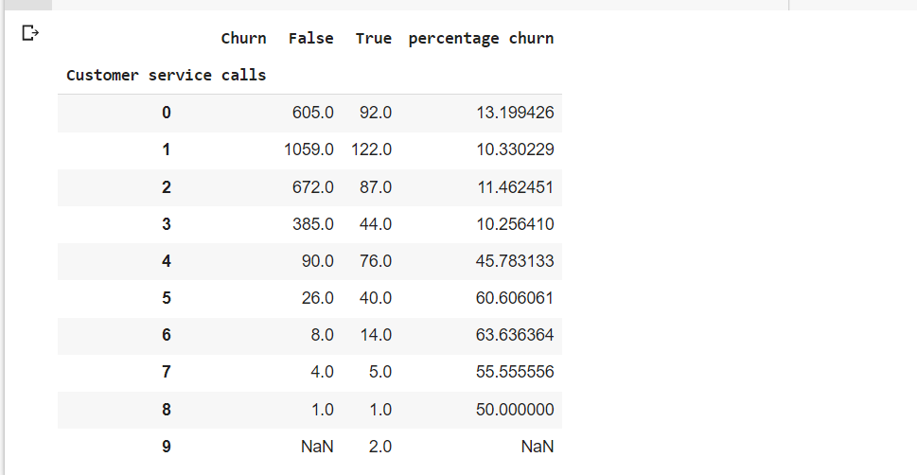
ANALYSING CUSTOMER CALLS CALLS

Slide 25
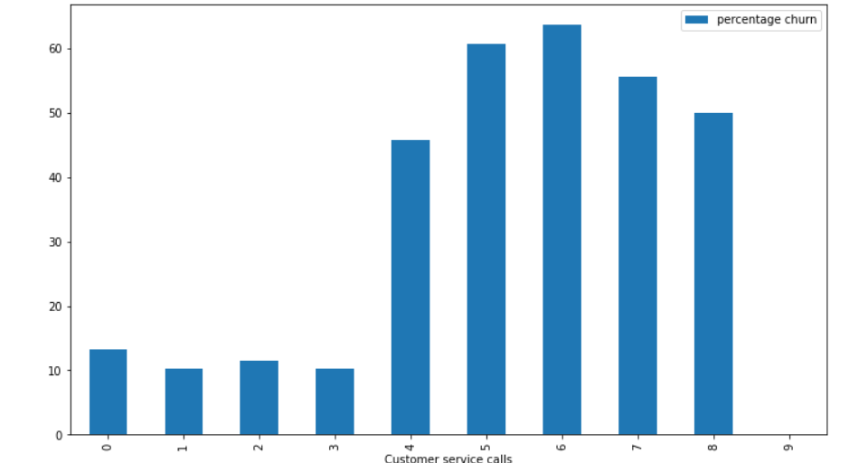
Comparing Customer service calls with CHURN
The customers who have called to customer service more than 3 calls have a more than 45% chance of leaving the subscription

Slide 26

Observation ● Churn rate increases with increase in customer service calls. ● High populated areas have high churn rate. ● Customers with international plan have high chance of leaving the subscription. ● For customers with no voice mail plan, the chance of discontinuing the subscription is greater than those with voice mail plan. ● Churn rate increases with an increase in customer service calls

Slide 27

CONCLUSION From the observations, we can conclude that the company needs to work on the following fields for customer retention: ● Offer better service in most populated areas. ● Provide better long talk time plans. ● Take feedback and suggestions on a regular basis, try to implement it and strive for better communication. ● Company can offer better International plans. ● Offer more Incentives in the form of discounts and cashbacks to churn customers.

Slide 28

CHALLENGES
● Selection of features was quite a challenge.
● For some of the variables like
‘Account length’, we have no idea about its relevance to Churn.
● We cannot consider all these variables as the exact reasons why customers left because they might leave for the better price offered by competitors or the bad economy at a certain time, etc.
● Churn does not take into consideration the types of customers that are leaving – new vs old

Slide 29


