Slide 1
A logistics and supply chain Problem
Design & presented by-
Ashwani Kumar

Slide 2
Introduction
A logistics and supply chain company wants to make a dashboard for OTIF Analysis. On-time in-full (OTIF) is a supply chain metric for measuring performance in the logistics industry.
OTIF was designed to improve store operations within Walmart itself and quickly led to a series of major changes as it was quickly adopted by other retailers and companies.

Slide 3
Data Set Details
We have given data which considers 4 sheets. They are Orders, Salesperson, Customer and City sheet with in given excel sheet.
Expectations of Stakeholders are:-
Make various KPIs.
Explain the OTIF Performance over Time
What is the Order delivery status over Time?
What are the Highest OTIF Performances?
Do something with Key Influencers and other advanced visualizations.

Slide 4
Data Wrangling Using Power Query
The First Loaded need to format first.
Checking column quality using view & formatting as per requirement.
Adding Date table using order date reference.
Adding Few required column such as- delivery_diff, On time, in full.
Creating important key metric for OTIF analysis using Dax.

Slide 5
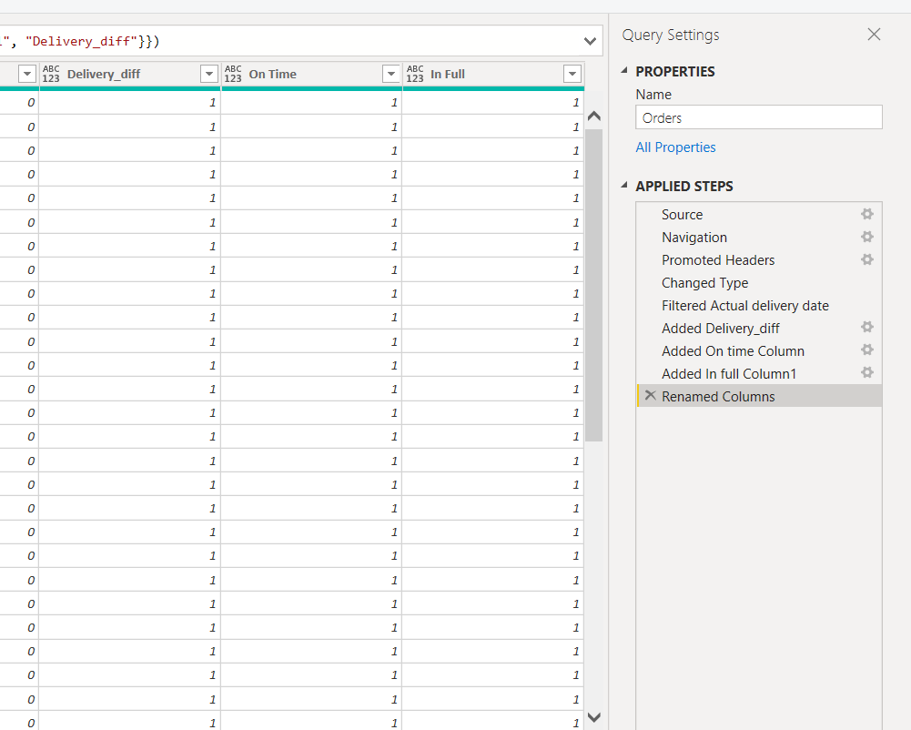
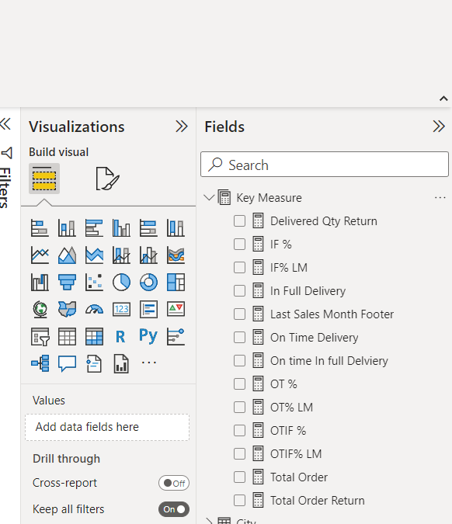
Added Column in Power Query
Key Metrics

Slide 6
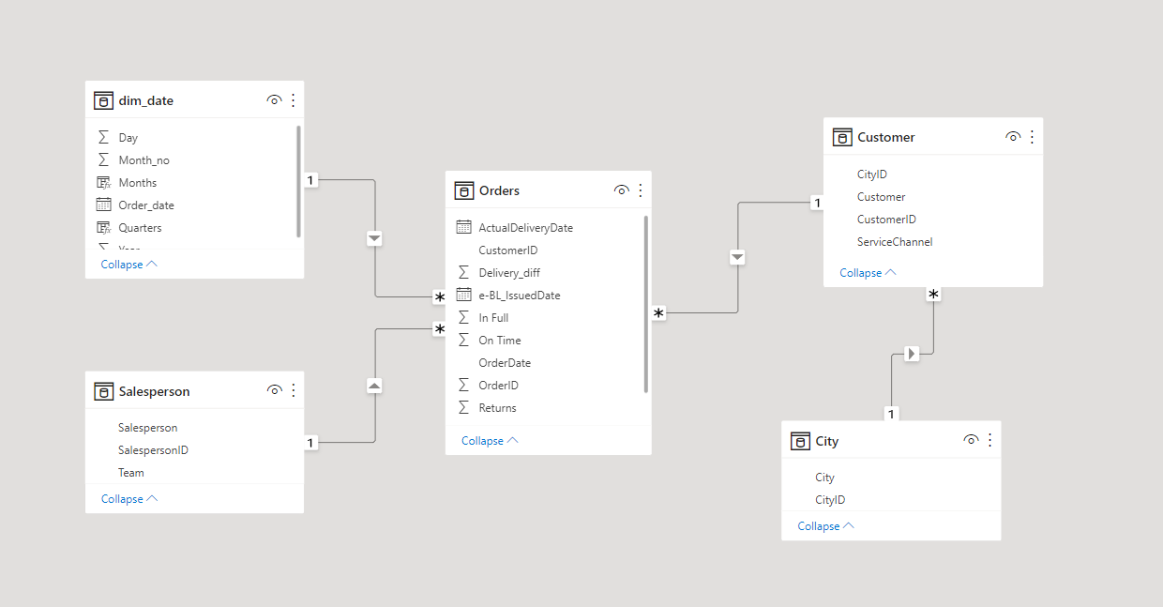
Data Models

Slide 7
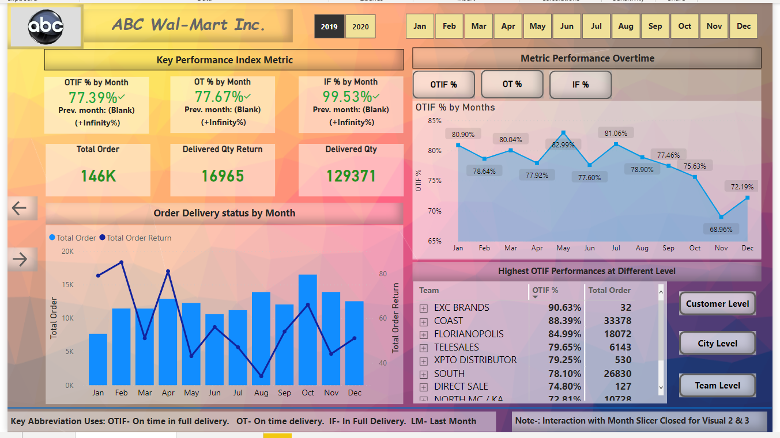
Build Dashboard

Slide 8
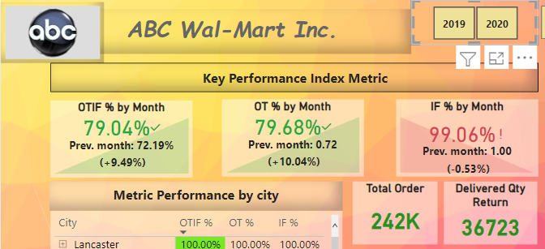
Key Insights
KPI Metric OTIF(On time in full),OT(On time),IF(In Full) the metrics define the delivery status of product to customer with respective over year.
Here On time define product delivered on time against total order.
In full define full Qty of product delivered against total order qty.
OTIF- Its define product delivery on time and in full quantity to customer.

Slide 9
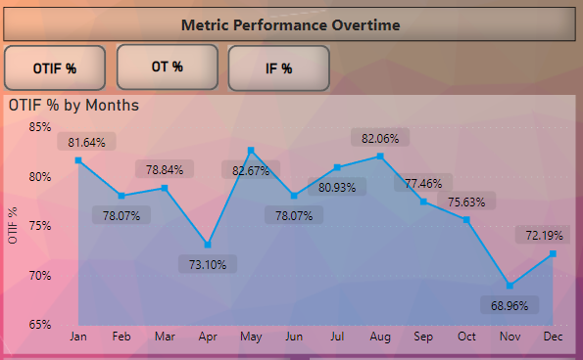
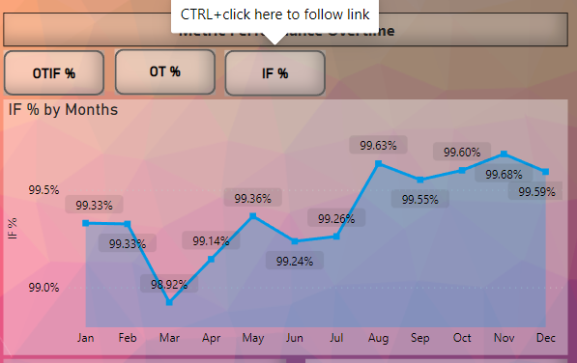
The OTIF, OT, IF Performance over Time

Slide 10
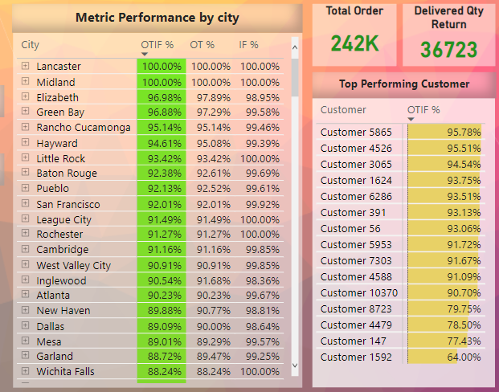
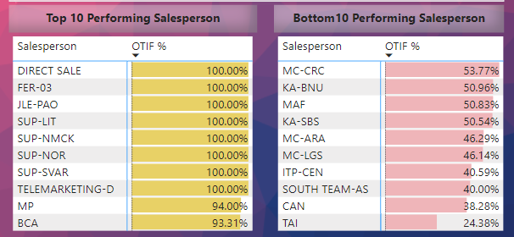
What are the Highest OTIF Performances?

Slide 11
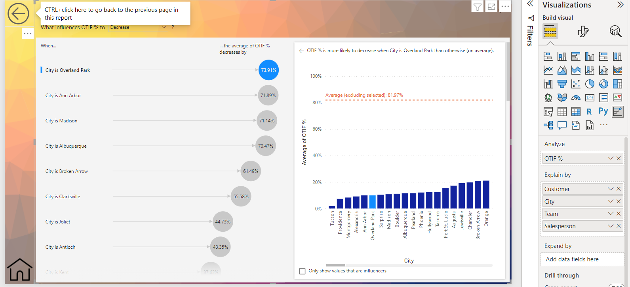
Key Influencers (used here to Analysis against OTIF% against factors like City, customers, Team.

Slide 12


