Slide 1
Randomized Algorithms CS648
Lecture 7
Two applications of Union Theorem
Balls into Bin experiment : Maximum load
Randomized Quick Sort: Concentration of the running time

Slide 2

Union theorem
Theorem: Suppose there is an event $ε$defined over a probability space ($Ω$,P) such that $ε$ = $\bigcup_{i}{ ε_{i}}$ , then
P($ε$) ≤ $\sum_{i}{ P(ε_{i})}$
Furthermore, if $P(ε_{i})$ is same for each $i$, then
P($ε$) ≤ $n$ $P(ε_{i})$

Slide 3
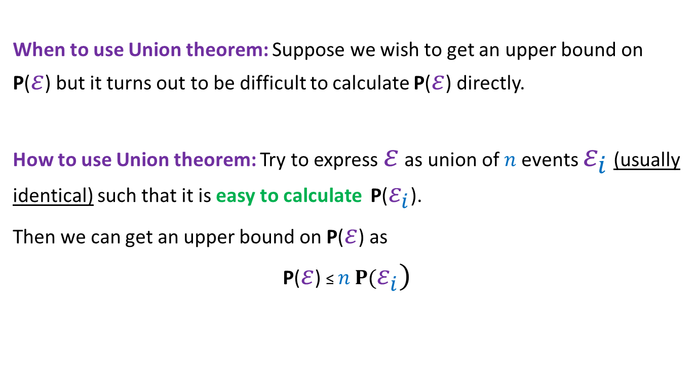
Union theorem
When to use Union theorem: Suppose we wish to get an upper bound on P($ε$) but it turns out to be difficult to calculate P($ε$) directly.
How to use Union theorem: Try to express $ε$ as union of $n$events $ε_{i}$ (usually identical) such that it is easy to calculate P($ε_{i}$).
Then we can get an upper bound on P($ε$) as
P($ε$) ≤ $n$ $P(ε_{i})$

Slide 4
Application 1 of the Union Theorem balls into Bins: Maximum load

Slide 5

Balls into Bins
1 2 3 4 5 … m-1 m
Ball-bin Experiment: There are $m$ balls and $n$ bins. Each ball selects its bin randomly uniformly and independent of other balls and falls into it.
Used in:
Hashing
Load balancing in distributed environment
1 2 3 … i … n

Slide 6

Balls into Bins
1 2 3 4 5 … m-1 m
Ball-bin Experiment: There are $m$ balls and $n$ bins. Each ball selects its bin randomly uniformly and independent of other balls and falls into it.
Theorem: For the case when $m=n$, prove that with very high probability, every bin has O(log $n$) balls.
1 2 3 … j … n

Slide 7
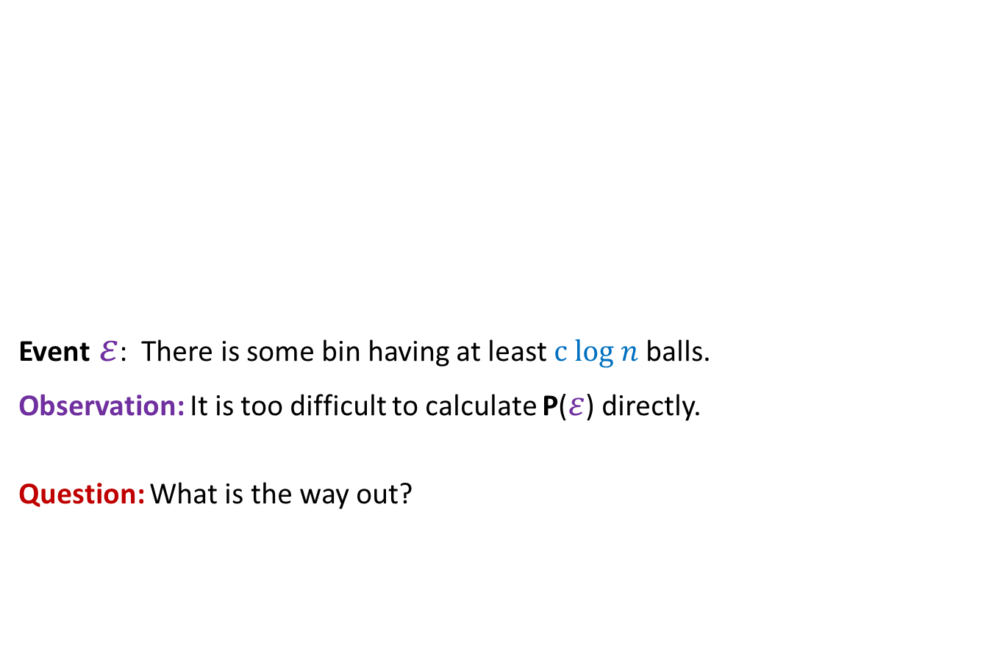
Balls into Bins The main difficulty and the way out
1 2 3 4 5 … m-1 m
Event $ε$: There is some bin having at least $c log n$ balls.
Observation: It is too difficult to calculate P($ε$) directly.
Question: What is the way out?
1 2 3 … j … n

Slide 8
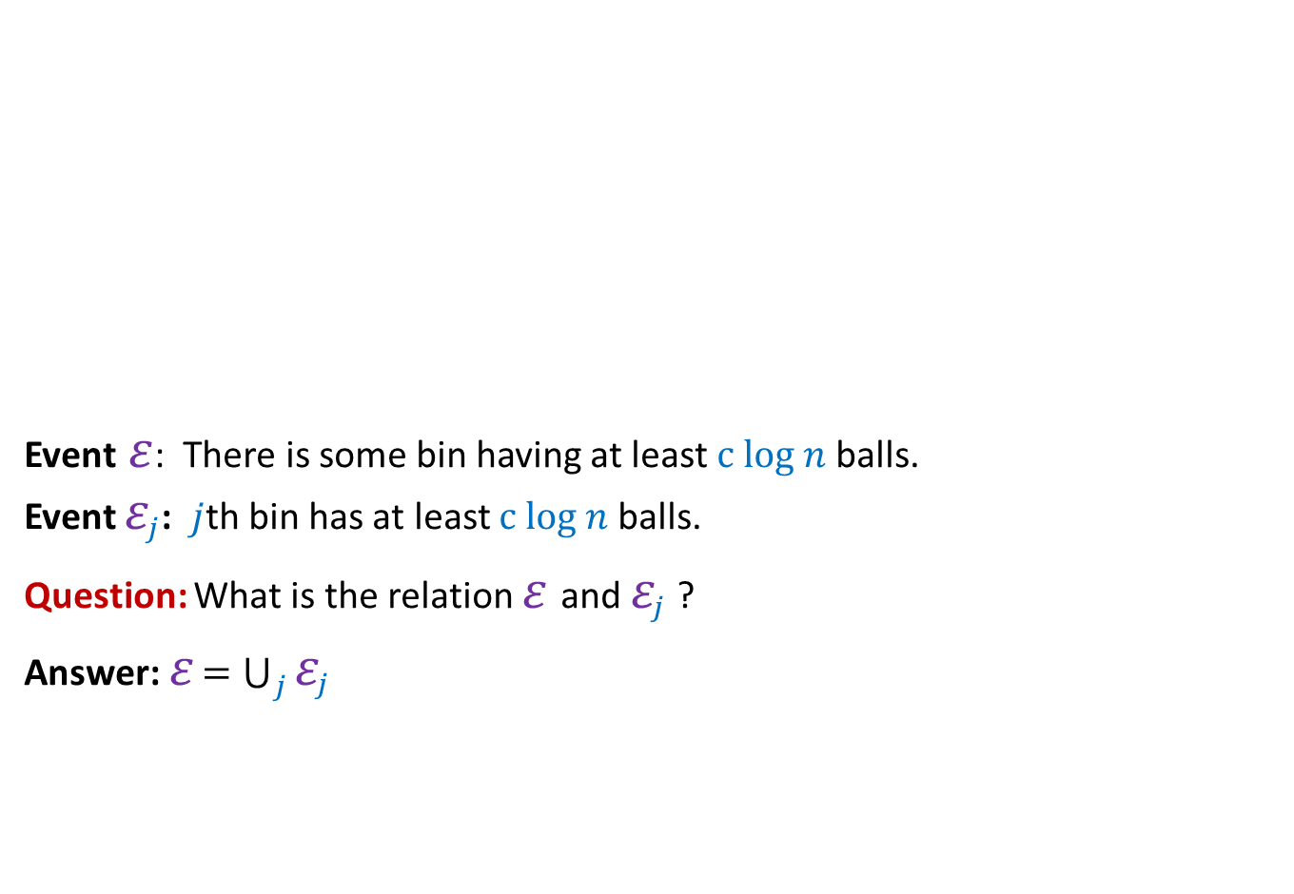

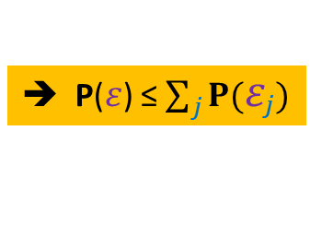
Balls into Bins From perspective of $j$th bin
1 2 3 4 5 … m-1 m
Event $ε$: There is some bin having at least $c log n$ balls.
Event $ε_{j}$: $j$th bin has at least $c log n$ balls.
Question: What is the relation $ε$and $ε_{j}$ ?
Answer: $ε$ $=\bigcup_{j}{ε_{j}}$
1 2 3 … j … n
➔ P($ε$) ≤ $\sum_{j}{P(ε_{j})}$

Slide 9


Balls into Bins From perspective of $j$th bin
1 2 3 4 5 … m-1 m
Event $ε$: There is some bin having at least $c log n$ balls.
Event $ε_{j}$: $j$th bin has at least $c log n$ balls.
Observation: In order to show P($ε$) < $n^{−4}$, it suffice to show P($ε_{j}$) < ??
P($ε_{j}$) < $n^{−5}$
1 2 3 … j … n
➔ P($ε$) ≤ $\sum_{j}{P(ε_{j})}$
$$n^{−5}$$

Slide 10
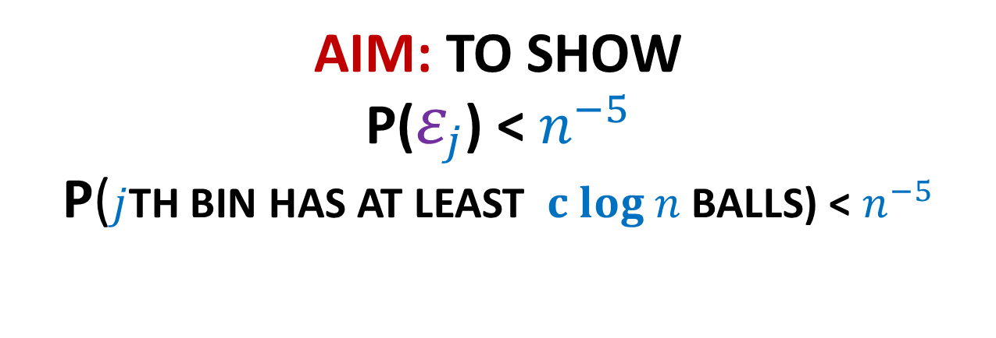
AIM: To show P($ε_{j}$) < $n^{−5}$ P($j$th bin has at least $c log n$ balls) < $n^{−5}$

Slide 11
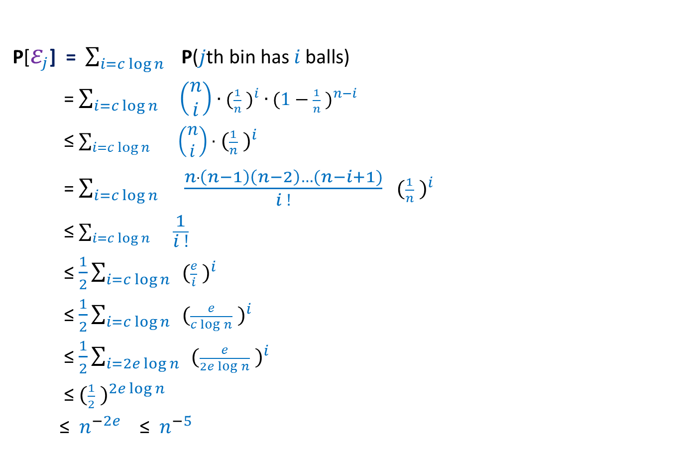



Calculating P($ε_{j}$)
P[$ε_{j}$] = $\sum_{i=c\log{n}}{ \text{P}\text{(}j\text{th} \text{bin} \text{has} i \text{balls}\text{)}}$
= $\sum_{i=c\log{n}}{ \left(\begin{matrix}n \\ i\end{matrix}\right)∙{{(\frac{1}{n} )}^{i} ∙(1−\frac{1}{n} )}^{n−i}}$
≤ $\sum_{i=c\log{n}}{ \left(\begin{matrix}n \\ i\end{matrix}\right)∙}$ ${(\frac{1}{n} )}^{i}$
= $\sum_{i=c\log{n}}{ }$ $\frac{n∙\left(n−1\right)\left(n−2\right)…(n−i+1)}{i !}$ ${(\frac{1}{n} )}^{i}$
≤ $\sum_{i=c\log{n}}{ }\frac{1}{i !}$
≤ $\frac{1}{2}\sum_{i=c\log{n}}{ }{(\frac{e}{i} )}^{i}$
≤ $\frac{1}{2}\sum_{i=c\log{n}}{ }{(\frac{e}{c\log{n}} )}^{i}$
≤ $\frac{1}{2}\sum_{i=2e\log{n}}{ }{(\frac{e}{2e\log{n}} )}^{i}$
≤ ${(\frac{1}{2} )}^{2e\log{n}}$
≤ $n^{−2e}$ ≤ $n^{−5}$
Using Stirling’s formula $m!≈$ ${(\frac{m}{e} )}^{m}\sqrt{2πm}$
Choosing $c=2e$

Slide 12
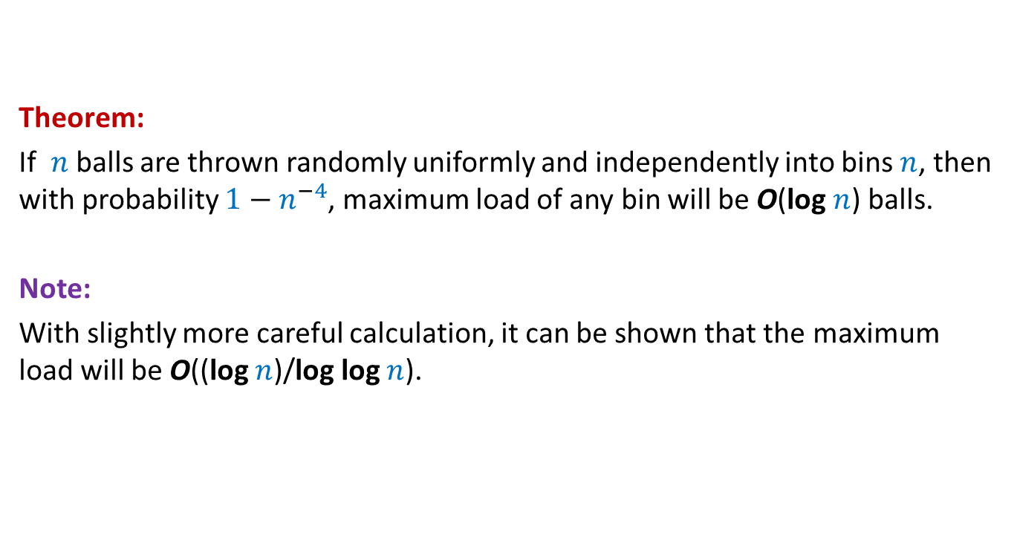
Balls into Bins
Theorem:
If $n$balls are thrown randomly uniformly and independently into bins $n$, then with probability $1−n^{−4}$, maximum load of any bin will be O(log $n$) balls.
Note:
With slightly more careful calculation, it can be shown that the maximum load will be O((log $n$)/log log $n$).

Slide 13
Application 2 of the Union Theorem Randomized Quick sort: The secret of its popularity

Slide 14
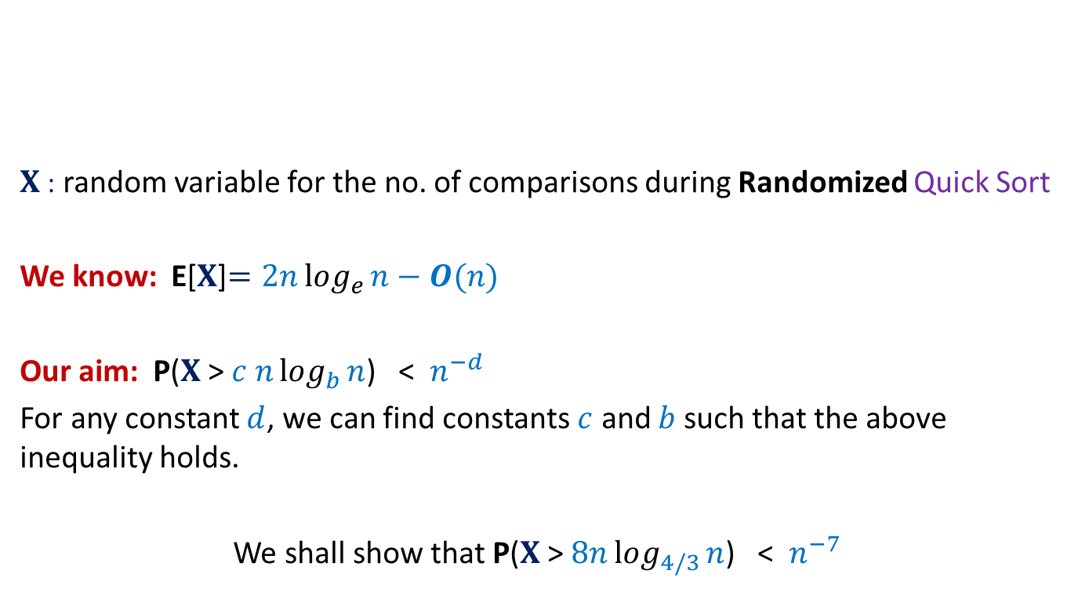


Concentration of Randomized Quick Sort
$X$: random variable for the no. of comparisons during Randomized Quick Sort
We know: E[$X$]$=2nlog_{e}{n}−O(n)$
Our aim: P($X$ > $c nlog_{b}{n}$) < $n^{−d}$
For any constant $d$, we can find constants $c$ and $b$ such that the above inequality holds.
We shall show that P($X$ > $8nlog_{4/3}{n}$) < $n^{−7}$
$1$ …
$$n$$
A

Slide 15

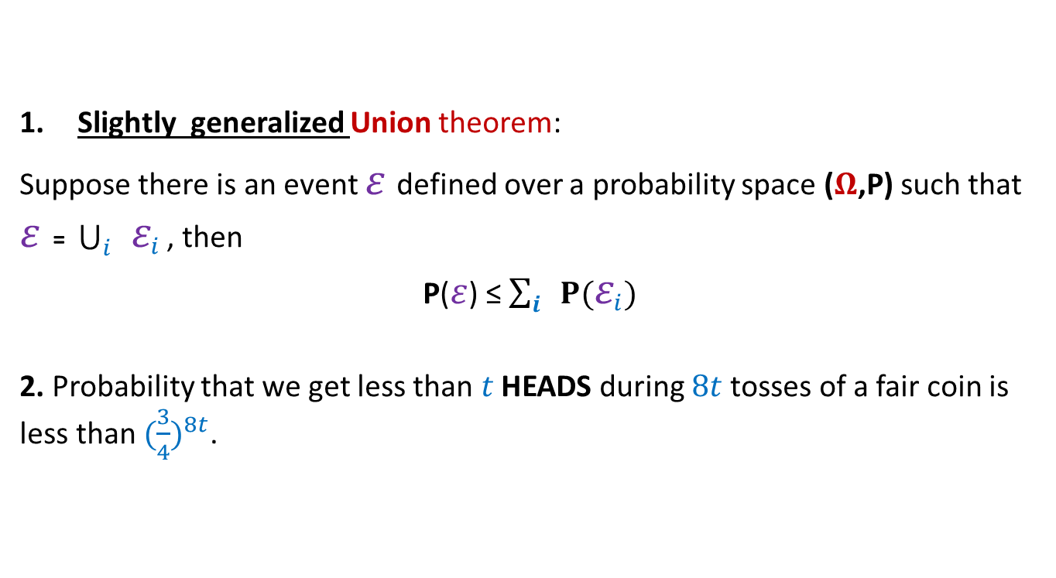
Concentration of Randomized Quick Sort Tools needed
Slightly generalized Union theorem:
Suppose there is an event $ε$defined over a probability space ($Ω$,P) such that $ε$ = $\bigcup_{i}{ ε_{i}}$ , then
P($ε$) ≤ $\sum_{i}{ P(ε_{i})}$
2. Probability that we get less than $t$ HEADS during $8t$tosses of a fair coin is less than ${(\frac{3}{4})}^{8t}$.
$$⊆$$

Slide 16

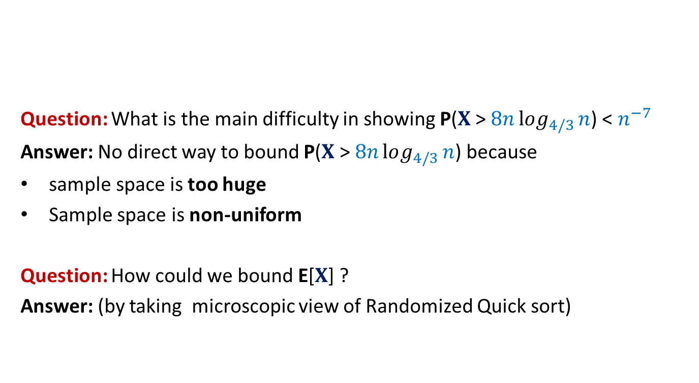

Randomized QuickSort The main difficulty and the way out
Elements of A arranged in Increasing order of values
$$e_{i}$$
$$e_{j}$$
Question: What is the main difficulty in showing P($X$ > $8nlog_{4/3}{n}$) < $n^{−7}$
Answer: No direct way to bound P($X$ > $8nlog_{4/3}{n}$) because
sample space is too huge
Sample space is non-uniform
Question: How could we bound E[$X$] ?
Answer: (by taking microscopic view of Randomized Quick sort)

Slide 17
Randomized QuickSort The main difficulty and the way out
Elements of A arranged in Increasing order of values
$$e_{i}$$
Question: What is the main difficulty in showing P($X$ > $8nlog_{4/3}{n}$) < $n^{−7}$
Answer: No direct way to bound P($X$ > $8nlog_{4/3}{n}$) because
sample space is too huge
Sample space is non-uniform
Question: How could we bound E[$X$] ?
Answer: (by taking microscopic view of Randomized Quick sort)

Slide 18


Randomized QuickSort from perspective of $e_{i}$
Elements of A arranged in Increasing order of values
$$e_{i}$$
$e_{i}$leaves the algorithm

Slide 19

Randomized QuickSort from perspective of $e_{i}$
$Y_{i}$: no. of recursive calls in which $e_{i}$ participates before being selected as a pivot.
Question: Is there any relation between $X$ and $Y_{i}$ ?
Answer: $X=\sum_{i=1}^{n}{Y_{i}}$

Slide 20
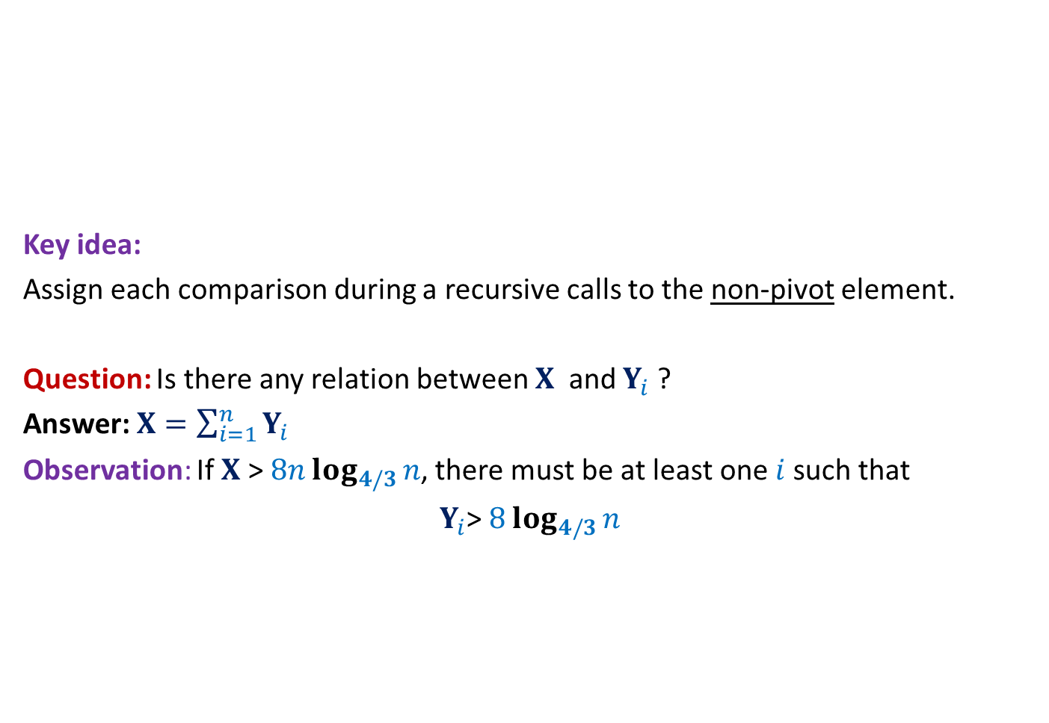
Randomized QuickSort A new way to count the comparisons
Elements of A arranged in Increasing order of values
Key idea:
Assign each comparison during a recursive calls to the non-pivot element.
Question: Is there any relation between $X$ and $Y_{i}$ ?
Answer: $X=\sum_{i=1}^{n}{Y_{i}}$
Observation: If $X$ > $8nlog_{4/3}{n}$, there must be at least one $i$such that
$Y_{i}$> $8log_{4/3}{n}$

Slide 21

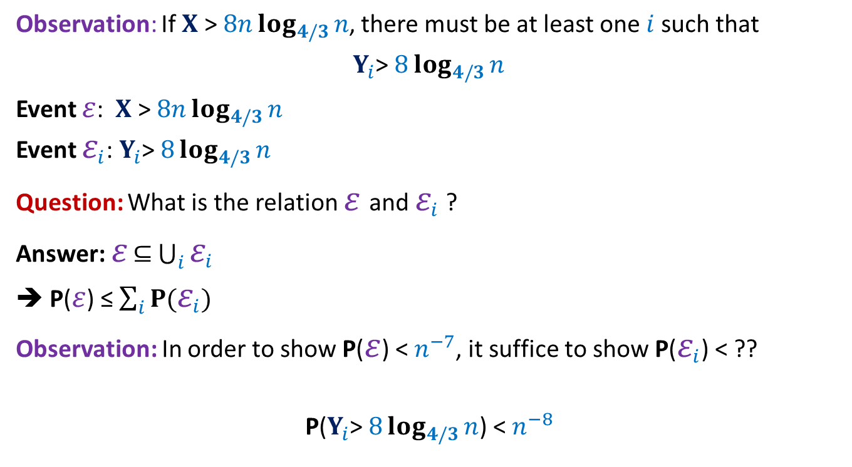
Randomized QuickSort Applying Union theorem
Observation: If $X$ > $8nlog_{4/3}{n}$, there must be at least one $i$such that
$Y_{i}$> $8log_{4/3}{n}$
Event $ε$: $X$ > $8nlog_{4/3}{n}$
Event $ε_{i}$: $Y_{i}$> $8log_{4/3}{n}$
Question: What is the relation $ε$and $ε_{i}$ ?
Answer: $ε$ $⊆$ $\bigcup_{i}{ε_{i}}$
➔ P($ε$) ≤ $\sum_{i}{P(ε_{i})}$
Observation: In order to show P($ε$) < $n^{−7}$, it suffice to show P($ε_{i}$) < ??
P($Y_{i}$> $8log_{4/3}{n}$) < $n^{−8}$
$$n^{−8}$$

Slide 22

AIM: To show P($Y_{i}$> $8log_{4/3}{n}$) < $n^{−8}$

Slide 23

Randomized Quick Sort
Increasing order of values
Definition: a recursive call is good if the pivot is selected from the middle half, and bad otherwise.
P(a recursive call is good) = ??
Notation: The size of a recursive call is the size of the subarray it sorts.
…
middle-half
$$\frac{1}{2}$$

Slide 24
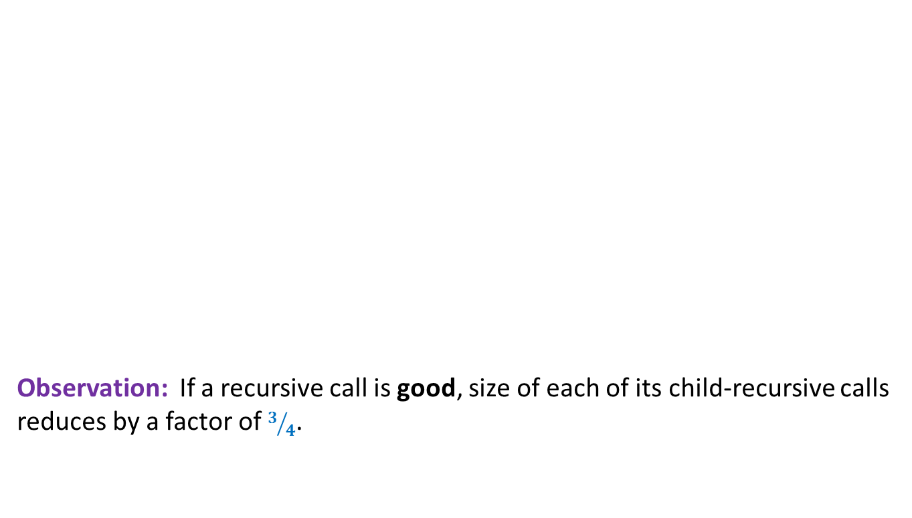
Randomized Quick Sort
Increasing order of values
Observation: If a recursive call is good, size of each of its child-recursive calls reduces by a factor of $3/4$.
…
middle-half

Slide 25

Randomized Quick Sort
$$e_{i}$$
Increasing order of values
Question: What is the maximum no. of good recursive calls can $e_{i}$ have ?
Answer: $log_{4/3}{n}$.
…
middle-half

Slide 26


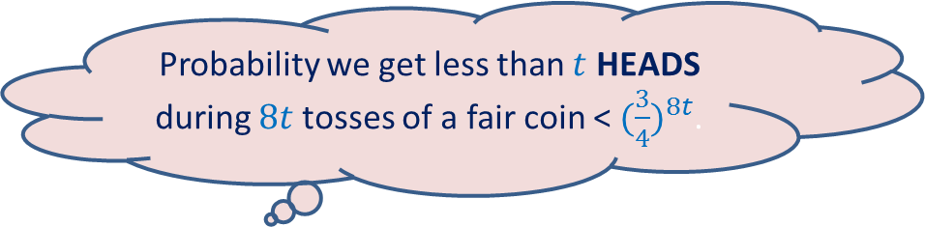
Randomized Quick Sort Summary from the perspective of $e_{i}$
During Randomized Quick Sort element $e_{i}$
Participates in a sequence of recursive calls each of which is good independently with probability $1/2$.
$e_{i}$ leaves the algorithm on or before participating in $log_{4/3}{n}$ good recursive calls.
$ε_{i}$can be re-stated as:
$e_{i}$ participated in more than $8 log_{4/3}{n}$ recursive calls but fewer than $log_{4/3}{n}$ turned out to be good.
P($ε_{i}$) < ${(\frac{3}{4})}^{8log_{4/3}{n}}$
= $n^{−8}$
Probability we get less than $t$ HEADS during $8t$tosses of a fair coin < ${(\frac{3}{4})}^{8t}$.

Slide 27
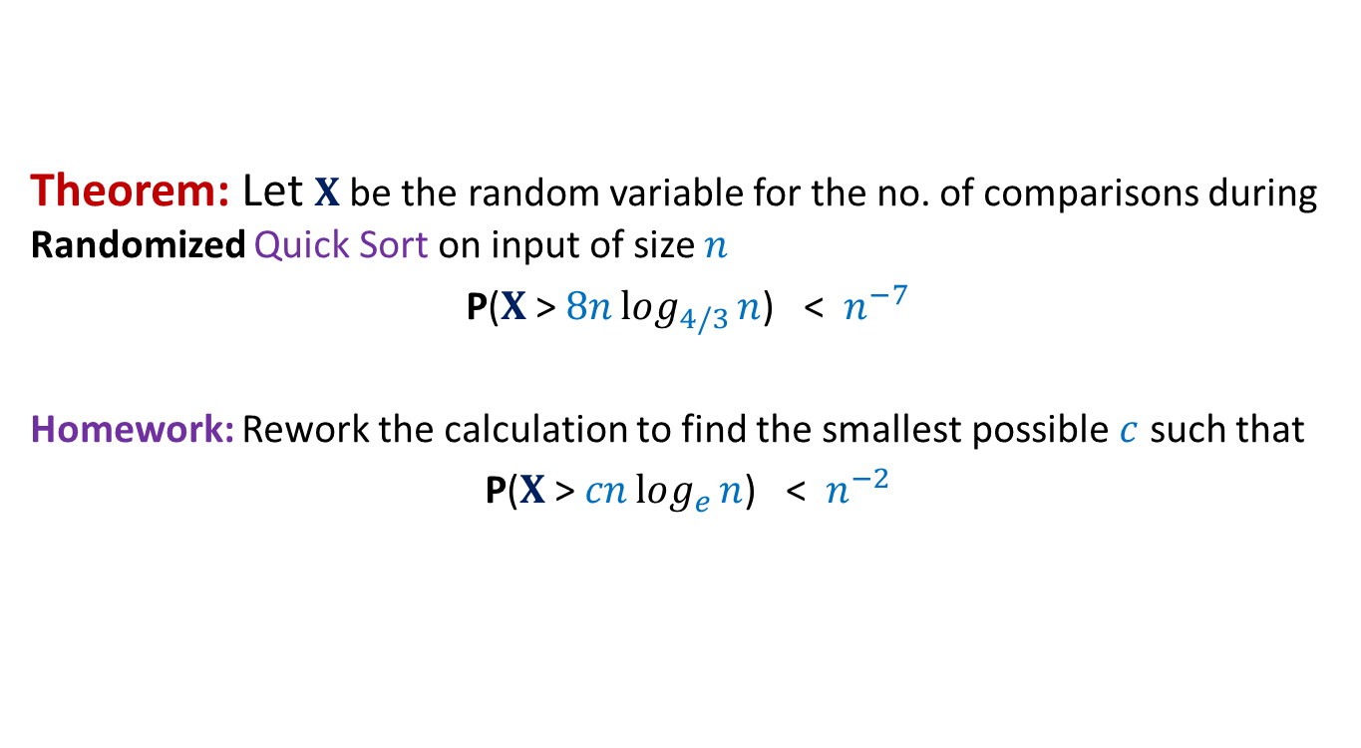
Randomized Quick Sort Final result
Theorem: Let $X$be the random variable for the no. of comparisons during Randomized Quick Sort on input of size $n$
P($X$ > $8nlog_{4/3}{n}$) < $n^{−7}$
Homework: Rework the calculation to find the smallest possible $c$ such that
P($X$ > $cnlog_{e}{n}$) < $n^{−2}$

Slide 28
Some Well Known and Well STUDIED Random Variables

Slide 29
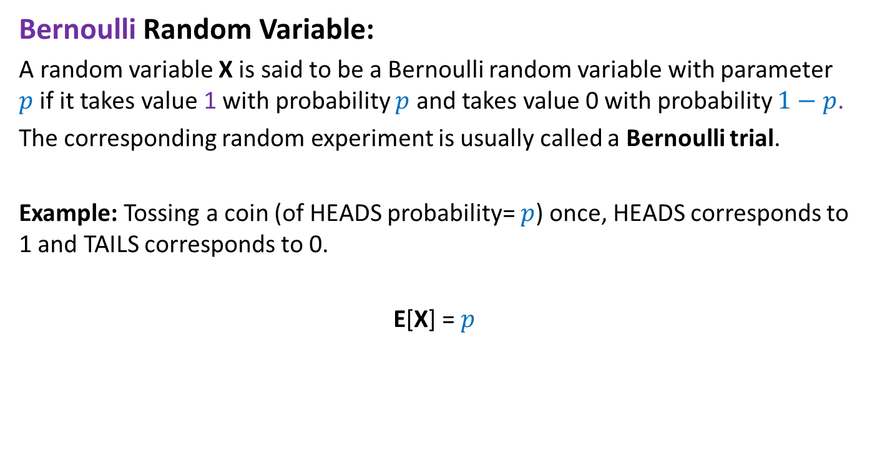
Bernoulli Random Variable
Bernoulli Random Variable:
A random variable X is said to be a Bernoulli random variable with parameter $p$if it takes value 1 with probability $p$ and takes value 0 with probability $1−p$.
The corresponding random experiment is usually called a Bernoulli trial.
Example: Tossing a coin (of HEADS probability= $p$) once, HEADS corresponds to 1 and TAILS corresponds to 0.
E[X] = $p$

Slide 30
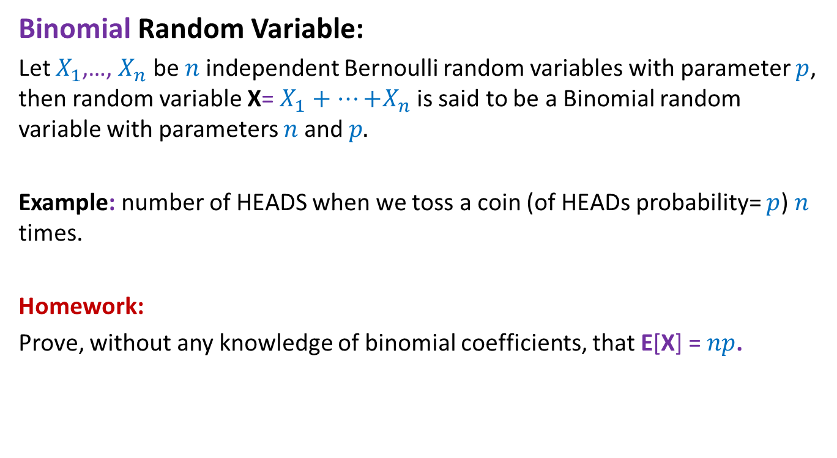
Binomial Random Variable
Binomial Random Variable:
Let $X_{1}$,…, $X_{n}$ be $n$independent Bernoulli random variables with parameter $p$, then random variable X= $X_{1}+…{+X}_{n}$ is said to be a Binomial random variable with parameters $n$and $p.$
Example: number of HEADS when we toss a coin (of HEADs probability= $p$) $n$ times.
Homework:
Prove, without any knowledge of binomial coefficients, that E[X] = $np$.

Slide 31
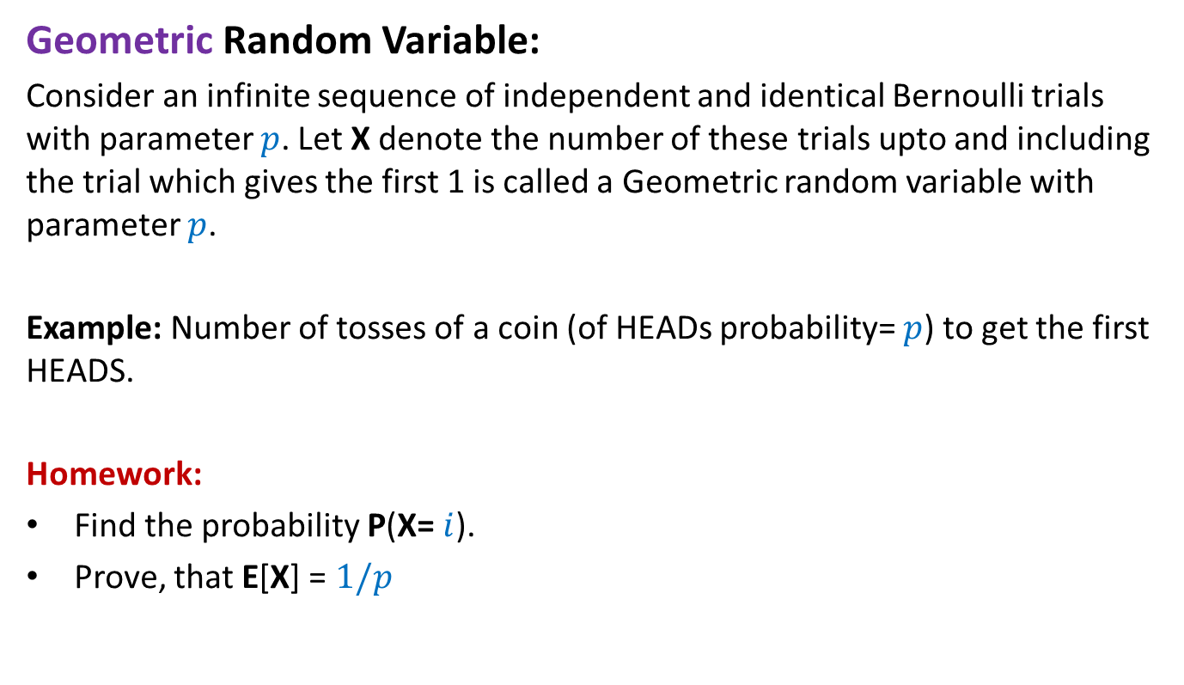
Geometric Random Variable
Geometric Random Variable:
Consider an infinite sequence of independent and identical Bernoulli trials with parameter $p$. Let X denote the number of these trials upto and including the trial which gives the first 1 is called a Geometric random variable with parameter $p$.
Example: Number of tosses of a coin (of HEADs probability= $p$) to get the first HEADS.
Homework:
Find the probability P(X= $i$).
Prove, that E[X] = $1/p$

Slide 32
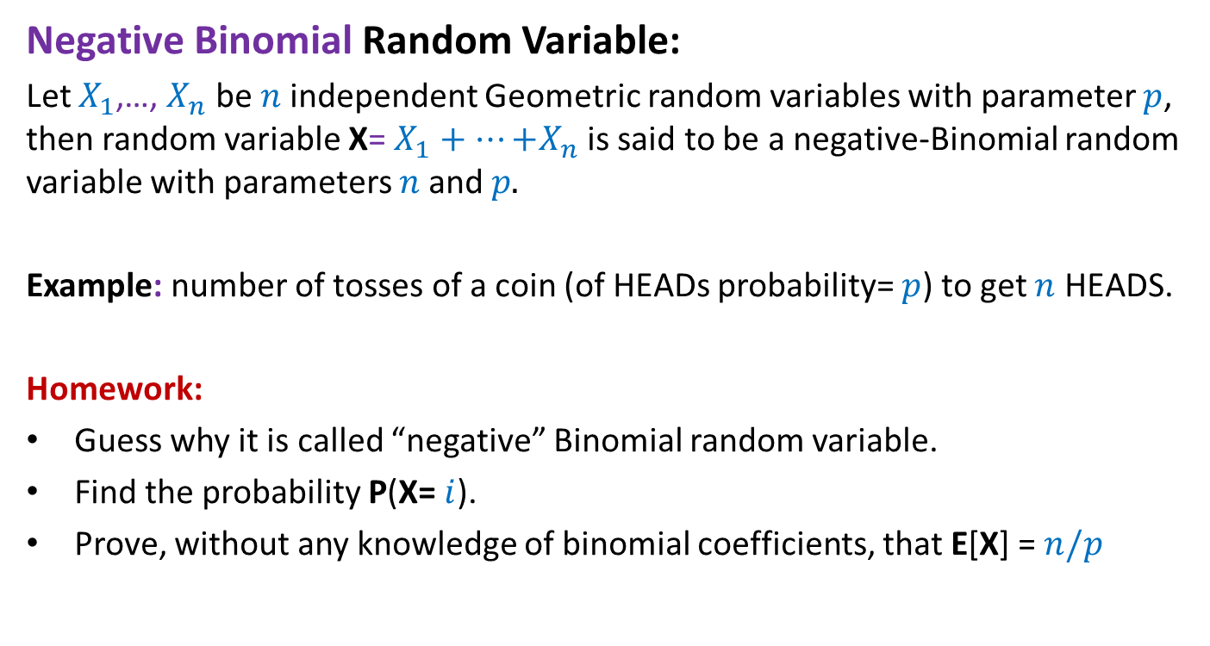
Negative Binomial Random Variable
Negative Binomial Random Variable:
Let $X_{1}$,…, $X_{n}$ be $n$independent Geometric random variables with parameter $p$, then random variable X= $X_{1}+…{+X}_{n}$ is said to be a negative-Binomial random variable with parameters $n$and $p.$
Example: number of tosses of a coin (of HEADs probability= $p$) to get $n$ HEADS.
Homework:
Guess why it is called “negative” Binomial random variable.
Find the probability P(X= $i$).
Prove, without any knowledge of binomial coefficients, that E[X] = $n/p$

