Slide 1
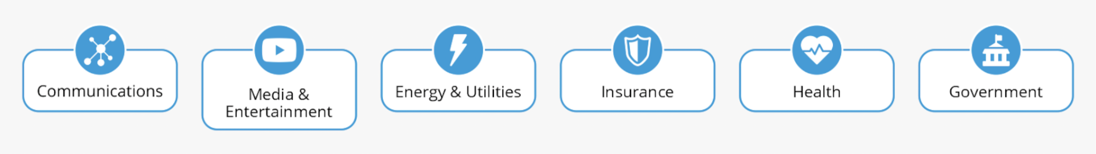
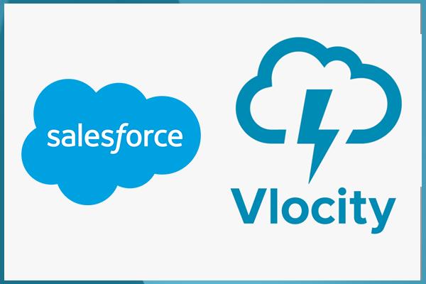
Salesforce Industries Cloud
Salesforce Industries Cloud offers pre-built solutions on the Salesforce platform that solve the needs of particular industries. Salesforce use Omnistudio (vlocity) managed package to build application without use of code (APEX or LWC/VF Pages/Aura)
Vlocity applications (built on the Salesforce platform) solve the needs of particular industries using:
Omnichannel sales
Marketing tool
Guided forms
Service management
Product solutions.

Slide 2
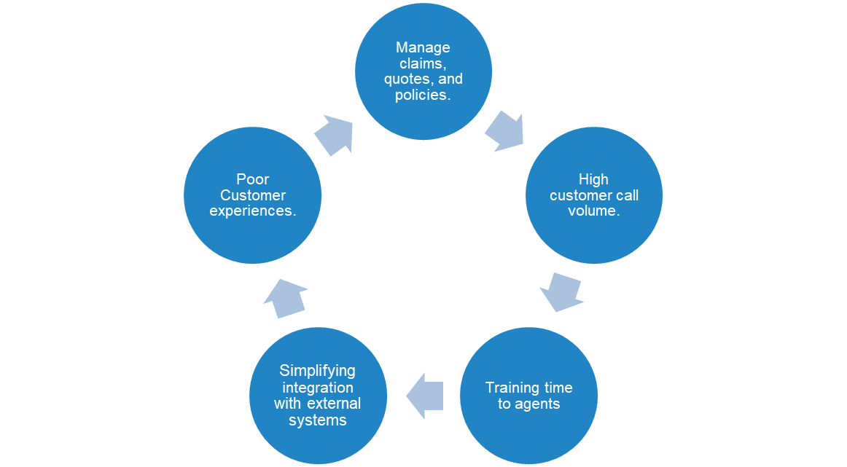
Common issues companies facing

Slide 3
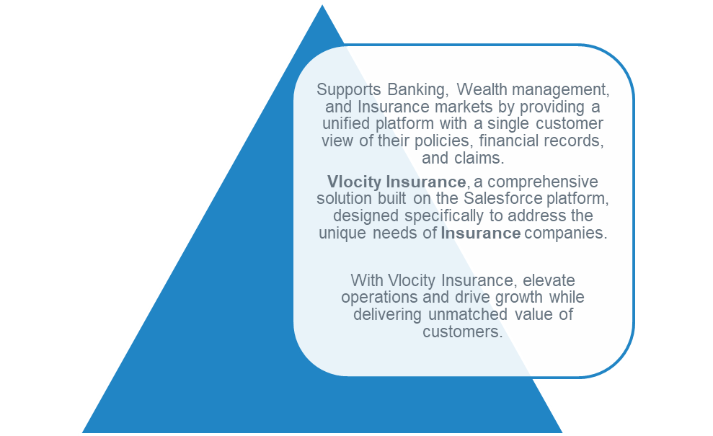
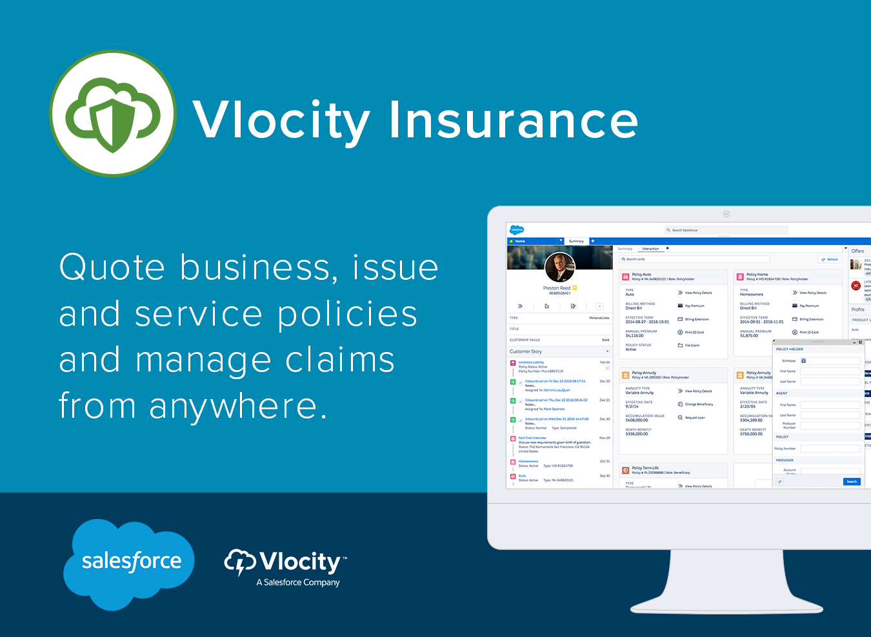
Industries

Slide 4
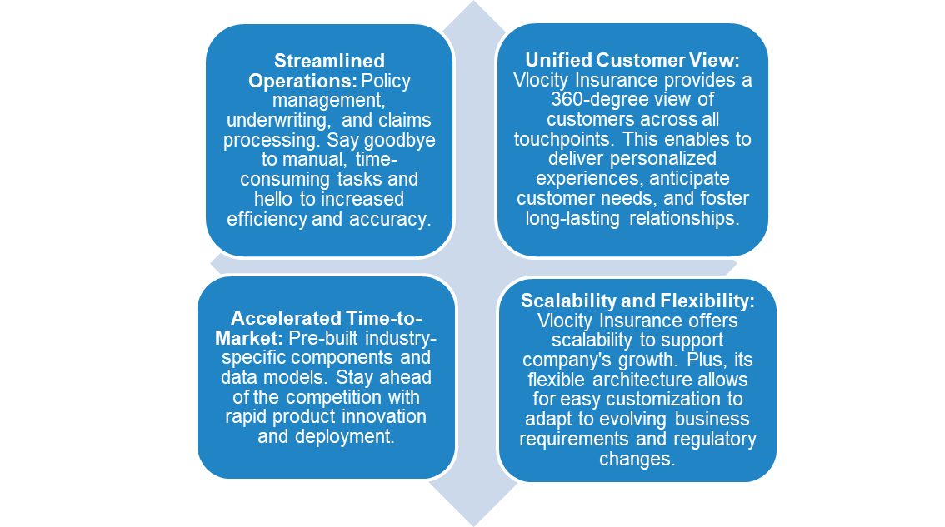

Solution

Slide 5
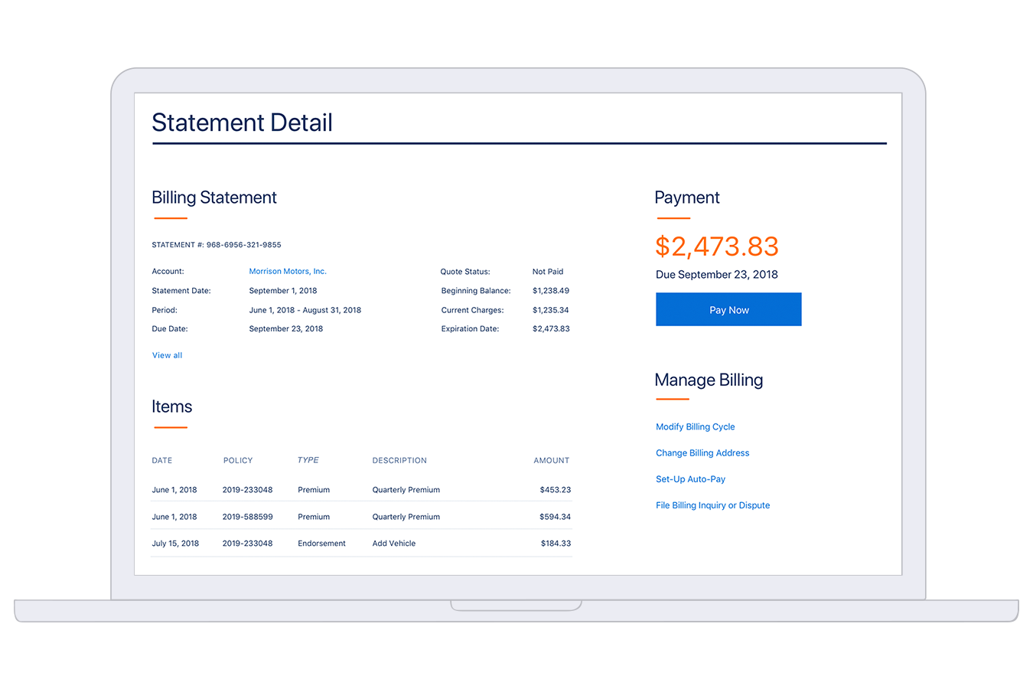
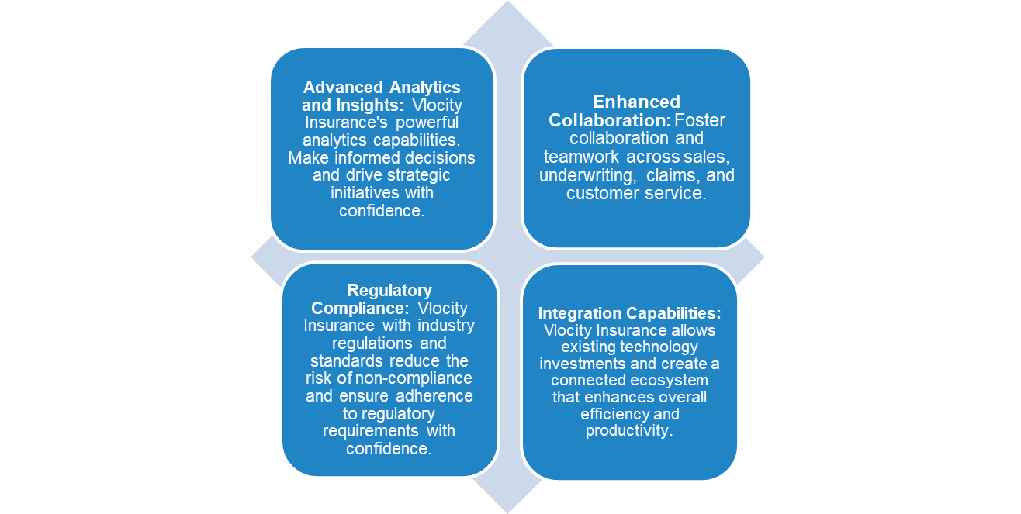
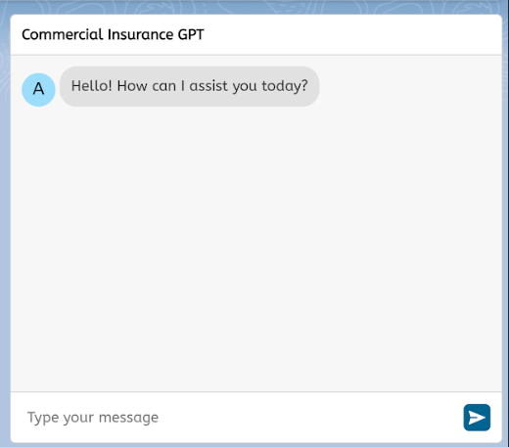
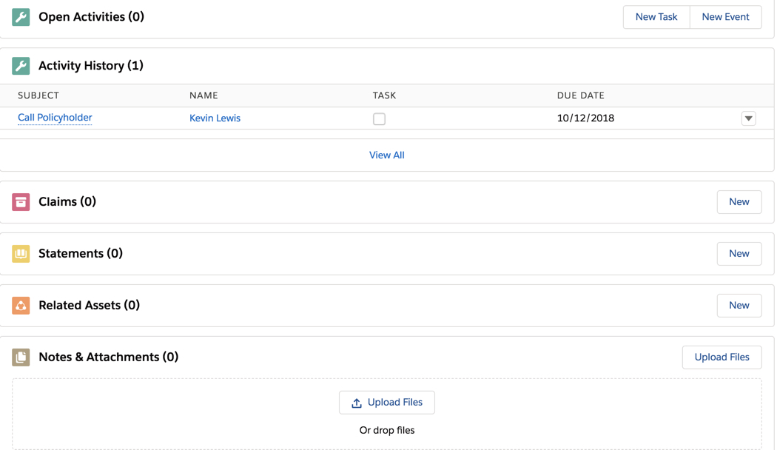
Enhanced view

