Slide 1
E-Commerce Website
Aman Verma
Ashwani Kumar
Garv Sharma
Deevyansh Chabra
GLA Unversity, Mathura.
Computer Science Engineering and Applications.
Date : 1 Dec 2023.

Slide 2
Introduction
The core idea of the proposed application shows opening,high and low.
This model predicts today’s closing price.
Proposed application will give the closing price of a particular day.

Slide 3
Objectives
The primary objective of this project is to sell Second-hand things and show new events within the college campus.

Slide 4
Problem Statement
Our Focus will be on the technical analysis and the visualization part for achieving maximum efficiency in the prediction made by our model.
It is relevant for Investment Decision Making, Financial Planning,etc.

Slide 5
Methodology
The project will employ the following methodologies, tools, and technologies:
Programming Languages: HTML, CSS, Java Script (for FrontEnd Development).
Software: Vs Code, WebStorm.

Slide 6
Implementation
Project Initiation and Requirements Analysis ( Days : 1 )
UI/UX Design ( Days : 2-3 )
Frontend Development Days ( 4-10 )
Backend Development Days ( 10-14 )
Testing and Quality Assurance ( Day : 15)
Project Completion and Deployment ( Day : 16 )

Slide 7
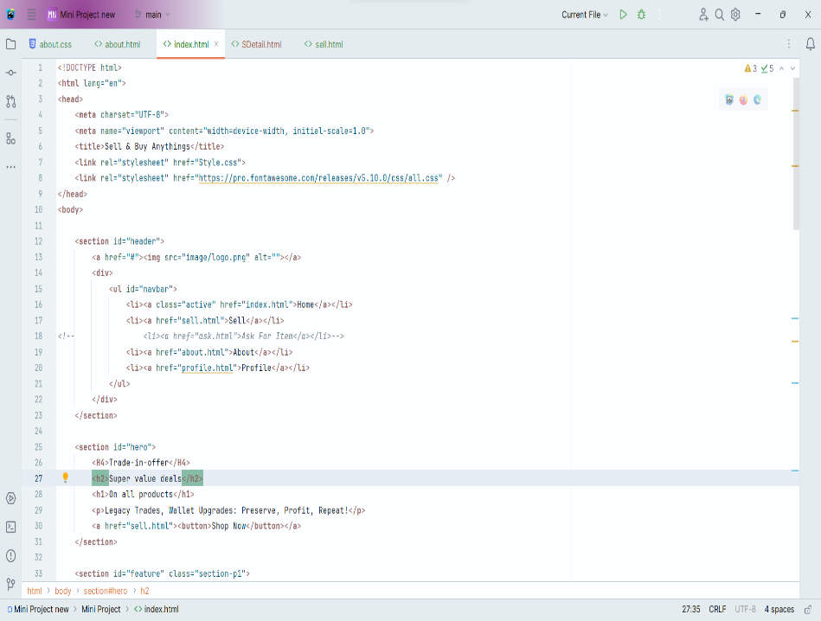
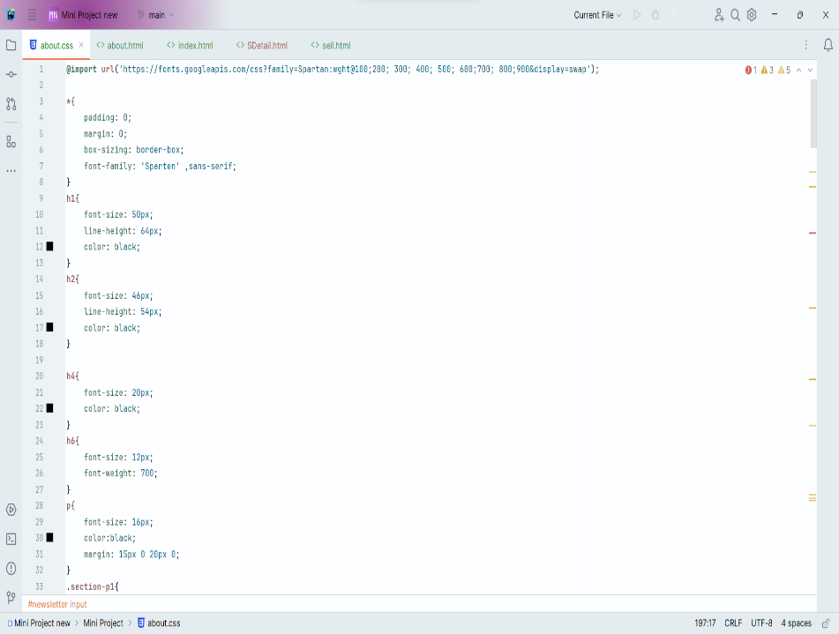
Code Snippets

Slide 8
Features
User Friendly.
Intuitive User Interface.
Accessible Platform.
Non Hackable.

Slide 9

Results

Slide 10
Future Work
Enhanced Security Measures.
Green Initiatives.
Enhanced User Experience.
Additional Features based on Feedback.

Slide 11
Conclusion
The second-hand e-commerce website project aims to create a user-friendly platform for buying and selling pre-owned products. The system incorporates essential features such as user authentication, comprehensive product management, secure checkout processes, and effective communication channels. With an emphasis on user feedback through ratings, reviews, and a feedback form, the platform encourages a trustworthy and transparent environment.

Slide 12
Acknowledgments
I would like to express my sincere appreciation to Mr. Ankit Arora (Technical Trainer) for developing supporting environment for us to develop this project.

