Slide 1
A
Mini Project (BCC-351)
Presentation on
“ DriveX ”
Presented by-
1.Ashwani patel (2400320310049) 3. anuj bansal (2400320310038)
2.Bhumika chaudhary (2400320310058) 4.anil soini (2400320310027)
Department of Electronics & Communication Engineering

Slide 2
Content
Introduction
Objectives
Motivation
Working
Applications
Conclusion & Future Scope
References

Slide 3
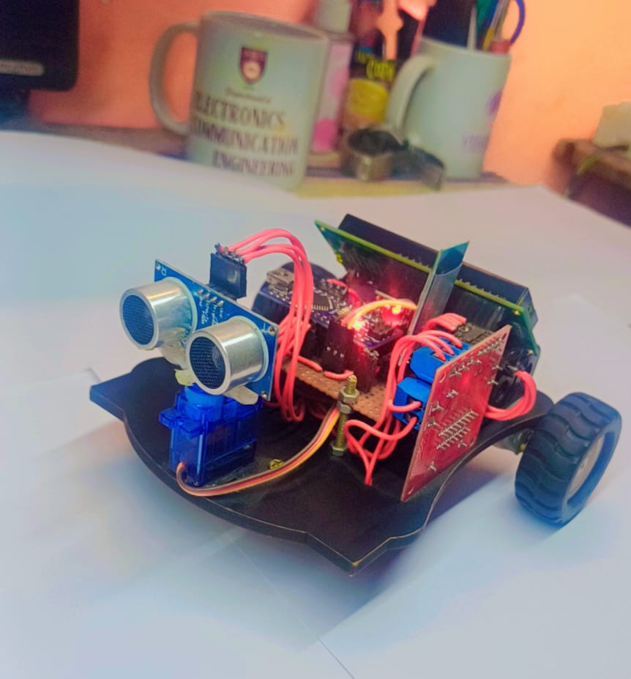
INTRODUCTION
DriveX is a smart dual-mode robotic car capable of operating in both manual (Bluetooth) and autonomous (obstacle-avoidance) modes.
The project combines embedded systems, IoT communication, and automation concepts.
Designed to demonstrate real-world robotic mobility and sensor-based navigation.

Slide 4
OBJECTIVE
Develop a dual-mode robotic car using Arduino Nano.
Implement wireless control through Bluetooth (mobile app).
Integrate ultrasonic sensors for obstacle detection and avoidance.
Display real-time data such as mode and distance on an LCD.
Ensure smooth switching between manual and autonomous modes.

Slide 5
MOTIVATION
Growing importance of autonomous vehicles and IoT-driven automation.
Desire to create a low-cost prototype that simulates modern smart car technologies.
To understand embedded system integration, real-time sensing, and control logic.
Helpful for students and researchers exploring robotics and automation.

Slide 6
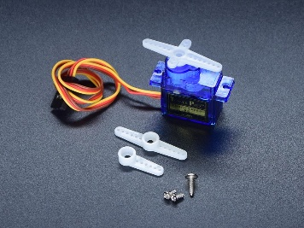
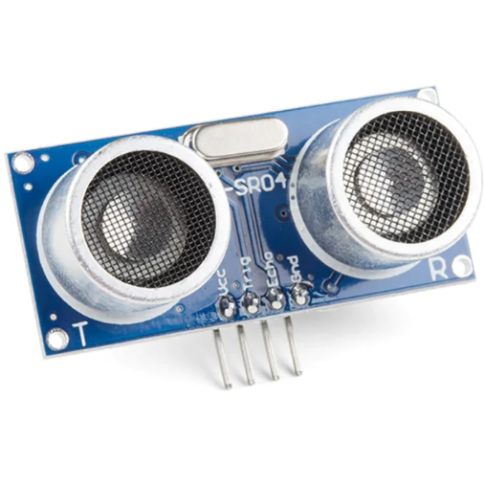
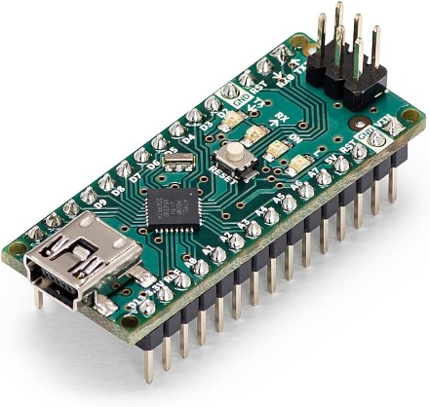
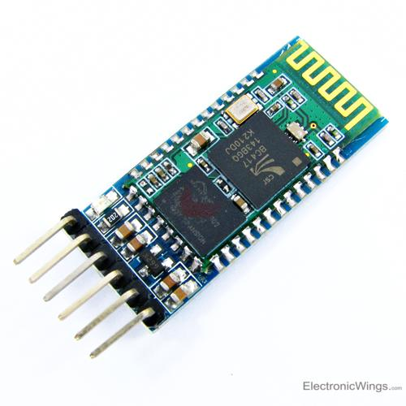
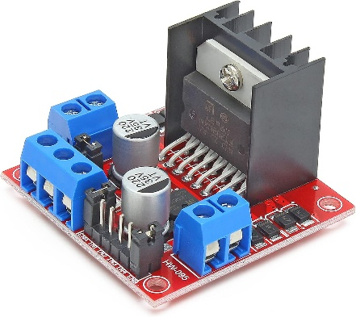
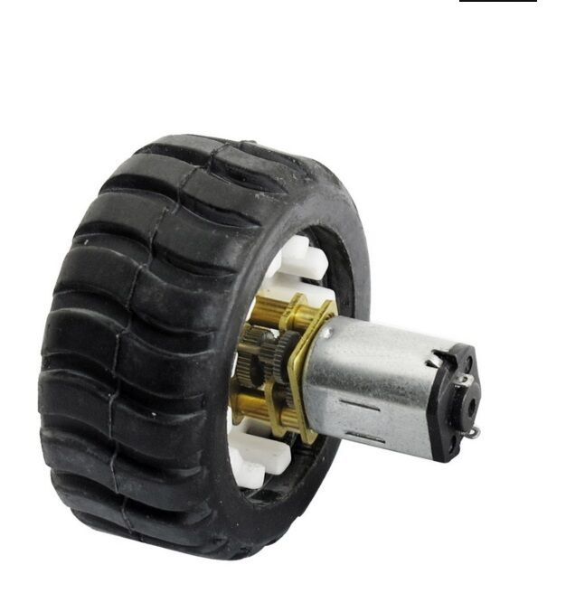
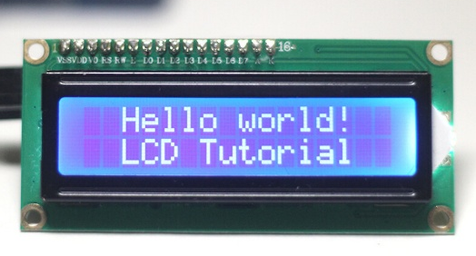
COMPONENTS
Arduino Nano
HC-05 Bluetooth Module
Ultrasonic Sensor
L298N Motor Driver
N20 Motors and Wheels
Servo Motor
LCD Display
Battery, and Chassis

Slide 7
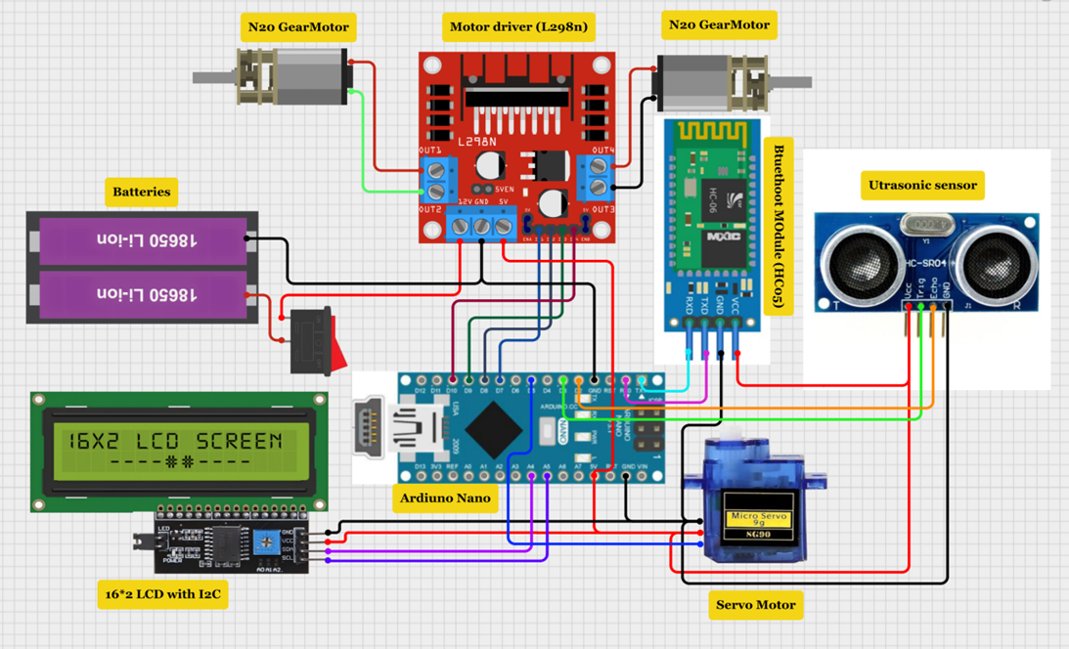

Slide 8
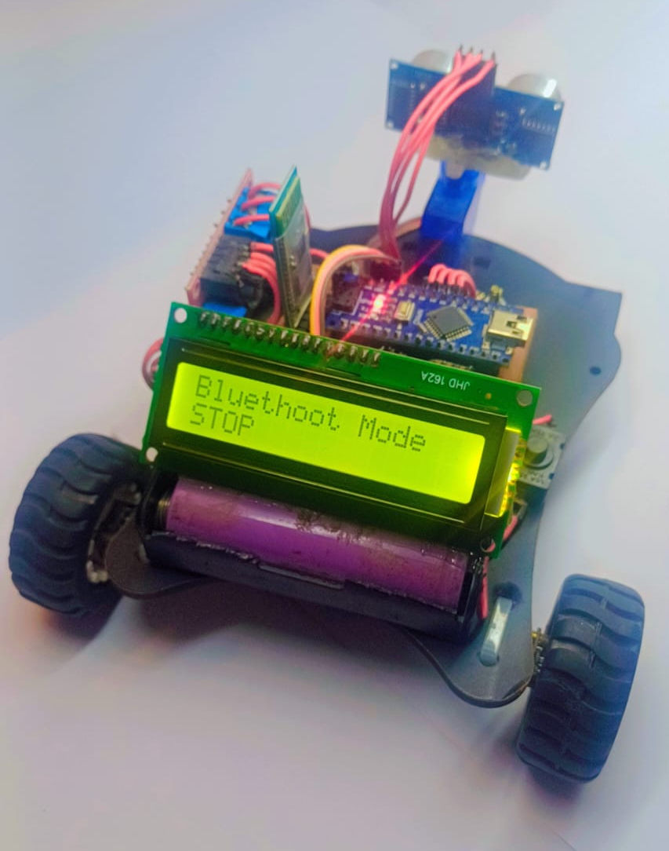
WORKING
Mode 1: Bluetooth Mode
DriveX connects with a mobile app via HC-05 Bluetooth module.
2. User can send movement commands: forward, backward, left, right.
3. LCD shows “Bluetooth Mode” and movement direction.

Slide 9
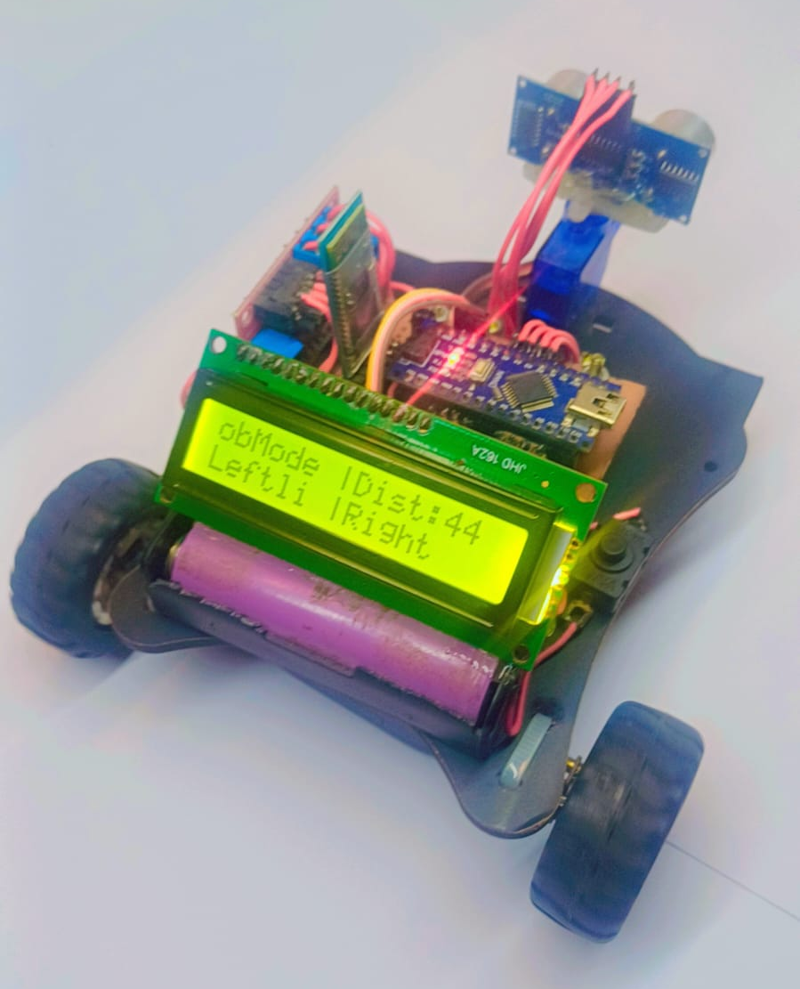
WORKING
Mode 2: Obstacle Avoidance Mode
Ultrasonic sensor continuously measures distance.
Arduino processes data
if an obstacle is detected, the car changes direction automatically.
4. LCD displays “Obstacle Mode” and the detected distance.

Slide 10
Flow Chart
Mode
Bluetooth Mode
Change Mode
Obstacle Mode
Check for obstical
Move
Send signals to motor driver
Process and take decision
DriveX moves (F,B,L,R)
Obstacle/ Bluetooth Mode
No obstacle Move Forward
Obstacle present then read left and right distance
If right dist. > left dist then turn right
If left dist. > right dist then turn left
In obstacle mode only respond to change mode

Slide 11
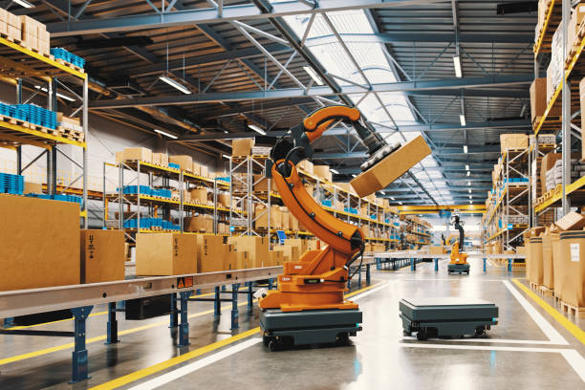
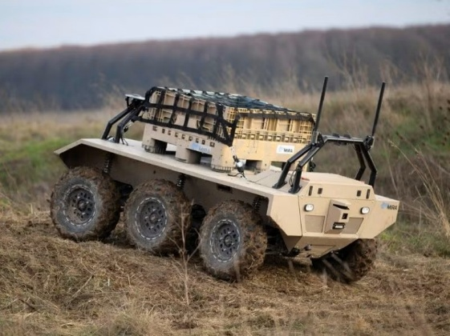
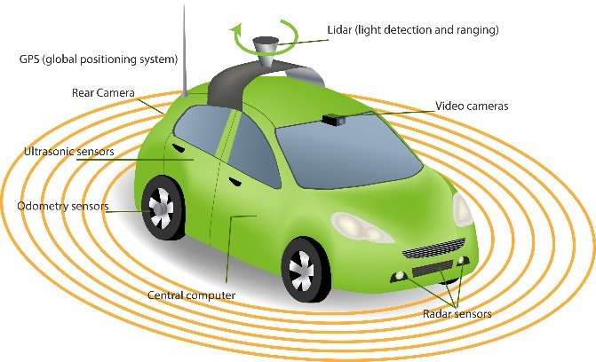
APPLICATIONS
Autonomous robotic car systems.
Smart vehicle and home automation projects.
Educational platform for embedded systems and IoT learning.
Warehouse robots or delivery bots.
Prototyping base for self-driving technology.

Slide 12
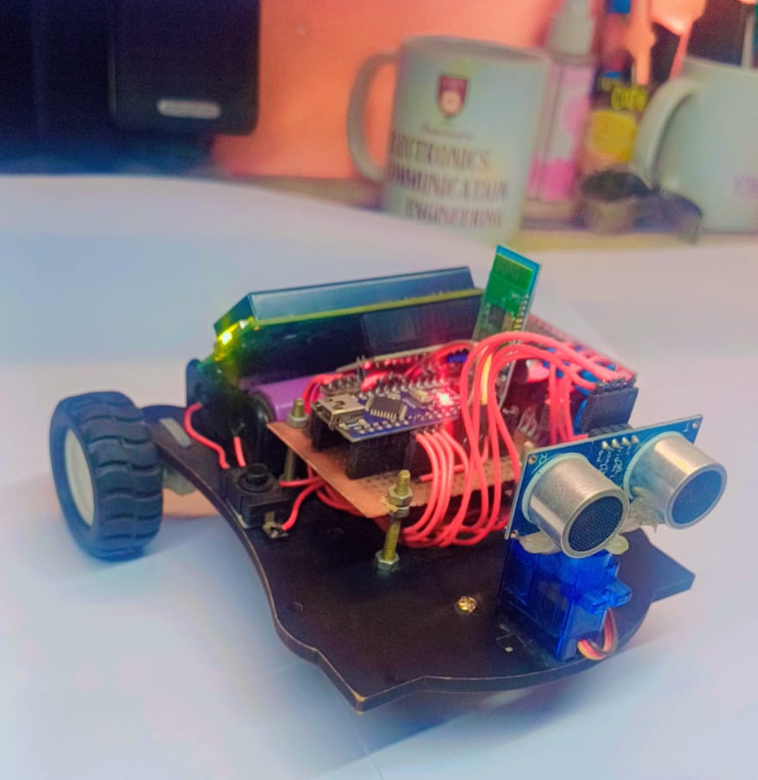
CONCLUSION & FUTURE SCOPE
Conclusion:
Successfully developed a dual-mode smart car with both manual and autonomous capabilities.
Demonstrated integration of Arduino, Bluetooth, and ultrasonic technologies.

Slide 13
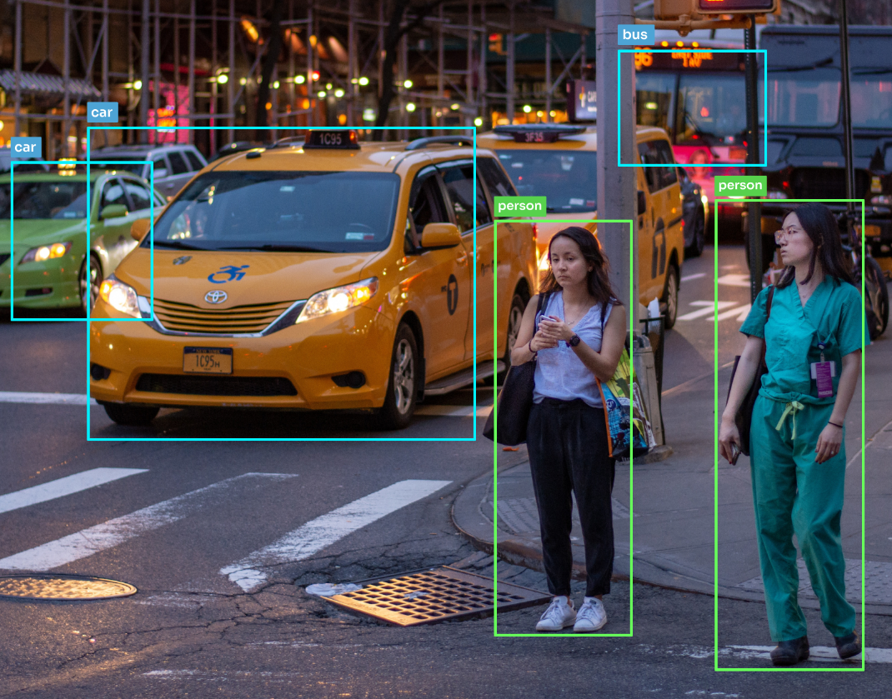
CONCLUSION & FUTURE SCOPE
Future Scope:
Add AI-based object recognition using camera.
Integrate GPS and Wi-Fi for remote tracking.
Introduce voice commands and cloud monitoring.
Use solar power for sustainable operation.

Slide 14
References
1. Arduino Official Documentation – https://docs.arduino.cc/
2. HC-05 Bluetooth Module Datasheet
3. L298N Motor Driver Technical Manual
4. Ultrasonic Sensor HC-SR04 Datasheet
5. IoT & Robotics Tutorials

Slide 15
Thank You

