Slide 1
Crime Report Management System
A low-code application built on Zoho Creator
Ashwanth K (240701057)
CB23F35 – Low-Code Application Development using Zoho Creator
Rajalakshmi Engineering College · B.E. CSE · November 2026

Slide 2
Problem and Objectives
The problem
The objectives
Complaints, officers, investigations and evidence are kept in separate registers and files
No link between a complaint, its officer, evidence and outcome
Status and crime-type counts are made by hand
No standard closure record; citizens give no feedback
Eight connected forms for the full crime-report life cycle
Picklist references instead of retyping data
Eight reports and one Admin_Dashboard
Profiles, roles and sharing rules for access control
Web, phone and tablet layouts

Slide 3
The Solution at a Glance
8
8
1
Forms
Reports
Admin dashboard
65
10
5
Fields, 10 field types
Picklist references
Sharing rules
Built entirely by configuration – no custom Deluge scripts.

Slide 4
Crime Report Life Cycle
1
Citizen Registration
2
Crime Report Submission
3
Case Assignment
4
Investigation Details
➜
➜
➜
5
Evidence Management
6
Case Resolution
7
Citizen Feedback
8
Admin Monitoring
➜
➜
➜
Report_ID is generated at submission and links every later step.

Slide 5
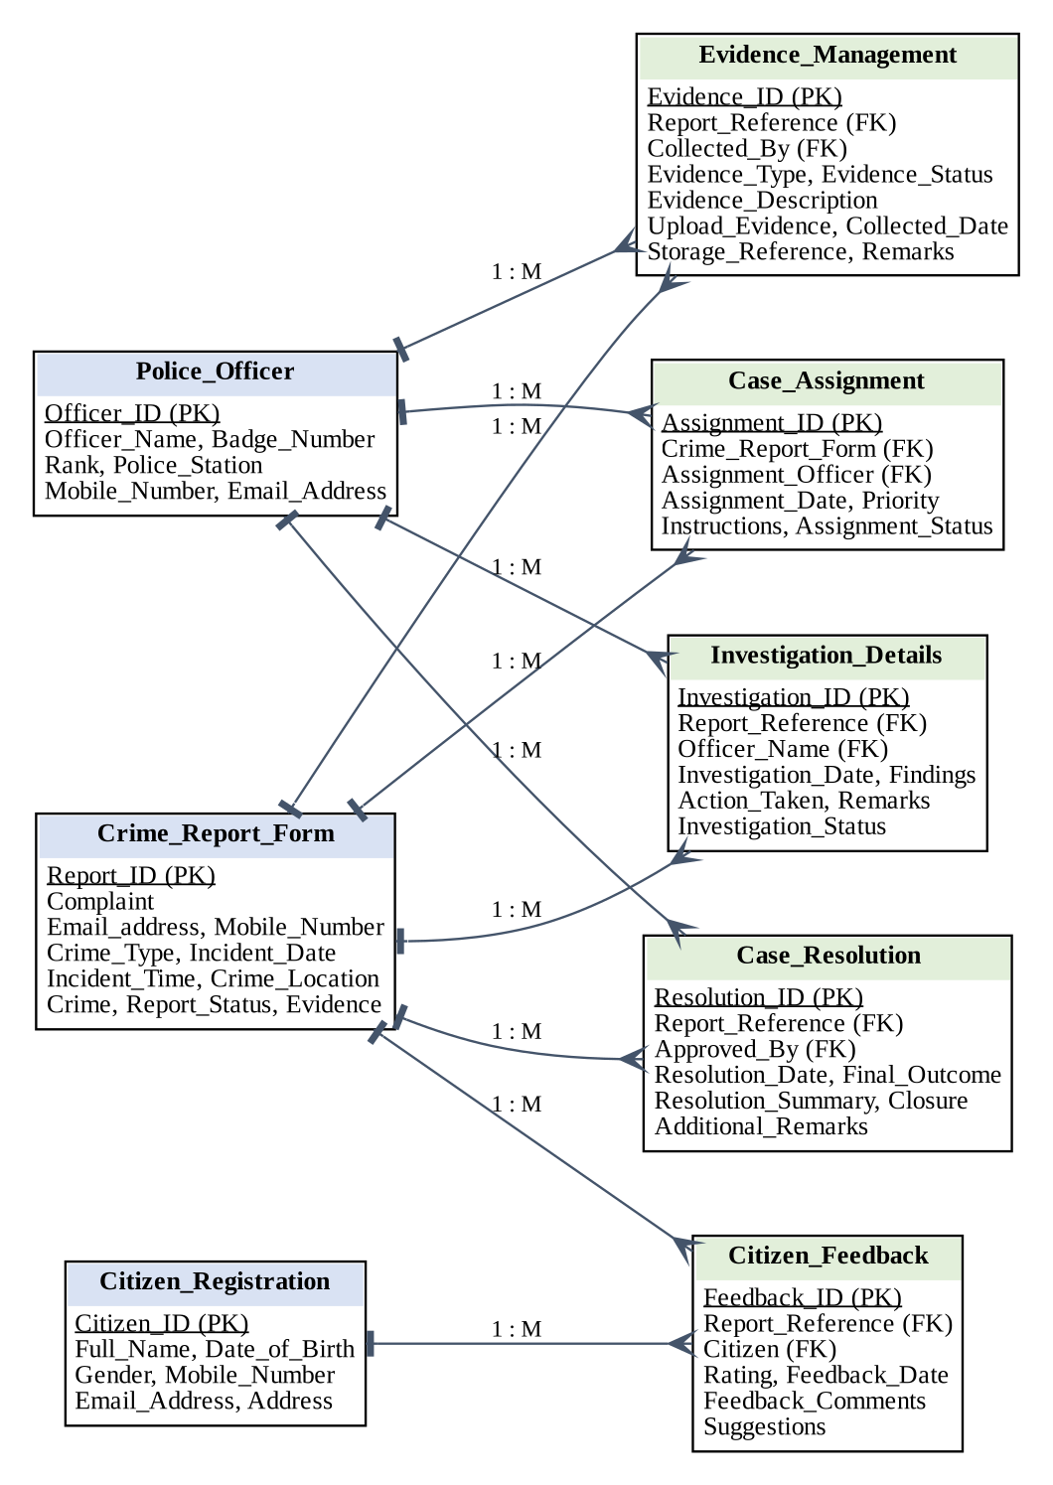
Data Model
Three master forms: Citizen_Registration, Police_Officer, Crime_Report_Form
Five transaction forms refer to them through picklist references
A report can have many assignments, investigations, evidence, resolutions and feedback records
An officer appears in assignments, investigations, evidence and resolutions
Observation: a complaint is not linked directly to a registered citizen (future enhancement)

Slide 6
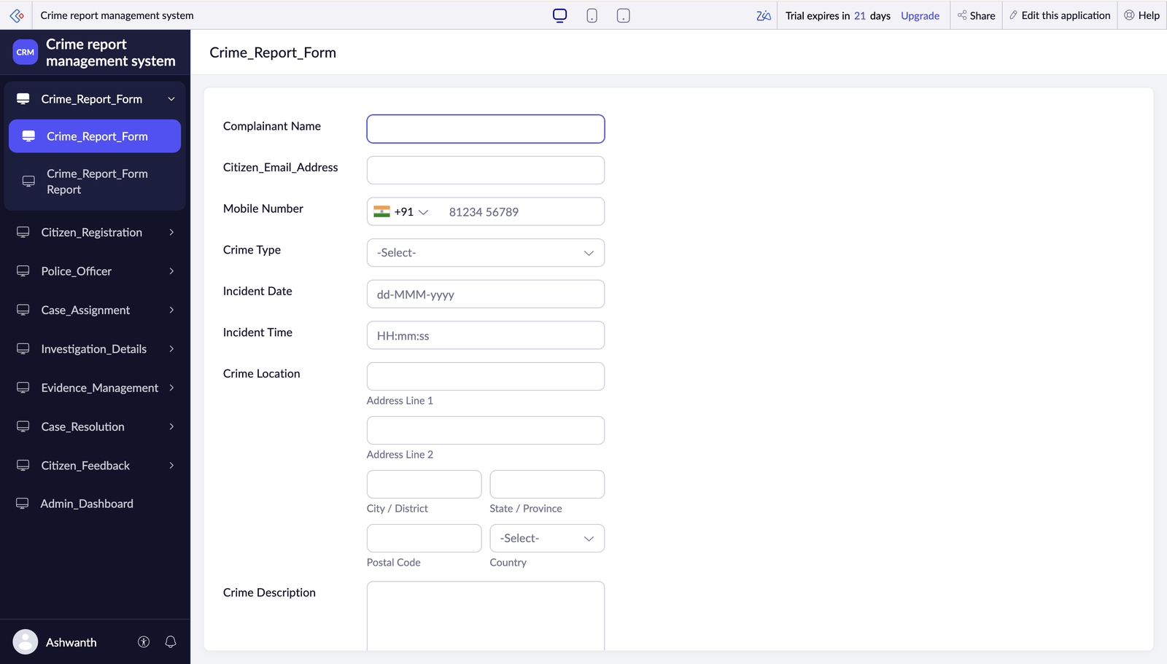
Forms and Data Capture
Auto Number IDs on every form
Picklists for type, status, rank, outcome, rating
Crime location address with coordinate capture
Evidence upload: up to 10 files
Crime types: Theft, Robbery, Cybercrime, Assault, Fraud and more
Crime_Report_Form in live mode

Slide 7
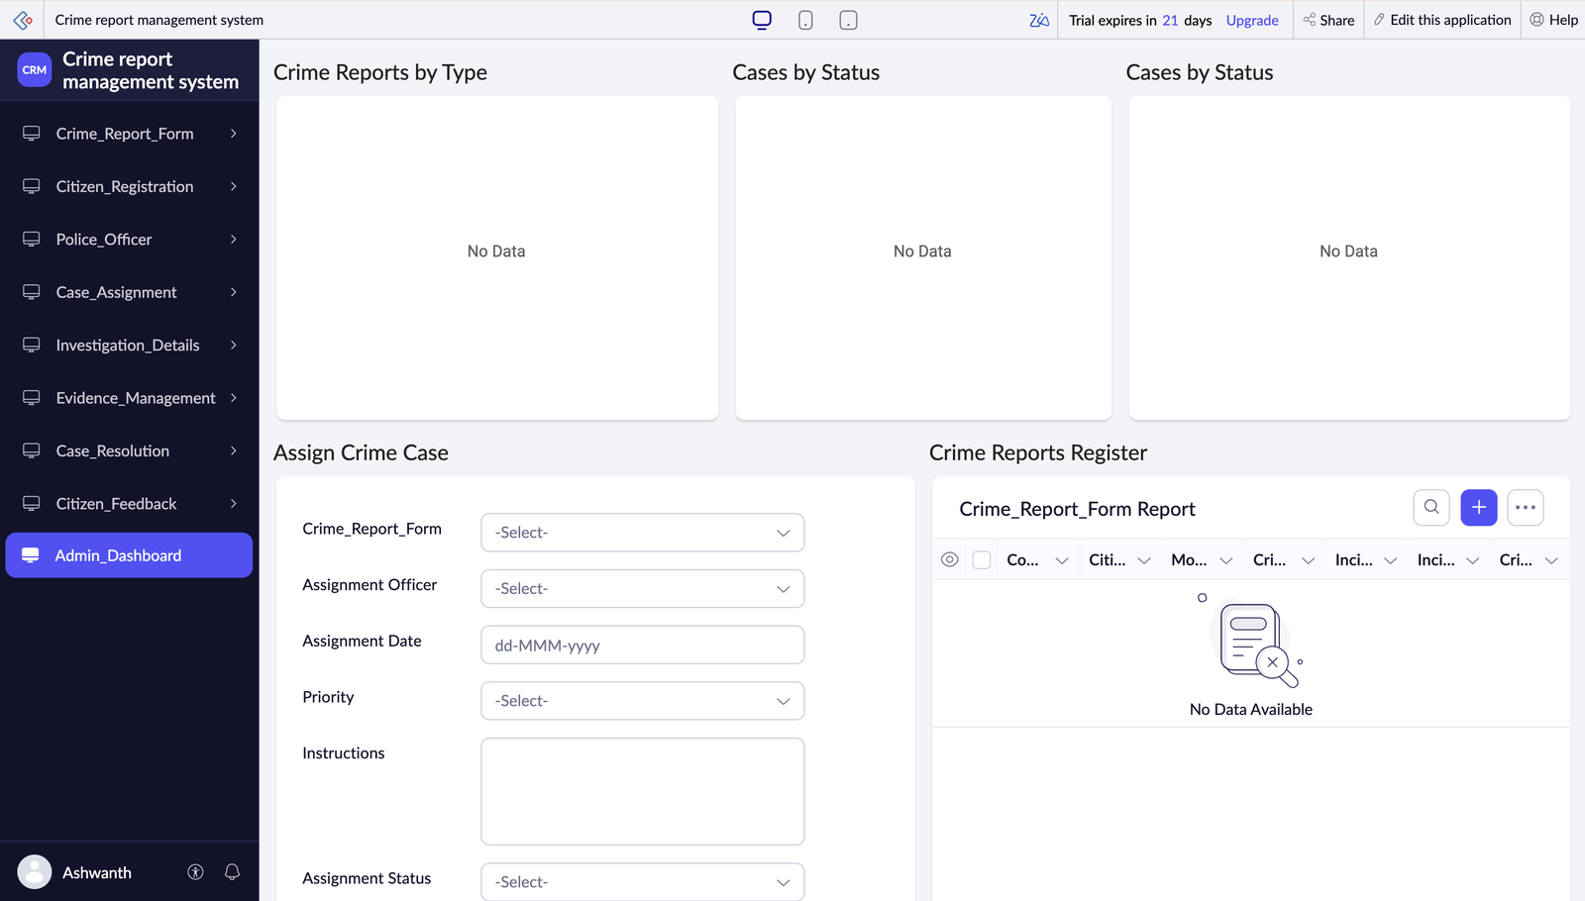
Admin Dashboard and Reports
Donut: crime reports by type
Donut and bar: cases by status
Embedded form: Assign Crime Case
Embedded Crime Reports Register with bulk actions disabled
One report for each of the 8 forms
Admin_Dashboard (sample data not yet entered)

Slide 8
Access Control
Profiles: Administrator, Police_Officer_Permissions, Citizen_Permissions, Read, Write, Developer, Customer · Roles: CEO, Police Officer, Citizen
Sharing rule | Form | From → To | Access
Share_Investigation_Details_With_Police | Investigation Details | CEO → Police Officer | Read
Share_Evidence_With_Police | Evidence Management | CEO → Police Officer | Read
Share_Case_Assignments_With_Police | Case Assignment | CEO → Police Officer | Read
Share_Crime_Reports_With_Police | Crime Report Form | Citizen → Police Officer | Read
Share_Case_Resolutions_With_Admin | Case Resolution | Police Officer → CEO | Read

Slide 9
User Interface and Device Support
Web
Phone
Tablet
Lato font
Left-aligned labels
Section-based navigation
Icon text: CRM
All 8 forms
Automatic labels
Two-column layout
Chrysler Purple
All 8 forms
Automatic labels
Sliding-pane layout
Dark Grey

Slide 10
Testing, Limitations and Future Work
Testing
Future enhancements
20 test cases: forms, picklists, reports, dashboard, access, layouts
Debugging cycle for configuration errors
Results to be recorded in the live application
Link complaints to registered citizens
Deluge workflows for automatic status updates
E-mail / SMS notifications
Approval process for case closure
Crime heat maps from captured coordinates

Slide 11
Conclusion
One online system replaces paper registers for the whole crime-report life cycle
Every case is traceable through its Report_ID
Administrators get a live view of crime types and case status
A complete application built with low-code configuration
Thank you

