Slide 1
FACE AND VOICE RECOGNITION SYSTEM

Slide 2

INTRODUCTION
IDEA IS TO DESIGN A HOME SECURITY SYSTEM WITH A 2 STEP AUTHENTICATION
COMBINE FACE AND VOICE RECOGNITION TO AUTHENTICATE
MOTION DETECTION – THIRD SECURITY MEASURE

Slide 3
SECURITY SYSTEM
FACE AUTHENTICATION
VOICE AUTHENTICATION
MOTION DETECTION

Slide 4
FACIAL RECOGNITION
A FACE RECOGNITION SYSTEM EXTRACTS FEATURES FROM AN INPUT IMAGE AND COMPARES THEM TO FEATURES OF LABELED FACES IN A DATABASE

Slide 5
VOICE RECOGNITION
VOICE RECOGNITION IS DONE USING VOICE IT API WHICH RECORDS A VOICE AND ITS FEATURES SUCH AS PITCH, TONE AND MODULATION

Slide 6
MOTION DETECTION
DETECTS ANY ACTIVITY IN THE FRAME AND RECORDS THE ACTIVITY
MOTION DETECTION RUNS AT THE BACKEND

Slide 7
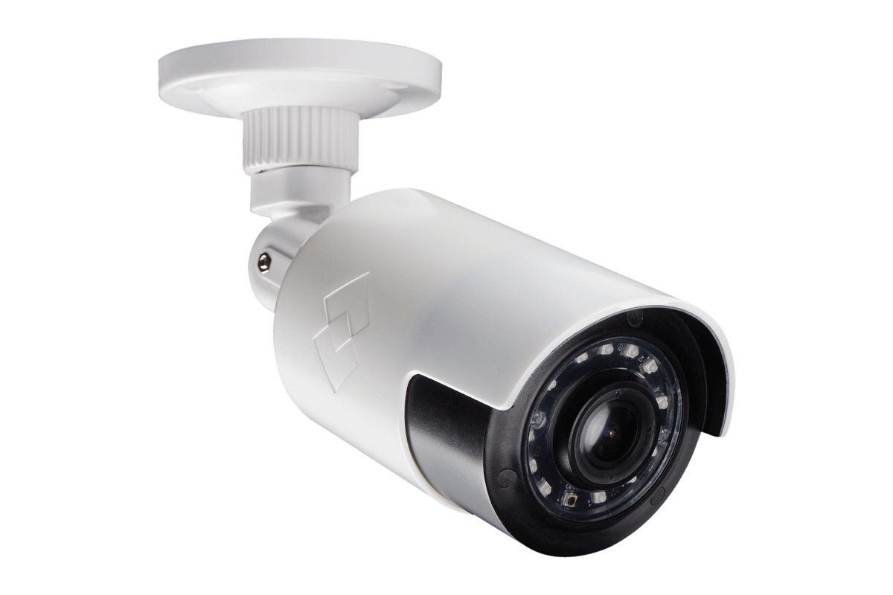
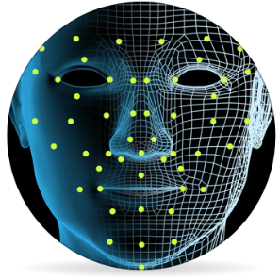

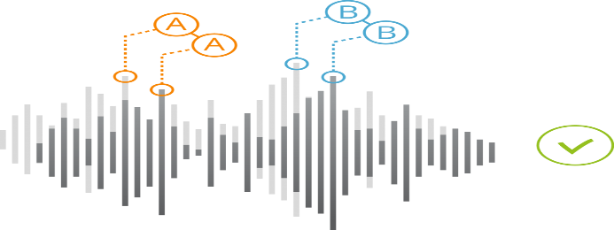

FACE AND VOICE RECOGNITION

Slide 8
USE CASE -1
WHEN A KNOWN FACE ENTERS THE FRAME THE FIRST STEP FACE GETS RECOGNIZED AND VOICE GETS AUTHENTICATED AS WELL
THE PERSON CAN ENTER THE HOUSE

Slide 9
USE CASE -2
WHEN AN UNKNOWN FACE ENTERS THE FRAME THE CODE DOESN’T GO INTO FACE RECOGNITION STEP
UNTIL THE PERSON LEAVES THE FRAME HE/SHE IS TAGGED AS UNKNOWN
9

Slide 10
USE CASE -3
WHEN A KNOWN FACE ENTERS FRAME AND FACE GETS RECOGNIZED AND VOICE DOES NOT
THE PERSON IS GIVEN 3 CHANCES TO GET HIS/HER VOICE AUTHENTICATED. IF AUTHENTICATION FAILS, HE/SHE CANNOT ENTER THE HOUSE. IF SUCCESS, HE/SHE CAN ENTER THE HOUSE
10
10

Slide 11
USE CASE -4
WHEN A KNOWN AND AN UNKNOWN FACE COME IN THE FRAME A PROMPT STATING THAT ONLY ONE PERSON SHOULD APPEAR IN THE FRAME IS GIVEN
11
11
11

