Slide 1

Presented By: Mohammed Ashwaq
PROJECT ON
EMPLOYEE MANAGEMENT SYSTEM

Slide 2
Agenda:
Overview of the Employee Management System Project
Database Structure: ER Diagram & Schema Walk-Through
Business Questions & Real-Time Use Case Scenarios
SQL Implementation: Queries, Outputs & Key Findings
Department, Leave & Payroll Insights Derived
Strategic Observations & Actionable Recommendations
Overall Conclusion & Final Takeaways
Learning Outcomes & Challenges Faced During the Project
Open Discussion / Q&A

Slide 3
Introduction & Project Overview:
This project focuses on developing an Employee Management System to efficiently manage organizational employee data.
The system stores and tracks key information such as employee details, job roles, salaries, qualifications, leaves, and payroll records.
A structured relational database is designed using MySQL, ensuring data consistency with foreign keys, constraints, and cascading rules.
The goal is to provide a centralized, accurate, and insightful employee data management and reporting system.
SQL queries are used to perform detailed analysis to support HR decision-making and improve operational efficiency.

Slide 4
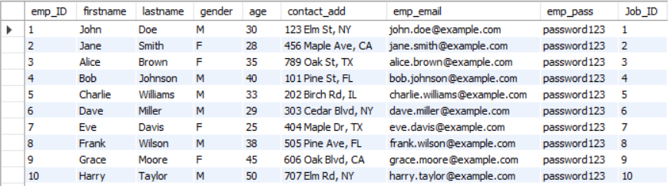
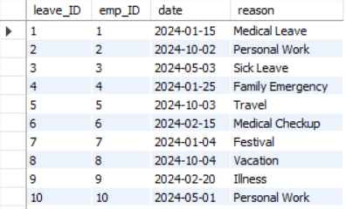
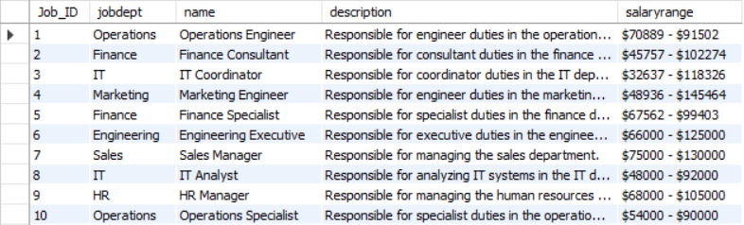
Tables :
1. EMPLOYEE :
3. LEAVES :
2. JOB DEPARTMENT :

Slide 5
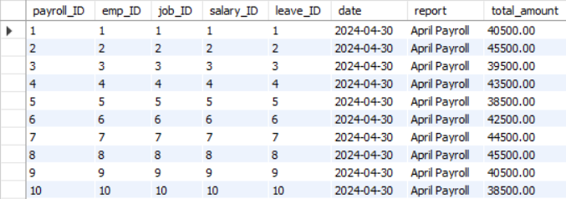
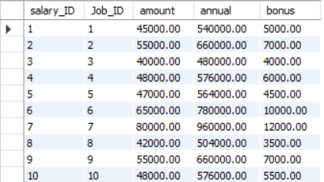
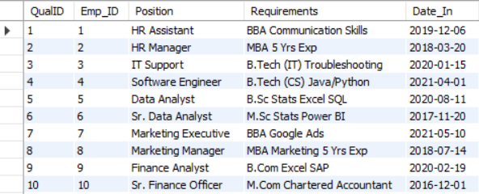
4. PAYROLL :
3. SALARY BONUS :
5. QUALIFICATION :

Slide 6
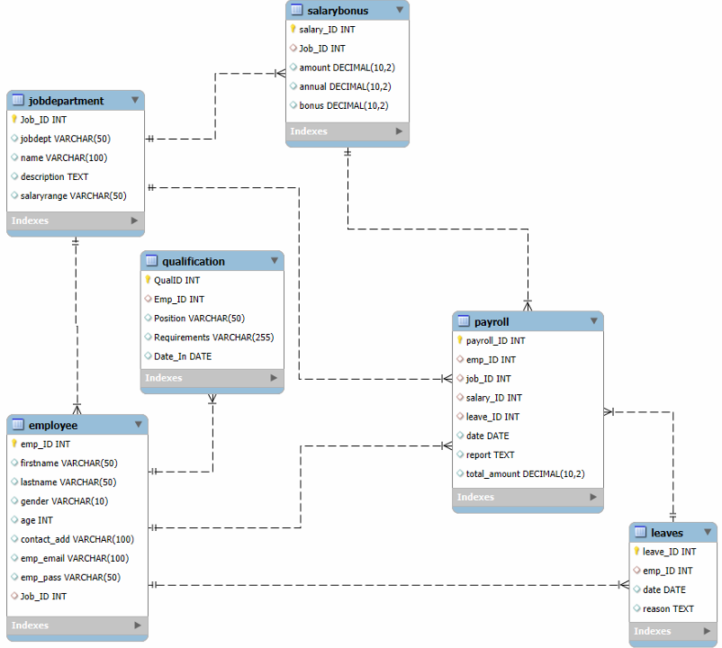
ER DIAGRAM :

Slide 7
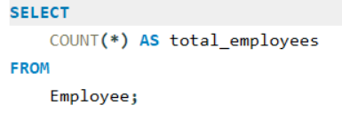

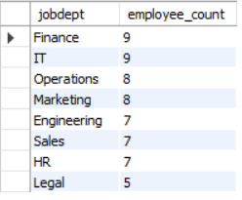
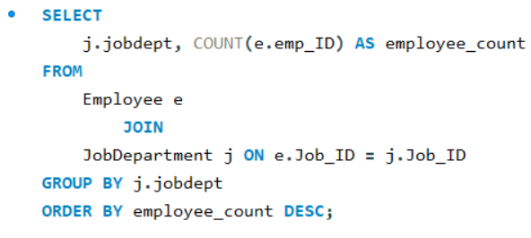
Comprehensive SQL Analysis:
1. EMPLOYEE INSIGHTS
A. How many unique employees are currently in the system?
OUTPUT:
B. Which departments have the highest number of employees?
OUTPUT:

Slide 8
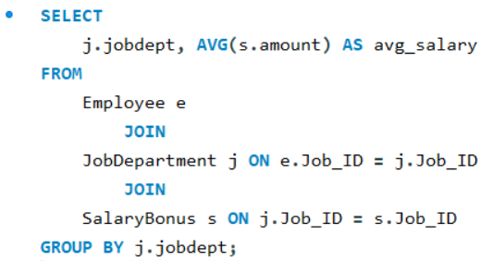
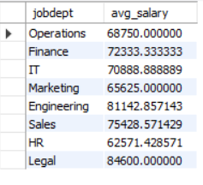
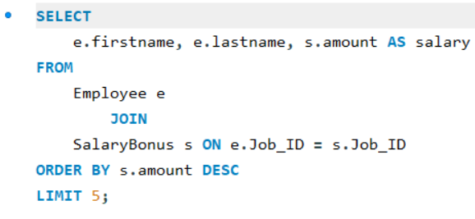
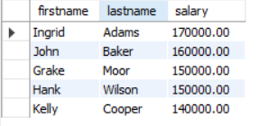
C. What is the average salary per department?
OUTPUT:
D. Who are the top 5 highest-paid employees?
OUTPUT:

Slide 9
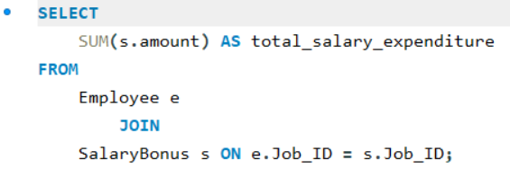

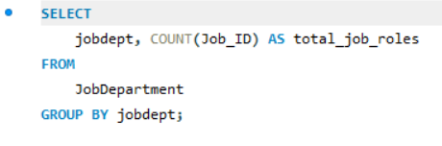
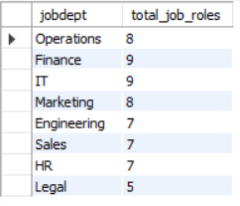
E. What is the total salary expenditure across the company?
OUTPUT:
2. JOB ROLE AND DEPARTMENT ANALYSIS
A. How many different job roles exist in each department?
OUTPUT:

Slide 10
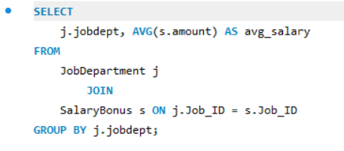
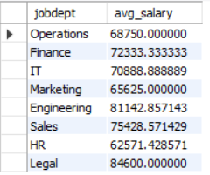
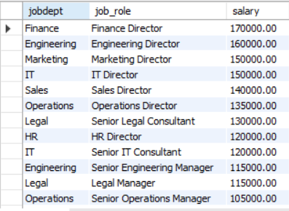
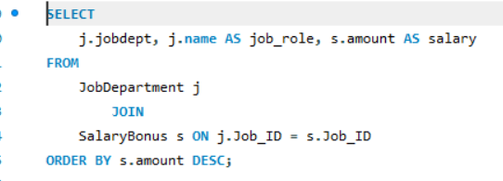
B. What is the average salary range per department?
OUTPUT:
C. Which job roles offer the highest salary?
OUTPUT:

Slide 11
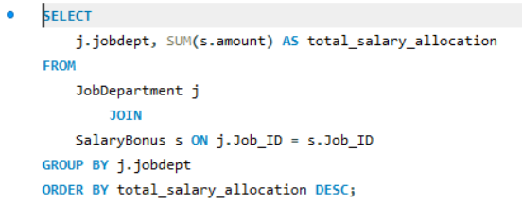
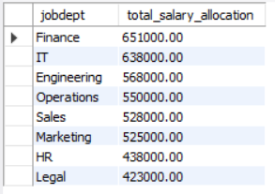
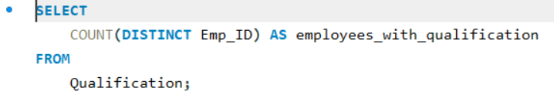

D. Which departments have the highest total salary allocation?
OUTPUT:
3. QUALIFICATION AND SKILLS ANALYSIS
A. How many employees have at least one qualification listed?
OUTPUT:

Slide 12
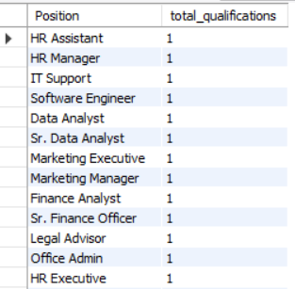
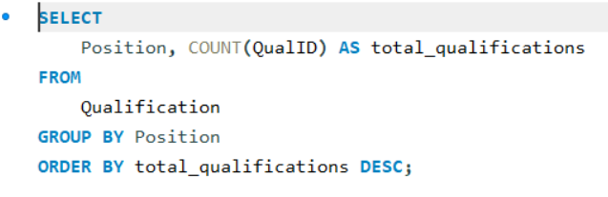
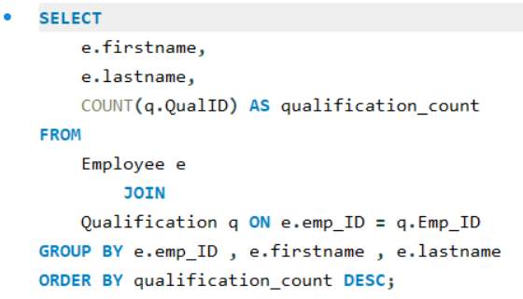
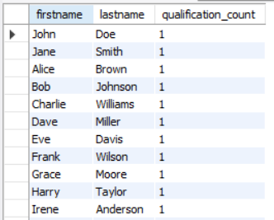
B. Which positions require the most qualifications?
OUTPUT:
C. Which employees have the highest number of qualifications?
OUTPUT:

Slide 13
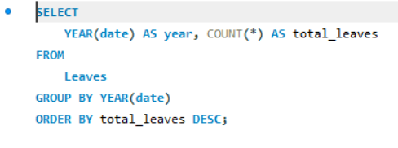

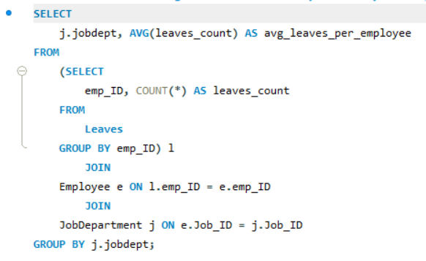
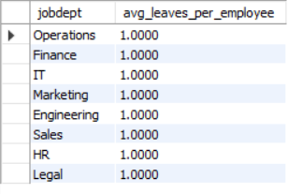
4. LEAVE AND ABSENCE PATTERNS
A. Which year had the most employees taking leaves?
OUTPUT:
B. What is the average number of leave days taken by its employees per department?
OUTPUT:

Slide 14
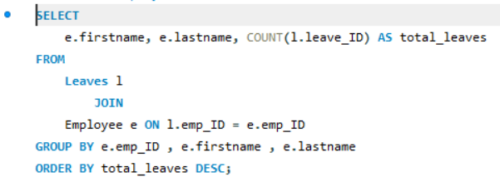
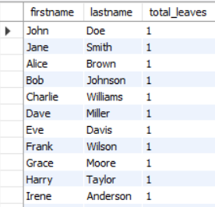
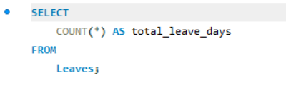

C. Which employees have taken the most leaves?
OUTPUT:
D. What is the total number of leave days taken company-wide?
OUTPUT:

Slide 15
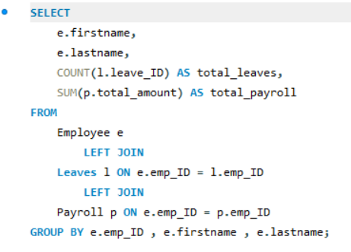
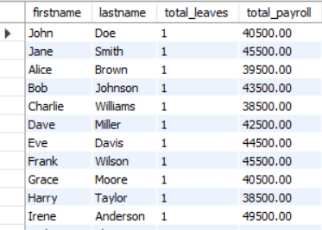
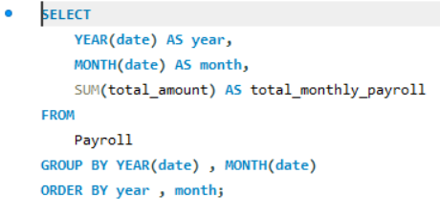

E. How do leave days correlate with payroll amounts?
OUTPUT:
5. PAYROLL AND COMPENSATION ANALYSIS
A. What is the total monthly payroll processed?
OUTPUT:

Slide 16
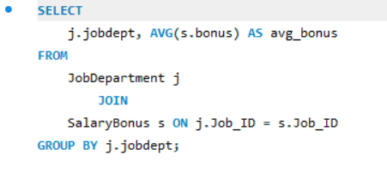
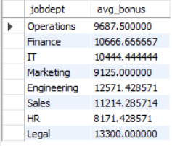
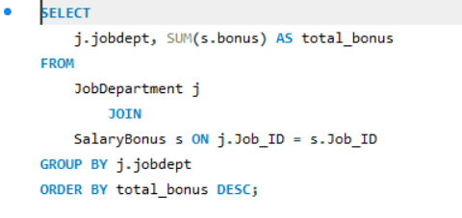
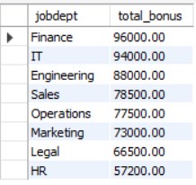
B. What is the average bonus given per department?
OUTPUT:
C. Which department receives the highest total bonuses?
OUTPUT:

Slide 17
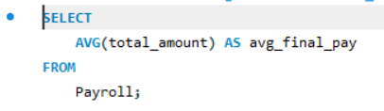

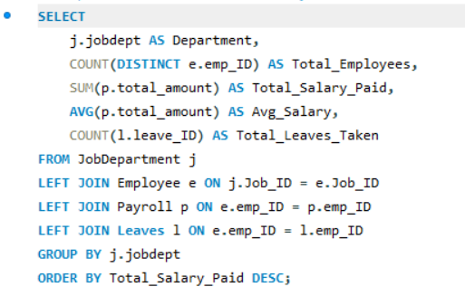
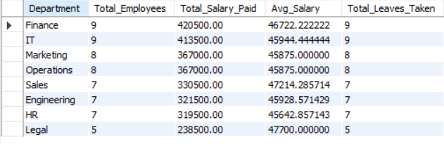
D. What is the average value of total amount after considering leave deductions?
OUTPUT:
Department-wise Overall Summary
OUTPUT:

Slide 18
Key Findings & Business Insights:
Identified departments with the highest number of employees and salary expenditure.
Determined top-paid employees and high-paying job roles.
Analyzed leave patterns: employees taking most leaves and yearly trends.
Evaluated average salary and bonuses per department for budget planning.
Observed qualification distribution and positions requiring more skills.
Insights help HR and management make informed decisions on payroll, recruitment, and resource allocation.

Slide 19
Conclusion – Overall Key Findings:
Payroll, leave, and department analyses provide actionable insights for HR and management.
Departments with high salary expenditure and employees with frequent leaves are clearly identified.
The Employee Management System ensures centralized and accurate employee data management.
Qualification and job role analysis helps in strategic workforce planning.
SQL-based analysis enables efficient reporting, decision-making, and resource optimization.
Overall, the system streamlines HR operations and improves organizational efficiency.

Slide 20
Experience & Challenges:
Hands-on experience with MySQL Workbench: creating tables, foreign keys, and constraints.
Learned to maintain data integrity using cascading updates and deletes.
Gained expertise in writing complex SQL queries for multi-table analysis.
Ensured proper date formats, unique constraints, and data consistency across tables.
Challenges faced: managing foreign key dependencies, handling large datasets, and joining multiple tables for insightful reports.
Overall, the project enhanced practical SQL skills and data analysis capabilities.

Slide 21

THANK YOU

