Slide 1

Dr. N.G.P. INSTITUTE OF TECHNOLOGY
Coimbatore - 48
(An Autonomous Institution)
(Approved by AICTE, New Delhi & Affiliated to Anna University, Chennai)
Recognized by UGC & Accredited by NAAC A+ and NBA (CSE, BME, EEE, ECE and Mech) Dr.N.G.P. Nagar,
Kalapatti Main Rd, Coimbatore, Tamil Nadu 641048
Ph No: 0422 - 236 9105, Fax: 04222369106, E-mail: info@drngpit.ac.in
DEPARTMENT OF ARTIFICIAL INTELLIGENCE AND DATA SCIENCE
22EEC501 – PROFESSIONAL READINESS COURSE
on
16/05/2026 – 30/05/2026
FACULTY IN-CHARGE
Ms. C. DIVYA REVATHI M.E.
Assistant Professor (AI & DS)
STUDENT NAME: DHANVANTH SENTHIL KUMAR
REG NO: 710724243020
9/25/2026
SUMMER INTERNSHIP
1

Slide 2
OUTLINE
➤ ABOUT THE COMPANY
➤ KEY LEARNINGS FROM THE INTERNSHIP
➤ ABOUT THE PROJECT
➤ TOOLS AND TECHNOLOGY USED
➤ LIST OF MODULES WITH EXPLANATION
➤ IMPLEMENTATION
➤ OUTPUT SCREENSHOTS
➤ CONCLUSION
➤ CONTRIBUTIONS IN THE PROJECT
➤ REFERENCES
9/25/2026
SUMMER INTERNSHIP
2

Slide 3
ABOUT THE COMPANY
COMPANY NAME | DLK SOFTWARE SOLUTIONS
STARTED YEAR | 2012
LOCATION | Vadapalani, Chennai, Tamil Nadu
SERVICES OFFERED | Software Development, Web & Mobile Apps, Data Science & AI, Digital Marketing & Internships
INDUSTRY MENTOR NAME | Mr. Satheesh Kumar
DESIGNATION | Chief Executive Officer
DURATION OF INTERN | 16/05/2026 – 30/05/2026 (15 days)
9/25/2026
SUMMER INTERNSHIP
3

Slide 4
KEY LEARNINGS FROM THE INTERNSHIP
Technical Skills
• Programming & Data Handling – Python, NumPy, Pandas and Matplotlib
• Machine Learning – Regression, Classification, Clustering and Model Evaluation
• Deep Learning – Artificial Neural Networks (ANN) and CNN for image classification
• Deployment & Testing – Flask API and Postman
• Generative AI, Prompt Engineering and Responsible AI – Fairness, transparency, privacy, and ethics
9/25/2026
SUMMER INTERNSHIP
4

Slide 5
ABOUT THE PROJECT
AI-Powered Diabetes Predictor
A machine learning and healthcare web application that predicts whether a patient belongs to the diabetic or non-diabetic class from numerical clinical features – Pregnancies, Glucose, Blood Pressure, Skin Thickness, Insulin, BMI, Pedigree, and Age. The trained models are served through a Flask API and presented in the DiabetesPredict.AI dashboard.
Objectives
• Prepare raw clinical data through zero-value cleaning, median imputation, scaling, and feature engineering.
• Train and compare supervised classification models (Logistic Regression, KNN, Decision Tree, ANN) on real-world medical data.
• Evaluate performance with standard metrics (Accuracy, Precision, Recall, Confusion Matrix) and identify sources of error.
• Deploy the trained models as a usable Flask API with an interactive web dashboard.
Project workflow :
1. Data collection & preprocessing
2. Feature engineering & EDA
3. Model training & evaluation
4. Flask API & dashboard deployment
9/25/2026
SUMMER INTERNSHIP
5

Slide 6
SYSTEM REQUIREMENTS
Software:
• Visual Studio Code
• Python, Jupyter Notebook / Google Colab
• Web Browser
• Postman
Development Environment
• Machine Learning: Scikit-Learn, Pandas, NumPy
• Deep Learning: TensorFlow / Keras
• Backend & API: Flask
• Frontend: HTML templates & CSS
9/25/2026
SUMMER INTERNSHIP
6

Slide 7
TOOLS AND TECHNOLOGIES USED
Data & Visualisation
Machine Learning
Deployment
Environments
Python
Core programming language
NumPy
Numerical arrays, vectorised maths
Pandas
Data loading, cleaning, analysis
Matplotlib
Charts and data visualisation
Scikit-Learn
Classification, clustering, evaluation
TensorFlow / Keras
Deep learning and neural networks
PyTorch
Deep learning framework (introduction)
Flask
REST API to serve the model
Postman
Testing prediction requests
Web UI
DiabetesPredict.AI dashboard
Jupyter Notebook
Interactive coding and experiments
Google Colab
Cloud notebooks, no local setup
VS Code
Project and script development
9/25/2026
SUMMER INTERNSHIP
7

Slide 8
LIST OF MODULES WITH EXPLANATION
1
Data Preprocessing
2
Exploratory Data Analysis
3
Feature Engineering
Loads diabetes.csv (768 records), cleans invalid zeros, imputes missing values with median, and scales numeric features.
Pandas summaries, class balance checks, and correlation checks with Matplotlib charts show Glucose and BMI drive risk most.
Creates interaction feature (Glucose * Age), evaluates correlation rankings, and prepares optimal training matrices.
4
Model Training & Evaluation
5
Clustering & Neural Network
6
DiabetesPredict.AI Dashboard
Trains Logistic Regression, KNN, and Decision Trees; evaluates with Accuracy, Precision, Recall, and Confusion Matrices.
Demonstrates K-Means & Hierarchical grouping (K=3) and builds a Keras ANN with ReLU and Sigmoid activations.
Web front-end where patient health metrics are entered and independent multi-model prediction reports are generated.
9/25/2026
SUMMER INTERNSHIP
8

Slide 9
IMPLEMENTATION
1
Data Collection & Preprocessing
2
Exploratory Data Analysis
3
Feature Engineering
• Collected diabetes.csv dataset (768 records)
• Handled missing and zero readings in vital signs
• Imputed missing observations using column median
• Standardized features with StandardScaler
• Pandas summaries and statistical analysis
• Visualized distributions using Matplotlib
• Correlation analysis to identify key risk features
• Found Glucose and BMI strongly correlate with class
• Created interaction feature (Glucose * Age)
• Calculated correlation importance scores
• Engineered optimal feature input representations
• Prepared train/test split for validation
4
Model Training
5
Model Evaluation
6
Flask API Deployment & Web Dashboard
• Trained Logistic Regression, KNN, Decision Tree
• Built & trained Keras Artificial Neural Network
• Executed K-Means & Hierarchical clustering
• Optimized models on 80% training split
• Evaluated Accuracy, Precision, and Recall
• Generated Confusion Matrices (TP, TN, FP, FN)
• Compared performance across all classifiers
• Selected ANN (75.3%) & Decision Tree for deployment
• Integrated trained models with Flask REST API
• Tested prediction endpoints and payload validation
• Developed 10-page responsive web dashboard
• Embedded medical disclaimer for Responsible AI
9/25/2026
SUMMER INTERNSHIP
9

Slide 10
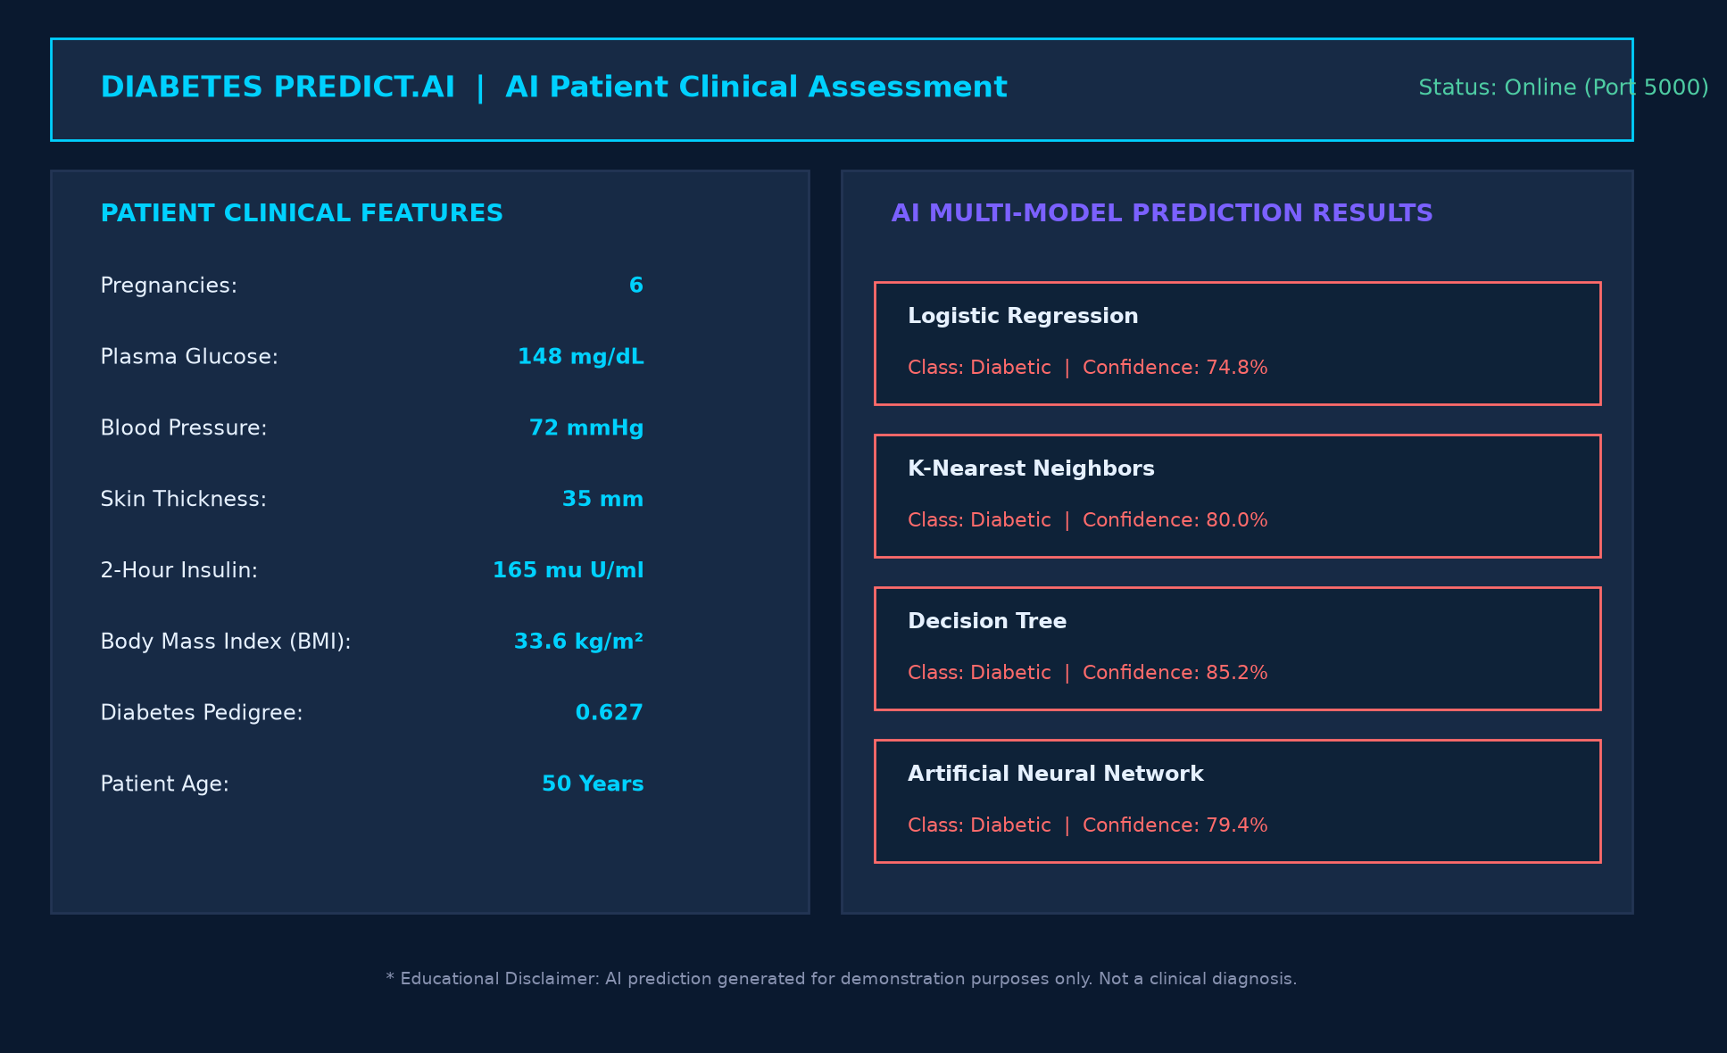
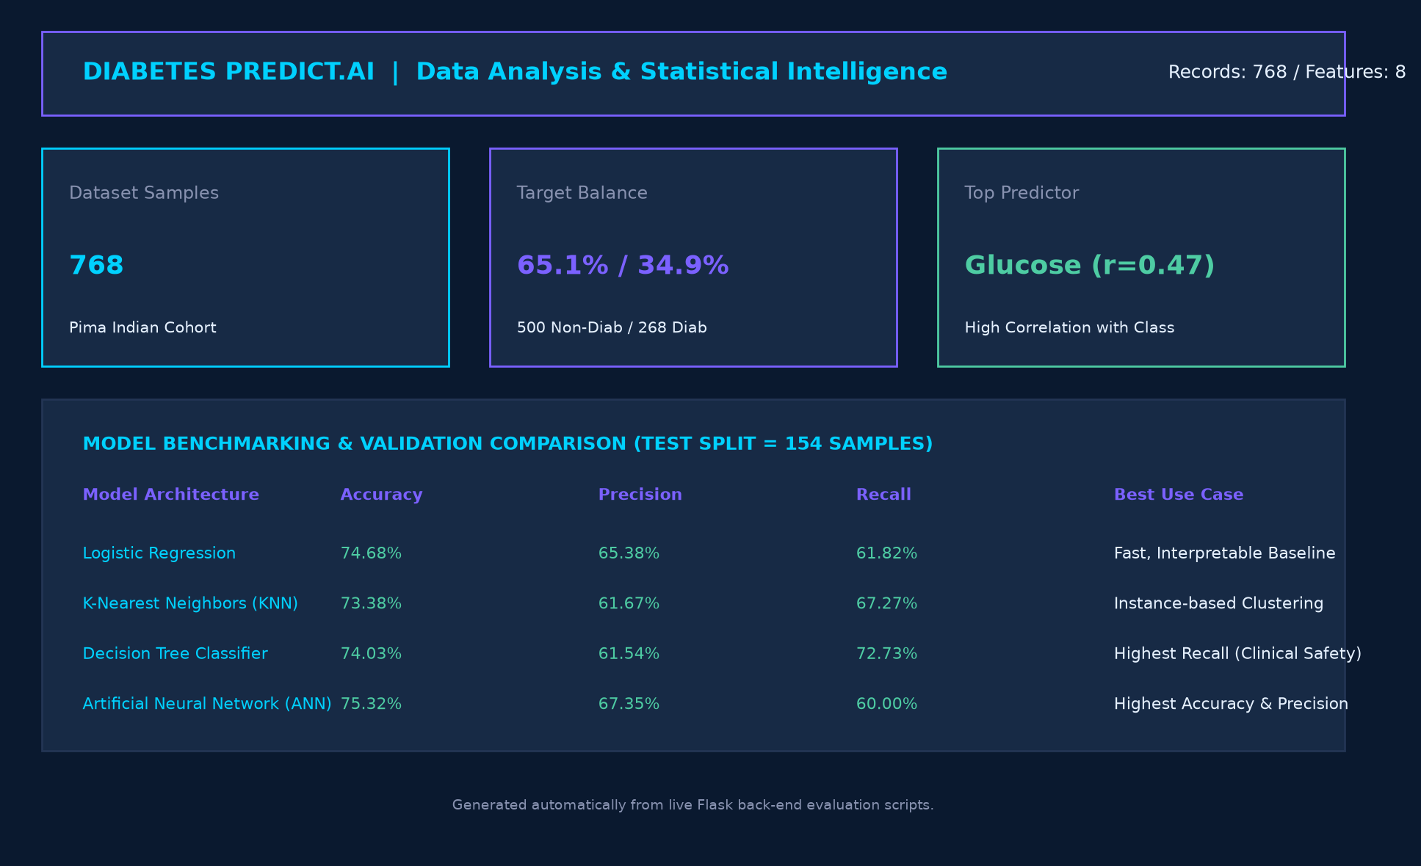
OUTPUT SCREENSHOTS
9/25/2026
SUMMER INTERNSHIP
10

Slide 11
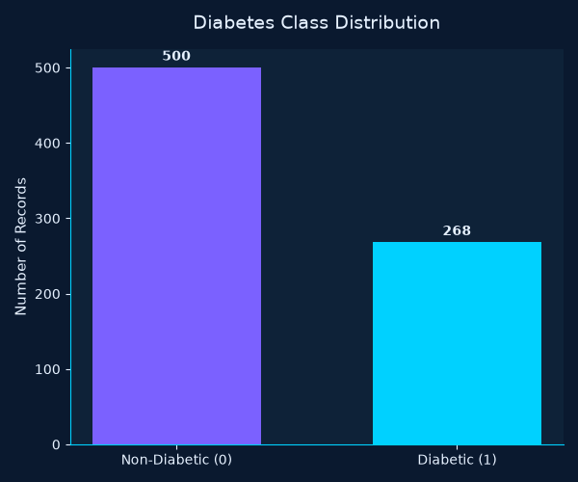
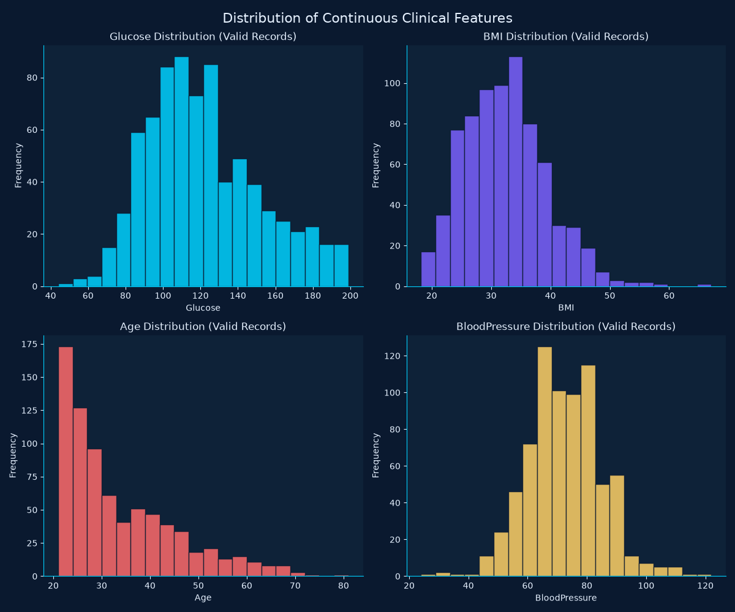
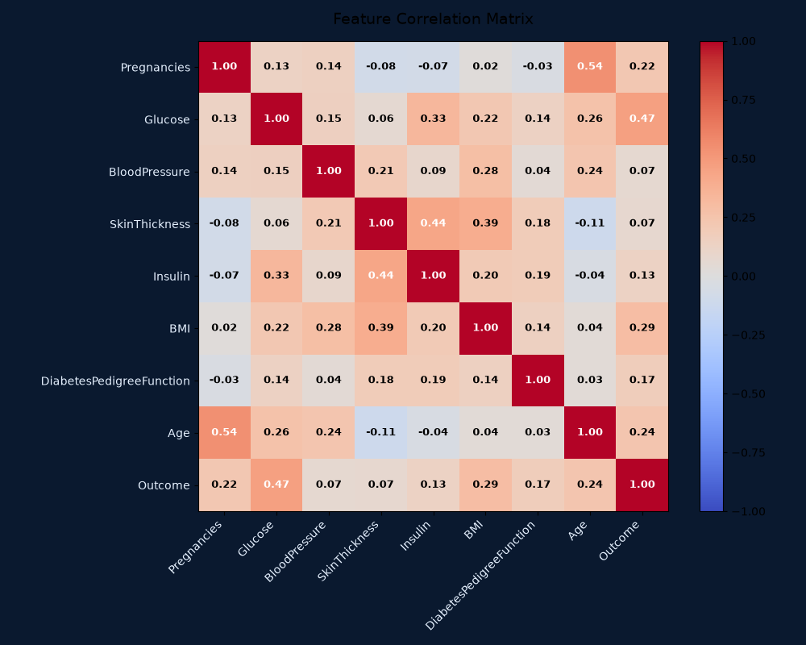
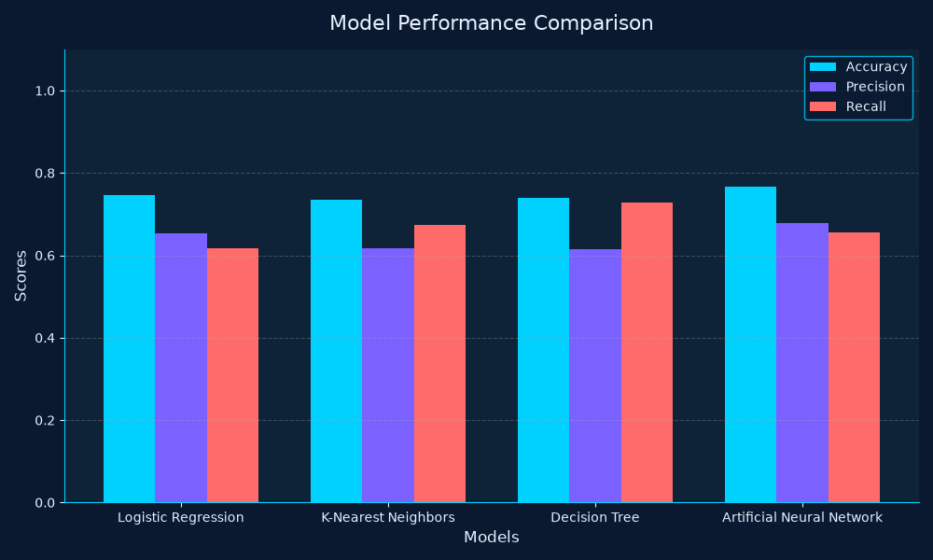
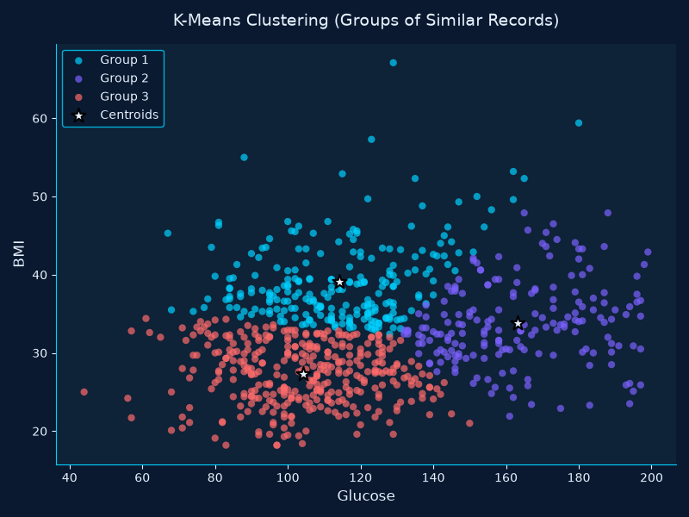
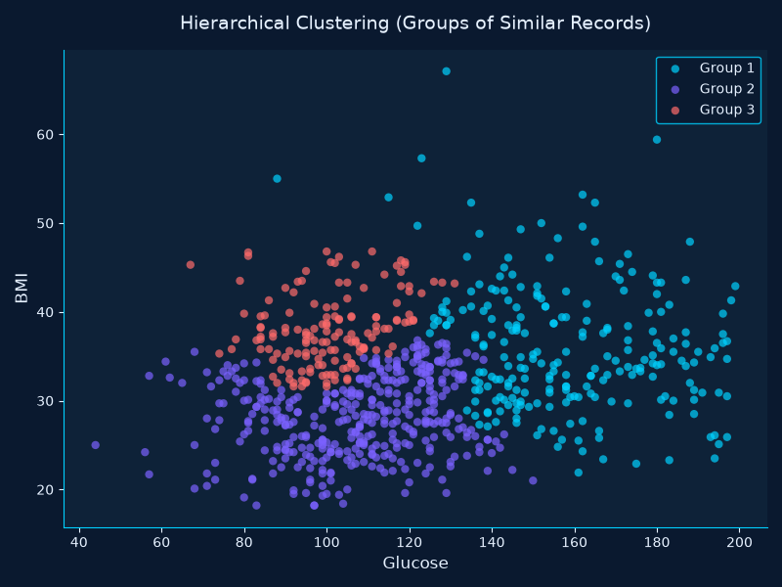
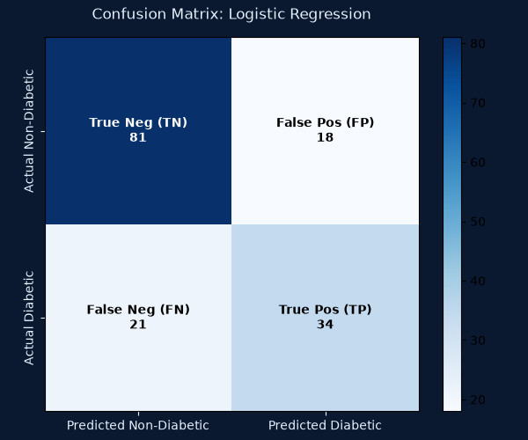
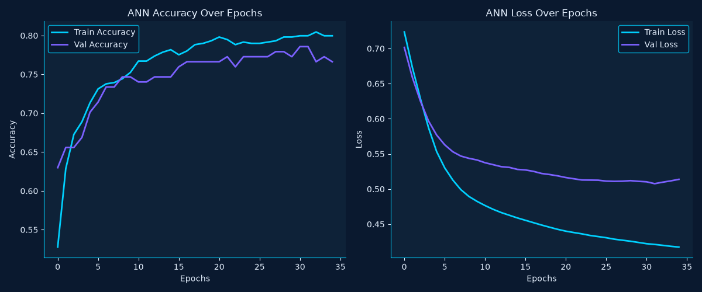
OUTPUT SCREENSHOTS
9/25/2026
SUMMER INTERNSHIP
11

Slide 12
CONCLUSION
• The 15-day internship at DLK Software Solutions provided practical exposure to Artificial Intelligence, Machine Learning and Data Science, and helped bridge academic knowledge with real-world application.
• The AI-Powered Diabetes Prediction & Healthcare Intelligence System successfully integrated data preprocessing, classification algorithms, unsupervised clustering, ANN, and a Flask API tested with Postman.
• The internship strengthened my skills in Python, NumPy, Pandas, Matplotlib, Scikit-Learn, TensorFlow/Keras, Flask and Postman.
• It also improved my problem-solving, debugging and systematic project development skills.
9/25/2026
SUMMER INTERNSHIP
12

Slide 13
CONTRIBUTIONS IN THE PROJECT
• Prepared and engineered features for model training and resolved clinical zero readings
• Trained and evaluated supervised classification models (Logistic Regression, KNN, Decision Tree)
• Constructed and optimized a multi-layer Artificial Neural Network using TensorFlow/Keras
• Implemented K-Means and Hierarchical clustering for unsupervised patient profiling
• Integrated the trained models with a Flask-based REST API and web application
• Tested API requests and responses systematically using Postman
• Tested each stage separately and debugged errors systematically
• Worked on improving the overall application workflow, data privacy and responsible AI practices
9/25/2026
SUMMER INTERNSHIP
13

Slide 14
REFERENCES
• Python Documentation – https://docs.python.org/3/
• NumPy Documentation – https://numpy.org/doc/
• Pandas Documentation – https://pandas.pydata.org/docs/
• Matplotlib Documentation – https://matplotlib.org/stable/
• Scikit-Learn Documentation – https://scikit-learn.org/stable/
• TensorFlow & Keras Documentation – https://www.tensorflow.org/
• Flask Documentation – https://flask.palletsprojects.com/
• Postman Documentation – https://learning.postman.com/docs/
9/25/2026
SUMMER INTERNSHIP
14

Slide 15
Thank
you

