Slide 1
NEWS DATA ANALYSIS – HUFFINGTON POST
ASHWATHGURU S | NOOPUR AGRAWAL
181046039 | 181046002
BDA – 1st Semester | BDA – 1st Semester
Under the guidance
of
Mr. Arokiaraj

Slide 2
Data Description
JSON format
2,00,852 records
Columns : Author, Category, Date, Headline, Link, Short Description
28 – 01 – 2012 to 26 – 05 – 2018

Slide 3
PROBLEM STATEMENTS – End Goals
Date to Date Analysis of Content Creation
Seasonal Analysis based on posts published
Trend Analysis – Popular Category / Popular Author
Weekday vs Weekend Analysis
Author Analysis
Content prediction using Machine Learning
Word popularity in each category using NLP
Word Classification prediction

Slide 4
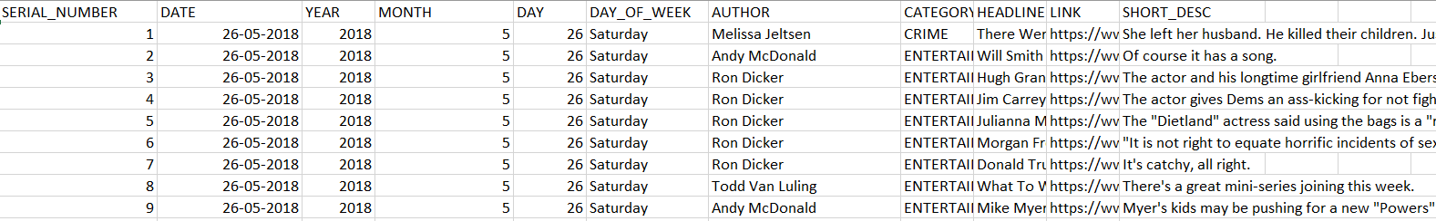
Data Preparation
Existing Columns : Author, Category, Date, Headline, Link, Short Description
NOW : in CSV

Slide 5
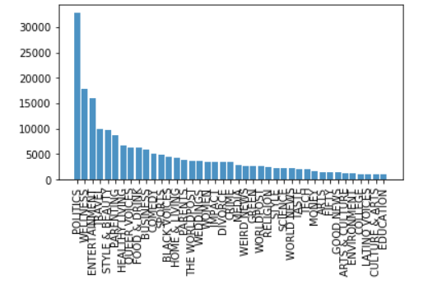
CATEGORY Vs COUNT

Slide 6
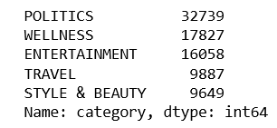
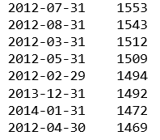

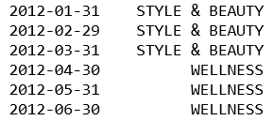
Top 5 Categories
Number of Articles Per Month
Average Number of Articles Per Month
Popular Content Category Each Month

Slide 7
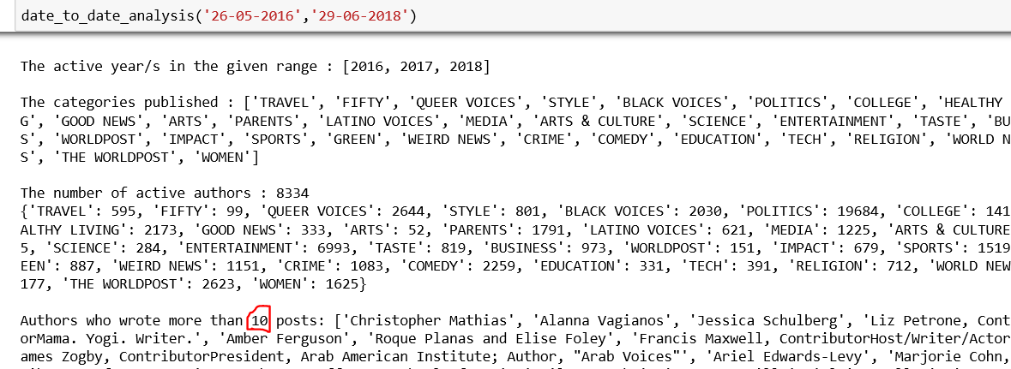
DATE TO DATE ANALYSIS
Input : Start Date and End Date

