Slide 1
University Students’ Mental Health
Andrew Greco & Ashwati Nair

Slide 2
Agenda
Introduction (Background, Motivation, Objectives)
Problem Statement
Data Analysis Methods
Results & Discussion
Conclusion

Slide 3
Background
University students are at an increased risk of developing mental health issues
Increased responsibilities
Academic pressure
New social situations
Young adults (ages 15-24) are more likely to endorse symptoms of depression
Also the age of onset of multiple psychiatric illnesses
48.6% of students report moderate stress
27.9% report severe
Being part of a marginalized group can impact an individual’s resilience

Slide 4
Motivation
Universities and colleges should examine and address factors that negatively impact students’ mental health in order to ensure that they are successful.
Using data, institutions of higher learning can implement interventions to mitigate the effects of stress
This will improve students’ performance and overall health.

Slide 5
Objectives
Using data from the Student Mental health | Kaggle and Medical Student Mental Health-Kaggle datasets, relationships between identified stressors and negative changes in mental health are identified.
Institutions can then use the results of these analyses to plan for and implement programs for students for mental health.

Slide 6
Problem Statement
Struggles with mental health can result in lower performance and lower grade point averages in students. Identifying these risks through the datasets can help universities to facilitate supportive measures, ensuring greater success for students.

Slide 7
Data Analysis Methods
Medical Student Dataset:
Preprocessing: SPSS was used to conduct feature selection, data preprocessing, and data visualizations. The data had no missing values, and the data was numerical or categorical.
Machine Learning: Linear regression models in Stata, kNN, random forest, SVM, and linear regression in Orange
Variables: Dependent: students’ scores on various psychological tests, Independent: age, year of study, whether the student had a partner or job, hours of studying, perception of health and whether the student was receiving psychotherapy services
Student Mental Health Dataset:
Preprocessing: Created binary variables and modified formats of answer to be easier to work with in programs. Orange for best Machine Learning Model out of SVM, kNN, random forest, Naive Bayes, logistic regression, and neural network.
In Stata, logistic regression, Spearman’s Correlation, t-tests, and general descriptive summaries were performed, as well as graph and chart visuals
Machine Learning: SPSS for Naive Bayes
Variables: Dependent: having depression or not, Independent: year in college, major, cGPA

Slide 8
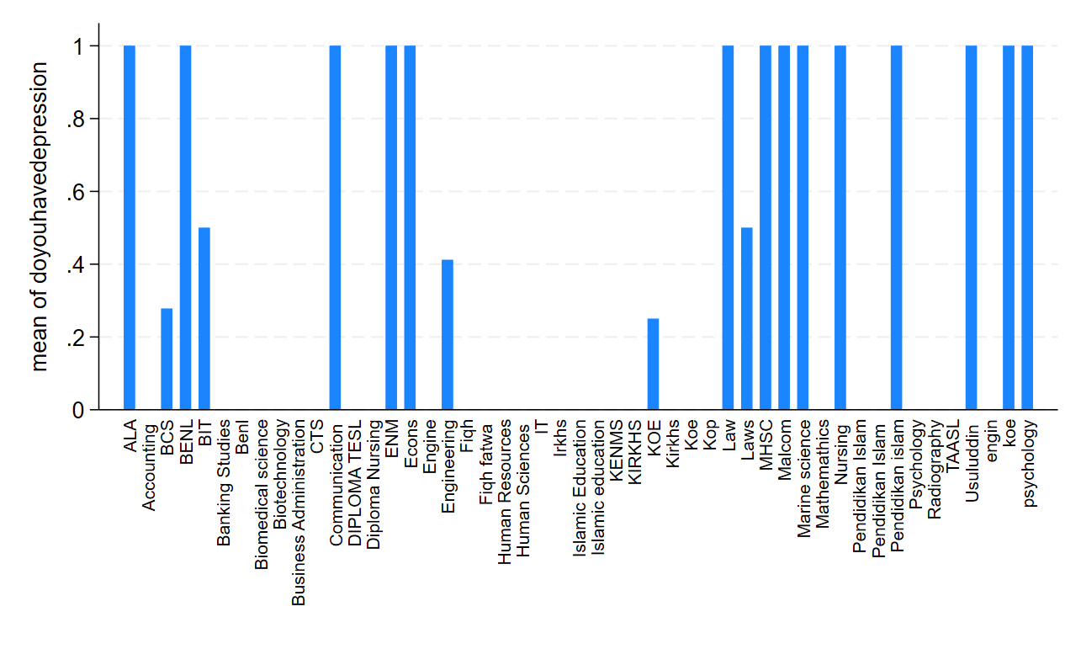
Visual of students in specific majors who stated having depression (Student Mental Health Dataset)

Slide 9
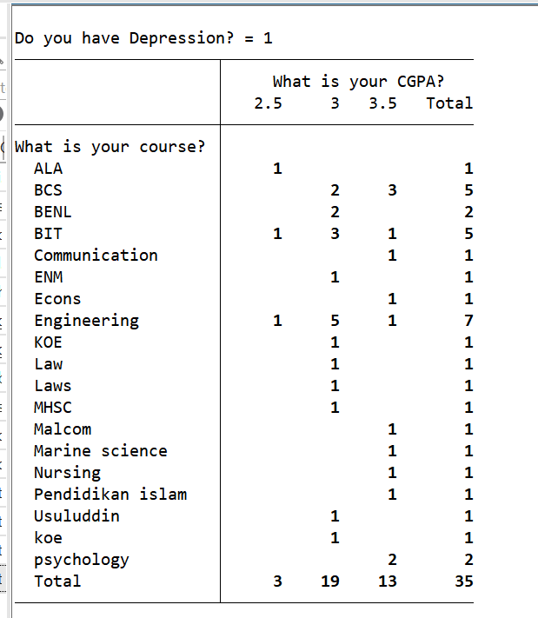
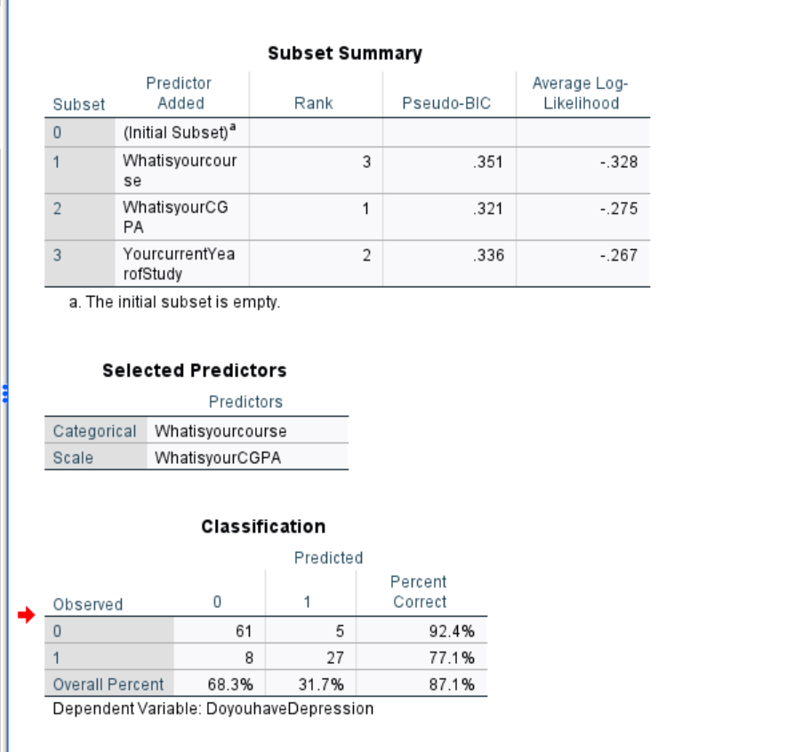
# of students that stated they have depression, based on cGPA & course for Students Dataset
Naive Bayes

Slide 10
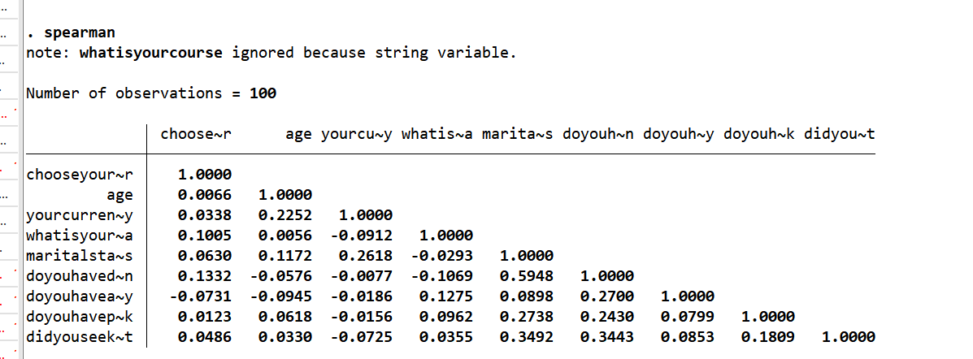
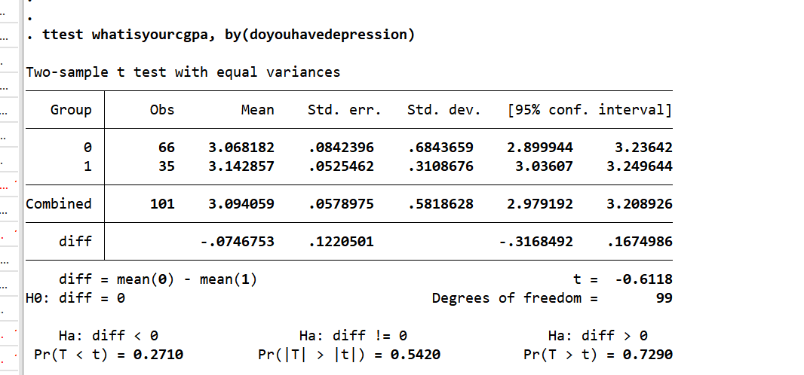
Spearman’s Correlation Test for Student Mental Health
T-Test

Slide 11
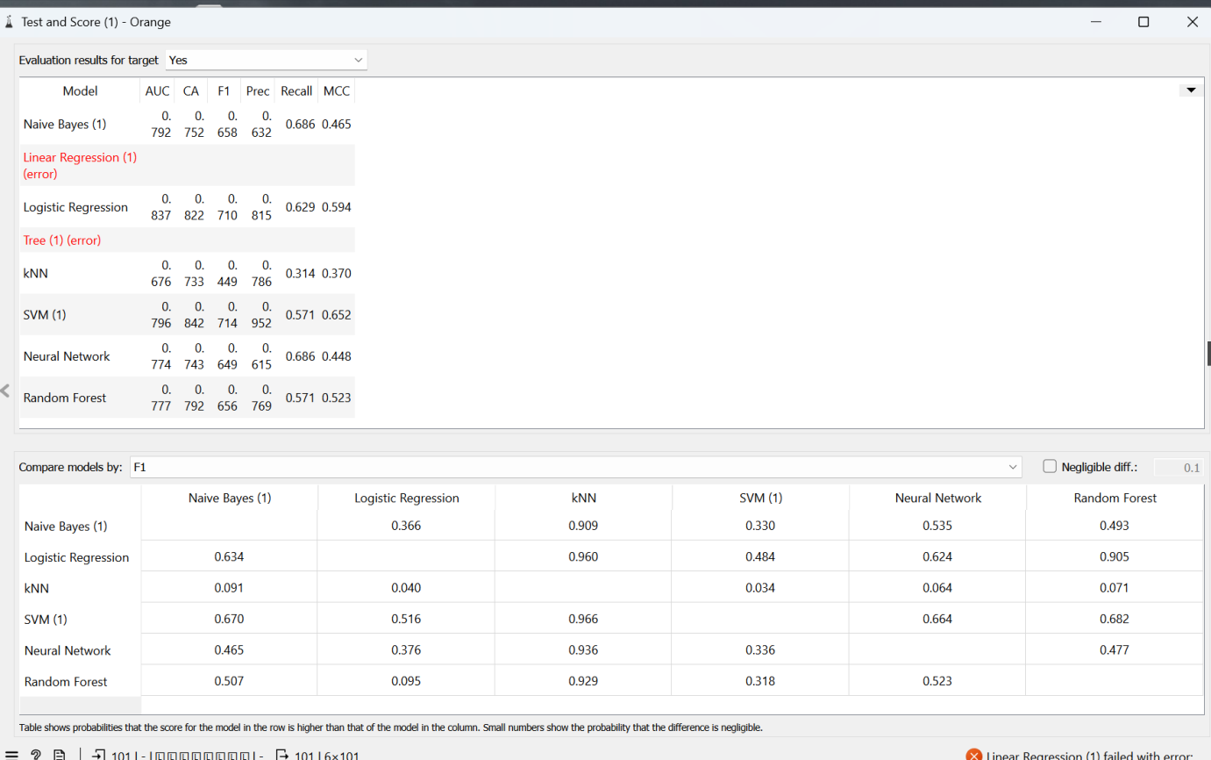
Finding the best ML model for Student Mental Health Dataset

Slide 12
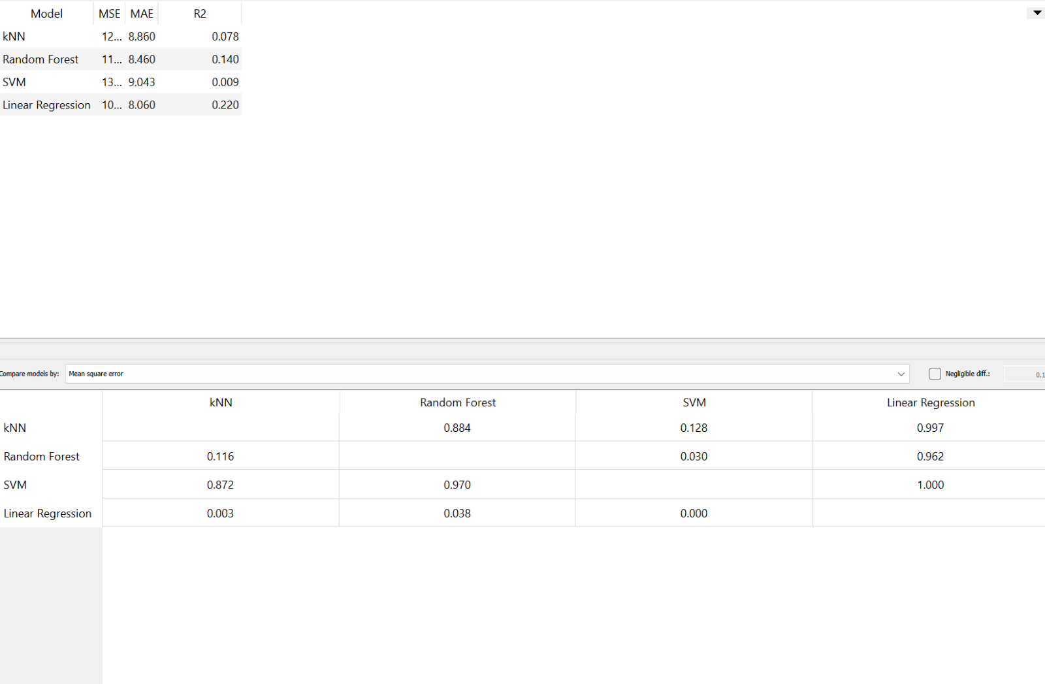
Depression Scales for Medical Student Dataset

Slide 13
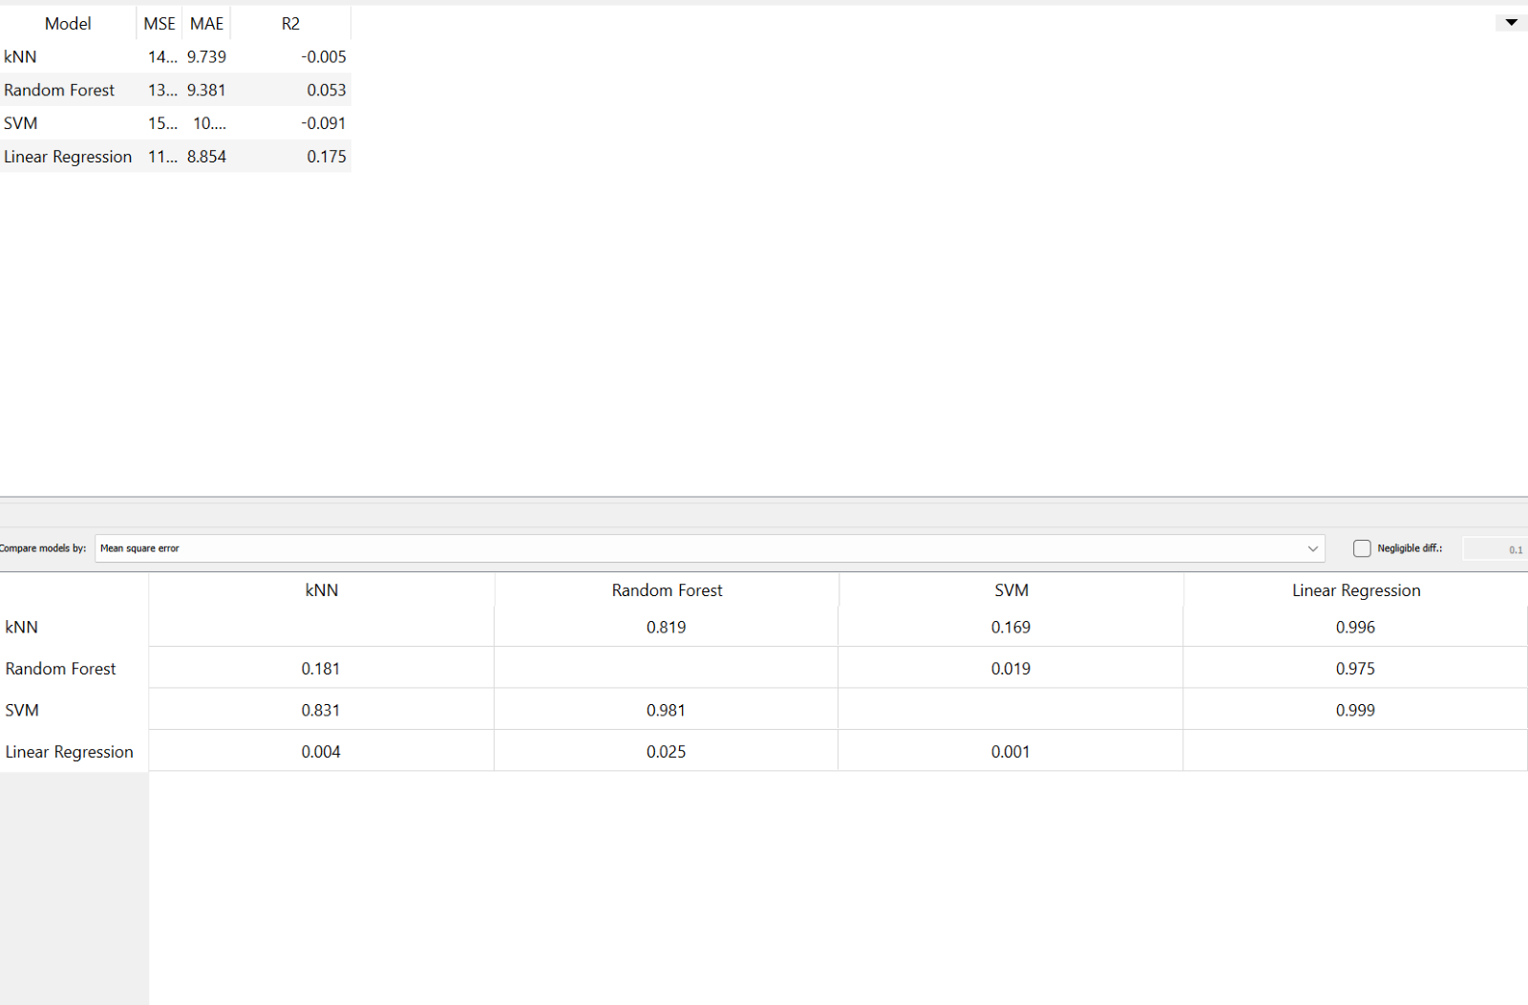
Anxiety Scales for Medical Student Dataset

Slide 14
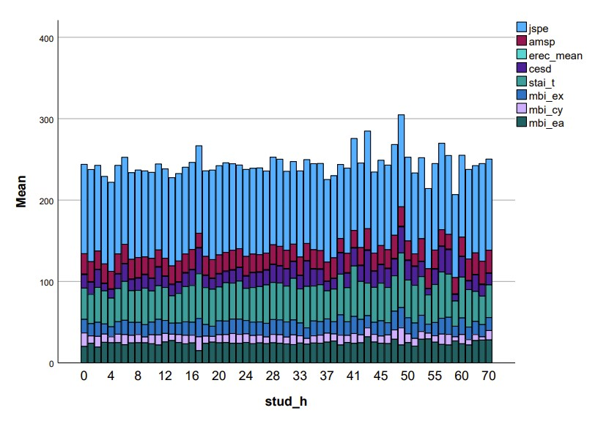
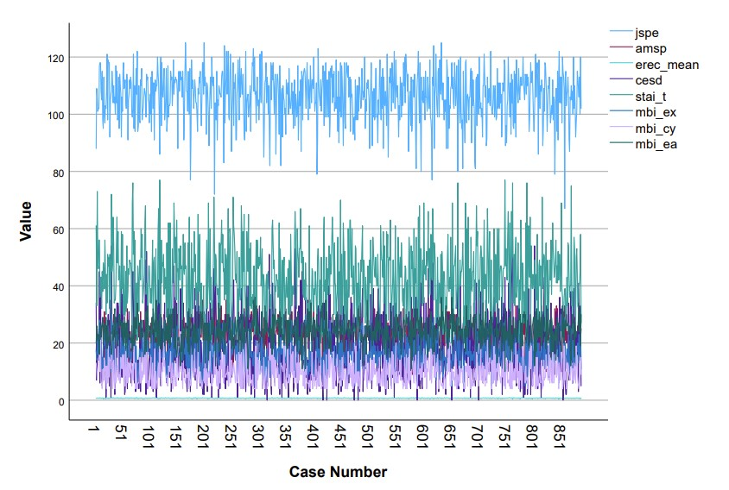
Test score result by case
# of hours spent studying (Medical Student Dataset)

Slide 15
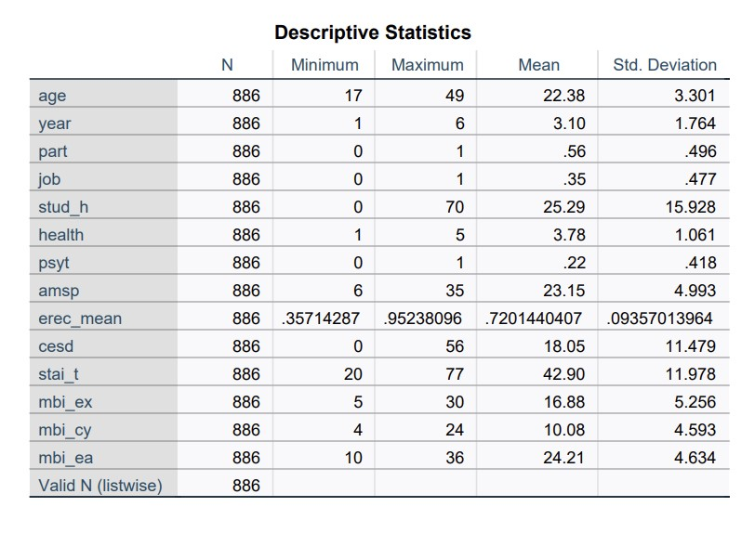
Medical Student Dataset Descriptive Statistics

Slide 16
Results and Discussion
Medical Student Dataset:
Students that reported receiving psychotherapy services reported higher scores on the psychological tests.
Students who were in their early years of study scored higher on the tests for depression, anxiety, and emotional burnout.
Students who were further along reported higher levels of cynicism and lower sense of achievement.
Students who were dissatisfied or neutral about their overall health reported higher scores of depression, anxiety, and burnout. Scores on these tests also increased the more time students spent studying outside of classes
Linear regression was the best performing model for predicting depression, anxiety, and burnout.

Slide 17
Results and Discussion (continued)
Student Mental Health Dataset:
Machine Learning: performance matrices of precision, recall, F1, MCC, AUC, and CA were all calculated. Many models had scores in each category above 0.5, and were close to 0.7 or 0.8, indicating a good model fit. Naive Bayes, logistic regression, random forest, and SVM had good models, as mentioned previously.
Naive Bayes: Classification results showed that the model accurately predicts students not having depression by 92.4%, and predicts if students do have depression with 77.1% correctness. Overall, the Naive Bayes model accurately predicted if a student would have depression or not at 87.1%.
Students in the bachelor’s of computer science program with a 3.5 cGPA have higher rates of depression than any other 3.5 cGPA category. The program with the highest rate of depression, overall, was engineering. Students with cGPA averages of 3.0 and 3.5+ had higher rates of depression than those with cGPA averages of less than 2.5.
Spearman’s Correlation test showed that more women have depression than men, that married students have a higher rate of depression, and as age increases, depression rates decrease. Also, it shows that as students get further in their degree, the rate of depression decreases. It also showed that if a student has depression, then they are also more likely to have anxiety, panic attacks, and seek help for mental health.
The t-test showed that there is evidence to state that having depression is related to cGPA, with the null hypothesis being not having depression, and the T>t being 0.542, which is much greater than the standard significance level of 0.05.

Slide 18
Conclusion
With these two datasets, it shows how impactful different stressors in life impact mental health. GPA/cGPA, gender, age, chosen major / program, year into the program, job satisfaction, studying habits, test scores, and overall outlook on life all impact, or are impacted by, mental health.
With mental health crises, there should be programs or discussions in place that help to destigmatize mental health and bring more awareness to it, as well as find ways to help improve vulnerable groups’ mental health statuses

