Slide 1
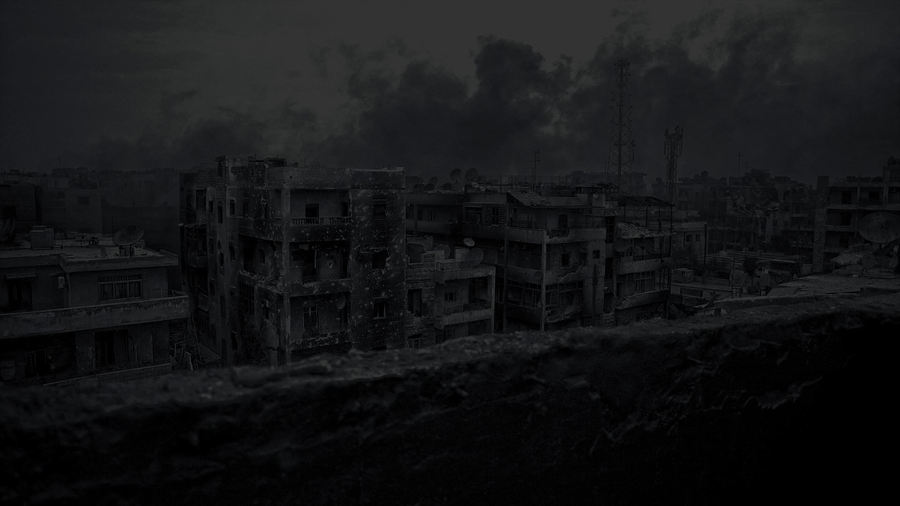
NON STATE ACTOR
MASS ATROCITIES
Ashwed Patil
Vatsal Jatakia
Saniya Ambavanekar
Akshay Naik
(TEAM SAN DIEGO)
Indiana University Bloomington | Tuesday April 17th, 2018

Slide 2
GIVEN A MASS ATROCITY HAPPENS, WHAT CONDITIONS MAKE IT WORSE?
“The recent surge in violence by groups such as IS and Boko Haram, along with their deliberate targeting of civilians, has intensified the need to understand the conditions under which nonstate groups choose to deliberately and systematically target civilians for extermination. To date, most of our research into genocide and mass atrocities has focused on those actions perpetrated by state actors. Yet current events have increased the need to understand this behavior across nonstate groups as well.”
Dr. Cyanne Loyle (IU Department of Political Science)
CONFLICT RESOLUTION
HUMANITARIAN RELIEF
POLICY INTERVENTION
& RECOMMENDATION
WAR STATISTICS
HUMAN RIGHTS VIOLATION

Slide 3
DATA DESCRIPTION
501 observations of 37 Variables
Group Characteristics: Islamist, Separatist, Leftist, Ethnic Membership,
Political Party Link, PGM (Pro-Government Militia), Rebel, Group Duration
Conflict Characteristics: Conflict Duration, Battle Deaths, Incompatibility
(Government/Territory), Number of Groups in Conflict, State Atrocity (Yes/No)
Identification and Atrocity Variables: Region, Country, UCDPID, Civilian
Deaths, Regime Type, Group Name
VARIABLES OF INTEREST
Response/Target Variable: Mass Atrocity Event (0 or 1)
- Calculated by checking whether or not a group has killed at least 50 people during a conflict

Slide 4
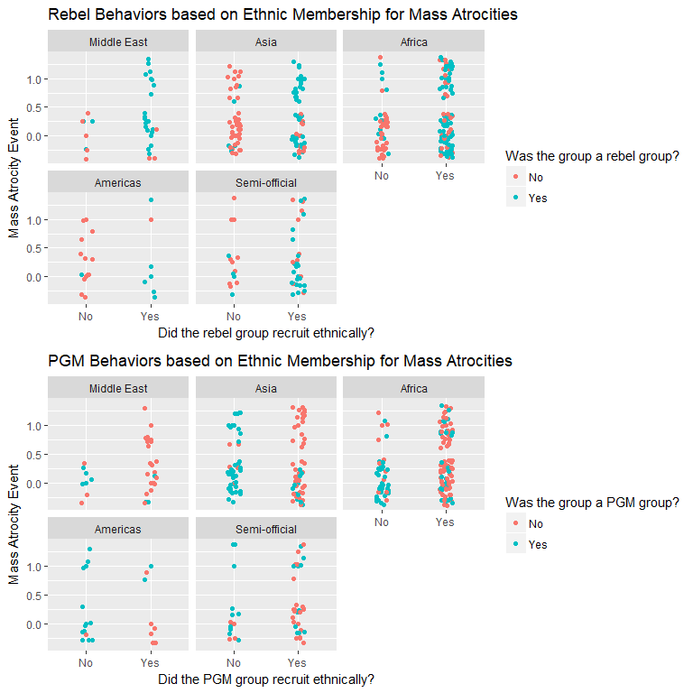
IS MASS ATROCITY BEHAVIOR CHARACTERIZED BY ETHNIC DIFFERENCES?

Slide 5
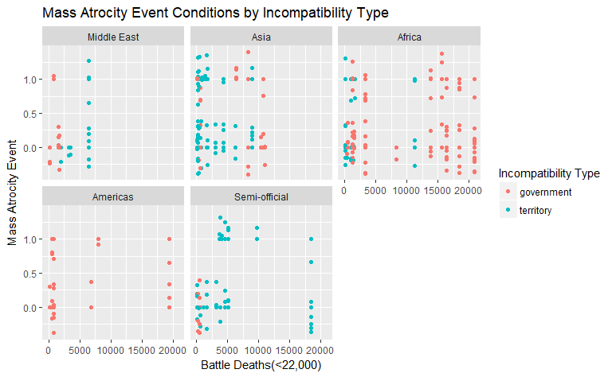
DOES THE TYPE OF CONFLICT AFFECT THE NUMBER OF DEATHS DURING A MASS ATROCITY EVENT?

Slide 6
MODEL
We fitted a logistic regression model with the group variables and the conflict variables as our predictors
The model was considered on the full NSA sample with no distinction between a group being a PGM or a rebel
Ethnic Membership and Islamist Ideology are important variables that affect the mass atrocity conditions
Including Group Duration and Battle Deaths significantly affects the model performance

Slide 7
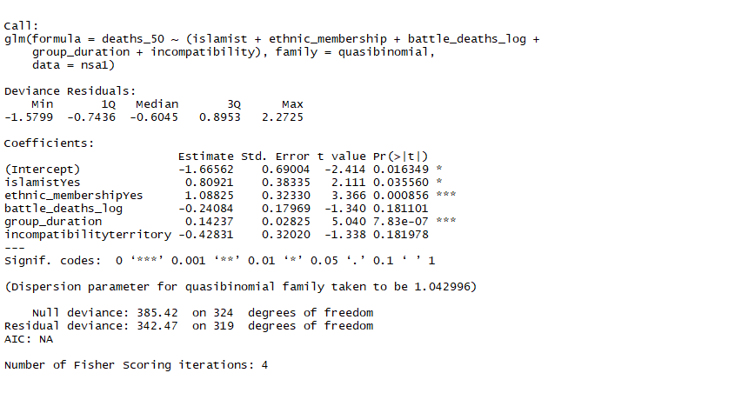
MODEL

Slide 8
CONCLUSION AND FUTURE WORK
NSA Conflict Group behaviors vary significantly across different regions. In general, NSA Groups in Asia and Africa tend to hire based on certain group characteristics such as Islamist ideology or ethnic similarities
Additionally, NSA Groups differ in their motives to commit mass atrocities across different regions. Conflicts in Americas and Africa are primarily characterized by targeting the incumbent government while those in Asia and semi-official/disputed regions are mostly territorial conflicts
Future Work
Investigate separate models for PGM and Rebel Groups, Regions (Asia and Africa) and Death Value thresholds
Dimensionality reduction with PCA

