Slide 1
JAVA DATABASE
CONNECTIVITY

Slide 2
Java Database Connectivity(JDBC)
JDBC is a Java API to connect and execute the query with the database.
JDBC API uses JDBC drivers to connect with the database
The java.sql package contains classes and interfaces for JDBC API.
JDBC API
Database
Java Application
Jdbc
drivers

Slide 3
A list of popular interfaces of JDBC API are given below:
Driver interface
Connection interface
Statement interface
PreparedStatement interface
CallableStatement interface
ResultSet interface
ResultSetMetaData interface
DatabaseMetaData interface
RowSet interface

Slide 4
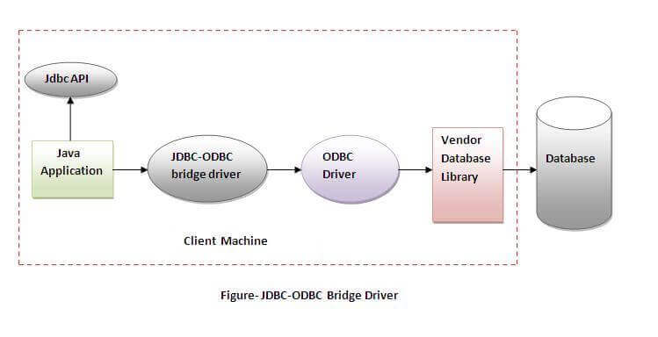
There are four types of JDBC drivers:
JDBC-ODBC Bridge Driver
Native Driver
Network Protocol Driver
Thin Driver
JDBC-ODBC BRIDGE DRIVER

Slide 5
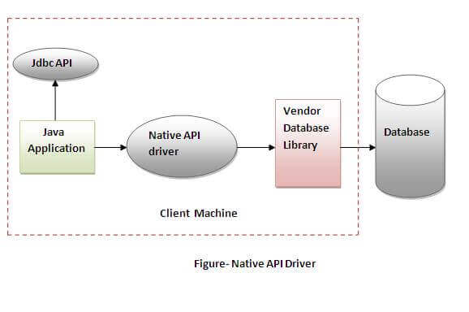
NATIVE-API DRIVER

Slide 6
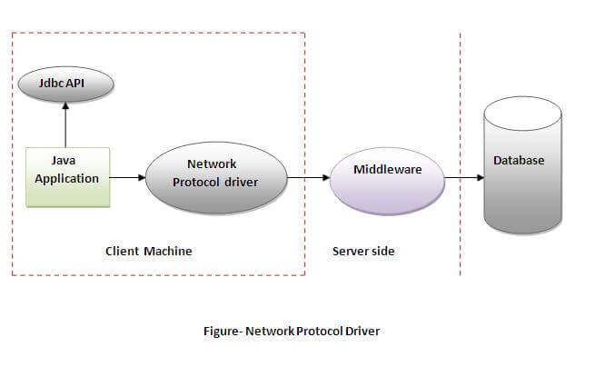
NETWORK PROTOCOL DRIVER

Slide 7
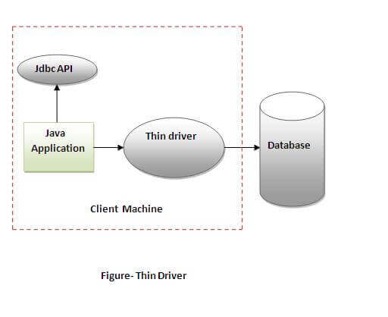
THIN DRIVER

Slide 8
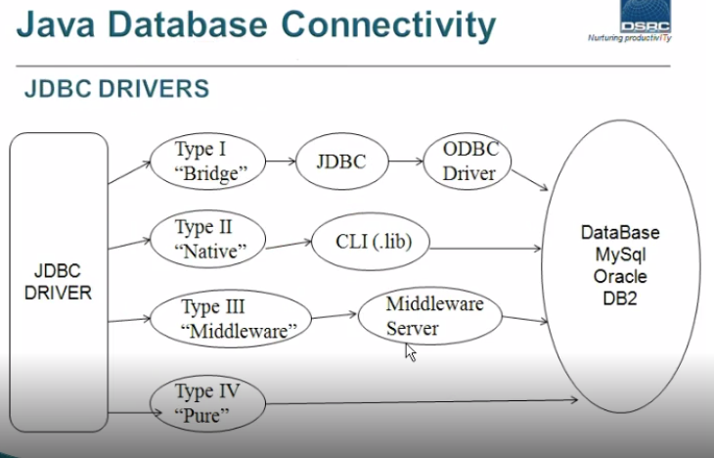

Slide 9
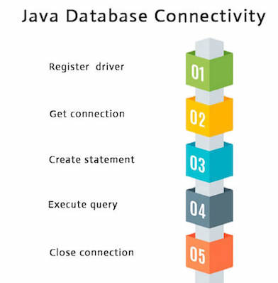
5 Steps to connect to the database in java
Register the driver class
Create the connection object
Create the Statement object
Execute the query
Close the connection object

Slide 10
Loading a driver can be done in two ways:
1. Using forName() method:
Class.forName("oracle.jdbc.driver.OracleDriver");
Class.forName("com.mysql.jdbc.Driver");
2. Using registerDriver() method:
Driver d=new com.mysql.jdbc.Driver;
DriverManager.registerDriver(d);

Slide 11
Create the connection object
Connection con=
DriverManager.getConnection("jdbc:mysql://localhost:3306/ash","root","dsrc");
Create the Statement object
Statement stmt=con.createStatement();
Execute the query
ResultSet rs=stmt.executeQuery("select * from emp");
while(rs.next()){
System.out.println(rs.getInt(1)+" "+rs.getString(2));
}
Close the connection object
con.close();

Slide 12
Statement interface
The important methods of Statement interface are as follows:
1) public ResultSet executeQuery(String sql): is used to execute SELECT query. It returns the object of ResultSet.
2) public int executeUpdate(String sql): is used to execute specified query, it may be create, drop, insert, update, delete etc.
3) public boolean execute(String sql): is used to execute queries that may return multiple results.
4) public int[] executeBatch(): is used to execute batch of commands.

Slide 13
Example of PreparedStatement interface that updates the record
import java.sql.*;
class InsertPrepared{
public static void main(String args[]){
try{
Class.forName("oracle.jdbc.driver.OracleDriver");
Connection con=DriverManager.getConnection("jdbc:oracle:thin:@localhost:1521:xe","system","oracle");
PreparedStatement stmt=con.prepareStatement("insert into Emp values(?,?)");
stmt.setInt(1,101); //1 specifies the first parameter in the query
stmt.setString(2,"Ratan");
int i=stmt.executeUpdate();
System.out.println(i+" records inserted");
con.close();
}catch(Exception e){ System.out.println(e);}
}
}

Slide 14
Methods Of Resultsetmetadata Interface
public int getColumnCount()throws SQLException:
it returns the total number of columns in the ResultSet object.
public String getColumnName(int index)throws SQLException:
it returns the column name of the specified column index.
public String getColumnTypeName(int index)throws SQLException:
it returns the column type name for the specified index.
public String getTableName(int index)throws SQLException:
it returns the table name for the specified column index.

Slide 15
Example of ResultSetMetaData interface :
import java.sql.*;
class Rsmd{
public static void main(String args[]){
try{
Class.forName("oracle.jdbc.driver.OracleDriver");
Connection con=DriverManager.getConnection(
"jdbc:oracle:thin:@localhost:1521:xe","system","oracle");
PreparedStatement ps=con.prepareStatement("select * from emp");
ResultSet rs=ps.executeQuery();
ResultSetMetaData rsmd=rs.getMetaData();
System.out.println("Total columns: "+rsmd.getColumnCount());
System.out.println("Column Name of 1st column: "+rsmd.getColumnName(1));
System.out.println("Column Type Name of 1st column: "+rsmd.getColumnTypeName(1));
con.close();
}catch(Exception e){ System.out.println(e);}
}
}
Output: Total columns: 2
Column Name of 1st column: ID
Column Type Name of 1st column: NUMBER

