Slide 1
DREAMERS
Bringing Dreams to Reality

Slide 2
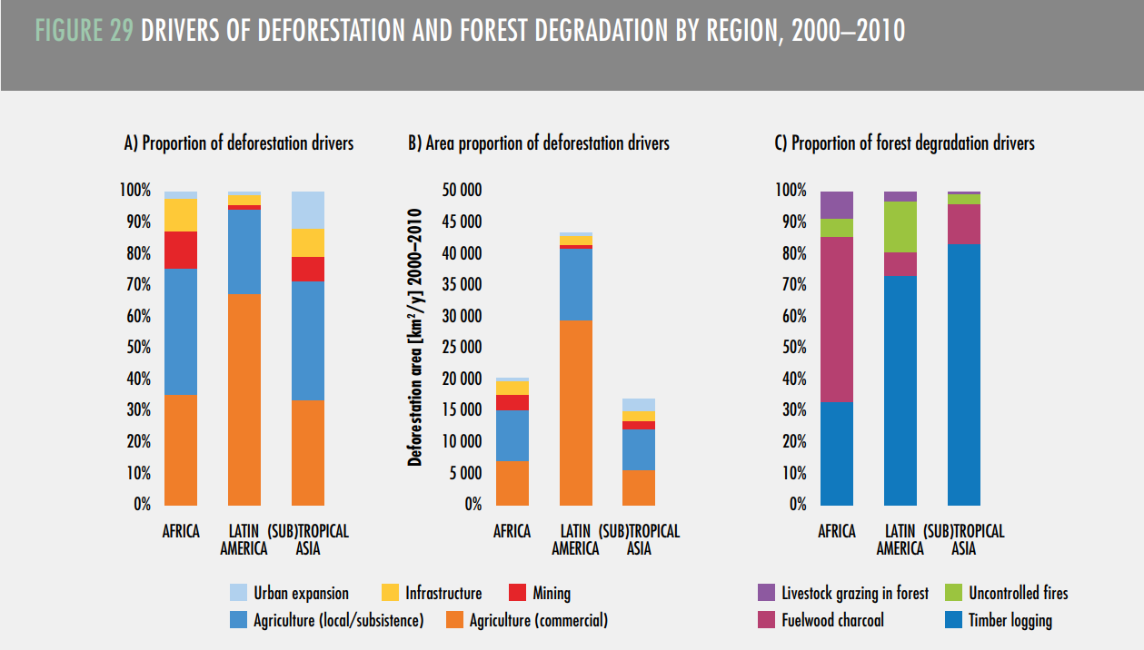
The problem
Agriculture causes 80% of deforestation.

Slide 3
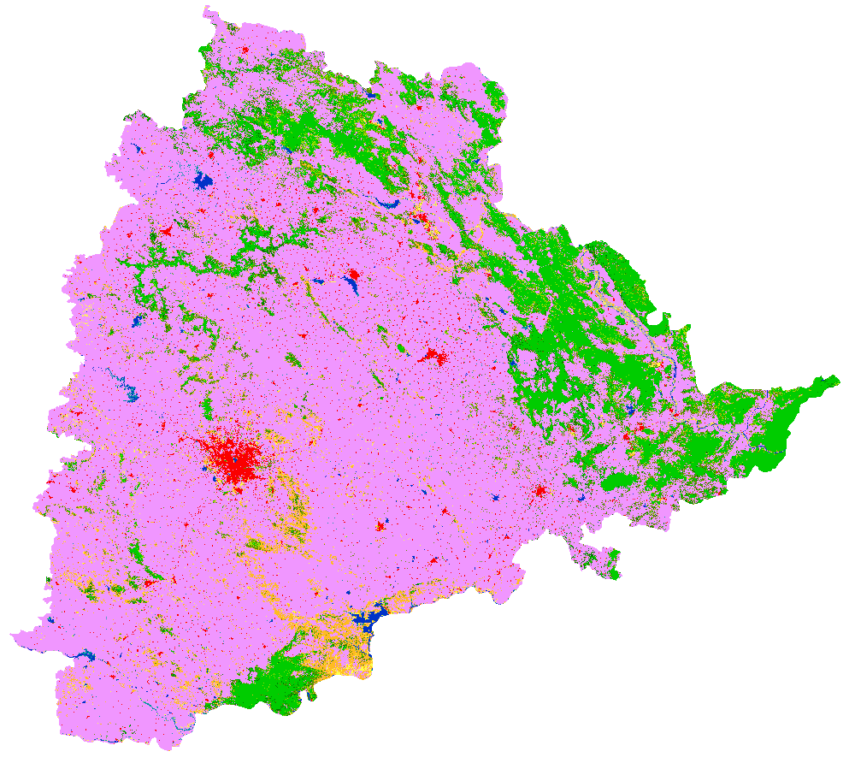
The solution
Promote positive interaction between agriculture and forestry to build sustainable agricultural systems and improve food security.

Slide 4
How?
Step 3
Step 2
Step 1
Prediction and making decision.
Analysis and Visualization
Agricultural data collection

Slide 5
Thank You

