Slide 1

NextGenJobs: A Modern Job Portal Built with React
Transforming Career Opportunities with Style and Interactivity
by Ashwin Yadav

Slide 2





Key Components
Header
Steps Section
Video Section
Navbar & Footer
Full-screen image background (100vh desktop, 40vh mobile), company logos, bold call-to-action ("Search, Apply & Get Your Dream Job").
Four animated cards (fade-in, pulse icons) guiding users through the job search process.
Scroll-triggered video playback (BMW.mp4), styled with a glowing, color-changing box-shadow (cyan, pink, purple cycle).
Gradient design, smooth scroll navigation.

Slide 3




Interactivity Features
Scroll-triggered video playback with audio support (Intersection Observer).
Hover effects: Button ripple, card lift and scale.
Potential: Functional search bar and job listings (mockup suggested).

Slide 4
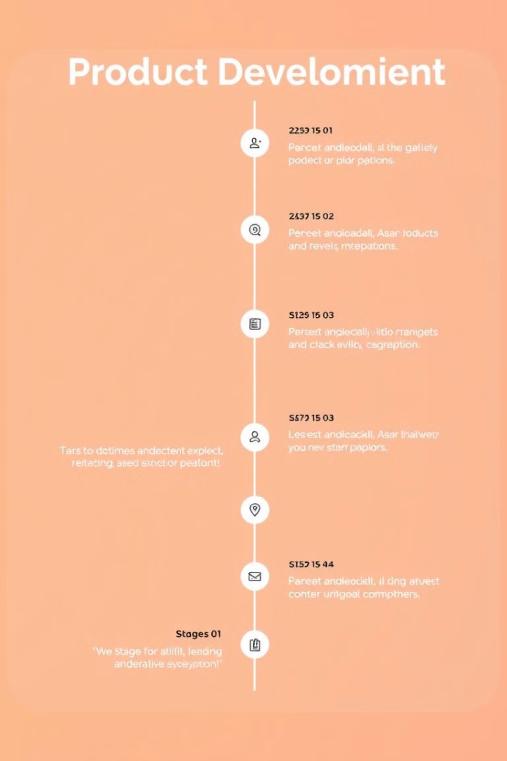
Realism & Future Enhancements
1
Current: Static job steps and video showcase.
2
Planned: Job search bar, dynamic job listings, application modal, smooth scroll links.
3
Vision: "A fully functional job platform with real-time job postings and user accounts."

Slide 5
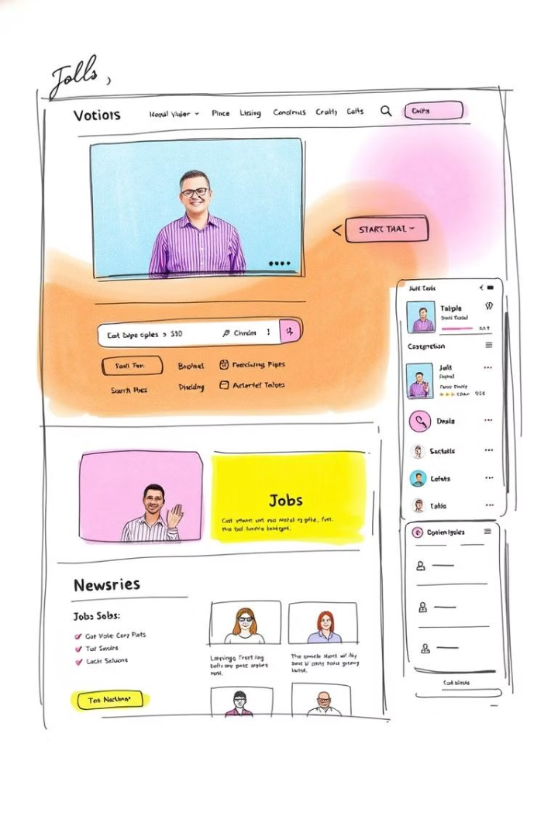
Challenges & Solutions
Challenge
Video audio blocked by browsers.
Solution
Added controls and manual play option.
Challenge
Responsive sizing.
Solution
Tailored heights (100vh desktop, 40vh mobile) with media queries.

Slide 6

Conclusion
NextGenJobs combines modern design with interactivity, poised to become a leading job portal.

