Slide 1
24285 FATE
Practice Session 4, 5 & 6
Algorithmic Fairness and mitigation

Slide 2
Rules for Practices
6 sessions (3 modules)
Attendance: 4 of 6 classes mandatory
Individual deliverables:
Practice Module 1 (40% - Individual): 10/02/2023 at 23:59
Practice Module 2 (20% - Individual): 22/02/2023 at 23:59
Practice Module 3 (40% - In pairs): 17/03/2023 at 23:59
Notes:
Executar les següents sentències SQL en la connexió 1:

Slide 3
Goals of Module 3
Understand different fairness metrics
Learn a industry-oriented tool to implement fairness metrics
Learn how to apply mitigation strategies for unfair algorithms
This module is not exhaustive, there are other techniques and tools available for working with massive data and other kind of data formats.
Notes:
Executar les següents sentències SQL en la connexió 1:

Slide 4
Final Project Part 4

Slide 5
Introduction to Dataset
Mexico is in the Top 5 countries with more COV19 deaths. many patients are dying every day in the hospitals.
This dataset was collected by Mexican health authorities and contains all registers about COV19 patients by the time this dataset was downloaded (April, 2021).
What's inside is data about the patients, and there are many things we can know about the patients such as where did they were hospitalized, in what state of Mexico, them age and the date of the death.
Also there are many interesting columns that tell us is the patient has a health issue apart from COVID19 and there's a long list about this issues such as obesity, hypertension, asthma, diabetes, ….
And there are other important features: if the patient smokes, if the patient was diagnosed with pneumonia or whether the patient was intubated.
Original dataset: https://www.kaggle.com/datasets/omarlarasa/cov19-open-data-mexico
Notes:
Executar les següents sentències SQL en la connexió 1:

Slide 6
One question per group
Group | Question | Dataset | ML target class
1 | What is the probability of dying increase with the patient's age? | deceased_dataset_v1 | 'covid_positive’ and/or 'deceased_patient'
2 | What does probability change if the patient has another health issue? | deceased_dataset_v1 | 'covid_positive’ and/or 'deceased_patient'
3 | How dying probability increases when the patient has been intubated? | decease_dataset_v2 | covid_positive
4 | Is it true that smoking increases the probability of dying by COV19? | decease_dataset_v3 | 'covid_positive’ and/or 'deceased_patient'
5 | Do pregnant women has more probability of being intubated? | dataset_women | covid_positive
6 | How is the probability of hospitalization and probability of death are related to the length of symptoms? | deceased_dataset_v1 | 'covid_positive’ and/or 'deceased_patient'
7 | Is there a potential discrimination against Migrants? Hint: calculate the ratio between death and ICU/intubation | dataset_migrancy | covid_positive

Slide 7
One question per group

Slide 8
Deliverable parts
[L3.1] Load and analyse your dataset
[L3.2] Prepare your dataset and train a model
[L3.3] Assess your model performance
[L3.4] Assess the fairness metrics [L3.5] Apply mitigation algorithms to your model [L3.6] Assess the effects of the mitigation technique [L3.7] Executive report
Practice Module 3 (40% - In pairs): 17/03/2023 at 23:59
To deliver: Notebooks + Report in PDF
Notes:
Executar les següents sentències SQL en la connexió 1:

Slide 9
Fairness Metrics Part 3

Slide 10
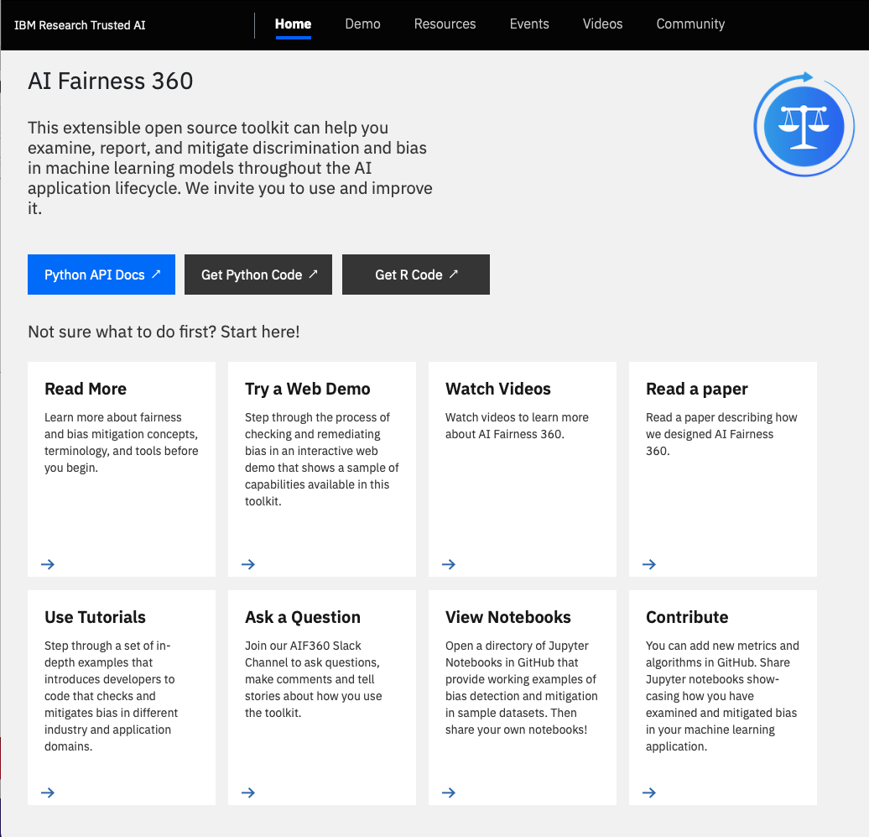
https://aif360.mybluemix.net
Notes:
Executar les següents sentències SQL en la connexió 1:

Slide 11
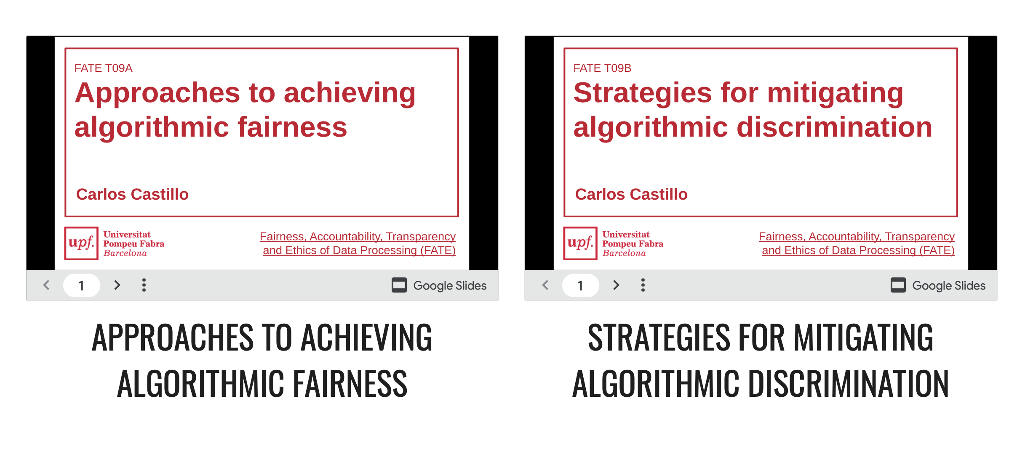
Notes:
Executar les següents sentències SQL en la connexió 1:

Slide 12
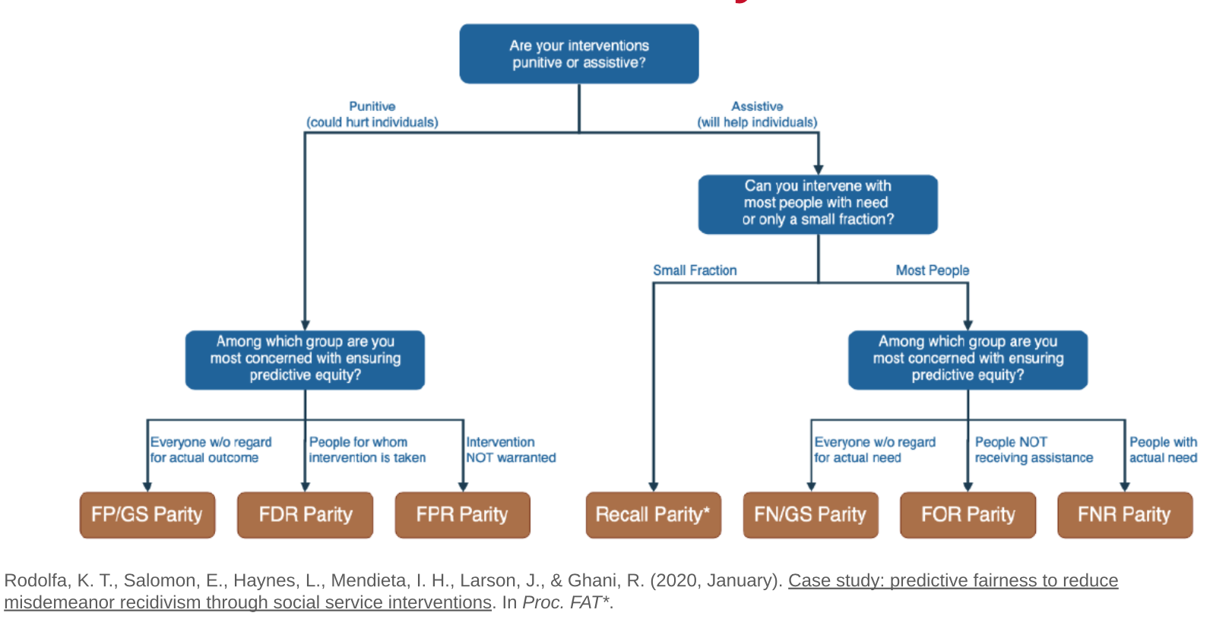
Fairness Metrics for Classification in AIF360
Notes:
Executar les següents sentències SQL en la connexió 1:

Slide 13
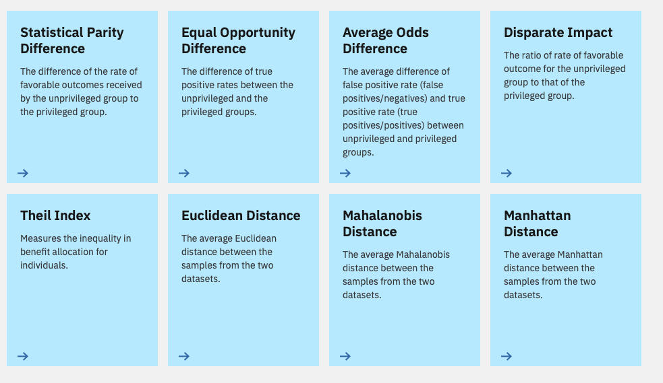
Fairness Metrics for Classification in AIF360
https://aif360.mybluemix.net
Notes:
Executar les següents sentències SQL en la connexió 1:

Slide 14
Mitigation algorithms

Slide 15
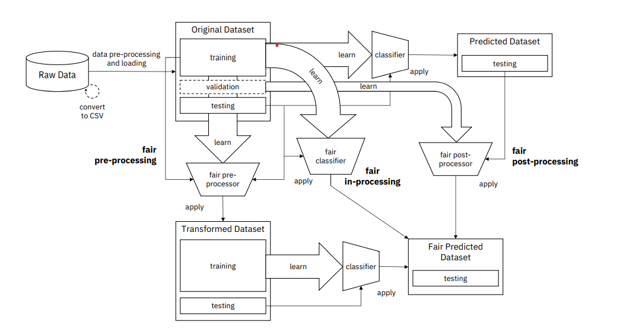
Mitigation algorithms
Source:https://arxiv.org/pdf/1810.01943.pdf
Notes:
Executar les següents sentències SQL en la connexió 1:

Slide 16
Mitigation in pre-processing
Opportunities experienced by the privileged group may not have been presented to the unprivileged group; members of each group may not have access to the same resources, whether financial or otherwise. This means their circumstances, and consequently, their features for a machine learning model, are different and not necessarily comparable. This is a consequence of systematic bias.
Disparate Impact Remover
Edits values, which will be used as features, to increase fairness between the groups.
The algorithm requires the user to specify a repair_level,
this indicates how much you wish for the distributions of the groups to overlap.
Reweighing (you need a classifier that allows you to parametrize sample weights for this) Weights the examples in each (group, label) combination differently to ensure fairness before classification.
Notes:
Executar les següents sentències SQL en la connexió 1:

Slide 17
Mitigation in in-processing
MetaFairClassifier
The meta algorithm here takes the fairness metric as part of the input and returns a classifier optimized w.r.t. that fairness metric.
Notes:
Executar les següents sentències SQL en la connexió 1:

Slide 18
Mitigation in post-processing
EqOddsPostprocessing (You need to use the equalized odds ratio to measure performance of this classifier and the classifier trained above) Equalized odds postprocessing is a post-processing technique that solves a linear program to find probabilities with which to change output labels to optimize equalized odds.
Notes:
Executar les següents sentències SQL en la connexió 1:

Slide 19
Mitigation algorithms
Sometimes, certain algorithms do not work well with certain classifiers / output distributions
This can happen for several reasons, one of them being the changes done for subsequent versions of the tool
If you see that your unfairness mitigation algorithm does not work as expected, do not invest too much time trying to solve it, use another algorithm!
Notes:
Executar les següents sentències SQL en la connexió 1:

Slide 20
Remarks from P1 & P2

Slide 21
Remarks
Explore the data deeply, looking for answers and unknowns. Develop your own plots, functions and analytic tools.
On your conclusions, be specific but also look for explanations, not just describing what you see. Try to go deeper with the level of analysis.
Review the concepts of identifiers, K-anonymous and L-Diversity.
Fairness is about treatment but also impact. Thus, is sought at the individual level (≃consistency) and at the group level (≃parity)
Notes:
Executar les següents sentències SQL en la connexió 1:

Slide 22
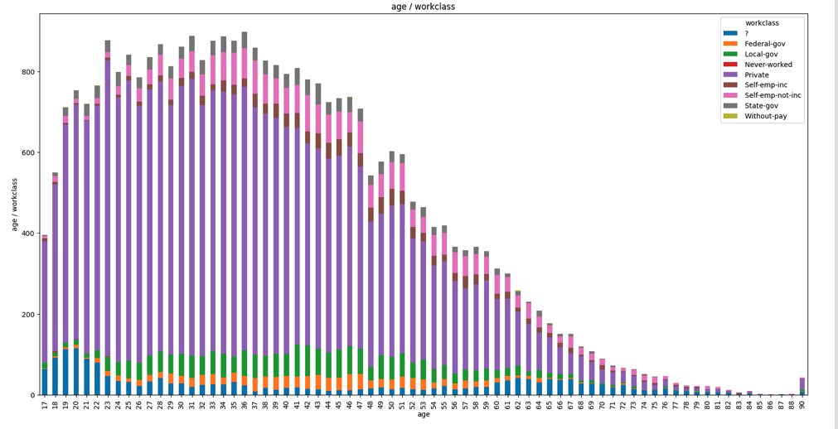
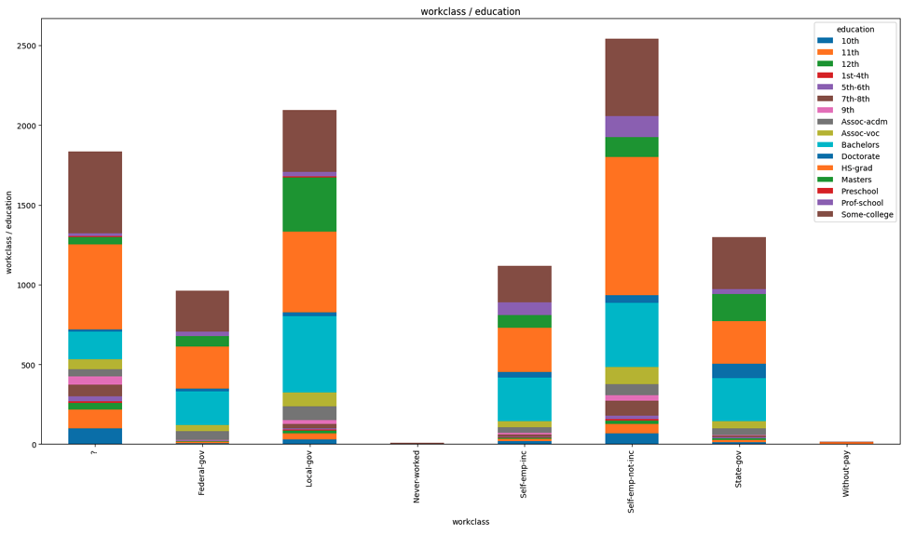
Plots and functions
Notes:
Executar les següents sentències SQL en la connexió 1:

Slide 23
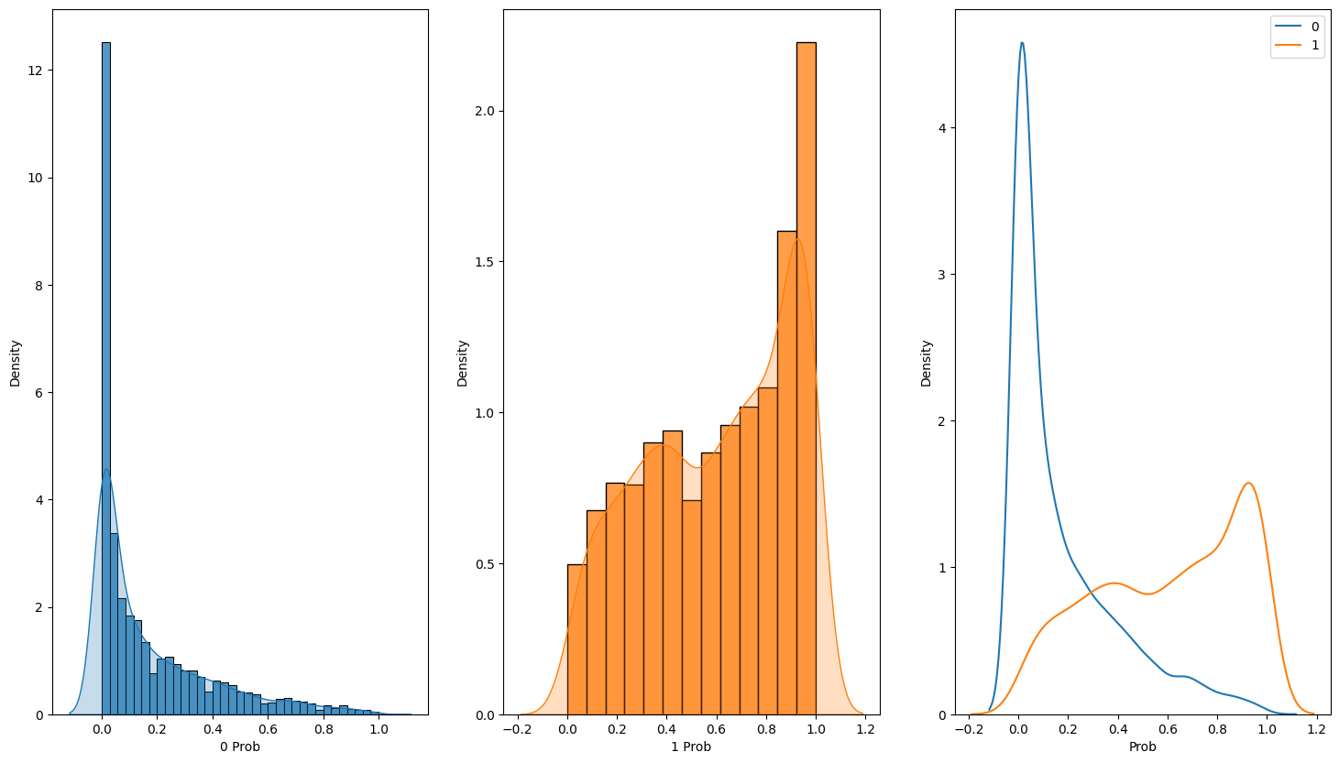
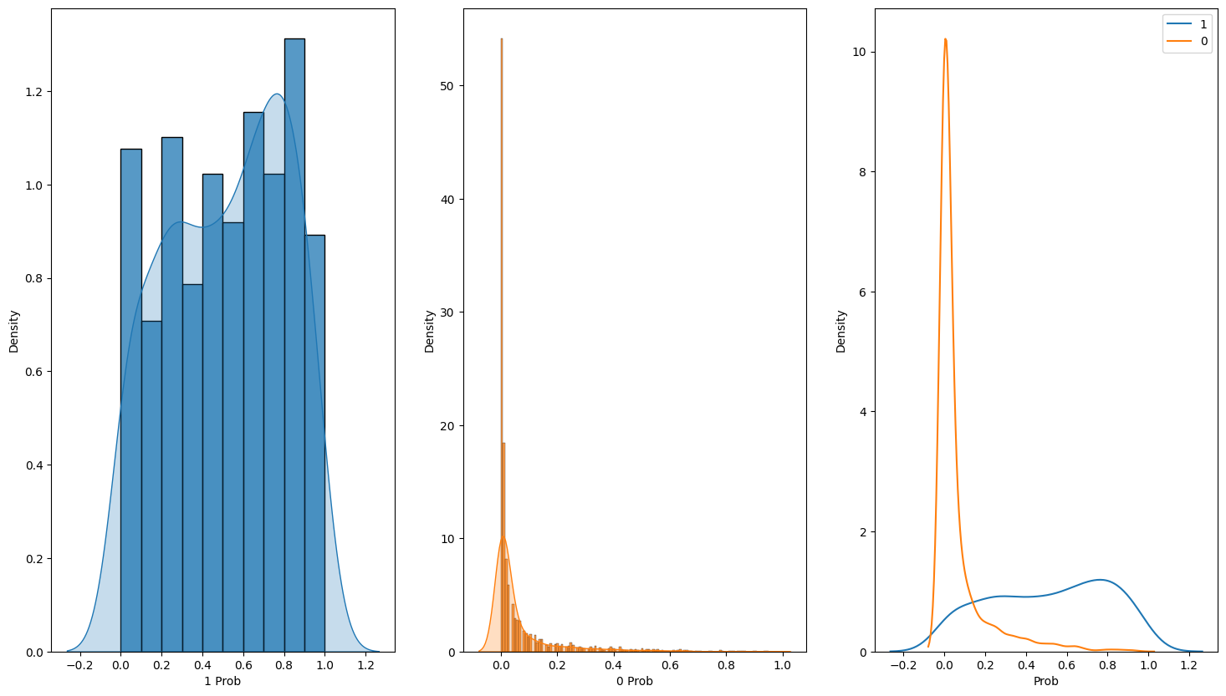
Plots and functions
Male FR
Female FR
Notes:
Executar les següents sentències SQL en la connexió 1:

Slide 24
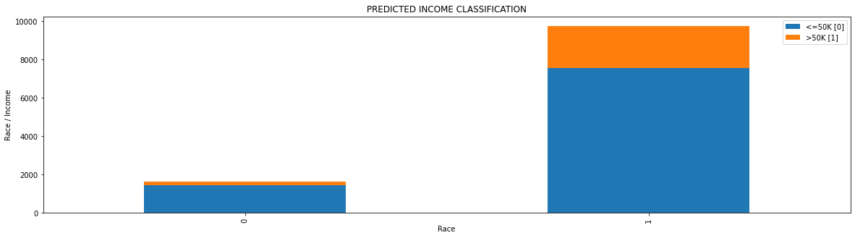
Explanations
I tried to train another model, and it seemed to do worse (actually, I trained 2 other models prior to this one, a logistic regression model and a MLPClassifier model), so I'll be basing off the first model.
The model seems to do a good job of predicting income, with an accuracy score of over 85% and such a low FPR. The FNR is much higher than the FPR meaning the model was actually punishing more people and predicting them as making less than 50K, and judging from the percentages in the plot, it seems that the disadvantaged group had more people punished. I say so because only 2.5% more people were predicted as making less than 50K in the protected group, but 4.1% more people of the disadvantaged group were predicted as making less than 50K. From the plots of the true values and the predicted values, they look pretty similar and have similar percentages in the data both for below and above the 50K mark. The model seemed to predict more people as making below 50K across both groups(protected and disadvantaged), but nonetheless, there was still always a higher percentage of the protected group predicted to make above over 50K, in fact the model predicted that more than double the number making over 50K in the disadvantaged group would be making over 50K in the protected group.
Notes:
Executar les següents sentències SQL en la connexió 1:

Slide 25
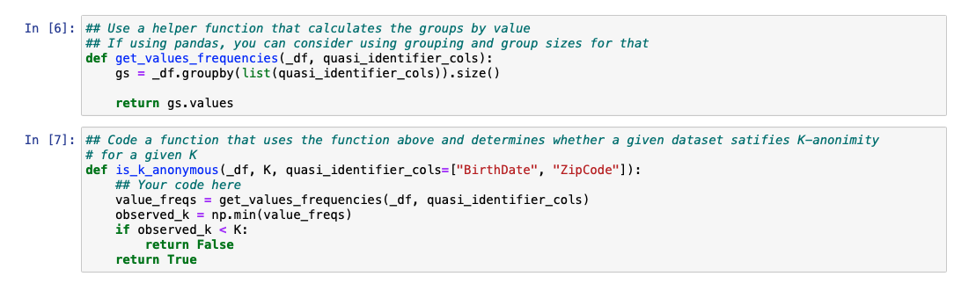
K-anonymous
Notes:
Executar les següents sentències SQL en la connexió 1:

Slide 26
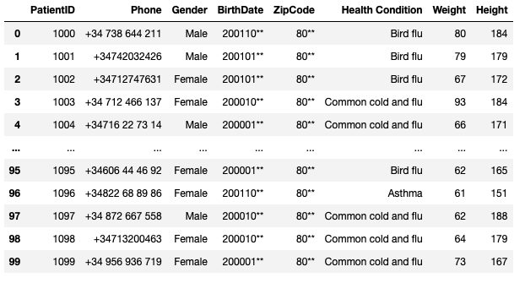
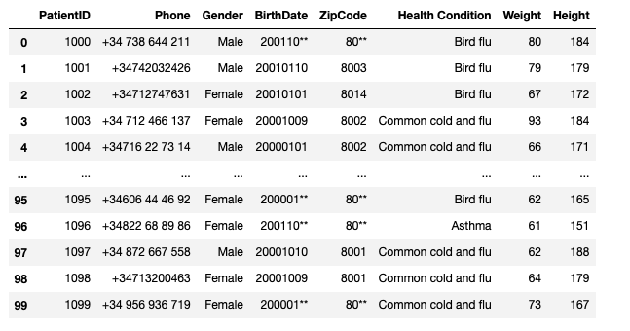
Generalization methods
Global Generalization
Local Generalization
Notes:
Executar les següents sentències SQL en la connexió 1:

Slide 27
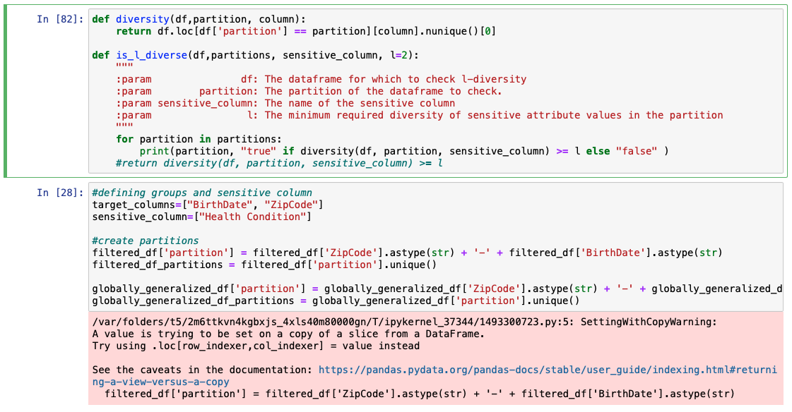
L-diversity
8003-20011009 false 8003-20010110 true 8014-20010101 false 8002-20001009 false 8002-20000101 true 8001-20001010 true 8013-20010110 false 8013-20011009 false 8012-20001009 true 8001-20011001 false 8014-20010109 false 8004-20000111 true 8012-20001011 false 8013-20011010 false
Notes:
Executar les següents sentències SQL en la connexió 1:

Slide 28
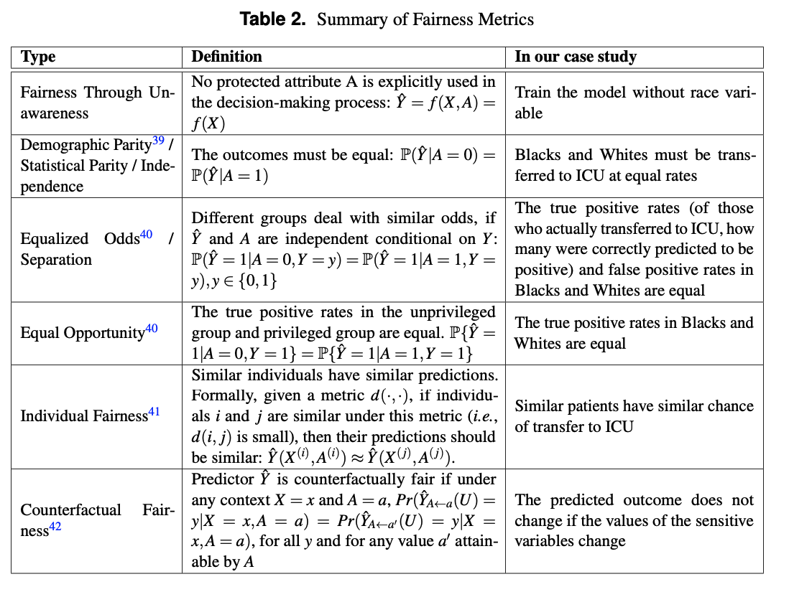
Fairness Metrics in Healthcare
https://www.medrxiv.org/content/10.1101/2022.01.16.21267299v1.full.pdf
https://arxiv.org/pdf/2110.00603.pdf
Notes:
Executar les següents sentències SQL en la connexió 1:

Slide 29
Questions about COVID dataset
ioannis.bilionis01@estudiant.upf.edu
Notes:
Executar les següents sentències SQL en la connexió 1:

