Slide 1
24285 FATE
Practice Session 3&4
Algorithmic Fairness

Slide 2
Rules for Practices
6 sessions (3 modules)
Attendance: 3 of 6 classes mandatory
Deliverables:
Practice Module 1 (40% - Individual): 12/02/2024 at 23:59
Practice Module 2 (20% - Individual): 26/02/2024 at 23:59
Practice Module 3 (40% - In pairs): 22/03/2024 at 23:59
Notes:
Executar les següents sentències SQL en la connexió 1:

Slide 3
Goals of Module 2
To understand Disparate Impact as an approach to Algorithmic Fairness
To apply concepts in a systematic way
Assessment of mitigation strategies
This module is not exhaustive, there are other techniques and tools available for working with massive data and other kind of data formats.
Notes:
Executar les següents sentències SQL en la connexió 1:

Slide 4
Disparate Impact

Slide 5
Disparate Impact
﻿Disparate impact refers to policies or practices that are facially neutral but have a disproportionately adverse impact on protected classes. Disparate impact is not concerned with the intent or motive for a policy. ﻿Barocas, S. (2014) Big Data ’ S Disparate Impact. California Law Review, 104(671), pp. 671–732.
﻿Settings wherein a penalty policy has unintended disproportionate adverse impact on a particular group. [..] It is important to bear in mind that fairness itself—
along with the notion of disparate impact—is a social and ethical concept, not a statistical concept. Chouldechova, A. (2017) Fair Prediction with Disparate Impact: A Study of Bias in Recidivism Prediction Instruments. Big Data, 5(2), pp. 153–163. doi:10.1089/big.2016.0047.
Notes:
Executar les següents sentències SQL en la connexió 1:

Slide 6
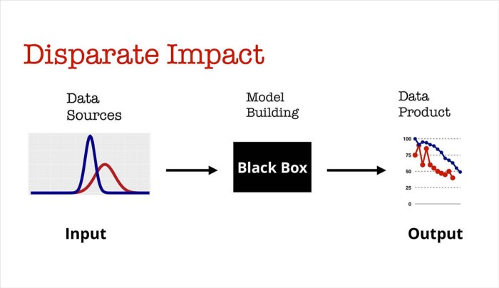
Disparate Impact
Illustration of disparate impact — in this diagram the data distribution of two groups is very different, which leads to differences in the output of the algorithm without any explicit association of the groups. Source: KdNuggets
Notes:
Executar les següents sentències SQL en la connexió 1:

Slide 7
Analysing a toy dataset

Slide 8
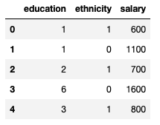
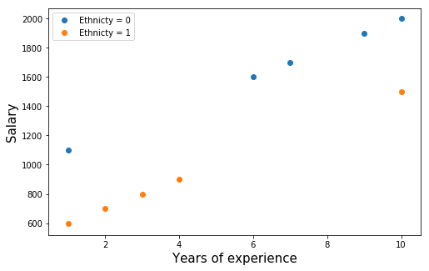
Toy dataset
Notes:
Executar les següents sentències SQL en la connexió 1:

Slide 9
Toy dataset
Oberservations: Data is well balanced (half of the samples have *ethnicity* = 1).
Most of highest salaries are given to *ethnicity* = 0.
In the following, we will refer to ethnicity = 0 as the privileged group and ethnicity = 1 as disadvantaged or protected group.
Notes:
Executar les següents sentències SQL en la connexió 1:

Slide 10
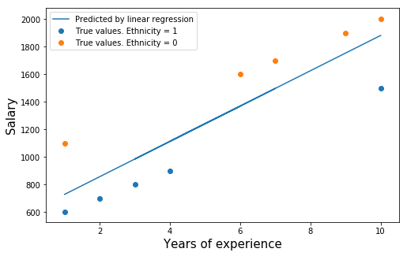
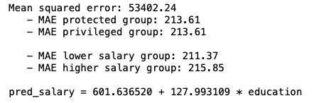
Predicting salaries w/o protected attributes
Notes:
Executar les següents sentències SQL en la connexió 1:

Slide 11
Predicting salaries w/o protected attributes
Oberservations: The fitted model punishes people with low education more than necessary.
Also, it rewards people with high education more than deserved
It is by itself already incorrect reflection of the underlying process, and would make incorrect recommendations, if used as a recommender system for salaries.
Notes:
Executar les següents sentències SQL en la connexió 1:

Slide 12
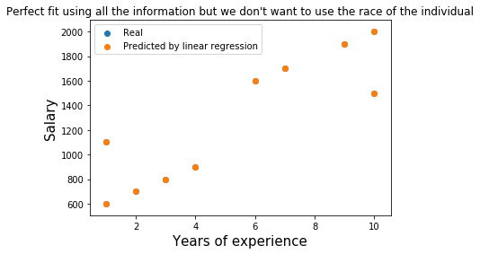
Predicting salaries w/ protected attributes
Mean squared error: 0.00
pred_salary_model = 1000.000000 + 100.000000 * education + -500.000000 * ethnicity
Notes:
Executar les següents sentències SQL en la connexió 1:

Slide 13
Predicting salaries w/ protected attributes
Mean squared error: 0.00
pred_salary_model = 1000.000000 + 100.000000 * education + -500.000000 * ethnicity
Oberservations: Using all the information, we obtain a perfect fit, but we don't want to use a model that explicitly depends on the race!
Notes:
Executar les següents sentències SQL en la connexió 1:

Slide 14
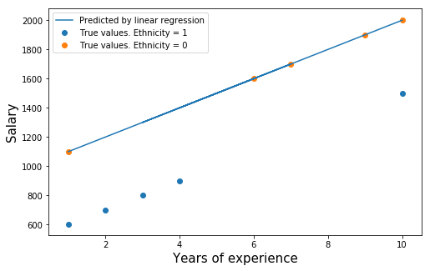
Predicting salaries w/o protected coefficient
Mean squared error: 0.00 - MSE protected group: 250000.00 - MSE privileged group: 0.00
Notes:
Executar les següents sentències SQL en la connexió 1:

Slide 15
Predicting salaries w/o protected coefficient
Mean squared error: 0.00 - MSE protected group: 250000.00 - MSE privileged group: 0.00
Oberservations: It equalizes salaries at the top bound
Also, it satisfies color-awareness since it does not use the enthnicity as input attribute
Notes:
Executar les següents sentències SQL en la connexió 1:

Slide 16
Predicting salaries
Which option do you think is the more fair?
Which option would you prefer if you were a company having to pay the salaries?
Which option would you prefer if you were an individual with ethnicity=1?
Do you think ML engineers typically consider this ideas?
Notes:
Executar les següents sentències SQL en la connexió 1:

Slide 17
Working on a real-world dataset

