Slide 1
DATAQUEST 3.0 | REVIEW 2 | VIT CHENNAI
ProfitPulse
Autonomous D2C Advertising Intelligence & Decision Engine
Ingest > Diagnose > Decide > Learn
4
4
3.82x
5
Ad networks unified
Causal models active
Blended ROAS
Anomalies diagnosed

Slide 2
The problem and our answer
Problem statement: siloed data, slow diagnosis, reactive spend, no decision automation
Siloed data
>
Unified dashboard: Meta, Google, Amazon, TikTok + Shopify + ERP
Slow diagnosis
>
Causal root-cause hub with anomaly feed
Guesswork spend
>
Predictive what-if sandbox with per-channel revenue forecast
Low marginal return
>
Reallocation tied to SKU margin and days of stock
No automation
>
Approve & Execute directives, audit log with rollback

Slide 3
How it works: closed-loop intelligence
Four stages, one engine (build v3.2.0-prod, 99.8% healthy)
1 INGEST
2 DIAGNOSE
3 DECIDE
4 LEARN
Ad spend, Shopify orders, GA events, ERP stock, SKU margin
1,240 events/sec, zero-lag sync
Bayesian causal graph (96.4% confidence)
Anomaly feed + root cause
Prioritised directives with urgency and AI confidence
Margin + stock aware
Approved actions run via ad APIs (200 OK log)
Outcomes feed back, rollback available
Feedback loop: outcomes flow back into Ingest
1,240/s
4
96.4%
99.8%
Data ingestion
Causal models
Graph confidence
Engine health

Slide 4
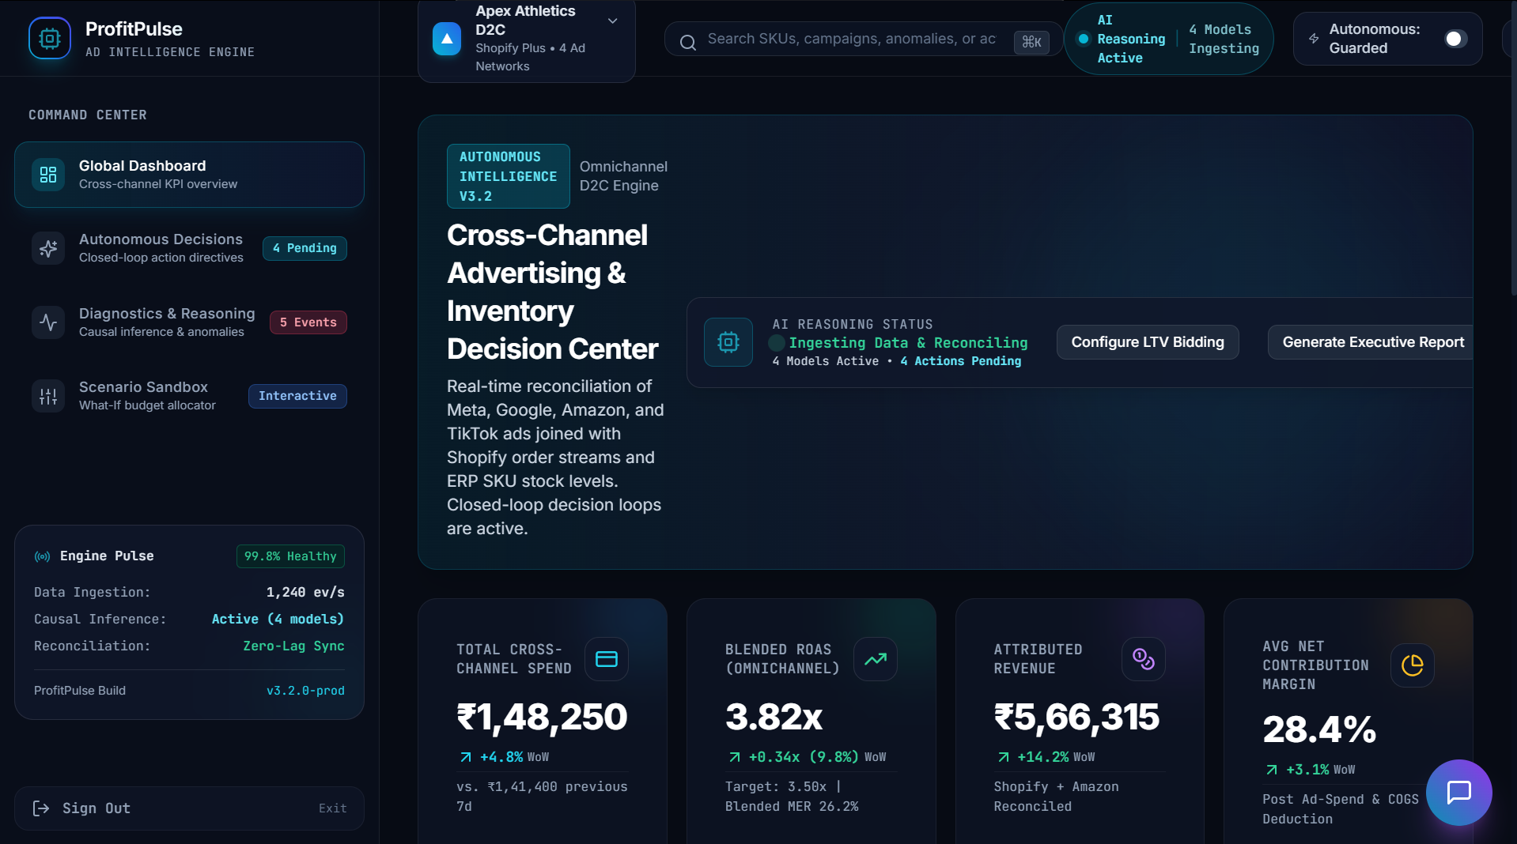
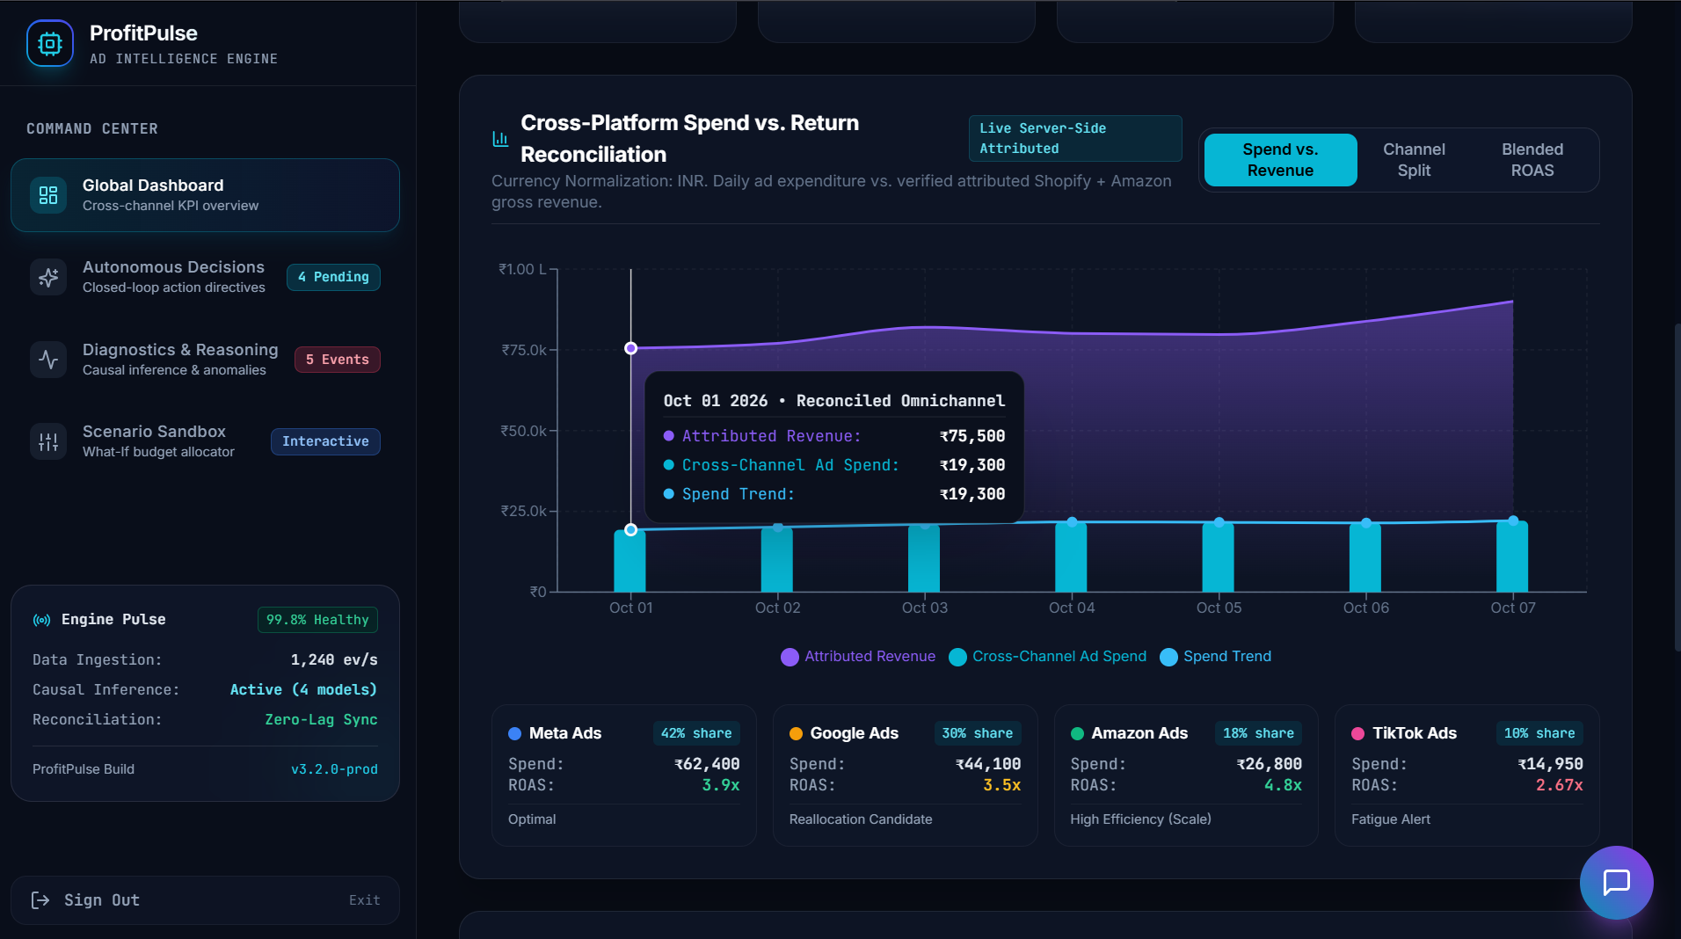
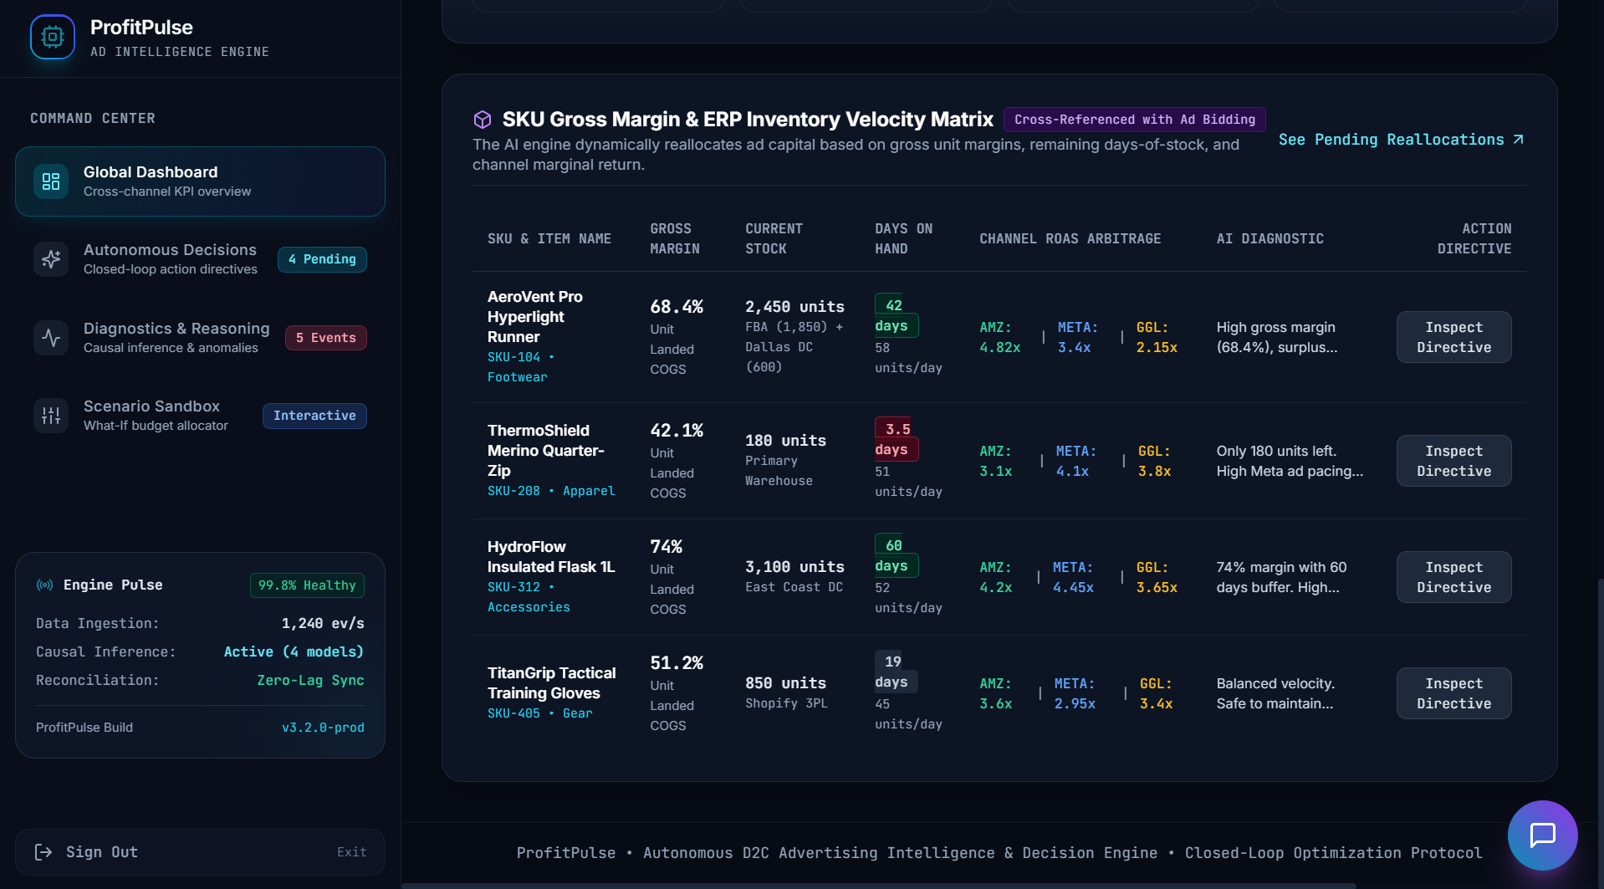
1. Global Dashboard: see everything in one place
Overview KPIs, spend vs revenue reconciliation, SKU margin + inventory matrix
Spend Rs 1,48,250 (+4.8% WoW), revenue Rs 5,66,315, ROAS 3.82x vs 3.50x target, MER 26.2%
Net contribution margin 28.4%
Amazon (18% share) scales; TikTok (10%) has a fatigue alert
SKU matrix: ThermoShield has 3.5 days of stock left; AeroVent Pro has 42 days at 68.4% margin

Slide 5
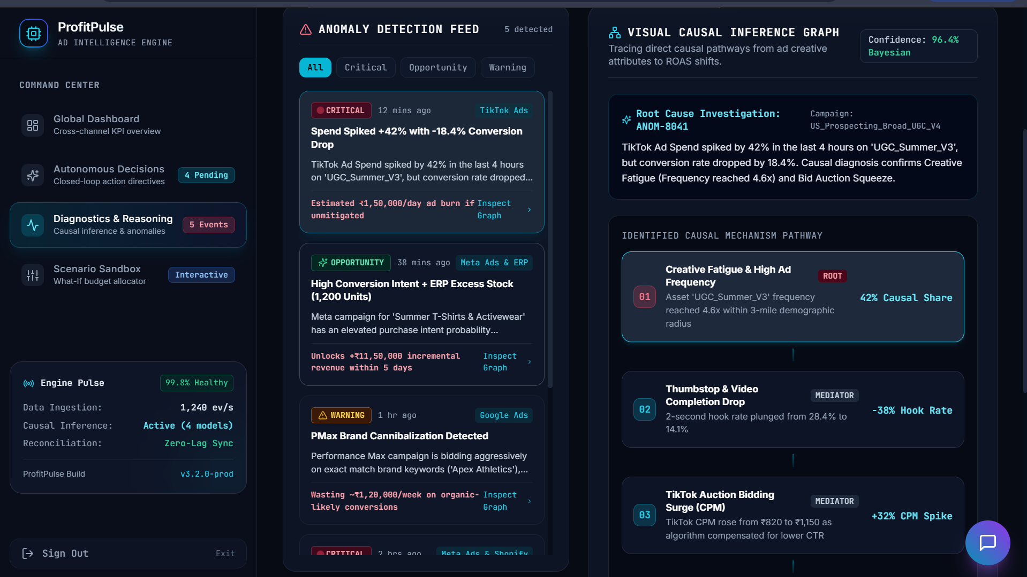
2. Diagnostics: the "why" behind the metrics
Anomaly feed + causal inference graph for TikTok spend spike (ANOM-8041)
5 anomalies detected: TikTok spend +42% with CVR -18.4% (Critical), PMax brand cannibalisation, SKU #208 stockout, Meta + ERP excess stock (+Rs 11.5L opportunity)
Root cause: creative fatigue (frequency 4.6x), 42% causal share
Chain: fatigue > hook rate 28.4% to 14.1% > CPM Rs 820 to 1,150 > ROAS decay
Critical: Rs 1,50,000/day burn if unmitigated
Warning: Rs 1,20,000/week wasted on organic-likely conversions
Opportunity window: Amazon competitor stockout, 36 hours

Slide 6
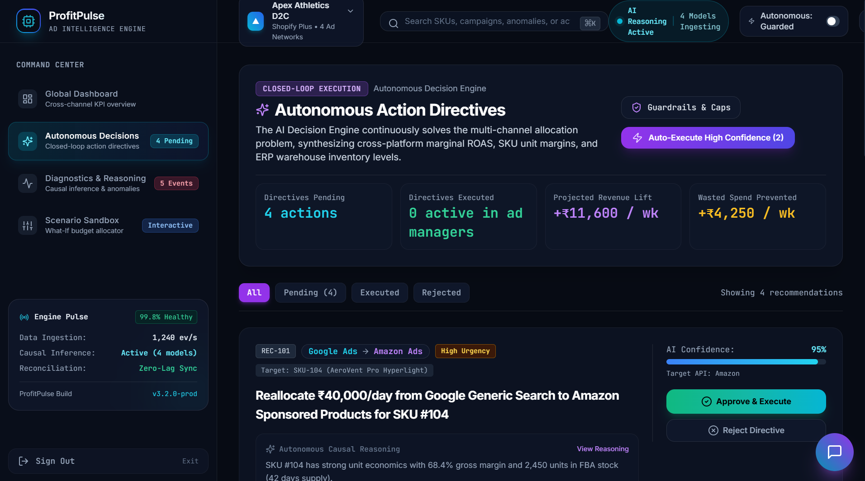
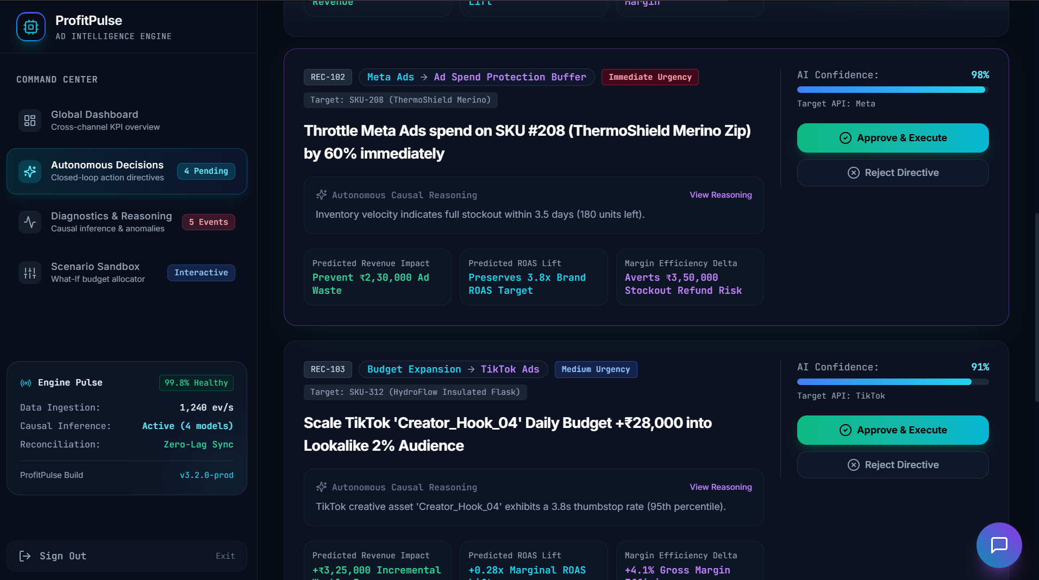
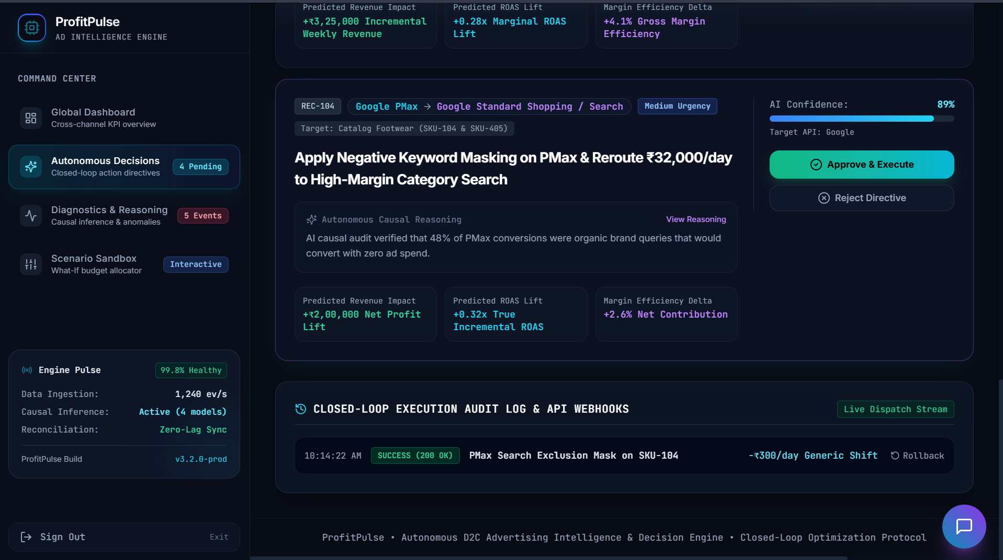
3. Autonomous Decisions: from insight to action
4 pending directives with reasoning, impact, confidence and one-click Approve & Execute
AI confidence: REC-102 98%, REC-101 95%, REC-103 91%, REC-104 89%
REC-101: +0.45x ROAS on SKU-104; REC-102: prevents Rs 2.3L waste and Rs 3.5L refund risk
REC-104: 48% of PMax conversions were organic brand queries
Audit log: PMax exclusion mask executed (200 OK), with Rollback

Slide 7
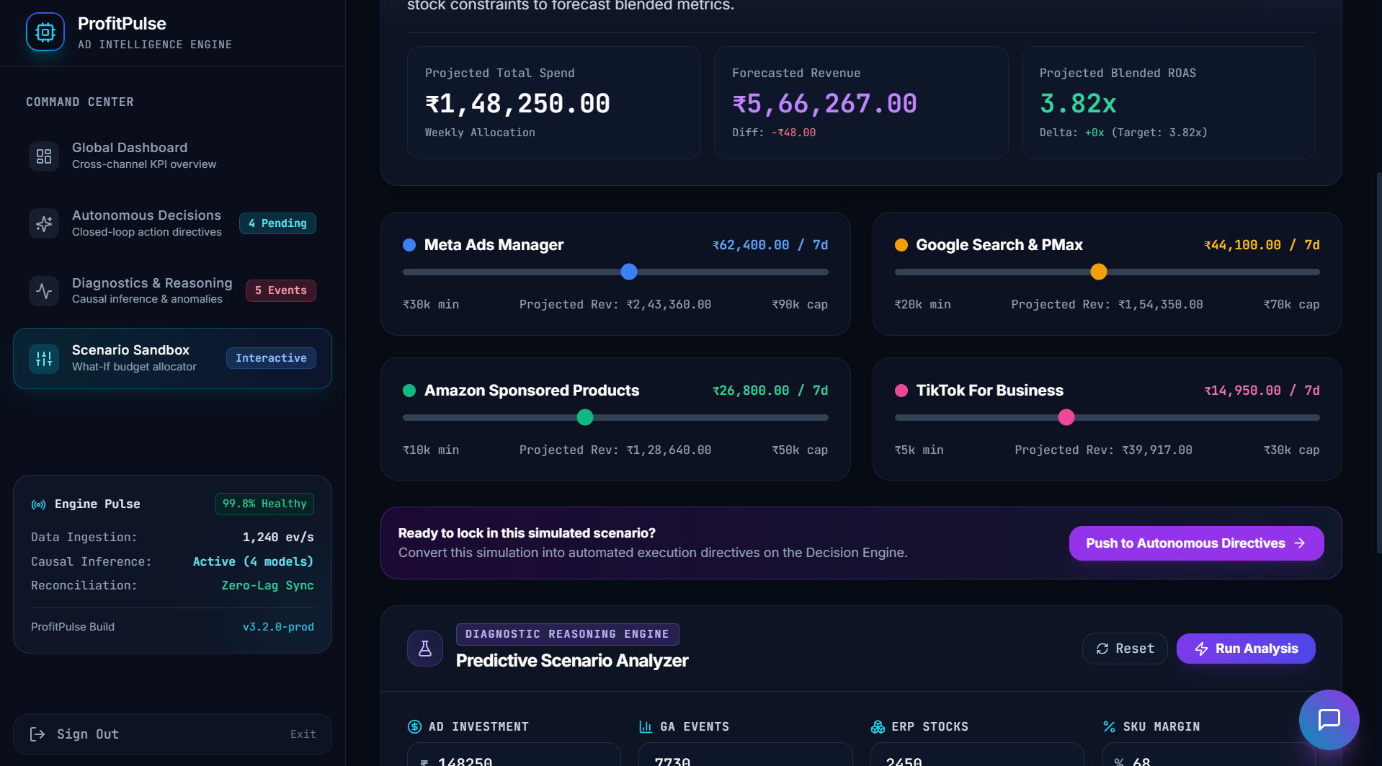
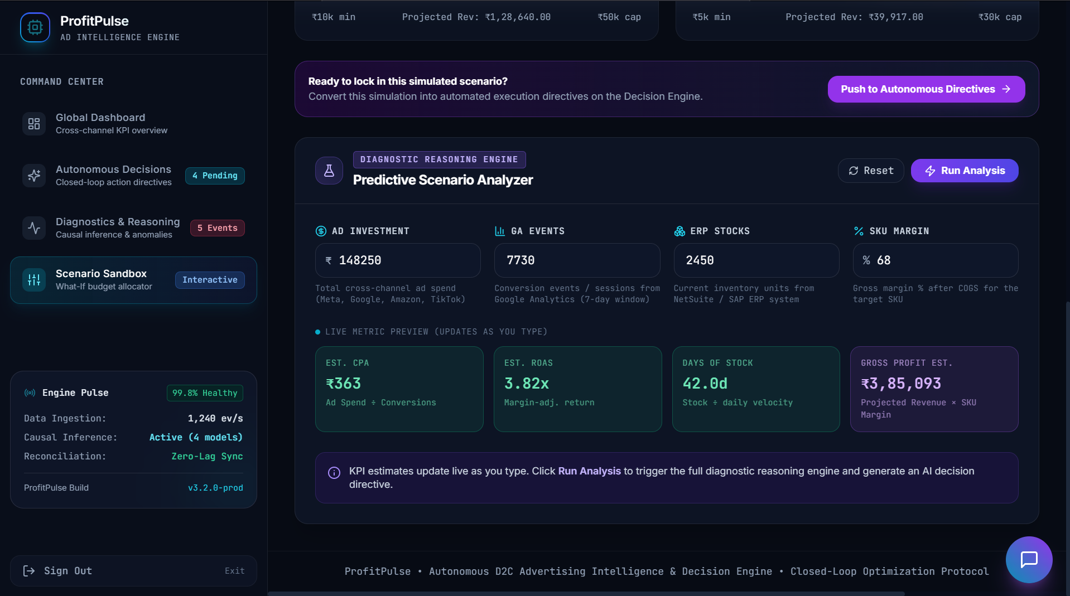
4. Scenario Sandbox + what we deliver
What-if budget simulator, predictive analyzer, then push the winning scenario to live directives
Analyzer inputs: spend Rs 1,48,250, stock 2,450, margin 68%
Outputs: ROAS 3.82x, 42 days of stock, gross profit Rs 3,85,093
Impact: higher blended ROAS, fewer stockouts, less wasted spend
Next: live ad-API execution, outcome-feedback retraining, more data sources

