Slide 1
Q-learning vs SARSA
for warehouse robot navigation
On-policy and off-policy temporal-difference control, built from scratch
and compared over 30 paired seeds on a floor built from real Kaggle layouts
Smart Warehouse Robot Navigation · Reinforcement Learning case study
Notes:
The robot must learn the shortest collision-free delivery route. Two classical algorithms, built from scratch, differing in exactly one line. The short answer: they separate in opposite directions on two different questions.

Slide 2
Problem statement and objectives
Problem & Objectives · 5 marks
How do Q-learning and SARSA compare when a warehouse robot must learn the shortest collision-free route?
1
A shared workspace
2
Learning has a cost
3
Two algorithms, one difference
Robots and people use the same floor. The route must be short AND safe to execute.
In a simulator, training mistakes are free. On a live floor, every one is an incident.
Q-learning and SARSA differ in a single expression — which policy's value they learn.
Objectives
The hypothesis under test
1. Implement the environment and both algorithms from scratch.
2. Audit the dataset and use only the columns that carry signal.
3. Verify numerically before running any experiment.
4. Compare over 30 paired seeds with significance testing.
5. Test robustness against a baseline, other floors, and the key assumption.
The shortest route runs alongside a pedestrian walkway. A safer route one row further is longer.
Q-learning should take the fast risky route; SARSA should keep clearance — because only SARSA prices in the cost of its own exploration.
Notes:
Five objectives. The key framing is that learning itself has a cost when it happens on a real floor, and that is exactly where these two algorithms differ.

Slide 3
Dataset and methodology
Dataset & Methodology · 5 marks
7,980
5,045
96.1%
4 of 48
rows
distinct layouts
goal reachable
columns usable
zoya77/robot-path-planning
real 5×5 occupancy grids
start/goal never on a shelf
the rest are audited out
An RL agent cannot learn from rows. It needs an environment that answers “what if the robot had turned left?” — a CSV only records what did happen.
Element | Source | Detail
Racking layouts | DATA | 16 real 5×5 patches tiled into a 20×20 floor
Start / goal validity | DATA | never placed on an obstacle in any of 7,980 rows
Action encoding | DATA | recovered empirically: up / down / left / right
Cross-aisle + walkway | ASSUMED | the hazard; without it there is no effect to measure
Reward constants | ASSUMED | declared, and swept from 0 to −200 in the analysis
Notes:
Be upfront: the layouts are real, the reward structure is assumed. That distinction is stated in the notebook and the report, and the assumption is swept in the sensitivity analysis.

Slide 4
The audit: most of this dataset is unusable
Dataset & Methodology · 5 marks
Column | Claim | Evidence | Verdict
episode_id / time_step | trajectories | 5,727 of 7,980 rows duplicate the key; grid and start change mid-episode | EXCLUDED
reward | a reward signal | correlation with true shortest-path distance = −0.03 | EXCLUDED
path_length_so_far | path cost | correlation with true distance = +0.01 | EXCLUDED
converged_flag | convergence | constant 1 in every row | EXCLUDED
joint_angle_1 / 2 | robot arm angles | irrelevant to grid navigation | EXCLUDED
obs_grid_flat_0..24 | occupancy grid | 5,045 distinct layouts, internally consistent | USED
No reference paths exist either
Why this matters
The dataset ships no optimal path. Ground truth is therefore computed here by breadth-first search — exact on a unit-cost grid, and itself verified against a hand-checked example.
Using the supplied reward column would have trained both agents on noise, and the comparison would still have produced a plausible-looking result.
Notes:
This is the slide that shows the work. Several columns look meaningful and are not. The correlations are the evidence, not an opinion.

Slide 5
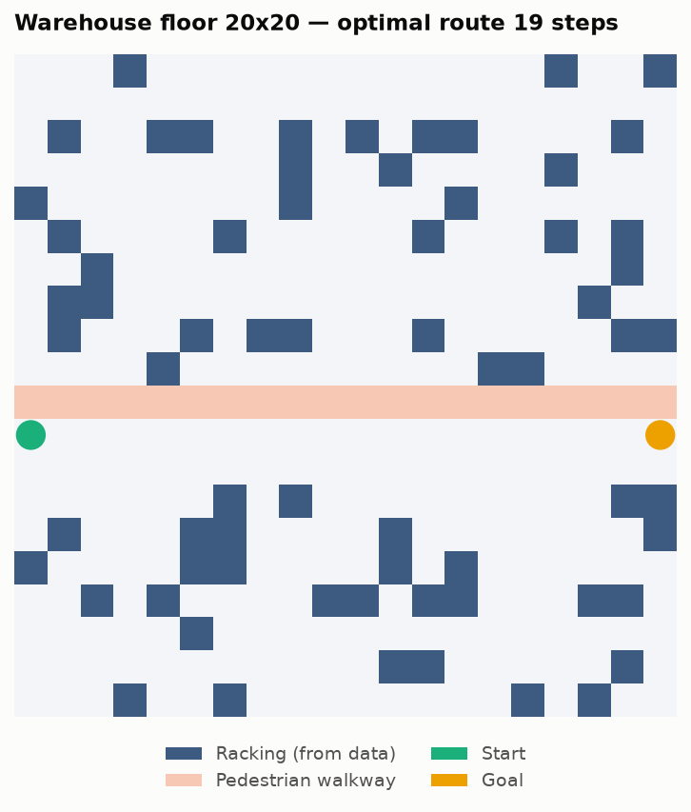
The MDP: states, actions, rewards
Dataset & Methodology · 5 marks
States and actions
The three cleared rows
s = row × W + col, so 20 × 20 = 400 states.
Four actions: up, down, left, right — the encoding recovered from the data.
Deterministic transitions.
Row 10 pedestrian walkway (hazard)
Row 11 main aisle — the fast route
Row 12 safe lane — the detour
Start and goal sit at the aisle ends.
Event | Reward | Effect
Ordinary step | −1 | moves
Nudging the racking | −5 | stays put
Entering the walkway | −100 | returned to the charging station
Reaching the goal | +100 | episode ends
Optimal legal route: 19 steps along the main aisle (BFS). That route is fast — and every cell of it sits directly below the walkway.
Notes:
This is Cliff Walking in warehouse terms, and the report says so. The racking is real; the three cleared rows are the declared design choice.

Slide 6
Model implementation — built from first principles
Model Implementation · 10 marks
The shared base — everything they have in common
1
No reinforcement learning library
class TDControlAgent:
def act(self, s):
if self.rng.random() < self.eps:
return int(self.rng.integers(self.n_actions))
return self.greedy(s)
def update(self, s, a, r, s_next, a_next, done):
tgt = self._target(r, s_next, a_next, done)
self.Q[s, a] += self.alpha * (tgt - self.Q[s, a])
No gymnasium, no stable-baselines. NumPy supplies arrays and RNG; the MDP, the TD control loop and both update rules are written out.
2
Random tie-breaking, deliberately
Q starts at zero so every action ties. Breaking ties by argmax would bias the robot toward action 0 — straight into the walkway.
3
Terminal states bootstrap to zero
On termination the target is r alone. Omitting that inflates every value by a spurious gamma·V(terminal) term.
One harness, both algorithms
A single train() function runs both, so the episode budget, hyperparameters, epsilon schedule and seed are identical by construction rather than by careful duplication.
Notes:
Everything is shared except one method. The two footguns called out here are real: tie-breaking bias and the terminal bootstrap.

Slide 7
The entire difference is one expression
Model Implementation · 10 marks
Q-learning · off-policy γ = discount factor
SARSA · on-policy
target = r + γ · max Q(s′, a′)
a′
target = r + γ · Q(s′, a′)
with a′ ~ ε-greedy(s′)
Values the BEST next action — whatever the robot actually does
Values the action it WILL ACTUALLY TAKE — exploration included
Why that produces different routes
Take a cell on the main aisle, with the walkway directly above it.
Q-learning backs up through max Q(s,a), which selects the safe action — so the −100 attaches to Q(s, a_bad) but NEVER reaches V(s). The aisle looks exactly as good as any other corridor.
SARSA backs up through Q(s, A') where A' is sampled from the ε-greedy policy, so E[Q(s,A')] carries a term of weight ε/|A| on Q(s, a_bad). The −100 propagates into V(s), the aisle is devalued, and the safe lane wins.
Notes:
This is the core teaching point. The max operator is what makes the hazard invisible to Q-learning's state values. Slide 11 shows that prediction confirmed in the measurements.

Slide 8
Verification: 13 checks before any experiment
Model Implementation · 10 marks
An RL bug does not announce itself. A mis-signed reward or a wrong bootstrap still produces a learning curve that goes up and to the right — the agent learns something, just not what you are measuring.
Check | Rules out | Result
State encoding bijective | index collisions | 400 / 400
Bump: no movement, no termination | transition bookkeeping | pass
Incident: returned to charging station | hazard semantics | pass
Goal: reward paid once, episode ends | double-counted terminal | pass
BFS vs a hand-checked grid | broken ground truth | 8 = 8
ε = 0: the two agents are IDENTICAL | any difference beyond on-policy/off-policy | 0.00e+00
Both optimal on a 3×3 open grid | dead value propagation | 4 of 4 steps
Return accounting matches the env | drift between env and agent | exact
The decisive one: at ε = 0 the behaviour policy is greedy, so max Q(s',a') and Q(s',a') are the SAME quantity — the two update rules are mathematically identical and must produce bit-identical tables. They do, to 0.00e+00.
Notes:
The epsilon-zero equivalence test is the strongest statement available: it proves the two classes differ only in how exploration is handled, which is exactly what the study claims to measure.

Slide 9
Results: they separate in opposite directions
Results & Evaluation · 10 marks
19.40
33.34
4.3×
Q-learning route
SARSA route
more incidents
steps, vs a BFS optimum of 19
steps — a deliberate detour
Q-learning, while training
Measure | Q-learning | SARSA | Wilcoxon p
Online return while learning | −838.33 | −297.32 | 1.9 × 10⁻⁹
Walkway incidents in training | 21,626 | 5,068 | 1.9 × 10⁻⁹
Deployed route length | 19.40 | 33.34 | 6.7 × 10⁻⁷
Distance kept from the walkway | 1.00 | 5.21 | —
30 paired seeds · 3,000 episodes each · identical hyperparameters · Wilcoxon signed-rank on the paired differences
Notes:
Four of five metrics significant, with large effects. Note the two winners are different: Q-learning deploys better, SARSA trains cheaper. Those are two different questions.

Slide 10
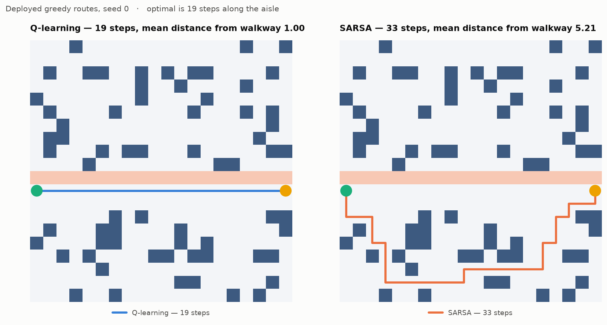
What each algorithm actually learned
Results & Evaluation · 10 marks
Q-learning
A dead-straight 19-step run along the aisle, hugging the walkway. Mean distance from people: 1.00 cells.
SARSA
Dives into the racking and takes 33 steps. Mean distance from people: 5.21 cells — five times the clearance.
Identical data, identical hyperparameters, identical experience budget. They differ only in which policy's value they estimate — and one produced a straight line along the hazard while the other produced a detour that never approaches it.
Notes:
This figure makes the whole argument on its own. Everything else is the measurement behind it.

Slide 11
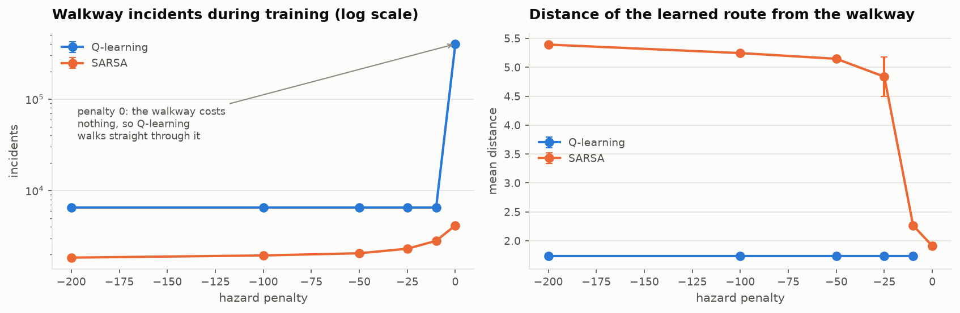
The mechanism, confirmed by measurement
Results & Evaluation · 10 marks
Q-learning is INVARIANT to the penalty
Identical incident counts and identical clearance at −10, −25, −50, −100 and −200.
A twenty-fold increase in the cost of an incident changes its behaviour by nothing at all.
Hazard penalty | Q-learning incidents | Q clearance | SARSA clearance
−10 | 6,522 | 1.74 | 2.27
−25 | 6,522 | 1.74 | 4.84
−50 | 6,522 | 1.74 | 5.15
−100 | 6,522 | 1.74 | 5.25
−200 | 6,522 | 1.74 | 5.39
Exactly as the theory predicts
The max operator selects the safe action, so the penalty attaches to Q(s, a_bad) but never propagates into V(s).
SARSA's clearance rises monotonically, 1.91 → 5.39.
Notes:
This is the most informative result in the study and it is not the headline one. The derivation and the measurement line up exactly, which is what gives confidence the implementation measures the intended quantity.

Slide 12
Is the result real? Three checks
Results & Evaluation · 10 marks
1
Against external baselines
2
Across 12 independent floors
3
Across the hazard penalty
BFS optimum 19 steps. Q-learning 19.40, SARSA 33.34. Neither deployed policy causes any incident.
Pattern holds on every one: Q-learning +2.17 excess steps, SARSA +11.33; incidents 5,927 vs 1,792, p = 4.9e−4.
Holds from −10 to −200. At penalty 0 the effect disappears entirely — as predicted.
The negative control
On a floor of scattered racking with NO localised hazard, both algorithms converged on the identical 39-step optimum. There was no difference to measure. The on-policy/off-policy distinction is a response to a property of the task — not a general ranking of the two algorithms.
An uncomfortable finding, reported anyway
What that means
The heuristic recovered from the dataset — simply move toward the goal — also achieves 19 steps with zero incidents, matching Q-learning and beating SARSA on this floor.
This floor is a good instrument for isolating the on-policy/off-policy distinction, and a poor advertisement for RL on this particular routing problem. Stated in the report, not buried.
Notes:
Reporting the heuristic matching the learned agents is the honest thing to do. The floor was designed to isolate the algorithmic difference, not to show RL beating a simple rule.

Slide 13
The technical report and codebase
Technical Report · 5 marks
49
13
30
6
pages
checks
paired seeds
figures
LaTeX, 9 chapters + 5 appendices
all passing, before any run
with significance testing
all generated by the notebook
Chapter | Contents
1–2 Introduction, literature | MDPs, TD learning, Watkins' Q-learning, Rummery & Niranjan's SARSA, Cliff Walking, safe RL
3 Theory | Bellman equations, TD(0), both update rules derived, convergence conditions, pseudocode
4 Dataset and environment | the full audit, and the explicit separation of data from assumption
5–6 Implementation, verification | both agents, and the 13 numerical checks
7–9 Results, discussion, conclusion | 30-seed comparison, significance, robustness, threats to validity
Reproducibility
One command executes the whole study end to end in about four minutes. All generators are seeded; the experiment was run twice and every reported metric was identical.
Notes:
Mention that the notebook, the report source and the deck are all in the repository, and the whole experiment reruns in four minutes.

Slide 14
Conclusions, limitations, and likely questions
Conclusion & Viva · 10 marks
1
Opposite answers to two questions
2
The mechanism is directly visible
Q-learning deploys better (19.40 vs 33.34 steps); SARSA trains 4.3× cheaper in incidents.
Q-learning's behaviour is numerically invariant to a 20× change in hazard penalty.
3
No hazard, no difference
4
A four-line heuristic matched it
On a floor without a localised hazard both find the identical optimum.
Reported rather than hidden — this floor isolates the algorithms, it does not sell RL.
Limitations
Anticipated questions
· Reward constants are assumptions, not data
· The walkway is a construction; without it there is no effect
· Tabular only — nothing here transfers to function approximation
· Deterministic dynamics; slip probability was zero
· Why is SARSA's route longer if it is “better”? It is not better — it is cheaper to learn.
· Would decaying ε to 0 remove the gap? Yes — both converge to optimal under GLIE.
· Why not DQN? 400 states are enumerable; approximation adds instability, not insight.
Notes:
Close on the trade-off, the limitations stated plainly, and three questions you are likely to be asked in the viva with short answers ready.

