Slide 1
Recurrent networks vs. Transformers,
built from scratch
How do the two architectures compare at classifying short news texts?
A controlled study on AG News · four classes · 7,600 held-out test documents
Transformer Modeling and Sequence Learning · Case Study Topic 2
Notes:
Research question: how do recurrent networks and Transformers compare at classifying short news texts. Both models built from first principles - no nn.LSTM, no nn.MultiheadAttention. The short answer is that they tie, and the interesting part is why.

Slide 2
The question, and why AG News answers it well
How do recurrent networks and Transformers compare at classifying short news texts?
1
Four classes, not two
2
Genuinely short text
3
A standard benchmark
World, Sports, Business, Sci/Tech. Twelve off-diagonal confusion cells show how a model fails, not just how often.
Median 39 tokens. This is exactly the regime where attention's long-range advantage is weakest.
Published results span roughly 88-95%, so the result can be situated against prior work.
120k
7,600
4
39
Training articles
Test articles
Classes
Median tokens
60,000 sampled for the controlled run
Official split, used once
Exactly balanced, 1,900 each
The number that explains the result
Notes:
AG News is a good vehicle for this question for three reasons. Four classes give a rich confusion structure. The documents are short, which is the regime where the comparison is most informative. And it is a standard benchmark so we can situate the result.

Slide 3
A controlled experiment: architecture is the only variable
1. Same data
2. Same preprocessing
3. Same capacity
4. Same budget
One stratified 60k subset, one split, one seed. Both models see identical records in identical order.
One tokeniser, one vocabulary built on train only, one max length. The same tensors, not merely equivalent ones.
265,220 vs 265,732 non-embedding parameters - a difference of 0.19%.
Identical batch size, epoch cap, optimiser, weight decay, clipping, early stopping and seed.
Split | Records | Per class | Purpose
Training | 54,000 | 13,500 | Parameter estimation
Validation | 6,000 | 1,500 | Early stopping and learning-rate choice
Test (official) | 7,600 | 1,900 | Final evaluation - used exactly once
The one quantity not shared is the learning rate (1e-3 vs 3e-4), tuned per architecture on validation only. A single shared rate would look fairer but would handicap whichever model it suited less.
Notes:
Four controls: data, preprocessing, capacity, budget. The learning rate is the one thing tuned per model, on validation only - forcing a shared rate would measure sensitivity to that rate rather than the architectures.

Slide 4
Model A — bidirectional LSTM, written by hand
The four gates, in one fused matmul
1
Padding must not corrupt the state
i_t = sigmoid(W_i x_t + U_i h_prev + b_i) input
f_t = sigmoid(W_f x_t + U_f h_prev + b_f) forget
g_t = tanh (W_g x_t + U_g h_prev + b_g) candidate
o_t = sigmoid(W_o x_t + U_o h_prev + b_o) output
c_t = f_t (*) c_prev + i_t (*) g_t
h_t = o_t (*) tanh(c_t)
(*) = elementwise product
Each step is gated by the mask, h ← m·h_new + (1−m)·h_prev, so a padded step is an exact no-op.
2
The backward pass starts at the true end
Padding sits at the right and masked steps are no-ops, so iterating t = T−1…0 begins at each sequence's own last real token.
Neither defect raises an error. Both simply make the model quietly worse — which is why slide 7 exists.
Pooling
Masked mean over all timesteps, concatenated with the final state of each direction (4H features). The mean alone discards the endpoint the recurrence built; the endpoint alone is noisy at 39 tokens.
Configuration
128-dim embedding · 128 hidden units · bidirectional · dropout 0.30
265,220 non-embedding parameters, matched to the Transformer within 0.19%.
Notes:
The LSTM cell is written out: four gates, fused into one matmul, split with chunk. Gate order i-f-g-o deliberately matches PyTorch so the verification can copy nn.LSTM weights across. The two masking details are the classic silent-failure points.

Slide 5
Model B — Transformer encoder, written by hand
Scaled dot-product attention
1
The mask is −1e9, never −∞
A fully-masked row would softmax to NaN under −∞ and destroy the gradients of the whole batch.
Attention(Q, K, V) = softmax( QKᵀ / √dₖ + M ) V
The √dₖ scaling keeps the softmax out of saturation: dot products of unit-variance vectors have variance dₖ.
2
Capacity matched to the BiLSTM
d_model 128, 4 heads, 2 layers, d_ff 256 — 265,732 non-embedding parameters, within 0.19% of Model A.
Multi-head
Positional encoding
Project once at full width, reshape into 4 heads. The reshape is the most error-prone step.
Sinusoidal. Without it, self-attention is permutation-invariant — a bag of words.
3
Nothing borrowed from the library
No nn.MultiheadAttention, no nn.TransformerEncoderLayer, no nn.LayerNorm, no F.scaled_dot_product_attention.
Layer norm
Pre-norm block
Hand-written, biased variance, to match the reference exactly.
x + attn(norm(x)). Trains stably with no warmup schedule.
Notes:
Pre-norm encoder, four hand-written pieces: positional encoding, layer norm, multi-head attention with the head split and merge done by hand, and the residual block. The minus-1e9 mask constant rather than minus infinity is a real numerical detail, not pedantry.

Slide 6
Matched capacity makes it an architecture comparison
265,220
265,732
0.19%
BiLSTM
Transformer
Difference
non-embedding parameters
non-embedding parameters
512 parameters out of ~265,000
Why the non-embedding figure is the one that matters
The shared embedding table holds 4,347,392 parameters — about 94% of each model's 4.61M total. Quoting totals would make the two models look 0.01% apart, which is true but says nothing about architecture. Stripping the embeddings out leaves the parts that actually differ, and those are matched to within 512 parameters. No performance difference observed later can reasonably be attributed to model size.
Notes:
This is the control that makes the comparison meaningful. The embedding table dominates both totals and is identical, so the honest measure is non-embedding parameters - matched to 0.19%.

Slide 7
Proving the hand-written layers are actually correct
A hand-written layer that is subtly wrong does not crash. It trains, converges, and reports an accuracy two or three points low — exactly the size of an “architectural finding”.
Check | What it rules out | Measured
LSTM cell vs nn.LSTM | Wrong gate order or algebra, misplaced bias | 5.96e-08
Layer norm vs reference | Biased vs unbiased variance | 4.77e-07
Attention vs per-head loop | Wrong head split / merge reshape | 8.94e-08
Attention rows sum to 1 | Softmax over the wrong axis | 1.79e-07
Padded keys get no mass | Mask never reaching the scores | 0.00e+00
BiLSTM padding invariance | Unmasked state, wrong backward start | 0.00e+00
Transformer padding invariance | Padding leaking into pooling | 1.19e-07
Both models overfit 200 examples | Dead gradients, broken backward path | 100%
All 9 checks pass, and they run before training on every execution — the suite asserts, so results cannot be produced from an unverified implementation.
Notes:
This is the slide that licenses everything after it. Padding invariance - checks 6 and 7 - is the decisive one, because the masking bugs it catches produce no error at all, only a quietly worse model.

Slide 8
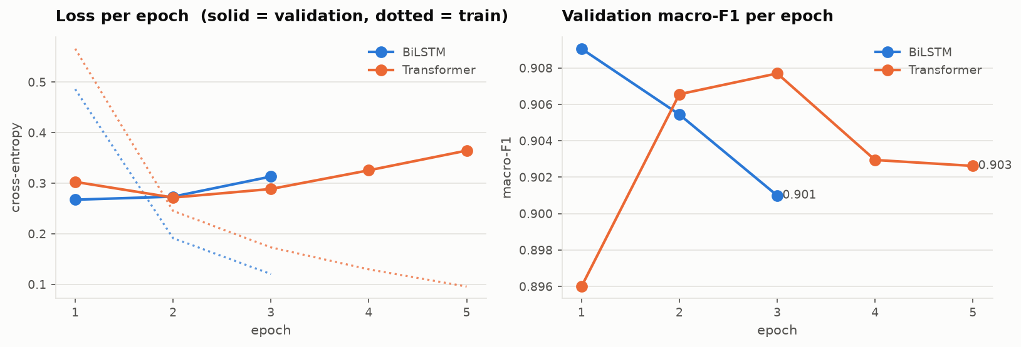
Both models overfit fast — early stopping did the work
What the curves show
Training loss keeps falling while validation loss climbs from epoch 2 in both models.
The BiLSTM peaked after a single epoch; the Transformer at epoch 3.
The 8-epoch cap was never the binding constraint.
1
3
0.9091
0.9077
BiLSTM best epoch
Transformer best epoch
Best val macro-F1
Best val macro-F1
of 3 run before stopping
of 5 run before stopping
BiLSTM
Transformer
Notes:
Worth being upfront: the recurrent model's effective budget was one epoch. Early stopping caught it and restored the right checkpoint, but both models consume 54,000 records very quickly at this capacity.

Slide 9
Headline result on the held-out test set
91.14%
91.05%
0.09 pp
BiLSTM
Transformer
The gap
macro-F1 0.9111
macro-F1 0.9104
seven documents out of 7,600
Do not interpret this difference yet
Both models land in the 90–92% band the literature predicts for a from-scratch model without pretraining. The BiLSTM is nominally ahead on every metric except test loss — by seven documents. Whether that is a result or sampling noise is a question a significance test answers, and it is the next slide.
Notes:
Both in the expected band. The BiLSTM is nominally ahead by 0.09 points, which is seven documents. The temptation is to call that a win. Do not.

Slide 10
Is the difference real? McNemar's test says no
 | BiLSTM correct | BiLSTM wrong
Transformer correct | 6,740 | 180
Transformer wrong | 187 | 493
187
180
Only BiLSTM
Only Transformer
correct
correct
Only the discordant cells carry information. The agreements — 6,740 and 493 — say nothing about which model is better and are discarded.
p = 0.754
The architectures are indistinguishable
McNemar exact binomial
not significant at α = 0.05
A 187-to-180 split is as close to a coin flip as a 7,600-document test set can resolve. The two models also agree on 94.78% of individual predictions.
The correct conclusion is equivalence — not that the BiLSTM won.
This test cost a few lines of code and reversed the qualitative conclusion of the whole study.
Notes:
This is the central result. McNemar looks only at the documents exactly one model gets right: 187 versus 180, p equals 0.754. Not significant. Reporting a winner from a 0.09 point gap would have been wrong, and the test is what prevents it.

Slide 11
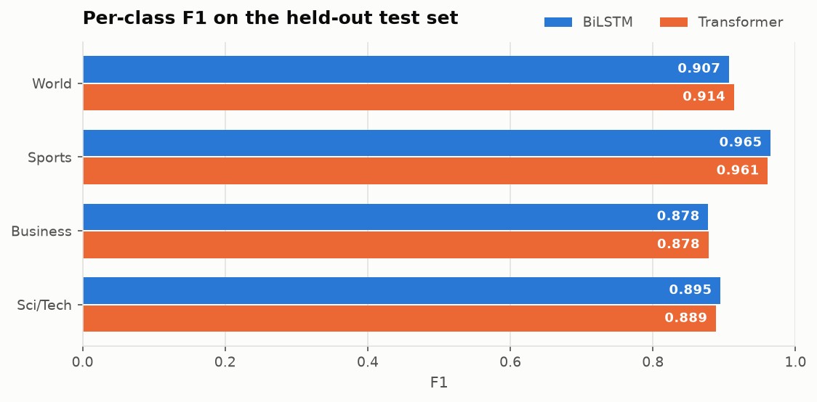
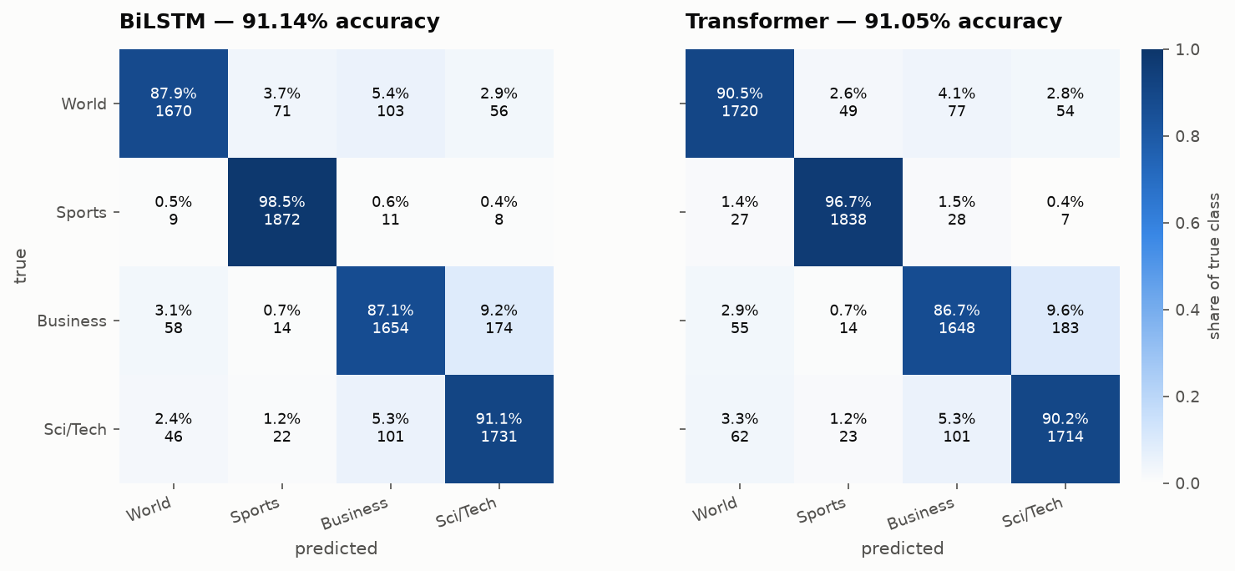
They do not just tie — they fail in the same way
1
Identical difficulty ordering
Sports (≈0.96) > World (≈0.91) > Sci/Tech (≈0.89) > Business (≈0.878), for both models.
2
Agreement to four decimal places
On the hardest class, Business, the two models score 0.8777 and 0.8780.
3
The same dominant error
Business predicted as Sci/Tech: 9.2% and 9.6%. That boundary accounts for about a quarter of all errors.
Why that boundary is irreducible
A semiconductor firm's quarterly earnings story is legitimately Business and legitimately Sci/Tech. The corpus assigns one label. This caps what any architecture can reach.
Notes:
Two models with genuinely different inductive biases would differ somewhere in this profile. These do not. Both are limited by the same thing: documents whose gold label is one of several defensible choices.

Slide 12
The cost result inverts the textbook expectation
1.67×
2.43×
faster to train
faster inference
…in favour of the recurrent model, at matched accuracy and matched capacity.
Why this does not contradict the theory
Attention's advantage is asymptotic: O(1) sequential depth against O(n), and it needs parallel hardware to cash in.
Neither condition holds here. On 6 CPU threads there is little parallelism to exploit, and per-layer cost is O(n·d²) vs O(n²·d) — with n = 64 and d = 128 these are the same order, so attention does not even win on operation count.
When neither parallelism nor arithmetic favours attention, constant factors decide.
Inference is measured separately: 138 ms vs 335 ms per 1,000 documents. Seconds and milliseconds are deliberately not plotted on a shared axis.
This is a finding about a regime, not about the architectures. The ordering should reverse on a GPU, and the recurrent model's disadvantage grows with sequence length.
Notes:
I expected the Transformer to be faster and it was not. Rather than explain that away, the report analyses it: the parallelism argument is asymptotic, and at 64 tokens on CPU neither parallelism nor arithmetic favours attention.

Slide 13
Why they tie: there is no long range to model
39
1
Attention's advantage is about distance
Self-attention gives an O(1) path between any two positions, against O(n) for recurrence. In a 39-token document there are almost no distant positions to connect.
median tokens per document
A headline plus one sentence
2
The signal here is lexical, not structural
“coach”, “Olympic”, “medal” identify a sports story regardless of their arrangement. A bidirectional LSTM captures that just as well.
The general form of the argument
An architecture's advantage can only show up on a task that exercises the property it is good at.
Transformers are superior at long-range dependency. AG News contains almost none. So the two architectures perform equivalently.
This is a statement about the task, not a limitation of the Transformer.
3
The literature corroborates it
FastText averages word vectors and models no order at all — yet reaches ≈92.5% on AG News, at or above both models here.
Notes:
This is the explanation that makes the negative result informative rather than just inconclusive. Median 39 tokens means there is nothing for the long-range mechanism to do. FastText corroborates it independently.

Slide 14
Conclusions, and what I would do next
1
Statistically indistinguishable
2
Document length explains it
91.14% vs 91.05%, McNemar p = 0.754, 94.78% agreement.
Median 39 tokens leaves attention's long-range advantage nothing to act on.
3
They fail identically
4
Cost inverted expectation
Same difficulty ordering, same dominant Business/Sci-Tech confusion.
The BiLSTM trained 1.67× faster — a statement about scale, not architecture.
Principal limitation
Next steps
A single seed per architecture. The 0.09-point gap sits inside typical seed variance — which is exactly why the claim made is “indistinguishable” and not a ranking in either direction.
Multiple seeds for a confidence interval · a sequence-length sweep to test the explanation directly · repeat the timing on a GPU to test the predicted reversal.
Notes:
Four findings. The most useful one is negative, and we only have it because a significance test was applied to a difference that looked like a result. The single-seed limitation is stated first because it is the honest bound on the claim.

