Slide 1


TOOTH DECAY DETECTION USING DEEP LEARNING
ST. JOSEPH’S GROUP OF INSTITUTIONS
OMR, CHENNAI-119
TEAM MEMBERS: ASHWIN AK, PRAVIN BALAJI B
GUIDED BY SAM V GEORGE
DATE : 14/06/2024

Slide 2
PROBLEM STATEMENT
DENTAL CARIES (tooth decay) is a widespread oral health issue that often remains undetected in its early stages, especially in under-resourced areas. Manual diagnosis through VISUAL INSPECTION or RADIOGRAPHS can be time-consuming, subjective, and prone to human error. To improve early detection and reduce diagnostic delays, there is a growing need for automated, accurate, and scalable methods. This project aims to develop a DEEP LEARNING-BASED SYSTEM that can automatically detect and classify dental caries from dental images, enhancing clinical decision-making and preventive care.

Slide 3
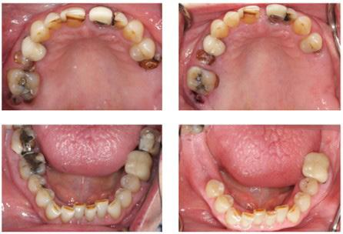
OBJECTIVES
Detect Dental Caries Automatically using deep learning models on tooth images.
Assess Severity Levels (mild, moderate, severe) based on visual cues.
Provide AI-Based Dental Guidance through a GPT-style assistant.
Educate and Assist Patients with clear, personalized care suggestions.
Support Remote Diagnosis to reduce delays and dentist workload.

Slide 4
LITERATURE SURVEY
The Literature survey is based on the past 5 years of research papers related to Dental HealthCare and Tooth Decay Detection. The 5 important research papers are listed below.
2021 2022 2023 2024 2025
2021
Title: Deep Learning for Dental Caries Detection
Using Bitewing Radiographs
Contributions: Introduced early CNN models to detect caries from 2D dental X-rays.
Tech Stack: ResNet Variants
Merits: Pioneered the use of deep learning in dental diagnostics; set a foundational benchmark.
Limitations: Limited dataset size and lack of severity classification.
2022
Title: YOLOv5 for Real-Time Caries Detection in Intraoral Images
Contributions: Applied object detection to identify caries locations in real-time.
Tech Stack: YOLOv5, OpenCV
Merits: Enabled fast, real-time processing for clinical or mobile use.
Limitations: Performance reduced under poor lighting or image blur.

Slide 5
2023
Title: Automated Dental X-ray Analysis Using Transformer Networks
Contributions: Used a transformer-based architecture (ViT) for dental image analysis.
Tech Stack: ViT, PyTorch
Merits: High accuracy and interpretability; handled full image context.
Limitations: Computationally intensive, not mobile-friendly.
2024
Title: Explainable AI for dental disease Diagnosis using CNN and SHAP.
Contributions: Integrated explainability tools with CNNs to highlight decision regions.
Tech Stack: CNN + SHAP + Grad-CAM
Merits: Improved trust and usability in clinical settings
Limitations: Explainability methods can still mislead in edge cases.
2025
Title: AI-Powered Diagnostic Tool for Dental Disease Using Voice and Image Fusion.
Contributions: Combined image and speech input for best-in-class diagnostic accuracy.
Tech Stack: FusionNet, Multimodal Transformers
Merits: Highest accuracy, robust across formats; supports future conversational AI integration.
Limitations: High model complexity and inference latency.

Slide 6
DATASET DESCRIPTION
DATASET TYPE: Image dataset with instance Segmentation labels.
DATASET SIZE: 1,400+ annotated dental Images
SOURCE OF DATA: Roboflow Universe – Arab Academy dental dataset
DATA FORMAT: YoloV8 – COCO JSON, Pascal VOC – TensorFlow TFRecord
IMAGE TYPES: intraoral photos
(varied lighting and angles)
PRE-PROCESSING STEPS:
1. Resize Images (e.g. 416x416 pixels for YOLO input)
2. Normalize Pixel Values (0-255)
3. Data Augmentation (flip, rotation, zoom, brightness adjustment)
4. Label Format Conversion (choose YOLO during export)
5. Train / Test Split (usually 70% train / 20% valid / 10% test).

Slide 7
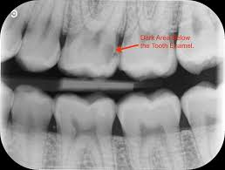
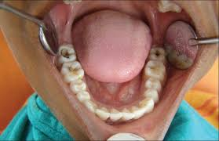
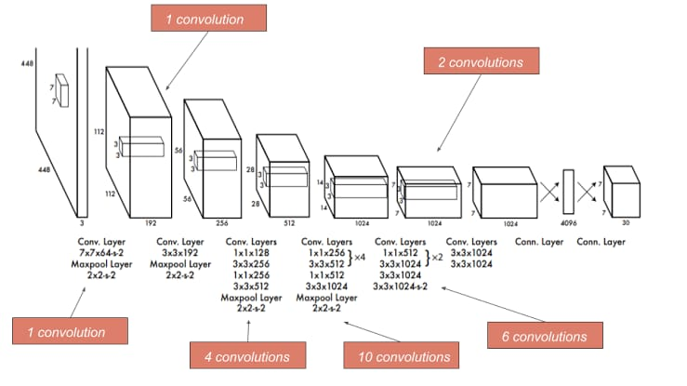
PROPOSED METHODOLOGY / ARCHITECTURE DIAGRAM
TOOTH CARIES/ DECAY DETECTION + SEVERITY CLASSIFICATION
FORMATTED OUTPUT
(JSON / LABEL)
X-RAY IMAGE
INTRAORAL IMAGE
IMAGE
ACQUISITION
GPT ASSISTANCE AND WEB / APP INTERFACE
PREPROCESSING
(Resize, Normalize, Augment)
DL MODEL (YOLO/CNN)

Slide 8
CONCLUSION
This project built a smart system that detects tooth decay using deep learning and explains the results with a GPT-based assistant. It helps identify caries, classify severity, and provide treatment suggestions in plain language—making dental diagnostics faster and more accessible.
KEY FINDINGS
The model accurately detected caries and severity when trained on good-quality images. Preprocessing improved results, and the GPT assistant made outputs easier to understand for patients.
MODEL PERFORMANCE
The system showed strong accuracy and reliability in detecting and classifying tooth decay. YOLOv8/v11 enabled real-time results, while CNN offered high accuracy in image-based tests.
REAL WORLD APPLICABILITY
This tool can support dentists, speed up diagnosis, and assist patients in remote areas. It’s suitable for clinics, mobile apps, and tele-dentistry platforms.

Slide 9
FUTURE IMPROVEMENTS
Optimize the model for real-time deployment in clinics and dental labs.
Develop a mobile app for remote access and self-check by patients.
Train the model on pediatric dental images for child-specific diagnosis.
Add a feedback loop from dentists to improve accuracy and trust.
Explore multi-language GPT responses for wider accessibility.

Slide 10
REFERENCES
RESEARCH PAPERS:
1. YOLO‑V5 for Tooth Detection & Segmentation
2. AI‑Dentify – Deep Learning for Proximal Caries Detection
3. YOLO v8 for Interproximal Caries Detection
DATASET & REPOSITORIES:
1. Arab Academy Dental Instance-Segmentation Dataset
GPT & CONVERSATIONAL AI INTEGRATION:
1. “Custom GPT” platforms facilitate creating tailored dental chat assistants with zero code .

Slide 11
THANK YOU

