Slide 1
Customer Churn: What's Driving It, and What to Do Next
Five data-backed insights, honestly scoped to what a 15-customer sample can and can't tell us
Prepared for: Leadership review Data: customer_churn_cleaned.csv
Notes:
Welcome — today I'm walking through a churn analysis built from our customer data. Before I show any numbers, I want to be upfront: this dataset has 15 customers in it. That's small. So my goal today isn't to hand you a verdict — it's to hand you a prioritized, quantified set of hypotheses worth testing at scale, plus a clear recommendation for what to do first.

Slide 2
The Problem
46.7%
$409.93
32.3%
Sample churn rate
(7 of 15 customers)
Monthly revenue
lost to churn
Share of total MRR
held by churned accounts
Nearly half of the customers in this dataset have churned. Leadership needs to know: is this churn random, or does it cluster around specific, actionable conditions we can change?
Read this first — sample size caveat. This analysis rests on 15 customers (7 churned, 8 retained). That's enough to spot candidate patterns worth investigating, but far too small to treat any single number as a precise, stable estimate of company-wide behavior. Every finding here is a hypothesis to validate — not a verdict to act on blindly.
Customer Churn Analysis | n = 15 customers | Confidential
2
Notes:
Here's the headline: 46.7% of customers in this sample have churned, representing about a third of monthly recurring revenue. The question I was asked to answer is whether that churn is random noise or something we can act on. I want to flag the caveat box up front, because it governs how you should read every slide that follows: 15 customers is a small sample. I'll show you confidence intervals throughout so you can see exactly how much uncertainty is baked into each number.

Slide 3
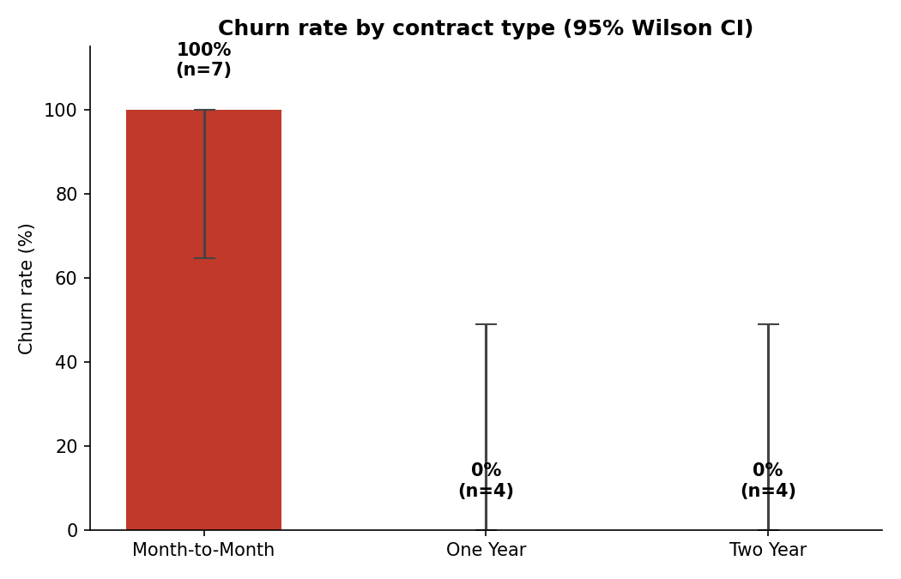
Insight 1: Contract Type Is the Strongest Signal
High confidence — but flagged for validation
100% of month-to-month customers churned (7 of 7, 95% CI: 65–100%)
0% of one-year or two-year customers churned (0 of 8, 95% CI: 0–49% each)
Fisher's exact test: p < 0.001 — too clean to be noise, but also too clean for n=15
Limitation: a perfect split with zero counterexamples could reflect a strong real effect, or how this sample was selected — confirm at scale before resourcing a program
Customer Churn Analysis | n = 15 customers | Confidential
3
Notes:
This is the single strongest pattern in the data. Every month-to-month customer in our sample churned; every annual or two-year customer stayed. Statistically that's a p-value under 0.001 — very unlikely to be chance. But I want to be careful here: a 100-to-0 split with no exceptions, in a sample this small, is also the kind of pattern you'd want to double check isn't an artifact of how these 15 customers were picked. My recommendation is to treat this as our top hypothesis, and confirm it on the full customer base before we build a retention program around it.

Slide 4
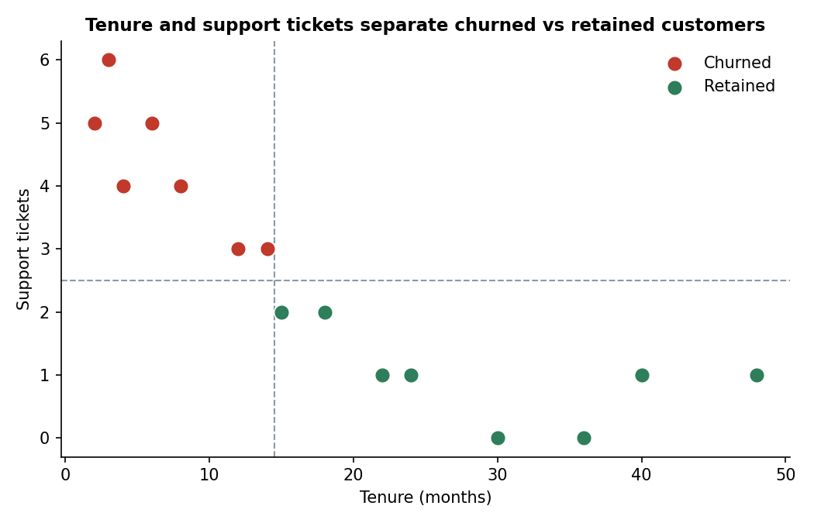
Insight 2: Support Tickets Separate the Two Groups
Moderate–high confidence — correlation, not yet proven cause
Churned customers logged 3–6 support tickets (average 4.3)
Retained customers logged 0–2 support tickets (average 1.0)
No customer crossed both thresholds in the "wrong" direction in this sample
Limitation: tickets could be a symptom of an already-souring relationship rather than a cause — treat 3+ tickets as a monitoring trigger, not a proven lever
Customer Churn Analysis | n = 15 customers | Confidential
4
Notes:
Support ticket volume is our second strongest signal, and it's practically useful because it's easy to instrument — we already track tickets per account. The gap here is real: roughly a 4x difference in average tickets between churned and retained customers, with almost no overlap. The open question is direction of causality — are tickets driving dissatisfaction, or are customers who are already planning to leave just more likely to complain on the way out? I'd treat crossing 3 tickets as an early-warning flag worth watching, not yet a lever we've proven we can pull.

Slide 5
Insight 3: Churn Concentrates in the First 14 Months
Moderate confidence — partly definitional
Churned customers
Retained customers
2–14 months tenure
average: 7 months
15–48 months tenure
average: 29 months
The two groups do not overlap in this sample — every churned customer left before every retained customer's tenure even began
Points to an early-relationship risk window rather than a constant churn hazard over time
Limitation: this pattern is partly mechanical — a customer must survive long enough to accumulate tenure, so "churned early" and "low tenure" are related almost by definition. It's still a useful targeting rule, but don't read it as proof risk disappears after month 14.
Customer Churn Analysis | n = 15 customers | Confidential
5
Notes:
Tenure tells a clean story: nobody who churned had more than 14 months with us, and nobody who stayed had less than 15. That's a useful targeting window for retention outreach — focus energy in the first year and change. But I want to flag the logical trap here: by definition, a customer who churns early can't have high tenure, so part of this separation is just arithmetic, not insight. It's still operationally useful, just don't oversell it as a discovery that risk vanishes after 14 months — we simply don't have anyone in this sample who churned later than that to compare against.

Slide 6
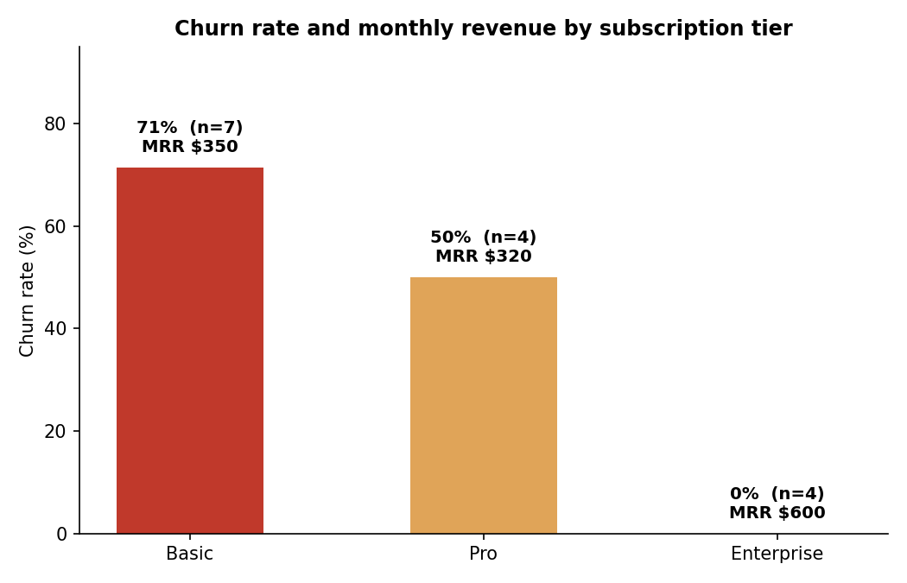
Insights 4 & 5: Tier and Payment Method
Moderate and low confidence — smaller, noisier groups
Insight 4 — Subscription tier
Basic churns at 71%, Pro at 50%, Enterprise at 0% — but tier overlaps heavily with contract type and tenure, so it may not be an independent driver.
Insight 5 — Payment method
UPI (75%) and debit card (100%) customers churned more than bank transfer (0%) — but cell sizes of 2–3 customers make confidence intervals span nearly 0–100%. Flag for monitoring, not action.
Customer Churn Analysis | n = 15 customers | Confidential
6
Notes:
Two more findings, both worth mentioning but neither ready to act on alone. Subscription tier lines up with churn — cheaper tiers churn more — but tier is entangled with contract type and tenure in this sample, so I can't tell you it's an independent cause. Payment method shows a directional pattern too, digital and instant payment methods look riskier than bank transfer, but we're talking about groups of two and three customers. I'm including it for completeness and to flag it for future monitoring, not because it should drive any decision today.

Slide 7
At a Glance
Insight | Churned group | Comparison group | Confidence
1. Contract type | 100% (7/7) month-to-month | 0% (0/8) annual or longer | High
2. Support tickets | avg 4.3 (range 3–6) | avg 1.0 (range 0–2) | Moderate–High
3. Tenure | avg 7 months (2–14) | avg 29 months (15–48) | Moderate
4. Subscription tier | 71% Basic tier churn | 0% Enterprise tier churn | Moderate
5. Payment method | 75–100% UPI / Debit | 0–33% Bank / Credit | Low
Customer Churn Analysis | n = 15 customers | Confidential
7
Notes:
Quick summary table for reference — this is also in the executive PDF and the dashboard. The main thing I want you to take away from this slide is the rightmost column: confidence varies a lot across these five findings, and that should directly drive how much weight each one gets in decision-making.

Slide 8
Recommended Action
1
Validate (1–2 weeks, low cost)
Re-run this analysis against the full customer base. Confirm the month-to-month vs. annual split and the support-ticket threshold hold at scale. Highest leverage next step — Insight 1 is our strongest pattern but rests on only 15 customers.
2
Pilot (if confirmed)
Target month-to-month customers in months 1–14 of tenure with 3+ support tickets — the highest-overlap-risk group — with a proactive save offer, e.g. a discount to move to an annual contract. Measure the effect before scaling.
3
Deprioritize for now
Hold off on a payment-method-specific intervention (Insight 5) until it can be tested on a larger, more balanced sample — current evidence is too thin to justify the cost.
Bottom line: treat every number in this analysis as "worth testing," not "proven," until validated on a larger population.
Notes:
So, what should we actually do Monday morning? Three steps. First, and most important: validate. This whole analysis is built on 15 customers, and our strongest finding — contract type — deserves a full-base check before we commit any budget. Second, if that holds, run a small pilot targeting the highest-overlap risk group: month-to-month customers, early in their tenure, with elevated support contact. Third, explicitly deprioritize acting on the payment-method finding — it's the weakest evidence we have. The through-line I want to leave you with: this is a prioritized set of hypotheses, not a finished verdict, and that distinction should shape how much budget and urgency we attach to each one.

