Slide 1

Machine Learning (19CSE305)
Term Project: Group 24
Project Title: License Number Plate Recognition
Department of Computer Science & Engineering,
Amrita School of Engineering, Bengaluru

Slide 2
Team Members
Sl no. | Member Name | Registration Number
1 | Benaka V Rao | BL.EN.U4CSE19013
2 | E Kruthika Reddy | BL.EN.U4CSE19037
3 | Ganti Surya Sai Ashwin | BL.EN.U4CSE19043
4 | Shreyas S | BL.EN.U4CSE19122
5 | Vivek R Krishnan | BL.EN.U4CSE19147

Slide 3
Agenda
Problem statement & Data Description
Techniques tried and justifications
Results and interpretation
Conclusion

Slide 4
Introduction
Problem Statement
Our project aims to recognize license number plates.
This system assumes a frontal view of the vehicle and license plate, which is common in applications such as toll monitoring and parking lot validation, for instance.
Our contribution is to detect the license plate in many different camera poses and allowing a rectification process before optimal character recognition.
Data Description
Our dataset contains various images of license number plates collected from various resources.
It also contains images of different characters used for character recognition.
Link for images: https://drive.google.com/file/d/1XeWDqO4wCswK2tWxBQffTQXlM0vA3Mj_/view?usp=sharing

Slide 5
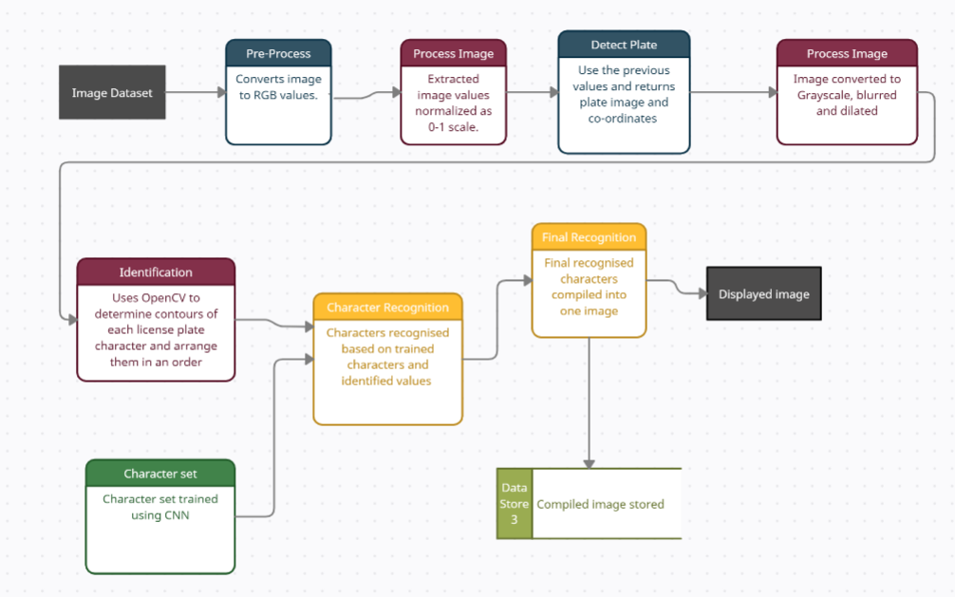
Technique Description
Data Flow Diagram

Slide 6
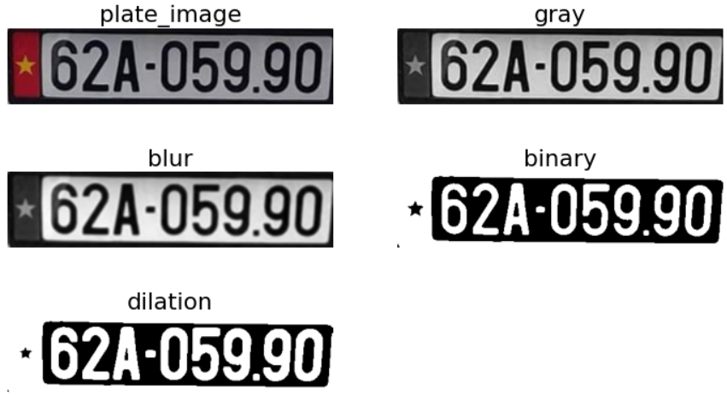
Technique Description
Resource gathering & Pre-processing :
Collect license number plate images and convert it to RGB values. Using wpod the number plate is recognized, its coordinates are normalized as 0-1 scale. Image is converted to gray scale, then blurred and dilated for better recognition. We use cvtColor to convert the image to grayscale. We use Guassianblur to smoothen the image, use threshold to get binary image and use morphologyEx to get the dilated image.

Slide 7
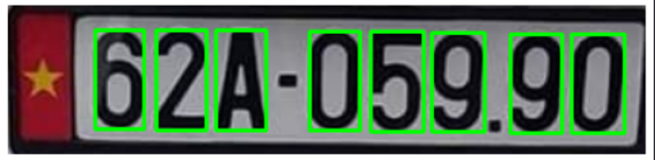
Technique Description
Sort contours and Character recognition:
Contours are the curves containing points of same intensity, used for object recognition. OpenCV provides cv2.findcontours() function for this feature. After finding contours, it is appended and sorted.

Slide 8
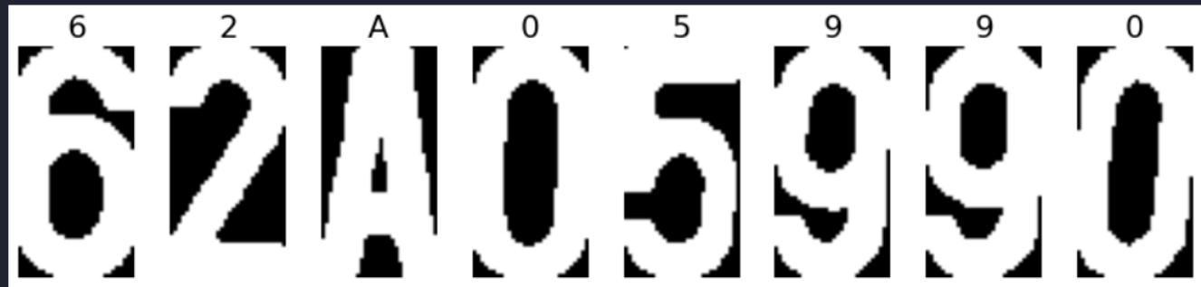
Technique Description
With help of trained character set, characters are recognized, and compiled into one single image.

Slide 9



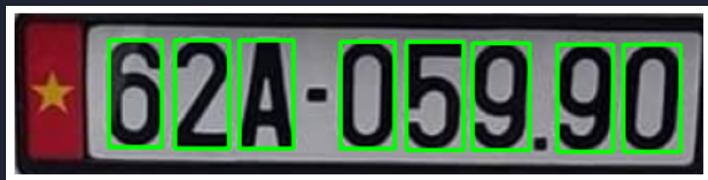
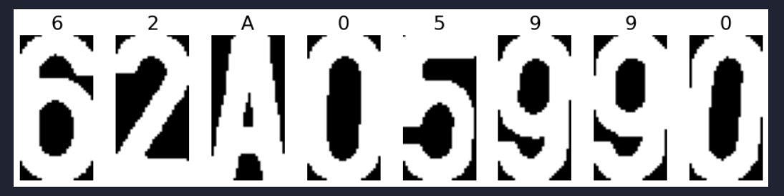
Results & Discussion
For a given vehicle image, license number plate is recognized and image is displayed.

Slide 10

Thank you !!!!!

