Slide 1
Bus Details Search
Mini project by:
Ashwin Hariharan R
Batch Code - DS-WD-E-B15

Slide 2
Contents
Requirement
Scope
Goal
Technologies used with justification
Result

Slide 3
Requirement
Create a web scraper to automate the extraction of bus route details, schedules, and other relevant data from the RedBus website across multiple states.
The scraped data will be stored in an SQL database.
With a user-friendly visualization and dynamic filtering enabled through a Streamlit app.

Slide 4
Scope
Data Extraction
Automation
Data Storage
Visualization

Slide 5
Goal
Successfully scrape data
Store the data
Develop an interactive application

Slide 6
Technologies used with justification
Selenium:
Utilize Selenium for automating web interactions and data extraction from RedBus. The script will manage dynamic content loading and pagination.
Selenium is chosen for its ability to interact with dynamic web pages and handle JavaScript-rendered content.
MySQL:
Use MySQL to store the extracted data in a structured format.
Streamlit:
Provide an interactive, user-friendly platform for visualizing and analyzing the data

Slide 7
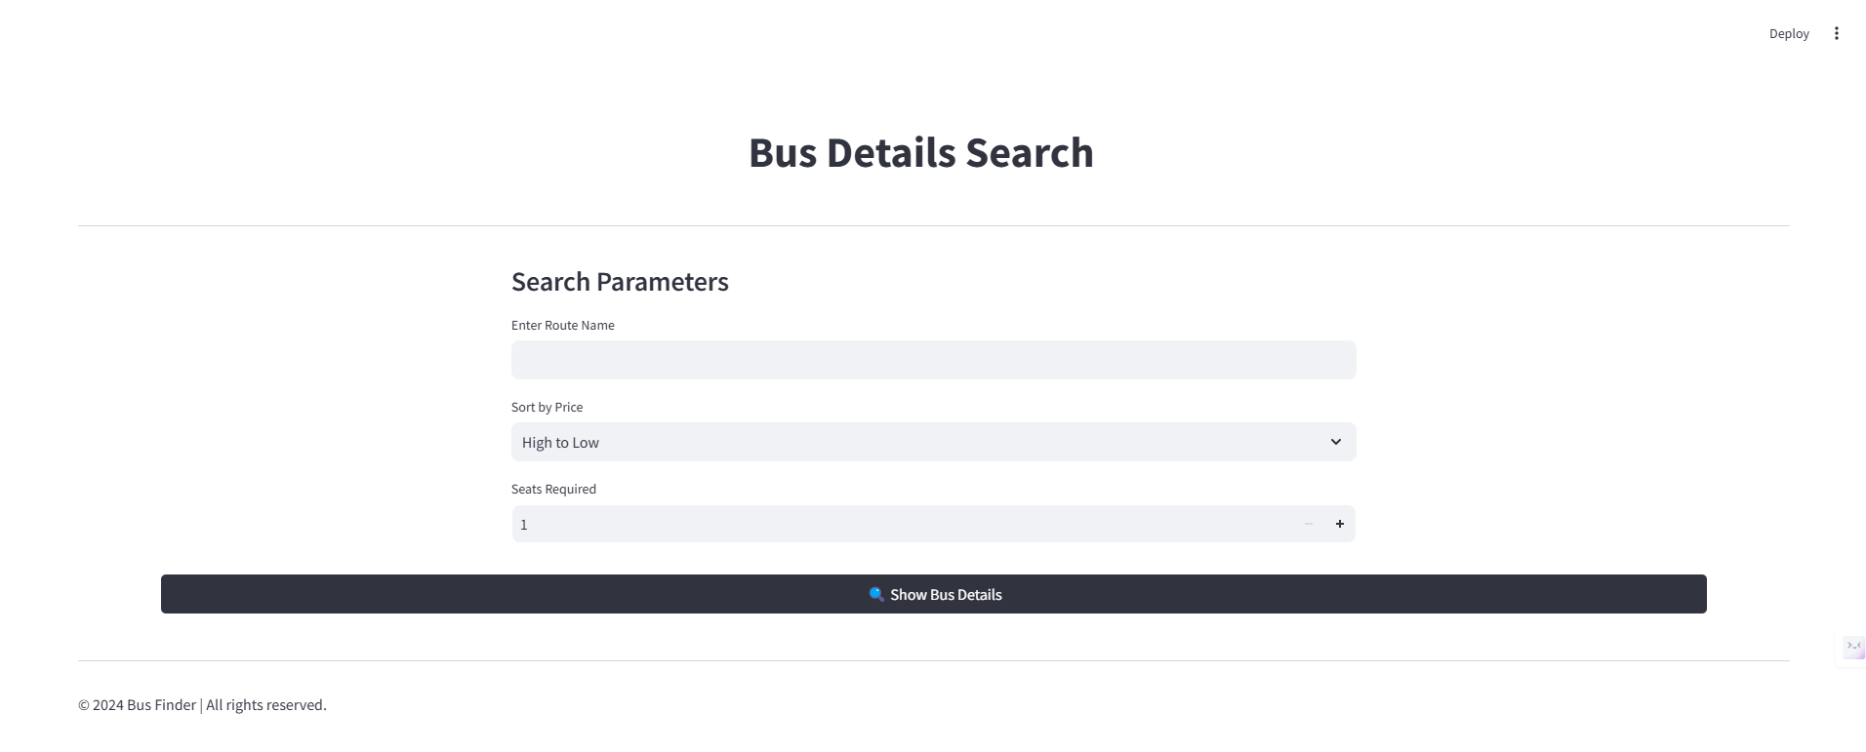
Result
Condition 1: Appllication view

Slide 8
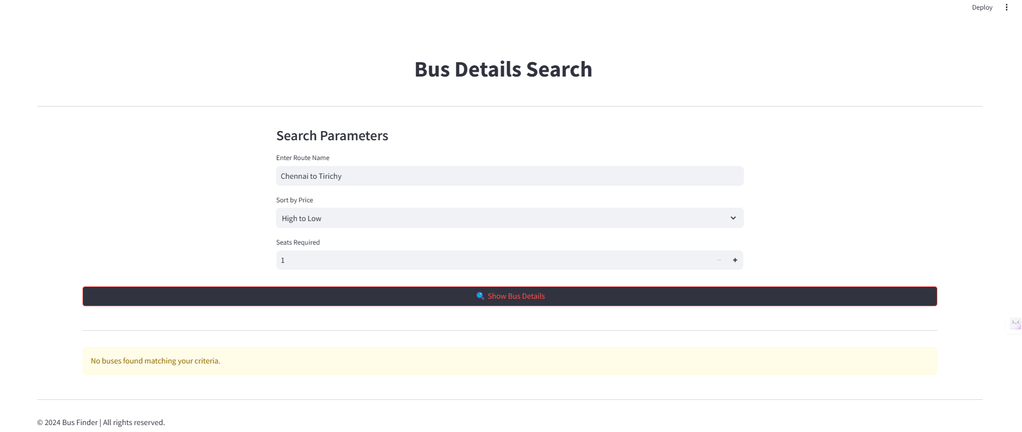
Condition 2: Wrong bus details or Condition Mismatch

Slide 9
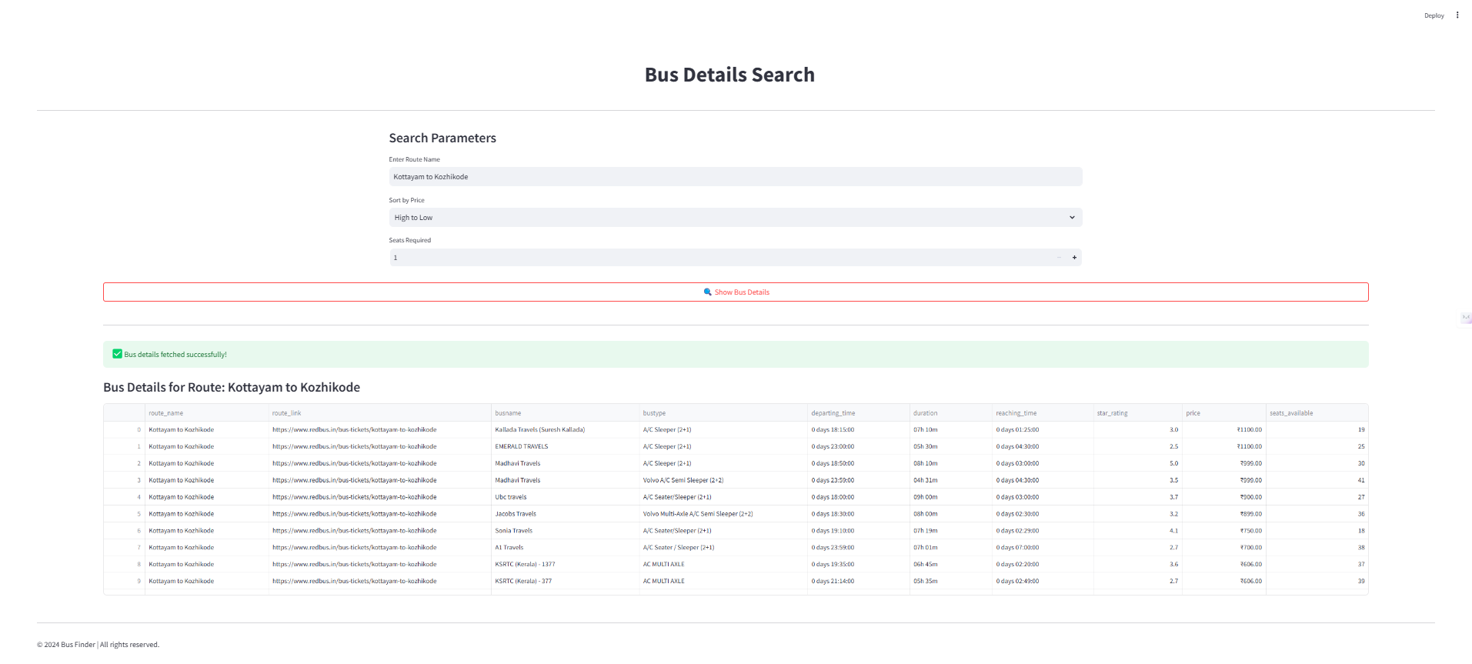
Condition 3: Successful sql fetch of details

Slide 10
Thank you

