Slide 1

Optimizing Drug Candidates: Deep Reinforcement Learning for De Novo Drug Design
TEAM 13
Final review
CH.EN.U4AIE21022 – Ashwin Koduri
CH.EN.U4AIE21026 – Prabhas Naidu M

Slide 2
Introduction
INTRODUCTION:
The project focuses on optimizing drug candidates using Deep Reinforcement Learning (DRL) for de novo drug design.
Traditional drug discovery methods are resource-intensive; DRL provides a faster and more effective alternative.
The model explores chemical space through SMILES strings, discovering compounds with desirable pharmacological profiles.
DRL enhances the ability to design molecules for specific receptors like dopamine receptor D2 used in neurological treatments.

Slide 3
Agenda
OBJECTIVE
Design novel therapeutic candidates targeting dopamine receptor D2.
Incorporate DRL to optimize molecular structure and activity.
Use SMILES encoding and reward systems for molecular activity.
Develop a framework that produces high-quality, diverse drug candidates.

Slide 4
EXISTING WORKS
Title | Authors | Research Focus | Key Findings | Research Gap Identified
Utilizing reinforcement learning for de novo drug design | Hampus Gummesson Svensson, Christian Tyrchan, Ola Engkvist, Morteza Haghir Chehreghani | Development of a unified framework for applying reinforcement learning to generate novel drug molecules targeting the dopamine receptor DRD2. | Using both top-scoring and low-scoring molecules enhances policy updates for structural diversity; off-policy algorithms with replay buffers improve diversity and active molecule generation. | Previous work in de novo drug design has not systematically explored off-policy algorithms with replay buffers.
Artificial Intelligence and Machine Learning Technology Driven Modern Drug Discovery and Development | Chayna Sarkar, Biswadeep Das, Vikram Singh Rawat, Julie Birdie Wahlang, Arvind Nongpiur, Iadarilang Tiewsoh, Nari M. Lyngdoh, Debasmita Das, Manjunath Bidarolli, Hannah Theresa Sony | The paper reviews the applications of artificial intelligence (AI) and machine learning (ML) technologies in various stages of the modern drug discovery and development process. | AI and ML have been extensively applied in target identification, hit discovery, lead optimization, ADME/T prediction, and other aspects of drug discovery. DL methods like artificial neural networks have shown great potential in protein structure prediction, protein-protein interaction prediction, and virtual screening. | While AI and ML have made significant progress in drug discovery, accurately predicting 3D protein structures and PPIs remains a challenge. More research is needed to fully harness the potential of these technologies.
De Novo Drug Design Using Reinforcement Learning with Graph-Based Deep Generative Models | Sara Romeo Atance, Juan Viguera Diez, Ola Engkvist, Simon Olsson, Rocío Mercado | The study focuses on utilizing reinforcement learning to enhance graph-based deep generative models for the de novo design of molecules with specific properties. | The proposed framework successfully guides a pretrained generative model to generate diverse compounds with high predicted activity for DRD2, outperforming previous methods. | Limited previous applications of reinforcement learning to graph-based molecular design and the need for addressing complex design objectives remain unexamined.
Artificial Intelligence Technologies for COVID-19 De Novo Drug Design | Giuseppe Floresta, Chiara Zagni, Davide Gentile, Vincenzo Patamia, Antonio Rescifina | The paper reviews the application of artificial intelligence (AI) in the de novo drug design process specifically targeting COVID-19. | AI has significantly accelerated the identification of novel drug candidates against COVID-19, demonstrating enhanced effectiveness and reduced time in drug development processes. | The study highlights the need for further exploration of AI methodologies to improve the identification of allosteric inhibitors and to expand the range of potential drug candidates beyond the current focus.

Slide 5
EXISTING WORKS
Title | Authors | Research Focus | Key Findings | Research Gap Identified
RELATION: A Deep Generative Model for Structure-Based De Novo Drug Design | Mingyang Wang, Chang-Yu Hsieh, Jike Wang, Dong Wang, Gaoqi Weng, Chao Shen, Xiaojun Yao, Zhitong Bing, Honglin Li, Dongsheng Cao, Tingjun Hou | Structure-based de novo drug design using a 3D generative model to improve molecular generation | The RELATION model outperforms existing models in generating valid, unique, and diverse molecules with favorable binding affinities for targets AKT1 and CDK2 | Previous models primarily focused on ligand-centric approaches, neglecting the importance of 3D geometries in drug design
DrugEx v3: scaffold‐constrained drug design with graph transformer‐based reinforcement learning | Xuhan Liu, Kai Ye, Herman W. T. van Vlijmen, Adriaan P. IJzerman, Gerard J. P. van Westen | Scaffold-constrained drug design using graph transformer and reinforcement learning | Graph transformer model with growing and connecting procedures for molecule generation from scaffolds, trained under reinforcement learning to increase desired ligands | Previous DrugEx versions had fixed objectives and did not allow user-provided scaffolds
DRlinker: Deep Reinforcement Learning for Optimization in Fragment Linking Design | Youhai Tan, Lingxue Dai, Weifeng Huang, Yinfeng Guo, Shuangjia Zheng, Jinping Lei, Hongming Chen, Yuedong Yang. | Fragment-based drug discovery using deep reinforcement learning for optimizing linker design | DRlinker effectively generates compounds with desired linker lengths and log P values, achieving 91.0% and 93.9% compliance, and improves bioactivity optimization by 7.5 pChEMBL units | Previous methods lacked flexibility in generating linkers with complex desired attributes and were limited by small chemical spaces
F2A2: Flexible Fully-decentralized Approximate Actor-critic for Cooperative Multi-agent Reinforcement Learning | Wenhao Li, Bo Jin, Xiangfeng Wang, Junchi Yan, Hongyuan Zha | The paper focuses on developing a flexible decentralized framework for multi-agent reinforcement learning (MARL) that addresses limitations in traditional centralized methods. | The proposed framework achieves scalability and stability in large-scale environments and performs competitively against existing centralized and decentralized MARL methods. | Existing decentralized MARL methods primarily handle fully cooperative settings but struggle with the complexity and dimensionality of large-scale applications.

Slide 6
EXISTING WORKS
Title | Authors | Research Focus | Key Findings | Research Gap Identified
Policy Gradient and Actor–Critic Learning in Continuous Time and Space: Theory and Algorithms | Yanwei Jia, Xun Yu Zhou | The paper studies policy gradient (PG) for reinforcement learning in continuous time and space under an entropy-regularized exploratory formulation. It proposes actor-critic algorithms for simultaneous learning and updating of value functions and policies. | The authors represent the policy gradient as the expected integration of an auxiliary reward function, turning PG into a policy evaluation problem. They propose two types of actor-critic algorithms - one based directly on this representation for offline learning, and another using martingale orthogonality conditions for online learning. | Most existing PG and actor-critic algorithms have been developed for discrete-time Markov decision processes. Developing general continuous-time PG and actor-critic algorithms with theoretical underpinnings remains an open question.
Deep Reinforcement Learning for Tehran Stock Trading | Neda Yousefi | The study explores the application of deep reinforcement learning (DRL) algorithms, specifically Deep Deterministic Policy Gradient (DDPG) and Advantage Actor-Critic (A2C), for stock trading in the Tehran stock market. | The research demonstrates that the DDPG algorithm outperforms the A2C algorithm in terms of convergence, stability, and evaluation metrics, achieving better annualized returns and Sharpe ratios. | Despite significant research in stock prediction and trading automation, the application of DRL in stock trading remains an open area, particularly in adapting to the complexities of dynamic trading environments.
Revolutionizing Pharmaceutical Research: Harnessing Machine Learning for a Paradigm Shift in Drug Discovery | Ali Husnain, Saad Rasool, Ayesha Saeed, Hafiz Khawar Hussain | The study investigates the impact of machine learning on various phases of drug discovery, development, and patient care. | Machine learning enhances the accuracy of compound screening, optimizes ADMET profiling, and accelerates the drug discovery process, while addressing ethical considerations and the need for interdisciplinary collaboration. | Challenges related to data quality, model interpretability, and ethical issues in AI-driven drug discovery remain unaddressed.
Comparison of On-Policy Deep Reinforcement Learning A2C with Off-Policy DQN in Irrigation Optimization: A Case Study at a Site in Portugal | Khadijeh Alibabaei, Pedro D. Gaspar, Eduardo Assunção, Saeid Alirezazadeh, Tânia M. Lima, Vasco N. G. J. Soares, João M. L. P. Caldeira | The paper investigates the effectiveness of on-policy (A2C) versus off-policy (DQN) deep reinforcement learning models for optimizing irrigation scheduling in agriculture. | The A2C model reduced water consumption by 20% compared to the DQN model while maintaining similar net rewards, highlighting its potential for efficient irrigation management. | The study indicates that while both models are effective, further analysis is needed to explore their applicability across different crops and environmental conditions.

Slide 7
EXISTING WORKS
Title | Authors | Research Focus | Key Findings | Research Gap Identified
Reinforcement learning applied to production planning and control | Ana Esteso, David Peidro, Josefa Mula, Manuel Díaz-Madroñero | Review of reinforcement learning techniques applied to production planning and control areas like facility resource planning, capacity planning, purchase and supply management, production scheduling and inventory management | RL was applied mainly to production scheduling problems, with value-based approaches like Q-learning being most common, but actor-critic methods are increasingly used | Lack of comprehensive review of reinforcement learning in production planning and control
Online Actor-critic Reinforcement Learning Control for Uncertain Surface Vessel Systems with External Disturbances | Van Tu Vu, Quang Huy Tran, Thanh Loc Pham, Phuong Nam Dao | Development of a trajectory tracking control approach for uncertain surface vessel systems using an adaptive reinforcement learning algorithm combined with kinematic control. | The proposed control scheme guarantees uniformly ultimately bounded stability and effectively handles trajectory tracking despite uncertainties and external disturbances. | Previous methods did not sufficiently address the non-autonomous optimal control problem in surface vessel systems.
Soham Choudhuri, Manas Yendluri, Sudip Poddar, Aimin Li, Koushik Mallick, Saurav Mallik, Bhaswar Ghosh | Recent Advancements in Computational Drug Design Algorithms through Machine Learning and Optimization | The paper reviews advancements in computational drug design algorithms, emphasizing machine learning and deep learning techniques for drug discovery, particularly targeting kinase enzymes. | The authors highlight that machine learning models significantly reduce costs and time in drug discovery, improve predictive accuracy, and address challenges in traditional drug development processes. | The review identifies the need for more robust and repeatable computational approaches in drug discovery to meet the challenges posed by the Precision Medicine Initiative.

Slide 8
METHODOLOGY
Dataset:
The "Big Molecules SMILES Dataset" was used, containing large molecular structures encoded in SMILES format.
The dataset includes molecular properties like *molecular weight, LogP, and other descriptors essential for drug design.
Data Processing:
SMILES strings were converted into molecular fingerprints using cheminformatics tools like RDKit.
Calculated properties include molecular weight, hydrogen bond donors, hydrogen bond acceptors, and LogP.
Invalid or missing SMILES strings were filtered out.
Normalization techniques were applied to ensure consistent feature scaling for model input.
Data Visualization:
Histograms were plotted for molecular attributes such as atom count and LogP values.
Scatter plots were used to explore relationships between molecular attributes, helping to guide model training.

Slide 9
METHODOLOGY
Data Splitting:
The dataset was split into training and testing sets (80%-20% split).
Model Architecture:
A Deep Q-Network (DQN) model with Long Short-Term Memory (LSTM) layers was used to process the sequential data from SMILES strings.
SMILES tokens were converted to embeddings, passed through LSTM layers, and the Q-value was calculated to predict future rewards.
Reward Function:
A reward function assessed the biological activity of generated molecules, guiding the DRL agent to optimize molecular diversity and pharmacological efficacy.
Model Training:
The DQN model was trained to predict the best action (next token in the SMILES sequence) based on current states.
The model's loss was calculated using Mean Squared Error (MSE) between actual and predicted Q-values.

Slide 10
METHODOLOGY
Model Evaluation:
Tanimoto Similarity was used to assess the structural diversity of generated molecules.
Metrics such as training loss, reward curve, and epsilon decay were tracked to evaluate the model’s performance over time.
Model Fine-tuning and Reuse:
After initial training, model weights were saved for future use, allowing the model to be fine-tuned with new data without starting from scratch.
Model Output:
The trained model generated SMILES strings for new molecules and predicted their bioactivity scores (pIC50).

Slide 11
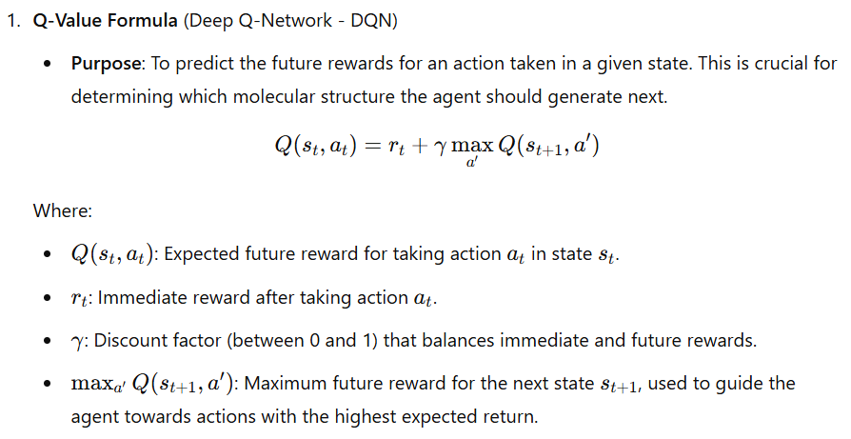
Formulas Used

Slide 12
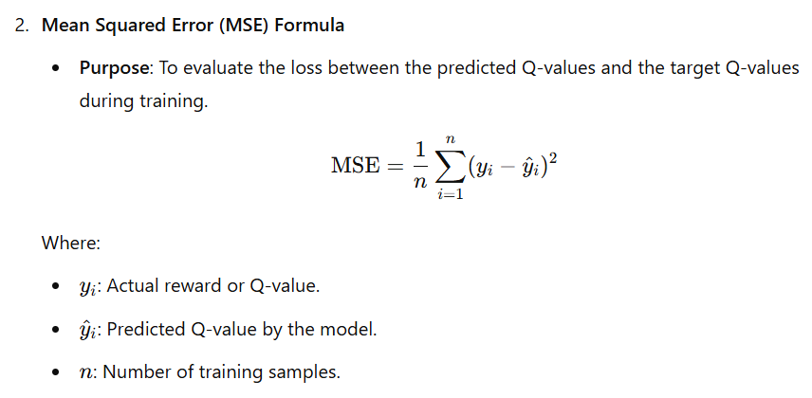
Formulas Used

Slide 13
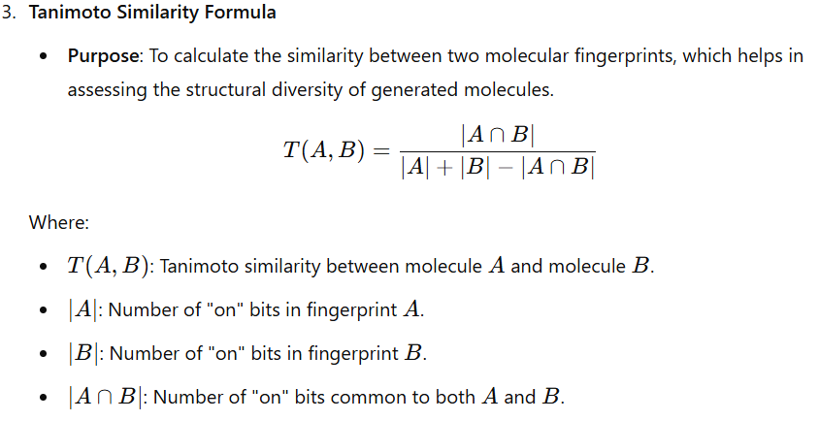
Formulas Used

Slide 14
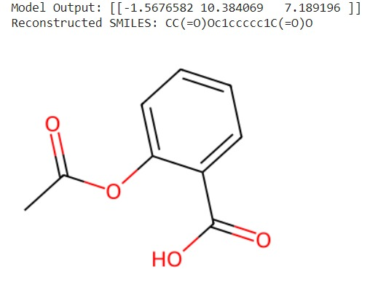
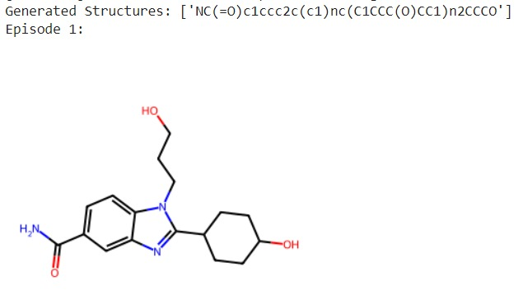
Output

Slide 15
Result
DRL model produces high-quality, diverse molecules.
Significant improvement in drug design efficiency compared to traditional methods.
Successful targeting of dopamine receptor D2, crucial for neurological treatments.
Improved convergence and stability in drug candidate design with off-policy learning algorithms.

Slide 16


