Slide 1

Quick, Localized Learning: How Distinctive Toxicity Norms Are Maintained in Political Subreddits ICWSM 2020
Ashwin Rajadesingan
Paul Resnick
Ceren Budak
@R_Ashwin

Slide 2
Puzzle
r/NeutralPolitics
3.7% of r/NeutralPolitics comments are toxic!
~ 3 months later
4.7% of r/NeutralPolitics comments are toxic!
r/uncensorednews
37.1% of r/uncensorednews comments are toxic!
~ 3 months later
37.9% of r/uncensorednews comments are toxic!
Notes:
Only 19.2% of the people who posted in the first month posted in the third month in np and and only 20.0% in uc. That's the puzzle: how can the toxicity levels be stable when the membership turns over?

Slide 3
Maintaining stable but distinct toxicity norms
Toxicity levels in different political subreddits can be:
Distinctive
Stable
Even though membership is:
Unstable

Slide 4
Major norm conforming processes
Pre-entry processes
Post-entry processes
Self Selection
(Panciera et al., 2009)
(Kiene et al, 2016)
Notes:
Where the users who join the community may be closer to the community’s toxicity levels even before joining.

Slide 5
Major norm conforming processes
Pre-entry processes
Post-entry processes
Self Selection
(Panciera et al., 2009)
(Kiene et al, 2016)
Pre-entry Learning
(Burke et al., 2009)
(Lampe and Johnson, 2005)
Notes:
Usually newcomers to a community,don’t participate immediately, they lurk and learn, looking at the rules and behavior of exisiting users, before adjusting to post their own comment. This initial adjustment is pre-entry learning.

Slide 6
Major norm conforming processes
Pre-entry processes
Post-entry processes
Self Selection
Selective Retention
(Panciera et al., 2009)
(Kiene et al, 2016)
(Schilling et al., 2012)
Pre-entry Learning
(Burke et al., 2009)
(Lampe and Johnson, 2005)
Notes:
some newcomers after posting may decide that the community is not for them and leave. However, we expect those who stay after their first comments to be more in line with the norms.

Slide 7
Major norm conforming processes
Pre-entry processes
Post-entry processes
Self Selection
Selective Retention
(Panciera et al., 2009)
(Kiene et al, 2016)
(Schilling et al., 2012)
Pre-entry Learning
Post-entry Learning
(Burke et al., 2009)
(Lampe and Johnson, 2005)
(Yang et al., 2017) (Choi et al, 2010)
(Danescu-Niculescu-Mizil et al., 2013)
(Burke et al, 2010) (Ciampaglia et al., 2005) and many more..
Notes:
Finally, the most studied process, post entry learning or socialization, where newcomers to the norms of the community through experience and feedback.

Slide 8
Research Questions
What is the relative strength of norm conforming processes?
Is adjustment to a community’s norms transformative for newcomers?
Notes:
knowing which of these processes contribute most to newcomers conforming will allow us to target interventions to improve norm conformity at the most opportune moment
Another question we ask is if this adjustment to community norms is transofrmative to newcomers. Do these low toxicity norms rub off on newcomers in neutralpolitics and lead to them exhibiting low toxicity in other subreddits they participate in the future. But there answer is no, they don’t have much of a transformative effect.

Slide 9
Measuring toxicity and toxicity norms
Identifying
political subreddits
Overview
Reddit
data
Identifying stable and distinct toxicity norms
Quantifying norm conforming processes and transformative learning
Results
and Implications

Slide 10
Measuring toxicity and toxicity norms
Identifying
political subreddits
Measuring toxicity and toxicity norms
Overview
Reddit
data
Identifying stable and distinct toxicity norms
Quantifying norm conforming processes and transformative learning
Quantifying norm conforming processes and transformative learning
Results
and Implications
Results
and Implications

Slide 11
Measuring toxicity and toxicity norms
Identifying
political subreddits
Measuring toxicity and toxicity norms
Reddit
data
Identifying stable and distinct toxicity norms
Quantifying norm conforming processes and transformative learning
Results
and Implications

Slide 12
Measuring toxicity using Perspective API
“a rude, disrespectful, or unreasonable comment that is likely to make people leave a discussion”
Toxicity norms of a community
Measured per month as the percent of comments that are toxic in that month in the community

Slide 13
Measuring toxicity and toxicity norms
Identifying
political subreddits
Quantifying norm conforming processes and transformative learning
Reddit
data
Identifying stable and distinct toxicity norms
Quantifying norm conforming processes and transformative learning
Results
and Implications

Slide 14
Self Selection
Toxicity
Toxicity of non-members
(in other political subreddits)
SS
Toxicity of newcomers
(in other political subreddits)
r/NeutralPolitics toxicity
previous
month
joining
month
r/NeutralPolitics

Slide 15
Pre-Entry Learning
Toxicity
Toxicity of non-members
(in other political subreddits)
SS
Toxicity of newcomers
(in other political subreddits)
LPre
Toxicity of newcomers in their first comment in subreddit
previous
month
joining
month
r/NeutralPolitics

Slide 16
Selective Retention
Toxicity
SS
LPre
SR
Toxicity of first comment of
newcomers who will exit
Toxicity of first comment of
newcomers who will return
previous
month
joining
month
r/NeutralPolitics

Slide 17
Post-Entry Learning
Toxicity
SS
LPre
SR
Toxicity of first comment of
newcomers who will return
LPost
previous
month
joining
month
Newcomers’ toxicity
in first month
r/NeutralPolitics

Slide 18
Quantifying norm conforming processes
Toxicity
Toxicity of non-members
(in other political subreddits)
SS
Self selection
SS
LPre
Pre-entry learning
Toxicity of newcomers
(in other political subreddits)
LPre
SR
Selective retention
Toxicity of first comment of
newcomers who will exit
LPost
Post-entry learning
Toxicity of newcomers in their first comment in subreddit
SR
LPost
Toxicity of first comment of
newcomers who will return
previous
month
joining
month
Newcomers’ toxicity
in first month
Mixed effects binomial regression modeling mean toxicity exhibited by users

Slide 19
Measuring toxicity and toxicity norms
Identifying
political subreddits
Results
and Implications
Reddit
data
Identifying stable and distinct toxicity norms
Quantifying norm conforming processes and transformative learning
Results
and Implications

Slide 20
Results! Norm conforming processes
Self-selection Pre-entry learning Selective retention Post-entry learning
r/NeutralPolitics
r/NeutralPolitics
$${distinctive toxicity}_{C,T}={toxicity}_{C,T} −{ overall politics toxicity}_{T}$$
Pre-entry learning contribute most to matching newcomers’ toxicity level to that of the community.
Notes:
For each subreddit, we’ve calculated the strength of each norm conforming process. To understand how these process vary for subreddits, we plot all subreddits as points in a graph, the y axis is the size of the norm conforming process. The x axis is the distinctive toxicity for each subreddit which is the toxicity of the subreddit adjust for the average toxicity in political subreddits at that time. negative distinctive toxicity scores mean that the subreddits are less toxic than average and postive scores mean that they are more toxic.
Now looking at the leftmost graph on self selection, most communities exhibit some amount of selection effect. However, this isn’t a large effect, for example, neutral politics has a distinctive tox level of -0.18, yet has a selection effect of -0.03, meaning while the subreddit is 18% points lower in toxicity on average, the newcomers it attracts are only 3% less toxic than average.
Now looking at the center-left graph on pre-entry learning, we find that most communiites exhibit large amounts of pre-entry learning – that is newcomers adjust their toxicity levels significantly when posting their first comment. For neutral politics, pre-entry learning effect was -0.132, meaning newcomers reduced their toxicity levels by over 13% when posting their first comment in the community.
Now looking at the center-right graph on selective retention, we find that most communities exhibit small retention effects. The estimated retention effect for NP was not significant.RE=−0.008
Now looking at the right-most graph on post entry learning, we find that most communities exhibit no post entry learning effects. The estimated post-entry learning effect for NP was not sig LPost= +0.007.
Surprinsingly post-entry processes

Slide 21
Recommendations
Make norms more visible to prospective newcomers
Make moderator actions more visible
Judge newcomers only by their behavior in the community and not based on their past behavior elsewhere

Slide 22
Summary
Most of the toxicity norm conforming occurs through pre-entry learning
Questions!
arajades@umich.edu
@R_Ashwin
www.ashwinrajadesingan.com

Slide 23
Extra Slides

Slide 24
Multiple norm conforming configurations
Toxicity
Toxicity
SS
Self selection
SS
SS
LPre
SR
LPre
Pre-entry learning
Selective retention
LPre
SR
LPost
LPost
Post-entry learning
SR
LPost
previous
month
joining
month
previous
month
joining
month
High self selection,
High pre-entry learning
High selective retention,
High post-entry learning
r/NeutralPolitics

Slide 25
Measuring toxicity using Perspective
“a rude, disrespectful, or unreasonable comment that is likely to make people leave a discussion”
Toxicity norms of a community
Measured per month as the percent of comments that are toxic in that month in the community
We exclude moderator removed comments in calculating community norms
Toxicity level of newcomers
Measured as the percent of comments that are toxic for an average newcomer
We include moderator removed comments in calculating newcomer toxicity levels

Slide 26
Reddit Dataset
PushShift Reddit dump: Comments in between April 2017- Feb 2018
PushShift API: Comments removed by moderators (approach similar to Chandrasekharan et al., 2018)
Does not include comments removed by AutoModeratorBot

Slide 27


Identifying stable and distinct toxicity norms
Toxicity range < 0.02
Distance from overall > 0.02
65 political subreddits with stable and distinct norms
toxicity norm
A
Norm in political subreddits
B
Jan Feb Mar Apr May Jun Jul

Slide 28







Quantifying transformative learning
Toxicity
SS
Toxicity of joiners
(in other political subreddits)
LPre
TL
SR
Toxicity of joiners
(in other political subreddits)
LPost
previous
month
joining
month
next
month
Toxicity of non-joiners
$β_{control_last_month}$
Subreddit toxicity
Toxicity of first comment of
newcomers who will exit $β_{first|exiter}$
Toxicity of joiners before joining $β_{elsewhere_last_month}$
Toxicity of joiners’ in their first comment in subreddit${ β}_{first}$
Toxicity of first comment of
newcomers who will return $β_{first|returner}$
Toxicity of joiners’ in other subreddits ${ β}_{future}$
Newcomers’ toxicity
in first month $β_{all_this_month}$

Slide 29
Results! Transformative learning
No evidence of transformative learning

Slide 30
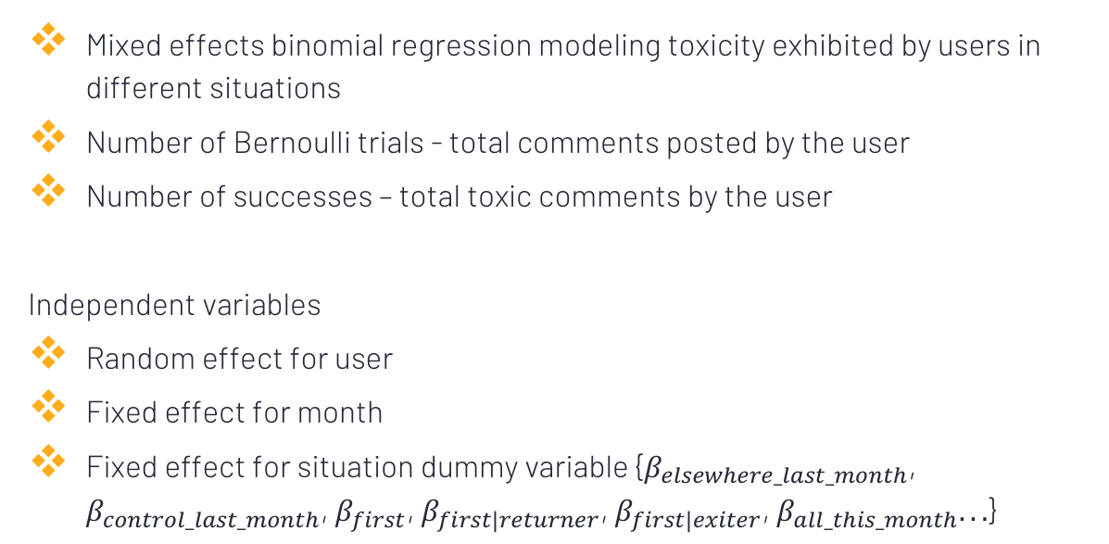
Model Details
Mixed effects binomial regression modeling toxicity exhibited by users in different situations
Number of Bernoulli trials - total comments posted by the user
Number of successes – total toxic comments by the user
Independent variables
Random effect for user
Fixed effect for month
Fixed effect for situation dummy variable {$β_{elsewhere_last_month}$, $β_{control_last_month}$, $β_{first}$, $β_{first|returner}$, $β_{first|exiter}$, $β_{all_this_month}...$}
Notes:
For each subreddit we build a mixed.. Here number of trials correspond to total posts by a user and number of success is the total.
random effect to account for differences in user activity levels
Fixed effect for month
And a fixed effect for each of the comment-group variables
Using the beta coefficient values, we can estimate the strength of norm conforming processes and transformative learning for each subreddit

