Slide 1

GuesSync!: An Online Casual Game To Reduce Affective Polarization
Daniel Choo, Jessica Zhang, Mia Inakage, Ceren Budak, Paul Resnick
Ashwin Rajadesingan
University of Texas at Austin
Department of Communication Studies
18th Oct 2023
arajades@austin.utexas.edu
@R_Ashwin
Notes:
Hello everyone, thank you so much for staying for this talk on reducing affective polarization. I am Ashwin Rajadesingan, an assistant professor at the university of Texas at Austin. This work was part of my dissertation at Michigan with Ceren budak and Paul resnick and undergraduaates Daniel choo, Jessica zhang and Mia ina cage. Lets get started

Slide 2
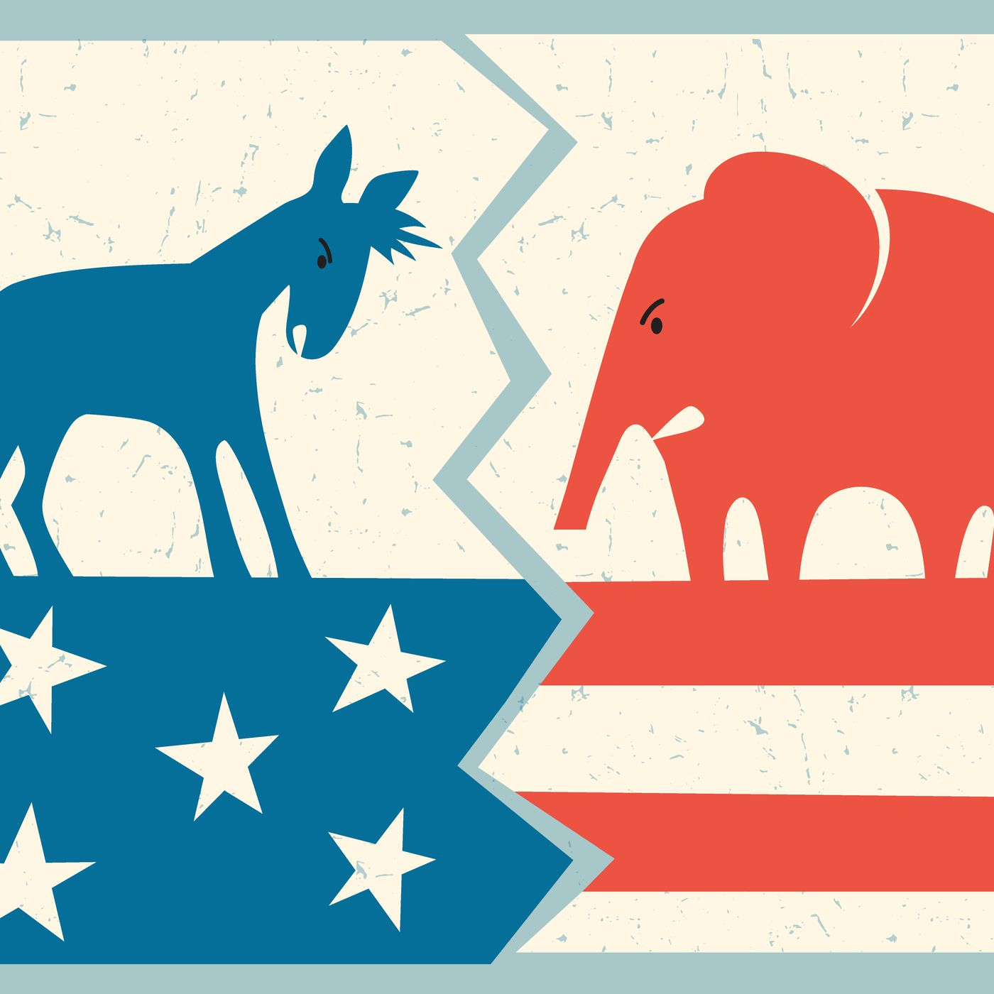
Partisan hostility in the US
59% somewhat or strongly believe that the opposing party is “downright evil.” (Kalmoe and Mason, 2022)
2
istockphoto
Notes:
in the current political climate in the US, Its no secret that republicans and dmeocrats don’t really like each other. A recent survey suggests that a majority of ordinary Americans believed that the opposing party was downright evil. This hostility towards the opposing party which is termed affective polarization has serious implications.

Slide 3
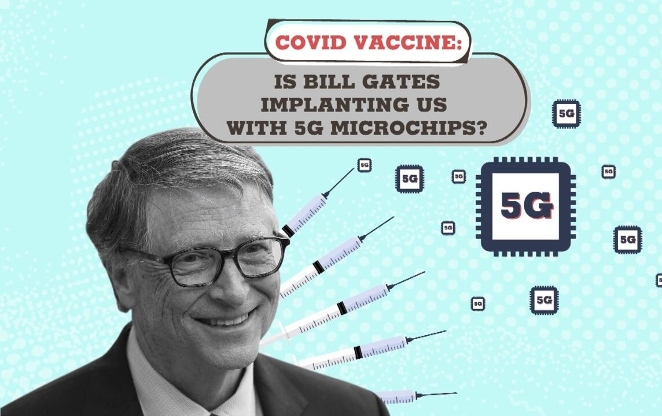
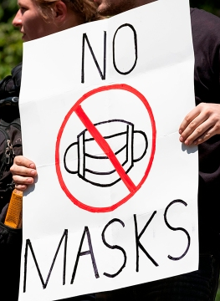
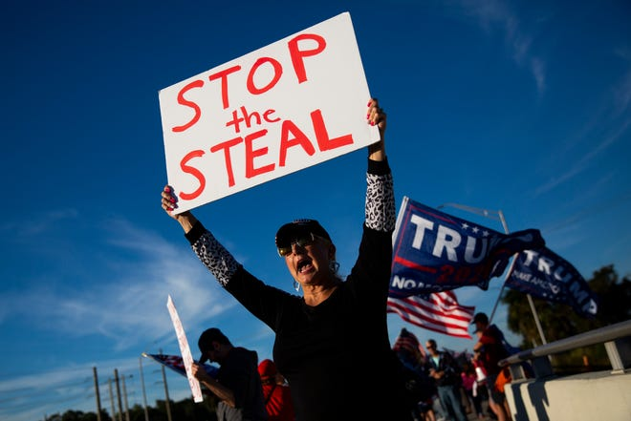
Consequences of Affective Polarization
3
(Jeff Dean/AFP via Getty Images, Alex Driehaus via USA Today, France24)
Notes:
CLICK Affectively polarized individuals are are more likely to consume and share fake news online CLICK they have reduced trust in govt and judiciary CLICK affectively polarized republicans resist masking policies more than other republicans.

Slide 4
How can we reduce affective polarization?
People perceive outparty supporters to be a lot more extreme than they actually are
What percentage of Republicans support requiring background checks
for gun purchases at private sales or gun shows?
82%
Correcting misperceptions can reduce affective polarization
Voelkel, Jan G., et al. "Megastudy identifying effective interventions to strengthen Americans’ democratic attitudes." (2023)
4
Notes:
these are serious issues. So what can we do to reduce affective polarization? CLICK It turns out that atleast *some* of the hostility stems from people perceiving the other side to be more extreme than they actually are. CLICK For instance CLICK can y’all make a guess, now if you guessed a low number, you are in trouble, the answer is CLICK 82%.. Correcting for those misperceptions in known to reduce affective polarization at least in survey settings. But how can we scale this up? How can we correct misperceptions at scale without giving them civics lession?

Slide 5
Reducing hostility through a party game
Misperception Correction + Party Game
Easier to play than talk politics
Appeals to a wider audience
Provides a wide range of interactions between players
Provides a “magic circle”
5
Notes:
My admittedly unorthodox answer is to incorporate misperception correction in a fun game. Here me out, I think this is a great idea!
For one, its fun, It’s definitely easier to play a game than to talk politics, which means that this kind of intervention is more likely to be adopted by a wider audience. also games provide a wider range of interaction possibilities between opposing partisans without being limited to back-and-forth discussions, which we know is hard. and crucially, games are immersive, they provide what game designers call a magic circle, a separate social and psychological space that players enter into when deciding to play a game, where the rules and norms of the game are activated, which likely temper hostile partisan norms.

Slide 6
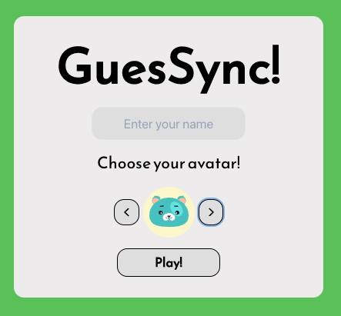
GuesSync!
Guess + Sync
Two-player cooperative party game.
Pairs of players are randomly matched together and play 5 rounds.
In each round, the two players are shown a question. They work together as a team, provide clues and guess the answer.
www.guessync.com
6
Notes:
So I present to you guesSync. It is a two player cooperative game. CLICK in the game, players are randomly paired and play 5 rounds together. CLICK in each round they are shown a question, they work together, provide clues and guess the answer. The game is available to play now at www.guessync.com.

Slide 7
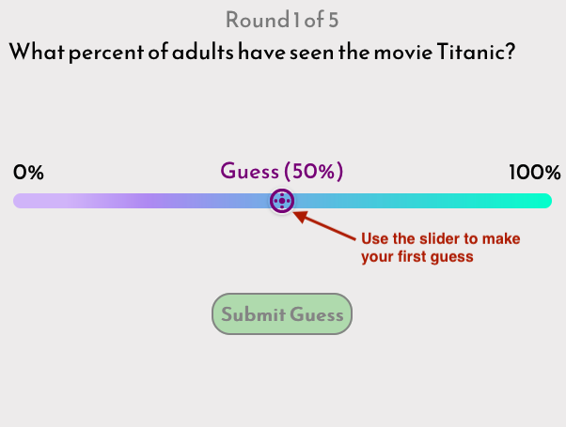
Both players select their first guess independently
What percent of Republicans say that the government should make it easier to buy a gun?
7
Notes:
in each round, they are both asked asked a question like this READ. CLICK Some of these qns may be political. READ Both players independently submit their answers.

Slide 8
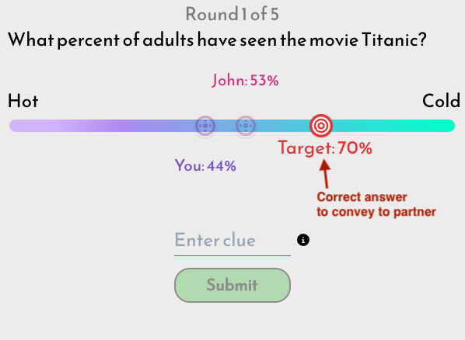
Clue giver is shown the correct answer and must provide a clue to help teammate
8
Notes:
Then one player is chosen as the clue giver, that player is shown the correct answer and the prior guesses. Here 70% is the correct answer. Now the clue giver has to come up with a clue to convey the answer to their partner. They are provided with a game scale, in this case, Hot-Cold. Here, a good clue would be something that you can identify as being more cold than hot as the 70% target is closer to the cold end of the scale.

Slide 9
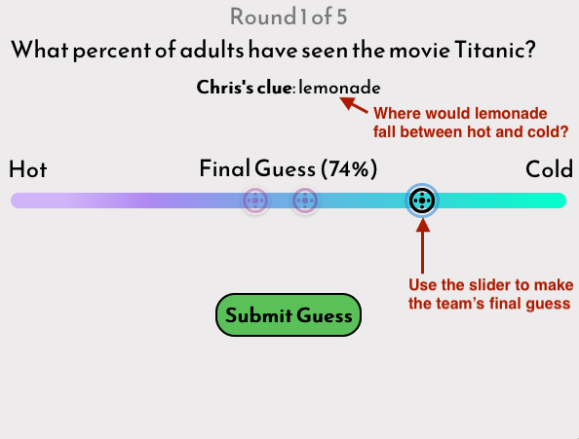
Guesser sees clue and prior guesses to make final guess
9
Notes:
Here Lemonade might be a good clue here since it's usually had cold. If the correct answer was 5% that is very close to the hot end of the scale, something really hot, like the 'sun' might be a good clue. If the correct answer was 95% 'arctic' might be a good clue. Now, with the clue and the prior guesses, the partner makes the the team's final guess

Slide 10
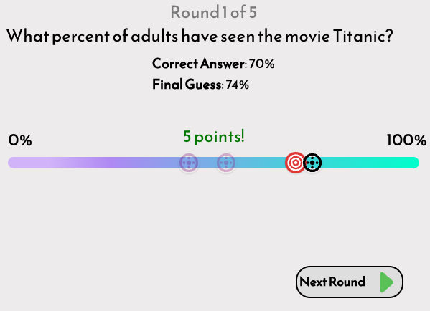
Both players are shown how close they were to the final guess
Reward
guess within 5%, 5 points
guess within 10%, 2 points
10
Notes:
After the partner guesses, the correct answer is revealed and the team gets points based on how close they are to the correct answer

Slide 11
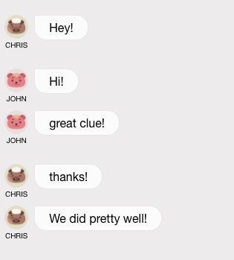
Players can chat between rounds
11
Notes:
Players can chat between rounds, In each round, we change the questions and game scales and alternate the clue giver role.

Slide 12
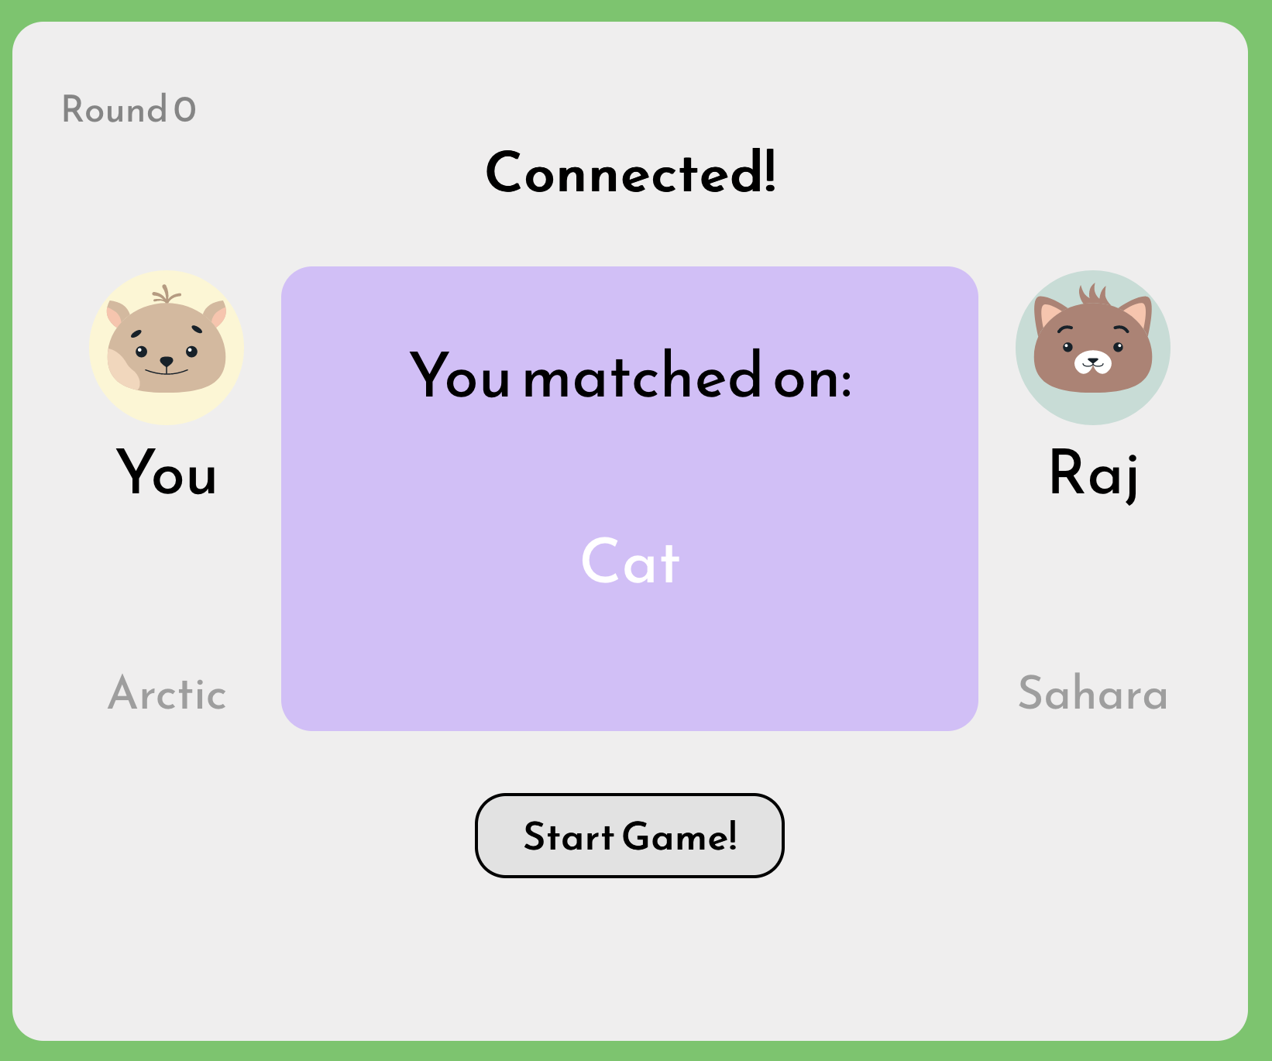
Core Design principles behind GuesSync!
No prior political knowledge needed
Minimal partisan cues
Cooperative game
Slow thinking
In-game messages
12
Notes:
Now let me explain some of the design principles behind guessync.
you don't need to know politics to play the game. We deliberately avoided designing it as a political trivia game as those would likely attract only individuals with high political knowledge.
There are Minimal partisan cues in the game We do not ask about the players' political leanings at any time during the game. CLICK We also included cute animals as avatars to cue playful norms.
Ofcourse, the game was designed to be cooperative to reduce contentious moments
The game encourages slow thinking –We did not want to have rapid-fire style game that likely resulted in stereotyped responses. we have time limits but they are generous, you get 2 minutes to come up with clues.
while optional, players ended up chatting in game quite a bit, median was 6 chat exchanges. apart from making the game social and fun, chat also allowed for reflection of especially surprising answers, which can aid retention

Slide 13
Political questions that correct misperceptions
Political questions from nationally representative ANES, CES and GSS surveys
Manually selected 556 questions on Democrats’ and Republicans’ political views.
What percentage of:
Republicans say that the federal minimum wage should be decreased? – 4%
Democrats support the death penalty for convicted murderers? – 44%
Used Mturk to select questions on Republicans and Democrats based on
the size of misperception and how important the issue was to the outparty
13
Notes:
So the game requires 3 types of game content, political questions that correct misperceptions, nonpolitical questions and game scales. Because of time constraints I’ll describe only how we picked the political questions for the game. more details are in the supplementary materials.
To obtain an initial set of questions on party supporters' political views, we used nationally representative survey data.CLICK we manually selected 500odd questions on political views from these sources. Here are a couple of examples: CLICK, then we used a simple amazon mechanical turk survey to selected a subset of questions. CLICK We select questions about Republicans that democratic mturk workers said were on issues most important to them and on which they had the most misperceptions, and vice versa

Slide 14
Three Game versions
Game version | Description
Control version | all 5 rounds are nonpolitical
Mixed version | 2 rounds are political, 3 rounds are nonpolitical
Fully political version | All 5 rounds are political
14
Notes:
We developed 3 versions of the game, one control versions where READ, a mixed version where READ, and a fully political version where READ.

Slide 15
Main Hypothesis
[H1] Players playing the mixed and fully political game will exhibit:
Lower outparty hostility,
Higher willingness to talk to outparty supporters
than those playing the control version.
15
Notes:
The paper has a lot more details, we evaluate potential mediators and moderators but the primary hypothesis is ofcourse that playing the mixed or the fully political games reduce outparty hostility and increase willingness to engage in conversations with outpartisans than those playing the control version of the game.
The out party hostility measure is a measure of attitude and willingness to talk to outparty members is a measure of behavioral intent.

Slide 16
Experiment procedure
Pre-registered between-subjects MTurk experiment
Players
Players were randomly paired and assigned to play the control, mixed or fully political game
Complete post-game survey containing outcome, mediator and moderator measures
665 participants: 224 control version players, 225 mixed version players and 216 full version players
16
Preregistration url: https://aspredicted.org/hy4a5.pdf
Notes:
To test the hypothesis, we performed a preregistered between subjects experiment on Mturk. Participants were randomly paired and assigned to play one of the three version of the game. After the game they completed a post game survey. In total, we had 665 participants in total.
The preregistration link is on the slides. You can checkout the regressions and the robustness checks in the paper and the supplementary material, we also examined potential mediators and moderators. I’ll go straight to the main results.

Slide 17
Results
Did the mixed and fully political games reduce outparty hostility?
No main effect on reducing outparty hostility
Reduced outparty hostility among Democrats, not Republicans
Increased willingness to talk politics with outparty
Was the game fun?
Yes! (rated 7.75 out of 10)
“I think this is a brilliant game, and I frequently play online games through BoardGameArena… it is already nearly perfect in its present form.”
“It was a lot of fun! I am glad I got to play it. I only wish there were more rounds.”
17
Notes:
So did the game reduce hositltiy? Well, we did not find a main effect on reducing hostility. But preregistered subgroup analysis indicates that the games reduced outparty hostility among democrats not republicans and I’m happy to get into why this might be the case in the discussions. imp these games were effective in increasing willingness to talk politics with outparty.
Now arguably an even more important question. CLICK Was the game fun? Yes. We got some rave reviews. And the the game was rated just as highly as the nonpoltiical control versions! Crucial result as it suggesting that people don’t mind mixing politics and play, encouraging signs for us to design more such games in the future.

Slide 18

Thank you!
Paper available here:
arajades@austin.utexas.edu
@R_Ashwin
https://bit.ly/guessync
www.guessync.com
GuesSync!: An Online Casual Game To Reduce
Affective Polarization
Daniel Choo, Jessica Zhang, Mia Inakage, Ceren Budak and Paul Resnick
18
Notes:
With that I conclude the presentation. Do try out the game and send me feedback.. Thank you!

