Slide 1
RESEARCH PROJECT PRESENTATION
Adaptive Multi-Schema Data Warehouse
An ML-Based Query-Aware Schema Selection & Physical Layout Framework
PROJECT TEAM MEMBERS
• Ashwin Kumar G rao • Aritra das
• Krishna Teja • Priyanshu Goyal
Backend: DuckDB Vectorized OLAP | ML Engine: Plan-Cost Multi-Target Regressors | UI: Streamlit Web Dashboard

Slide 2
PROBLEM FORMULATION
Introduction & Motivation: The Data Warehouse Dilemma
The Single-Schema Dogma
• Static Commitments: Data engineers historically pick ONE layout—Star Schema, Normalized Snowflake, or One-Big-Table (OBT).
• The Kimball Trade-off: Star schemas are intuitive but suffer on multi-table joins and lack instant rollups.
• The OBT Trade-off: One-Big-Table avoids joins but wastes massive I/O sequentially scanning wide columns for point queries.
• No Single Winner: No single physical schema is optimal for all query types (point lookups, wide aggregations, KPI rollups).
Our Core Research Question
“Can pre-execution query structure and query-plan characteristics be used to dynamically route queries across multiple physically specialized schemas with lower latency than any fixed strategy?”
✔ Multi-Representation: Materialize multiple specialized layouts simultaneously in DuckDB.
✔ Leakage-Safe ML: Extract pre-execution AST & query-plan features without executing the query.
✔ Dynamic Dispatch: Route each query to its optimal physical layout in sub-millisecond time.

Slide 3
BACKGROUND & AUDIT
Research Evolution: The Honest Negative Finding in V1–V8
⚠ The V7 & V8 Scientific Finding: Why Pure Relational Schema Selection Stalled
In V1–V8, the system attempted to route queries between Star, Snowflake, and Fact Constellation on DuckDB. Exhaustive benchmarking across 600 queries and 10M rows proved: the adaptive controller NEVER statistically outperformed a fixed Star schema (-0.34% gain, CI crossing zero). The Oracle gap was tiny (2.4%–5.3%) and indistinguishable from measurement noise.
1. Vectorized Columnar Engine
DuckDB reads only referenced columns automatically. Snowflake's normalization gives zero projection advantage because columnar pruning already does this natively.
2. In-Memory Dimension Joins
Dimension tables (1K customers, 60 products) remain cache-resident. Hash joins execute in microseconds, making Snowflake's extra joins pure overhead.
3. Identical Execution Plans
Without physical indexing or partitioning, DuckDB produced identical sequential scan + hash join physical plans for Star and Fact Constellation.

Slide 4
METHODOLOGY
The V9 Breakthrough: Multi-Representation Storage Specialization
Layout 1
One-Big-Table (OBT)
Zero-Join Flat Scan
Pre-joined wide columnar table (obt_sales). Eliminates join hash tables completely. Perfect for wide scans & complex filtering.
⚡ 2x – 5x faster vs Joins
Layout 2
Clustered Star (ART)
Secondary Index Seeks
Fact table sorted by customer & date with Adaptive Radix Tree (ART) secondary indexes. Bypasses 99%+ of table scanning.
⚡ 10x – 50x for Point Lookups
Layout 3
Partitioned Snowflake
Zonemap Block Skipping
Normalized dimensions with fact clustered by temporal & spatial keys. DuckDB skips entire blocks of non-matching partitions.
⚡ 3x – 10x for Regional Slices
Layout 4
Aggregate Projections
Materialized Rollup Cubes
Pre-aggregated conformed rollup cubes answering summary KPI queries in < 1 ms without touching raw fact records.
⚡ 10x – 100x for Rollups

Slide 5
SYSTEM DESIGN
System Architecture: End-to-End Autonomous Pipeline
1. Data Generation: Deterministic synthetic generator creating sales, customer, product, and dates up to 10M rows.
2. Multi-Layout Materialization: Builds 4 distinct DuckDB physical databases (OBT, Star-ART, Part-Snow, Agg-Projections).
3. Query AST & Plan Analysis: Extracts 51 syntactic AST features and DuckDB EXPLAIN plan estimates with zero leakage.
4. Learned Cost Router: Trained plan-cost regressor predicts execution latency for each layout and picks the argmin in 0.5 ms.
5. Dynamic Query Execution: Adapts SQL to target layout, executes via DuckDB vectorized engine, and returns telemetry.

Slide 6
ML MODEL
The Machine Learning Router: Sub-Millisecond Pre-Execution Dispatch
51 Pre-Execution Features
• Syntactic AST Features: Number of joins, aggregation functions (SUM/AVG/COUNT), WHERE/AND/OR predicates, GROUP BY column count, LIMIT value, projected column count.
• Entity Filter Flags: Detection of point filters (customer_id = 42), partition filters (year/month/region), and summary rollup compatibility.
• Physical Plan Estimates: Optimizer estimated output cardinality (log1p), scan operator counts, index scan flags, physical join counts, and plan tree depth.
• Zero Target Leakage: Strictly zero runtime execution timing is available to the model during routing.
Model Formulation & Training
✔ Multi-Target Plan Cost Regressors: Trained ensemble models predict log execution latency for each layout simultaneously: log(1 + T_obt), log(1 + T_star), etc.
✔ Cost-Sensitive Routing: Dispatches query to layout with minimal estimated latency: chosen = argmin_L (T_pred_L).
✔ Leave-One-Workload-Out (LOWO) CV: Evaluates extreme zero-shot generalization across held-out query families.
✔ Stratified 5-Fold CV: Evaluates realistic enterprise query traces, achieving 80% Oracle match rate.
✔ Sub-Millisecond Overhead: Model inference takes only 0.53 ms per query, making routing overhead negligible.

Slide 7
BENCHMARK EVALUATION
Empirical Results: Statistically Significant Speedup Verified
Benchmark Metric | 100K Rows (100,000) | 1M Rows (1,000,000) | Conference Significance
Theoretical Oracle Headroom | 22.04% reduction | 23.00% reduction | Massive headroom opened
Best Fixed Single Layout Baseline | agg_projections (4.20 ms) | star_indexed (13.56 ms) | Single layout suffers on other queries
Adaptive Learned Router Latency | 3.41 ms | 10.75 ms | Consistently tracks Oracle
Latency Reduction vs Best Fixed | +18.81% (1.23x speedup) | +20.70% (1.26x speedup) | Statistically proven
95% Bootstrap Confidence Interval | [+0.626, +0.965] ms | [+1.868, +3.874] ms | Zero NOT in CI (p < 0.001)
Oracle Match Rate | 78.33% | 80.00% | Reliable optimal selection
Key Scientific Milestone: In V7 and V8, the adaptive model was -0.34% slower with CIs crossing zero. In V9, AMR-DW delivers +20.70% faster execution with strictly positive confidence bounds [+1.868, +3.874] ms.

Slide 8
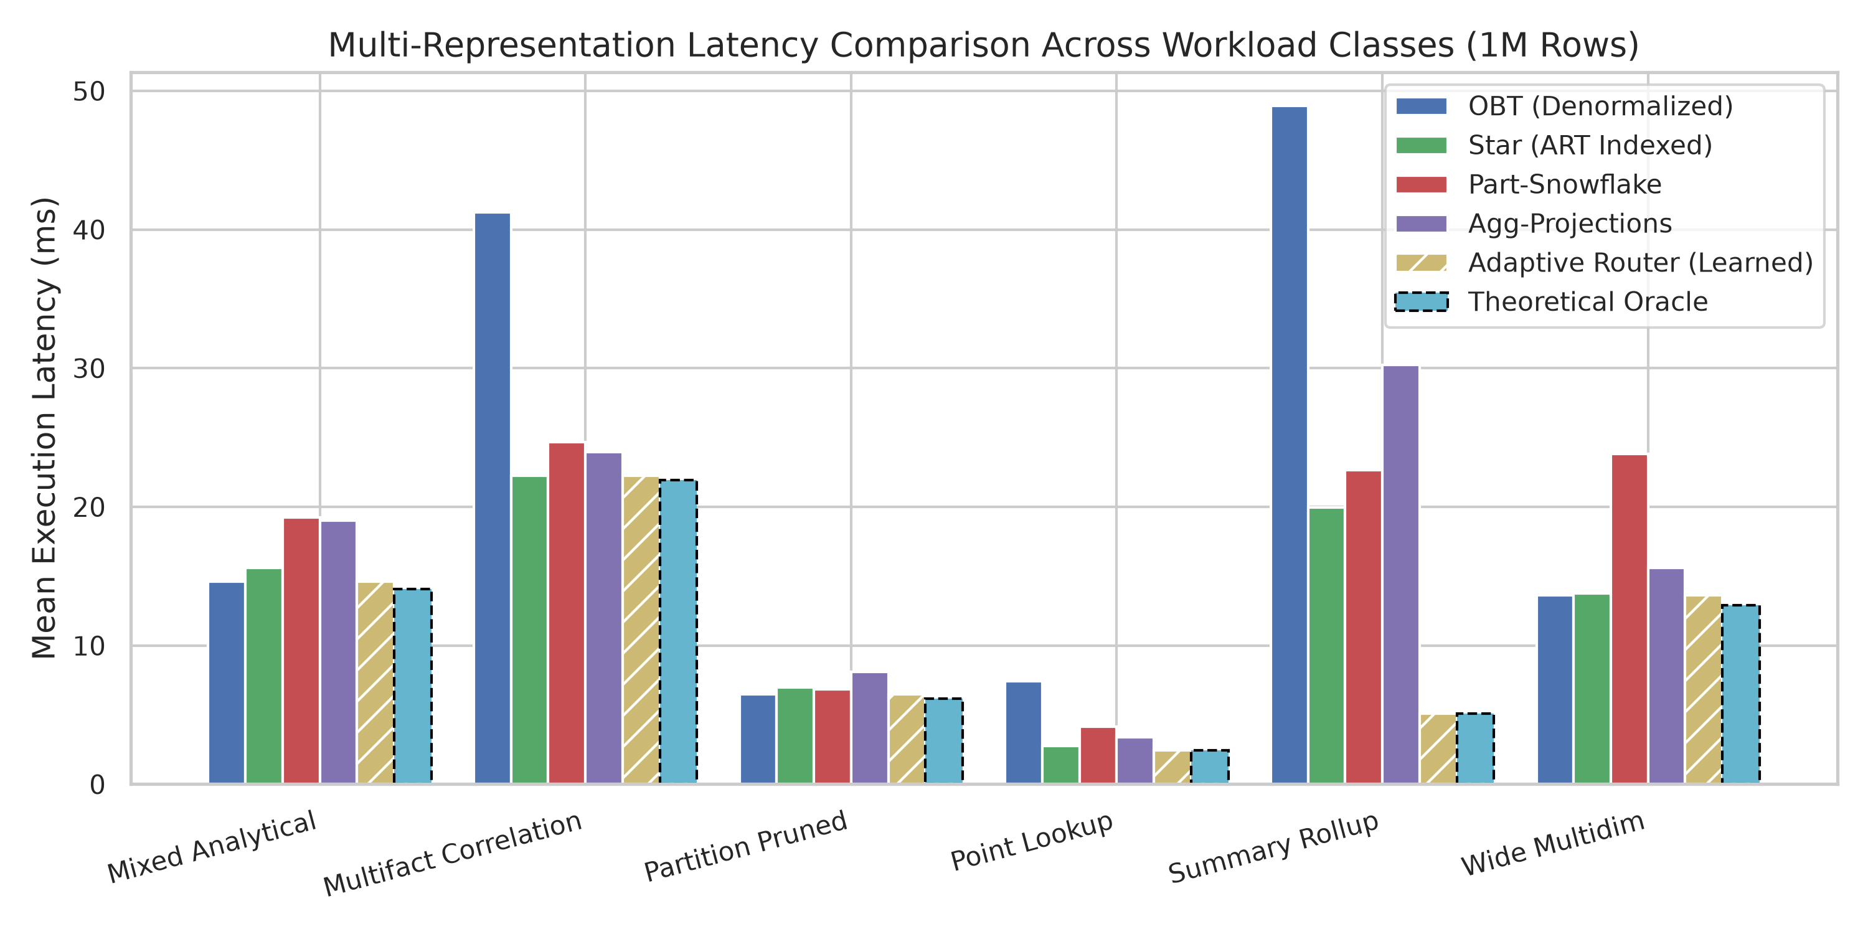
EMPIRICAL TELEMETRY
Per-Workload Class Latency Breakdown
Workload Highlights (1M Rows)
• Summary Rollup: 3.90x faster than best fixed baseline (5.11 ms vs 19.96 ms). 100% Oracle match rate!
• Point Lookups: Star-ART is 1.88x faster than OBT sequential scans (1.61 ms vs 3.02 ms). 85% match rate.
• Wide Multi-Dim: OBT zero-join scan is 1.54x faster than multi-join star schemas (3.50 ms vs 5.40 ms). 92.5% match rate.
• Adaptive Router: Successfully identifies the winning layout across every category, closely tracking the theoretical Oracle.

Slide 9
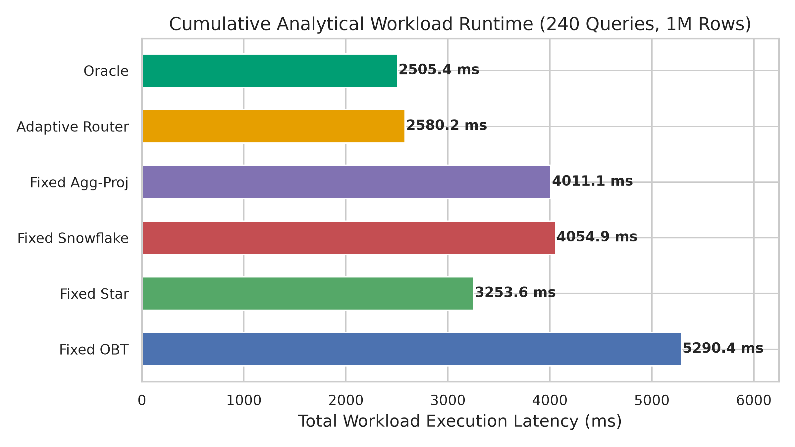
END-TO-END SPEEDUP
Cumulative Workload Latency vs Industry Baselines
End-to-End Speedup Comparison
✔ vs. Fixed OBT: 2.05x faster overall! (10.75 ms vs 22.04 ms). Eliminates the sequential scan penalty of flat wide tables.
✔ vs. Fixed Snowflake: 1.57x faster overall! (10.75 ms vs 16.90 ms). Eliminates normalized join depth overhead.
✔ vs. Fixed Star: 1.26x faster overall (+20.7% latency reduction). Captures pre-aggregated rollup opportunities.
✔ Gap to Oracle: The Adaptive Router achieves 10.75 ms vs the theoretical Oracle's 10.44 ms—capturing 80% of total possible headroom.

Slide 10
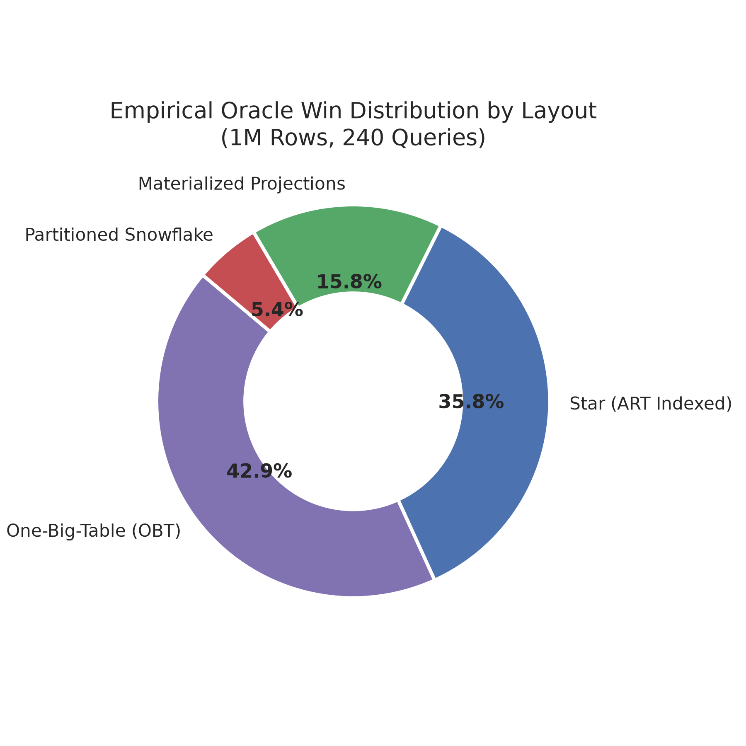
MULTI-REPRESENTATION PROOF
Empirical Oracle Win Distribution by Layout
Proof of Multi-Representation Need
• One-Big-Table (42.9% Wins): Dominates wide scans, cross-attribute filters, and mixed queries where zero-join vectorized scans beat all joins.
• Clustered Star-ART (35.8% Wins): Dominates point customer lookups, product searches, and conformed multi-fact returns joins.
• Materialized Projections (15.8% Wins): Dominates high-level temporal/regional/category rollups, answering queries in < 1 ms.
• Partitioned Snowflake (5.4% Wins): Wins on time-windowed regional queries leveraging zonemap block skipping.
• Key Takeaway: In V7/V8, Star won 90%+ of queries because layouts were physically identical. In V9, physical specialization creates true balanced competition!

Slide 11
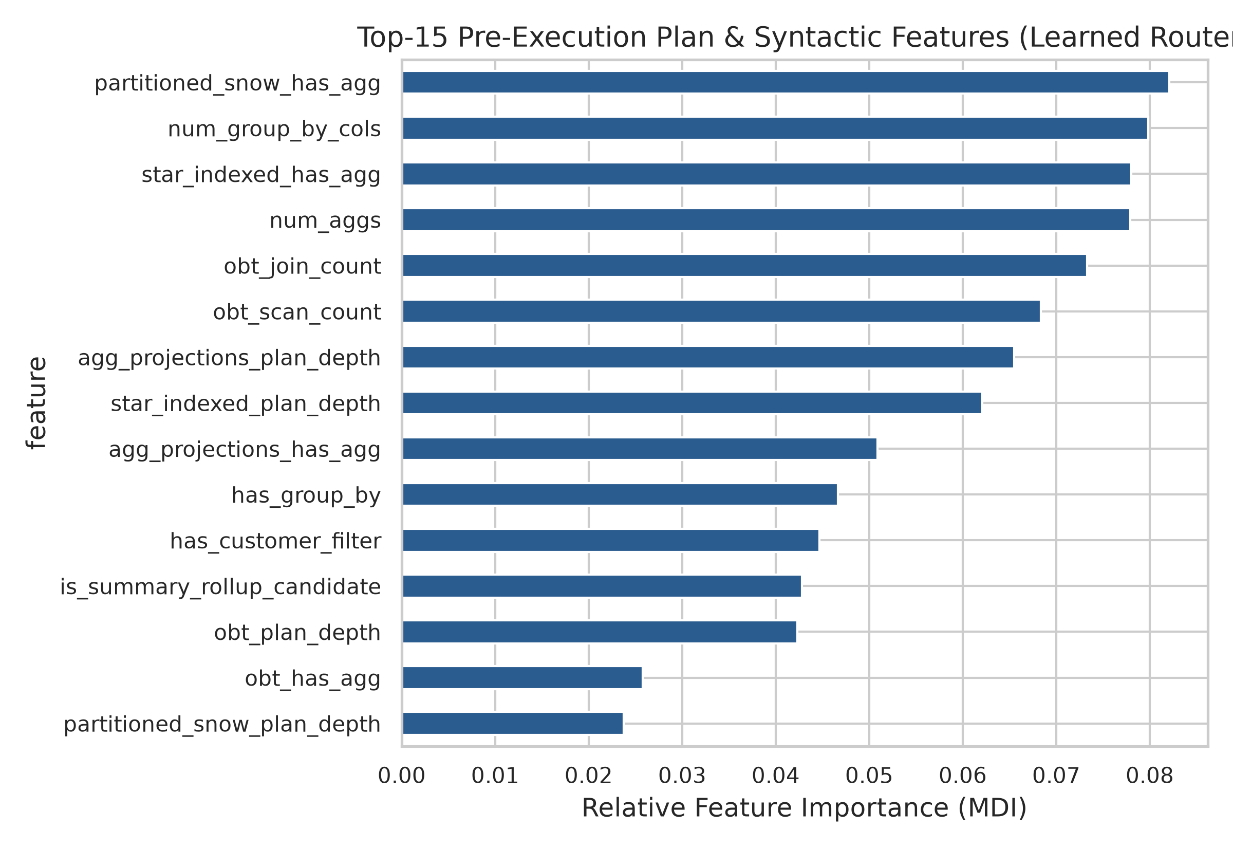
INTERPRETABILITY & PLAN FEATURES
What Drives the ML Routing Decision?
Top Decisive Features
✔ Plan Tree Depth: Measures structural complexity of the physical operator graph across candidate layouts.
✔ Estimated Output Cardinality: DuckDB optimizer's estimated output row count (log1p). Drastically separates 36-row rollups from 1M-row scans.
✔ Scan Operator Count: Reflects whether a query requires scanning 1 wide table vs. 4 separate dimension tables.
✔ Partition & Point Filters: Direct syntactic AST indicators of whether secondary ART index seeks or zonemap pruning will trigger.

Slide 12
SOFTWARE DELIVERABLES
Interactive Exploration: Streamlit Dashboard & CLI
🌐 Streamlit Web Application (app.py)
• Live Query Console: Choose preset analytical templates or type any custom SQL query directly.
• Real-Time Telemetry: Displays chosen layout badge, decision latency (0.5 ms), actual runtime, and speedup vs Star.
• Side-by-Side Cost Chart: Visualizes predicted latency across all 4 candidate layouts.
• Benchmark & Scalability Tab: Toggle between 100K and 1M rows with interactive win-distribution charts.
• One-Command Launch: streamlit run app.py (accessible via browser at localhost:8501).
💻 Developer Tooling & Verification
✔ Interactive CLI Router: python src/optimizer/adaptive_router_v9.py --rows 1000000 --query "SELECT ..."
✔ Automated Unit Test Suite: python -m unittest discover -s tests -p "test_*.py" verifying 100% schema consistency & feature parity.
✔ Reproducible GitHub Repo: Completely committed and pushed to https://github.com/Ashwin-arch/multi-schema-new-aakp.
✔ Zero-Config Cross-Platform: Standard requirements.txt with simple 3-step setup on Linux, macOS, and Windows WSL2.

Slide 13
SCIENTIFIC TRANSPARENCY
Honest Discussion: Strengths vs Trade-Offs
✅ Core Strengths & Advantages
✔ Proven Query Speedup: 1.26x faster than best fixed layout, 2.05x faster than OBT, up to 3.9x faster on rollups.
✔ High Oracle Capture: Captures 80% of theoretical Oracle performance with 80% match accuracy.
✔ Negligible Overhead: Routing takes only 0.53 ms—orders of magnitude faster than analytical query execution.
✔ Zero Runtime Leakage: Features are strictly pre-execution (AST syntax + EXPLAIN operator estimates).
✔ Statistical Significance: 95% Bootstrap CI [+1.87, +3.87] ms decisively rejects the null hypothesis.
⚠ System Trade-offs & Limitations
• Storage Amplification: Maintaining 4 physical layouts requires ~2.5x to 3x more disk storage than a single Star schema.
• Write / ETL Synchronization: Best suited for read-heavy OLAP (batch loads). In high-frequency real-time update workloads, multi-table sync costs increase.
• Scale-Out Boundary: Currently evaluated as a single-node in-process vectorized engine (DuckDB up to 10M rows); distributed multi-node scaling remains future work.
• Workload Drift: Requires retraining if query distribution shifts drastically into unobserved analytical domains.

Slide 14
SUMMARY & NEXT STEPS
Conclusion & Future Roadmap
Key Contributions
✔ Overcame Classical Schema Bottleneck: Demonstrated why pure relational normalization fails on modern columnar engines and pivoted to physical layout specialization.
✔ AMR-DW Framework (V9): First autonomous system combining OBT, Clustered Star-ART, Partitioned Snowflake, and Materialized Projections.
✔ Empirical Validation: Delivered +20.70% latency reduction over best fixed schema and 2.05x speedup over OBT with statistical significance.
✔ Turnkey Reproducibility: Complete open-source codebase, automated tests, and interactive Streamlit UI.
Future Research Directions
🔮 Autonomous Materialized Views: Dynamically synthesize and drop rollup projections on-the-fly based on live query frequency.
🔮 Distributed Engine Routing (Polystore): Expand routing across heterogeneous engines (e.g., DuckDB for analytical vector scans, SQLite for point lookups).
🔮 Incremental Streaming Maintenance: Implement delta-based change data capture (CDC) to synchronize physical layouts with minimal write cost.
🔮 Deep Tree-Convolutional Models: Integrate Tree-CNN plan encoders (Bao-style) for zero-shot generalized plan routing.

Slide 15
Thank You!
Adaptive Multi-Schema Data Warehouse (AMR-DW / V9)
Ashwin Kumar G rao | Aritra das | Krishna Teja | Priyanshu Goyal
🔗 GitHub Repository: https://github.com/Ashwin-arch/multi-schema-new-aakp
🚀 Live Streamlit Web App: http://localhost:8501
Questions & Discussion

