Slide 1


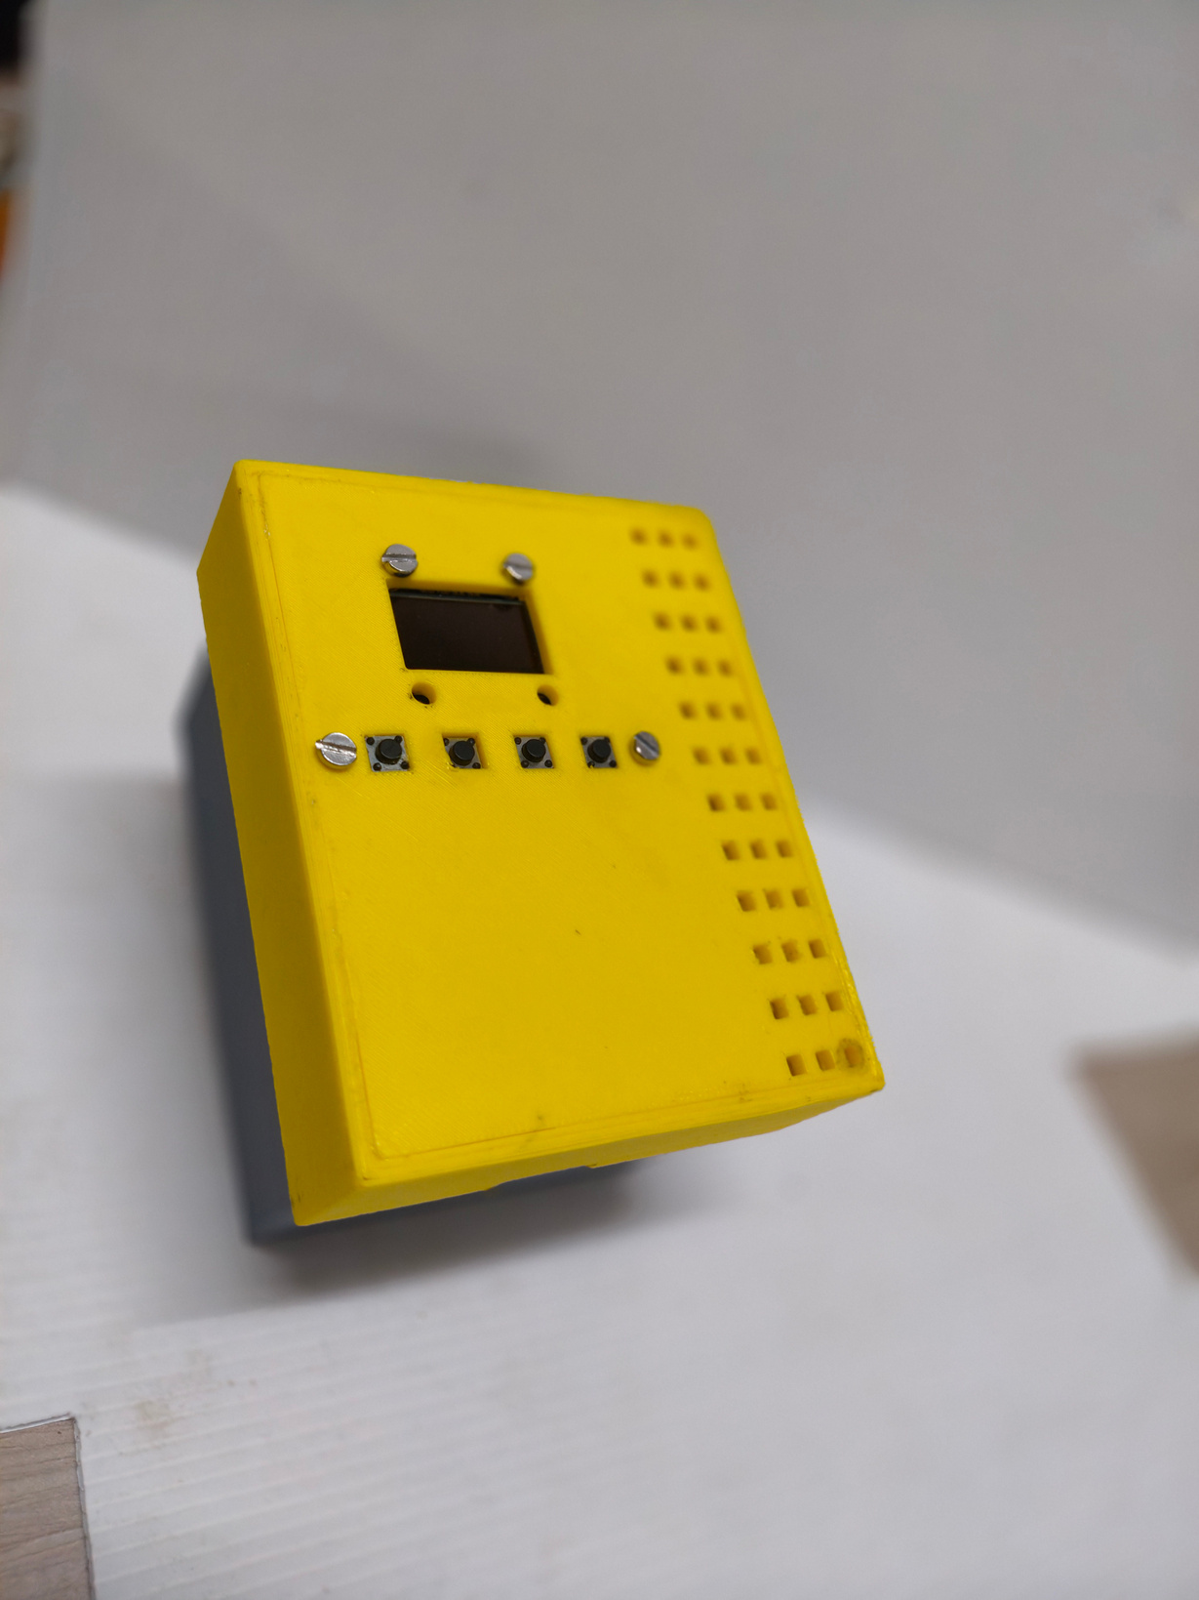
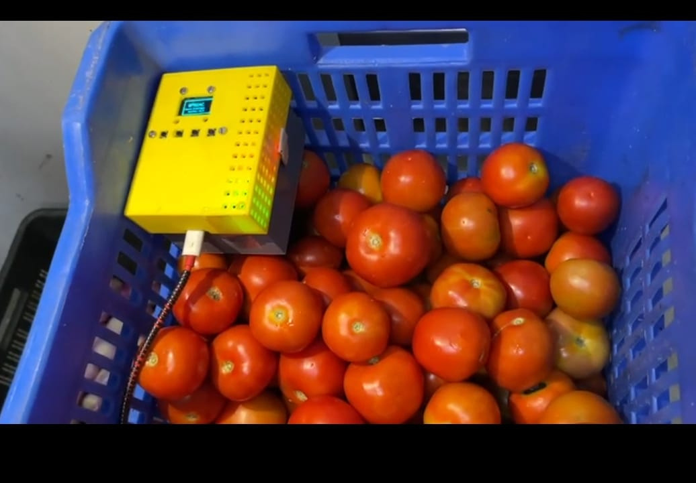
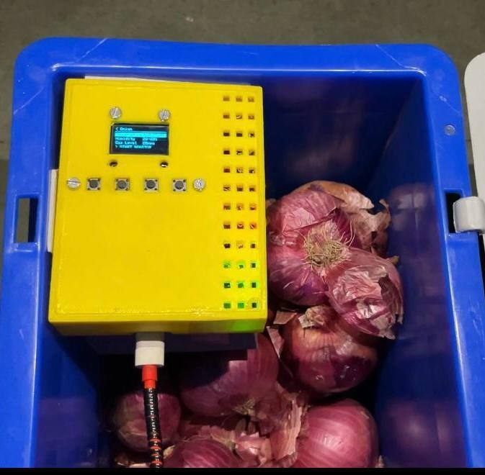
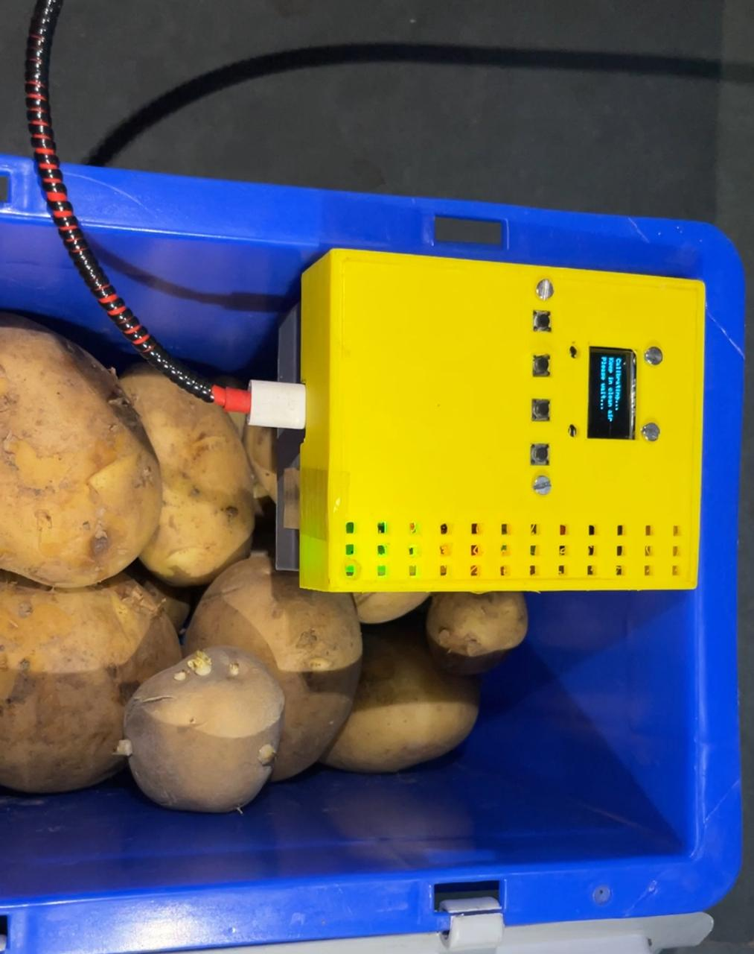
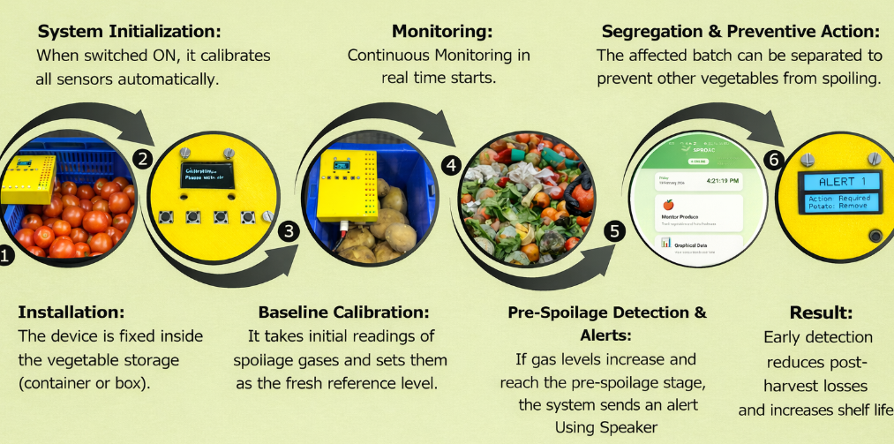
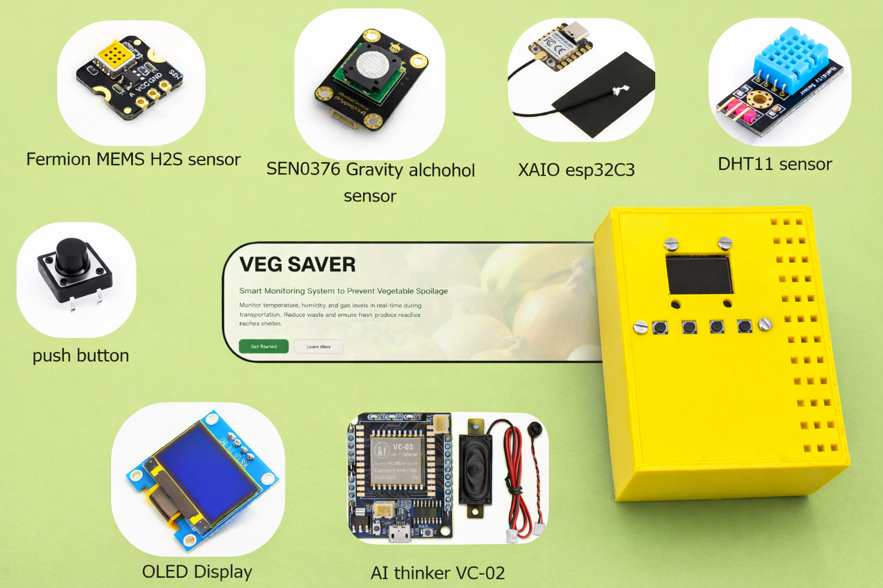
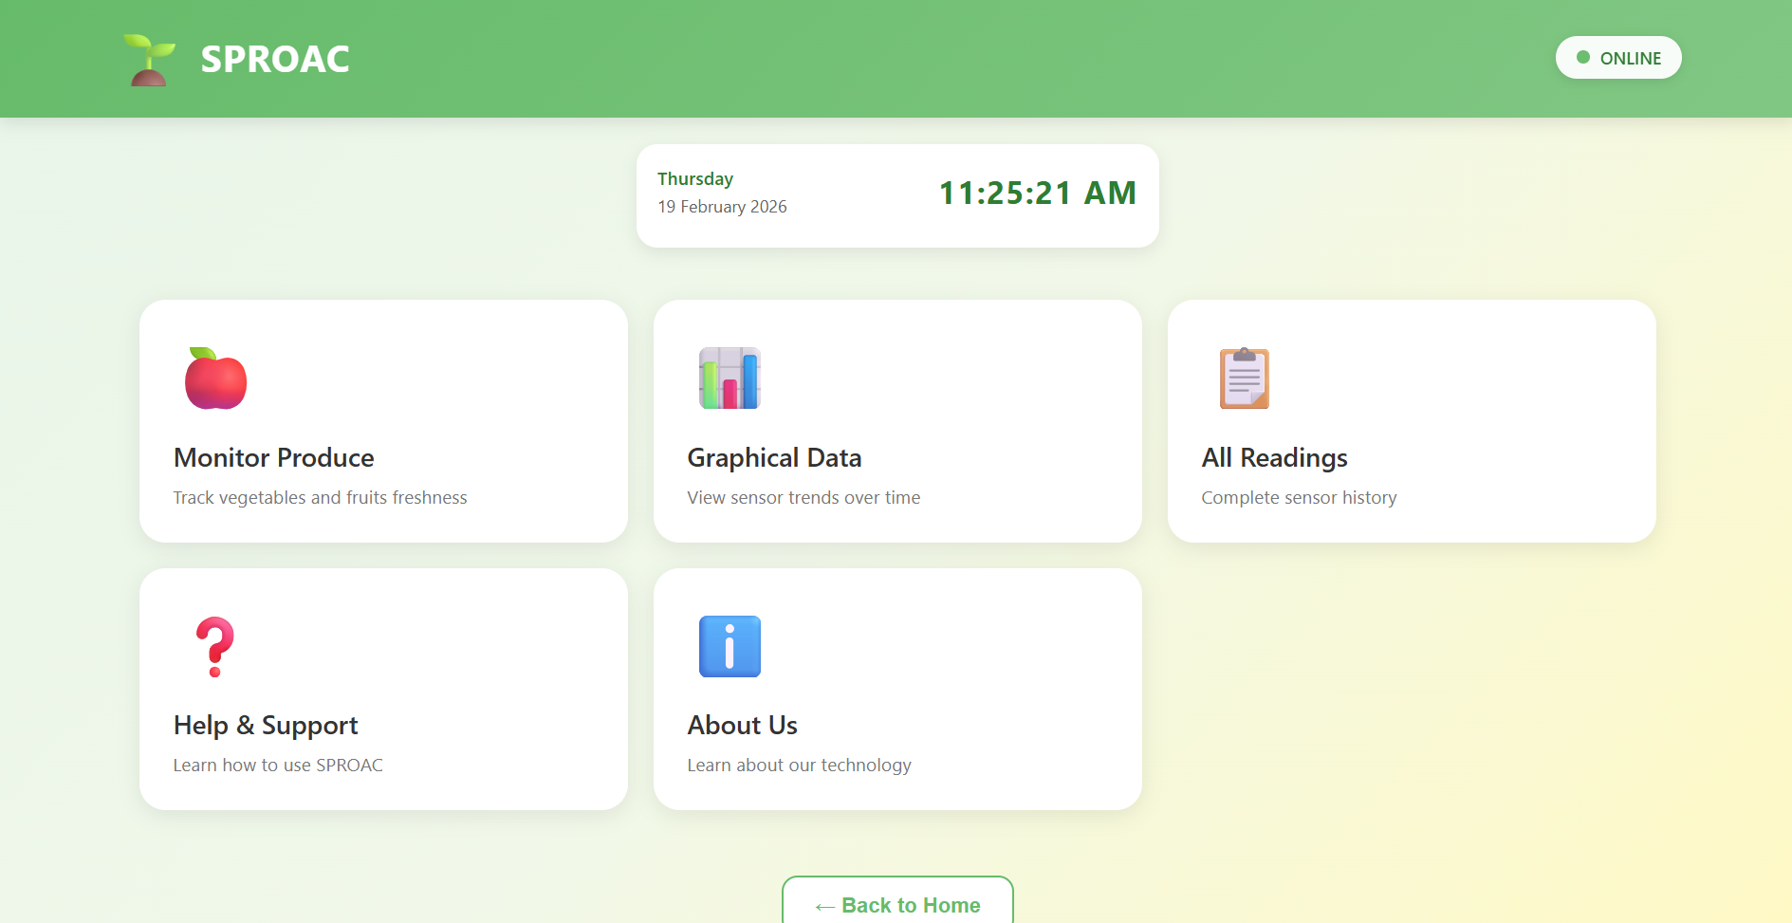
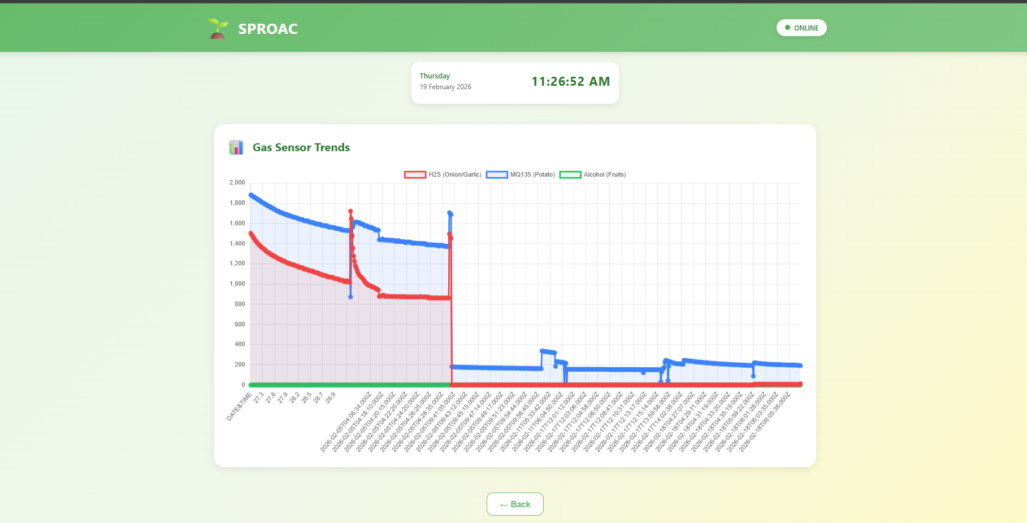

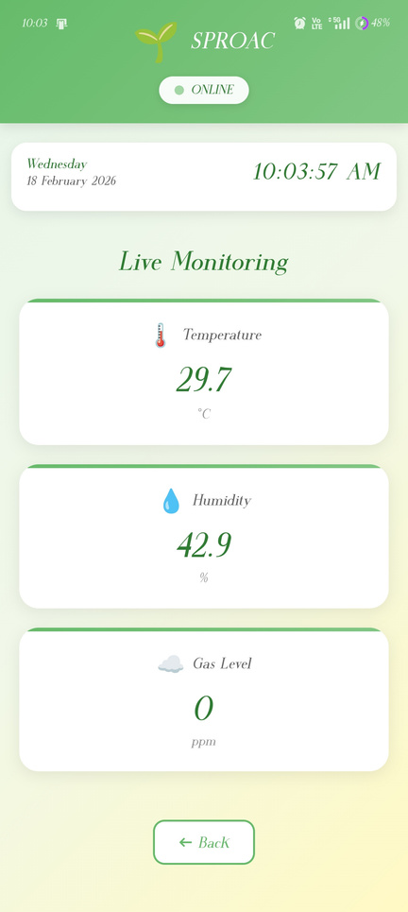
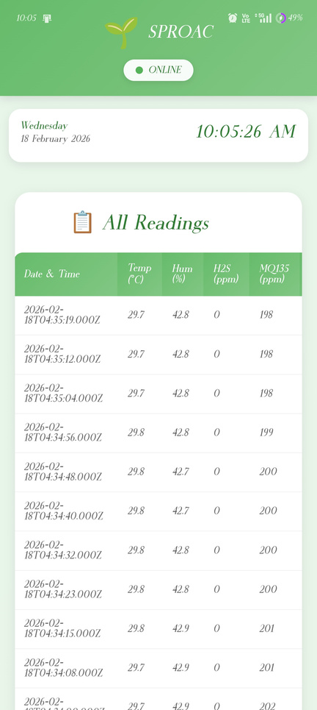
SPROAC
SHELF-LIFE PREVENTION OF ALL VEG CONSUMED
College
KPR Institute Of Engineering And Technology, Coimbatore
ABSTRACT
Design
India is one of the largest producers of vegetables globally, with an annual production of about 200–210 million metric tonnes. However, nearly 15%–25% of vegetables are lost during the post-harvest stage, resulting in approximately 30–50 million metric tonnes of wastage each year. These losses are mainly due to poor storage infrastructure, lack of environmental monitoring, short shelf life, and inefficient transportation systems. our product focus on the reduction of post harvest losses and it comes under SDG02 Zero Hunger.
OBJECTTIVES
To detect spoilage in stored onions and vegetables using gas and provide timely alerts to prevent quality degradation.
To develop an interactive device interface that allows users to easily monitor storage conditions.
To identify issues related to artificial/forced ripening of fruits by abnormal gas concentrations and storage conditions.
To provide real-time alerts to mandi owners ,farmers, transporter for quick action and reduced spoilage.
To design a portable retrofit device that can be easily installed in existing tray boxes, storage units, and transport containers.
FEATURES
WEB APP UI
Spoilage & Forced Ripening Detection – Detects early spoilage and abnormal ripening using gas sensing.
Interactive Real-Time Monitoring – Live tracking of temperature, humidity, and gas levels and interact with user
Instant App & Hardware Alerts – Sends alerts to through mobile app and provides on-device warning.
Portable Retrofit Device – Easily attachable to existing storage and transport tray boxes.
TARGETED USERS
  Wholesalers ,mandi owners – for monitoring produce quality during
supply.
  Logistics & Transport Providers – to track conditions during transit
  Hotels & College Messes – to ensure fresh produce for food preparation
  Grocery Shop Owners – to reduce daily spoilage and wastage
  Hotels & College Messes – to ensure fresh produce for food preparation
CONCLUSION
SPROAC is a smart system designed to reduce post-harvest losses of fruits and vegetables by monitoring transport conditions and detecting spoilage. With App-scripts based data logging and app visualization, it enables timely decisions to extend shelf life and ripen fruits. It supports supply chain efficiency and contributes to SDG-2 (Zero Hunger).

