Slide 1


Introduction to
Robotic Process Automation
Language Translation Automation
220701033
A.ASHWIN
Mrs.J .JINU SOPHIA
ASSISSTANT PROFESSER(SG)
Computer Science and Engineering

Slide 2
Abstract
The Language Translation Automation Project leverages Robotic Process Automation (RPA) to automate text translation and email distribution. Using APIs like Google Translate or Microsoft Translator and tools like UiPath, it ensures efficient, accurate, and secure multilingual communication, significantly reducing manual effort and errors.
The project addresses the growing demand for efficient multilingual communication by combining cutting-edge automation technologies with user-friendly interfaces, offering a robust solution for industries requiring accurate and scalable language translation and message distribution.

Slide 3
Need for the Proposed System
Manual translation and email distribution processes are time-consuming, prone to errors, and inefficient for high-volume tasks. Businesses and individuals require a streamlined, scalable solution to overcome these limitations.
Businesses operating globally require fast and accurate translations to communicate effectively with diverse clients, partners, and employees, making manual processes inadequate for scaling.

Slide 4
Advantages of the Proposed System
Automates repetitive tasks, reducing manual workload.
Ensures high accuracy with context-aware translations.
Provides secure and reliable email delivery.
Scalable for high-volume multilingual communication needs.
Provides consistent and contextually accurate translations across multiple languages.
Reduces operational costs by minimizing the need for human intervention in translation and email distribution.

Slide 5
Literature Survey
Attention Is All You Need
Advantages: Introduced Transformer models, revolutionizing machine translation.
Disadvantages: Requires high computational resources.
Neural Machine Translation by Jointly Learning to Align and Translate
Advantages: Enhanced accuracy for sequence-to-sequence translations.
Disadvantages: Limited context awareness in early implementations.

Slide 6
Main Objective
To automate the process of translating text into multiple languages and delivering it via email using RPA, reducing inefficiencies and improving communication quality.
To develop an intuitive and user-friendly interface that allows users to input text or upload files for seamless translation and email distribution
To integrate advanced error-handling and logging mechanisms to ensure system reliability and provide detailed insights for troubleshooting and optimization.

Slide 7
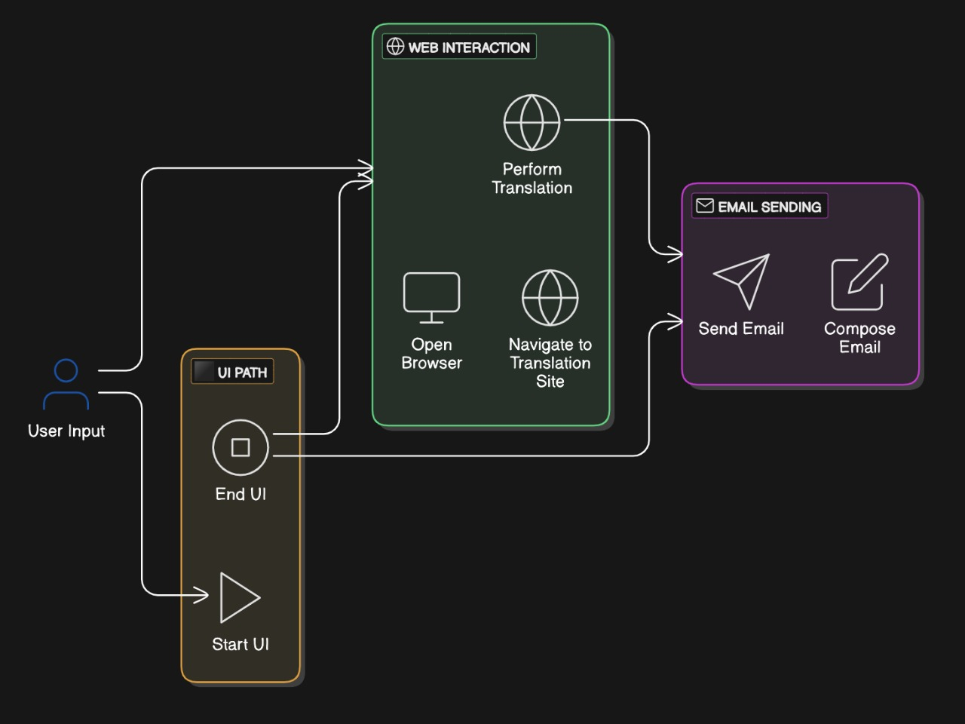
Architecture

Slide 8
System Requirements
Hardware:
PC with minimum 8GB RAM.
256GB Hard Disk.
Ryzen 7 Processor or above.
Software:
UiPath Studio.
Google Translate API.
SMTP email services.

Slide 9
Functional Description
Module 1: User Input Module
Accepts text input manually or via file upload.
Validates and prepares text for translation.
Module 2: Translation Module
Processes and translates text using APIs.
Formats content for email delivery.
Module 3: Email Delivery Module
Formats translated text and sends it to specified email addresses.
Provides options for single or bulk email distribution.

Slide 10
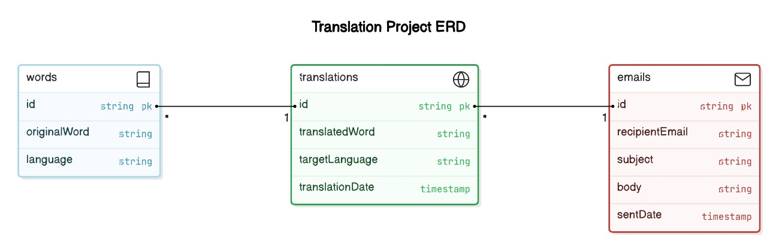
Table Design

Slide 11
Process Design
Main Process
The main process of the Language Translation Automation system involves automating the translation of text and distributing it via email. The process begins with user input, followed by text translation using APIs like Google Translate. The translated text is then formatted into an email and delivered securely, ensuring efficient multilingual communication with minimal manual effort.
Sub Process
The sub-processes include input collection, language selection, translation processing, email composition, and secure delivery. Input is validated, translated using APIs, and formatted appropriately. The system then integrates with email services to send the translated text. Error handling and activity logging ensure smooth operation and provide detailed records for troubleshooting and monitoring.

Slide 12
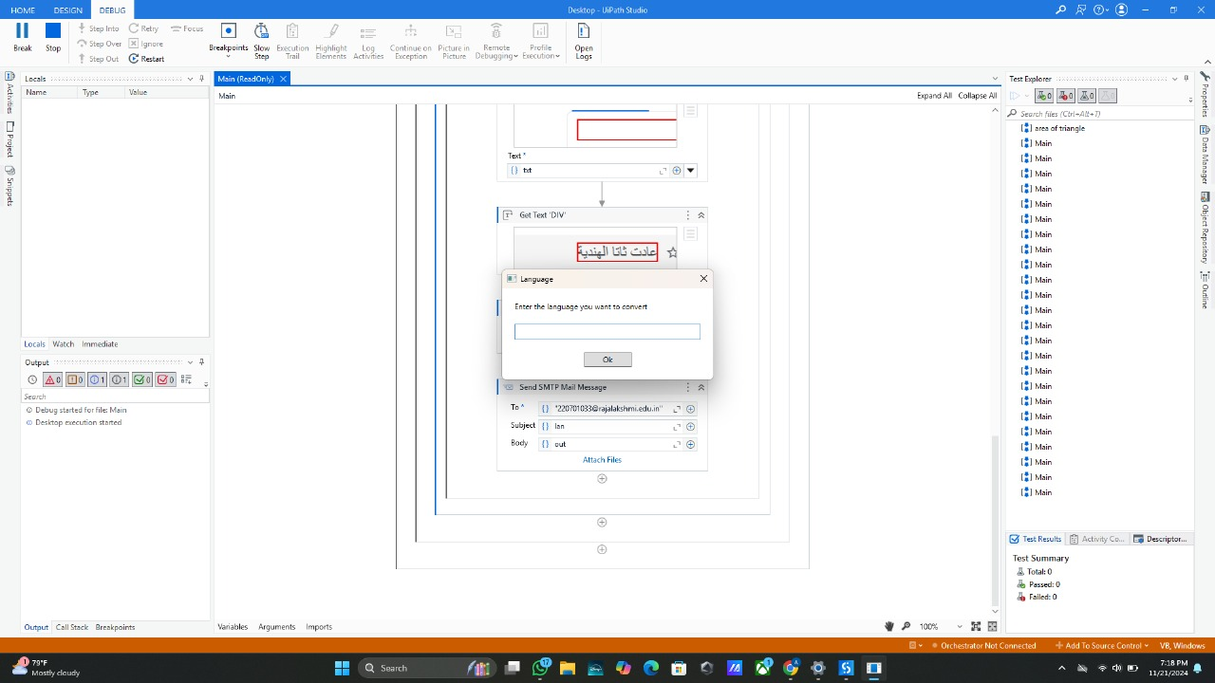
Implementation
Module 1: User Input Module
Description: Enables input validation and prepares text for translation.
Screenshots: Interface for user input.
Module 2: Translation Module
Description: Uses APIs to translate text and formats emails for secure delivery.
Screenshots: Translated content screen.

Slide 13
Testing
Translation accuracy.
Email delivery reliability.
Robust error handling.
Ensured smooth data flow and interaction between different modules.
Simulated errors like invalid inputs and API failures to ensure proper logging and notifications.
Verified that individual modules like input validation, translation, and email delivery work as expected. All components performed as expected with minimal errors.

Slide 14
Conclusions
The project automates translation and email distribution, saving time and reducing errors. It demonstrates the potential of RPA to enhance productivity and streamline multilingual communication
The implemented system enhances operational efficiency and reduces dependency on manual intervention, paving the way for further advancements in automated communication workflows.
The project demonstrates the effectiveness of integrating automation tools with translation and communication technologies, providing a scalable solution for multilingual tasks..

Slide 15
Future Enhancement
Support for more languages.
Integration with additional communication platforms.
Adding analytics and insights to track translation usage, efficiency, and performance metrics.
Incorporating advanced security measures like two-factor authentication for enhanced data protection.
Providing customization options for industry-specific terminologies and glossaries.
Expanding communication methods by integrating messaging platforms like WhatsApp, Slack, or Microsoft Teams.

Slide 16
References
Vaswani, A. et al. (2017). Attention Is All You Need.
Bahdanau, D., Cho, K., & Bengio, Y. (2014). Neural Machine Translation by Jointly Learning to Align and Translate.
Coursera: Natural Language Processing Specialization by Stanford University.
edX: Machine Learning for Language Technology by Delft University of Technology.

Slide 17
Thank You

