Slide 1
Brief Behavioural Activation (BBA) as a Transdiagnostic Therapy
Carl W. Lejuez, Ph.D.
Executive Vice President and Provost
Professor, Department of Psychology
and Department of Psychiatry and Behavioral Health
Stony Brook University – the State University of New York
carl.Lejuez@stonybrook.edu

Slide 2
Poll Question #1
How confident are you with implementing brief behavioral activation from 0 (not at all confident) to 5 (very confident)?
  0
  1
  2
  3
  4
  5
Notes:
c

Slide 3
Brief Behavioral Activation (BBA)
Today’s Agenda, Goals, and Ground Rules
Goals – You will leave…
Understanding the core conceptualization and underlying framework of BBA
Able to conduct BBA with individuals/groups across multiple disorders/settings
With tools to brainstorm challenges/barriers as they arise
Awareness of when you can and shouldn’t deviate from the protocol
Ground Rules
Ask questions and share thoughts
  Any time
  Often
  Hard/challenging content welcome
Agenda
BBA History/Data/Conceptualization
BBA Core Principles
Session Review
Applications: Opportunities & Challenges
Final Discussion

Slide 4
Early Behavioral Approaches for Depression
Ferster and Lewinsohn (and others)
Depression develops/maintains in response to:
  unsupportive environments with limited access to rewarding (pleasant) events and/or
  overexposure to punishing events
Treatment needed to increase those pleasant events and reduce the punishing events

Slide 5
Pleasant Events Conceptual Model
Vicious cycle of depression
Positive cycle of activity
Feel low
Feel better
“I can’t be bothered”
Stop doing things
Pleasant Events
Do more
Pleasant Events
“I’m going to do it anyway”

Slide 6
+ support from Gilbert Ryle
Thoughts/feelings are not causes but actually consequences of our actions/experiences
– Gilbert Ryle

Slide 7
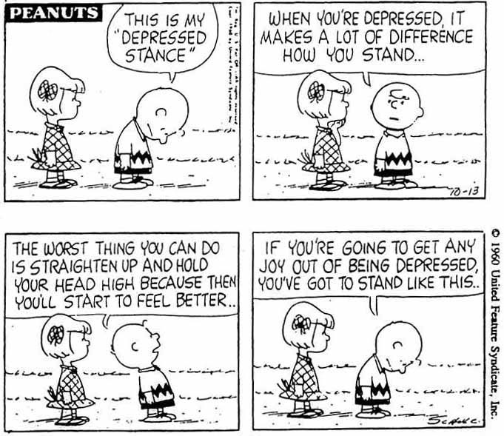
+ support from Gilbert Ryle & Charlie Brown
Thoughts/feelings are not causes but actually consequences of our actions/experiences
– Gilbert Ryle

Slide 8
Not everyone Agreed
Purely behavioral approaches did not endure and over time, cognitive interventions were integrated
As Lewinsohn and colleagues work developed, even it incorporated more and more cognitive techniques
In some cases, the behavioral components were dropped altogether

Slide 9
Data that Changed the Conversation
Jacobson et al., 1996
  Component analysis of (CBT) for depression
  Conditions (with 152 randomly assigned depressed outpatients)
    Behavioral Component (BC)
    BC + modification of dysfunctional automatic thoughts (BC+AT)
    Entire CBT package
  Key finding: BC = BC+AT = Full
Gortner et al., 1998
  These findings persisted over time

Slide 10
Additional Data that Further
Changed the Conversation
Dimidjian et al. (2006)
  Replication: BA Again comparable to cognitive therapy
  Extension I: BA Comparable to medication
  Extension II: Compared to cognitive therapy, BA outperformed cognitive therapy among those with more severe depression
Ekers et al. (2014)
  Meta-analysis of 26 randomized controlled trials
  BA was at worst comparable to cognitive therapy & medication
Richards et al. (2014)
  BA can be delivered by junior mental health workers with less intensive and
A range of additional more recent studies have followed these important foundational studies

Slide 11
What is Behavioral Activation
Originally a behavioral treatment for depression: 20+ session BA protocol
  Jacobson et al., 1996l Martell & Addis, 2001; Martell, Dimidjian, & Herman-Dunn, 2010
From this work, BA can be loosely defined as a set of strategies that engender positive behaviors that include:
  monitoring of daily activities
  assessment of pleasure and mastery that is achieved by engaging in a variety of activities
  assignment of increasingly difficult tasks to engender sense of pleasure or mastery
  discussion of specific problems and the prescription of relevant BA techniques
BA also places emphasis on:
  Standard BA activation components including in-session efforts to target/disrupt avoidance
  Strategies more indirectly related to BA including: periodic distraction from problems/unpleasant events, mindfulness training, skills training, cognitive rehearsal of scheduled activities, and self-reinforcement
Notes:
c

Slide 12
Brief Behavioral Activation (BBA)
Lejuez & Hopko: Behavioral Activation Treatment for Depression (BATD)
Typically 5-10 sessions with strict adherence to behavioral activation theory
More frequently applied to a rage of conditions beyond depression
1) Consideration of key life areas
2) Identification of values in each life area
3) Selection and daily engagement in valued activities
4) Structure & support available to live a valued life
* In the process of changing the name from BATD to BBA
Notes:
c

Slide 13
Application of BBA across Conditions (Transdiagnostic)
Soon became clear that BBA wasn’t limited to depression, with considerable work first starting with depressed substance users and then transitioning to a wide range of clinical presentations
Adjustments
  Same general structure but an added focus on substance use either explicitly as a Life Area or infused into all aspects of Life Areas
  Greater focus on impact of problem behaviors
  Attention to experiences prior to mental health issues
Notes:
c

Slide 14
Practice Exercise #1
Imagine someone is writing your biography
  What would you want it to say about you as a person and what you value?
  What are examples from your life that could be used to support what it is trying to say about you?
  Are there cases where you’d want it to say something about you as a person, but the examples are quite as good?

Slide 15
Poll Questions #2 & #3
Poll Questions #2 and #3 (same options for both)
Q#2: In which life areas do your daily activities best match your values
Q#3: In which life areas are your daily activities most incongruent with your values
  Relationships
  School / Career
  Hobbies/ Recreation/ Helping Others
  Mind, Body, & Spirituality
  Daily Responsibilities

Slide 16
Core Principles of BBA
Shaping
  Reinforcing approximations to target behavior
  Can include smaller approximations of final desired activity
Fading
  Provide support for success every time
  Structure of activation strategies (monitoring) are faded once targeted frequency/duration is attained (mastery)
  Therapist may need to periodically “fade in” prompts, structure, and functional analysis
Discounting
  Rewards and punishers are discounted by delay and uncertainty
Notes:
Carl

Slide 17
A Note About Individualization and the Role of the BBA Therapist
BBA is designed to be driven by the patient’s unique history and skill set, as well as cultural and other key contextual variables
Therapist is guide who sets the initial framework and provides structure throughout, but BBA is a patient driven therapy, that is meant to be used flexibly*
For this reason, it can be used in its current format across most situations and settings
BBA can be a stand alone treatment or used within the context of other therapeutic approaches
Notes:
Carl

Slide 18
BATD (BBA)
10-SESSION PROTOCOL
Notes:
s

Slide 19
Session 1
Treatment Rationale
Introduction to Behavior Monitoring
Notes:
S

Slide 20
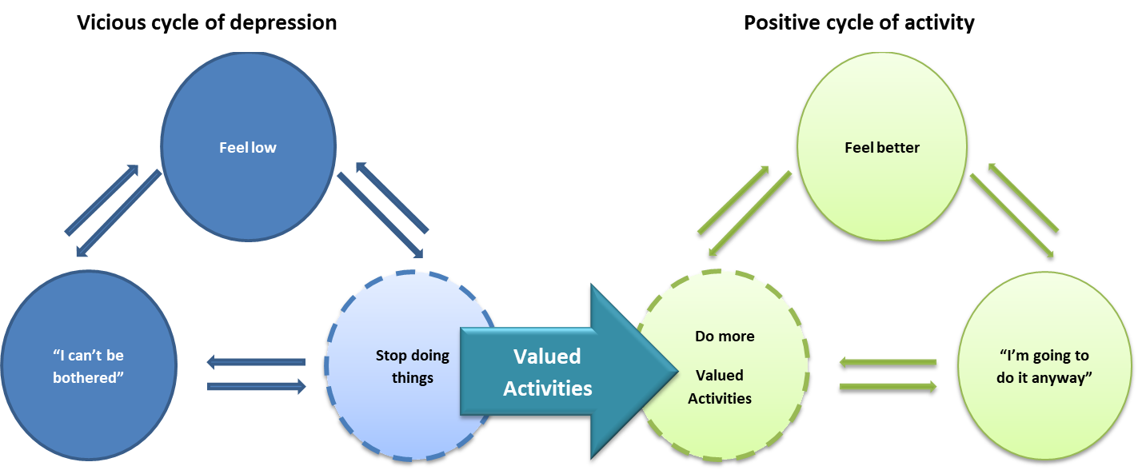
Treatment Rationale
Adjustment of conceptual model from pleasant events to valued activities
Rationale focuses on identifying importance of:
    1) The pattern of your depression
    2) The life areas that are most important to you
    3) The values you have in those life areas
    4) Valued activities that make your life feel fulfilling

Slide 21
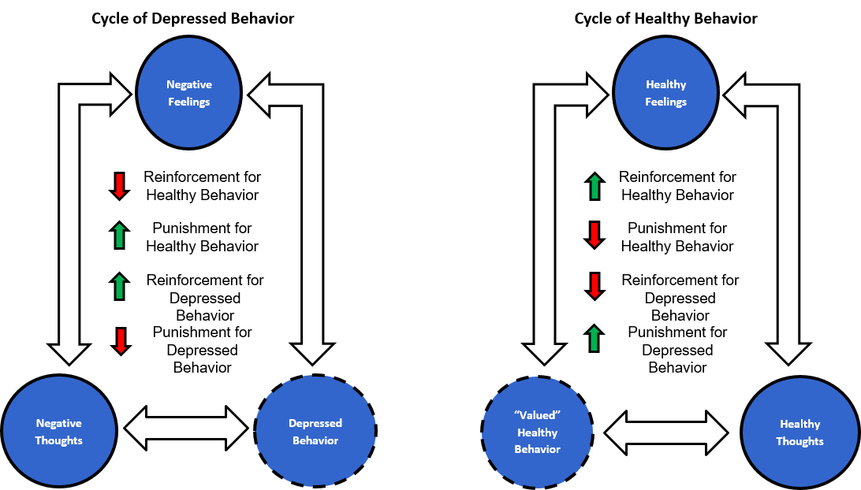
Reinforcement-based Conceptual Model Applied to Depression

Slide 22
Introduction to Clip
The upcoming clip is focused on the treatment rationale
  https://www.dropbox.com/scl/fi/1liug636u6c9hly17wcne/SLIDE_48_rationale-1-1.mp4?rlkey=3ae83m9omozbbpmexnqv5muar&st=t30my9bc&dl=0
After the clip, you will have the chance to answer Poll Question #4
Notes:
c

Slide 23
Poll Question #4
What aspect of the Brief BA treatment rationale might be most challenging for your client?
  Clients wanting to focus on sharing the details of their depression and/or other psychological symptoms before considering any behavior changes on their part
  Clients wanting to change their thoughts and mood before making behavior changes
  Clients being skeptical that their thoughts and mood can be positively impacted by their behavior change
  Clients being unable to conceptualize/identify valued activities to engage in
  Clients confusing any activity with valued activity
Notes:
c

Slide 24
Behavior Monitoring (Form 1)
Behavior monitoring is key to identifying depressed patterns (and healthy patterns!)
Behavior monitoring is done every day using Form 1
Activities are recorded on Form 1 throughout the day
For the first week, don’t make changes, just record activities
For every activity, rate importance and enjoyment
For each day, rate your depression/mood

Slide 25
Daily Monitoring (Form 1)
Date:_______________
Time | Activities | Importance (1-10) | Enjoyment (1-10)
7:00 – 8:00
8:00 – 9:00
9:00 – 10:00
10:00 – 11:00
11:00 – 12:00
12:00 – 1:00 pm
1:00 – 2:00 pm
2:00 – 3:00 pm
3:00 – 4:00 pm

Slide 26
Practice Exercise #2
Complete “Form 1: Daily Monitoring” for one day in the past week in your life

Slide 27
Introduction to Clip
The upcoming clip is focused on preparing a client for daily monitoring
  https://www.dropbox.com/scl/fi/5am2mvjjydoybvm6ypx4m/Slide_52_Baseline-Activity-Monitoring-2-19-122.mp4?rlkey=zj4yivlyur3w5uwtigebcodts&st=tqnfw380&dl=0
Notes:
c

Slide 28
Session 2
Behavior Monitoring: Review Assignment
Life Areas
Values
Activities
Life Areas, Values, and Activities Inventory (Form 2)

Slide 29
Behavior Monitoring Review (Form 1)
At the beginning of the session, review all 7 behavior monitoring forms from the previous week
Decide what to do if all forms aren’t complete
Identify depressed patterns
Identify where in their day/week they might begin to make some changes (adding more important and/or enjoyable activities)

Slide 30
Daily Monitoring (Form 1)
Date:_______________
Time | Activities | Importance (1-10) | Enjoyment (1-10)
7:00 – 8:00 | Sleep | 8 | 10
8:00 – 9:00 | Sleep | 8 | 10
9:00 – 10:00 | Sleep | 6 | 10
10:00 – 11:00 | Awake in bed | 2 | 3
11:00 – 12:00 | Awake in bed | 2 | 3
12:00 – 1:00 pm | TV | 4 | 7
1:00 – 2:00 pm | TV | 2 | 5
2:00 – 3:00 pm | TV | 1 | 2
3:00 – 4:00 pm | Laundry | 7 | 1

Slide 31
Introduction to Clip
The upcoming clip is focused on review of monitoring
  https://www.dropbox.com/scl/fi/5lttpt380dlgcumtp20bo/Slide_58_Reviewing-Baseline-Monitoring-with-Patient.mp4?rlkey=ipecgi31qqmsk3f6tmatb962c&st=54ur7h05&dl=0
After the clips, you will have the chance to answer Poll Question #5
Notes:
c

Slide 32
Poll Question #5
What is one challenge of monitoring as illustrated in the two clips?
  Clients might have little insight into their daily activities
  Clients may have trouble grasping the connection between activities and mood
  Monitoring can be a lot of work
  Monitoring can feel complex and overwhelming
Notes:
c

Slide 33
5 Life Areas
Relationships
School / Career
Hobbies/ Recreation/ Helping Others
Mind, Body, & Spirituality
Daily Responsibilities

Slide 34
Identify Values
Identify Values for each Life Area
A value is an ideal, quality, or strong belief in certain way of living
To think about values, ask patient what is important to you and how do you want to live your life in that area
Examples of values are:
  Be a good parent
  Get more formal education
  Live a spiritual life

Slide 35
Identify Activities
Select Activities for each Value
Break down values into specific activities
An activity is something you do that can be observed
  Go for a walk (activity)
  Think happier thoughts (not an activity)
Select easy and difficult activities
  Including those already being done
Once activities are selected they become the focus as opposed to the value→ that comes later
  Activities should be enjoyable or important or both

Slide 36
LAVA
Life Area: Relationships
Value: Being a loving parent
  Activity: Telling my child I love them every day
  Activity: Make a special breakfast for my child on Saturday
  Activity: Picking up my child from school promptly each day
Life Area: Mind, Body, Spirituality
Value: Caring for my physical health
  Activity: Cook healthier Meals
  Activity: Take the stairs once per day at work
Life Area: Responsibilities
Value: Be someone others can depend upon
  Activity: Arrive at work on time
  Activity: Pay my bills on time
Notes:
SHERRY

Slide 37
Activities as “Angles” and/or “Steps”
For most Life Area/Value sets, multiple activities will be chosen
It is useful to distinguish these activities as:
  distinct angles towards value achievement OR
  nested steps all part of a sequence towards value achievement
The existing BA materials do not differentiate angles and steps (though probably should and likely will in new updates) but its important for you to be aware of the difference
  More angles provide more unique ways to value achievement
  Steps are a great example of shaping and may be necessary to build momentum if the activity itself may be too hard at first

Slide 38
Practice Exercise #3
For 2 different life areas, identify a value and at least 2 activities in each for “Form 2: LAVA Inventory” using only activities that are different “angles”

Slide 39
Session 3
Behavior Monitoring Form 1: Review Assignment
Life Areas, Values, and Activities Inventory (Form 2): Review Assignment
Activity Selection and Ranking (Form 3)

Slide 40
Activity Selection & Ranking (Form 3)
Select 15 activities from the Life Areas, Values, and Activities Inventory
Activities rank-ordered from 1 (easiest) to 15 (most difficult)
These are a starting point and activities can be reordered, added, and removed anytime

Slide 41
Activity Ranking Form
Instructions: List your desired activities and rate the difficulty of each from 1 = least difficult to 15 = most difficult
ACTIVITY | Rank
Go to work | 2
Wake up before 1 P.M | 8
Play with daughter | 1
Make dinner | 4
Call friend | 3
Clean bedroom | 5
Go for a walk outside | 6
Meditate | 7

Slide 42
Session 4
Behavior Monitoring Form 1: Review Assignment
Activity Selection and Ranking (Form 3): Review Assignment
Activity Planning (with Daily Monitoring Form 1)

Slide 43
In-Session Planning
Behavior Monitoring with Activity Planning (Form 1)
Monitoring transitions to planning and monitoring
Activities planned can range from only 1 very easy activity for the whole week or several challenging activities each day
Planning is done in the session for the whole week but changes can be made at any time

Slide 44
Daily Monitoring (Form 1)
Date:_______________
Time | Activities | Importance (1-10) | Enjoyment (1-10)
7:00 – 8:00 | Sleep | 8 | 10
8:00 – 9:00 | Sleep | 8 | 10
9:00 – 10:00 | Sleep | 8 | 10
10:00 – 11:00 | Awake in bed | 2 | 3
11:00 – 12:00 | Awake in bed | 2 | 3
12:00 – 1:00 pm | TV | 4 | 7
1:00 – 2:00 pm | TV | 2 | 5
2:00 – 3:00 pm | TV | 1 | 2
3:00 – 4:00 pm | Laundry | 7 | 1

Slide 45
Daily Monitoring (Form 1)
Date:_______________
Time | Activities | Importance (1-10) | Enjoyment (1-10)
7:00 – 8:00
8:00 – 9:00
9:00 – 10:00
10:00 – 11:00 | Call friend
11:00 – 12:00
12:00 – 1:00 pm
1:00 – 2:00 pm | Edit resume
2:00 – 3:00 pm
3:00 – 4:00 pm | Laundry (1 load)

Slide 46
Planning and Monitoring
In addition to regular monitoring, completion of planned activities should be noted by circling it in Form 1
If the activity does not occur it should be crossed out, and the actual performed activity written in
This activity can be planned at another time in the week by writing it into a future time point in Form 1- and then circling it or crossing it out again

Slide 47
Introduction to Clip
The upcoming clip is focused on the valued activity planning
  https://www.dropbox.com/scl/fi/9t3efluco2ef0q5ef22h4/Slide_82_Provider-to-Patient-Activity-Scheduling-Demonstration-NEW-12-291.mp4?rlkey=vxxkm5hzlgjhn6naahb085x2o&st=13chozgy&dl=0
After the clip, you will have the chance to answer Poll Question #6
Notes:
c

Slide 48
Session 5
Daily Monitoring with Planning (Form 1): Review Assignment
Behavior Contracts (Form 4)
Daily Monitoring with Planning (Form 1) for upcoming week
Notes:
K

Slide 49
Daily Monitoring (Form 1) – SUD Version
Date:_______________
Time | Activities | Importance (1-10) | Enjoyment (1-10) | Craving (1-10)
7:00 – 8:00 | Sleep | 8 | 10 | N/A
8:00 – 9:00 | Sleep | 8 | 10 | N/A
9:00 – 10:00 | Sleep | 6 | 10 | N/A
10:00 – 11:00 | Call sponsor | 7 | 5 | 2
11:00 – 12:00 | Go Coffee shop | 6 | 10 | 2
12:00 – 1:00 pm | TV | 4 | 7 | 5
1:00 – 2:00 pm | Edit Resume TV | 1 | 1 | 8
2:00 – 3:00 pm | Edit Resume | 10 | 4 | 2
3:00 – 4:00 pm | Laundry (1 load) | 7 | 1 | 2

Slide 50
Contracts (Form 4)
Designed to facilitate getting support from others for difficult activities
Establish “outside” environment that supports healthy behavior through assertive requests
Outline specific means of assistance
Create separate contract for each problem activity
Doesn’t need to be done explicitly as a contract

Slide 51
Contracts (Form 4) - Example
What is one activity that you could use help completing?
_____________________________________________________________________
Name one person who can help you with this activity:
_____________________________________________________________________
What are the ways this person can help you with this activity:
1. _______________________________________________________________________
2. ________________________________________________________________________
3. ________________________________________________________________________

Slide 52
Sessions 6-10
Daily Monitoring and Planning (Form 1): Review of past week and prepare for upcoming week
Concept review for:
Contracts (Form 4) – session 6 (1st time reviewed)
Life Areas, Values, and Activities (Form 2) – session 7
Activity Selection and Ranking (Form 3) – session 8
Contracts (Form 4) – session 9
Session 10: Ending therapy
Notes:
K

Slide 53

BBA as a Swiss Army Knife Intervention?

Slide 54
Some Challenging Issues
Rationale can be complicated for some especially if their substance use has created cognitive difficulties/arrested development
Values will mean different things across patients and at different times of their sobriety – some may feel undeserving
You may need to address non-adherence (in and out of session) related to their substance use and/or treatment structure
Some patients will have limited environments (especially related to substance use consequences) that make many activities hard to do
Patients may bring clinical myopia overly focused on substance use that will make it hard to develop a rounded approach

Slide 55
Tips for Using Brief BA in a Group Setting
Essential
Facilitate brainstorming opportunities as a group
Create multiple break-out discussion group opportunities
Balance participation with comfort-level/privacy
Optional
Leverage those who are “getting it”
Optional: Add members into each other’s activities/contracts
Notes:
S AND K (K HAS CASES)

Slide 56
Complete NOW
Simplified Form: One per Day
Review at NEXT SESSION
What is one value you’d like to work on today?
What is an activity that you can do today for your value?
What time in the next 24 hours do you plan to do this activity?
Did you complete the activity? YES NO
If you did complete the activity, when did you do it?
Was it when you planned to do it? If not, what happened?
If you did complete the activity, circle how much you enjoyed it:
If you did complete the activity, circle how important this activity was to your value:
If you didn’t complete the activity, why not?

Slide 57
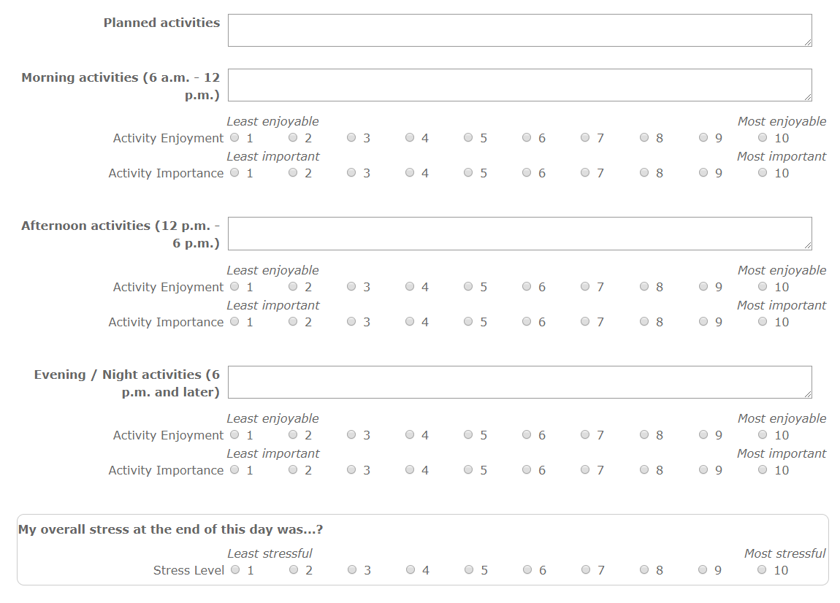
Simplified Form: Blocks of Time

Slide 58



Simplified Form: Low Literacy
sleep
phone
shower
watch tv
work
work
Notes:
C AND S

Slide 59
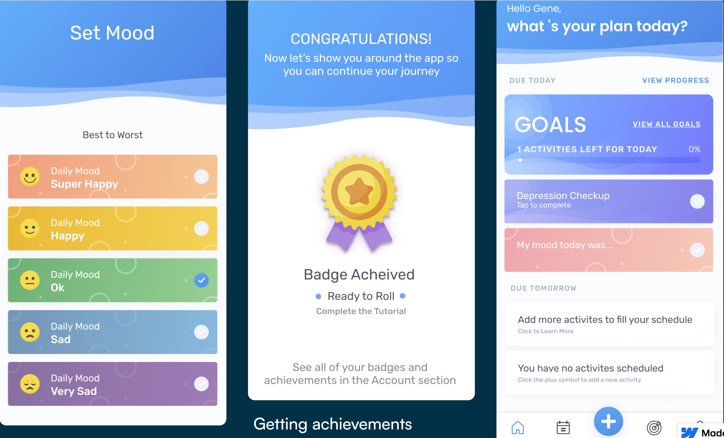
Therapist-assisted App-based Brief BA
https://www.behavioralactivationtech.com/about (please direct any questions to dahne@musc.edu)
For a Lets Act specific app, see: Paquette CE, Rubalcava DT, Chen Y, Anand D, Daughters SB.; A Mobile App to Enhance Behavioral Activation Treatment for Substance Use Disorder: App Design, Use, and Integration Into Treatment in the Context of a Randomized Controlled Trial; JMIR Form Res 2021;5(11):e25749; doi: 10.2196/25749
Notes:
S AND K (K HAS CASES)

Slide 60
Poll Question #7
Following today’s session, how confident are you with implementing brief behavioral activation from 0 (not at all confident) to 5 (very confident)?
  0
  1
  2
  3
  4
  5
Notes:
c

Slide 61
Poll Question #8
Following today’s workshop, what aspect of behavioral activation remains most challenging?
  Rationale
  Monitoring
  LAVA
  Activity Ranking
  Planning and Monitoring
  Contracts
  Maintenance
Notes:
c

Slide 62
Final Discussion and Questions
Notes:
Carl

