Slide 1

EUPHEUS
it is this willingness to keep learning that makes the difference in the long run

Slide 2

ABSTRACT
EUPHEUS is a website developed for the usage of the students and the parents who are in search of the correct platform for the future. This system will be a path finder for the students who are planning for their further studies. The users will be guided with the courses across India with the approximate fees structures. This website will give the complete details about the course and also the job opportunities related to it. Eupheus will also tell us information about the examinations conducted by the governments for certain jobs. This would be an entire package of course, jobs related to it and also the information about that.
This system helps the students to choose a right course which is perfect for them, from the variety of courses available and also helps the job seekers to find a good job. Eupheus also assists the parents who do not know about the courses but need to admit their child in a good platform with the necessary information and their advantages. Many people are not aware of the various paths that are at hand and they just go for only the most commonly taken courses. There are a lot of people suffering out there without proper guidance and to end that this website is made. This website will be the solution for the students or job seekers who are in need of guidance in terms of higher education and job opportunities.

Slide 3
MODULES - USERS, ADMIN
Register.
Login.
Home.
Courses
Colleges
Job portal
Scholarships
Overseas
Additional info

Slide 4
SYSTEM SPECIFICATIONS
HARDWARE SPECIFICATIONS
SOFTWARE SPECIFICATIONS
PROCESSOR
2GHz or more
HARD DISK CAPACITY
64GB or above
RAM
4 GB or above
KEYBOARD
105 keys
MOUSE
Compactable pointing device.
INTERNET CONNECTION
OPERATING SYSTEM
Windows 7
FRONT END
HTML, CSS and Java Script
BACK END
FIREBASE

Slide 5

LIMITATIONS in EXISTING SYSTEM
Only separate websites are available.
No information about the fees structure (available but on different websites for different courses).
There is no single website to view all the required details. We have to visit different websites for the details we need.
Huge content (which will make the people feel lazy to read).
No website calculates the cut off and recommend the colleges based on the marks.
No website tell us about the online courses based on the courses they are doing.

Slide 6

PROPOSED SYSTEM-ADVANTAGES
Conglomeration of all information about courses and jobs under single site.
Notify us about the scholarships.
User friendly.
Approximate fees will be presented.
Students can decide whether to join abroad courses knowing the approximate expenses via Eupheus.
It tells about the online courses based on the courses they are doing.
It calculates the cut-off and the colleges will be displayed based on their colleges.

Slide 7

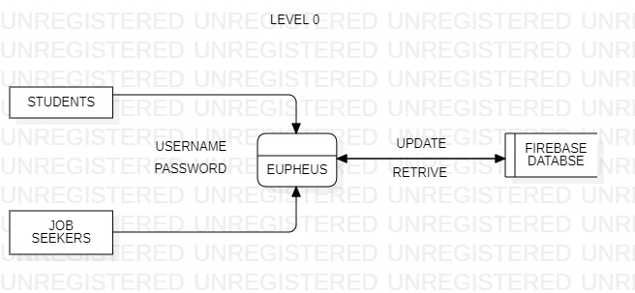
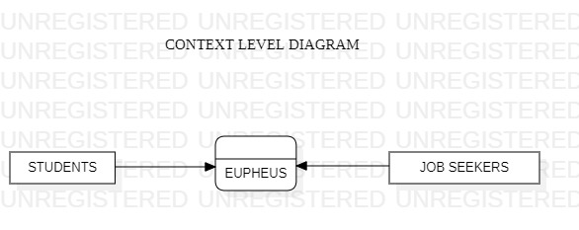
DATA FLOW DIAGRAM
CONTEXT LEVEL DIAGRAM
LEVEL 0

Slide 8
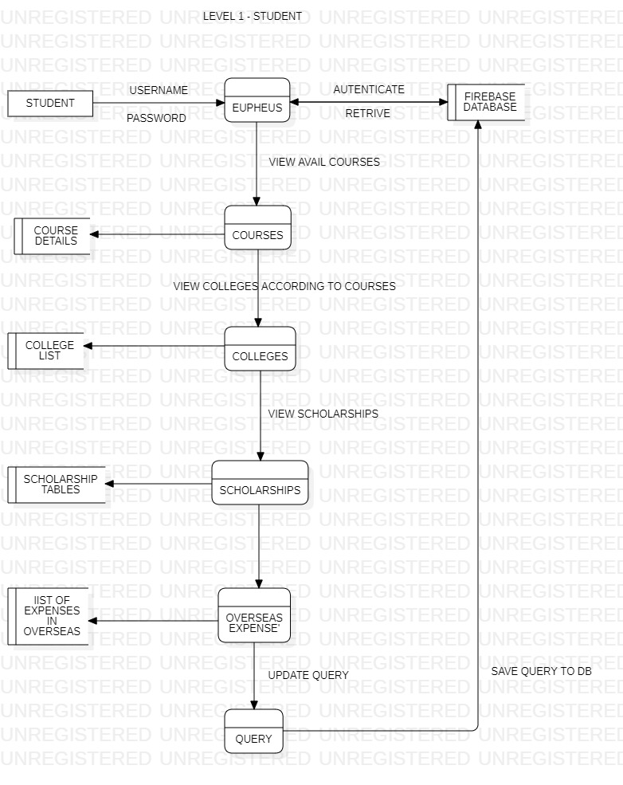
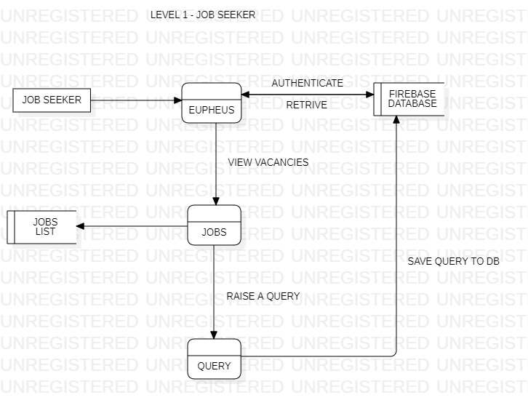
DATA FLOW DIAGRAM
LEVEL 1 – JOB SEEKER
LEVEL 1 - STUDENT

Slide 9

FUTURE ENHANCEMENTS
According to the marks, all the colleges across India will be displayed.
Students will be instructed about the exam dates.
The students will also be provided with the university details in abroad.
The students will be allotted with separate counsellors if required.
Chat bots will help the students then and there.

Slide 10

CONCLUSION
It is concluded that the website “EUPHEUS” is to provide guidance for the students about all the paths that are available for them and the job opportunities for the people who are in search of the jobs. Eupheus overcomes the snag of the existing system and designed as an entire bundle which gives wholly information about the courses, jobs, fees. This website acts as a perfect guide for the students who are in need of guidance regarding their studies.

