Slide 1
MIDAS
(Meteor Identification and Detection Automation System)
CE901 - Msc Dissertation Project
Author: Ashwin Purushothama Dhas
Registration number: 2320993

Slide 2
Agenda
Introduction
1
Using MIDAS
6
Related Works
Future Scope
2
7
Dataset
Conclusion
3
8
Methodology
Acknowledgements
4
9
Evaluation
5

Slide 3
1
Introduction

Slide 4
Introduction to MIDAS
What is MIDAS?
MIDAS (Meteor Identification and Detection Automation System): A project to automate meteor detection in spectrogram images from BRAMS (Belgian RAdio Meteor Stations).
Why MIDAS?
Manual analysis of large spectrogram datasets is inefficient and time-consuming.
Machine learning enables accurate and efficient detection of meteors.
Models Evaluated in MIDAS:
YOLO11m: High-performing object detection model.
MeteorNet: Custom neural network model.
Hybrid Model: MobileNet_v3 + Random Forest classifier.
Fusion Model: Combines YOLO11m and MeteorNet for enhanced accuracy.
Key Deliverable:
A web application enabling users to upload spectrogram images and detect meteors automatically.
Impact:
Provides valuable tools for meteor observation, advancing research in atmospheric science and machine learning.

Slide 5
2
Related works

Slide 6
Background
What is a Meteor?
A meteor, or "shooting star," is the streak of light from a meteoroid entering Earth's atmosphere.
The light is caused by intense heat from friction between the meteoroid and atmospheric gases.
What Meteors Leave in Space?
Meteoroids vaporize in the atmosphere, leaving behind ionized particle trails.
These trails can reflect radio waves detectable by ground-based stations.
Radio Signals and Meteors:
Ionized trails reflect radio waves, enabling meteor detection via radio signals.
Reflected radio waves produce characteristic signals for analysis.
Importance of Meteor Detection
Helps understand meteoroid behaviour, composition, and movement in Earth's atmosphere.
Provides insights into atmospheric science and space debris interactions.
Role of Spectrogram Images
Represents frequency-time data of meteor echoes.
Enables detailed analysis of meteors' size, shape, and movement using Doppler shifts.

Slide 7
Previous works in meteor detection
Optical Techniques:
          Long-exposure photography to study meteor showers (Hawkes & Jones, 1975).
          Provided insights into brightness, frequency, and spatial distribution.
Radio-Based Methods:
Forward-scattering techniques reflect radio waves off ionized meteor trails (McKinley, 1961).
Enabled 24/7 meteor monitoring in all weather conditions.
Current Machine Learning Approaches:
Dilated CNNs outputs image different than the original image.
Used sliding windows over labeled spectrograms. Developed a CNN model for pixel-level detection of meteor echoes (Stan Draulans, 2019).
Explored simple CNN, transposed CNN, and dilated CNN for improved detection. Dilated CNN achieved the highest F1-score (0.870) due to effective noise handling (Jean Lobet, (2021).

Slide 8
Limitations of previous works
Optical Techniques:
          Dependent on clear skies and darkness.
          Cannot detect faint meteors or those obscured by clouds.
          Time-consuming and labor-intensive.
          Radio-Based Methods:
Generate massive spectrogram data requiring advanced analysis tools.
Manual interpretation is slow and prone to errors.
Current Machine Learning Approaches:
Challenges in detecting irregularly shaped meteor echoes.
bounding boxes are inconsistent with the actual meteor shapes.
Over-smoothing misses finer details of meteor echoes.
Military aircrafts are incorrectly identified as meteor echoes.

Slide 9
Objectives
Download spectrogram images from BRAMS downloader.
Label meteor objects within spectrogram images.
Train Machine Learning Models(YOLO11, MeteorNet, and Hybrid Model).
Evaluate performance using McNemar’s test.
Build MIDAS web application using trained models.
Automate meteor detection from BRAMS spectrogram images.

Slide 10
3
Dataset

Slide 11
Data preparation
Data Collection:
          Downloaded 8,000 spectrograms using the BRAMS Data Downloader (09/09/2024 to 10/09/2024).
          Selected diverse locations for varied-quality.
          Data Filtering:
Selected 1300 images for labeling.
Diversity: Balanced mix of underdense and overdense echoes, normal and military aircrafts echoes, beacon signal, broadband signal echoes and background only.
Data Annotation:
Annotated using LabelMe for bounding boxes around meteor echoes.
Augmentation (horizontal/vertical flips) increased dataset to 3,400 samples.
Focused on meteor echoes only, avoiding clutter from irrelevant objects.
Format: Class ID, normalized center coordinates (x, y), width, height.
Data Splitting:
Training: 3,000 samples.
Validation: 200 samples.
Testing: 200 samples.
Ensured proper learning, validation, and fair evaluation.

Slide 12
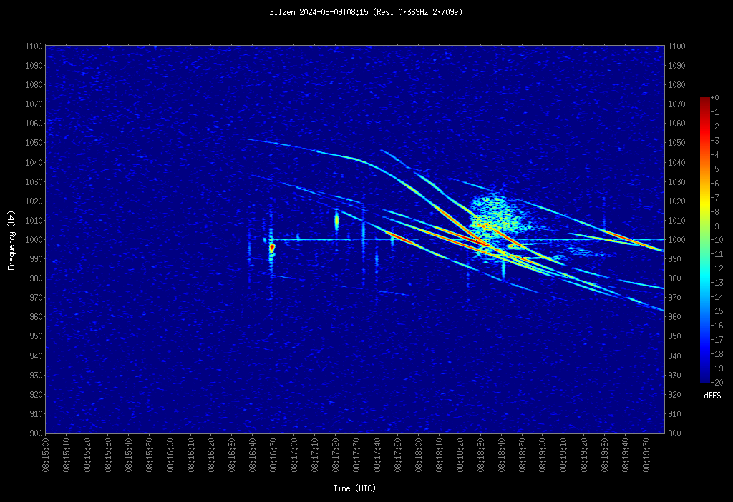
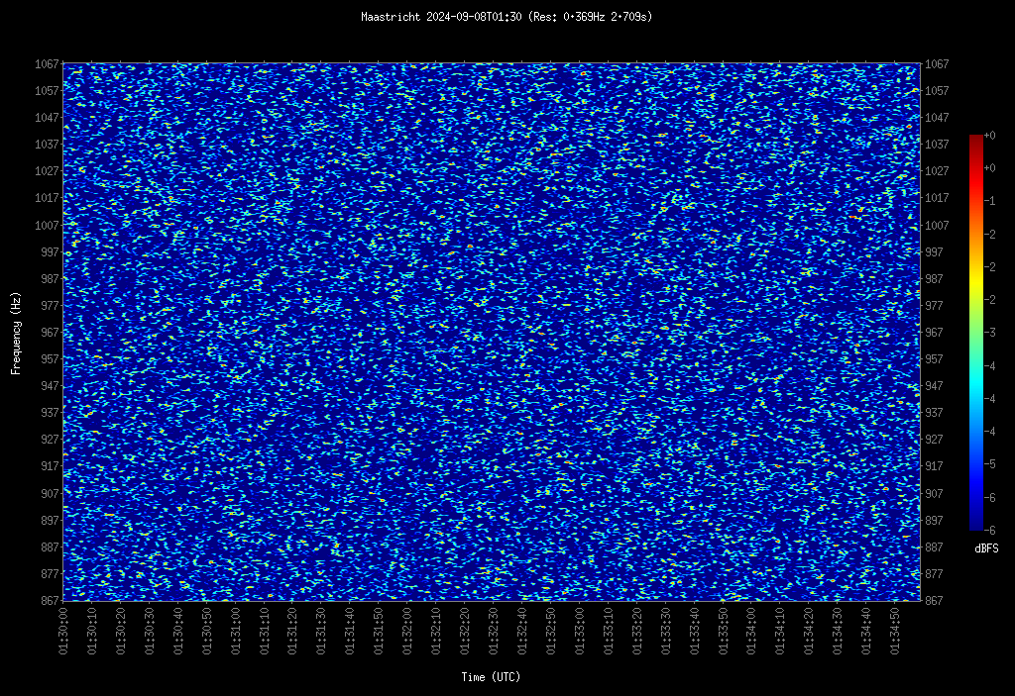
Spectrogram images with and without objects

Slide 13
4
Methodology

Slide 14
Model Development
YOLO11m:
SOTA object detection model.
Configuration:
Pretrained weights: YOLO11m.pt
Optimizer: SGD, Learning Rate: 0.001
Augmentations: Auto-augment, horizontal/vertical flips
Training Epochs: 300 (early stopping: 10 epochs) Dataset: Trained on 3 sizes (3000, 2000, 1000 samples).
Input: 960×960 pixels,
Batch Size: 16
Confidence Threshold: 0.3, IoU: 0.6
MeteorNet:
Custom CNN for object detection.
Configuration:
Input: 256×256 pixels, Batch Size: 16
Optimizer: Adam, Loss: Binary cross-entropy
Metrics: Precision, Recall, F1-Score, IoU
Data Preparation: Created binary masks for meteor regions from YOLO labels.
Training on subsets of 3000, 2000, and 1000 samples.
Features: High segmentation precision for meteor echoes.

Slide 15
Model Development
Hybrid Model (MobileNet_V3 + Random Forest) :
Purpose: Lightweight feature extraction with classification.
Configuration:
MobileNet_V3: Feature extractor, Random Forest: Classifier
Input: Resized to 256×256 pixels
Random Forest Estimators: 50, Class Weight: Balanced.
Feature Patches: 16×16 pixels using MobileNet_V3.
Outcome: Lower accuracy than YOLO11m and MeteorNet.
    Fusion Detection Technique :
    Overview: Combines YOLO11m and MeteorNet.
    Goal: Improve meteor detection accuracy by leveraging strengths of both models.
    Pipeline:
                YOLO11m: Detects potential meteor regions using bounding boxes.
    MeteorNet: Segments meteor regions for more precise bounding boxes.
    Bounding Box Combiner: Merges overlapping/adjacent boxes for consolidated detections.
    Outcome:
    Clear visual representation of meteor objects in spectrograms.
    Enhanced accuracy through complementary model integration.

Slide 16
5
Evaluation

Slide 17
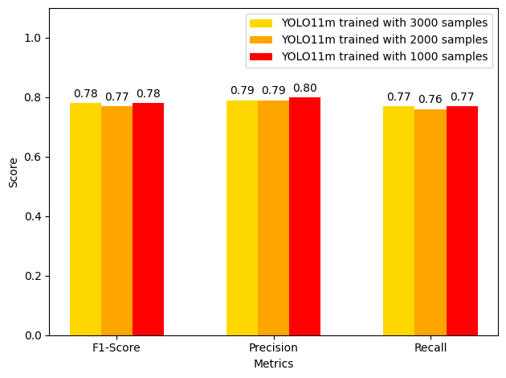
Comparative Analysis of YOLO11m Performance
YOLO11m was trained on 3 configurations: 3000, 2000, and 1000 samples.
Training on 1000 samples achieved the best balance, while 3000 samples excelled in precision.

Slide 18
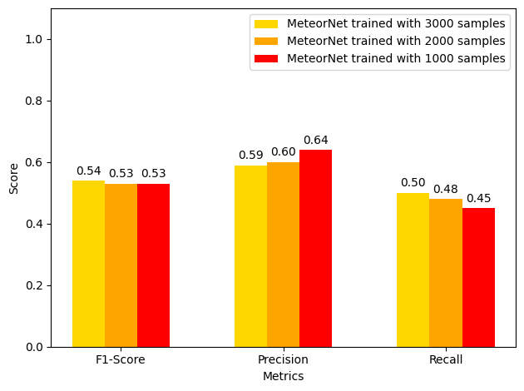
Comparative Analysis of MeteorNet Performance
MeteorNet was trained on 3 configurations: 3000, 2000, and 1000 samples.
3000 samples provide the best balance of metrics and is the optimal choice for MeteorNet in MIDAS.

Slide 19
Analysis of Hybrid Model Performance
Trained on 3000 samples, not tested on smaller datasets.
Less precise compared to YOLO11m (well-centered) and MeteorNet (detailed boundaries). Often misplaced or covering extra areas.
The hybrid model had a weaker balance of true positive detection and false positive avoidance.
YOLO11m and MeteorNet outperformed the hybrid model in accuracy and reliability.

Slide 20
Analysis of Fusion Technique Performance
Combines YOLO11m and MeteorNet outputs.
Improved meteor detection accuracy by leveraging strengths of both models.
Detected meteors missed by YOLO11m or MeteorNet alone.
Merged overlapping bounding boxes for better placement.
Resolved inconsistencies from individual model predictions.
Removed false positives from MeteorNet if not confirmed by YOLO11m.
Resulted in cleaner, more reliable predictions.

Slide 21
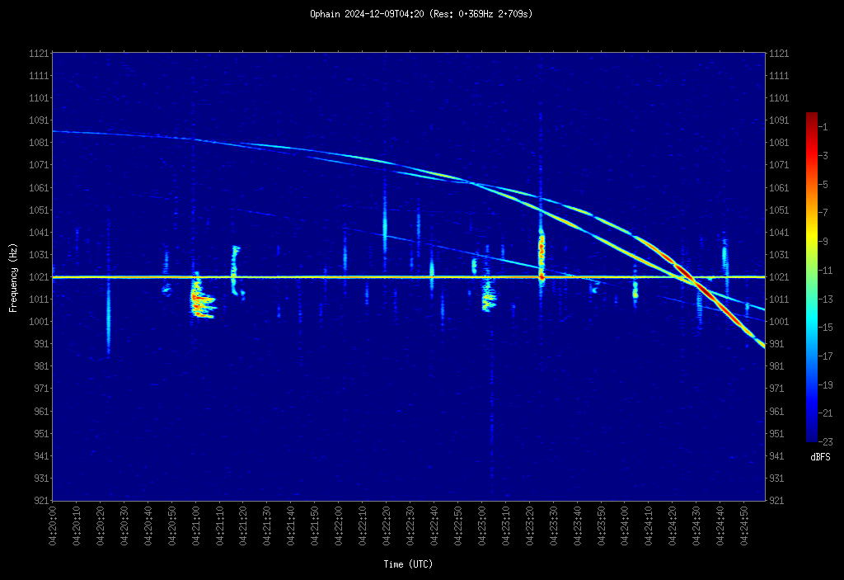
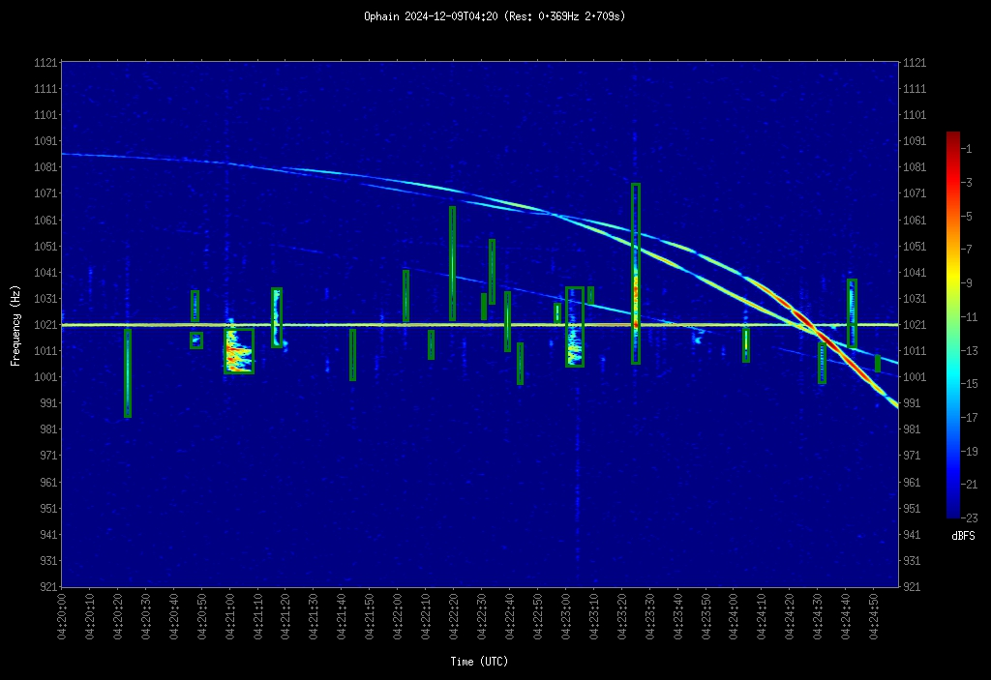
Prediction power of Yolo11m

Slide 22
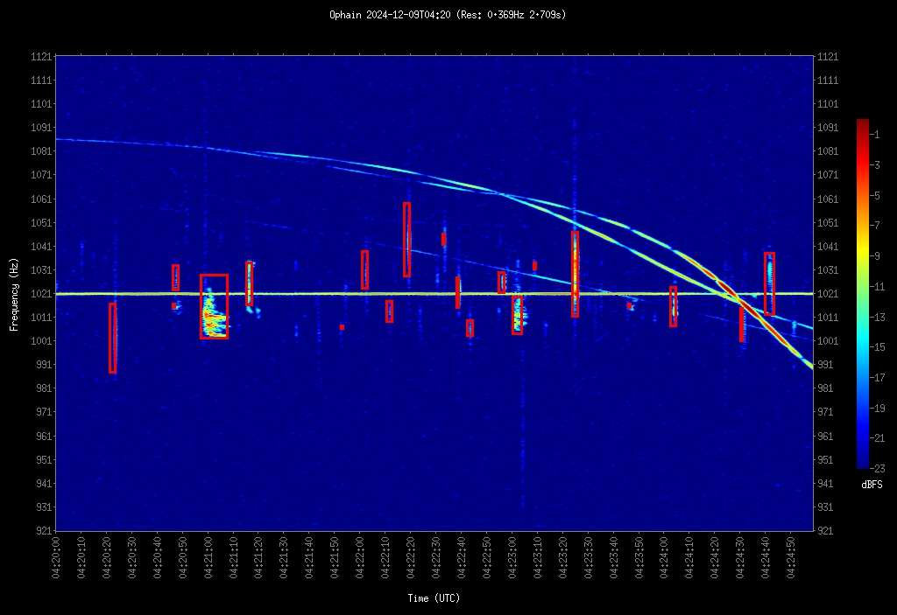
Prediction power of MeteorNet

Slide 23
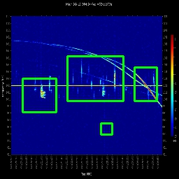
Prediction power of Hybrid Model

Slide 24
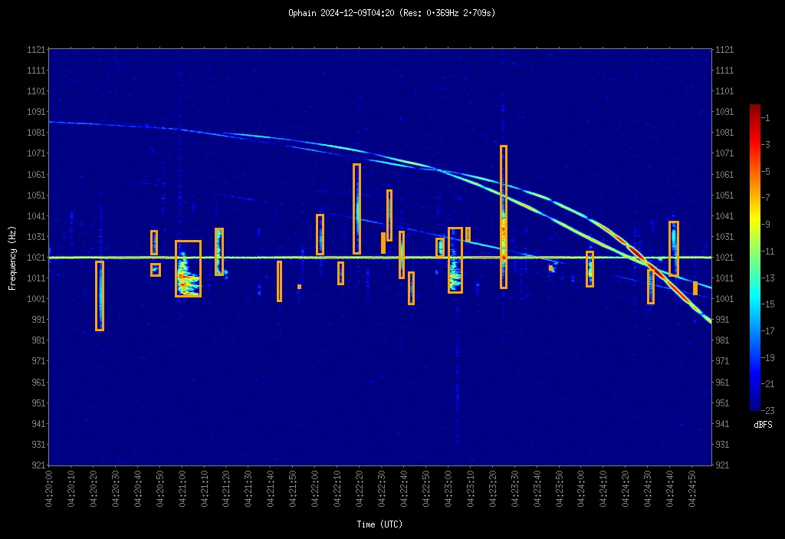
Prediction power of Fusion Technique

Slide 25
McNemar’s Test Results and Analysis
Purpose of McNemar's Test:
Compare the performance of YOLO11m, MeteorNet, and Fusion models.
Evaluate strengths and weaknesses statistically.
Excluded Hybrid model due to poor performance.
Implications:
Fusion model is the best-performing approach for meteor detection.
Statistical Significance: All comparisons have p-value < 0.05..

Slide 26
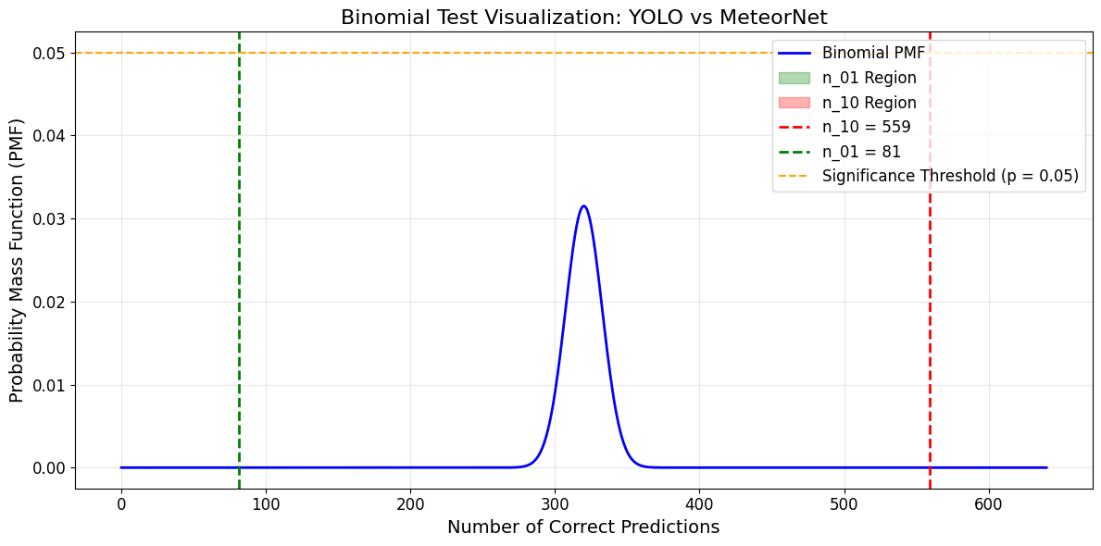
McNemar’s Test Results and Analysis
YOLO11m vs MeteorNet:
Correct YOLO11m Predictions Missed by MeteorNet: 559 (n_10)
Correct MeteorNet Predictions Missed by YOLO11m: 81 (n_01)
Z-Score: 18.8946
p-value is < 0.05
Conclusion: YOLO11m outperforms MeteorNet significantly due to its design for object detection.

Slide 27
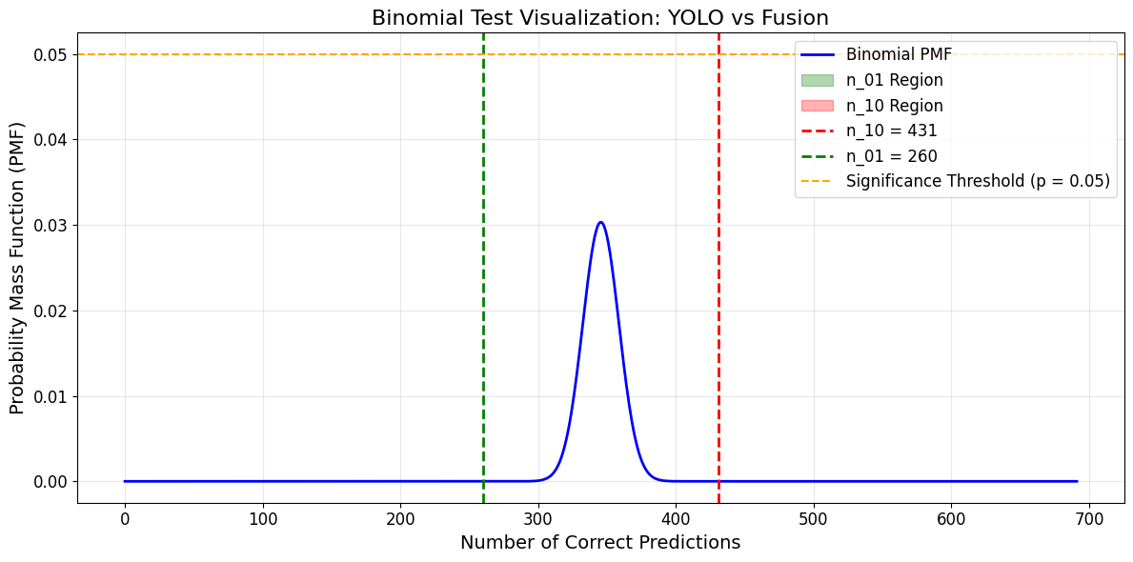
McNemar’s Test Results and Analysis
YOLO11m vs Fusion:
Correct YOLO11m Predictions Missed by Fusion: 431 (n_10)
Correct Fusion Predictions Missed by YOLO11m: 260 (n_01)
Z-Score: 6.5051
p-value is < 0.05
Conclusion: Fusion surpasses YOLO11m by combining strengths of YOLO11m and MeteorNet.

Slide 28
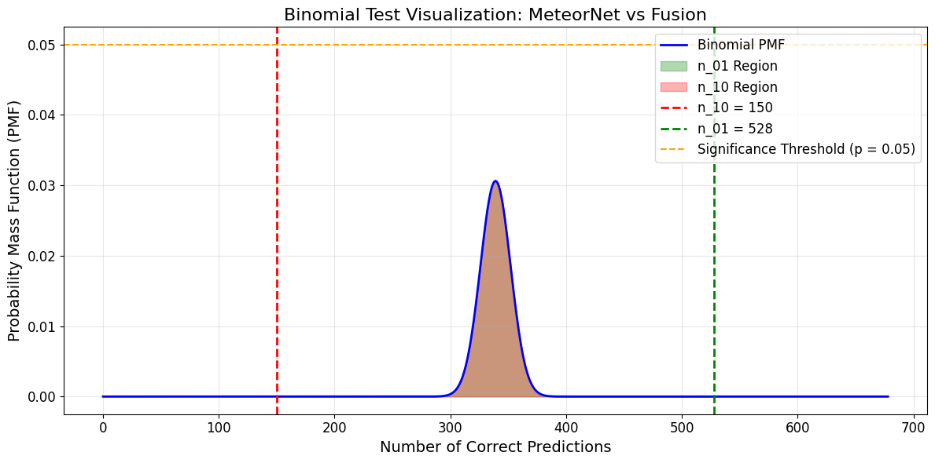
McNemar’s Test Results and Analysis
MeteorNet vs Fusion:
Correct MeteorNet Predictions Missed by Fusion: 150 (n_10)
Correct Fusion Predictions Missed by MeteorNet: 528 (n_01)
Z-Score: -14.5170
p-value is < 0.05
Conclusion: Fusion resolves MeteorNet's limitations with YOLO11m’s precision.

Slide 29
6
Using MIDAS

Slide 30
Operating MIDAS
MIDAS simplifies meteor detection with an intuitive GUI and integrated models, but its limitations in deployment and performance highlight areas for future improvement.
Steps to Operate MIDAS:
Model Selection: Choose a detection model from the sidebar dropdown.
Image Upload: Drag and drop or browse to upload spectrogram images.
Run Detection: Click the Detect button to process images.
View Results: Results appear with annotated bounding boxes in the main display area.
Color-Coded Outputs:
YOLO11m: Green bounding boxes.
MeteorNet: Red bounding boxes.
Hybrid: Light Green bounding boxes.
Fusion: Orange bounding boxes.
Limitations:
Requires manual installation of dependencies.
Runs only on local machines.

Slide 31
7
Future Scope

Slide 32
Future Scope
Cloud Hosting: Deploy MIDAS on a cloud platform for remote accessibility. Eliminates the need for local setup and manual dependency installation.
Integration with Meteor Networks: Connect MIDAS with systems like BRAMS for real-time meteor detection and classification.
Dataset Expansion: Increase training data.
Increasing the input size for MeteorNet should definitely improve its detection power.
Implement automated hyperparameter tuning for all models to enhance performance.
Wider Applications: Test MIDAS in different meteor observatories using spectrogram data. Explore deployment in real time meteor observation systems.

Slide 33
8
Conclusion

Slide 34
Conclusion
MIDAS achieved its goal of improving meteor detection in spectrogram images.
The Fusion model emerged as the best-performing approach.
YOLO11m: Reliable for precise detection but missed faint meteors.
MeteorNet: Detected faint meteors effectively but missed few meteors.
Hybrid Model: Underperformed due to misplaced bounding boxes and poor handling of complex patterns.

Slide 35
Learnings
Labelling techniques.
Importance of balancing precision and recall.
Combining models can lead to superior performance.
Techniques like dropout, regularization, and learning rate adjustments enhanced model robustness.
Hyperparameter tuning (e.g., learning rate, dropout) enhanced model performance.
Evaluating the model performance using McNemars test.
Accurate labelling improves model training and detection reliability.

Slide 36
9
Acknowledgements

Slide 37
Acknowledgements
Dr. Adrian F Clark
BRAMS

Slide 38
Thank You!

