Slide 1
Recognize emotions in audio
Xinyu Hong, Xin Liang, Yuan Liu
HackPrinceton Fall 2017

Slide 2
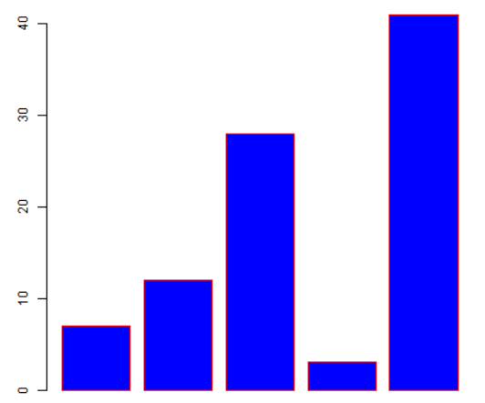
Workflow overview
speech to text
I am excited
text to emotion
anger? joy?
real-time visualization
Text cleaning
_ be excite

Slide 3
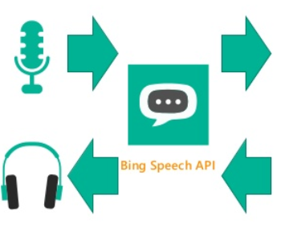
Step1: convert speech to text

Slide 4

Step2: Speech text clean up
What is it? Why do we need it?
Tokenize text
Normalize text: convert capital alphabet to lower case, and plural to single
Recognize named entity and annotation
Remove punctuation
How do we do it?
Use the python “spaCy” library
It can detect pronoun, tense, end of sentences and etc.
It can detect named entities.
We map each word to its lemma.

Slide 5
Speech text clean up: example
Use a review from Yelp as an example
Before clean up:
“This is probably one of the best if not THE best ramen in central Connecticut.”
After clean up:
“this be probably one of the good if not the good ramen in central connecticut”
Send this type of ”normalized” speech text for NLP analysis.

Slide 6
Step3: Word2Vec – meaningful representation
Word vector embedding model V: word string → R³⁰⁰:
Example: V(cat”) = (0.01, 0.20, -0.29, …)
Map each speech word to a vector according to 'GoogleNews-vectors-negative300.bin'
Measure words based on different emotions: ‘anger’, ‘disgust’, ‘fear’…
Embedded vector pairs represent similar logic:
W(“uncle”)-W(“aunt”)
≅W(“man”)-W(“woman”)
Train with neural network

Slide 7
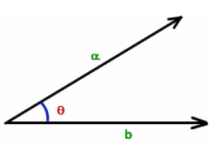
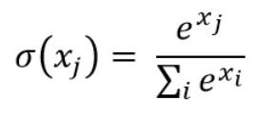
Step4: Quantify emotion
Compute the inner product between speech word and emotions Euclidean distance is also tested but performed poorly in identify emotions
Average and normalize (SoftMax)
Data Smoothing with Convolution

