Slide 1

Advance Blind turn traffic indicator and accident prevention system.
Department of Computer Science and Information Technology
Acropolis Institute of Technology & Research, Indore
Under the Supervision of:
Submitted By:
Prof. Nisha Rathi Mam
Aman Sharma (0827CT191008)
Aniket Tiwari (0827CT191010)
Ashwin Vyas (0827CT191012)

Slide 2
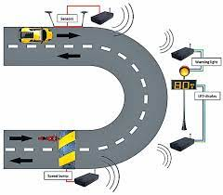
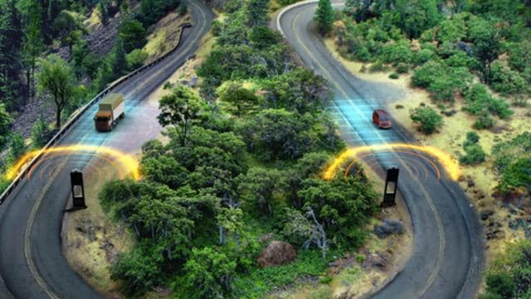
Project Idea
There are many accidents due to blind turns and U-turns especially in hilly areas because the drivers of one side are not aware that the vehicle is coming on the other side and at what speed and which type of vehicle, due to which it leads to accidents.

Slide 3
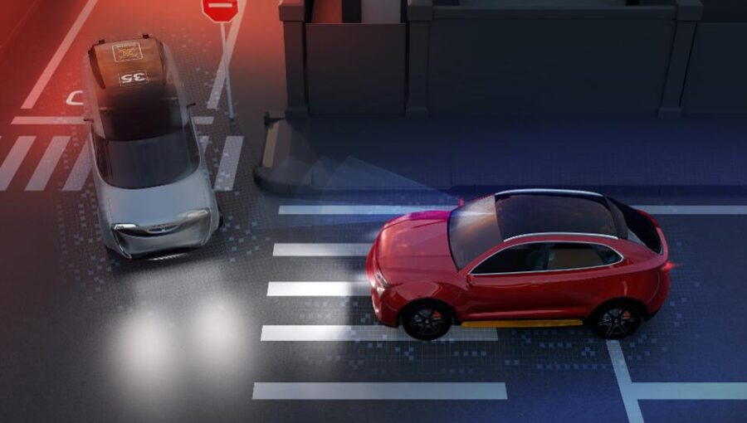
The Objective is to decrease the number of accidents in curve roads.
This is done by alerting the driver by means of LED light which glows when vehicle comes from the other side of the curve.
It will display what type of vehicle which is coming on the other hand of the road.
It will also display speed of vehicle which is coming on the other hand of the road.

Slide 4

IOT(INTERNET OF THINGS)
The Internet of Things, or IOT, refers to the billions of physical devices around the world that are now connected to the internet, all collecting and sharing data.

Slide 5
Project Requirement
Hardwares :-
Arduino
Crystal Oscillator
Resistors
Capacitors
Transistors
Cables and Connectors
Diodes
PCB and Breadboards
LED
Transformer/Adapter
Push Buttons
Switch IC
IC
IC Sockets
Sensors
Software:-
The arduino integrated development environment (IDE) is a cross-platform application (for windows, macos, linux) that is written in the programming language java. It is used to write and upload programs to arduino board.
And we will also use AI/ML framework for detecting which type of vehicle. A smart vehicle speed monitoring system is proposed using arduino and speed sensor.

Slide 6
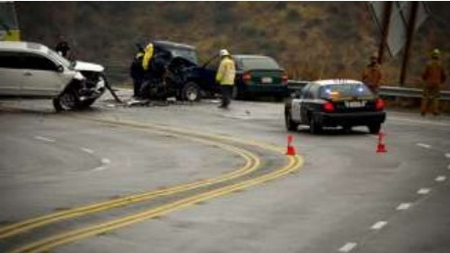
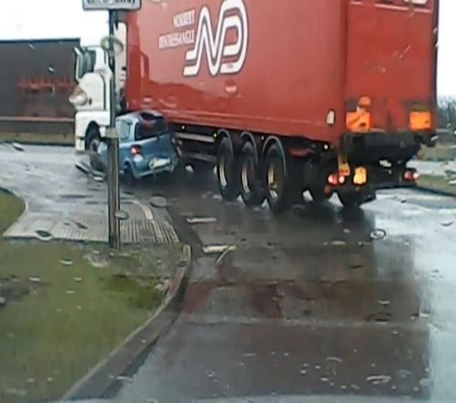
Project Motivation
Why do you care about the problem?
There are many dangerous roads in the world like mountain roads, narrow curve roads, T roads. Some mountain roads are very narrow and they have many curves.
The problems in these curve roads is that the drivers are not able to see the vehicle or obstacles coming from another end of the curve.
Hence there is a need of many road safety systems. To avoid these problems in curve roads of mountain areas, we have proposed this vehicle accident prevention system.

Slide 7
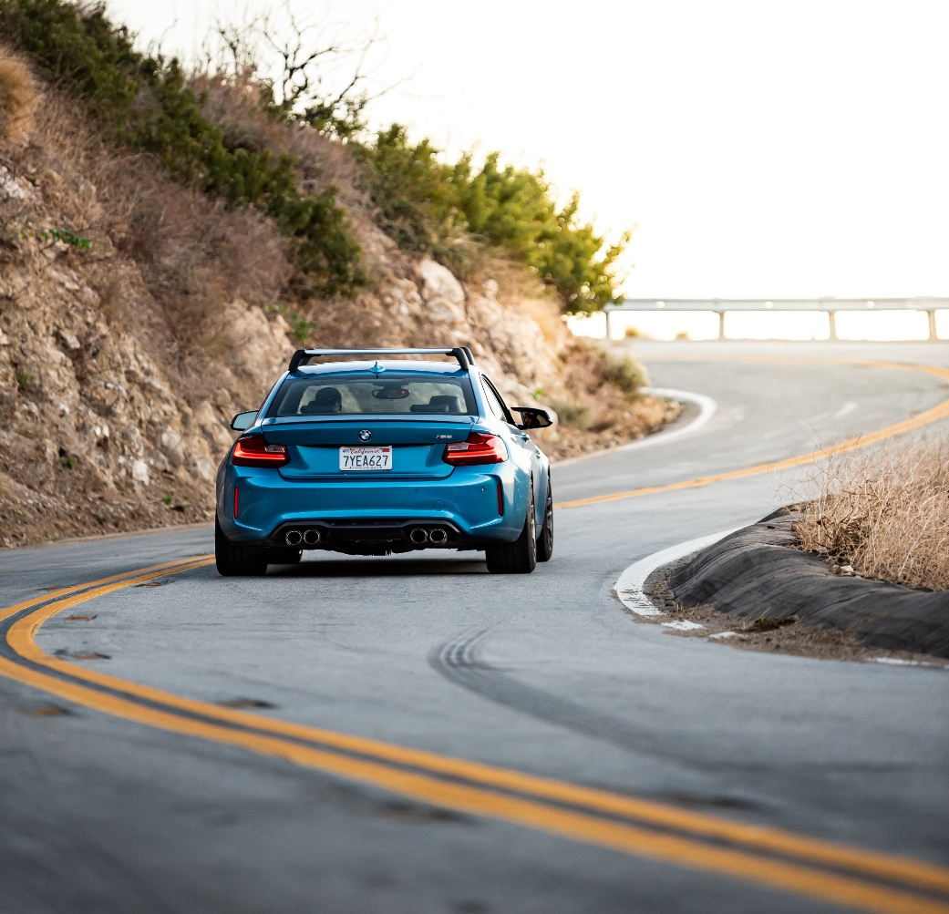

Project Stakeholders
To whom the solution matter.
Stake Holders of Project :-Various stakeholders such as native people from hilly area, tourist, frequent drivers, Transporters.

Slide 8
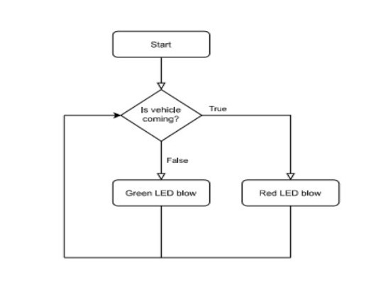
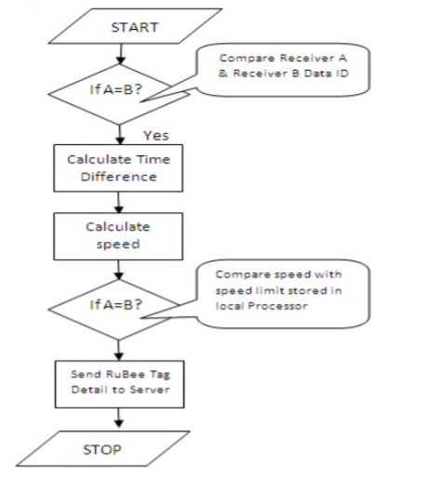
Project Architecture /Modules
Vehicle tracking
Speed monitoring system

Slide 9
Team Members and their expertise
Guide | Technical Expertise
Prof. Nisha Rathi | Machine Learning, Analysis and Design of Algorithms
Student Name and Enrollment No. | Technical Expertise
Aman Sharma (0827CT191008) | C, C++, HTML, CSS, JAVASCRIPT, JAVA
Aniket Tiwari (0827CT191010) | C++, HTML, CSS, JAVASCRIPT, JAVA
Ashwin Vyas (0827CT191012) | C, C++, JAVA, HTML

Slide 10
Conclusion
Thus, the system helps to prevent head-on collision and also a fatal accident that is very frequent in blind corners. With the inclusion of both visual and audio systems, the current situation in the corner can be showcased. The system alerts the driver before entering the corner itself so that driver can take precautionary steps in order to sail through the corner. Thus, it will be an effective solution that can be implemented in mountain and ghat roads where mirrors cannot be used effectively due to low visibility.
This system can greatly improve the safety of the passengers traveling through those roads.

