Slide 1

USING CONTEXTUAL REPRESENTATIONS FOR SUICIDE RISK ASSESSMENT FROM INTERNET FORUMS
Ashwin Karthik Ambalavanan¹, Pranjali Dileep Jagtap¹, Soumya Adhya¹,
Murthy Devarakonda, PhD²
¹Computer Science, Arizona State University, Tempe, AZ;
²Biomedical Informatics, Arizona State University, Scottsdale, AZ

Slide 2
Introduction
Hypothesis: Can a model without domain-specific features perform well in predicting suicide risk from Internet posts?
Task Description:
Given posts of users, identify the suicide risk of the user
Risk Labels:
‘a’: low, ‘b’: moderate, ‘c’: high, ‘d’: extreme

Slide 3
Challenges
Large text from multiple posts
Imbalanced classes: suicide risk class ‘B’ has very few examples
“Understanding” suicide terminology without using domain-specific customization

Slide 4
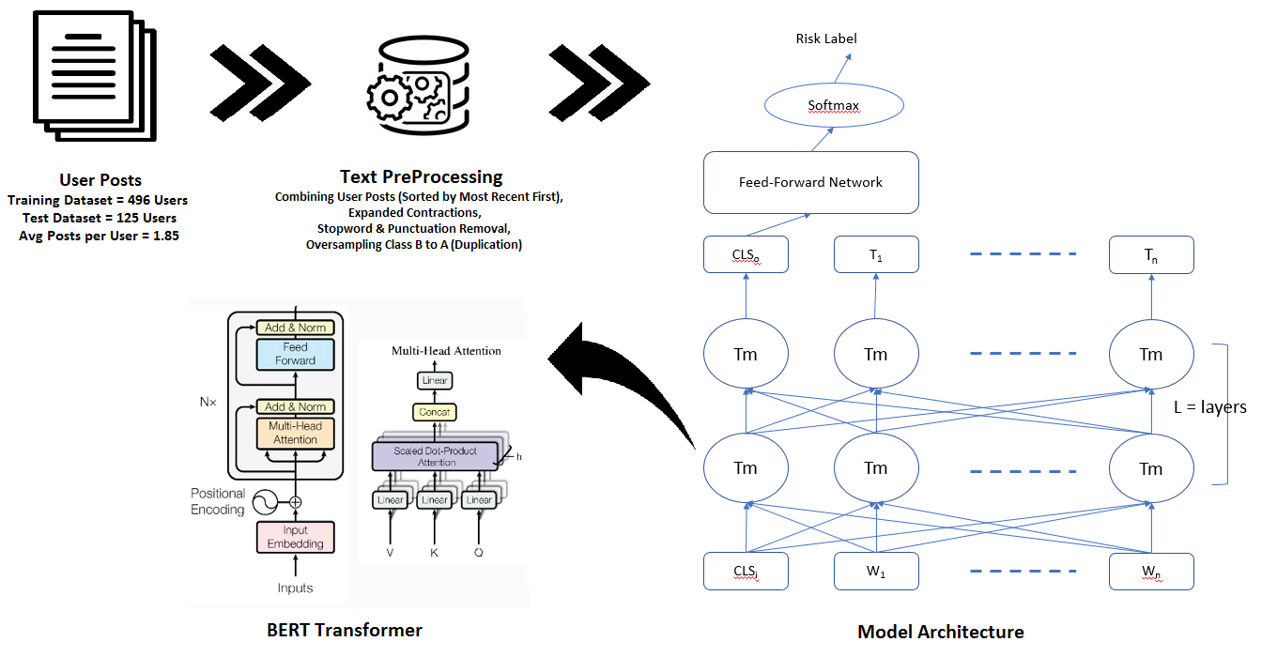
Methodology

Slide 5
Approach
We studied three methods for risk classification:
Concatenated posts input to BERT, with fine tuning, using feed-forward network (FFN) for prediction
BERT pre-trained sentence level representations input to a BiLSTM-Attention network
BERT pre-trained post level representations input to a Multiple Instance Learning (MIL) model of BiLSTM-Attention components
Oversampling class ‘B’ randomly to class ‘A’ size

Slide 6
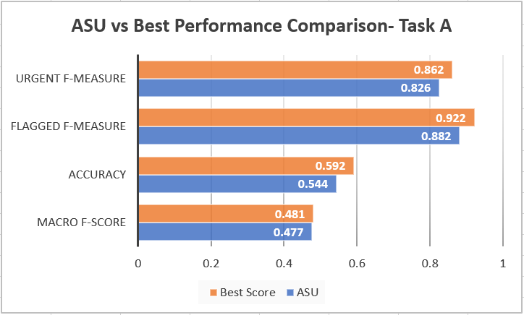
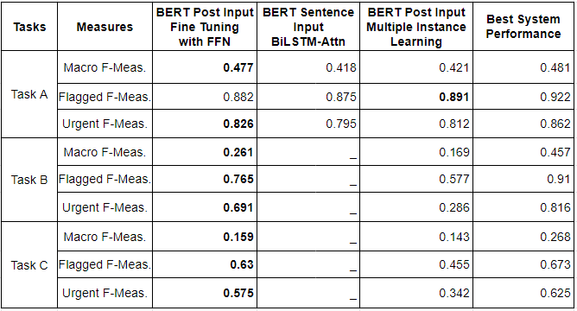
Results

Slide 7
Conclusion
Without suicide-specific domain knowledge our system finished close 2nd on Task A.
Results indicate that either the most recent words are the most important and/or our secondary methods do not represent larger text well
Future work: Experiment adding domain-specific knowledge to BERT (Automated Lexicon Generation)

Slide 8
Questions?

