Slide 1
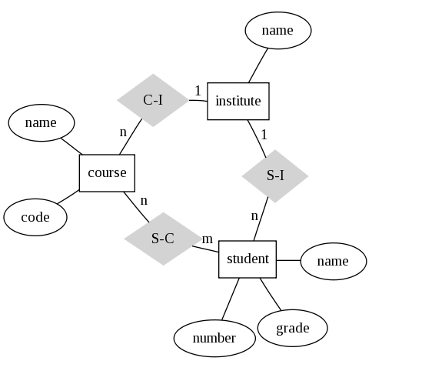
mappER

Slide 2
Contents
Introduction(mappER)
Requirements
Data Flow Diagram(DFD)
Work Flow
Graphviz
Backend Input Processing
Graphic User Interface
Bibliography

Slide 3
Introduction
mappER is a Window Application which can be used to Generate ER Diagrams.
Application User allowed enter relevant information about the entities and relations in the application (mappER) to display Entity Relation Diagram.
Primarily made using Python language for the interpretation of entry in preset string format.
Graphviz Module is used to generate entity relationship diagram.
Graphic User Interface is made using Tkinter Module in Python.

Slide 4
Requirements
Python 3.3
Python 3.6.1
Tkinter Module for GUI
Graphviz 2.3
QT Designer
Pycharm Compiler

Slide 5
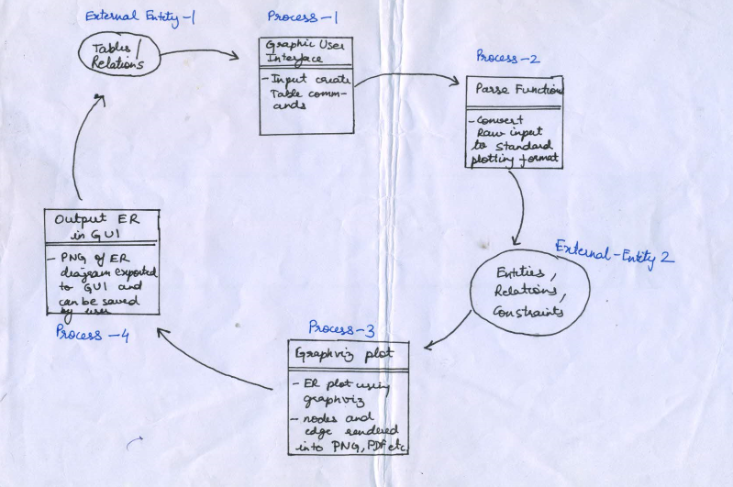
Data Flow Diagram

Slide 6
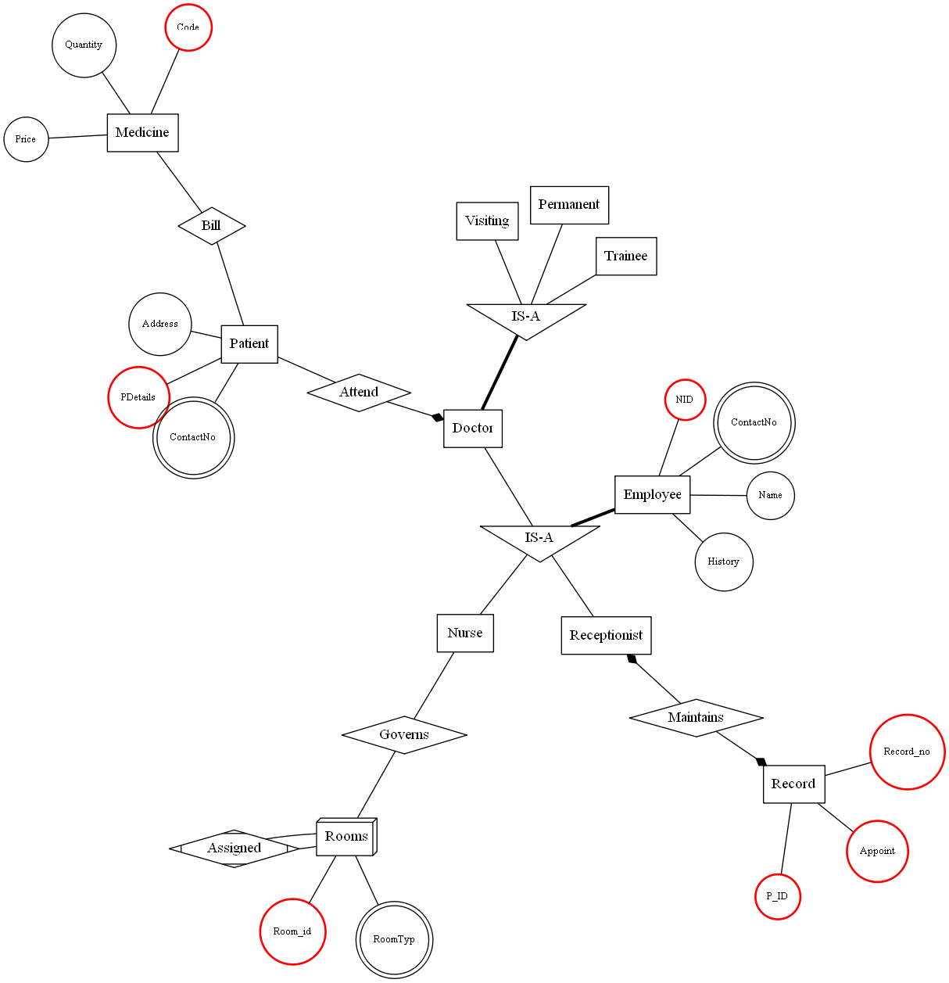
Examples of Graphviz (Input Parsing)
Hospital
.

Slide 7
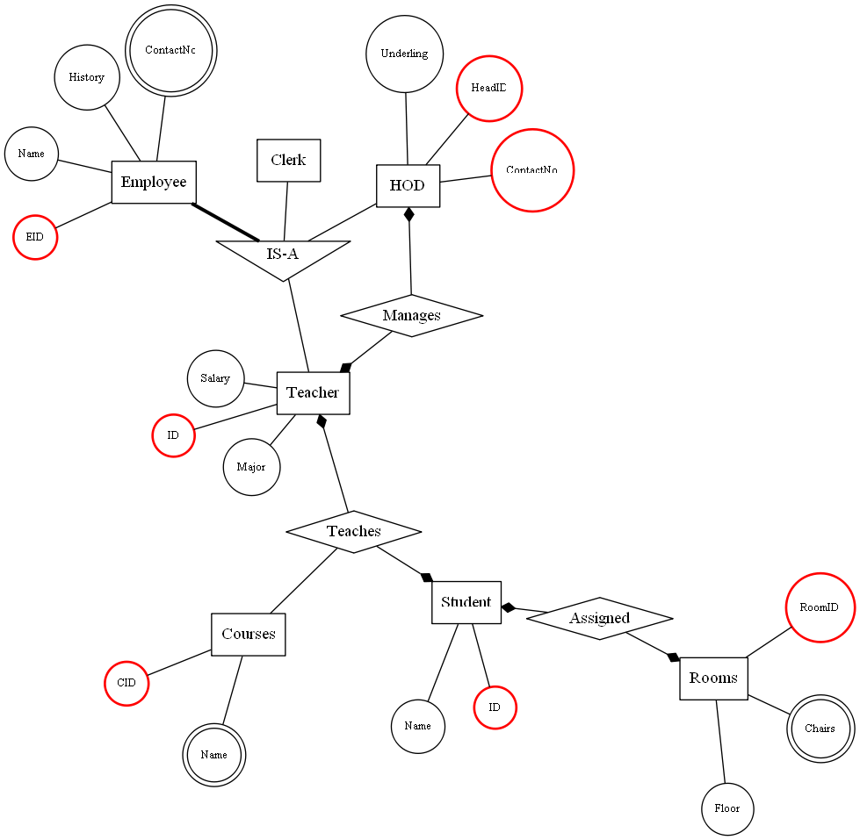
School

Slide 8
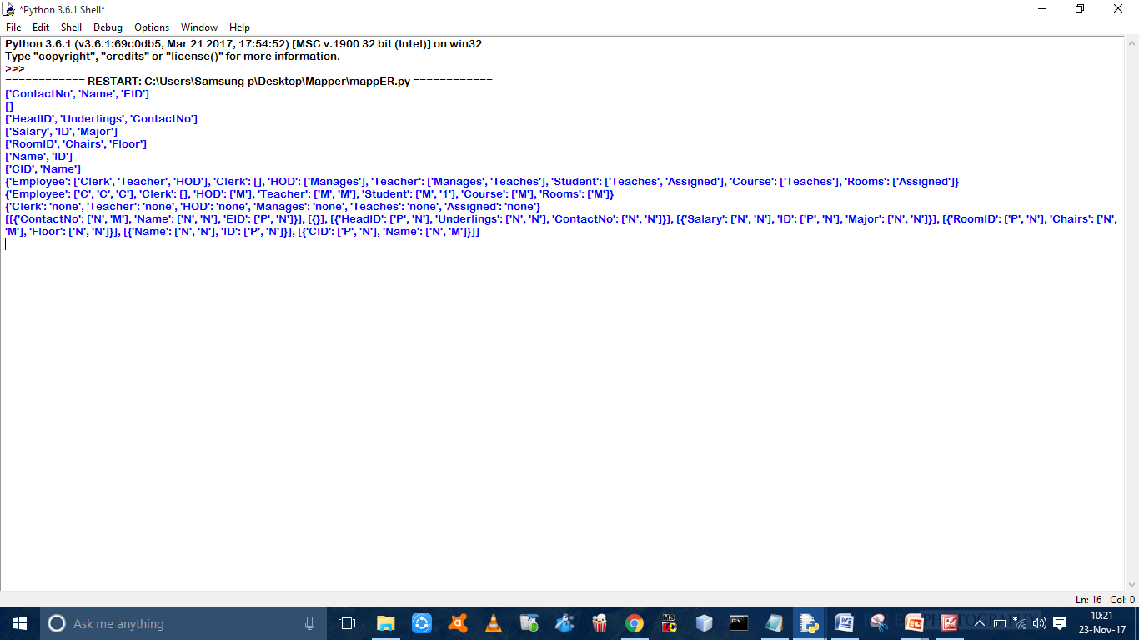
Input Backend Processing

Slide 9
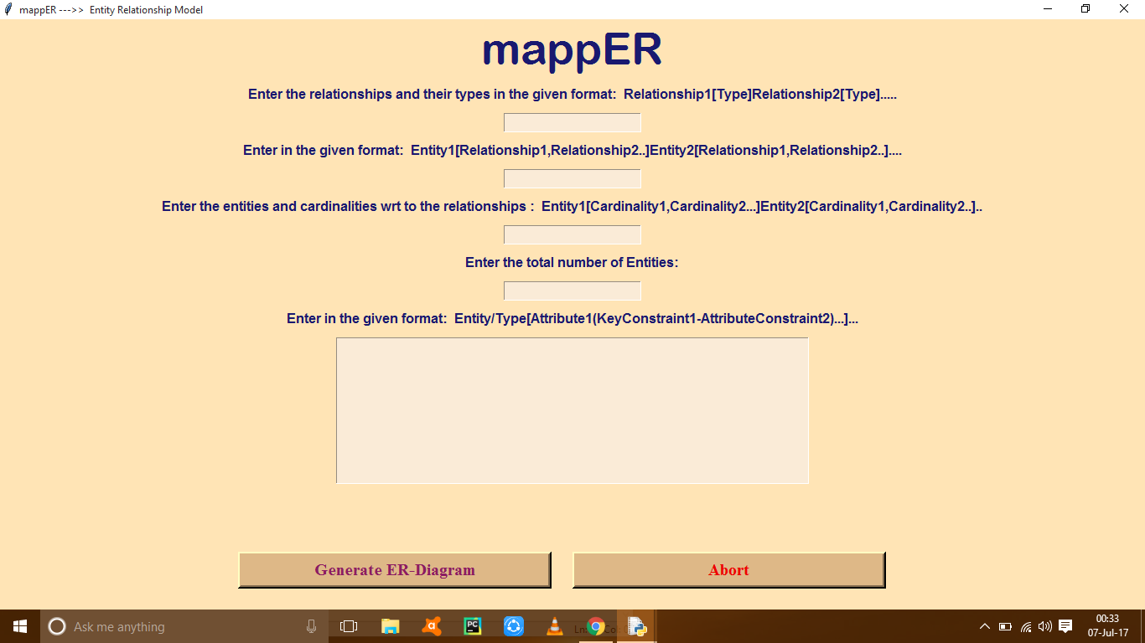
Graphic User Interface
Test GUI (Initial)

Slide 10
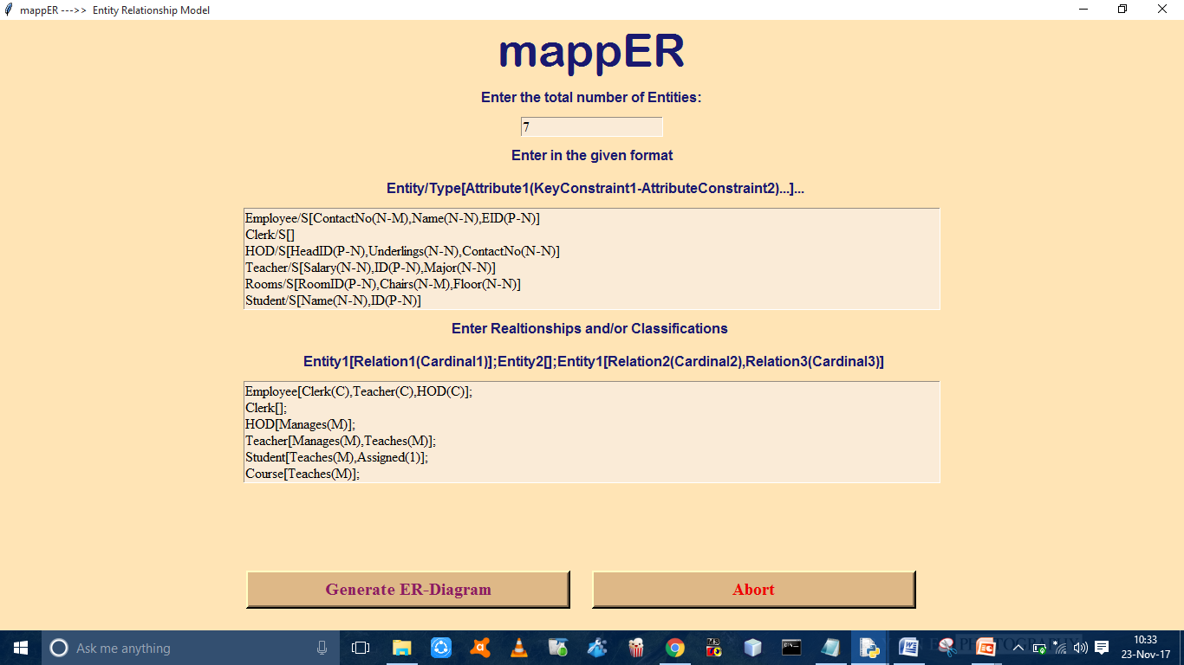
Graphic User Interface (Final)

Slide 11
Bibliography
http://www.graphviz.org/Home.php
https://pythonprogramming.net
https://www.tutorialspoint.com/pyqt/
https://stackoverflow.com/

