Slide 1
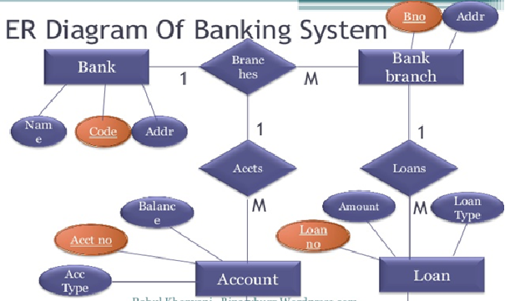
mappER
(Windows Application)

Slide 2
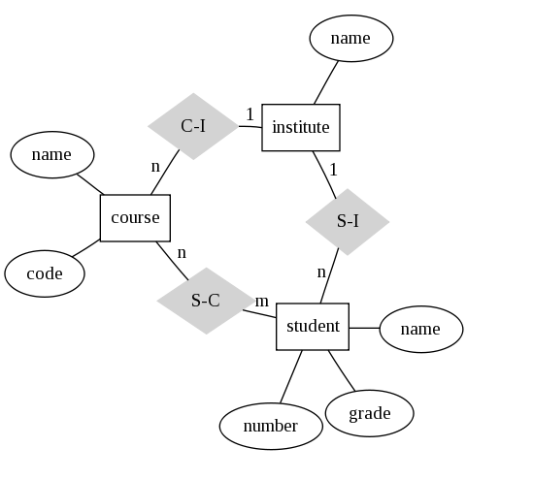
Project Members
Ashwin Balaji
Karandeep Singh
Ritika Chauhan
Tulika

Slide 3
Contents
Introduction(mappER)
Data Flow Diagram(DFD)
Activity List
GANTT Chart
PERT Chart
Requirements
Examples Of Graphviz
Work Flow
Test GUI
GRAPHICAL USER INTERFACE
Bibliography

Slide 4
Introduction
mappER is a Window Application which can be used to Generate ER Diagrams. User will just give all the the relevant information as input and the application (mappER) will display the ER Diagram for it.

Slide 5
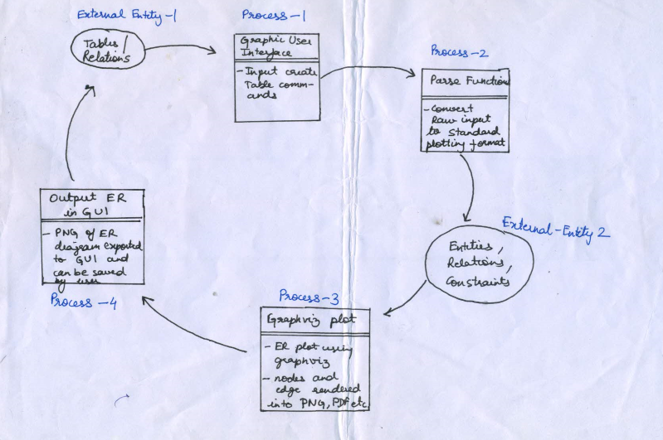
Data Flow Diagram(DFD)

Slide 6
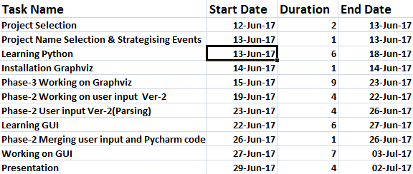
Activity list

Slide 7
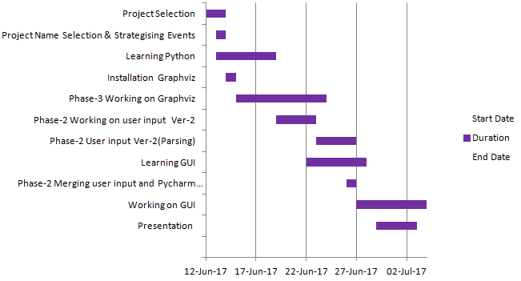
GANTT Chart

Slide 8
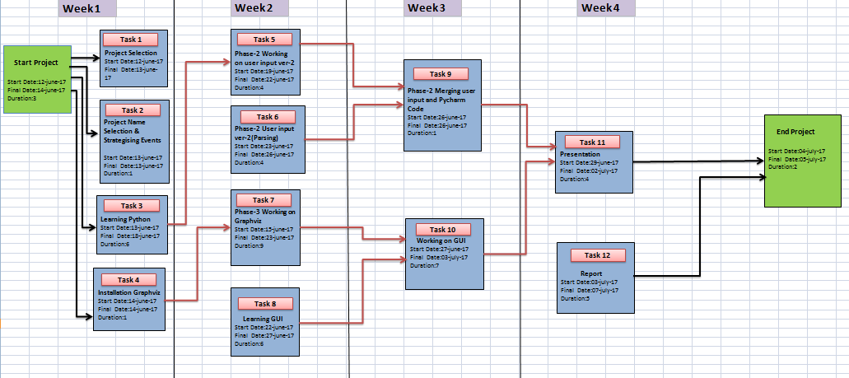
PERT Chart

Slide 9
Requirements
Python 3.3
Python 3.6.1
PyQT Module for GUI
Graphviz 2.3
Tkinter
Pycharm Compiler

Slide 10
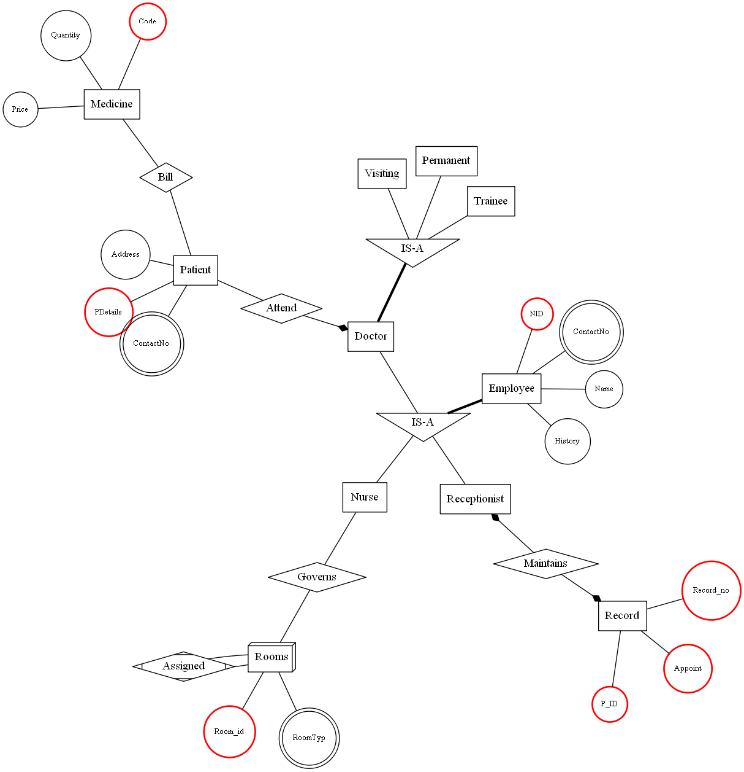
Examples of Graphviz
Hospital

Slide 11
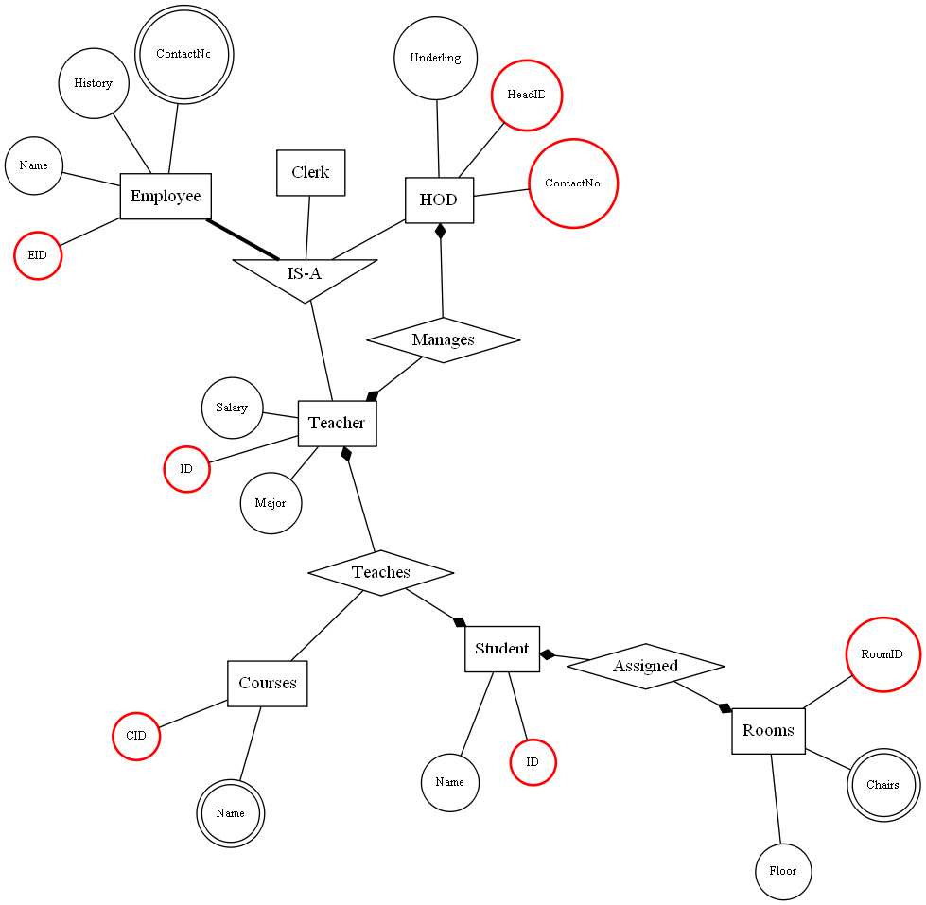
School

Slide 12
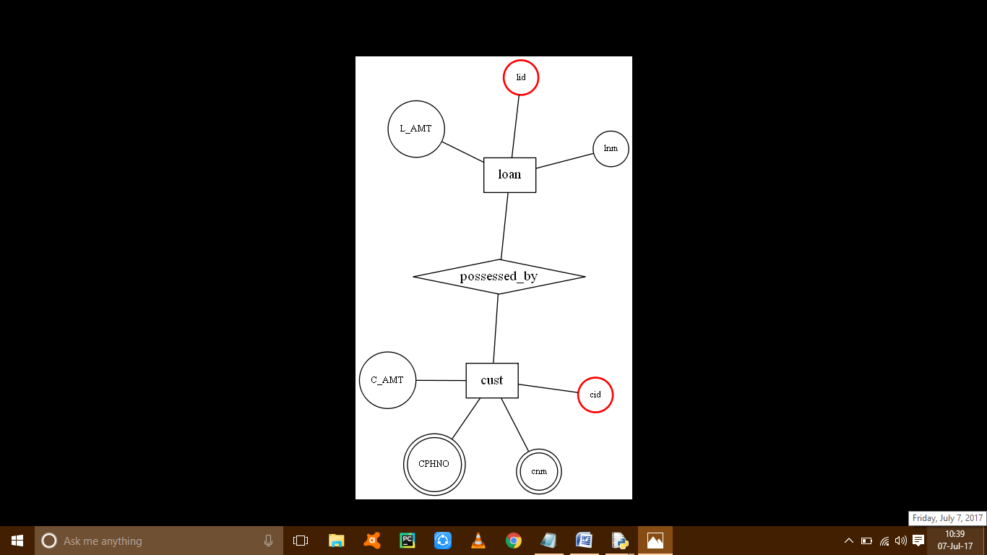
Work Flow
Output ER Diagram

Slide 13
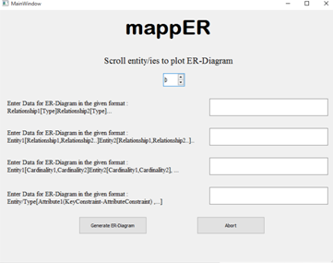
Test GUI

Slide 14
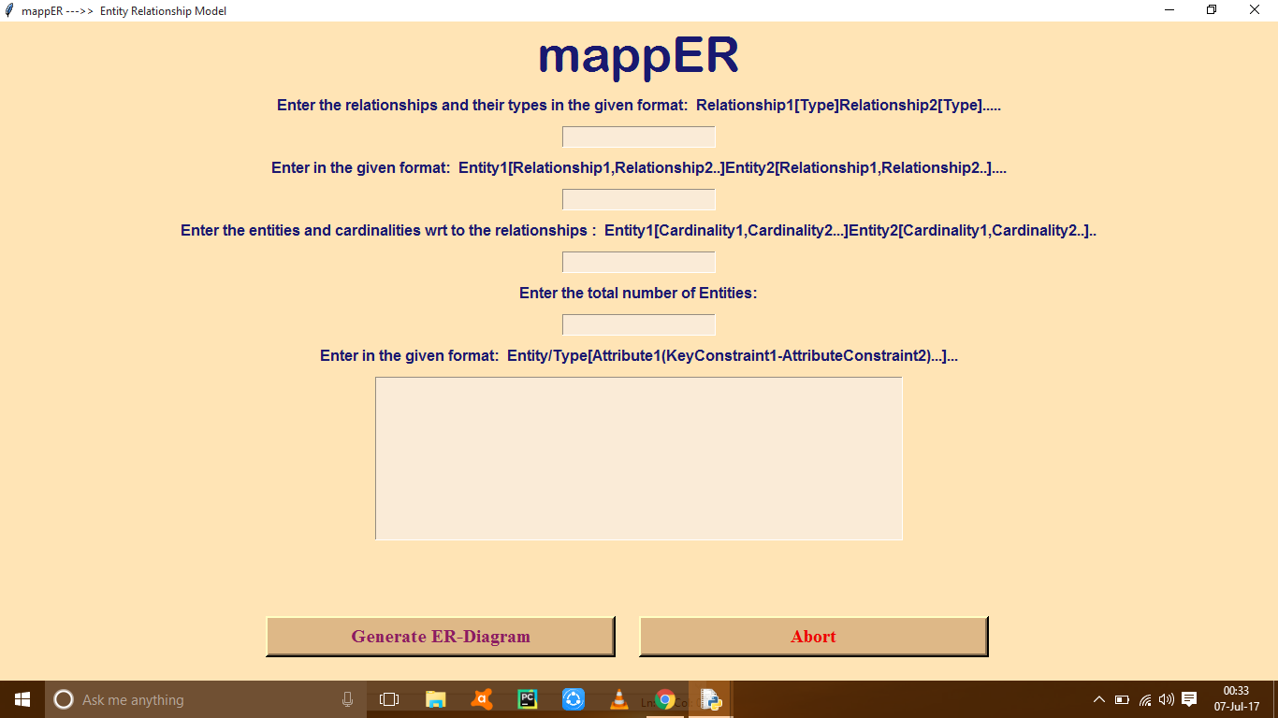
GRAPHIC USER INTERFACE(GUI)

Slide 15
Bibliography
http://www.graphviz.org/Home.php
https://pythonprogramming.net
https://www.tutorialspoint.com/pyqt/
https://stackoverflow.com/
https://docs.python.org/3/library/tkinter.html/

Slide 16
thanks

